Slide 1
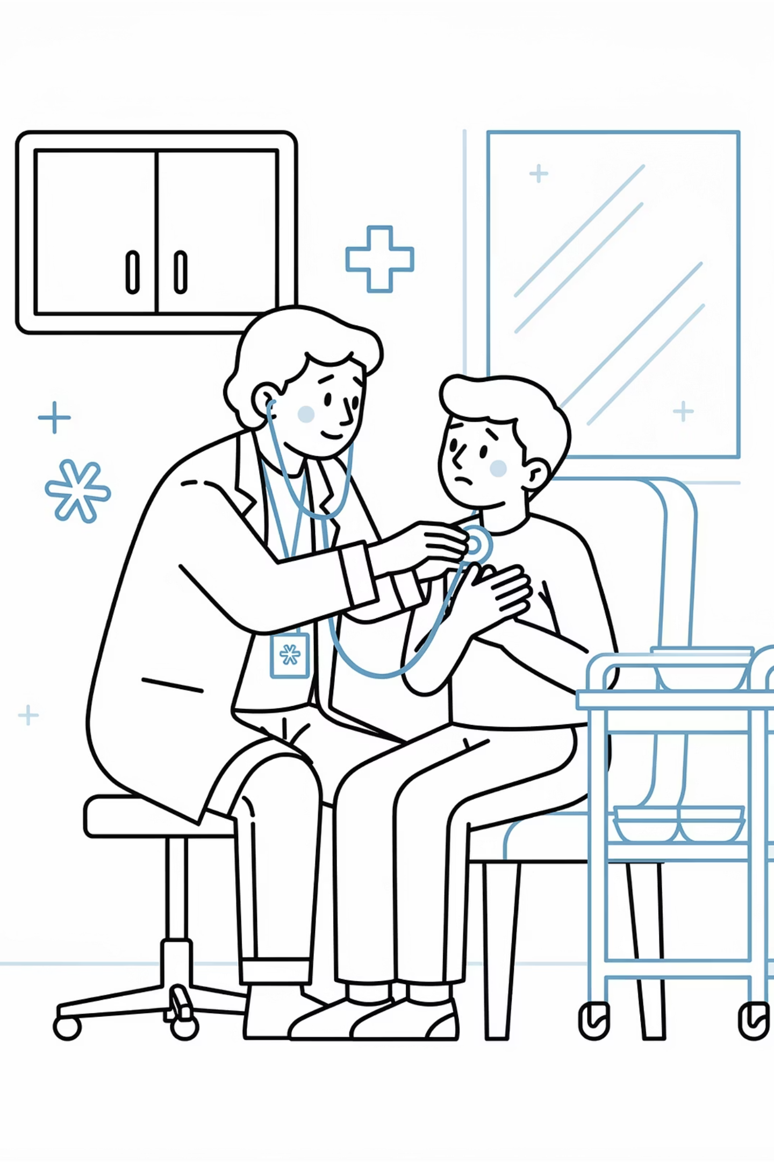
Acute Asthma: Management Guide
A summary sheet for GP trainees and trainers in UK primary care. Covers severity assessment, immediate management, red flags, and safe discharge planning — based on BTS/SIGN guidance.
BRADFORD VTS TEACHING DECK
MAY 2026

Slide 2



Assessing Severity
Accurate severity classification drives every subsequent management decision. Use the BTS/SIGN framework to categorise the attack rapidly.
Moderate
Acute Severe
Life-Threatening
PEF >50–75% best or predicted; speech normal; no life-threatening features present.
Any one of: PEF 33–50%, RR ≥25/min, pulse ≥110/min, or unable to complete sentences in one breath.
Any one of: PEF <33%, SpO₂ <92%, silent chest, cyanosis, poor respiratory effort, hypotension, arrhythmia, exhaustion, or altered consciousness.

Slide 3
Severity at a Glance
Moderate
PEF >50–75%; normal speech; no life-threatening feature
Acute Severe
PEF 33–50%; RR ≥25; pulse ≥110; cannot complete sentences
Life-Threatening
PEF <33%; SpO₂ <92%; silent chest; cyanosis; confusion; exhaustion; arrhythmia; hypotension

Slide 4

Immediate Management: Oxygen
Target SpO₂: 94–98%
Hypercapnic Risk
For most patients, give oxygen to maintain saturations in this range. Titrate flow to achieve and sustain the target.
If the patient is at risk of hypercapnic respiratory failure (e.g. known COPD overlap), use controlled oxygen and aim for a lower target of 88–92%. Do not withhold oxygen — but monitor carefully.
Never delay oxygen while waiting for PEFR. Treat the patient first.

Slide 5
Immediate Management: Bronchodilators & Steroids
Salbutamol (Nebulised)
Prednisolone (Early)
Ipratropium (Severe/Life-Threatening)
Adults / child >5 yrs: 5 mg nebulised
Age 1 month–5 yrs: 2.5 mg nebulised
If no nebuliser available, use repeated puffs via spacer.
Adults: 40–50 mg orally
Children: 1–2 mg/kg (usual max 40 mg) per local pathway
Give early — do not delay.
Adults & child >12 yrs: 500 micrograms nebulised
Children 1 month–12 yrs: 250 micrograms nebulised
Add to salbutamol in severe or life-threatening attacks.

Slide 6

Red Flags: Call 999 Immediately
Escalate without delay if any of the following are present:
Severe or Life-Threatening Attack
Any features meeting life-threatening criteria on initial assessment.
Silent Chest / Cyanosis
Absent breath sounds or visible bluish discolouration of lips or fingertips.
Altered Consciousness / Exhaustion
Confusion, reduced consciousness, or patient too exhausted to maintain effort.
Poor Response to Bronchodilator
Worsening oxygenation or no improvement after first treatment.

Slide 7
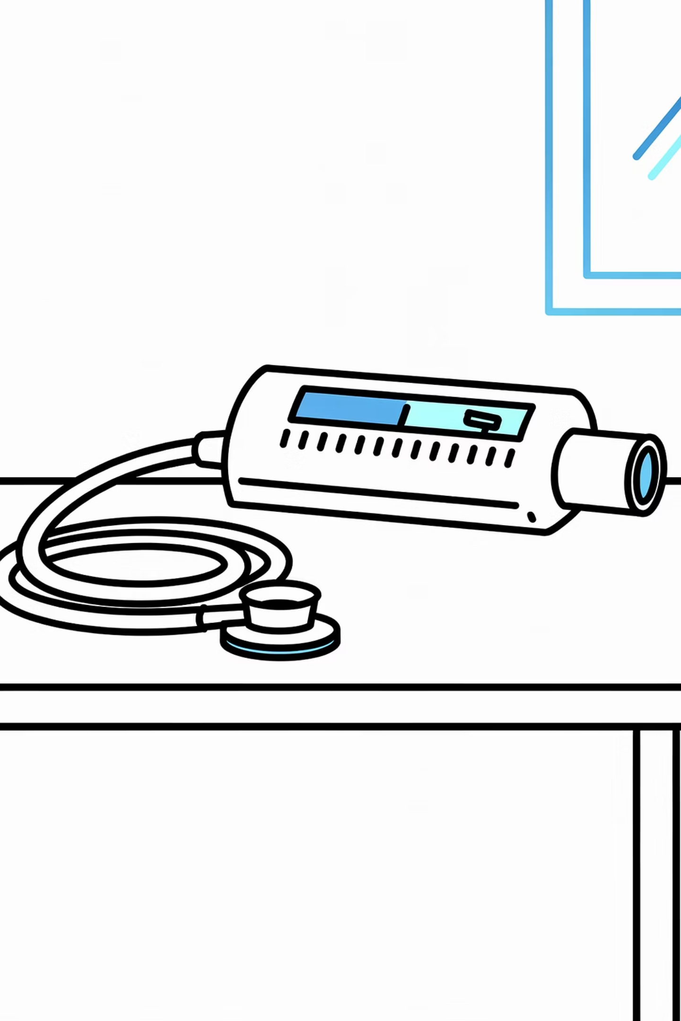
Key Pitfall to Avoid
Do not delay oxygen or bronchodilator treatment while waiting for PEFR. Treat the patient first.
PEFR measurement is a useful monitoring tool, but it must never hold up the initiation of life-saving treatment. Clinical assessment takes priority — act on what you see and hear.

Slide 8

Reassessment After Treatment
After initial treatment, systematically reassess the patient before making any disposition decision.
Evaluate Response
Need for Hospital
Compare symptoms and objective measures to baseline.
Decide if hospital assessment or admission is required.
Reassess Vitals
Discharge or Escalate
Check pulse, RR, SpO₂, speech, work of breathing, PEFR.
Plan safe discharge with follow-up or escalate care.
Severe attacks usually require hospital assessment even if they appear to improve initially — early improvement can be deceptive.

Slide 9
Safe Discharge Checklist
Only discharge if the patient is clinically stable and all of the following are in place:
01
02
Written Asthma Action Plan
Inhaler Technique Check
Provide a personalised written plan so the patient knows how to respond if symptoms worsen at home.
Confirm the patient can use their inhaler correctly before they leave. Poor technique is a common cause of treatment failure.
03
04
Steroid Course Supplied
Early Follow-Up Arranged
Ensure a full course of prednisolone is dispensed and the patient understands how to complete it.
Book a follow-up appointment within 48 hours or as per local pathway to review recovery and ongoing management.

Slide 10

Educational Disclaimer
This document is for educational purposes only. Always double-check this advice and all drug doses against the latest NICE/BNF guidance before clinical use. Local pathways may vary.
Bradford VTS
BTS/SIGN Framework
Teaching aids for GP trainees and trainers in UK primary care.
Severity classification and management aligned to current BTS/SIGN asthma guidelines.
May 2026
Review date: check for updated guidance regularly as recommendations evolve.

