Slide 1
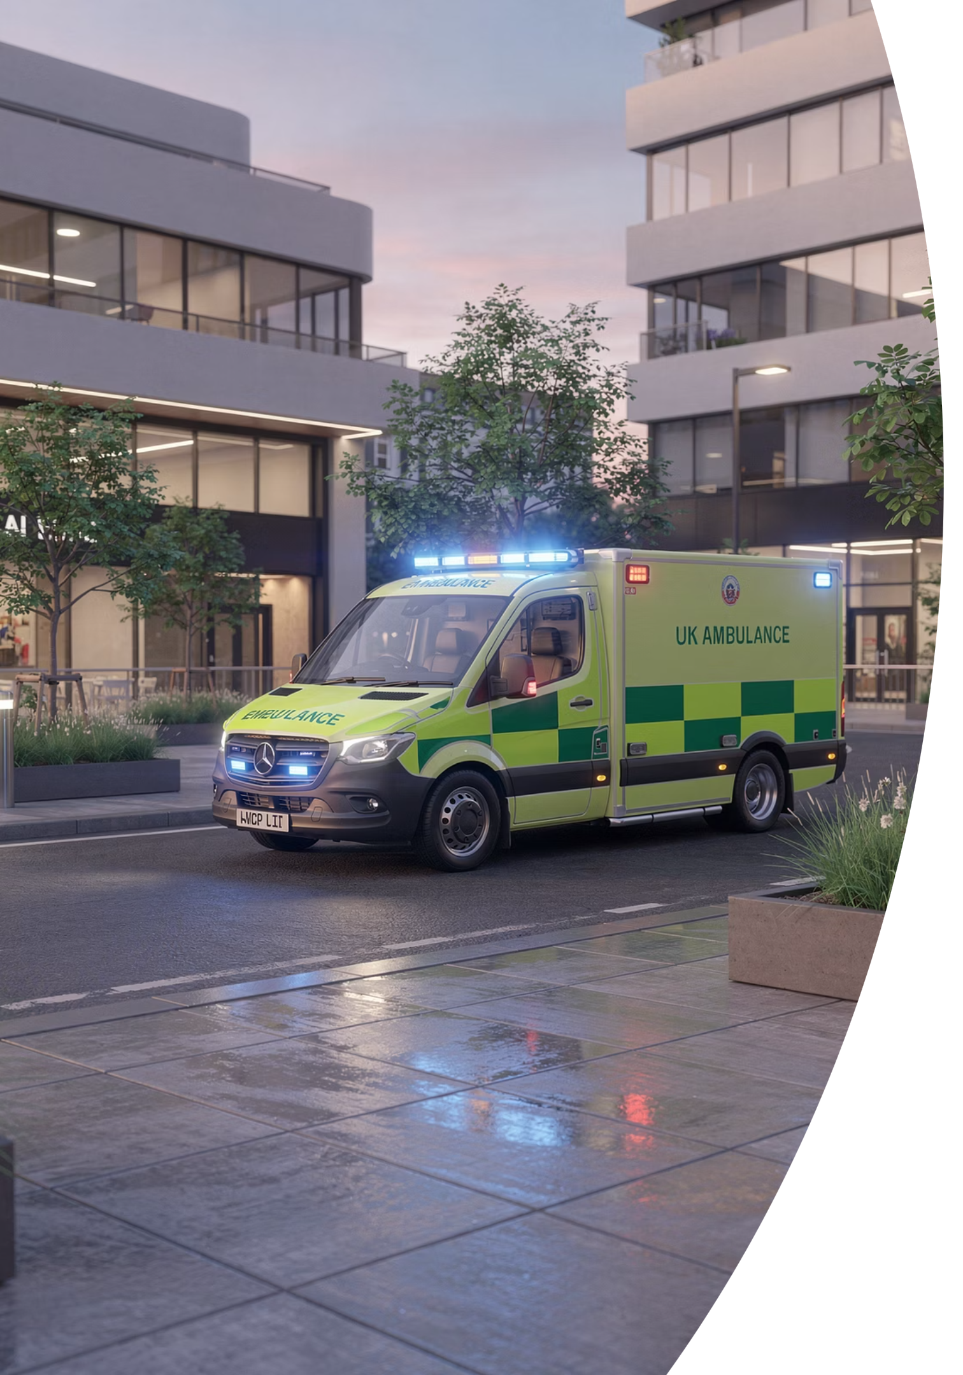
Ambulance Use — Categories and When to Call 999
BRADFORD VTS TEACHING DECK
MAY 2026
Ambulance use summary sheet for GP trainees and trainers in UK primary care. A practical guide to understanding ambulance categories, when to call 999, and how to communicate effectively with emergency services.

Slide 2

When to Call 999
Core Rule: Use 999 for time-critical, potentially life-threatening illness or injury where emergency assessment or transfer is needed now.
Category 1
Immediate life-threatening emergencies
e.g. cardiac arrest, severe airway compromise, major anaphylaxis or profound unconsciousness.
Category 2
Emergency conditions
e.g. suspected stroke, chest pain suggestive of MI, severe breathing difficulty or prolonged seizure.
Category 3
Urgent conditions needing assessment and likely face-to-face response
e.g. late labour, some burns or significant but not immediately life-threatening illness.
Category 4
Less urgent problems where telephone advice, referral to another service or delayed transport may be more appropriate.

Slide 3






What Makes a True 999 Call?
Recognising when a situation genuinely warrants an emergency ambulance is a critical clinical skill. The following indicators should prompt an immediate 999 call:
Immediate Risk to Life
Airway, Breathing or Circulation
Rapidly Worsening State
The patient's condition poses an immediate threat that cannot be safely managed in the primary care setting.
Any compromise to the fundamental ABC triad requires emergency paramedic response without delay.
A patient whose condition is deteriorating quickly despite initial management needs urgent escalation.
Need for Paramedic Treatment
Urgent Monitored Transfer
Interventions beyond the scope of primary care — such as advanced airway management or IV drug administration — require a paramedic on scene.
Patients who require continuous monitoring during transport to hospital must travel by ambulance, not private vehicle.

Slide 4

How to Communicate Using SBAR
SBAR is a structured communication framework that ensures critical information is conveyed clearly and efficiently to the ambulance call handler or receiving team.
1
2
Situation
Background
Identify yourself and your role, give your location, state the patient's age, and describe the nature of the emergency clearly and concisely.
Provide the short clinical story — key diagnoses, relevant medications, and significant comorbidities that may affect the patient's management or transport.
3
4
Assessment
Recommendation
Share your current observations and vital signs, convey the severity of the presentation, and describe any treatment already given and the patient's response.
State clearly what response is needed, the level of urgency, and flag any practical concerns such as difficult access, patient agitation, or risk of rapid deterioration.
Background
Situation
Assessment
Recommendation

Slide 5
What Not to Do — and GP Responsibilities
What Not to Do
GP Responsibilities
Do not drive a seriously unwell patient to hospital yourself. This places both you and the patient at significant risk.
Recognise the emergency promptly and accurately.
Do not underplay severity when calling 999. Clear, accurate language directly improves triage and the speed of response.
Give immediate first-line treatment within your scope.
Do not abandon the patient if they remain unstable. Continue active care until the ambulance crew formally takes over responsibility.
Communicate clearly with the 999 call handler using SBAR.
Document your clinical decisions and the handover given.
Provide a safe escort of care until transfer to the ambulance crew occurs.

Slide 6

Educational Disclaimer
Important: Always double check this advice and drug doses with the latest NICE/BNF guidance. This document is for educational purposes only.
About This Resource
Key References
This teaching aid has been produced by Bradford VTS for use by GP trainees and their trainers working in UK primary care. It is intended as a quick-reference educational summary and does not replace formal clinical training, local protocols, or up-to-date national guidance.
NICE Guidelines
Refer to the latest NICE clinical guidelines for emergency and urgent care pathways relevant to primary care.
Clinical practice evolves — always verify current recommendations through authoritative sources before applying guidance in practice.
BNF / BNFC
Always verify drug doses, contraindications and interactions using the current British National Formulary before prescribing or administering.
Local Trust Protocols
Follow your local ambulance service and trust protocols, which may differ from national guidance in specific circumstances.
BRADFORD VTS
MAY 2026
FOR EDUCATIONAL USE ONLY

