Slide 1




BRADFORD VTS TEACHING DECK
Arterial Blood Gases — Interpretation & Procedure
A systematic 5-step approach to ABG analysis, procedural techniques, and clinical correlates for GP trainees. Exam-focused insights for AKT and SCA.
www.bradfordvts.co.uk
Created May 2026

Slide 2


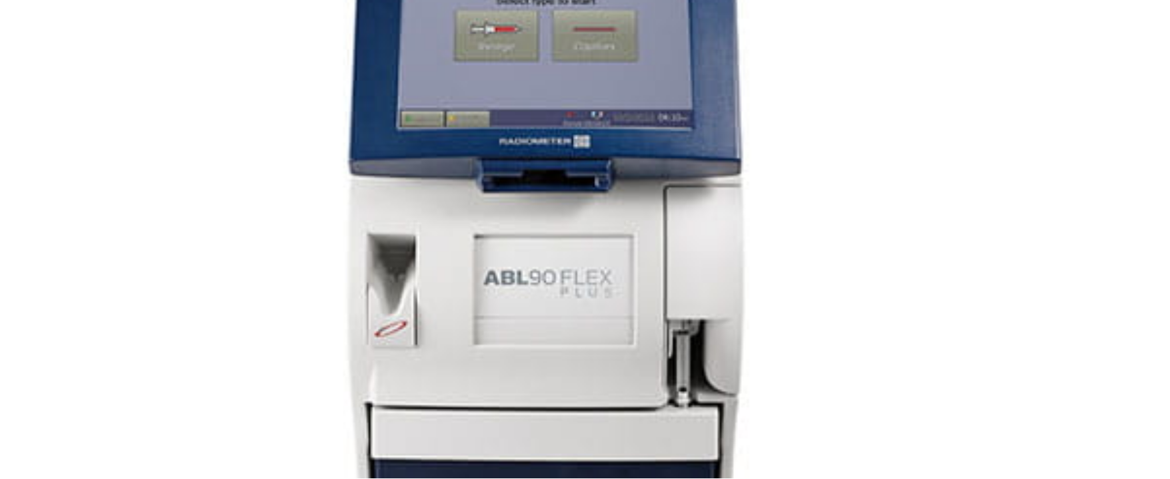












WHAT IS AN ABG AND WHEN DO YOU NEED ONE?
CLINICAL INDICATIONS & MEASURED PARAMETERS
Clinical Indications
Acute Respiratory Failure: Dyspnoea, low SpO2, or suspected hypercapnia.
Monitoring Ventilation: In patients with chronic COPD, severe asthma, or pneumonia.
Acid-Base Assessment: DKA, sepsis, renal failure, or suspected overdose.
Parameters Obtained
Metabolic Emergencies: Lactic acidosis and toxic ingestion monitoring.
GAS ANALYSIS
METABOLIC
Critical Care: Assessment of oxygenation in ICU/HDU environments.
pH, PaO2, PaCO2
HCO3-, BE, Lactate
An ABG provides a rapid "snapshot" of a patient's physiological status.
ELECTROLYTES
CO-OXIMETRY
Na+, K+, Ca2+, Cl-
Hb, COHb, MetHb

Slide 3











ABG PROCEDURE — Allen's Test
CLINICAL SKILLS & DIAGNOSTICS
Step 1: Occlusion
Purpose: To ensure adequate collateral circulation via the ulnar artery before potentially damaging the radial artery.
Compress both radial and ulnar arteries while the patient makes a tight fist.
Positive Result (Normal)
Palm refills and becomes pink within 4 seconds. Collateral flow is sufficient. Safe to proceed with radial puncture.
Step 2: Blanching
Patient opens hand; the palm should appear pale or blanched due to lack of flow.
Negative Result (Abnormal)
Step 3: Release
Palm remains pale or refills slowly (>4s). Inadequate collateral circulation. DO NOT USE radial artery; use brachial or femoral.
Release pressure from the ulnar artery only while keeping radial compressed.

Slide 4



















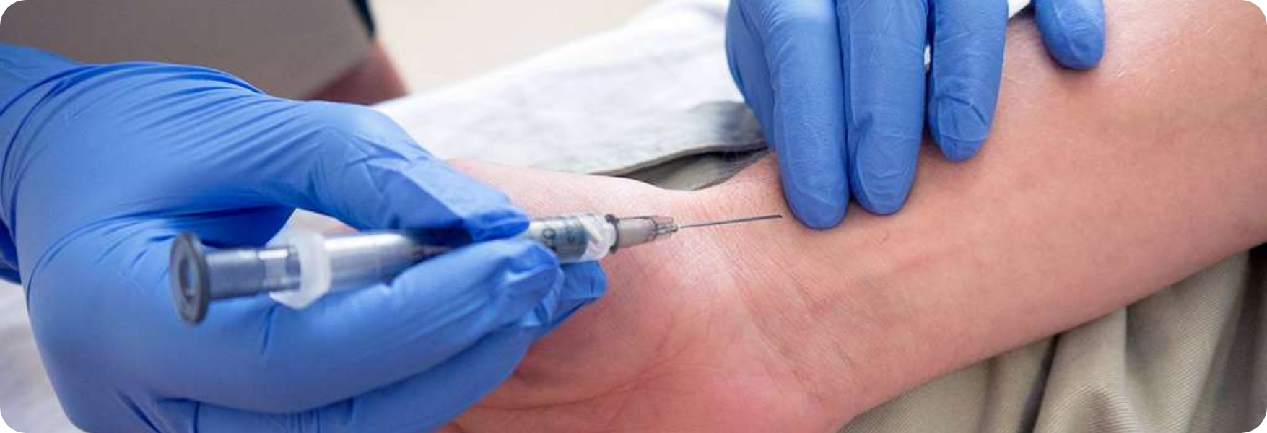

ABG PROCEDURE — Step-by-Step and Comparison
CLINICAL SKILLS & DIAGNOSTICS
Preparation: Wash hands, confirm identity, explain procedure, and obtain consent.
Artery Comparison
Oxygen: Confirm FiO2; keep stable for 15 mins before sampling.
Artery
Angle
Advantages
Contraindications
Positioning: Wrist extended 20° on a pillow. Perform Allen's Test.
Radial
30°
Most accessible & compressible
Negative Allen's, AVF, Raynaud's
Access: Clean site; palpate artery with two fingers, leaving gap for needle.
Insertion: Angle needle 30° against flow; advance until pulsatile flash.
Brachial
30°
Easily accessible
AVF, Elbow fractures, Ischaemia risk
Sampling: Withdraw 2–3 mL; remove needle and apply firm pressure ×5 mins.
Finalize: Expel air bubbles, cap syringe, and analyze immediately.
Femoral
60°
Best in shock/arrest
Severe PVD, Aortofemoral bypass
Critical Warning: Never proceed with radial puncture if Allen's test is negative (refill >4s). Use brachial or femoral alternatives to avoid limb-threatening ischaemia.

Slide 5
















ABG Normal Values
REFERENCE RANGES & PROCEDURE RISKS
Common Procedural Risks
BLOOD GAS PARAMETER
NORMAL REFERENCE RANGE
Haematoma: The most common complication; requires 5 mins firm pressure.
pH
7.35 – 7.45
Thrombosis: Risk of arterial occlusion; avoid multiple puncture attempts.
PaO2 (on air)
10 – 13 kPa (75–100 mmHg)
PaCO2
4.7 – 6.0 kPa (35–45 mmHg)
HCO3 (Bicarbonate)
22 – 26 mmol/L
Systemic & Severe Risks
Base Excess
-2 to +2 mmol/L
Infection: Arteritis risk; always use strict aseptic technique.
Lactate
< 2 mmol/L
Air Embolism: Rare but serious; expel bubbles and cap syringe immediately.
SpO2 (Saturation)
94 – 98% (Adult target)

Slide 6


























SYSTEMATIC ABG INTERPRETATION — Steps 1 to 3
CLINICAL SKILLS & DIAGNOSTICS
Step 1: Oxygenation
Step 2: pH Status
Step 3: Primary Logic
Assess for hypoxaemia by checking the partial pressure of oxygen.
Determine the acid-base balance of the blood.
Identify if the source is Respiratory (CO2) or Metabolic (HCO3-).
< 7.35: Acidosis
PaO2 < 10 kPa: Hypoxaemia (on room air).
PRIMARY DISORDER
PH
DRIVER
> 7.45: Alkalosis
Resp. Acidosis
↓
PaCO2 ↑
Context: Always relate PaO2 to the delivered FiO2.
7.35 – 7.45: Normal or Compensated
Resp. Alkalosis
↑
PaCO2 ↓
Met. Acidosis
↓
HCO3- ↓
Met. Alkalosis
↑
HCO3- ↑
A patient with a "normal" PaO2 on high-flow oxygen may still be in respiratory failure.
Normal pH with abnormal CO2/HCO3 indicates a fully compensated state.

Slide 7















SYSTEMATIC ABG INTERPRETATION — Steps 4 and 5
CLINICAL SKILLS & DIAGNOSTICS
Step 4: Assess Compensation
Step 5: Calculate Anion Gap
Respiratory Acidosis CompensationKidneys retain HCO3- to normalize pH. This is a slow metabolic process taking 2–5 days.
Required only if metabolic acidosis is present. Helps differentiate causes of low bicarbonate.
Metabolic Acidosis CompensationLungs "blow off" CO2 (Kussmaul breathing). This is a rapid respiratory response occurring in minutes.
FORMULA
(Na + K) – (HCO3 + Cl)
Normal Range: 8–16 mmol/LA Raised Anion Gap suggests added acids (e.g., Lactate, Ketones, Toxins) as seen in MUDPILES.
Full Compensation: The pH returns to the normal range (7.35–7.45), but both CO2 and HCO3- remain abnormal.
Normal Anion Gap (NAGMA)Suggests loss of HCO3- (e.g., Diarrhoea, Renal Tubular Acidosis).

Slide 8

























COMMON ABG PATTERNS — MUDPILES
CLINICAL SKILLS & DIAGNOSTICS
MUDPILES Mnemonic
High Anion Gap Metabolic Acidosis
Pattern
pH
PaCO₂
HCO₃⁻
Common Causes
M
Methanol
↓
↑
Normal/↑
COPD, Type 2 Resp Failure
Resp. Acidosis
U
Uraemia
↑
↓
Normal/↓
Anxiety, PE, Pregnancy
Resp. Alkalosis
D
Diabetic Ketoacidosis (DKA)
↓
Normal/↓
↓
DKA, Sepsis, Toxins
Met. Acidosis (High AG)
P
Propylene Glycol / Paracetamol
↓
Normal/↓
↓
Diarrhoea, RTA, Addison's
I
Isoniazid / Iron
Met. Acidosis (Norm AG)
L
Lactic Acidosis (Sepsis/Shock)
↑
Normal/↑
↑
Vomiting, Diuretics
Met. Alkalosis
E
Ethylene Glycol
S
Salicylates

Slide 9


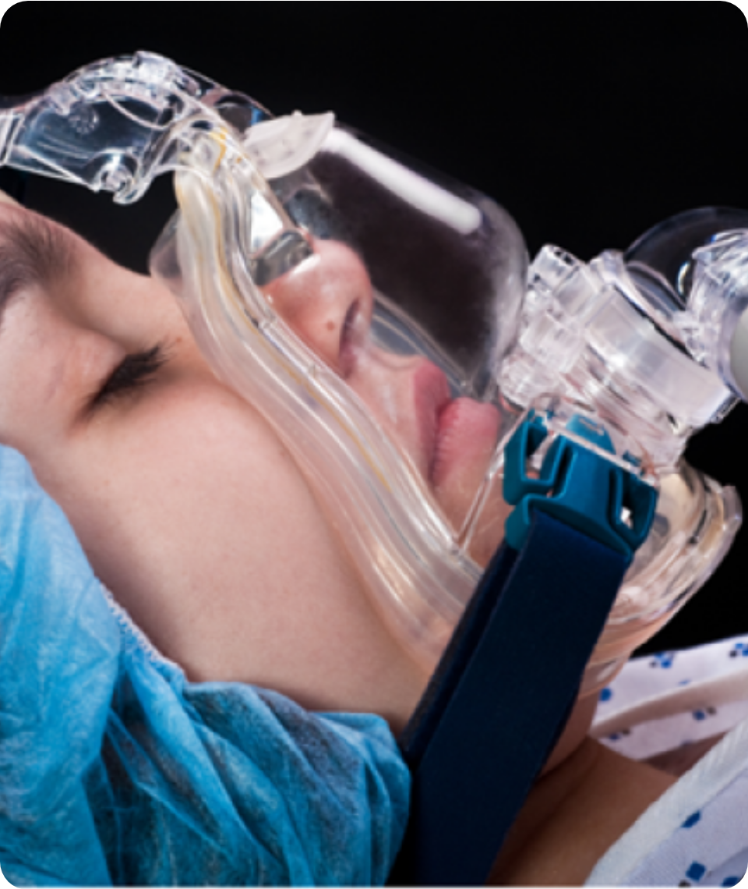











Type 1 vs Type 2 Respiratory Failure
CLINICAL SKILLS & DIAGNOSTICS
Type 1: Oxygenation Failure
Type 2: Ventilation Failure
PaO2
< 8 kPa
PaO2
< 8 kPa
PaCO2
Normal / Low (< 6.0)
PaCO2
Raised (> 6.0 kPa)
Failure of gas exchange across the alveolar membrane
Failure of the "pump" (lungs/chest wall/muscles)
Common Causes: COPD, Neuromuscular disease, Obesity
Common Causes: Pneumonia, Pulmonary Oedema, PE
Risk: Loss of hypoxic drive if over-oxygenated
Compensation: Hyperventilation (lowers CO2)
COPD Target Oxygen Saturation
88 – 92%
In patients with known COPD or Type 2 failure risk, avoid high-flow oxygen. Use 24% or 28% Venturi masks to prevent CO2 retention.
BRADFORD VTS TEACHING DECK • May 2026
ABG Interpretation in GP • Slide 9 of 15

Slide 10







ABG IN SPECIFIC CONDITIONS — COPD and DKA
CLINICAL SKILLS & DIAGNOSTICS
COPD EXACERBATION
DIABETIC KETOACIDOSIS
TYPICAL ABG FINDINGS
TYPICAL ABG FINDINGS
Type 2 Resp Failure: pH ↓, PaCO2 ↑
Acid-Base: High Anion Gap Metabolic Acidosis
Compensation: HCO3- ↑ (if chronic/long-standing)
Vitals: pH ↓, HCO3- ↓, PaCO2 ↓ (compensation)
Hypoxaemia: PaO2 < 10 kPa (on air)
Biochemistry: Glucose ↑↑ + Ketones positive
MANAGEMENT STRATEGY
MANAGEMENT STRATEGY
Target SpO2: 88–92% via 24% or 28% Venturi
Fluid Resus: IV 0.9% Saline (BNF 2024)
NIV (BiPAP): Consider if pH < 7.35 + PaCO2 > 6
Insulin: Fixed rate infusion 0.1 units/kg/hr
Avoid high-flow O2 (prevents loss of hypoxic drive)
Monitor electrolytes (K+) and acid-base resolution

Slide 11









ABG in Specific Conditions — PE and Salicylate
CLINICAL SKILLS & DIAGNOSTICS
Pulmonary Embolism (PE)
Salicylate Overdose
Primary Pattern
Mixed Picture
Characteristically causes Type 1 Respiratory Failure (failure of oxygenation).
A classic Mixed Acid-Base Disorder involving two distinct physiological mechanisms.
Gas Parameters
Early: Resp. Alkalosis
PaO2 ↓ due to V/Q mismatch.
PaCO2 ↓ due to compensatory hyperventilation (tachypnoea).
Direct stimulation of the medullary respiratory centre leads to hyperventilation and ↓ PaCO2.
Acid-Base Status
Late: Metabolic Acidosis
Results in a Respiratory Alkalosis (pH ↑) from blowing off excessive CO2.
Interference with Krebs cycle and oxidative phosphorylation leads to organic acid accumulation (↑ Anion Gap).
PRIMARY CARE WORKUP
EXAM PEARL
D-dimer if low clinical probability (Wells score); CTPA for definitive hospital diagnosis.
Recognizing a near-normal pH with both low HCO3- and low PaCO2 suggests this dual pathology.

Slide 12

















Top Tips and Red Flags
ESSENTIAL CLINICAL PEARLS & URGENT INTERVENTIONS
CLINICAL ESSENTIALS
URGENT RED FLAGS
1
FiO2 DocumentationAlways record inspired oxygen; PaO2 values are only interpretable relative to FiO2.
pH < 7.2
Severe acidosis indicates critical physiological decompensation. Requires immediate senior review and potential ICU admission.
2
COPD Oxygen TargetsIn Type 2 failure, target SpO2 88–92% to avoid loss of hypercapnic respiratory drive.
PaCO2 > 8 kPa + ↓ GCS
Impending respiratory arrest due to CO2 narcosis. Call 999 immediately for emergency airway management.
3
Metabolic DiagnosticsIf the anion gap is raised, systematically apply MUDPILES to identify the underlying cause.
Lactate > 4 mmol/L
Evidence of severe tissue hypoperfusion. Strongly suggestive of severe sepsis or occult shock. Initiate immediate fluid resuscitation.
BEST PRACTICE
ALWAYS CORRELATE NUMBERS WITH CLINICAL PICTURE
4
Pre-Puncture SafetyNever omit Allen's test; ensure collateral circulation is confirmed before radial access.
5
Haematoma PreventionApply firm, continuous pressure for a full 5 minutes; arterial bleeding is rapid and high-pressure.
6
Compensation PitfallA normal pH can mask pathology; if CO2 or HCO3 are abnormal, the patient is fully compensated.

Slide 13














Common Pitfalls
AVOIDING PROCEDURAL & CLINICAL ERRORS
PROCEDURAL ERRORS
CLINICAL MANAGEMENT ERRORS
Neglecting Allen’s Test
Excessive Oxygen Delivery
Performing radial puncture without confirming collateral ulnar flow risks permanent ischaemic damage if the radial artery thromboses.
Giving high-flow O2 to Type 2 COPD patients risks removing the hypoxic drive, leading to worsening hypercapnia and respiratory arrest.
Air Bubbles in Syringe
Numerical Tunnel Vision
Failure to expel air immediately causes gas equilibration, which falsely lowers PaCO2 and can artificially raise PaO2 measurements.
Treating the "numbers" rather than the patient. Always correlate ABG findings with the clinical state (e.g., GCS, work of breathing).
Delayed Analysis
Missing FiO2 Context
Samples must be analysed within 15 minutes. Delays lead to metabolic changes (↓pH, ↑PaCO2) as blood cells continue to respire.
Recording results without the inspired oxygen concentration (FiO2) makes the PaO2 value clinically uninterpretable and useless for trends.

Slide 14











Exam Pearls: AKT & SCA Preparation
CLINICAL SKILLS & DIAGNOSTICS
AKT: Knowledge & Interpretation
SCA: Communication & Safety
Core Normal Values
Explaining Results
Memorize ranges for pH (7.35-7.45), PaCO2 (4.7-6.0), and HCO3- (22-26).
Avoid jargon. Explain "acid levels" and "oxygen balance" simply to the patient or relatives.
The Anion Gap Calculation
NIV Discussions
Required for metabolic acidosis questions (Normal: 8–16 mmol/L).
AG = (Na⁺ + K⁺) – (HCO₃⁻ + Cl⁻)
Be prepared to discuss the transition to BiPAP/NIV in Type 2 failure (pH <7.35 + pCO2 >6).
Key Mnemonics & Targets
Oxygen Target Setting
MUDPILES for high AG acidosis; Type 1 vs Type 2 failure; SpO2 88–92% in COPD.
Clearly state oxygen targets in your management plan to show safety awareness.
Clinical Correlation
Always treat the patient, not just the gas. Correlate with GCS and work of breathing.
BRADFORD VTS TEACHING DECK — MAY 2026
www.bradfordvts.co.uk

Slide 15






















Quick Recall
CLINICAL SKILLS & DIAGNOSTICS
pH & Primary Source
Respiratory Failure
MUDPILES
Timing & Pressure
Type 1: PaO2 ↓ with normal/low PaCO2.
Type 2: PaO2 ↓ with raised PaCO2 >6 kPa.
High AG metabolic acidosis causes: Methanol, Uraemia, DKA, Paracetamol, Isoniazid, Lactate, Ethylene glycol, Salicylates.
Apply firm pressure for 5 minutes.
Analyse sample within 15 minutes of collection.
pH <7.35 = Acidosis; >7.45 = Alkalosis.
PaCO2 ↑ indicates a respiratory problem.
HCO3 ↓ indicates metabolic acidosis.
Clinical Targets
Allen's Test
Compensation
Anion Gap
COPD target SpO2: 88–92%.
Always correlate results with clinical picture.
Perform before radial puncture. Positive (refill <4s) = safe to proceed with sample.
Fully compensated: pH is normal, but both CO2 and HCO3 are abnormal.
Normal range: 8–16 mmol/L.
(Na+ + K+) – (HCO3- + Cl-)
BRADFORD VTS TEACHING DECK
www.bradfordvts.co.uk
MAY 2026

