Slide 1



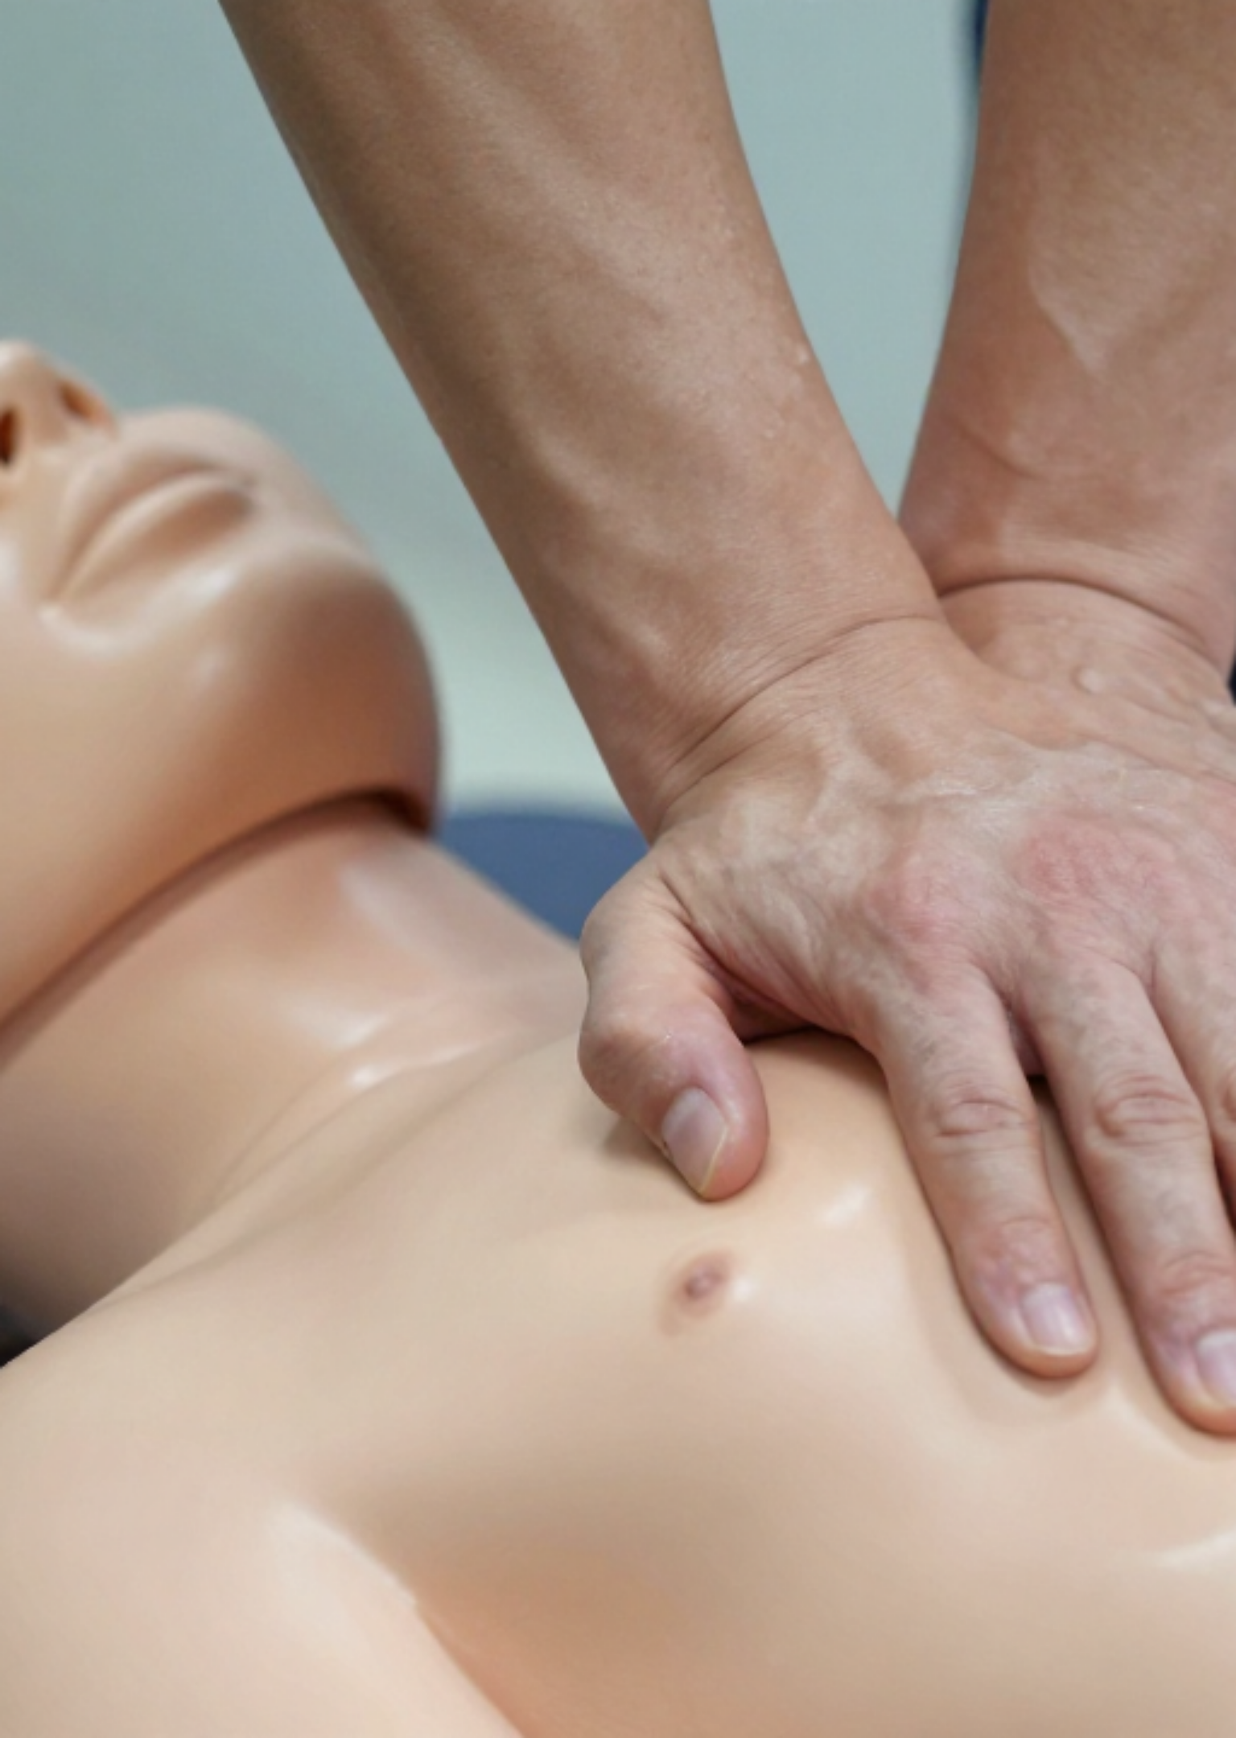

BLS & ALS IN GENERAL PRACTICE
Bradford VTS Teaching Deck
UPDATED TO RCUK 2025 GUIDELINES
Clinical Authority: Resuscitation Council UK (Published 27 October 2025)
Created May 2026 • Updated to RCUK 2025 standards
www.bradfordvts.co.uk

Slide 2
















RCUK 2025 GUIDELINES: OVERVIEW AND KEY CHANGES
RCUK 2025 Guidelines • GP Practice Context
TOPIC
2021 GUIDELINE
2025 CHANGE / EMPHASIS
999 Activation
After assessing breathing
Core Principle Unchanged
Call BEFORE breathing assessment for any unresponsive patient.
It is more important that people feel able to do something than focus on small details. No greater harm can occur than failing to act. Implemented in clinical practice from January 2026.
First Aid
General mention
Brand New Dedicated Chapter covering choking, trauma, and medical emergencies.
ALS Pads
Antero-lateral
Greater emphasis: Lateral pad must be directly below armpit in mid-axillary line.
THE "BIG CHANGE"
Athletes
No specific guidance
Recognise near-normal/panting breathing as cardiac arrest onset.
Call 999 BEFORE assessing breathing for any unresponsive person. Ambulance dispatchers guide CPR recognition immediately.
Post-ROSC
Active cooling 32-36°C
Focus on Fever Prevention (≤37.5°C) for comatose patients.
*Crucial for athletes who may show near-normal or panting breathing at onset.
Defibrillation
Dual sequential noted
Explicitly NOT recommended (insufficient evidence).
AKT TIP
SCA TIP
Note the implementation date: Guidelines published Oct 2025, active in courses/exams from Jan 2026.
Communication: Reassure bystanders that any attempt is better than no attempt—"failing to act" is the only harm.
www.bradfordvts.co.uk
Created May 2026 • RCUK 2025 Standards

Slide 3






















ADULT BASIC LIFE SUPPORT (BLS)
RCUK 2025 Guidelines • GP Practice Context
High-Quality CPR Specs
Rate: 100–120 compressions per minute
1
SUSPECT Cardiac Arrest
Depth: 5–6 cm (avoid exceeding 6 cm)
Any unresponsive person. Athletes may show near-normal breathing or panting; do not be reassured.
Position: Heel on lower half of sternum
Ratio: 30:2 (1 sec breaths) or Compression-only
2
CALL 999 NEW 2025
Call BEFORE assessing breathing for unresponsive persons. Activate speaker function immediately.
AED & Safety
3
START CPR
Anyone can use an AED — no training needed
Begin chest compressions as soon as possible. Dispatchers guide CPR and AED use via phone.
Use as soon as available; follow voice prompts
Risk of harm to rescuer/patient is very low
Ensure AED is registered on "The Circuit"
AKT TIP: Memorize the 100-120 bpm and 5-6cm depth. Compression-only CPR is recommended if untrained or unwilling to breathe.
SCA TIP: Verbalize instructions to staff clearly: "Call 999, get the AED, and put the phone on speaker next to me."
www.bradfordvts.co.uk

Slide 4












ADULT ADVANCED LIFE SUPPORT (ALS) ALGORITHM
RCUK 2025 Guidelines • GP Practice Context
Shockable (VF / pVT)
Non-Shockable (PEA / Asystole)
1
Deliver 1 Shock (Biphasic ≥150J). Immediately resume CPR for 2 mins.
1
Give Adrenaline 1mg IV/IO Immediately ASAP.
2
Resume CPR for 2 mins. Minimize interruptions during rhythm checks and drug delivery.
2
After 3rd Shock: Give Adrenaline 1mg IV/IO & Amiodarone 300mg IV/IO.
3
Repeat Adrenaline 1mg every 3-5 mins (alternate cycles). Search for reversible causes (4Hs & 4Ts).
3
After 5th Shock: Give Adrenaline 1mg & Amiodarone 150mg. Repeat Adrenaline every 3-5 min.
SCA COMMUNICATION
AKT HIGH YIELD
Lead the team clearly: "The rhythm is non-shockable. Administer 1mg Adrenaline now and resume chest compressions immediately."
Timing of drugs is critical. For shockable rhythms, adrenaline and amiodarone are only given after the 3rd shock and then the 5th shock.
Clinical Authority: RCUK Guidelines 2025 (Updated Oct 2025)
www.bradfordvts.co.uk

Slide 5















ALS: REVERSIBLE CAUSES & PHARMACOLOGY
RCUK 2025 Guidelines • GP Practice Context
Reversible Causes: 4 Hs
Pharmacology Updates
Hypoxia
Hypovolaemia
Adrenaline 1mg
Non-shockable: ASAP
Shockable: After 3rd shock
Ensure patent airway; give highest possible O₂.
Assess for internal/external hemorrhage; fluid bolus.
Amiodarone 300mg
Shockable only: After 3rd shock
Hypo/Hyperkalaemia
Hypothermia
Amiodarone 150mg
Shockable only: After 5th shock
And metabolic disorders; check recent bloods/history.
Check temp; consider active/passive rewarming.
Repeat Adrenaline
Every 3–5 minutes (alternate cycles)
Reversible Causes: 4 Ts
Tension Pneumothorax
Tamponade (Cardiac)
2025 PAD PLACEMENT EMPHASIS
Needle decompression if suspected (tracheal shift, etc).
Suspect in trauma or post-cardiac surgery cases.
The lateral (apical) pad must be positioned directly below the armpit in the mid-axillary line for optimal vector across the myocardium.
Toxins
Thrombosis
AKT HIGH-YIELD TIP
Review patient medications and possible overdose.
PE or Coronary (MI). Consider thrombolytics if PE suspected.
MCQs frequently test the timing of adrenaline. Remember: ASAP for PEA/Asystole, but wait until after the 3rd DC shock for VF/pVT. Do not give drugs if a shockable rhythm is converted to ROSC after shock 1 or 2.
www.bradfordvts.co.uk

Slide 6
















PERI-ARREST ARRHYTHMIAS MANAGEMENT
RCUK 2025 Guidelines • GP Practice Context
ADVERSE FEATURES (UNSTABLE)
Bradycardia Management
• Shock (SBP <90 mmHg)
• Heart Failure
• Syncope
• Myocardial Ischaemia
First Line: Atropine 500 mcg IV (repeat up to 3mg).
If Atropine Fails: Isoprenaline 5mcg/min or Adrenaline 2–10mcg/min infusion.
Tachyarrhythmia Management
Pacing: Transcutaneous bridge to transvenous pacing.
Unstable: Immediate Synchronised DC Cardioversion.
AF: Initial shock at maximum output (not escalating).
2025 UPDATE: Cardiac Transplant / Spinal Cord Injury
NO ATROPINE (Risk of high-degree AV block). Use Aminophylline 100–200mg slow IV.
SVT / Atrial Flutter: Initial 70–120 J, then stepwise.
Stable VT: Amiodarone 300mg IV over 10–20 min.
AKT TIP
Dosages: Max dose of Atropine is 3mg. Remember Glucagon for bradycardia caused by Beta-blocker or Calcium Channel Blocker overdose.
SCA TIP
Communication: Clearly explain the need for cardioversion to a conscious but unstable patient. "Your heart is beating too fast and making you unwell; we need to use a controlled shock to reset it."
www.bradfordvts.co.uk

Slide 7

















PAEDIATRIC BASIC LIFE SUPPORT (PBLS)
RCUK 2025 Guidelines • GP Practice Context
Trained Sequence (PBLS)
Initial Check: Responsiveness (verbal/tactile) + Open Airway (Head tilt-chin lift; neutral in infants).
Give 5 Initial Rescue Breaths: Essential first step as most arrests are hypoxic.
Start CPR: 15 compressions followed by 2 breaths (15:2 ratio).
Call 999: Use speaker function; call immediately if alone or while starting CPR.
Top Tip: If untrained or only adult-trained, 30:2 is acceptable—but 15:2 is superior for children.
Compression Techniques
Infants (<1y): Two-thumb encircling technique (preferred) or two-finger technique.
AKT HIGH YIELDRatio is 15:2 for PBLS. Always start with 5 rescue breaths. Depth is 1/3 of chest diameter.
SCA COMM TIP"I'm giving your baby rescue breaths now because they need oxygen to help their heart start again."
Children (>1y): One or two hands (depending on size) to achieve 1/3 depth.
Rate & Depth: 100–120 bpm. Depth 4cm (infant) to 5cm (child). Max 6cm.
AED: Safe for all ages. Use paediatric pads/mode if <25kg (approx. ≤8 years).
www.bradfordvts.co.uk

Slide 8













PAEDIATRIC ADVANCED LIFE SUPPORT (PALS)
RCUK 2025 Guidelines • GP Practice Context
Shockable Rhythms (VF/pVT)
2025 Pharmacology Updates
DEFIBRILLATE
Deliver 1 shock at 4 J/kg (Max 120-200J) then resume CPR.
Hydrophilic Drugs: Use (Adrenaline, Ca, Mg, Salbutamol).
After 3rd shock: Adrenaline 10 mcg/kg + Amiodarone 5 mg/kg.
Lipophilic Drugs: Consider for Amiodarone.
After 5th shock: Adrenaline 10 mcg/kg + Amiodarone 5 mg/kg.
Vascular Access: IV first (max 2 attempts); if fails, transition to IO access immediately.
Non-Shockable (PEA/Asystole)
DRUGS ASAP
AKT HIGH-YIELD TIP
Remember the magic number: 10 mcg/kg of Adrenaline (0.01 mg/kg). For a 20kg child, this is 200mcg (0.2ml of 1:1,000).
Give Adrenaline 10 mcg/kg IV/IO immediately upon recognition.
Repeat Adrenaline every 3-5 minutes (every other 2-min cycle).
Start compressions if HR <60/min with poor perfusion despite ventilation.
SCA COMMUNICATION
In a paediatric arrest, use clear 'Closed-Loop' communication: "I am giving 150 micrograms of Adrenaline now."
Created May 2026 • Updated to RCUK 2025 Standards
www.bradfordvts.co.uk

Slide 9

























CHOKING AND NEW 2025 FIRST AID GUIDANCE
RCUK 2025 Guidelines • GP Practice Context
2025 First Aid Chapter (New)
ABCDE Assessment: Core principle for first aid.
Critical Emergencies: Bleeding, Drowning, Hypoglycaemia, Opioid Overdose, and Stroke.
CATEGORY
SEVERE OBSTRUCTION ACTION
IF UNCONSCIOUS
Interventions: Early use of Tourniquets, Naloxone, and Adrenaline autoinjectors.
5 Back Blows followed by
5 Abdominal Thrusts (Heimlich)
Start CPR (30:2).
Check mouth before breaths.
Adult
Scene Safety: Prioritize rescuer safety first.
5 Back Blows followed by
5 Abdominal Thrusts
5 Initial Rescue Breaths.
Then start CPR (15:2).
Child
5 Back Blows followed by
5 Chest Thrusts (No Abdominal)
5 Initial Rescue Breaths.
Then start CPR (15:2).
Infant
AKT HIGH-YIELD
Infants (<1yr) = Chest Thrusts. Children/Adults = Abdominal Thrusts. No blind finger sweeps in any age group.
For mild obstruction (coughing/speaking), encourage coughing. For severe obstruction, call 999 immediately.
SCA COMMUNICATION
Use command language: "I need to call 999 now." Reassure bystanders and explain actions clearly while managing the airway.
www.bradfordvts.co.uk

Slide 10















POST-RESUSCITATION CARE AND FOLLOW-UP
RCUK 2025 Guidelines • GP Practice Context
Immediate ROSC Stabilization
Prognostication & Neuro-Care
Oxygenation: Controlled target SpO2 94–98%. Avoid 100% saturation to prevent oxidative stress.
Timing: Do not perform formal neuro-prognostication until ≥72 hours post-ROSC.
Circulation: Target systolic BP >100 mmHg or MAP 60–65 mmHg. Early 12-lead ECG.
Multimodal Approach: Combine clinical exam, EEG, biomarkers (NSE), and imaging (CT/MRI) for accuracy.
Ventilation: Aim for normocapnia (ETCO2 4.5–5.5 kPa). Avoid hyperventilation which impairs cerebral flow.
Withdrawal: Decisions to withdraw life-sustaining therapy must be separate from the initial prognosis.
Rehabilitation & Support
Temperature Management (2025)
Follow-up: Structured clinical assessment within 3 months of discharge for physical and mental health.
Fever Prevention: Maintain temperature ≤37.5°C for at least 72 hours in comatose patients.
Bystander Support: Systems must offer psychological support to lay rescuers and family "co-survivors".
No Routine Cooling: Active therapeutic hypothermia (32–36°C) is no longer routinely recommended for all patients.
Seizure Control: Use levetiracetam or sodium valproate. Do not use neuroprotective drugs routinely.
AKT HIGH-YIELD TIP
2025 Guideline Change: The priority is Fever Prevention (≤37.5°C) rather than active cooling to 32-36°C. Target SpO2 94-98%, not 100%.
www.bradfordvts.co.uk

Slide 11

















SPECIAL CIRCUMSTANCES: PREGNANCY & ANAPHYLAXIS
RCUK 2025 Guidelines • GP Practice Context
Cardiac Arrest in Pregnancy
Anaphylaxis: IM Adrenaline Dosing
Perform standard ALS protocols; use standard drug dosages.
Administer IM (1:1000) into the anterolateral thigh immediately.
Manual Uterine Displacement: Push the uterus to the patient's left to relieve aortocaval compression.
PATIENT GROUP
ADRENALINE IM DOSE
Adult
0.5 mg
Aim for high-quality compressions; standard pad placement.
Child > 12 years
0.3 mg
Child 6 – 12 years
0.15 mg
Timing & Delivery
Child < 6 years
0.01 mg/kg
Resuscitative Hysterotomy: Consider if >20 weeks gestation and no ROSC after 4 minutes.
Repeat IM adrenaline after 5 minutes if no improvement.
The 5-Minute Rule: Aim to deliver the baby within 5 minutes of maternal cardiac arrest.
Position: Lay flat with legs raised (sit up only if breathing is the primary issue).
Prioritise maternal resuscitation to improve fetal outcome.
AKT TIP
SCA TIP
IM Adrenaline is the first-line treatment. Do not use IV adrenaline unless you are an experienced specialist in a critical care setting.
Demonstrate safety and patient education: "Have you been shown how to use your EpiPen? Let's practice the technique together now."
www.bradfordvts.co.uk

Slide 12


























GP-SPECIFIC CONSIDERATIONS & EQUIPMENT
RCUK 2025 Guidelines • Clinical Preparedness in Primary Care
When to Call 999 Immediately
The Emergency Doctor’s Bag (Minimum Kit)
Cardiac arrest or suspected arrest
Portable AED (Registered)
Oxygen Cylinder + Masks
Unresponsive + Not breathing normally
FAST positive (Stroke) or Major Trauma
Bag-Valve-Mask (BVM)
Pocket Mask / Face Shield
Anaphylaxis or Acute severe asthma
Adrenaline 1mg/1ml (×2)
Adrenaline Autoinjector
Obstetric emergency (e.g., eclampsia)
IV & IO Access Equipment
Glucagon Kit
Aspirin 300mg
GTN Spray
The Circuit & AED Access
AKT HIGH YIELDKnow your dosages for IM Adrenaline in Anaphylaxis and the priority of drugs in cardiac arrest. Adrenaline is 1:1,000 for IM.
SCA TIPUse clear, assertive language: "I need to call an ambulance right now. Please bring the emergency bag and AED to Room 4."
National AED Registry
Register your surgery AED on The Circuit. This ensures ambulance dispatchers can direct public rescuers to your device 24/7/365.
Connected Apps: GoodSAM & The Circuit volunteer networks.
www.bradfordvts.co.uk

Slide 13








DNACPR, RESPECT, AND ADVANCE CARE PLANNING
Guidance on person-centred emergency care planning, the use of ReSPECT forms, and navigating ethical conversations with patients and families.
The ReSPECT Framework
Replaces DNACPR in many regions; focus is on clinical recommendations for emergency care.
SCA COMMUNICATION TIP
Holistic summary: balances life-sustaining treatment vs. comfort-based care priorities.
"The aim of this form is to make sure your wishes are followed if your heart were to stop. It ensures we focus on the care that is most important to you."
Dynamic document: must be updated as clinical condition or patient wishes change.
Ethical & Clinical Decision Making
Families should be given the option to be present during resuscitation. Termination of CPR must consider patient values and the absence of reversible causes.
Advance Care Planning (ACP)
Early engagement: initiate conversations before a crisis occurs (e.g., chronic disease clinics).
AKT CLINICAL FACT
DNACPR/ReSPECT is not legally binding in all scenarios but constitutes a significant clinical recommendation. Clinical judgment on reversible causes always applies.
Person-centred: explore "What matters to you?" rather than just "What is wrong with you?".
Accessibility: ensure documentation is shared across settings (GP, OOH, Hospital, Ambulance).
www.bradfordvts.co.uk

Slide 14









AKT AND SCA EXAM SUCCESS TIPS
RCUK 2025 Guidelines • GP Practice Context
AKT HIGH-YIELD: BLS & ALS
SCA TIPS: CLINICAL ACTION
Adult BLS: 100–120 bpm, 5–6 cm depth. 30:2 ratio (trained) or compression-only (untrained).
Directness: "I need to call an ambulance right now" - show clear, decisive leadership under pressure.
ALS Adrenaline: Non-shockable ASAP; Shockable after 3rd shock; repeat every 3–5 mins.
Task Sharing: "While I start chest compressions, please tell me if this has happened before."
Amiodarone: 300mg after 3rd shock; 150mg after 5th shock. (Lidocaine 100mg is alternative).
ReSPECT: Focus on dignity - "The aim is to ensure your wishes are followed if your heart stops."
AKT HIGH-YIELD: PAEDS & UPDATES
SCA TIPS: FOLLOW-UP & SAFETY
Paediatric BLS: 5 initial breaths mandatory; 15:2 ratio for trained PBLS rescuers.
Empathy: "It is normal to feel very shaken after such an event; we are here to support you."
Bradycardia Caveat: Atropine is ineffective in cardiac transplants; use Aminophylline (100–200mg).
Practical Safety: "Have you been shown how to use your EpiPen? Let's practice the technique now."
2025 Update: Dual sequential defibrillation is NOT recommended (insufficient evidence).
Safety Netting: Clearly document instructions for bystanders/family regarding ROSC warning signs.
Top Tip: Use SBAR for the 999 handover to ensure no clinical data is missed.
www.bradfordvts.co.uk

Slide 15















SUMMARY AND EDUCATIONAL DISCLAIMER
RCUK 2025 Guidelines • Final Recap
The "Golden Hour" Recap: Top 2025 Updates
Educational Disclaimer
Immediate Call: Call 999 BEFORE assessing breathing in any unresponsive person. Ambulance handlers guide the recognition.
This resource is for educational purposes only. Always refer to current national guidelines and local protocols for clinical decisions. The information provided reflects the Resuscitation Council UK 2025 standards as of the publication date. Clinical judgment must remain paramount in individual patient care.
Pad Placement: Greater emphasis on correct lateral pad placement — directly below the armpit in the mid-axillary line.
New First Aid Chapter: RCUK 2025 now includes comprehensive guidance on drowning, trauma, and medical emergencies.
Quick Recall: Key Numbers
Post-ROSC Care: Shift from routine active cooling to fever prevention (maintain temperature ≤37.5°C).
CPR Rate/Depth100–120 bpm | 5–6 cm
Adult Ratio30:2 (Trained)
Dual Defibrillation: Dual sequential defibrillation is explicitly NOT recommended due to insufficient evidence.
Paediatric Ratio5 initial breaths | 15:2
Adrenaline IV1mg (Adult) | 10mcg/kg (Child)
"It is more important people feel able to do something than focus on small details... No greater harm can occur than failing to act." — RCUK 2025
AKT: Shockable vs Non-shockable timings
SCA: SBAR for 999 handover
www.bradfordvts.co.uk

