Slide 1



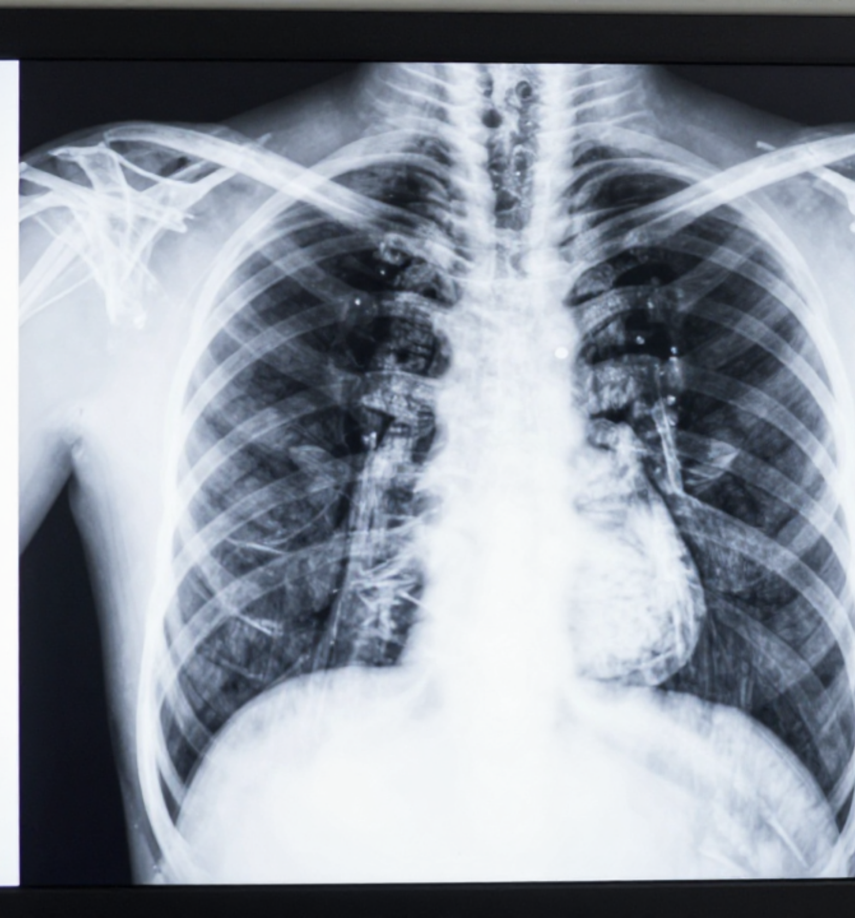

BRADFORD VTS TEACHING DECK
Chest X-Ray
Interpretation in
General Practice
A systematic approach to clinical patterns, management protocols, and primary care decision-making.
www.bradfordvts.co.uk
Created May 2026

Slide 2














QUALITY CHECK: THE RIPE APPROACH
Assessing film adequacy before clinical interpretation
Rotation
Inspiration
Clavicular heads must be equidistant from the spinous process.
Posterior right 10th or 11th ribs should be visible above the diaphragm.
Rotation can distort the heart shape and mediastinum.
Poor inspiration crowds lung markings and mimics pathology.
Penetration
Exposure
Thoracic vertebrae should be faintly visible behind the heart silhouette.
The entire lung fields must be visible on the film.
Check that apices and costophrenic angles are not cut off.
Under-penetration makes lung fields appear too white.
CLINICAL PEARL
Always check RIPE quality first — a rotated or under-inspired film will mislead you and may lead to unnecessary investigations.

Slide 3






SYSTEMATIC READING: ABCDEFGH
A structured method covering Airway, Bones, Cardiac silhouette, Diaphragm, Effusions, lung Fields, Gastric bubble, and Hila to ensure no pathology is missed.
A
AIRWAY
C
CARDIAC
E
EFFUSION
G
GASTRIC
• Trachea midline
• CTR <50% (PA film)
• Blunting of angle
• Bubble below left diaphragm
• Carina angle <70°
• Cardiac silhouette shape
• Meniscus sign (>200 mL)
• Absence can be pathological
B
BONES
D
DIAPHRAGM
F
FIELDS
H
HILA
• Ribs (fractures, metastases)
• Right higher than left
• Compare lung symmetry
• Left hila higher than right
• Clavicles, scapulae, vertebrae
• Costophrenic angles sharp
• Check each intercostal space
• Enlargement: LN, TB, Sarcoid
BRADFORD VTS TEACHING DECK
Created May 2026 • www.bradfordvts.co.uk

Slide 4







LUNG ANATOMY AND THE SILHOUETTE SIGN
Understanding lung lobes and using the silhouette sign to localize pathology based on the loss of normal anatomical borders.
Lung Lobes & Segments
The Silhouette Sign
Right Lung (3 Lobes)
"Loss of the normal border between two structures of similar density when they are in direct anatomical contact."
Upper, Middle (Lateral + Medial segments), and Lower (5 segments).
Left Lung (2 Lobes)
Upper (including Lingula: Superior + Inferior) and Lower.
Right Middle Lobe
Loss of Right Heart Border
Lower Lobe Segments
Apical, Antero-medial basal, Lateral basal, and Posterior basal segments.
Lingula Consolidation
Loss of Left Heart Border
Loss of Hemidiaphragm
Lower Lobe Pathology

Slide 5











CONSOLIDATION VERSUS COLLAPSE
Differentiating between airspace filling in consolidation and volume loss in collapse, including the presence of air bronchograms and mediastinal shift.
Consolidation
Collapse (Atelectasis)
AIRSPACE FILLING
VOLUME LOSS
Pathophysiology: Alveolar air replaced by fluid, pus (pneumonia), or blood.
Pathophysiology: Loss of aeration resulting in reduced volume of a lung segment or lobe.
Radiology: Dense white opacity; often lobar or segmental distribution.
Radiology: Linear or wedge-shaped opacity; displacement of fissures.
Air Bronchogram: Often visible as dark tubular structures (airways) within white lung.
Mediastinal Shift: Significant volume loss pulls the trachea/mediastinum TOWARD the lesion.
Volume: No volume loss. Mediastinum and trachea remain midline.
Hilar Signs: Elevation or depression of the hilum depending on which lobe has collapsed.
AKT CLINICAL PEARL: The fundamental differentiator is volume loss. Both appear "white" on CXR, but only collapse "pulls" anatomical structures (trachea/fissures) towards the opacity. If the trachea is pushed AWAY, think massive pleural effusion.

Slide 6



















PULMONARY OEDEMA & HEART FAILURE
Clinical Patterns and the ABCDE Systematic Mnemonic
A
B
C
D
E
ALVEOLAR
B LINES
CARDIAC
DIVERSION
EFFUSIONS
Bat-wing perihilar alveolar oedema & fluffy infiltrates.
Kerley B lines: horizontal, peripheral, 1–2 cm at bases.
Cardiomegaly: Cardiothoracic Ratio (CTR) > 50%.
Upper lobe blood diversion (prominent apical vessels).
Pleural effusions (often bilateral) & blunted angles.
Radiological Patterns
AKT Clinical Pearl
Upper lobe blood diversion is an early sign of heart failure and may occur before overt pulmonary oedema or effusions are visible.
Interstitial Oedema: Kerley B lines & peribronchial cuffing.
Alveolar Oedema: "Bat-wing" perihilar shadowing; fluffy bilateral infiltrates.
DIFFERENTIAL CAUSES
Volume Overload: Dilated azygos vein and widened mediastinum.
Left Ventricular Failure
Fluid Overload
ARDS
Renal Failure
BRADFORD VTS TEACHING DECK
Created May 2026 • www.bradfordvts.co.uk

Slide 7











PNEUMOTHORAX AND PLEURAL EFFUSION
Recognizing the pleural line in pneumothorax and the meniscus sign in effusions, with a focus on identifying tension pneumothorax and massive effusions.
Pneumothorax
Pleural Effusion
Pleural Edge: Visible as a thin white line parallel to the chest wall.
Meniscus Sign: Curvilinear upward-sloping opacity at the lung periphery.
Peripheral Lucency: Complete absence of lung markings distal to the pleural line.
Costophrenic Blunting: Loss of the sharp angle between diaphragm and ribs.
Apical Focus: Often most evident at the lung apex on an erect film.
Volume Threshold: At least 200 mL of fluid must be present to be visible on an erect CXR.
Pitfall: Do not confuse a skin fold with a genuine pleural line.
Density: Uniform white opacity obscuring the underlying lung base.
TENSION PNEUMOTHORAX
Clinical Emergency: Tracheal deviation away from the lesion and mediastinal shift. Action: Clinical diagnosis; do NOT wait for CXR. Immediate needle decompression required.
MASSIVE EFFUSION
White-out: Complete opacification of a hemithorax. Pressure Effect: Mediastinal shift AWAY from the effusion. Differentiate from collapse where shift is TOWARD.
BRADFORD VTS TEACHING DECK
May 2026 • www.bradfordvts.co.uk

Slide 8













HILAR CHANGES AND LUNG NODULES
Evaluation & Management Guidelines (Fleischner & NICE NG12)
Bilateral Hilar Lymphadenopathy
FLEISCHNER SOCIETY
Nodule Follow-up Criteria
Sarcoidosis: Most common cause in young adults; check Serum ACE levels.
Size >8 mm: In smokers >40 years, requires CT Thorax (BTS 2019).
Systemic Causes: Lymphoma, Tuberculosis (TB), or metastatic malignancy.
Low Risk (<6 mm): Often requires no follow-up in low-risk patients.
Infection: Fungal infections or mycoplasma (less common).
Serial Imaging: Comparison with old films is the most valuable first step.
Unilateral Hilar Enlargement
NICE NG12 / 2WW
Urgent Referral Triggers
Malignancy: Bronchogenic carcinoma is the primary concern; requires urgent CT.
Massive Size: Any mass >20 mm or with spiculated margins.
Tuberculosis: Primary TB often presents with unilateral hilar nodes.
Growth: Any increase in size on interval imaging.
Vascular: Pulmonary artery enlargement (pulmonary hypertension).
Suspicious Findings: Persistent opacity despite antibiotic treatment.
RED FLAG: DON'T MISS
New mass or nodule in a smoker/ex-smoker: Refer for Urgent CT Thorax via 2-week-wait if suspicious features present. Do not delay for serial CXR.

Slide 9











PNEUMONIA AND CURB-65 SCORING
Radiological features of lobar pneumonia and using the CURB-65 score to determine home treatment versus hospital admission.
CURB-65 Clinical Tool
C
Confusion (New onset AMT ≤ 8)
Radiological Features
U
Urea > 7 mmol/L
Lobar Consolidation
R
Respiratory Rate ≥ 30/min
Dense, uniform opacification localized to a specific lobe or segment.
Air Bronchogram
B
Blood Pressure (SBP < 90 or DBP ≤ 60 mmHg)
Visible tubular lucencies (air-filled bronchi) against the background of opaque lung.
65
Age ≥ 65 years
Non-Volume Loss
Unlike collapse, consolidation does not typically cause mediastinal shift.
Management Action
AKT CLINICAL PEARL
Presence of an air bronchogram confirms the pathology is in the lung parenchyma (consolidation), not the pleural space (effusion).
SCORE
RECOMMENDED ACTION
0 – 1
Low risk; Home treatment
2
Intermediate risk; Consider hospital referral
≥ 3
High risk; Urgent admission (Consider ICU)
Bradford VTS Teaching Deck © May 2026
www.bradfordvts.co.uk

Slide 10










TUBERCULOSIS AND COPD
Identifying patterns of infection and chronic obstructive disease
Tuberculosis Patterns
COPD Characteristics
Primary TB
Hyperinflation
Characterized by hilar lymphadenopathy and occasional pleural effusions. Often presents as a Ghon focus.
Increased lung volume; identified by seeing more than 6 anterior ribs above the diaphragm.
>6 Anterior Ribs
Post-Primary (Reactivation)
Upper zone infiltrates are classic. Look for cavitation, which indicates high infectivity.
Diaphragmatic Changes
Flattened hemidiaphragms (loss of normal dome shape) and increased retrosternal airspace.
Miliary TB
Fine, 1-2mm nodular pattern distributed evenly throughout both lung fields (resembling millet seeds).
Vascularity & Bullae
Reduced vascular markings (pruning) and presence of bullae (thin-walled air spaces).
RED FLAG: Miliary shadowing on CXR must be treated as TB until proved otherwise. Urgent referral required.

Slide 11

























LUNG VOLUMES AND CAUSES OF CLUBBING
Reviewing physiological lung capacities and volumes, and identifying respiratory conditions associated with finger clubbing such as lung cancer and bronchiectasis.
Standard Lung Volumes
Malignancy & Suppuration
Tidal Volume (TV)
500 mL (normal breath)
Lung Cancer
Often large-cell types
Inspiratory Reserve (IRV)
Extra air inhaled
Suppurative Disease
Bronchiectasis, Abscess
Expiratory Reserve (ERV)
Extra air exhaled
Mesothelioma
Asbestos-related
Calculated Capacities
Interstitial & Genetic
Total Lung Capacity (TLC)
IRV + TV + ERV + RV
Cystic Fibrosis
Chronic suppuration
Vital Capacity (VC)
TLC – RV
Fibrosing Alveolitis
Progressive scarring
Functional Residual (FRC)
ERV + RV
Interstitial Lung Disease
Various etiologies
BRADFORD VTS TEACHING DECK
www.bradfordvts.co.uk • May 2026

Slide 12










CXR INTERPRETATION
Top Tips for Practical Practice
Quality First: RIPE
Apical Pneumothorax
Always assess Rotation, Inspiration, Penetration, and Exposure before interpreting findings. A rotated film can mimic pathology.
Look carefully for the thin white pleural line at the apex. Be cautious not to confuse this with a skin fold or rib edge.
The Silhouette Sign
CURB-65 Application
Loss of a normal anatomical border (e.g., heart border or diaphragm) indicates adjacent pathology of similar density.
Use CXR to confirm pneumonia, then score: 0-1 = home treatment; ≥2 = consider hospital; ≥3 = urgent admission.
Tension Pneumothorax
Early Heart Failure
This is a clinical diagnosis. Do NOT wait for a CXR if clinically suspected; perform immediate needle decompression.
Upper lobe blood diversion is an early sign of pulmonary venous congestion, often appearing before overt alveolar oedema.
BRADFORD VTS TEACHING DECK
www.bradfordvts.co.uk • May 2026

Slide 13











RED FLAGS AND COMMON PITFALLS
Critical warnings and avoiding clinical errors in CXR interpretation
Critical Red Flags
Common Pitfalls to Avoid
Tracheal Deviation: Indicates tension pneumothorax or massive effusion — surgical emergency.
Ignoring RIPE: Poor rotation can mimic mediastinal shift or heart enlargement (rotational artefact).
New Mass/Nodule: In smokers >40 years, requires urgent CT and 2-week-wait (NG12) referral.
Apical Blind Spot: Small pneumothoraces are easily missed at the lung apices; look for the pleural line.
Bilateral Hilar LN: Often sarcoidosis in young adults; check ACE levels and refer urgently.
Effusion Confusion: Don't mistake a small pleural effusion for a simple elevation of the hemidiaphragm.
Miliary Pattern: Fine nodular shadowing suggests TB or fungal infection until proven otherwise.
Extra-pulmonary Tunnel Vision: Always check bones for metastases and soft tissues for emphysema.
Missing Context: Never interpret CXR in isolation; correlate with O₂ sats and clinical symptoms.
Bradford VTS Teaching Deck • May 2026
www.bradfordvts.co.uk

Slide 14









CXR INTERPRETATION
Systematic Approach & Clinical Patterns
AKT High-Yield Pearls
SCA Consultation Pearls
Clinical Scores & Guidelines
Explaining the Findings
CURB-65 thresholds: 0–1 Home; 2 Hospital; ≥3 ICU consideration.
Avoid jargon; use "shadowing" or "area of concern" rather than "infiltrate" or "opacity."
Fleischner Criteria: Follow-up rules for incidental lung nodules based on size and risk.
Address ICE: Specifically screen for concerns about cancer when discussing nodules.
NICE NG12: Urgent 2-week-wait referral for suspicious mass or hilar enlargement.
Explain the "Next Steps" clearly (e.g., "We need a CT scan to look at this in more detail").
Radiographic Pathognomonics
Management & Safety Netting
Kerley B Lines: Short, horizontal peripheral lines representing interstitial pulmonary oedema.
Pneumonia Follow-up: Repeat CXR in 6 weeks is mandatory to ensure resolution and exclude underlying malignancy.
Silhouette Sign: Essential for localizing consolidation (e.g., loss of right heart border = RML).
Tension Pneumothorax: Emphasize clinical diagnosis; do not wait for imaging in an emergency.
Egg-shell calcification: High-yield exam link to Silicosis.
Referral Urgency: Document "2-week-wait" discussion clearly in clinical notes.
Miliary Pattern: TB, Sarcoidosis, or Histoplasmosis.

Slide 15






















CXR INTERPRETATION
Systematic Approach & Clinical Patterns
Workflow Basics
Key Metrics & Scores
RIPE: Quality check first (Rotation, Inspiration, Penetration, Exposure)
CTR > 50%: Cardiomegaly threshold (PA film only)
ABCDEFGH: Systematic search to avoid "satisfaction of search" bias
CURB-65: 0-1 Home; 2 Consider; ≥3 Admit (Hospital/ICU)
Comparison: Always compare with previous films whenever available
Effusion: >200 mL required to blunt costophrenic angle
Diagnostic Logic
Critical Priorities
Silhouette Sign: Loss of border = pathology touching that border
Tension PTX: Clinical diagnosis — DO NOT wait for X-ray
Hilar LN: Bilateral = Sarcoidosis; Unilateral = Malignancy/TB
Miliary Pattern: TB until proven otherwise; emergency referral
Air Bronchogram: Confirms consolidation over collapse
Mass > 20mm: Urgent 2-Week-Wait referral in smokers > 40y
BRADFORD VTS TEACHING DECK
Created May 2026 | www.bradfordvts.co.uk

