Slide 1

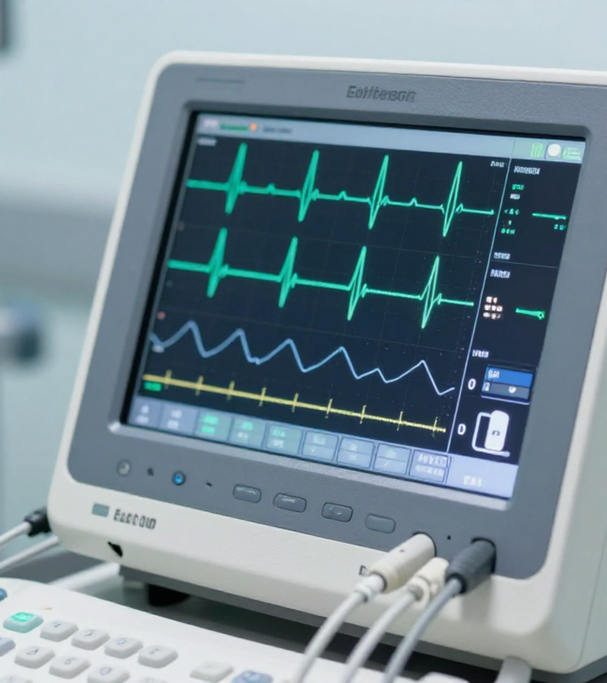

BRADFORD VTS TEACHING DECK
ECG & Cardiac Monitoring in General Practice
Clinical Protocol & AKT/SCA Exam Prep
Updated to NICE NG196 & BNF 2024 Standards
www.bradfordvts.co.uk
Created May 2026

Slide 2







ECG BASICS AND LEAD PLACEMENT
Overview of limb leads, precordial electrode positions V1–V6, and lead reversals.
Limb Leads (Einthoven's Triangle)
Common Lead Reversals
Lead I: Right arm (-) to Left arm (+)
Right Arm / Right Leg: Minimal signal in Lead II (often flatline)
Lead II: Right arm (-) to Left leg (+) — Standard rhythm strip
Right Arm / Left Arm: Lead I & III inverted; aVR & aVL reversed
Lead III: Left arm (-) to Left leg (+)
EXAM TIP: LEAD I INVERSION
Augmented Leads: aVR, aVL, aVF (Unipolar limb leads)
If Lead I is inverted, always check for Arm Lead Reversal first before diagnosing Dextrocardia or Axis Deviation.
Chest (Precordial) Electrodes
Dextrocardia vs. Lead Reversal
V1 & V2: 4th ICS, Right & Left sternal edges
Dextrocardia: No R-wave progression in V1–V6 (Small R-waves throughout)
V3: Midway between V2 and V4
Lead Reversal: R-wave progression in V1–V6 remains normal
V4: 5th ICS, Mid-clavicular line
Action: If suspected, repeat ECG with leads on correct limbs and re-verify positions
V5 & V6: Horizontal to V4, Anterior & Mid-axillary lines

Slide 3


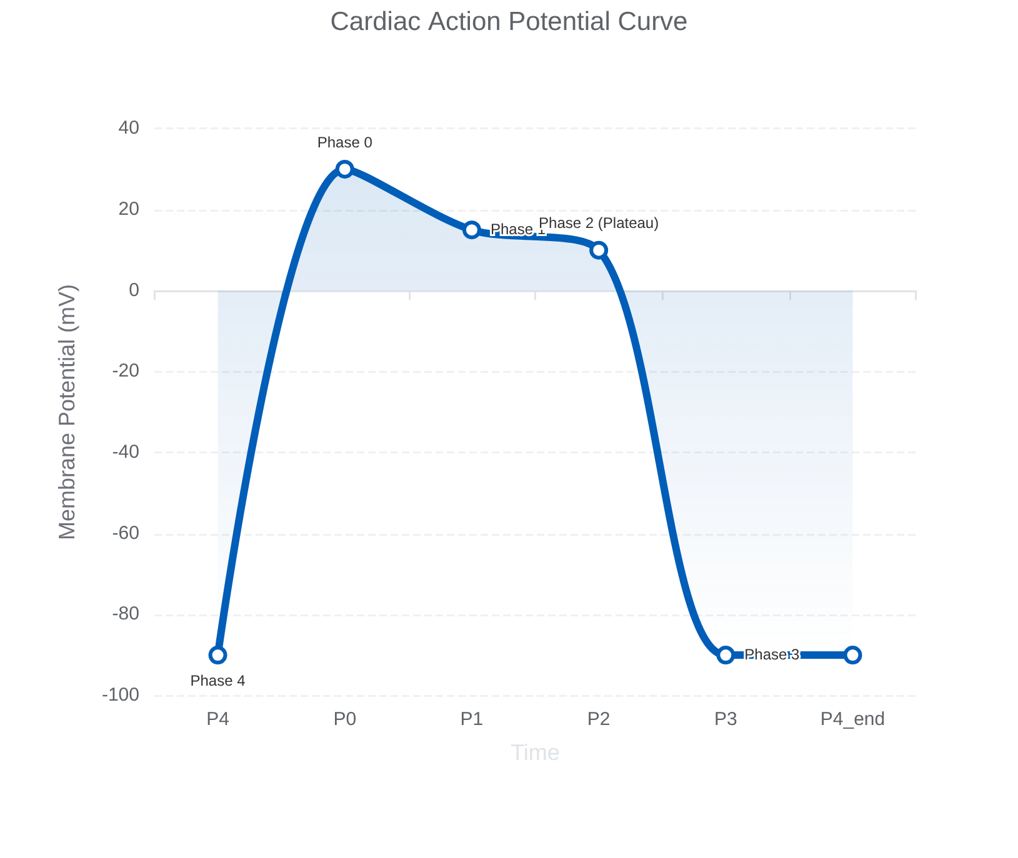





CARDIAC ACTION POTENTIAL
Physiological Phases & Class III Antiarrhythmic Mechanisms
Depolarisation & Plateau
Phase 0: Rapid depolarisation via fast Na+ channels opening.
Phase 1: Initial repolarisation; Na+ channels inactivate; net K+ outward.
Phase 2: Plateau phase; Ca2+ inward vs K+ outward. Key for QT interval.
Repolarisation & Resting
Phase 3: Rapid repolarisation; Ca2+ channels close; net K+ outward.
Phase 4: Resting potential; high K+ permeability; Na+/K+ pump active.
Amiodarone (Class III)Prolongs Phase 3 by blocking K+ channels. Leads to QT prolongation. Also possesses Class I, II, and IV effects.

Slide 4













SYSTEMATIC ECG READING USING RRATE
A structured approach to ECG interpretation focusing on Rate, Rhythm, Axis, Time intervals, and Every wave morphology.
R
R
A
T
E
RATE
RHYTHM
AXIS
TIME
EVERY WAVE
300 / (number of large squares between R waves)
Regular or irregular? (Check rhythm strip)
Normal: -30° to +90°
PR: 120–200 ms (3–5 small squares)
P wave and QRS morphology
LAD: I positive, aVF negative
Is every P wave followed by a QRS complex?
QRS: <120 ms (<3 small squares)
ST segment (elevation/depression)
Normal: 60–100 bpm
RAD: I negative, aVF positive
QTc: <440 ms (M), <460 ms (F)
T wave orientation and height
AKT Tip: Always calculate the corrected QT (QTc). Visual estimation is insufficient when assessing drug-induced prolongation (e.g., amiodarone, antipsychotics).

Slide 5














CORONARY TERRITORY & ECG LEAD CORRELATION
Clinical Protocol & AKT/SCA Exam Prep
ANATOMICAL TERRITORY
AFFECTED ARTERY
ECG LEADS & FINDINGS
Anterior
LAD (Left Anterior Descending)
V3–V4
Anteroseptal
LAD
V1–V3
Anterolateral
Circumflex
V1–V6
Lateral
Circumflex
I, aVL, V5–V6
Inferior
RCA (Right Coronary Artery)
II, III, aVF
Posterior
RCA or Circumflex
Tall R waves + ST depression in V1–V2Note: These are reciprocal changes to the posterior wall
Right Ventricular
RCA
RV4, RV5 (Right-sided leads)
AKT EXAM PEARL
CLINICAL PRACTICE TIP
Recognizing Posterior MI is high-yield. Do not mistake ST depression in V1-V2 for ischemia alone; in the context of chest pain, it often represents a posterior STEMI.
In any Inferior MI (II, III, aVF), always perform right-sided leads (V4R). Right ventricular involvement significantly changes fluid management protocols.
Bradford VTS Teaching Deck • May 2026
www.bradfordvts.co.uk

Slide 6











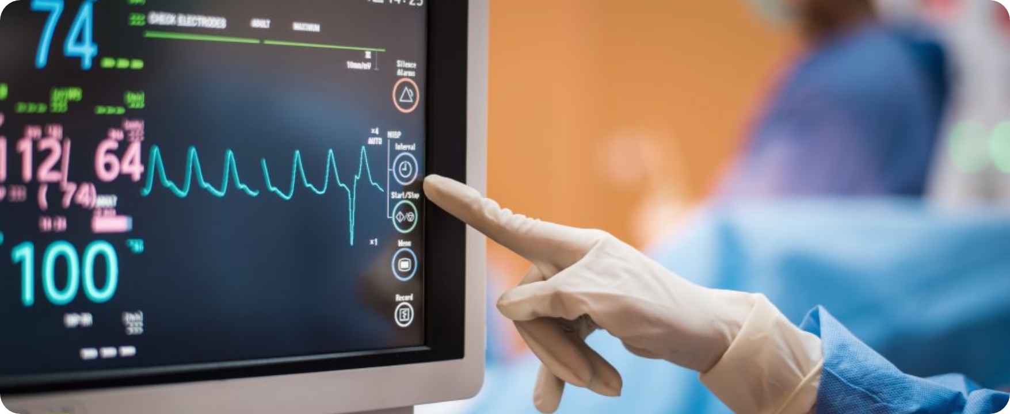
ECG IN ACUTE PRESENTATIONS: STEMI AND NSTEMI
Clinical Protocol & AKT/SCA Exam Prep
STEMI Criteria (NICE NG185)
NSTEMI & Unstable Angina
ST elevation ≥1 mm in ≥2 contiguous limb leads
ST segment depression or T-wave inversion
ST elevation ≥2 mm in ≥2 contiguous chest leads
Troponin rise distinguishes NSTEMI from UA
New LBBB with ischemic symptoms = Treat as STEMI
Risk Stratification: Utilize the GRACE score in hospital for mortality risk
Immediate GP Action
AKT Pearl: GRACE Score (6-month mortality)
Call 999 for emergency ambulance. Administer Aspirin 300mg (crushed/chewed). Do NOT thrombolyse in the community; ensure rapid transfer for primary PCI.
BRADFORD VTS TEACHING DECK — MAY 2026
NICE NG185 / BNF 2024 STANDARDS

Slide 7












ATRIAL FIBRILLATION MANAGEMENT
Guidance on AF diagnosis, rate and rhythm control strategies, and anticoagulation protocols using CHA₂DS₂-VASc scores and DOACs.
Diagnosis & Clinical Features
Anticoagulation Protocol
Irregularly irregular rhythm: Pulse check is mandatory; confirmed by 12-lead ECG.
Assess stroke risk using CHA₂DS₂-VASc. Anticoagulate if:
ECG Findings: Absence of distinct P waves; replaced by rapid fibrillatory waves.
≥ 2
≥ 3
In Men
In Women
Rate: Variable ventricular response; baseline often tachycardic if untreated.
DOAC Preferred: Apixaban, Edoxaban, Rivaroxaban, or Dabigatran (BNF 2024).
Apixaban: Generally preferred first-line in current local GP pathways.
BNF 2024 / NICE UPDATE
LMWH bridging is NOT required when starting a DOAC for stroke prevention in non-valvular AF.
MANAGEMENT STRATEGY (NICE NG196)
Rate Control: 1st line (e.g., Bisoprolol or Diltiazem) for most patients.
Rhythm Control: Consider if symptomatic, young, or first episode.

Slide 8










COMMON ARRHYTHMIAS IN GENERAL PRACTICE
Clinical identification, immediate management protocols, and emergency medication dosages
Rhythm
ECG Characteristics
Immediate Action & Dosage
Supraventricular Tachycardia (SVT)
• Narrow complex tachycardia
• Regular rhythm
• Rate typically 150–250 bpm
• P waves often buried in T waves
1. Initial: Vagal manoeuvres (Valsalva or carotid sinus massage)
2. Pharmacological: Adenosine 6 mg rapid IV bolus
Note: Adenosine requires large bore cannula (antecubital fossa) + rapid saline flush. Must have crash trolley/defibrillator on site.
Ventricular Tachycardia (VT)
• Broad complex tachycardia (>120ms)
• Regular rhythm
• Rapid rate (usually >100 bpm)
• AV dissociation may be seen
ASSESS FOR PULSE IMMEDIATELY• Pulse Present: Amiodarone 300 mg IV (over 10-60 mins)
• Pulseless: Call 999; Start ALS protocol immediately; Defibrillate (Shockable rhythm)
Complete Heart Block (3rd Degree)
• Complete AV dissociation
• P waves and QRS unrelated
• Ventricular rate typically 30–40 bpm
• Wide or narrow escape rhythm
999 EMERGENCY - HIGH RISK OF ASYSTOLE1. Atropine 500 mcg IV (repeat up to 3 mg max)
2. If haemodynamically unstable: Prepare for transcutaneous pacing (if equipment available).

Slide 9








ECG INTERPRETATION & CARDIAC MONITORING
Clinical Protocol & AKT/SCA Exam Prep
Hyperkalaemia & Long QT Syndrome
Hyperkalaemia ECG Evolution
Long QT Syndrome (LQTS)
Early Signs: Tall, tented T waves (all leads)
Criteria: QTc > 500ms (High Risk of Torsades)
Progression: P-wave flattening & QRS widening
Drug Causes: Amiodarone, Antipsychotics, Macrolides
Pre-Arrest: Sine wave pattern (impending VF/Asystole)
Metabolic: Hypokalaemia & Hypomagnesaemia
AKT: IDENTIFY SINE WAVE
SCA: MEDICATION REVIEW
Emergency Management
Clinical Management
Acute Torsades: IV Magnesium Sulfate 2g
Stabilize: IV Calcium Gluconate (protect myocardium)
Shift: Insulin/Dextrose & Salbutamol Nebuliser
Prevention: Remove triggers & correct electrolytes
Specialist: Cardiology referral for Beta-blockers/ICD
Action: 999 Referral & Continuous Cardiac Monitoring
BNF 2024: CHECK QTC INTERACTIONS

Slide 10


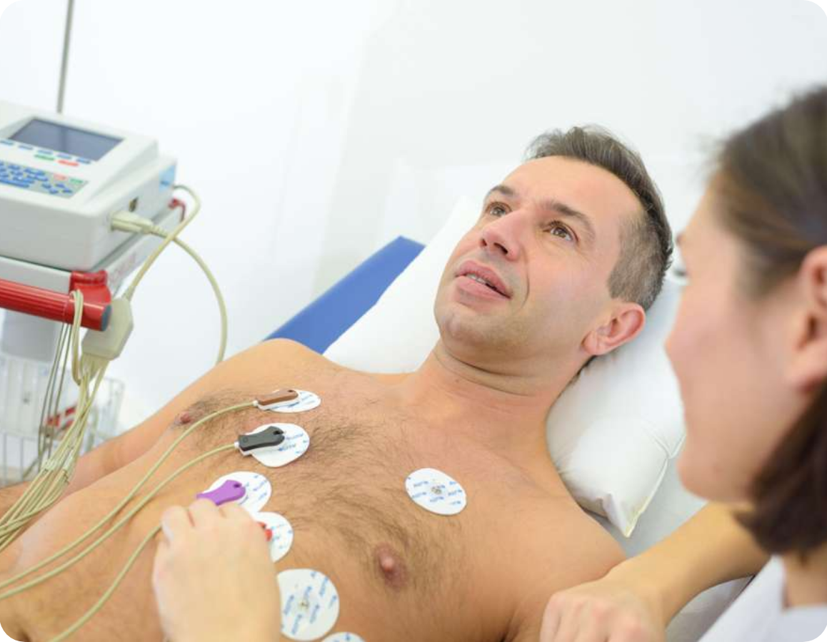












CARDIOVASCULAR EXAMINATION TECHNIQUE
Systematic OSCE Approach for GP Practice & SCA Prep
General & Hands
Precordium
Initial Steps: Wash hands, confirm identity, and obtain patient consent.
Palpation: Apex beat (5th ICS, MCL); check for right ventricular heaves and thrills.
End of Bed: Inspect for breathlessness, pallor, cyanosis, or malar flush.
Auscultation: Mitral (apex), Tricuspid (lower left), Pulmonary (2nd left), Aortic (2nd right).
Hands: Check for clubbing, splinter haemorrhages, Osler's nodes, and Janeway lesions.
Maneuvers: Left lateral for mitral stenosis; sit forward/expiration for aortic regurgitation.
Face & Neck
Peripheral Signs
SCA EXAM PEARL
Eyes/Mouth: Corneal arcus, xanthelasma, conjunctival pallor, and central cyanosis.
Lungs: Auscultate lung bases for bibasal crackles (pulmonary oedema).
In the SCA, verbalize your findings as you go. For example: "I am assessing the JVP at 45 degrees to look for signs of right-sided heart failure." This demonstrates clinical reasoning to the examiner and ensures you don't miss steps under pressure.
JVP: Assess at 45°; check for hepatojugular reflux if JVP is raised.
Abdomen: Palpate for hepatomegaly, ascites, and pulsatile aortic aneurysm.
Carotid: Palpate carotid pulse for character (e.g., slow-rising in aortic stenosis).
Ankles: Check for pitting peripheral oedema and assess distal pulses.

Slide 11















FOCUSED ECHO IN EMERGENCY
Point-of-Care Ultrasound (POCUS) Clinical Indications & Utility
Acute Emergency Indications
Clinical Advantages
Cardiac arrest (rhythm vs. pseudo-PEA)
Non-invasive and radiation-free modality
Suspicion of pericardial effusion/tamponade
Rapid results directly at the patient bedside
Assessment of massive pulmonary embolism
Highly repeatable for monitoring response
Clinical Assessment
Key Limitations
Gross LV function & wall motion assessment
Highly operator-dependent for accuracy
Evaluation of unexplained hypotension/shock
Requires formal training and accreditation
Exam Tip: POCUS is a focused assessment to answer binary clinical questions (e.g., "Is there an effusion?"), not a replacement for formal departmental echocardiography.

Slide 12















ECG INTERPRETATION & CARDIAC MONITORING
Clinical Protocol & AKT/SCA Exam Prep
Rate Calculation
STEMI Equivalents
Hyperkalaemia
The 300 Rule: Divide 300 by the number of large squares between R waves.
New LBBB + Chest Pain: Treat as STEMI until proven otherwise.
ECG Progression: Tall tented T waves → wide QRS → Sine wave.
Rapid Sequence: Memorise 300, 150, 100, 75, 60, 50.
Action: Call 999 immediately; Aspirin 300mg; Do not wait in GP.
Immediate Rx: IV Calcium Gluconate to stabilise myocardium.
Normal resting rate: 60–100 bpm.
Time is muscle—PCI is the gold standard.
This is a medical emergency requiring urgent hospital transfer.
AF Anticoagulation
Inferior MI Nuance
QTc Monitoring
NICE NG196: Use CHA₂DS₂-VASc score for risk stratification.
Leads II, III, aVF indicate RCA territory.
Risk Threshold: QTc >500 ms = high risk of Torsades de Pointes.
Mandatory: Perform right-sided leads (RV4, RV5) to check for RV involvement.
Threshold: Score ≥2 (men) or ≥3 (women) → DOAC (Apixaban preferred).
Review Drugs: Amiodarone, antipsychotics, clarithromycin.
RV MI drastically changes fluid and nitrate management.
LMWH bridge is NOT needed when starting DOAC for AF.
Correct electrolytes (K+, Mg2+) immediately.
Bradford VTS Teaching Deck • ECG & Cardiac Monitoring
Created May 2026 • NICE NG196 / BNF 2024 Standards • www.bradfordvts.co.uk

Slide 13






RED FLAGS AND COMMON PITFALLS
High-Risk Cardiac Presentations & Clinical Misinterpretations
EMERGENCY RED FLAGS
TECHNICAL PITFALLS
Complete Heart Block
Lead Reversal vs. Dextrocardia
Check R wave progression (V1-V6). If absent, it’s dextrocardia; if present, it’s lead reversal.
HR < 40 bpm + haemodynamic compromise. Action: 999 + Atropine 500 mcg IV.
VT with Pulse
Missing Posterior MI
Conscious: Synchronised DC cardioversion. Unconscious: Treat as VF (ALS protocol).
Always look for reciprocal tall R waves and ST depression in V1–V2.
Acute ST Elevation
Neglecting Right-Sided Leads
Every minute of delay costs myocardium. Action: Aspirin 300mg + 999 immediately.
Mandatory in Inferior MI (II, III, aVF) to exclude Right Ventricular involvement.
CLINICAL ERRORS
Raw QT vs. Corrected QTc
Never use the raw QT interval. Always calculate QTc to assess Torsades de Pointes risk.
Blind Antiarrhythmic Initiation
Avoid prescribing antiarrhythmics without a confirmed rhythm diagnosis on ECG.

Slide 14








EXAM PEARLS FOR AKT AND SCA
High-yield topics for GP trainees, focusing on diagnostic criteria, scoring systems, and effective patient communication regarding cardiac risks.
AKT: Core Clinical Knowledge
SCA: Patient Communication
STEMI Criteria: ≥1mm elevation in limb leads or ≥2mm in chest leads (contiguous).
Explaining Results: Use lay terms for arrhythmias (e.g., "short-circuit" or "irregular heartbeat") to reduce anxiety.
AF Anticoagulation: CHA₂DS₂-VASc ≥2 (men) / ≥3 (women) triggers DOAC initiation per NICE 2021.
Risk/Benefit Discussion: Use absolute risk figures for AF anticoagulation (e.g., stroke reduction vs. major bleed risk).
Lead Mapping: Inferior (II, III, aVF) = RCA; Anterior (V1-V4) = LAD; Lateral (I, aVL, V5-V6) = Circumflex.
Verbalizing Findings: In physical exam stations, clearly narrate your findings (e.g., "I am checking for peripheral cyanosis").
AKT: Emergency Management
SCA: Shared Decision Making
Hyperkalaemia: Sequential changes: tall tented T waves → PR prolongation → QRS widening → Sine wave.
Bleeding Risk: Address bleeding concerns using ORBIT/HAS-BLED scores to guide DOAC choice (e.g., Apixaban).
SVT Dose: Adenosine 6mg rapid IV bolus; if ineffective, 12mg then 12mg (total 3 doses).
Safety Netting: Crucial for suspected stable angina; clear instructions on GTN use and when to call 999.
Complete Heart Block: Atropine 500mcg IV if compromised; pacing is definitive.
DVLA Guidance: Remember to discuss driving restrictions for SVT, VT, or pacemaker insertion.
BRADFORD VTS TEACHING DECK • MAY 2026 • NICE NG196 / BNF 2024 STANDARDS

Slide 15












ECG INTERPRETATION & CARDIAC MONITORING
Clinical Protocol & AKT/SCA Exam Prep
Coronary Territory Mapping
STEMI Diagnostic Criteria
Anterior (LAD): Leads V1–V4
Limb Leads: ST Elevation ≥1mm (contiguous)
Inferior (RCA): Leads II, III, aVF
Chest Leads: ST Elevation ≥2mm (contiguous)
Lateral (Circumflex): Leads I, aVL, V5–V6
STEMI Equivalent: New LBBB + Chest Pain
AF & Anticoagulation (NICE)
Emergency Priorities
CHA₂DS₂-VASc: ≥2 (Men) / ≥3 (Women) → DOAC
Hyperkalaemia: IV Calcium Gluconate (1st line)
Drug Choice: Apixaban preferred (BNF 2024)
Complete Heart Block: 999 + Atropine 500mcg
Protocol: No LMWH bridge needed for AF DOAC start
Long QT (QTc >500): Stop triggers; IV Mg for Torsades
BRADFORD VTS TEACHING DECK
www.bradfordvts.co.uk • Updated May 2026

