Slide 1




BRADFORD VTS TEACHING DECK
Emergencies in General Practice
Comprehensive clinical management for acute emergencies in primary care and out-of-hours settings, tailored for GP trainees.
www.bradfordvts.co.uk
Created May 2026
Updated to current NICE / BNF / Resus Council 2024 standards

Slide 2


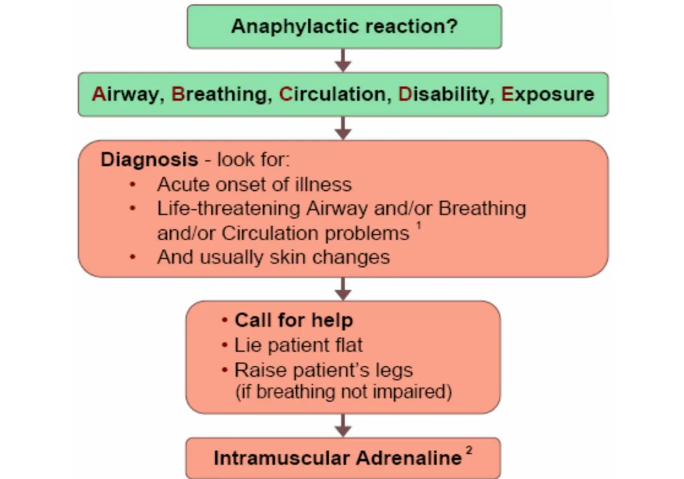

























Anaphylaxis Recognition & Management
CLINICAL MANAGEMENT & EXAM FOCUS
Recognition (ABCDE)
IM Adrenaline (1:1000)
Age Group
Dose (IM)
Volume
Airway: Hoarse voice, stridor, throat tightness
Breathing: Wheeze, fatigue, cyanosis, SpO2 <94%
Adult & Child >12y
0.5 mL
500 micrograms
Circulation: Low BP, shock, confusion, tachycardia
Child 6–12y
0.3 mL
300 micrograms
Child 6m–6y
0.15 mL
Skin: Urticaria, erythema, angioedema (common but not universal)
150 micrograms
Infant <6m
0.1–0.15 mL
100–150 micrograms
AKT BOX: KEY FACTS
SCA BOX: COMMUNICATION
First-line: IM Adrenaline 1:1000 in anterolateral mid-thigh.
"I'm giving you an injection in your thigh now — it's adrenaline and it's the most important treatment we can give you. It should start to work within minutes."
Repeat every 5 mins if no improvement.
Biphasic reactions: likely in food allergy and asthmatics.
Safety-net: "You MUST go to hospital even if you feel better."
Adjuncts: Chlorphenamine/Hydrocortisone are NOT first-line.
Prescribe TWO auto-injectors and ensure training on use.
Bradford VTS Teaching Deck • Emergencies in General Practice
Updated May 2026 • NICE/BNF/Resus Council Standards

Slide 3
















Myocardial Infarction & ACS
CLINICAL MANAGEMENT & EXAM FOCUS
Recognition & Presentation
AKT BOX: CLINICAL DATA
STEMI Criteria: ST elevation ≥1mm in ≥2 contiguous limb leads, or ≥2mm in chest leads.
Severe crushing central chest pain (may radiate to jaw, left arm, or back).
GRACE Score: Used in hospital for NSTEMI risk stratification.
Autonomic signs: Pallor, diaphoresis (sweating), and nausea.
Note: Thrombolysis is no longer given in GP; primary PCI is the current standard.
Atypical:Epigastric pain or dyspnoea alone (common in women, elderly, and diabetics).
Immediate GP Management (NICE 2024)
SCA BOX: COMMUNICATION
Professional Scripting:
Call 999 immediately: Request primary PCI pathway if STEMI suspected.
"I think you may be having a heart attack. I'm calling an ambulance now. I'm going to give you an aspirin to chew — are you allergic?"
Aspirin 300mg: Crushed or chewed stat (first-line antiplatelet).
Safety-net: Brief the family on what to do if the patient collapses before paramedics arrive.
GTN: Sublingual spray/tablet; repeat once after 5 mins if pain persists.
Oxygen: ONLY if SpO2 <94%. High-flow is NOT routine (NICE NG185).
BRADFORD VTS TEACHING DECK — MAY 2026
www.bradfordvts.co.uk
NICE NG185 / BNF 2024 STANDARDS

Slide 4
















Epileptic Seizures and Status Epilepticus
CLINICAL MANAGEMENT & EXAM FOCUS
STATUS EPILEPTICUS: Seizure ≥ 5 min OR recurring without recovery
AKT REVISION BOX
First-line Community: Buccal Midazolam (Epistatus/Buccolam).
Immediate Management
Glucose: Must be checked in ALL fitting patients to rule out metabolic causes.
Post-ictal: Confusion does not equal ongoing seizure; avoid unnecessary over-treatment.
Protect from injury: DO NOT restrain; DO NOT put anything in mouth.
High-flow oxygen: 15 L/min via non-rebreather mask.
DVLA: 1 year off driving following a first unprovoked seizure.
Check Blood Glucose: Treat if <4 mmol/L.
Differential: Cardiac arrhythmia, hypoglycaemia, vasovagal.
Call 999 if seizure ≥ 5 mins or repeated without recovery.
First-Line Rescue Medication
Patient Age
Buccal Midazolam Dose
Adult / Child >10 years
10 mg
SCA COMMUNICATION & SAFETY
Framing for Carers: "This is called a seizure—it looks very frightening but the most important thing is to keep them safe and time how long it lasts."
Child 5 – 10 years
7.5 mg
Child 1 – 5 years
5 mg
Safety-netting: "Call 999 if it lasts more than 5 minutes, or if they don't come round properly afterwards."
Infant 3 – 12 months
2.5 mg
*Prescribe two rescue doses and ensure training on administration for known epileptics.
Note: Buccal midazolam is preferred over rectal diazepam in community settings (BNF 2024).
BRADFORD VTS TEACHING DECK
www.bradfordvts.co.uk | Updated May 2026

Slide 5


















Hypoglycaemia Management
CLINICAL MANAGEMENT & EXAM FOCUS
Conscious & Intact Swallow
AKT EXAM PREP
Give 15–20g fast-acting carbohydrate (e.g. 5-6 glucose tabs, 115mL Lucozade, or 1 tube Glucogel).
Threshold: BG <4.0 mmol/L is the clinical trigger for treatment in symptomatic patients.
Recheck blood glucose after 15 minutes; repeat fast-acting dose if BG remains <4.0 mmol/L.
Failure: Glucagon is ineffective in chronic alcohol excess, prolonged fasting, or anorexia.
Once recovered, follow with long-acting carbohydrate (e.g. sandwich, fruit, or biscuits) to prevent recurrence.
Carer Support: Nasal glucagon is a key teaching point for carers who fear injections.
Impaired Consciousness / Safety
SCA COMMUNICATION
IM Glucagon (GlucaGen): Give 1mg IM (Adult/Child >8yr) or 0.5mg IM (Child <8yr or <25kg).
"This is called a 'hypo'—your blood sugar has dropped too low. I'm giving you something to bring it back up now."
Nasal Glucagon (Baqsimi): Alternative 3mg intranasal dose for adults and children >4 years (NICE approved).
Safety-net: Advise carers to call 999 if the patient becomes aggressive or won't wake.
Call 999 if no response within 10 minutes or if glycogen stores likely depleted (alcohol, fasting, liver disease).
Driving: Must inform DVLA and stop driving until medical review of the cause.
BRADFORD VTS TEACHING DECK • UPDATED MAY 2026 • NICE/BNF/RESUS COUNCIL 2024 STANDARDS

Slide 6
















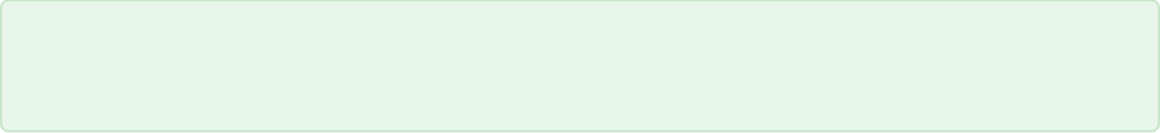

Acute Severe Asthma
CLINICAL MANAGEMENT & EXAM FOCUS
SEVERITY CLASSIFICATION
AKT FOCUS: CLINICAL RULES
MODERATE PEFR 50–75% of best/predicted; no features of severe.
Oxygen: Maintain SpO2 94–98%. Do NOT use routinely if saturations are normal.
SEVERE PEFR 33–50%, RR >25/min, HR >110/min, or inability to complete sentences in one breath.
Assessment: Never use PEFR alone; always integrate RR, HR, and clinical effort.
LIFE-THREATENING PEFR <33%, SpO2 <92%, silent chest, cyanosis, bradycardia, or exhaustion.
Disposition: Call 999 for any Life-threatening features or failure to improve.
MANAGEMENT PROTOCOL
SCA FOCUS: COMMUNICATION
Salbutamol: 4–10 puffs via spacer every 10–20m OR 2.5–5mg via nebuliser.
"Your breathing is very tight right now. I'm giving you back-to-back inhalers and a steroid tablet to open up your airways. If you don't improve in the next 10 minutes, I'll need to call an ambulance."
Prednisolone: 40–50mg orally stat (start immediately); continue for 5 days.
Ipratropium: 0.5mg nebulised every 4–6 hours (for Severe/Life-threatening only).
Safety-Netting: Provide a written asthma action plan and ensure patient knows when to call 999.

Slide 7


















Epistaxis and Choking
CLINICAL MANAGEMENT & EXAM FOCUS
Epistaxis Management
Resus Council: Choking
1
Lean forward and squeeze lower soft part (Little's area) continuously for 10–20 minutes.
Adult & Child (>1 year)
2
If visible bleeding point: Silver nitrate cautery (avoid bilateral treatment to prevent septal perforation).
1
Alternate 5 back blows (between blades) and 5 abdominal thrusts.
Infant (<1 year)
3
Ongoing bleeding: Anterior packing (e.g., Rapid Rhino) or urgent ENT referral for posterior source.
1
5 back blows, then 5 chest thrusts. Do NOT perform abdominal thrusts.
Unconscious
AKT BOX: EPISTAXIS
1
Start CPR (compressions may dislodge object); call 999.
Squeeze soft part of nose, NOT the bridge, for full 20 mins.
Review anticoagulants; screen for hypovolaemia in severe cases.
AKT BOX: CHOKING
Infants: Chest thrusts only (risk of organ damage with abdominal).
NO blind finger sweeps (risk of pushing object deeper).
Red Flags: Unilateral obstruction/mass (malignancy), shock.

Slide 8





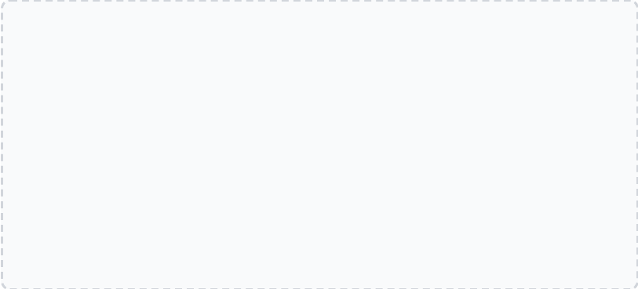
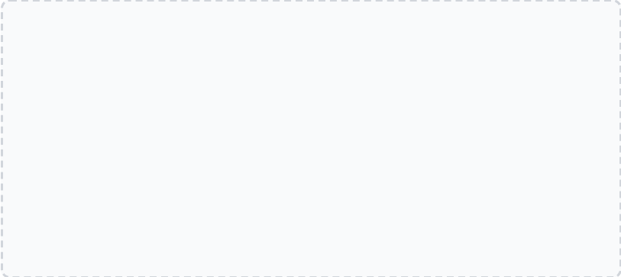












Major Trauma and ABCDE Assessment
CLINICAL MANAGEMENT & EXAM FOCUS
Primary Survey: ABCDE
Life-Threatening Indicators
A
Airway + C-spine: Chin lift/jaw thrust; immobilise spine. GCS <8 needs definitive airway.
TENSION PNEUMOTHORAX
BECK'S TRIAD (TAMPONADE)
• Tracheal deviation
• Hypotension
B
Breathing: Assess chest for tension pneumothorax, flail chest, or haemothorax. Check SpO2 and RR.
• Distended neck veins
• Muffled heart sounds
• Hyper-resonance
• Distended neck veins
• Absent breath sounds
C
Circulation: Haemorrhage control (direct pressure). Assess consciousness, skin colour, and pulse.
EMERGENCY ACTION
D
Disability: GCS score, pupil size/reactivity, lateralising signs, and check Blood Glucose.
Direct pressure controls most external bleeding. Use tourniquets only for traumatic amputations.
E
Exposure: Undress fully to find injuries; prevent hypothermia with warming blankets and fluids.
AKT Box: Trauma Essentials
Treat life-threatening problems as they are found; do not finish the survey first.
Secondary Survey: AMPLE
Blood loss is the main preventable cause of early trauma death.
GCS < 8 = definitive airway required (Intubation).
Allergies
Medications
Past history
Last meal
Events / Environment
Hypothermia prevention is a mandatory part of 'Exposure'.
"Is it safe to approach?" — Assess scene safety first.

Slide 9

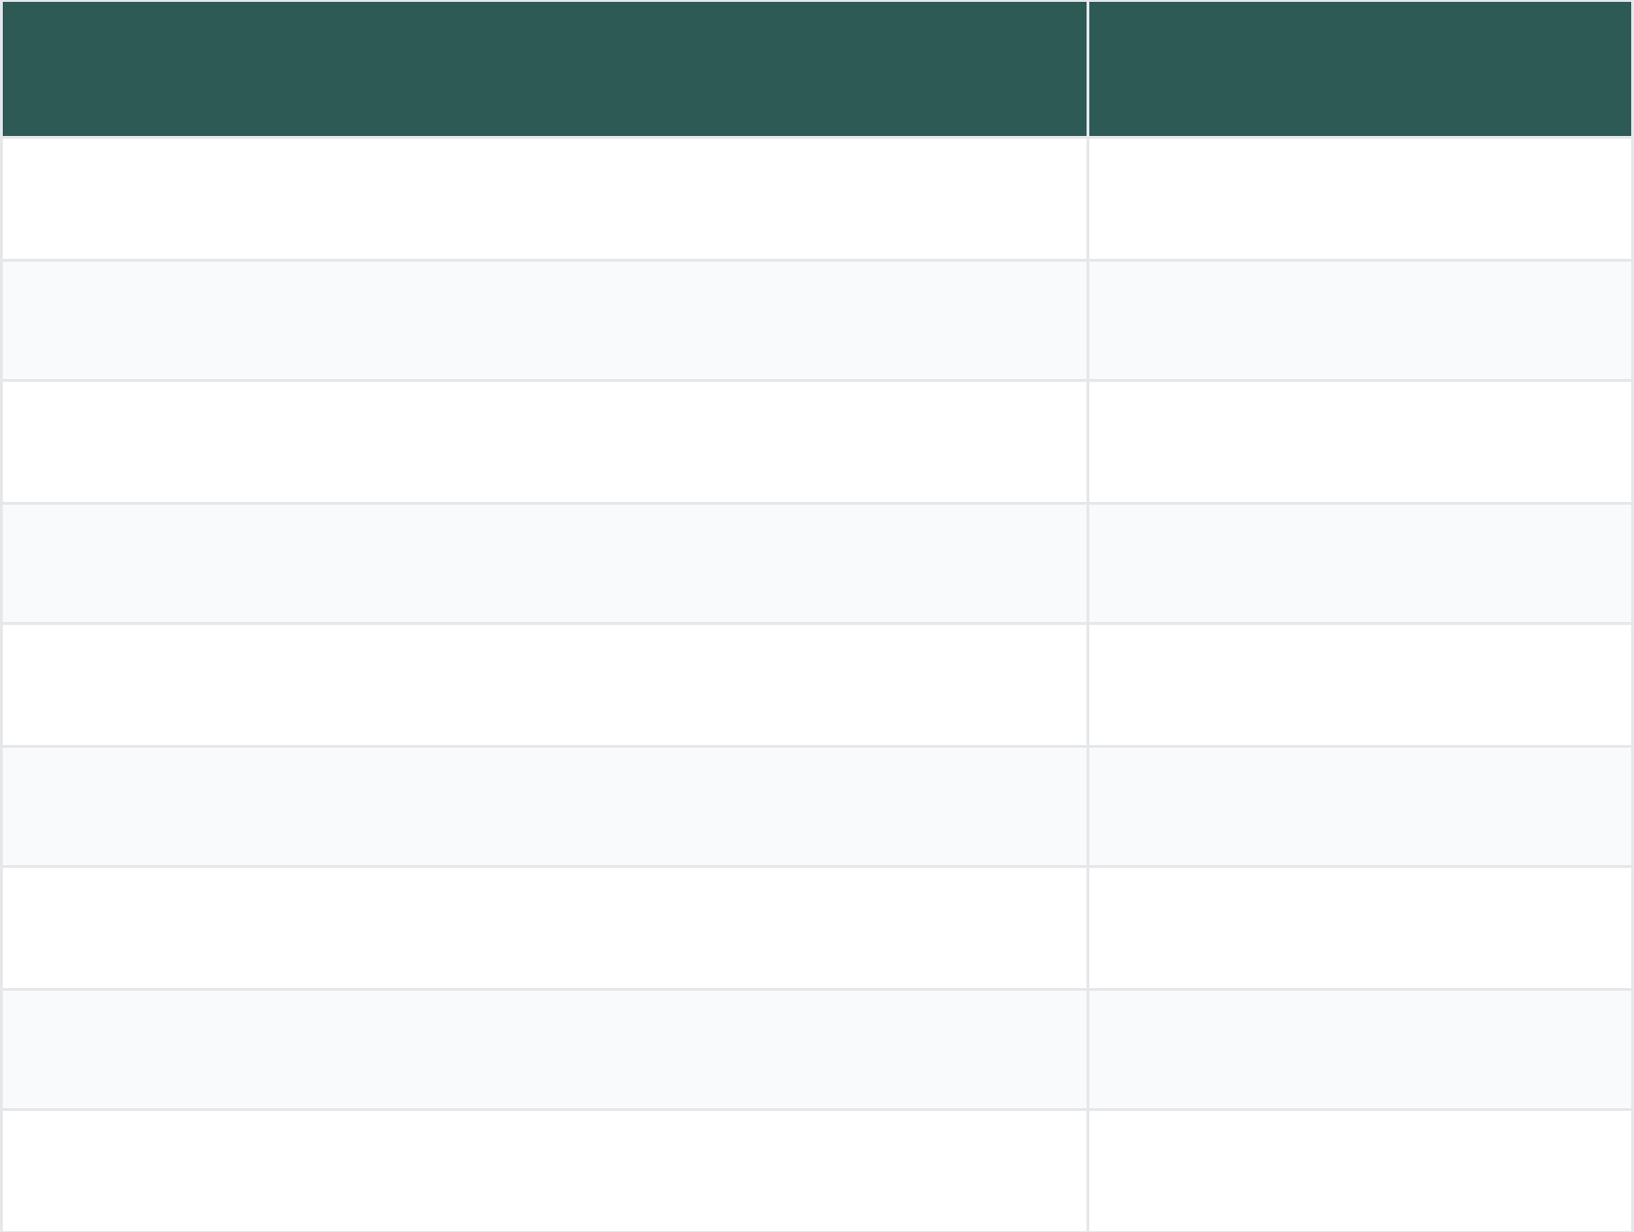






Gastrointestinal Bleeding and Rockall Score
CLINICAL MANAGEMENT & EXAM FOCUS
PRE-ENDOSCOPY ROCKALL SCORE
Immediate GP Management
Variable
Score
Call 999 if haemodynamically unstable (Shock).
Age <60
0
Establish large-bore IV access (x2) and resuscitate.
Urgent Bloods: FBC, U&E, LFT, Clotting, Group & Save.
Age 60–79
1
Withhold NSAIDs, anticoagulants, and antiplatelet agents.
PPI (e.g. Omeprazole 40mg) post-endoscopy confirm.
Age ≥80
2
No shock (Pulse <100, SBP >100)
0
Tachycardia (Pulse >100, SBP >100)
1
AKT Clinical Pearls
Hypotension (SBP <100)
2
ROCKALL INTERPRETATIONScore 0 = low risk, potential safe discharge with urgent O/P endoscopy.
No major comorbidity
0
CCF, IHD, or major comorbidity
H. PYLORI ERADICATION7-day triple therapy: PPI + Amoxicillin + Clarithromycin (or Metronidazole).
2
Renal/Liver failure or Disseminated malignancy
3
DRUG INTERACTIONSSSRIs significantly increase bleed risk, especially when combined with NSAIDs.
*Score 0: Consider outpatient management; Score >0: Admit for stabilization and early endoscopy.
BRADFORD VTS TEACHING DECK
www.bradfordvts.co.uk • May 2026 Update

Slide 10














Ectopic Pregnancy
CLINICAL MANAGEMENT & EXAM FOCUS
Key Recognition & Risks
GP Management Pathway
Leading cause of maternal death in 1st trimester. Suspect in ANY woman of reproductive age with abdominal pain ± bleeding.
Perform immediate urinary pregnancy test.
Positive Test + Symptoms: Immediate emergency admission.
Classic: Unilateral pain, missed period, vaginal bleeding.
Shock/Rupture: Call 999, stabilize with IV access en route.
Risk Factors: PID (Chlamydia), prev ectopic (10-20% risk), IUD in situ, IVF treatment, tubal surgery.
Hospital Gold Standard: Transvaginal Ultrasound (TVUS).
Atypical: Diarrhoea/vomiting, syncope, shoulder tip pain.
AKT BOX: RAPID RECALL
• Shoulder Tip Pain: Sign of haemoperitoneum causing diaphragmatic irritation.
• IUD: Prevents intrauterine pregnancy effectively, but NOT ectopic.
• Methotrexate: IM treatment for stable patients (hCG <3000).
CRITICAL WARNING
DO NOT perform bimanual vaginal examination in suspected cases — high risk of triggering tubal rupture and catastrophic haemorrhage.
SCA BOX: COMMUNICATION
"I need to rule out the possibility that this pregnancy is in your tube rather than your womb — this is called an ectopic pregnancy and it's important we check this urgently in hospital."
BRADFORD VTS TEACHING DECK
Updated May 2026 • NICE/BNF/Resus Council Standards
www.bradfordvts.co.uk

Slide 11











BRADFORD VTS TEACHING DECK
www.bradfordvts.co.uk
Paracetamol Overdose & NAC Regimen
CLINICAL MANAGEMENT & EXAM FOCUS
Immediate Management
MHRA 2012 Update: Single treatment line at 100 mg/kg. Risk factors (enzymes/weight) no longer lower the threshold for treatment.
< 1 Hour Post-Ingestion:
Activated Charcoal 50g
4-Hour Level:
Check level; plot on nomogram
AKT BOX: CRITICAL FACTS
*If staggered or uncertain timing, start NAC immediately without waiting for levels.
NAC Efficacy: Most effective within 8 hours of ingestion.
Prognostic Markers: pH, INR, Creatinine (King's College Criteria).
N-Acetylcysteine (NAC) 3-Bag Regimen
Anaphylactoid Reaction: Common with NAC Bag 1; stop infusion, give antihistamine, restart at slower rate.
Bag 1: Loading Dose
150 mg/kg in 200 mL Glucose 5% over 60 minutes
SCA: SUICIDE RISK ASSESSMENT
Bag 2: Second Infusion
SAD PERSONS Score:
50 mg/kg in 500 mL Glucose 5% over 4 hours
Sex (M), Age (<19/>45), Depression, Previous Attempt, Excess Alcohol, Rationality Loss, Social Support Lack, Organized Plan, No Spouse, Sickness.
Bag 3: Third Infusion
Score ≥8: Mandatory Psychiatric Admission
100 mg/kg in 1000 mL Glucose 5% over 16 hours
Monitor: LFTs, INR, Creatinine, and Bicarbonate at end of treatment.
Created May 2026 | Updated to NICE/BNF/Resus Council 2024 Standards
Slide 11 of 15

Slide 12




























Delirium and Syncope
CLINICAL MANAGEMENT & EXAM FOCUS
Differentiating Confusion
Syncope Risk Stratification
Feature
Delirium
Dementia
Cardiac Red Flags: Syncope during exertion, palpitations, history of heart disease, or FH of sudden cardiac death.
Onset
Acute (Hours to Days)
Gradual (Months to Years)
High Risk: New ECG abnormalities (Brugada, long QT, heart block), sudden onset without prodrome, severe anaemia.
Fluctuating (Sun-downing)
Course
Progressive decline
Low Risk: Prodrome (nausea, warmth), occurs after standing or unpleasant stimulus (vasovagal).
Decreased / Altered
Clear until late stages
Assessment: 12-lead ECG is mandatory; check postural BP and glucose.
Consciousness
Reversibility
Often reversible
Irreversible
AKT EXAM BOX
DVLA Rule: 1 year off driving after first unprovoked seizure. For syncope, rules vary by cause (6 months for unexplained).
Organic Causes (AEIOU TIPS)
Delirium Management: Treat underlying cause first; avoid sedation if possible (haloperidol only as last resort).
A Alcohol / Drugs
E Epilepsy (Post-ictal)
Blood Glucose: Must be checked in ALL patients presenting with confusion or collapse.
Prognosis: Delirium is associated with increased mortality and length of hospital stay.
I Infection (UTI/Meningitis)
O Oxygen (Hypoxia)
SCA ROLEPLAY FOCUS
U Uraemia / Metabolic
T Trauma (Head Injury)
Communication: "It’s common for people to get confused when they have an infection; we call this delirium. Usually, it settles as the infection clears."
I Infarct (Stroke / MI)
P Psychiatric
Safety-Netting: Explain DVLA restrictions clearly to patients with syncope or seizures; document the advice given.
S Sugar (Hypo/DKA)
ICE: Explore the carer's perspective—delirium is often more distressing for the family than the patient.
BRADFORD VTS TEACHING DECK
www.bradfordvts.co.uk | Updated May 2026

Slide 13











Psychiatric Emergencies
CLINICAL MANAGEMENT & EXAM FOCUS
IMMEDIATE SAFETY CHECKAssess scene safety before approach. Ensure an exit strategy is available. Call for assistance/security/police if there is a threat of violence or weapon presence.
AKT EXAM BOX
Key Doses & Monitoring:
Lorazepam: 1-2mg PO/IM. Max 4mg/24h in community. Monitor for respiratory depression.
DE-ESCALATION & ORGANIC SCREEN
Haloperidol: 2-5mg IM. Avoid in Parkinson's, Lewy Body Dementia, or prolonged QTc.
Verbal De-escalation: One person talking, calm low voice, avoid confrontation, acknowledge feelings, and offer choices where possible.
Olanzapine: 10mg IM. Do NOT give within 2 hours of IM Lorazepam (risk of fatal hypotension/bradycardia).
MHA: Section 4 (72h Emergency), Section 2 (Assessment), Section 3 (Treatment).
Exclude Organic Causes (AEIOU TIPS): Check Blood Glucose (Hypoglycaemia), SpO2 (Hypoxia), and signs of head injury or drug/alcohol toxicity.
Assessment: Review for signs of delirium vs. functional psychosis. Check for command hallucinations or intent to self-harm.
SCA COMMUNICATION
De-escalation Language:
"I can see you're very distressed, and I want to help make sure everyone is safe."
RAPID TRANQUILLISATION (COMMUNITY)
"My name is Dr [Name], I'm here to listen. Can you tell me what's upset you?"
First-line: Oral medication is always preferred if the patient is compliant. Offer Lorazepam 1-2mg or Haloperidol 2-5mg (if no cardiac history).
"I'm going to give you some space, but I'm not leaving you. We can talk when you're ready."
Safety-netting: Document capacity and risk to self/others clearly.
Parenteral: IM Lorazepam 1-2mg is the standard community/OOH choice. Repeat after 45-60 mins if required. Monitor RR and SpO2.
BRADFORD VTS TEACHING DECK Emergencies in General Practice
Created May 2026 | Updated to 2024 Standards | www.bradfordvts.co.uk

Slide 14








Clinical Pearls and Common Pitfalls
CLINICAL MANAGEMENT & EXAM FOCUS
DIAGNOSTIC ESSENTIALS
CRITICAL PITFALLS
AKT
NICE
Check blood glucose in ALL fitting or unconscious patients immediately.
Oxygen: Avoid routine high-flow in MI/ACS unless SpO2 is below 94%.
SCA
SCA
Rule out ectopic in any woman of reproductive age with abdominal pain.
Suspected Ectopic: NEVER perform a bimanual exam; risk of tubal rupture.
AKT
AKT
Check pulse rhythm and postural BP in all syncope presentations.
Epistaxis: Don't squeeze the nasal bridge; apply pressure to the lower soft part.
MANAGEMENT OPTIMISATION
ASSESSMENT ERRORS
NICE
IM Adrenaline: Administer in the anterolateral mid-thigh for fastest absorption.
AKT
Asthma: Do NOT use PEFR alone to assess severity; clinical signs are primary.
AKT
STEMI: Aspirin 300mg must be chewed or crushed to speed antiplatelet action.
SCA
Seizures: Don't over-treat post-ictal confusion; observe unless fitting resumes.
NICE
Nasal Glucagon: Now NICE-approved for patients >4 years; vital for carers.
NICE
Glucagon: Ineffective in chronic alcohol excess or prolonged starvation.
BRADFORD VTS TEACHING DECK
www.bradfordvts.co.uk • Updated May 2026

Slide 15








Exam Preparation and Quick Recall
KEY FACTS FOR AKT AND SCA EXAMS
AKT: CRITICAL IM DOSES
SCA: COMMUNICATION SCRIPTS
Anaphylaxis:
Adrenaline 500mcg IM (1:1000) mid-thigh.
Emergency Action:
"I’m giving you an adrenaline injection—it's the most important treatment."
Status Epilepticus:
10mg Buccal Midazolam (adults/>10yrs).
MI Safety-net:
Severe Hypo:
"I think you're having a heart attack. I'm calling an ambulance now."
Glucagon 1mg IM if unconscious or unable to swallow.
Ectopic Suspect:
"I need to rule out a pregnancy in your tube as it can be very dangerous."
AKT: SCORING & CRITERIA
SCA: SAFETY-NETTING & RULES
Rockall Score:
Used for GI bleeds; score 0 can often be managed as outpatient.
Anaphylaxis:
Prescribe TWO auto-injectors and refer to allergy clinic.
SAD PERSONS:
Risk stratification for suicide and deliberate self-harm.
DVLA Driving:
1 year off driving after first unprovoked seizure.
Asthma Severity:
Life-threatening features: PEFR <33%, SpO2 <92%, silent chest.
Discharge:
Always provide written action plans for asthma and seizures.
BRADFORD VTS TEACHING DECK • MAY 2026
www.bradfordvts.co.uk

