Slide 1
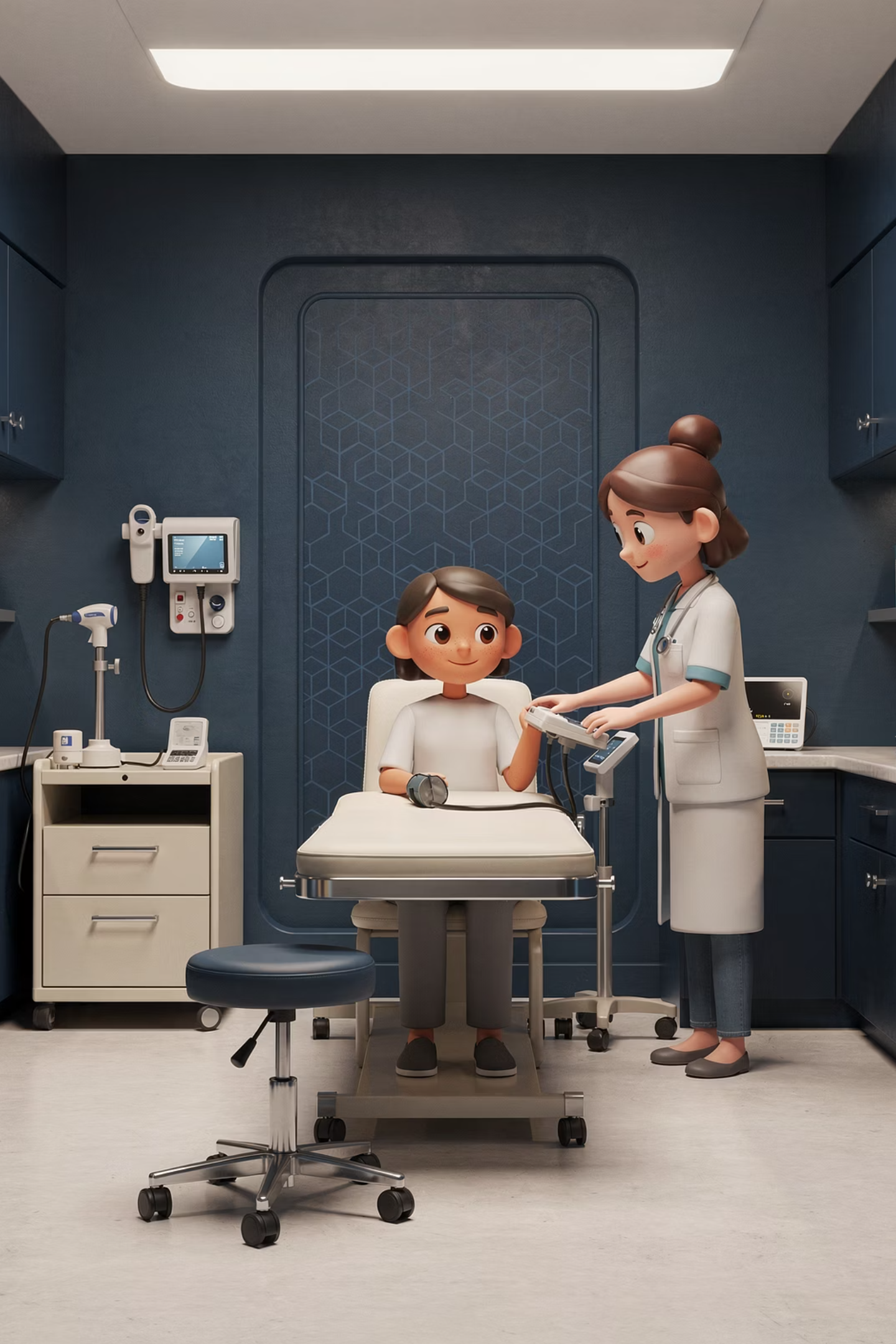
Fits & Seizures: Management Guide
Seizure management summary sheet for GP trainees and trainers in UK primary care.
BRADFORD VTS TEACHING DECK
MAY 2026

Slide 2

Initial Management
01
02
Stay Calm & Time It
Assess ABC
Note the start time, stay calm, and protect the person from injury. Cushion the head and loosen tight clothing. Do not restrain them or put anything in the mouth.
Assess airway, breathing, and circulation. Ask staff to bring the emergency trolley and prepare for ambulance transfer if needed.
03
Check Blood Glucose
Check capillary blood glucose early — hypoglycaemia is a reversible and easily missed cause of seizure.

Slide 3

When Is This Status Epilepticus?
Treat as status epilepticus if a convulsive seizure lasts more than 5 minutes, or if there are repeated seizures without recovery in between. Call 999 immediately.
Seizure > 5 Minutes
Repeated Seizures
Call 999
Any single convulsive seizure lasting beyond 5 minutes requires emergency treatment.
Multiple seizures without full recovery between episodes — treat as status epilepticus.
Do not wait. Activate emergency services immediately when either criterion is met.

Slide 4
Rescue Treatment in the Community
First-line
Buccal midazolam:
10 mg adult/age 10–<18 yrs
7.5 mg age 5–<10 yrs
5 mg age 1–<5 yrs
2.5 mg age 3 months–<1 yr
Alternative
Rectal diazepam if it is the patient's individual plan or buccal midazolam is unavailable and you are trained to administer it
Repeat dose
If still convulsing after 10 minutes and ambulance is on the way, a second dose may be given per the person's plan or local protocol. Monitor for respiratory depression.

Slide 5
Exam Essentials
AKT EXAM BOX
SCA EXAM BOX
Key Fact to Remember
Explaining to Relatives
Buccal midazolam is now the usual first-line community rescue medicine for prolonged convulsive seizures.
"If the seizure goes on beyond 5 minutes, we treat it as an emergency, give rescue medicine, and call 999."

Slide 6

When to Call 999 or Admit
Call 999 If Any of the Following:
Admit If:
Recovery is incomplete or diagnosis is unclear
Persistent reduced consciousness
Safeguarding or supervision concerns
First seizure, or seizure lasting >5 minutes
Repeated seizures, injury, or cyanosis
Pregnancy, diabetes, or prolonged post-ictal phase
Focal neurological deficit, or concerns about meningitis, stroke, intoxication, or head injury

Slide 7
Post-Ictal Care
Recovery Position
Check for Injuries
Stay Alert
Once the seizure stops, place the patient in the recovery position and recheck airway and breathing.
Look for injuries sustained during the seizure and document the duration and any treatment given.
Explain the expected drowsy phase to the patient, but remain vigilant for ongoing compromise, aspiration, recurrent seizure, or head injury.

Slide 8
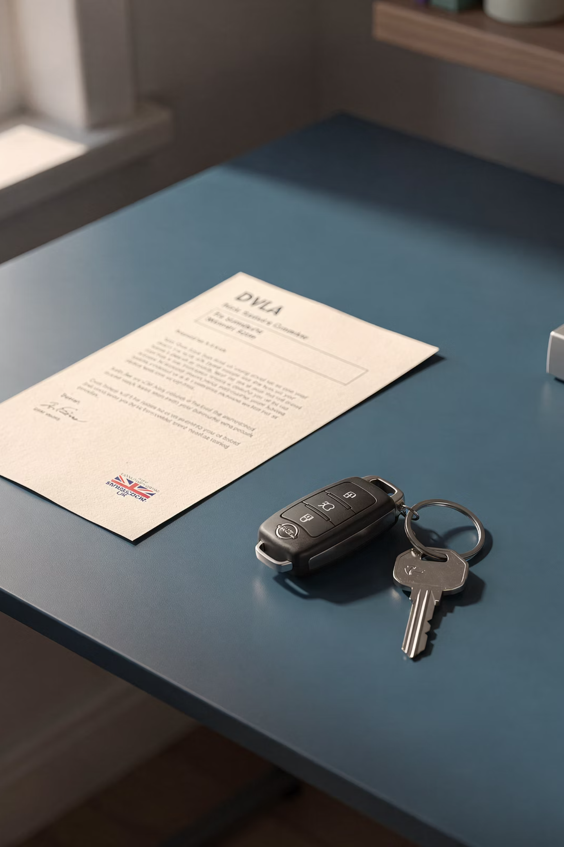

Driving & DVLA Advice
Driving rules depend on seizure type, diagnosis, and licence class. After any seizure or first fit, advise the patient not to drive and to check DVLA guidance urgently.
Always document that driving advice has been given. This is a medico-legal requirement.

Slide 9






Useful Patient Communication Phrases
"You are safe now. The shaking has stopped and we are keeping your airway clear."
"Because the seizure lasted this long, we are treating it as an emergency and arranging hospital assessment."
"Please do not drive until you have checked the DVLA rules and had specialist advice."

Slide 10
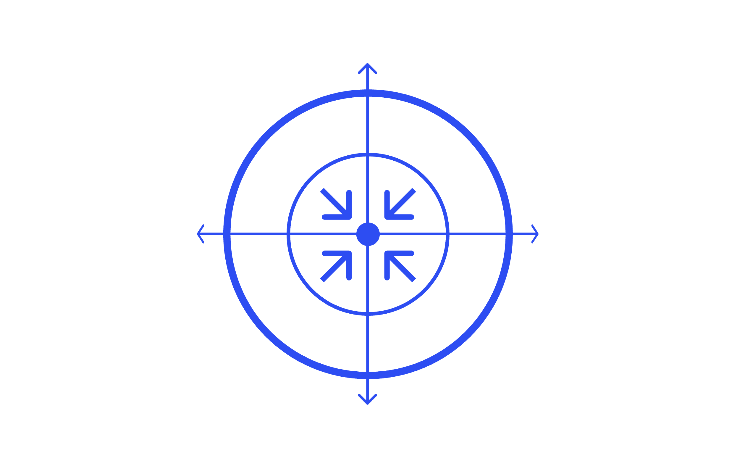

Key Takeaways
Protect & Time
DVLA Advice
Treat at 5 mins
Post‑ictal Care
Educational Disclaimer: Always double-check this advice and drug doses with the latest NICE/BNF guidance. This document is for educational purposes only.

