Slide 1





BRADFORD VTS TEACHING DECK
Managing Home Visit Requests in General Practice
A comprehensive framework for clinical triage, contractual obligations, and safety protocols—updated to 2024 NHS England standards.
Includes Targeted AKT and SCA Exam Pearls
www.bradfordvts.co.uk
Created May 2026
|
Updated to NICE/NHS England 2024 Standards

Slide 2









What is a Home Visit?
BRADFORD VTS • MANAGING HOME VISITS • MAY 2026
Defining the Home Visit
KEY PRINCIPLE
A home visit occurs when a GP or healthcare professional attends a patient at their home rather than the surgery. It is a vital service for those unable to access care through traditional means.
"The decision to visit is a clinical one — not an administrative one."
It should be based on clinical need, not patient preference or convenience.
Contractual Obligation
AKT / SCA PEARL
Under the GMS Contract, GPs must provide home visits when:
For exams, remember that lack of transport or minor illness manageable by phone are not grounds for a home visit. The clinician determines the mode of delivery (telephone, video, surgery, or home) based on clinical assessment.
It is clinically necessary for the patient to be seen.
The patient is physically unable to attend the surgery.

Slide 3








Categorizing Visit Requests
BRADFORD VTS • MANAGING HOME VISITS • MAY 2026
Urgent Visits
Routine Visits
Inappropriate
Acute Medical Emergency: Suspected stroke (FAST+), MI, or severe acute infection/sepsis.
Housebound Reviews: Chronic disease management and medication reviews for immobile patients.
Convenience: Requests based on lack of transport, childcare issues, or bad weather.
Minor Illness: Conditions safely manageable via telephone, eConsult, or local pharmacy.
Palliative Crisis: Uncontrolled terminal pain, agitation, or severe breathlessness.
Care Home Rounds: Proactive assessments and routine monitoring of residents.
Mental Health: Acute psychosis, active suicide risk, or severe self-neglect.
Preference: Patient is physically able to attend the surgery but prefers a visit.
Post-Discharge: Follow-up for frail or elderly patients recently home from hospital.
Acute Trauma: Recent fall with significant injury or inability to mobilise.
Social Issues: Non-clinical requests better served by social care or community support.
Stable Conditions: Non-urgent assessment of long-term symptoms.
SCA / AKT TIP
In the SCA, you must demonstrate sensitive communication when declining an inappropriate request. Explain the clinical reasoning clearly: "The surgery has better diagnostic equipment to assess your symptoms safely." For AKT, remember that the visit decision is a clinical judgment, not a contractual right based on patient request alone.

Slide 4

















Clinical Triage and Assessment
BRADFORD VTS • MANAGING HOME VISITS • MAY 2026
Core Triage Questions
Bradford Protocol Categories
Symptoms: What are they and how severe is the distress?
CATEGORY 1 — URGENT (WITHIN 1 HOUR)
Duration: How long present and are they worsening?
Acute CV/Resp events, collapse, or acute mental health crisis.
Access: Can they attend surgery or an Urgent Treatment Centre?
CATEGORY 2 — SAME DAY
Deteriorating chronic conditions, frail elderly, palliative needs.
CATEGORY 3 — ROUTINE
Stable housebound patients and routine chronic disease reviews.
Contextual Risk Assessment
Background: Frailty, mobility, and known chronic conditions?
Self-Care: Have they tried any initial management measures?
Safety: Is there an underlying safeguarding concern?
SCA EXAM PEARL
"The decision to visit is a clinical one, not an administrative one." In the SCA, demonstrate that you are triaging the clinical need rather than just responding to patient preference.

Slide 5









Medico-Legal and Ethical Framework
BRADFORD VTS • MANAGING HOME VISITS • MAY 2026
GMS Contract 2024 Obligations
Safeguarding Considerations
Mandatory provision for patients unable to attend surgery whose condition clinically requires a visit.
Vulnerable adults/children: Refusal may constitute a safeguarding failure if there is a known risk of harm.
The clinical decision to visit rests solely with the GP—patient request alone does not mandate attendance.
If a safeguarding concern exists, visit regardless or escalate immediately to the safeguarding lead/team.
Out-of-hours coverage is provided by designated services (e.g., BARDOC in the Bradford area).
Non-medical factors (neglect, abuse, isolation) can lower the threshold for a clinical home visit.
Appropriately Refusing a Visit
EXAM PEARLS (AKT & SCA)
Patient is physically able to attend but prefers a visit for convenience or transport issues.
AKT Focus: Understand the legal boundaries of the GMS contract—GPs are NOT obligated to visit for lack of transport. Know the categorization of urgency for triage scenarios.
SCA Focus: Practice professional communication when declining a visit. Acknowledge the patient's concerns but firmly explain the clinical rationale for attending the surgery.
Clinical condition is safely manageable via telephone advice, self-care, or community pharmacy.
Urgent Treatment Centres or A&E are more appropriate for the acuity of the presentation.
Always document your decision and reasoning in the notes.

Slide 6

















Safety and Lone Working Protocols
BRADFORD VTS • MANAGING HOME VISITS • MAY 2026
Before You Go
Assessing the Environment
Inform surgery of visit schedule, locations, and expected return time.
Scan for hazards: trip risks, loose pets, and adequate lighting upon entry.
Carry the doctor's bag with emergency equipment and essential drugs.
Maintain professional boundaries and position yourself near exits if possible.
Verify the address and phone number; use GPS to plan the route.
Consider chaperone needs for intimate exams—document if declined or unavailable.
Lone Working Protocol
SCA / AKT Exam Pearl
SCA Context: If a patient or relative is demanding an inappropriate visit in a high-risk area, you must demonstrate professional communication. Explain the clinical reasoning for surgery-based assessment while prioritizing staff safety.
Ensure mobile phone is fully charged and readily accessible.
Check-in: Notify the practice on arrival and departure from each address.
Red Flag: If you feel unsafe at any point, do not enter. Withdraw and call the surgery or police immediately.
If safety concerns exist (e.g., MARAC alerts), arrange police or colleague support.

Slide 7











Clinical Approach During the Visit
BRADFORD VTS • MANAGING HOME VISITS • MAY 2026
Initial Actions on Arrival
Introduction: Introduce yourself clearly and confirm patient identity immediately.
Visual Assessment: Perform a rapid "doorstep" assessment—does the patient look acutely unwell?
History: Conduct a targeted history focused on the reason for the visit request.
Management & Closing
Clinical Assessment
Decision: Treat at home, refer to UTC/SDEC, or call 999 for hospital admission.
Documentation: Record findings and decisions using electronic tablets or clear manual notes.
THE ABCDE APPROACH
Standardized systematic assessment for acutely unwell patients, adapted for limited home equipment.
Safety-netting: Provide verbal and written instructions for deterioration; arrange follow-up.
SCA Exam Tip
Focused examination based on triage symptoms and background frailty.
Ensure you verbalize safety-netting clearly to the patient or carer before leaving—this is a key marking criteria for SCA.
Assess mobility and environmental safety factors during the examination.

Slide 8












Emergency Escalation: When to Call 999
BRADFORD VTS • MANAGING HOME VISITS • MAY 2026
Decision Criteria
Clinical Red Flag Scenarios
Patient is deteriorating rapidly despite initial intervention.
Cardiac Arrest: Immediate CPR and 999.
Ambulance is required for safe transfer (e.g., oxygen, monitoring).
Severe Respiratory Distress: Acute asthma, anaphylaxis, or pulmonary edema.
Patient requires immediate hospital-level intervention (IV access, diagnostics).
Stroke (FAST Positive): Time-critical neurological deficit.
Anaphylaxis: Give IM Adrenaline (1:1000) and call 999.
Major Trauma: Significant falls or injuries requiring stabilization.
AKT / SCA EXAM PEARL
In the SCA, effectively communicate the gravity of the situation to relatives. Safety-netting involves clear instructions: if symptoms worsen before the ambulance arrives, they must re-contact emergency services.
CRITICAL SAFETY WARNING: If a patient is deteriorating rapidly at home, call 999 immediately. DO NOT attempt to transport the patient yourself in your own vehicle.

Slide 9













Essential Equipment: The Doctor's Bag
BRADFORD VTS • MANAGING HOME VISITS • MAY 2026
Essential Emergency Drugs
Core Diagnostics
Documentation
Adrenaline 1:1000: 0.5mg IM for anaphylaxis
Stethoscope & Sphygmomanometer (Manual/Auto)
FP10 Prescription Pad (securely stored)
Aspirin 300mg / GTN: Acute coronary syndrome
Controlled Drug (CD) Record Book
Pulse Oximeter & Thermometer
Blank Referral Forms & Emergency Contacts
Glucagon IM: Severe hypoglycaemia
Blood Glucose Meter & Lancets
Specialist Injectables
Specialist Assessment
Midazolam (Buccal): Status epilepticus
Otoscope & Ophthalmoscope
Morphine / Diamorphine: Palliative pain crisis
Urine Dipsticks & Specimen Containers
AKT / SCA EXAM PEARL
Salbutamol + Spacer: Acute asthma/COPD
Peak Flow Meter & Tongue Depressors
Ensure you know the legal requirements for carrying and recording Controlled Drugs. For the SCA, always verbalize that you are checking the expiry dates and drug dosages before administration in an emergency scenario.

Slide 10


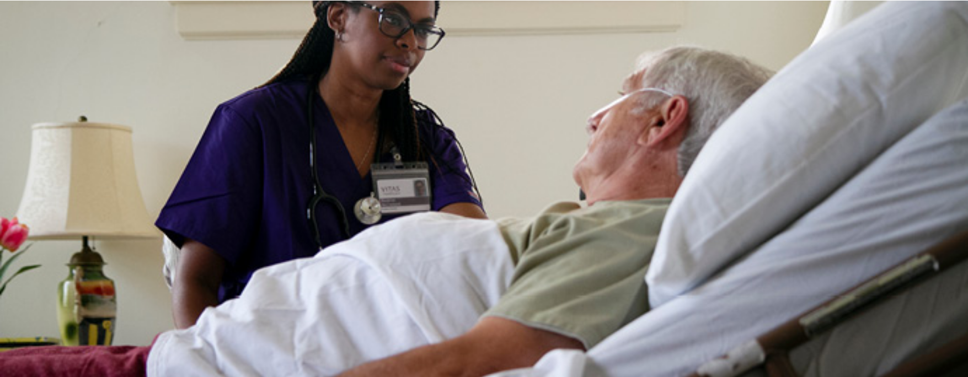







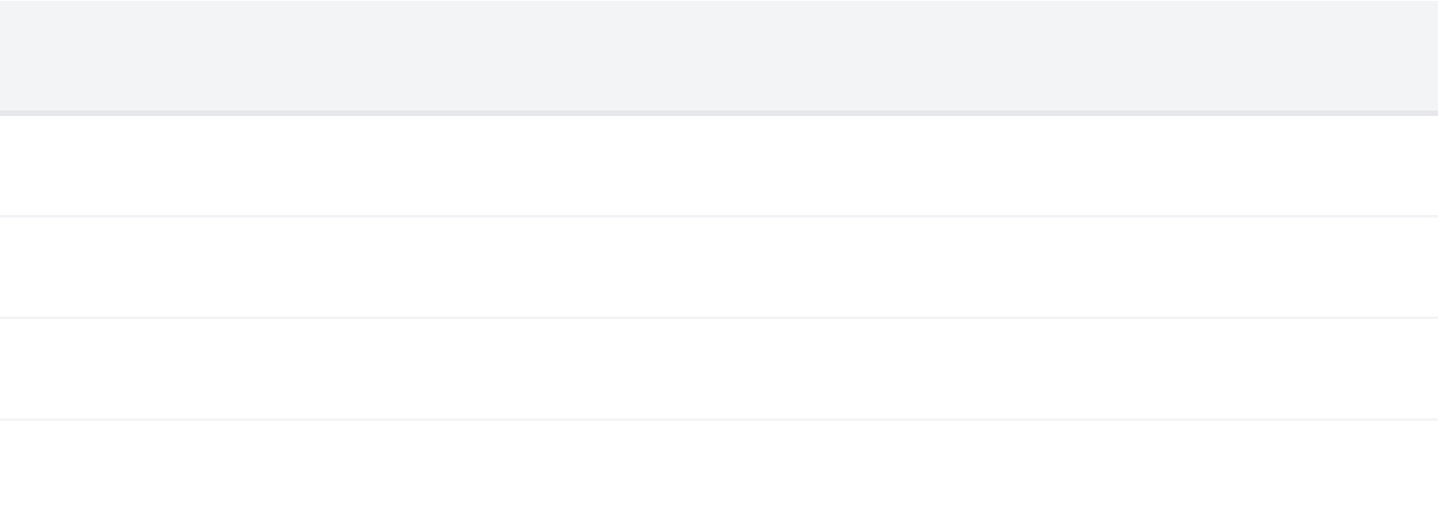











Palliative Care Home Visits
BRADFORD VTS • MANAGING HOME VISITS • MAY 2026
Common Palliative Crises
Uncontrolled Pain: Breakthrough pain not responding to current oral regimen.
Terminal Agitation: Restlessness, confusion, or distress in the final days.
Severe Breathlessness: Acute dyspnoea requiring immediate relief.
Respiratory Secretions: "Death rattle" causing significant family distress.
Family Support: Managing expectations and providing emotional containment.
Essential Subcutaneous Medications
Drug
Common Dose (SC)
Indication
Morphine
2.5mg – 5mg
Pain or Breathlessness
Midazolam
2.5mg – 5mg
Agitation / Distress
Haloperidol
1.5mg – 3mg
Nausea / Hallucinations
Hyoscine BB
20mg
Respiratory Secretions
AKT & SCA EXAM TIP
Anticipatory Prescribing: Ensure the "Just-In-Case" box is in the home before the crisis occurs. For SCA, demonstrate empathy when discussing terminal symptoms and verify that a DNACPR is signed and physically accessible at the bedside.
*Doses are illustrative; always check local palliative care guidelines and patient's current opioid load.

Slide 11













Palliative Care Documentation and Proactive Care
BRADFORD VTS • MANAGING HOME VISITS • MAY 2026
Proactive Crisis Prevention
Essential Documentation
Anticipatory Prescribing: Prescribe proactively in the last days of life to prevent emergency calls for uncontrolled symptoms.
DNACPR Accessibility: Forms must be documented, signed, and physically present in the patient's home.
DS1500 / SR1 Forms: Complete for terminal patients (prognosis <12 months) to fast-track PIP and support.
Digital records are not enough; paramedics and OOH teams need the physical copy to respect patient wishes.
Ensure family members and carers know exactly where the documentation and "Just-in-Case" box are kept.
AKT Box (The "Just-in-Case" Box)
Pain: Morphine or Oxycodone SC
Agitation: Midazolam or Haloperidol SC
Secretions: Hyoscine Butylbromide SC
AKT & SCA EXAM PEARL
AKT Knowledge: Memorize the 4 key drugs in the palliative "Just-in-Case" box and their specific indications (e.g., Midazolam for terminal agitation).
SCA Communication: Practice explaining the rationale for DNACPR and anticipatory drugs to family members with sensitivity and clarity.

Slide 12
















Mandatory Safety: Red Flags and Pitfalls
BRADFORD VTS • MANAGING HOME VISITS • MAY 2026
Clinical & Personal Red Flags
Operational Pitfalls
Personal Safety:
If you feel unsafe at any point, do not enter. Retreat to your car and call the police or practice manager immediately.
Skipping Triage:
Attending without phone triage wastes resources and risks missing higher-priority clinical cases.
Safeguarding:
If a child or vulnerable adult is at risk, visit regardless of clinical triage; escalate to the safeguarding lead.
Lone Worker Failure:
Neglecting to check-in/out with the surgery leaves you vulnerable in an emergency.
Rapid Deterioration:
Call 999 if the patient declines rapidly. Never attempt to transport a critically ill patient in your own vehicle.
Inadequate Bag:
Arriving without essential emergency drugs (Adrenaline, Aspirin, Glucagon) is a serious clinical risk.
Immediate Escalation
Documentation & Safety-Netting
ABCDE Compromise:
Any compromise to Airway, Breathing, or Circulation requires immediate hospital transfer.
Undocumented Refusals:
Failing to document clinical reasoning when declining a visit request is a significant medico-legal risk.
FAST Positive:
Suspected stroke is a time-critical emergency; stop assessment and call 999.
Poor Continuity:
Forgetting to arrange follow-up or provide clear verbal/written safety-netting instructions.
EXAM TIP: AKT questions often focus on the medico-legal necessity of documenting the decision NOT to visit.

Slide 13





















Exam Pearls: AKT and SCA Tips
BRADFORD VTS • MANAGING HOME VISITS • MAY 2026
AKT: Contract & Urgency
SCA: Triage & Communication
AKT FOCUS
SCA FOCUS
GMS Contract: The obligation is to provide visits when clinically necessary, not for patient convenience.
Declining Requests: Use empathy + clinical rationale. Differentiate "Unable to attend" from "Unwilling".
Triage Categories: Differentiate Category 1 (within 1hr) vs Category 3 (Routine) for housebound reviews.
Alternative Care: Propose alternatives (Pharmacy, UTC, or Surgery) when a visit is not clinically indicated.
OOH Provision: Knowledge of BARDOC/designated providers for clinical coverage outside core hours.
Handling Relatives: Practice verbalizing triage decisions to persistent family members while staying professional.
AKT: Palliative Pharmacology
SCA: Safety & Safety-Netting
AKT FOCUS
SCA FOCUS
Just-In-Case Box: Morphine (Pain), Midazolam (Agitation), Haloperidol (Nausea), Hyoscine (Secretions).
Lone Worker Safety: Demonstrate check-in/check-out protocols and environment assessment during roleplay.
SC Dosing: Familiarity with standard subcutaneous starting doses for terminal symptom management.
Closing the Visit: Ensure safety-netting is both verbal and written, with clear 999 triggers defined.
Documentation: Ensuring DNACPR and SR1 forms are correctly completed and accessible at home.
Clinical Decision: Always document the reasoning in the notes, especially if a requested visit was refused.

Slide 14



















Top Tips and Quick Recall
BRADFORD VTS • MANAGING HOME VISITS • MAY 2026
Triage Priority
Lone Worker Safety
Every visit request must be clinically triaged via telephone to establish urgency and necessity.
Always inform the surgery of your location and use a check-in protocol for arrival and departure at every visit.
Clinical Decision
Emergency Readiness
The final decision to visit rests with the GP based on clinical need, not patient preference or convenience.
Ensure your bag contains essential life-saving drugs including Adrenaline, Aspirin, and Glucagon at all times.
Documentation
Palliative Care
Clearly record your clinical reasoning for all decisions, especially when a home visit request is appropriately declined.
Proactively prescribe "just-in-case" medications and ensure DNACPR documentation is physically accessible at the home.
Final Recall: If the patient is deteriorating rapidly or safety is compromised, do not hesitate to call 999 or escalate to the practice lead.

