Slide 1
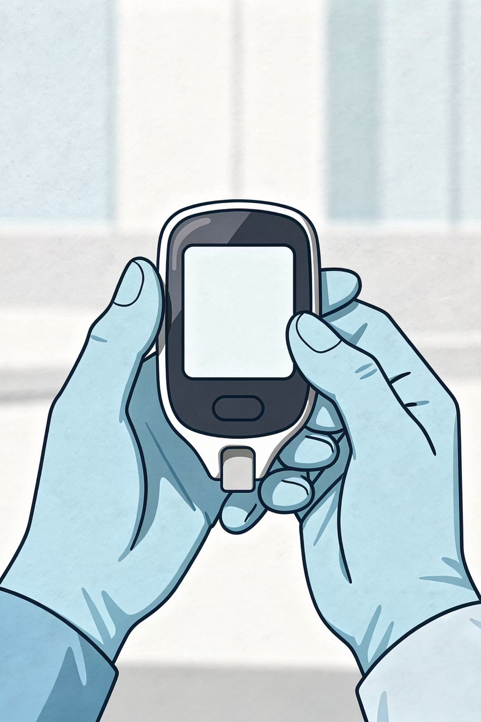

Hypoglycaemia Management Guide
A summary sheet for GP trainees and trainers in UK primary care.
Bradford VTS Teaching Deck · May 2026
Always double-check this advice and drug doses with the latest NICE/BNF guidance. This document is for educational purposes only.

Slide 2
What Is Hypoglycaemia?
Definition
Recognising the Symptoms
Capillary blood glucose below 4 mmol/L
Adrenergic: tremor, sweating, hunger, palpitations, nausea
Neuroglycopenic: confusion, drowsiness, blurred vision, seizures, loss of consciousness
Early recognition of both symptom types is essential — neuroglycopenic features indicate more severe glucose depletion and require prompt escalation.

Slide 3
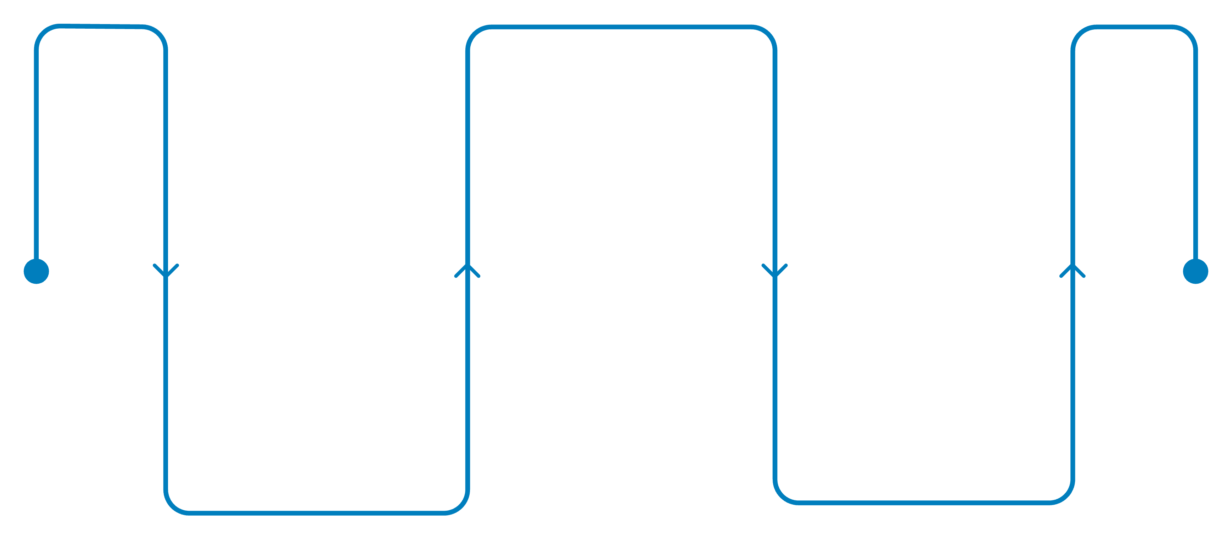
Stepwise Treatment Overview
Assisted care
Conscious but confused or struggling
Self-treat
Emergency care
Conscious and able to self-treat
Unconscious or fitting
Treatment is determined by the patient's clinical state. Always reassess blood glucose 10–15 minutes after each intervention before deciding on the next step.

Slide 4
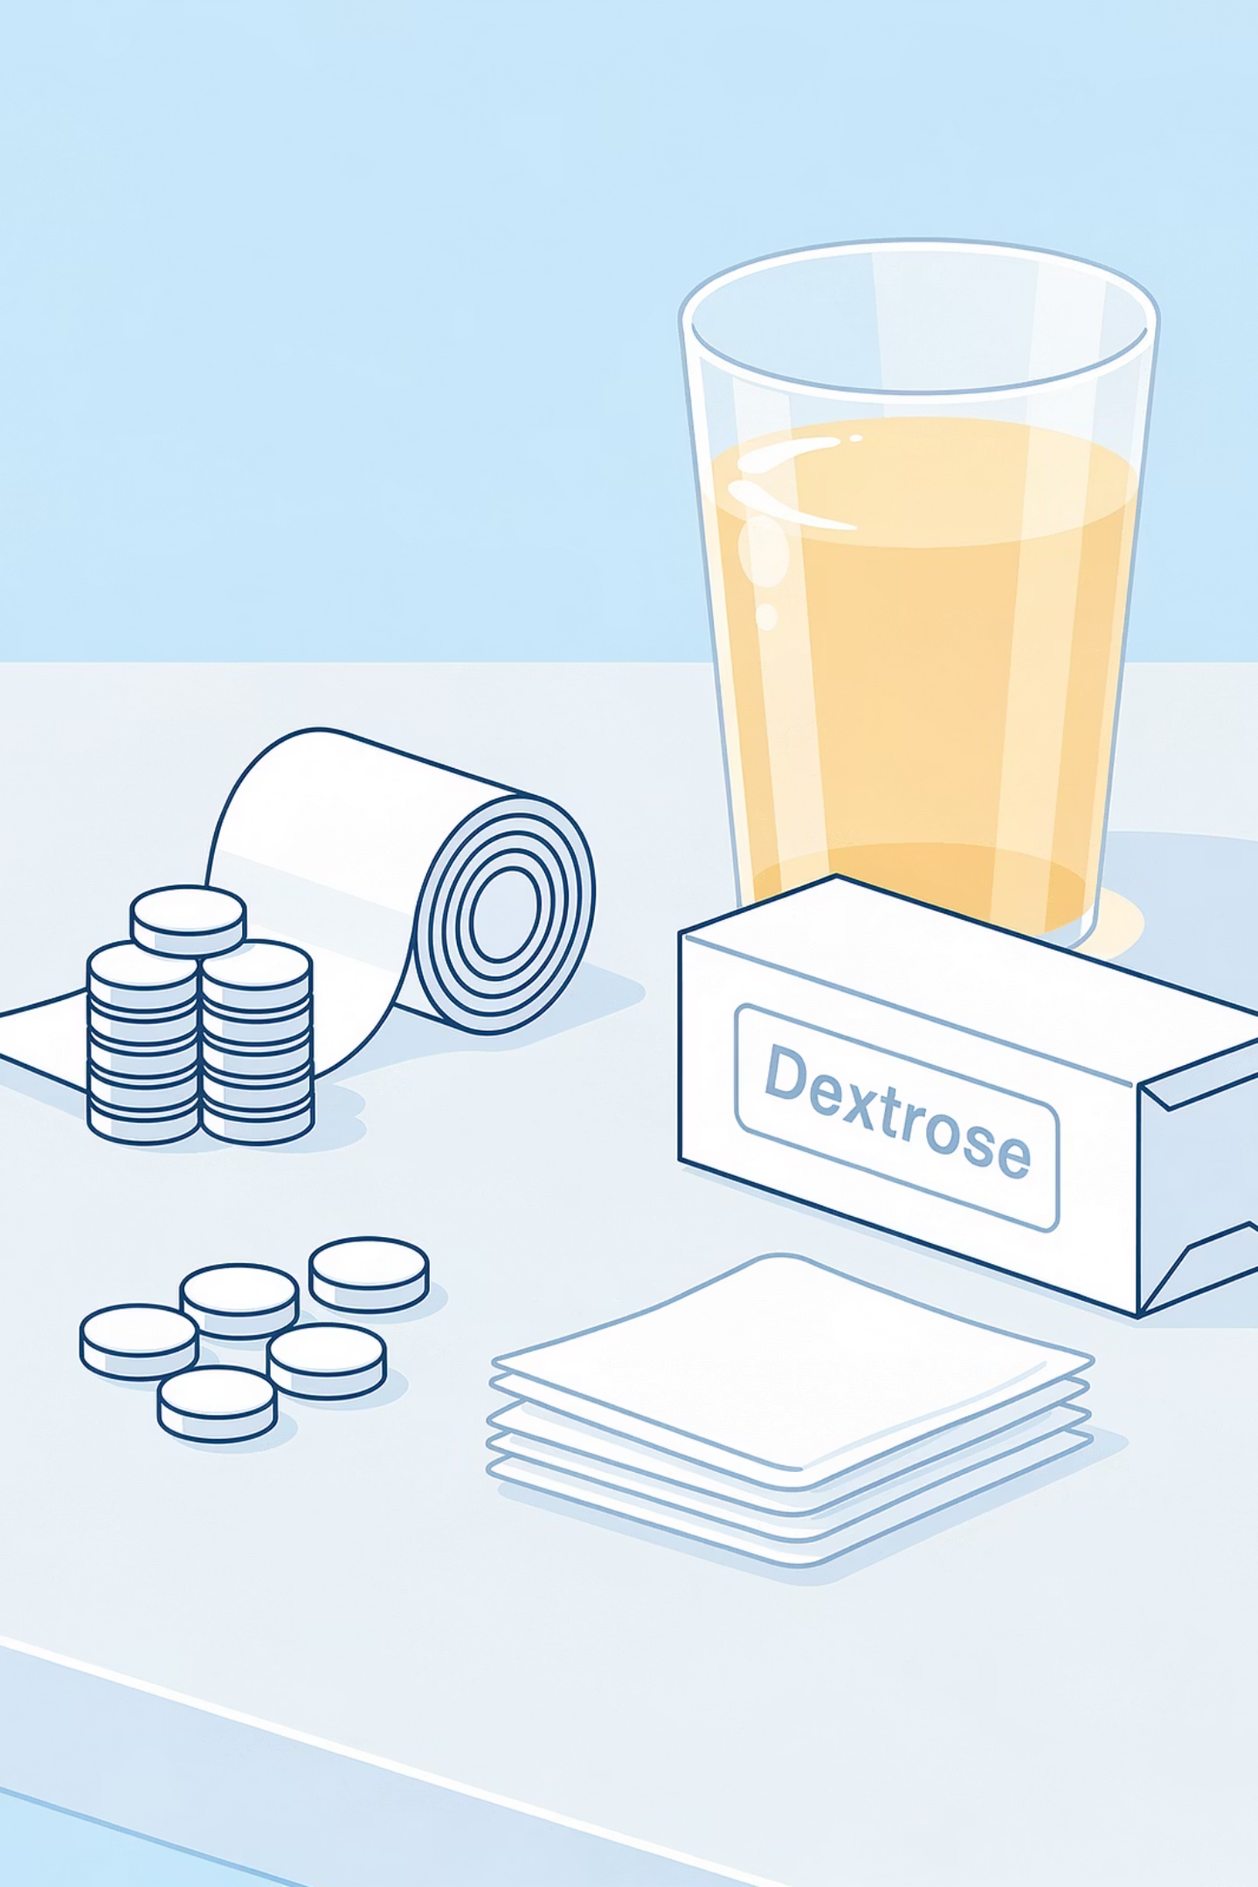
Step 1: Conscious & Able to Self-Treat
Give 15–20 g of fast-acting carbohydrate. Suitable options include:
Dextrose Tablets
Full-Sugar Drink
5–6 tablets
150–200 mL
Fruit Juice
200 mL
Recheck blood glucose after 10–15 minutes. Aim for recovery to 5 mmol/L or above.

Slide 5

Step 2: Conscious but Confused
Buccal Glucose Gel
Supervised Oral Glucose
Rub gel into the inside of the cheek if it is safe to do so. This is the preferred option when the patient cannot reliably self-treat.
Give oral glucose only if the patient can swallow safely. Never leave the patient unsupervised during treatment.
Recheck blood glucose after 10–15 minutes. If there is no improvement, escalate to Step 3 and call 999.

Slide 6
Step 3: Unconscious or Fitting
Call 999 Immediately
Recovery Position
Give Glucagon IM
Do not attempt to give any oral treatment — there is a serious aspiration risk.
Place the patient on their side and stay with them until emergency services arrive.
Administer intramuscular glucagon if available and you are trained to do so.

Slide 7

Glucagon Dosing
Group
IM Dose
Route
Adults & children over 25 kg or over 8 years
1 mg
Intramuscular
Children under 25 kg or under 8 years
500 micrograms
Intramuscular
Aged 4 years and over (where available)
Baqsimi 3 mg
Intranasal
Nasal glucagon (Baqsimi): 3 mg intranasal can be used for severe hypoglycaemia in people aged 4 years and over, where available and carers are trained.

Slide 8
When to Call 999
Unconsciousness or seizure
Failed recovery after treatment
Recurrent hypoglycaemia
No glucagon response after approximately 10 minutes
No safe supervision available after recovery

Slide 9
After Recovery
Target & Snack
Review the Cause
Once blood glucose is 5 mmol/L or above and the patient can swallow, give longer-acting carbohydrate: bread, biscuits, or the next meal.
Insulin timing error
Missed meal
Alcohol or exercise
Intercurrent illness
Medication error
Identifying the underlying cause is essential to prevent recurrence and to guide any medication review or patient education.

Slide 10
AKT Exam Summary & Key Takeaways
Treatment Target
Recheck Timing
Aim for blood glucose ≥ 5 mmol/L after treatment, then give longer-acting carbohydrate.
Always recheck blood glucose 10–15 minutes after each intervention.
Escalate Early
Check Guidelines
Call 999 for unconsciousness, seizure, or any failed recovery — do not delay.
Always verify doses against current NICE/BNF guidance. Educational use only.

