Slide 1
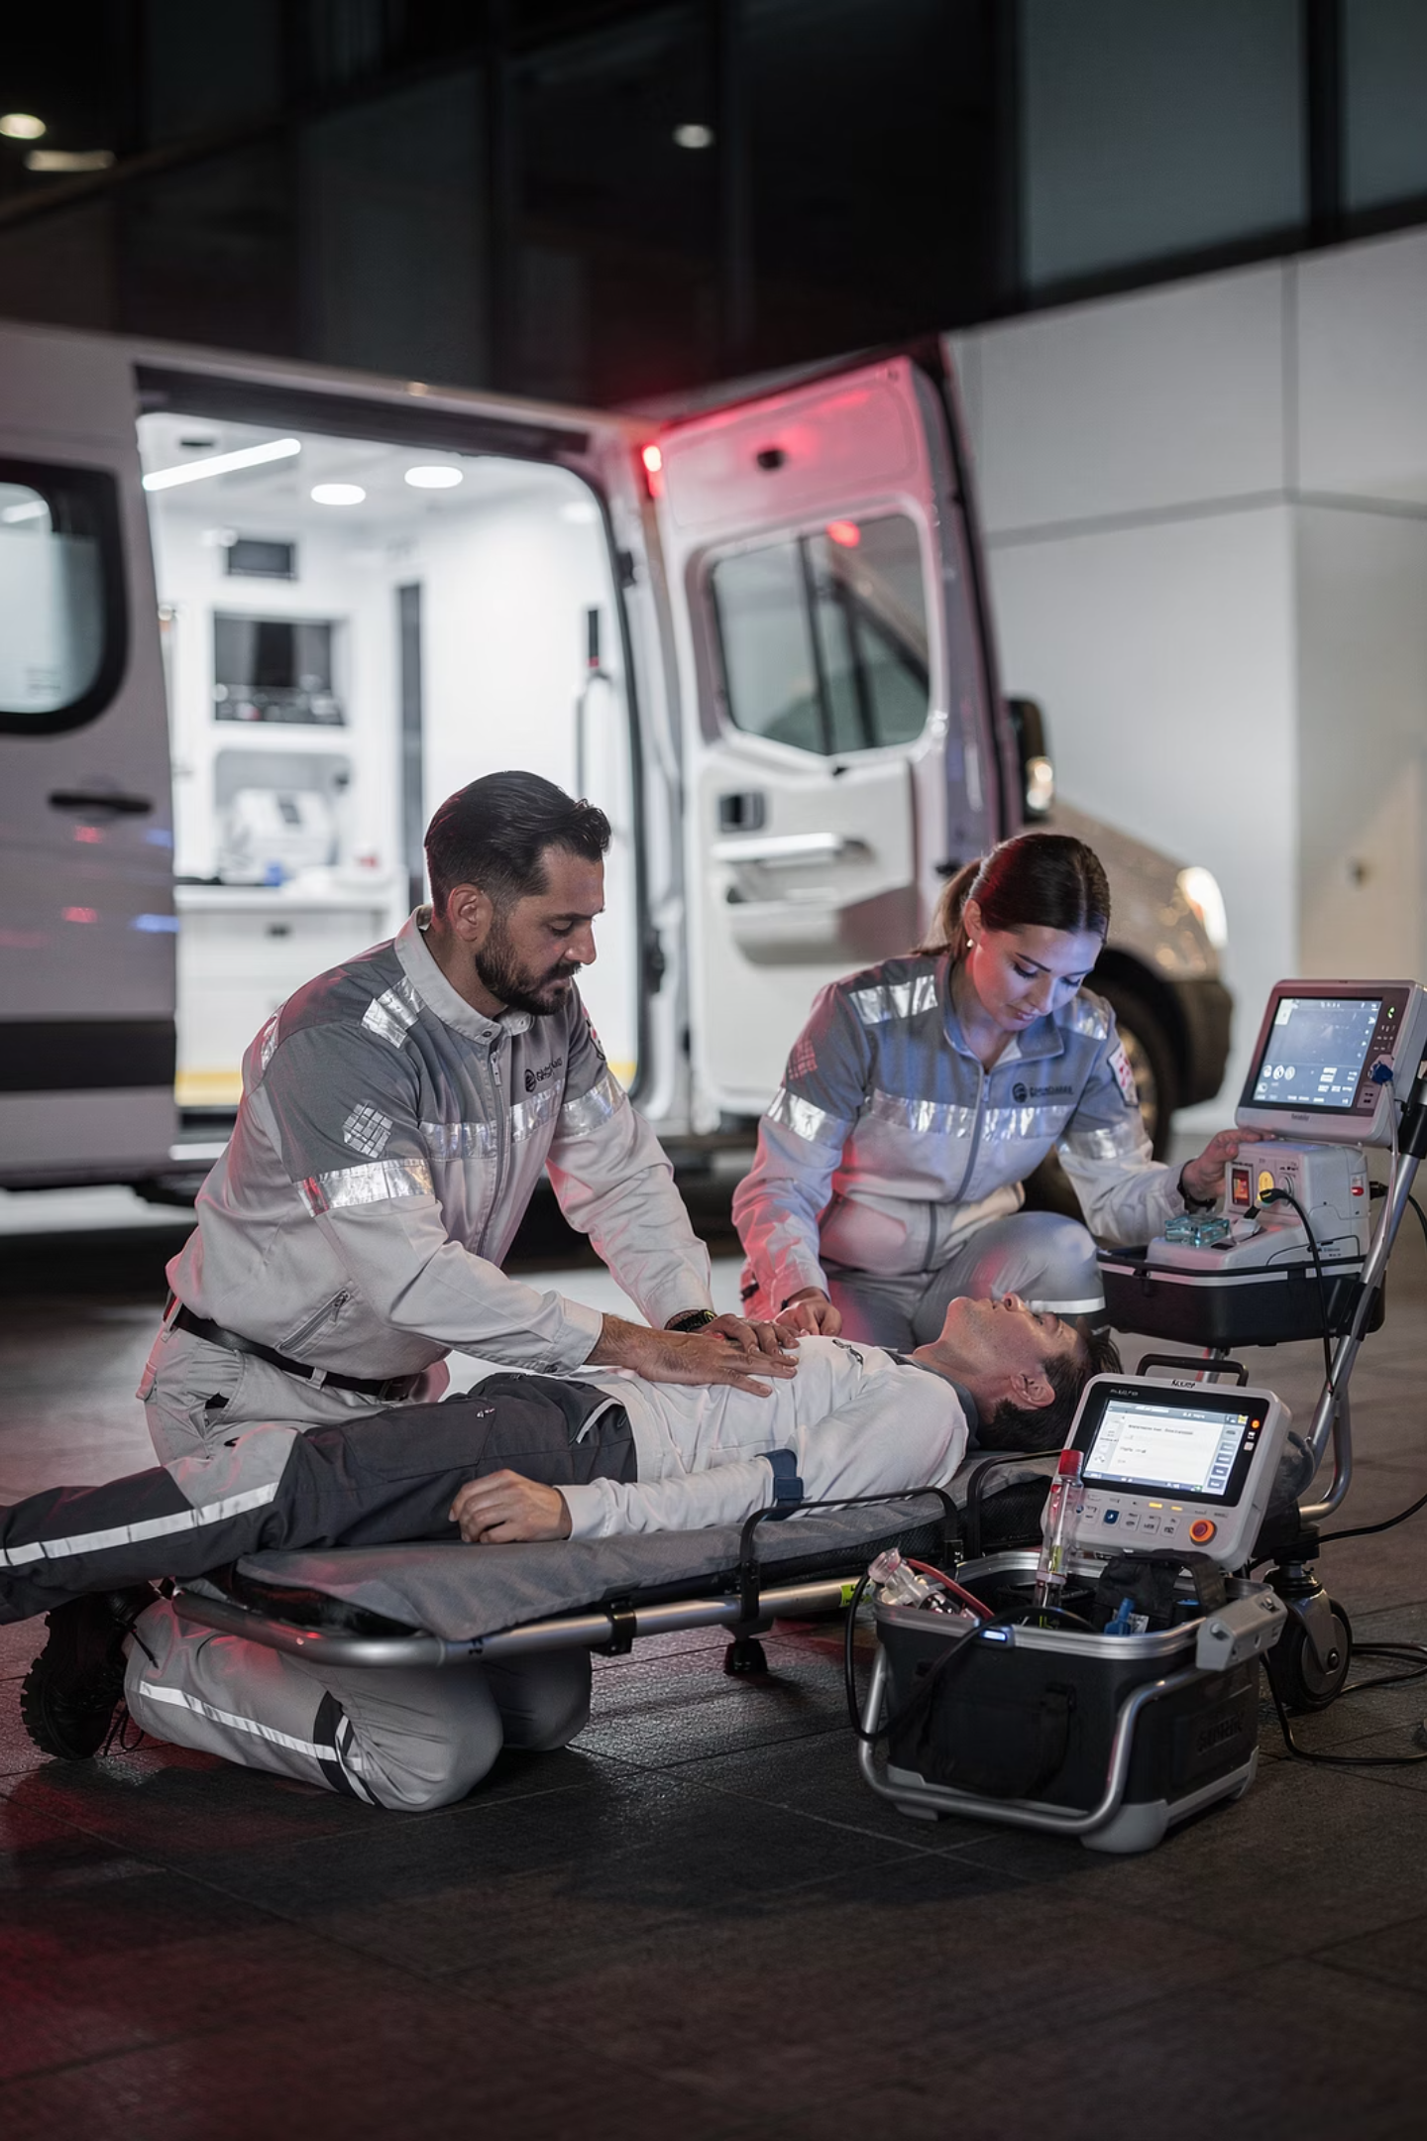
Suspected MI: Initial Management
A summary sheet for GP trainees and trainers in UK primary care · Bradford VTS · May 2026
BRADFORD VTS TEACHING DECK

Slide 2

Recognise the Presentation
Think Acute Coronary Syndrome
A Normal ECG Does Not Exclude MI
Central crushing chest pain is the classic presentation — but always consider ACS with any combination of clamminess, sweating, nausea, breathlessness, pallor, or collapse.
Do not be falsely reassured by a normal ECG. Treat the patient first, based on clinical presentation. Time is muscle — act early and decisively.
Treat the patient, not the ECG.

Slide 3
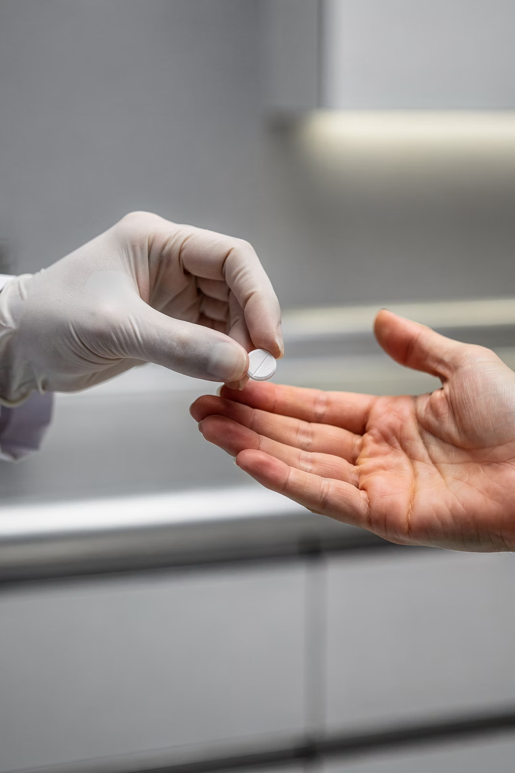
First Action: Aspirin
300 mg
Give 300 mg aspirin to chew as soon as possible. This is the single most important immediate pharmacological intervention in suspected MI.
Withhold only if there is a clear contraindication — true allergy or active major bleeding.

Slide 4
Immediate GP Management
1
2
Call 999
GTN
Call urgently and state suspected acute coronary syndrome / myocardial infarction. Do not delay the call.
Consider GTN if blood pressure allows and there is no contraindication.
3
4
Oxygen
Position
Give oxygen only if SpO₂ is below 94%. Aim 94–98%. If hypercapnic respiratory failure risk, aim 88–92%.
Sit the patient in a position of comfort — usually upright if breathless. Do not leave them alone.

Slide 5



Oxygen: Use With Caution
Why It Matters
Routine high-flow oxygen in normoxic patients with MI is not beneficial and may be harmful. Target saturations carefully:
94%
Standard target: 94–98%
Hypercapnic risk: 88–92%
Always titrate oxygen to saturations — do not give it routinely.
Threshold to Act
Give oxygen only if SpO₂ falls below 94%
88%
Hypercapnic Risk
Lower target if risk of hypercapnic respiratory failure

Slide 6


What to Tell the Ambulance Team
Symptom Onset
Time symptoms began and any progression since.
Medications Given
Aspirin given, response to GTN, oxygen requirement.
Observations
Current vital signs and any deterioration — arrhythmia or collapse.
Relevant History
Past medical history, anticoagulants, and any contraindications.

Slide 7

If the Patient Arrests
Continue Care
Start BLS
Use AED
Do not delay — every second counts in cardiac arrest. Begin basic life support immediately, apply the defibrillator as soon as it is available, and continue resuscitation efforts until the ambulance crew arrives and takes over.

Slide 8
SCA Exam: Good Phrase to Use
"I am concerned this could be a heart attack, so I am giving aspirin now and calling an emergency ambulance."
Why This Phrase Works
In the Exam Setting
Communicates clinical concern clearly
Demonstrates immediate action
Shows patient-centred communication
Examiners look for candidates who act decisively and communicate clearly under pressure. This phrase demonstrates both — use it confidently in OSCE and SCA scenarios.

Slide 9
Management at a Glance
Aspirin
300 mg to chew immediately unless true allergy or active major bleeding
GTN
Consider if BP allows and no contraindication
999
Call urgently — state suspected ACS / MI
Oxygen
Only if SpO₂ <94%; target 94–98% (or 88–92% if hypercapnic risk)
Position
Upright if breathless; do not leave patient alone
Arrest
Start BLS, use defibrillator, follow resuscitation guidance

Slide 10

Educational Disclaimer
Always double-check this advice and drug doses with the latest NICE/BNF guidance. This document is for educational purposes only.
This summary sheet is produced by Bradford VTS as a teaching aid for GP trainees and trainers. It is intended to support learning and clinical reasoning — it does not replace up-to-date clinical guidelines or individual clinical judgement.
BRADFORD VTS TEACHING AIDS
MAY 2026

