Slide 1

BRADFORD VTS CARD DECK
MAY 2026
Allergy and Immunology in General Practice
Understanding allergic reactions, testing, and common GP pitfalls
What is an Allergic Reaction?
The Main Types
An allergic reaction happens when the immune system reacts to something usually harmless — food, medicine, pollen, latex, or insect sting.
NICE defines drug allergy as a drug reaction with clinical features compatible with an immunological mechanism. Prior tolerance does not rule out later allergy.
1. Immediate (IgE-mediated)
2. Delayed (non-IgE-mediated)
Symptoms within minutes to 1–2 hours.
Symptoms hours to days after exposure.
3. Mixed Allergy
4. Non-Allergic Adverse Reactions
Features of both.
Intolerance, side effects — not immune-mediated.

Slide 2
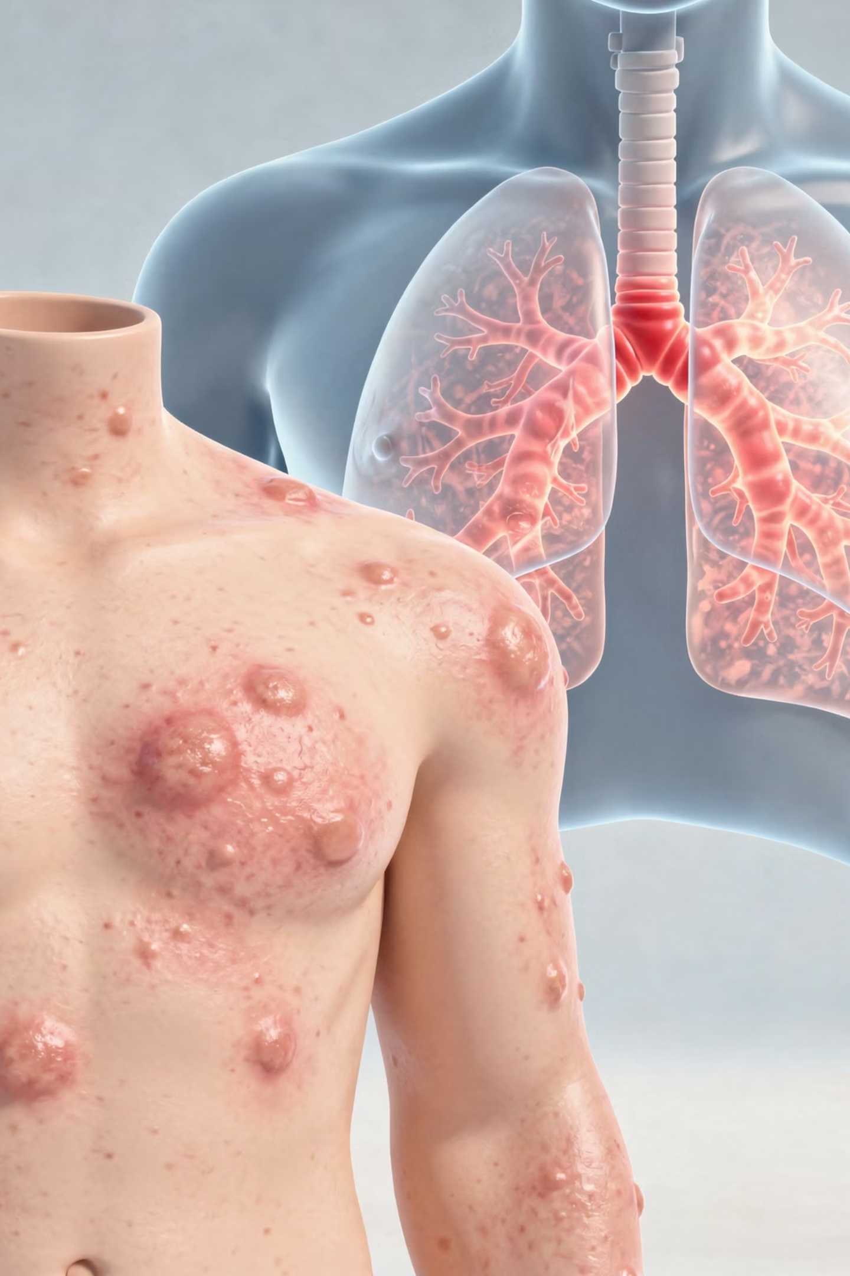


Immediate vs. Delayed Reactions: Clinical Features
IMMEDIATE (IGE-MEDIATED)
DELAYED (NON-IGE-MEDIATED)
Symptoms usually start within minutes, up to 1–2 hours after exposure.
Symptoms typically 2–72 hours after exposure (NICE CKS on cow's milk allergy).
Urticaria
Angio-oedema
Itch
Vomiting
Wheeze
Rhinitis
Collapse or anaphylaxis in severe cases
Vomiting, diarrhoea, constipation
Blood or mucus in stool
Reflux-type symptoms
Persistent eczema
Feed refusal and irritability
Faltering growth in infants
Skin prick testing and specific IgE blood tests can be useful here — but only if the history points to a likely allergen.
Skin prick testing is often not helpful here. Diagnosis relies on history, elimination trial, and reintroduction/challenge.

Slide 3

Allergy, Sensitisation, Sensitivity & Intolerance
These terms are frequently confused — by patients and clinicians alike. Understanding the distinctions is essential for safe practice.
Allergy
A clinical reaction caused by the immune system. Requires both a compatible history AND evidence fitting an immune-mediated mechanism.
Sensitisation
The immune system has produced specific IgE — test may be positive. But sensitisation ≠ clinical allergy. A patient may test positive and tolerate the food perfectly well.
Sensitivity
Medically vague. May mean "this upsets me," "I had a positive test," or "I don't tolerate this well." Not sufficient to diagnose allergy.
Intolerance
A non-immune adverse reaction. Real and troublesome, but not IgE allergy. Skin prick testing is NOT a general test for food sensitivity or intolerance.

Slide 4
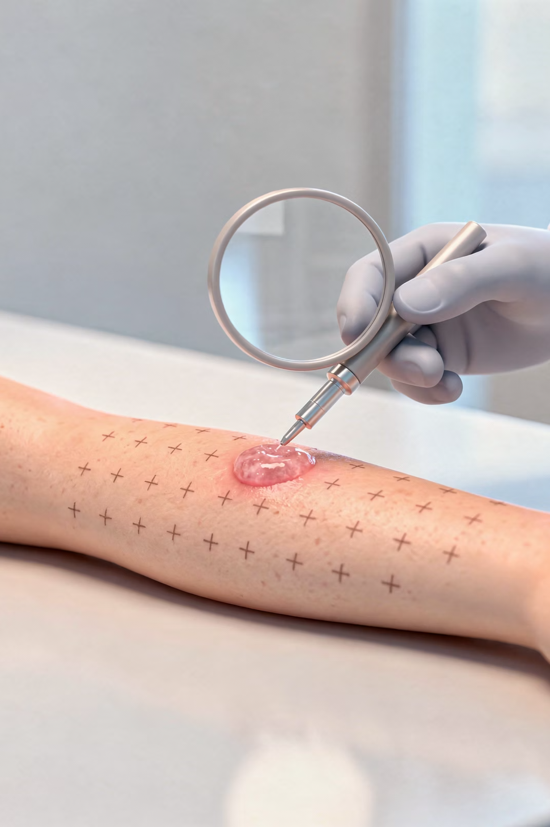
Why Specialists Avoid Broad Skin Prick Battery Testing
Specialists prefer targeted testing based on a good history. NICE and BSACI guidance support history-led assessment.
1
Allergy is a clinical diagnosis first — The history comes first. Testing should answer a specific clinical question, not go fishing for one.
2
A positive test does not prove clinical allergy — A positive skin prick test often means sensitisation, not necessarily allergy. This is the biggest trap in allergy medicine.
3
Broad panels increase false and irrelevant positives — The more allergens tested, the more likely you are to find irrelevant positives — leading to incorrect food avoidance and nutritional problems in children.
4
Unnecessary exclusion can itself create problems — In children who are sensitised but clinically tolerant, removing a food may lead to loss of tolerance.
5
Skin prick testing mainly helps with immediate IgE-mediated allergy — It does not diagnose most delayed, non-IgE-mediated conditions.
6
Whole-food extracts are not perfect — Some food allergens are unstable. A positive result must always be interpreted in the light of the history.
Specialists try not to over-diagnose food allergy, because an unnecessary label can lead to avoidable exclusion of foods that are actually being tolerated.

Slide 5




Food Allergy: The Practical GP View
IMMEDIATE FOOD ALLERGY
DELAYED FOOD ALLERGY
Think of this when symptoms happen rapidly after eating — usually within minutes and up to a couple of hours.
Think of this when symptoms come later and are more chronic or messy.
Vomiting, reflux-type symptoms
Diarrhoea, constipation
Blood or mucus in stool
Eczema, irritability, feed refusal
Urticaria
Angio-oedema
Vomiting
Wheeze
Obvious reproducibility after the same food
Skin prick testing may be normal. Diagnosis is usually based on allergy-focused history, food and symptom diary, elimination trial, and reintroduction or challenge.
In this situation, targeted specific IgE or skin prick testing may help if the likely food is already suspected from the history.
A very practical point about tolerated foods: If a child is already eating a food without symptoms, a positive test on its own is not a good reason to tell the family to stop that food.

Slide 6


Infants and Cow's Milk Allergy
One of the most important food allergy topics in UK primary care. NICE CKS says to think about cow's milk allergy when symptoms fit either an immediate or delayed pattern.
Immediate Clues – can do skin prick testing
Formula Pathway (NICE CKS)
Urticaria
Angio-oedema
Vomiting
Wheeze soon after milk exposure
First-line: Extensively Hydrolysed Formula (eHF)
Usual first-line for most infants with suspected cow's milk allergy.
Delayed Clues – skin prick testing unhelpful
Reflux-type symptoms
Vomiting, diarrhoea, constipation
Blood or mucus in stool
Eczema, feed refusal
Faltering growth
Unsettled behaviour in the right context
Second-line: Amino Acid Formula (AAF)
For more severe disease, when eHF fails, severe multisystem disease, faltering growth, or very significant symptoms.
Goat's milk and sheep's milk are NOT suitable substitutes. Soya formula is generally avoided under 6 months.
The 'improve off milk, worsen on reintroduction' pattern is often more useful than a test for delayed presentations.

