Slide 1
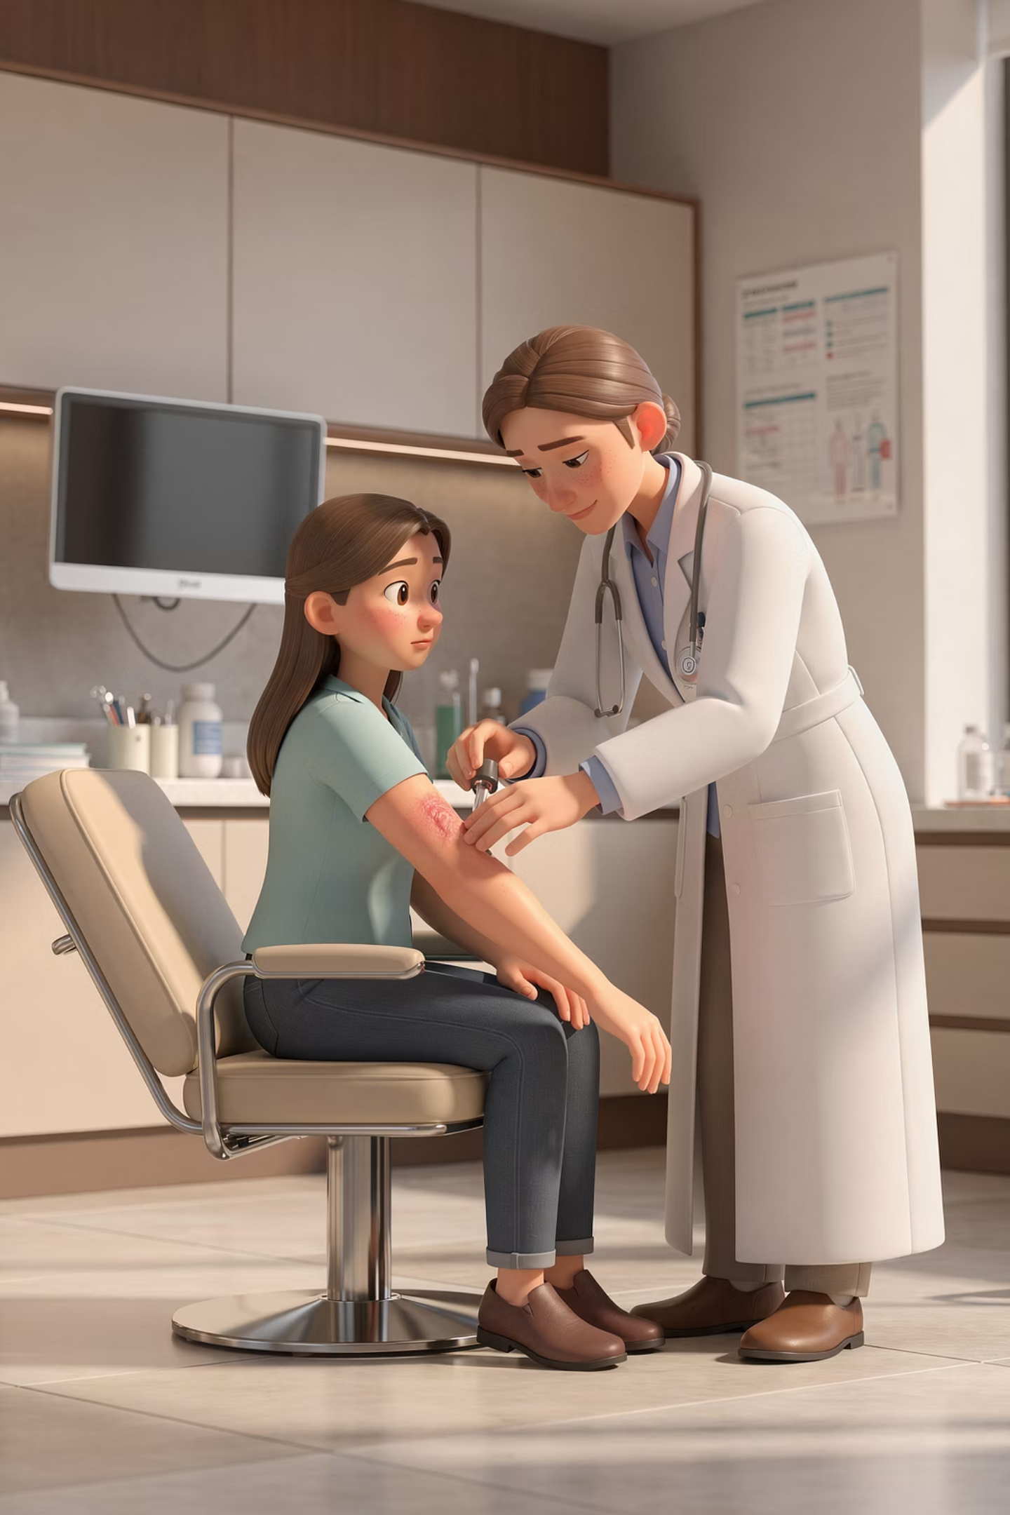
Common Allergy Problems in Primary Care
A comprehensive educational resource for UK primary care clinicians and trainees. Content is aligned with current NICE, BNF, BSACI, and Resuscitation Council UK guidance, modernised for contemporary UK primary care practice.
NICE · BNF · BSACI · RESUS COUNCIL UK

Slide 2

Allergy – An Overview
Pathogenesis
IgE-mediated and non-IgE-mediated mechanisms, immune cell roles, and mediator release.
Clinical Aspects
Recognition of allergic presentations across organ systems in primary care.
Investigations
Skin prick testing, specific IgE assays, and appropriate referral pathways.
Modern Therapies
Pharmacotherapy, immunotherapy, and emerging biologic treatments.
This module is updated to align with current UK NICE, BNF, and BSACI principles, and is modernised for contemporary primary care practice.

Slide 3

Allergic Diseases – Prevalence
A Growing Global Burden
UK Picture
Allergic disease remains one of the most common chronic conditions worldwide. Prevalence has risen substantially over recent decades, particularly in high-income countries, affecting up to 40% of the population at some point.
Allergic rhinitis affects approximately 1 in 5 people in the UK. Asthma affects around 5.4 million individuals. Food allergy prevalence is estimated at 5–8% in children and 1–2% in adults. Atopic eczema affects up to 20% of children and 3–5% of adults.
The reasons for rising prevalence are multifactorial and remain an active area of research.

Slide 4
Hypersensitivity – Types I–III
The Gell and Coombs classification describes four types of hypersensitivity reaction. Types I–III are antibody-mediated and remain clinically important in everyday practice.
1
2
3
Type I – Immediate (IgE-mediated)
Type II – Cytotoxic (IgG/IgM)
Type III – Immune Complex
Antibodies directed against cell surface antigens. Examples: haemolytic anaemia, drug-induced thrombocytopaenia.
Circulating antigen–antibody complexes deposited in tissues. Examples: serum sickness, certain drug reactions, hypersensitivity pneumonitis.
Allergen cross-links IgE on mast cells → rapid degranulation. Examples: anaphylaxis, allergic rhinitis, asthma, urticaria, food allergy.

Slide 5

Hypersensitivity – Type IV
T-Cell Mediated (Delayed)
Type IV reactions are NOT IgE-mediated and do not respond to adrenaline in the same way as anaphylaxis. Correct classification guides appropriate management.
Type IV hypersensitivity is distinct from antibody-mediated reactions. It is driven by sensitised T-lymphocytes rather than antibodies, and onset is characteristically delayed — typically 48–72 hours after exposure to the triggering antigen.
CD4+ Th1 cells release cytokines (IFN-γ, TNF) that activate macrophages and perpetuate tissue damage. CD8+ cytotoxic T-cells may also play a role in severe cutaneous reactions.
Contact dermatitis (e.g. nickel, fragrances, rubber)
Tuberculin skin test reaction
Granulomatous inflammation (e.g. sarcoidosis)
Drug-induced delayed hypersensitivity (e.g. Stevens–Johnson syndrome)

Slide 6




Immune Responses to Allergens
In genetically susceptible individuals, allergens — typically proteins — trigger an inappropriate adaptive immune response rather than immune tolerance. The key steps are sensitisation, then re-exposure and effector response.
Antigen Presentation
Dendritic cells capture allergen at mucosal surfaces and present peptides to naïve T-cells via MHC class II.
Th2 Skewing
Cytokine environment (IL-4, IL-13) promotes Th2 polarisation over regulatory or Th1 responses.
IgE Production
B-cells undergo class switching to produce allergen-specific IgE, which binds high-affinity Fcε RI receptors on mast cells and basophils.

Slide 7

IgE – Structure and Function
Key Properties of IgE
Clinical Relevance
IgE is the least abundant serum immunoglobulin but has the highest affinity for its receptor. It binds to high-affinity Fcε RI receptors on mast cells and basophils, and low-affinity Fcε RII (CD23) on B-cells and dendritic cells.
Sensitisation: allergen-specific IgE is produced after first exposure
Effector phase: re-exposure cross-links cell-bound IgE → degranulation
Total IgE can be elevated in atopy, parasitic infection, or certain lymphomas
Specific IgE levels do not always predict clinical severity
Omalizumab (anti-IgE) targets free IgE and has transformed severe asthma and chronic urticaria management.

Slide 8

IgE Production – Regulatory Mechanisms
The production of allergen-specific IgE is tightly regulated by the interplay of cytokines, T-cell subsets, and co-stimulatory signals. Understanding these pathways underpins modern biologic therapy.
IL-4 and IL-13
Th2 Polarisation
Regulatory T-cells
Key Th2 cytokines that drive B-cell class switching to IgE production. Dupilumab targets the IL-4Rα subunit shared by both receptor complexes.
Transcription factor GATA-3 drives Th2 differentiation. TSLP, IL-33, and IL-25 from epithelial cells amplify Th2 responses — these are upstream therapeutic targets.
Treg cells (FoxP3+) suppress IgE production and promote tolerance. Reduced Treg function is implicated in atopic disease and is restored by successful immunotherapy.

Slide 9
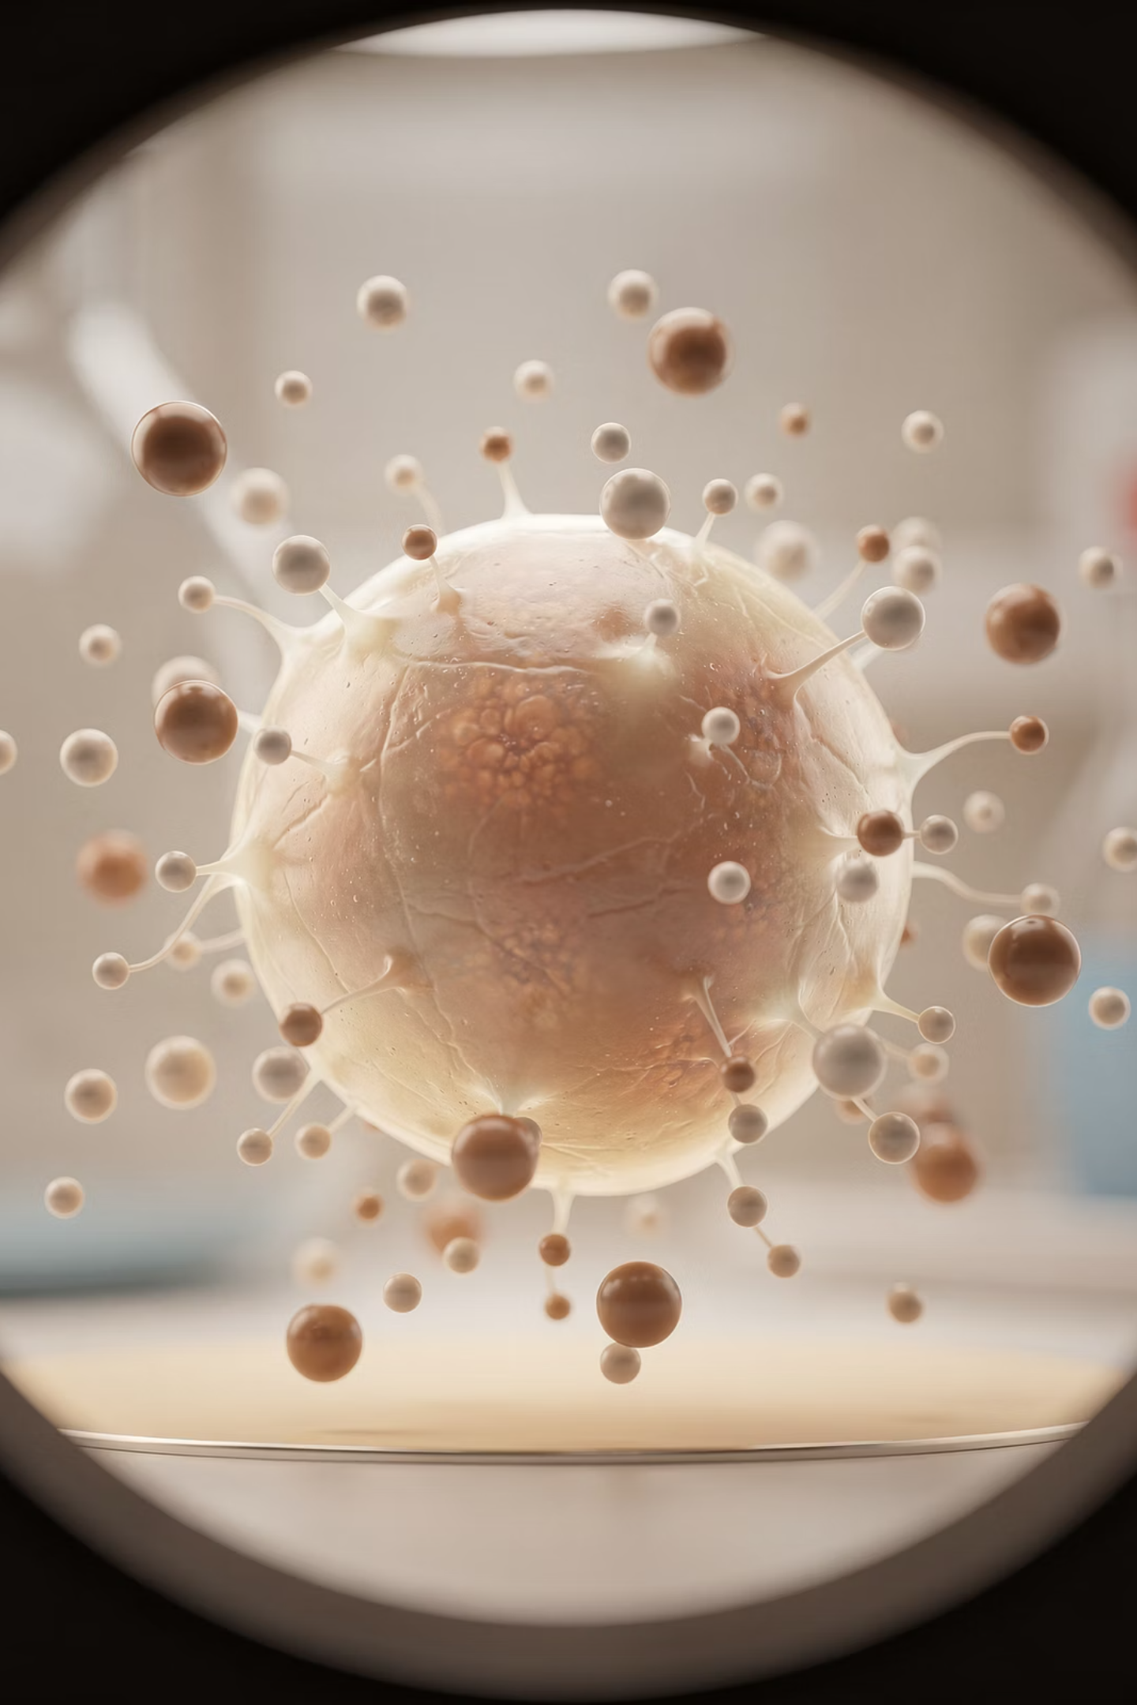
Early Phase Response
The early phase allergic response occurs within seconds to minutes of allergen re-exposure in a sensitised individual. Cross-linking of adjacent IgE molecules on mast cells by allergen triggers rapid degranulation.
Onset
Mediators Released
Symptoms begin within 5–30 minutes of exposure and typically resolve within 1–2 hours.
Preformed: histamine, tryptase, heparin. Newly synthesised: prostaglandins, leukotrienes, PAF.
Clinical Features
Urticaria, angioedema, bronchospasm, nasal congestion, hypotension — severity varies by organ involved.

Slide 10
Pre-formed Mediators
Histamine
Other Pre-formed Mediators
The principal pre-formed mediator stored in mast cell granules. Released immediately upon degranulation, it acts on H1 and H2 receptors throughout the body:
Tryptase: a serine protease specific to mast cells. Serum tryptase measured within 1–6 hours of suspected anaphylaxis supports the diagnosis and may aid medicolegal documentation.
Itch and urticaria — H1 receptor stimulation in skin
Vasodilation and increased permeability — erythema, oedema, hypotension
Bronchospasm — smooth muscle contraction in airways
Mucus hypersecretion — nasal and bronchial
Heparin: anti-coagulant properties; may contribute to local tissue changes.
Chymase and carboxypeptidase: tissue remodelling enzymes released in chronic allergic states.

Slide 11
Lipid Mediators
Newly synthesised lipid mediators are generated from arachidonic acid via the cyclo-oxygenase (COX) and lipoxygenase (LOX) pathways following mast cell activation. They are key contributors to prolonged and more severe allergic inflammation.
Leukotrienes (LTC4, LTD4, LTE4)
Prostaglandins (PGD2)
Platelet-Activating Factor (PAF)
The dominant prostaglandin released by mast cells. Contributes to vasodilation, bronchoconstriction, and recruitment of Th2 cells. PGD2 receptor antagonism is under investigation as a therapeutic target.
Produced via the 5-LOX pathway. Potent bronchoconstrictors and promoters of mucus secretion and eosinophil recruitment. Targeted by montelukast (leukotriene receptor antagonist) — though note MHRA warnings regarding neuropsychiatric side effects.
A potent phospholipid mediator contributing to bronchospasm, hypotension, and eosinophil activation — particularly relevant in severe anaphylaxis.

Slide 12
Late Phase Response – 1
Timing
Cellular Infiltration
The late phase response begins 4–8 hours after initial allergen exposure and may persist for 24–48 hours. It is clinically distinct from the early phase and may occur without a preceding early response.
Chemokines and adhesion molecules recruit inflammatory cells into affected tissues:
Eosinophils: central effector cells; cause tissue damage via major basic protein, ECP, and reactive oxygen species
Basophils: release additional histamine and IL-4, amplifying the Th2 response
Neutrophils: contribute to tissue oedema and damage in some patients
T-lymphocytes: sustain cytokine production and perpetuate inflammation

Slide 13
Late Phase Response – 2
Th2 cytokines are the molecular orchestrators of the late-phase allergic response and chronic allergic inflammation. Their identification has enabled targeted biologic therapy.
IL-4 and IL-13
IL-5
IL-33 and TSLP
Drive IgE class switching, mucus production, and airway remodelling. Targeted by dupilumab in severe atopic eczema and asthma.
Essential for eosinophil maturation, survival, and tissue recruitment. Targeted by mepolizumab, benralizumab, and reslizumab in severe eosinophilic asthma.
Epithelial-derived "alarmins" that amplify the Th2 response. Tezepelumab (anti-TSLP) is NICE-approved for severe uncontrolled asthma.

Slide 14

Genetic Influences on Allergic Disease
Allergic disease is polygenic — no single gene determines atopy. Risk is modulated by variants in multiple genes interacting with environmental exposures across the life course.
Heritability
Key Gene Variants
Concordance in identical twins is approximately 75% for asthma, suggesting strong genetic contribution but with significant environmental modulation.
Filaggrin (FLG) loss-of-function mutations strongly predispose to eczema and sensitisation. IL-4Rα, IL-13, and HLA variants influence IgE regulation and Th2 responses.
Familial Risk
One atopic parent: ~30% risk. Two atopic parents: ~60–70% risk. Risk is not allergy-specific — a parent with asthma may have a child with eczema.

Slide 15
Environmental Influences on Atopy – 1
The Role of Environment
Microbiome and Atopy
Genetics alone cannot explain the rapid rise in allergic disease over the past 50 years — the timeline is too short for genetic change. Environmental factors, particularly those affecting the microbiome and immune maturation, are central.
Reduced early microbial diversity in gut and skin microbiomes is consistently associated with increased risk of allergic sensitisation. The microbiome influences Treg development and shapes the Th1/Th2 balance during a critical early window of immune development.
Urbanisation: associated with increased atopy compared with rural living
Western diet: low fibre, high processed food — reduces microbial diversity
Antibiotic use: early life exposure linked to subsequent atopy risk
Caesarean delivery: alters early colonisation with commensal bacteria

Slide 16
Environmental Influences – 2
Exposure ≠ Allergy
Crucially, environmental allergen exposure alone does not cause clinical allergy. The majority of individuals exposed to house dust mite, pollen, or animal dander never develop sensitisation. Context, timing, route, and dose of exposure — alongside genetic susceptibility — all determine outcome.
Early Tolerance Induction
Dose and Route Matter
Occupational Exposures
Exposure to food allergens in early infancy (as per LEAP study findings) may promote oral tolerance rather than sensitisation — the basis for current early introduction guidance.
Low-dose skin exposure (e.g. via disrupted epithelial barrier in eczema) may promote sensitisation, whilst oral ingestion may promote tolerance — the "outside-in" hypothesis.
High-level occupational allergen exposure (e.g. latex, flour, laboratory animals) increases sensitisation risk — important in occupational history-taking.

Slide 17
Disease Influences – Parasites and Allergy
The Parasite–Allergy Paradox
Proposed Mechanisms
Helminth infections typically drive a strong Th2 and IgE response — superficially similar to atopy. Yet allergic disease is less prevalent in regions with high endemic parasitic infection. This apparent paradox has informed the hygiene hypothesis.
Helminths induce potent regulatory immune responses (IL-10, TGF-β, Tregs) that broadly suppress immune reactivity, including atopic responses
IgE raised by parasites may saturate mast cell receptors, reducing availability for allergen-specific IgE
Eradication of helminths in some populations has been associated with increases in atopy
These complex interactions suggest that the Th2–allergy relationship is context-dependent and modulated by co-existing infections.

Slide 18

Immunopathogenesis – Early Immune Skewing
The foundations of allergic disease may be laid in utero and during the first months of life, during a critical window of immune programming. Understanding this underpins prevention strategies.
Foetal Th2 Skewing
In utero bias toward Th2 at birth
Early Microbial Shaping
Microbiome and antigens tune Th1/Treg balance
Allergic Sensitisation
Failure of tolerance leads to allergy
Foetal immunity is physiologically Th2-skewed to prevent maternal rejection. Postnatal maturation normally shifts this balance towards Th1 and Treg responses. Failure of this transition — due to genetic or environmental factors — may predispose to sustained Th2 skewing and subsequent atopic disease.

Slide 19
Immunopathogenesis – Beyond the Hygiene Hypothesis
The Original Hygiene Hypothesis
Why It's Insufficient
Strachan (1989) proposed that reduced early childhood infection — due to improved sanitation and smaller family size — reduced Th1 stimulation and led to unopposed Th2 responses, manifesting as atopy. This simple Th1/Th2 paradigm is now considered oversimplified.
Rising rates of Th1-mediated autoimmune disease (e.g. Type 1 diabetes, IBD) in parallel with atopy cannot be explained by a simple Th1/Th2 switch. The current model focuses on deficient Treg function and reduced immune regulation, driven by loss of microbial diversity rather than specific infections.

Slide 20

The Hygiene Hypothesis & Microbiome Diversity
The modern reformulation of the hygiene hypothesis centres on the "old friends" hypothesis — it is exposure to a broad diversity of commensal organisms and environmental microbes, rather than overt infections, that calibrates immune regulation.
Gut Microbiome
Skin Microbiome
Early colonisation with diverse bacteria (Lactobacillus, Bifidobacterium) promotes Treg development and dampens Th2 responses. Diversity is reduced by formula feeding, antibiotics, and caesarean delivery.
Staphylococcus aureus dominance in eczema disrupts the skin barrier and amplifies Th2 inflammation. Restoring barrier function and microbiome balance is a therapeutic goal.
Implications
Probiotic and prebiotic interventions are under investigation. Current evidence does not support routine supplementation for allergy prevention outside of specific clinical contexts.

Slide 21

Allergy – Diagnosis
CLINICAL CORNERSTONE
History Is Everything
A thorough, structured clinical history remains the most important diagnostic tool in allergy. No test should be performed — or interpreted — without a robust clinical narrative. Key domains to explore:
Symptom Characterisation
Nature (urticaria, wheeze, angioedema), timing (immediate vs. delayed), severity, and reproducibility.
Trigger Identification
Specific foods, drugs, stinging insects, latex, aeroallergens; relationship between exposure and onset.
Atopic Background
Personal and family history of asthma, eczema, rhinitis — establishes atopic diathesis and informs pre-test probability.

Slide 22
Skin Prick Testing (SPT)
Indications and Technique
Practical Guidance
SPT is the most widely used allergy test in specialist practice. A small drop of standardised allergen extract is placed on the forearm, and a lancet is used to introduce the allergen into the superficial dermis. A positive result (wheal ≥3 mm greater than negative control) indicates sensitisation.
Must be guided by a focused clinical history — do not use as a screening panel
Requires positive (histamine) and negative (saline) controls
Antihistamines must be stopped ≥3–5 days beforehand
Results are immediate (15–20 minutes)
Should be performed where resuscitation facilities are available
SPT has high sensitivity but modest specificity. Always interpret in clinical context.

Slide 23
Problems with Skin Prick Testing
SPT is a useful tool but has important limitations that must be understood to avoid misdiagnosis and inappropriate management.
False Positives
False Negatives
Dermographism, atopic skin, very sensitive individuals, and cross-reactive allergens can produce positive results without clinical relevance. A positive SPT indicates sensitisation — not necessarily clinical allergy.
Antihistamines, tricyclic antidepressants, and systemic steroids can suppress the wheal response. Poor allergen standardisation or incorrect technique may also give false negatives.
Impracticality
Interpretation Challenges
SPT is not suitable for patients with severe eczema (limited skin surface), those at high risk of systemic reaction, infants, or those unable to stop antihistamines.
Currently, most SPT is performed in specialist allergy centres. Primary care referral is appropriate when the diagnosis is uncertain or management decisions depend on the result.

Slide 24
Assays for Specific IgE – Principles
Modern Specific IgE Testing
Key Points
Specific IgE (sIgE) blood testing has superseded the older RAST (radioallergosorbent test) terminology. Modern assays — such as ImmunoCAP (Thermo Fisher) — are highly sensitive fluorescent enzyme immunoassays that quantify sIgE levels in kU/L.
Can test for whole allergens (e.g. house dust mite, peanut) or individual allergen components (molecular diagnostics)
Component-resolved diagnostics (CRD) aid risk stratification — e.g. Ara h 2 sIgE in peanut allergy indicates higher risk of systemic reaction
Request selectively — a broad panel without clinical context generates unhelpful results
Results are reported numerically and graded from class 0 (undetectable) to class 6 (very high). Individual laboratories use slightly different reference ranges.

Slide 25
Assays for Specific IgE – When to Use
Specific IgE blood testing is particularly valuable when skin prick testing is not feasible or appropriate.
Extensive Eczema
Cannot Stop Antihistamines
SPT requires sufficient clear skin. In severe atopic eczema, sIgE testing is the preferred investigation.
When antihistamines cannot safely be withheld (e.g. chronic urticaria), sIgE avoids the need for medication withdrawal.
Young Children or High-Risk Patients
Remote or Community Setting
In young infants or those with a history of severe systemic reactions, in vitro testing is safer than SPT.
Blood testing can be requested from primary care without specialist facilities, enabling initial investigation prior to referral.

Slide 26
Specific IgE – Positive ≠ Clinically Relevant Allergy
The Sensitisation–Allergy Distinction
Clinical Implications
A positive specific IgE indicates immunological sensitisation — the presence of allergen-specific IgE antibodies. It does not confirm that this allergen causes clinical symptoms. Up to 50% of individuals with detectable sIgE to a given allergen will tolerate it without any reaction.
Always interpret sIgE results in the context of the clinical history
A positive result for a food the patient eats regularly without symptoms is not clinically significant
Avoid unnecessary dietary restriction based on positive tests alone
Component-resolved diagnostics (e.g. Ara h 2 for peanut) improve specificity for clinically relevant allergy
Inappropriate interpretation of allergy tests in primary care can lead to unnecessary food avoidance, nutritional risk, and reduced quality of life.

Slide 27

The Atopic Triad
Asthma, atopic eczema, and allergic rhinitis frequently coexist in the same individual — the atopic triad. Recognising this clustering informs holistic management and referral planning.
Asthma
Atopic Eczema
Affects ~5.4 million in the UK. Allergic asthma is the commonest phenotype in children; non-eosinophilic asthma more common in adults.
Typically the first manifestation — the "atopic march" begins in early infancy. Filaggrin mutations are a major risk factor.
Allergic Rhinitis
Affects 10–15% of the UK population. Frequently undertreated and has significant impact on quality of life and asthma control.

Slide 28
Asthma & Rhinitis – The United Airway
One Airway, One Disease
Clinical Evidence
The upper and lower airways share a continuous mucosal surface, common inflammatory pathways, and overlapping allergen triggers. This concept — the "united airway" — has important practical implications for UK primary care management.
Up to 80% of patients with asthma have coexisting rhinitis
Uncontrolled rhinitis worsens asthma control — nasal postnasal drip triggers coughing and bronchospasm
Treating rhinitis effectively (intranasal steroids) can improve asthma outcomes
NICE NG80 (asthma) and NICE CG134 (rhinitis) should be considered together
Always ask about nasal symptoms in any asthma review, and vice versa.

Slide 29
Asthma – Pathophysiology and Diagnosis
Asthma is a chronic inflammatory airway disease characterised by variable airflow obstruction, airway hyperresponsiveness, and underlying eosinophilic or mixed airway inflammation. Diagnosis in UK primary care follows NICE NG80 (adults) and NICE NG198 (children).
01
02
03
Symptom Assessment
Objective Testing
Risk Stratification
Episodic wheeze, breathlessness, chest tightness, and cough — particularly nocturnal or exercise-induced. Symptom variability is a key feature.
Spirometry with bronchodilator reversibility (≥12% and 200mL improvement), FeNO (≥40 ppb supports eosinophilic inflammation), peak flow variability.
Identify high-risk features: previous near-fatal attack, poor perception of dyspnoea, psychosocial risk factors, non-adherence with preventer therapy.

Slide 30
Asthma – Modern Management
Current UK asthma management (NICE NG80 / BTS-SIGN) is founded on ICS-based preventative therapy. The goal is complete control: no daytime symptoms, no night-time wakening, no rescue inhaler use, and normal activity.
Step 5
Add-on biologic therapy (e.g. mepolizumab, dupilumab, tezepelumab) via specialist referral for severe uncontrolled asthma.
Step 4
High-dose ICS + LABA ± LTRA ± theophylline. Consider MART (Maintenance and Reliever Therapy) with ICS/formoterol.
Step 3
Low-dose ICS + LABA (combination inhaler). MART strategy increasingly preferred. Assess adherence and inhaler technique first.
Steps 1–2
Low-dose ICS preventer + SABA reliever (or ICS/formoterol as reliever per NICE). Patient education and trigger avoidance essential at all steps.

Slide 31
Rhinitis – Classification and Clinical Features
Classification
Coexistence with Asthma
Allergic rhinitis is classified as:
Allergic rhinitis is present in up to 80% of asthma patients. BSACI and NICE recommend treating both conditions simultaneously. Poor nasal symptom control is a modifiable risk factor for asthma exacerbations and should be actively addressed at every asthma review.
Intermittent: symptoms <4 days/week or <4 consecutive weeks
Persistent: symptoms >4 days/week AND >4 weeks
Mild / Moderate–Severe: based on impact on quality of life
Non-allergic rhinitis (vasomotor, occupational, drug-induced) must be considered in the differential.

Slide 32
Rhinitis – Management
BSACI and NICE guidelines consistently recommend intranasal corticosteroids (INCS) as first-line pharmacotherapy for moderate–severe or persistent allergic rhinitis, superior to oral antihistamines for nasal blockage.
1
2
3
Intranasal Corticosteroids (First Line)
Oral Non-Sedating Antihistamines
Combination / Escalation
INCS + antihistamine if inadequate response. Intranasal antihistamine (azelastine) has rapid onset. Refer to ENT/Allergy if inadequate response, nasal polyps, or need for immunotherapy assessment.
e.g. mometasone, fluticasone furoate (Avamys), budesonide. Regular use essential — onset of action 1–2 weeks. Minimal systemic absorption with modern preparations.
e.g. cetirizine, loratadine, fexofenadine. Effective for sneezing and rhinorrhoea; less effective for nasal obstruction. Useful for mild or intermittent symptoms.

Slide 33
Atopic Dermatitis – Management
Atopic eczema (atopic dermatitis) management in primary care follows NICE NG190. The stepwise approach prioritises skin barrier restoration, trigger avoidance, and anti-inflammatory treatment when needed.
Emollients – The Foundation
Topical Corticosteroids
Antibiotics – Use Cautiously
Applied liberally and frequently (at least twice daily) regardless of disease severity. Quantity matters: adults may need 500g/week. Emollients restore barrier function and reduce transepidermal water loss.
Applied to active eczema using the fingertip unit (FTU) guide. Match potency to site and severity. Proactive therapy (twice weekly on previously affected skin) reduces flare frequency.
Routine oral antibiotics are NOT indicated for eczema without clear infection. NICE NG190 discourages antibiotic prescribing for eczema unless there are clinical signs of infection (impetiginisation, weeping, crusting, fever).

Slide 34
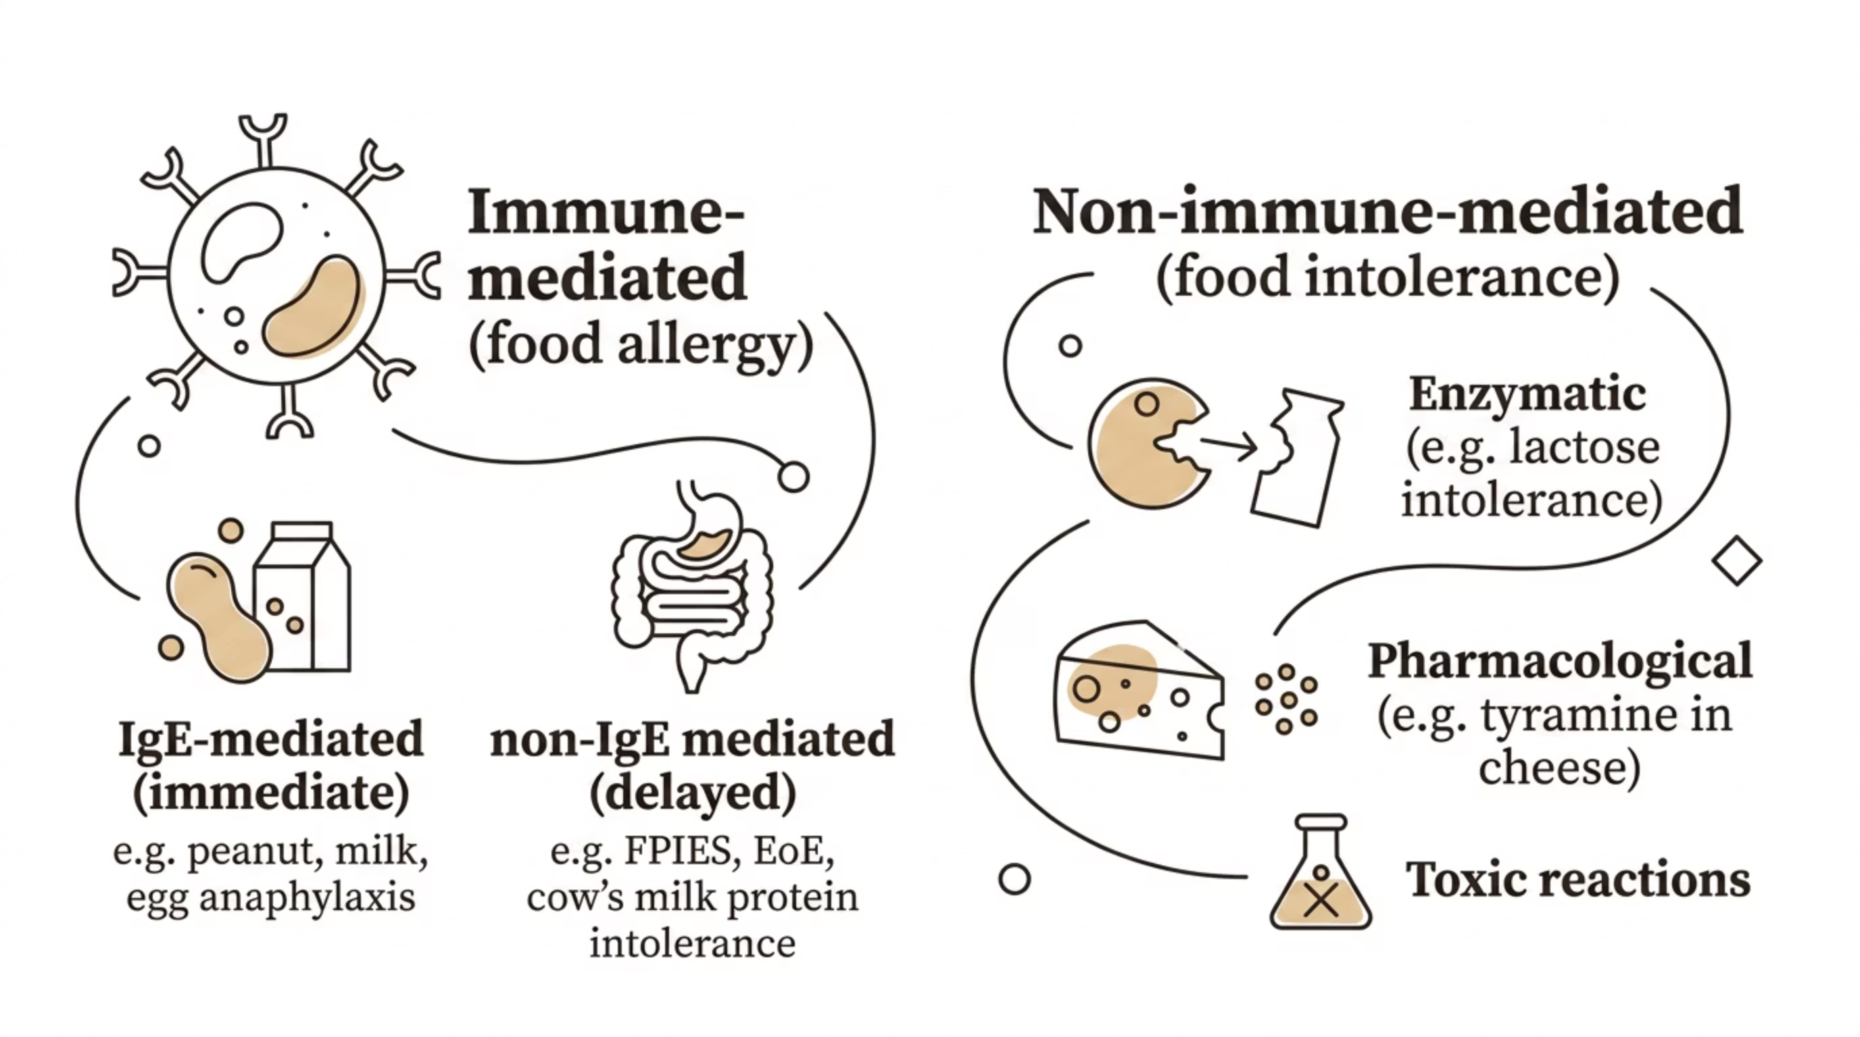

Adverse Reactions to Foods – Classification
Not all adverse reactions to food are allergic. Accurate classification is essential to avoid unnecessary dietary restriction and anxiety, particularly in children.
IgE-mediated food allergy is the most clinically urgent form, presenting with immediate reactions. Non-IgE-mediated reactions are delayed (hours to days) and require different investigation and management pathways.

Slide 35




Common Food Allergens in UK Practice (P-MEN)
The UK follows the EU/UK Food Information Regulations — 14 major allergens must be declared on pre-packed food. The most clinically significant allergens in UK practice are:
Peanut
Milk from Cows
Egg
Nuts from Trees
Most common cause of fatal food anaphylaxis in the UK. Ara h 2 component predicts higher risk of severe reaction.
Commonest food allergy in infants; most outgrow by school age. Both IgE-mediated (immediate) and non-IgE-mediated forms exist.
Second most common childhood food allergy. Most children tolerate baked egg before resolving allergy to raw egg.
Walnut, cashew, almond, and others — persistence into adulthood is common. Requires clear allergen labelling awareness.

Slide 36
Oral Allergy Syndrome (OAS)
What Is OAS?
Clinical Features and Management
Oral allergy syndrome (pollen-food syndrome) is a localised IgE-mediated reaction in the oropharynx triggered by raw fruits, vegetables, or nuts that share cross-reactive proteins with pollen allergens. It is the commonest form of food-related allergic reaction in adults in the UK.
Immediate oral tingling, itching, and mild swelling of lips, tongue, and palate — resolves within minutes
Triggered by raw foods (e.g. apples, peaches, hazelnuts, kiwi, celery) — cooking usually destroys the responsible lipo-transfer proteins
Associated with birch, grass, or weed pollen sensitisation
Systemic or respiratory symptoms are unusual — if present, reassess for systemic food allergy
Management: avoidance of triggering raw foods; AAI usually NOT required for pure OAS

Slide 37
Food Allergy – Respiratory Symptoms
When Breathing Is Affected
High-Risk Features
Respiratory symptoms — wheeze, stridor, hoarseness, or laryngeal oedema — in the context of food ingestion indicate severe IgE-mediated food allergy and significantly increase the risk of a life-threatening reaction. These features should prompt urgent management.
Any food-induced reaction involving the respiratory tract warrants:
Prescription of two adrenaline auto-injectors (AAIs)
Written anaphylaxis action plan
Referral to specialist allergy services
Asthma optimisation — poorly controlled asthma significantly increases fatality risk in food anaphylaxis
Laryngeal oedema (hoarse voice, stridor) = airway emergency
Bronchospasm + food exposure = likely anaphylaxis until proven otherwise
Rhinitis and conjunctivitis during food reactions suggest but do not confirm allergy

Slide 38
Food Allergy & Urticaria
An Often Overstated Association
Food allergy is an uncommon cause of chronic urticaria. This is a critical and frequently misunderstood distinction. Many patients with chronic urticaria self-diagnose "food allergy" and undertake unnecessary dietary restriction.
Acute Urticaria
Chronic Urticaria (>6 weeks)
Can be IgE-mediated food allergy — onset within minutes of exposure, usually with other allergic features. Foods are a relevant cause; confirm by clear temporal relationship and consistent reproducibility.
Food allergy is rarely the cause. The majority of chronic urticaria/angioedema (CUA) is idiopathic (autoimmune in ~40%). Allergy testing for food is unhelpful and misleading in the absence of a specific history.
Ordering broad food IgE panels in chronic urticaria generates false positive results, causes unnecessary food avoidance, and does not improve outcomes.

Slide 39
Food Allergy – Elimination Diets
When Are Elimination Diets Appropriate?
Structured Approach
Dietary elimination should only follow appropriate specialist assessment. In primary care, empirical elimination diets — particularly in children — carry real risks of nutritional deficiency, growth impairment, and unnecessary social restriction.
Elimination should be based on a plausible history and supported by objective testing or specialist review
Cow's milk elimination in infants with non-IgE-mediated allergy: follow NICE/MAP guideline — dietitian support is recommended
Duration of elimination should be defined (typically 2–6 weeks) with clear reintroduction plan
Food challenges (if required) should be supervised by allergy specialists
Refer to NICE guideline CG116 and the iMAP/MAP guidance for cow's milk protein allergy in infants.

Slide 40

Food Anaphylaxis – Adrenaline Saves Lives
CLINICAL PRIORITY
Prompt intramuscular adrenaline is the only first-line life-saving treatment for food anaphylaxis. Delay in administration is associated with fatal and near-fatal outcomes. Every primary care clinician should be able to recognise anaphylaxis and act without hesitation.
Act Immediately
Correct Dose
Do not wait for all features to develop. If anaphylaxis is suspected, give IM adrenaline into the outer mid-thigh without delay.
Adults and children >12 years: 0.5 mg IM (500 micrograms). Child 6–12 years: 0.3 mg. Child <6 years: 0.15 mg. Use auto-injector if available.
Call 999
All cases of suspected anaphylaxis require 999 and hospital transfer, even if initial response to adrenaline is good. Biphasic reactions may occur.

Slide 41
Food Allergy Management – Overview
Comprehensive management of food allergy extends well beyond the acute reaction. The triad of avoidance, education, and emergency planning forms the cornerstone of long-term care in primary care.
Allergen Avoidance
Education
Clear written information on allergen identification in food labels (14 major allergens). Cross-contamination awareness, eating out safely, and allergen-free alternatives.
Patient and carer training: recognition of early symptoms, when and how to use AAIs, importance of wearing medical alert identification.
Emergency Action Plan
Specialist Referral
Every patient at risk of anaphylaxis should have a written, personalised anaphylaxis action plan provided at point of prescription of AAIs.
Refer to allergy services for diagnostic confirmation, immunotherapy consideration, and food challenge if appropriate. Do not manage uncertain food allergy in isolation in primary care.

Slide 42
Food Allergy – Adrenaline Auto-Injectors (AAIs)
Who Needs Two AAIs?
Indications for Two AAIs
Current BSACI and Resuscitation Council UK guidance recommends prescribing two AAIs to patients with food allergy at significant risk of anaphylaxis. Two devices are recommended because a second dose may be required if symptoms recur before emergency services arrive, or if the first device fails.
Previous anaphylaxis to food
Known peanut, tree nut, or sesame allergy with systemic reaction history
Coexisting poorly controlled asthma — a major risk factor for fatal anaphylaxis
Remote location or delayed access to emergency services
Patient/carer preference where risk is significant
Ensure training on correct technique at every prescription. Devices should be carried at all times and not stored in extreme temperatures.

Slide 43
Drug Reactions – Penicillin Allergy
Penicillin allergy is one of the most common drug allergy labels encountered in UK primary care — yet it is frequently overdiagnosed. Approximately 90% of patients labelled as penicillin-allergic are found to tolerate penicillins on formal testing. Inaccurate labels drive antimicrobial stewardship failures.
Consequences of Mislabelling
Clinical Approach
De-labelling
Unnecessary use of broader-spectrum antibiotics (e.g. clindamycin, fluoroquinolones) — increased C. diff risk, resistance, worse clinical outcomes, and higher costs.
Take a structured history: nature of reaction, timing, circumstances. Many "reactions" were side effects (GI upset, yeast infection) not allergy. Refer for allergy assessment if systemic features were present.
NHS-led de-labelling initiatives using risk stratification and direct oral challenge improve antibiotic access. Primary care plays a key role in identifying and referring suitable patients.

Slide 44
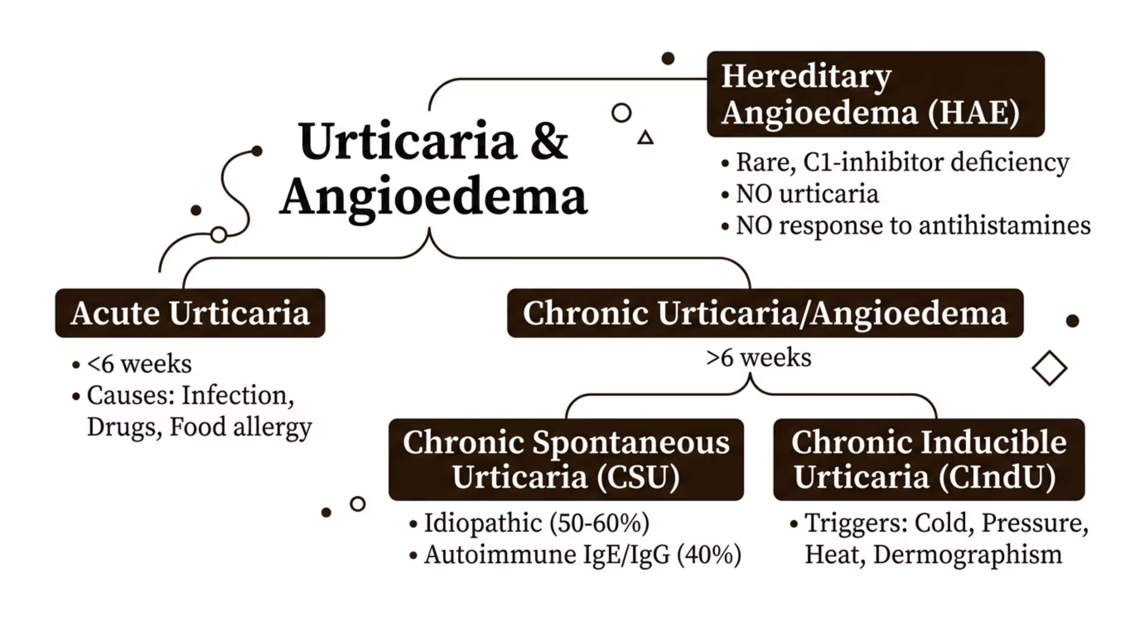
Angioedema ± Urticaria – Classification
Urticaria (wheals) and angioedema (deeper tissue swelling) may occur together or separately. Classification guides management and identifies patients at risk of anaphylaxis or hereditary angioedema.

Slide 45
Chronic Urticaria/Angioedema (CUA) – Management
Management follows the international EAACI/BSACI stepwise approach. The majority of patients with chronic spontaneous urticaria can be managed in primary care.
1
2
3
Step 1 – Non-Sedating Antihistamine (First Line)
Step 2 – Updosing (Up to 4× Licensed Dose)
Step 3 – Add Omalizumab or Refer
Licensed dose of a second-generation antihistamine (e.g. cetirizine 10mg, loratadine 10mg, bilastine 20mg). Taken daily. Avoid sedating antihistamines (chlorphenamine) for regular use.
If standard dose is insufficient after 2–4 weeks, updose the same antihistamine up to four times the licensed daily dose — supported by EAACI guidelines and BSACI guidance. Inform patient of off-label use.
If updosed antihistamine fails after 1–3 months, refer to specialist for consideration of omalizumab (anti-IgE, NICE-approved for refractory CSU) or ciclosporin. Short courses of prednisolone for severe flares only — not for maintenance.

Slide 46


Anaphylaxis – Recognition
RESUSCITATION COUNCIL UK
Anaphylaxis is a life-threatening systemic hypersensitivity reaction requiring immediate recognition and treatment. Diagnosis is clinical — do not delay treatment for investigations.
Anaphylaxis is likely when ALL THREE criteria are met: sudden onset and rapid progression; life-threatening Airway/Breathing/Circulation compromise; AND skin/mucosal changes (may be absent in ~20%).
Airway
Breathing
Stridor, hoarseness, throat tightening, difficulty swallowing, swollen tongue or lips.
Wheeze, bronchospasm, tachypnoea, hypoxia, respiratory arrest.
Circulation
Pallor, tachycardia, hypotension, dizziness, loss of consciousness, cardiac arrest.

Slide 47
Aetiology of Anaphylaxis – Common Triggers
Three Major Categories
Trigger-Specific Notes
Foods, drugs, and insect venom (Hymenoptera) account for the majority of anaphylaxis presentations in UK practice. Identifying the trigger is essential for subsequent management planning and referral.
Foods: peanut, tree nuts, sesame, fish, shellfish, milk, egg — commonest in children
Drugs: penicillins, NSAIDs, aspirin, ACE inhibitors, contrast media, biologics — commonest in adults
Insect venom: bee and wasp stings — systemic reactions warrant referral for venom immunotherapy
Latex: healthcare workers and patients with spina bifida at higher risk
Exercise: exercise-induced anaphylaxis — may be food co-factor dependent
Idiopathic: no trigger identified in up to 20% of cases

Slide 48
Aetiology of Anaphylaxis – Non-IgE Mechanisms
Not all anaphylaxis-like reactions are IgE-mediated. Non-IgE-mediated reactions can present identically to IgE-mediated anaphylaxis and require the same emergency management, but differ in mechanism and subsequent investigation.
Direct Mast Cell Activation
Complement Activation
Bradykinin-Mediated Angioedema
Some drugs (e.g. opioids, vancomycin, radiocontrast media) directly degranulate mast cells independently of IgE. Reactions are dose-dependent and reproducible. Premedication protocols can reduce risk for essential procedures.
Dextran, some biological therapies, and aggregated immunoglobulins may activate complement, generating C3a and C5a (anaphylatoxins) that cause mast cell degranulation.
ACE inhibitor-induced angioedema is bradykinin-mediated — NOT IgE or histamine-driven. Antihistamines and adrenaline are less effective; treat with icatibant or C1-inhibitor concentrate if severe.

Slide 49
Non-Allergic Reactions – Differential Diagnosis
Several conditions may mimic anaphylaxis or allergic reactions. Accurate diagnosis prevents both under-treatment of genuine emergencies and over-treatment of benign conditions.
Vasovagal Syncope
Panic Attack / Anxiety
Common post-injection or needle-related. Pallor, bradycardia, brief LOC — no urticaria, wheeze, or angioedema. Supine position restores consciousness rapidly. No adrenaline required.
Hyperventilation, chest tightness, perioral tingling — can closely resemble allergy. Normal oxygen saturations, no wheeze, no urticaria. May coexist with genuine allergy in high-anxiety patients.
Hereditary Angioedema (HAE)
Scombroid / Histamine Poisoning
Recurrent angioedema WITHOUT urticaria. C1-inhibitor deficiency — adrenaline and antihistamines are ineffective. Check C4 levels (low in 95%). Refer urgently.
From spoiled fish (tuna, mackerel). Mimics allergy with flushing, urticaria, headache. Responds to antihistamines. Not a true allergy — fish can be safely eaten again.

Slide 50

Anaphylaxis Management – Adrenaline First
RESUSCITATION COUNCIL UK 2021
IM Adrenaline — First-Line, Always
Dosing (IM, Outer Mid-Thigh)
Intramuscular adrenaline (epinephrine) is the ONLY first-line treatment for anaphylaxis. It must be given immediately, without delay, to the outer mid-thigh. It reverses bronchospasm, vasodilation, and angioedema simultaneously.
Adults and children >12 years: 500 micrograms (0.5 mg) — 0.5 mL of 1:1000
Children 6–12 years: 300 micrograms (0.3 mg)
Children 6 months–6 years: 150 micrograms (0.15 mg)
Infants <6 months: seek specialist/PICU guidance
Repeat after 5–15 minutes if no improvement
IV adrenaline carries high risk of fatal arrhythmia if given inappropriately. IM is safe and effective in most settings.

Slide 51
Anaphylaxis – The Role of Steroids and Antihistamines
Steroids — NOT First-Line
Antihistamines — Secondary Only
Hydrocortisone and other steroids have historically been used in anaphylaxis management, but are now confirmed as NOT first-line emergency treatment. Evidence for their effect on biphasic reactions is weak and inconsistent. They have a slow onset (hours) and should not delay or replace adrenaline administration.
Chlorphenamine (and cetirizine) relieve urticaria and pruritus but have no effect on life-threatening features (bronchospasm, hypotension, angioedema). They are an adjunct after adrenaline and stabilisation — never a substitute. Current Resus Council guidance de-emphasises their routine use in the acute phase.
Giving steroids instead of — or before — adrenaline is a dangerous error. Adrenaline must always come first.

Slide 52

Anaphylaxis – Immediate Actions
EMERGENCY PROTOCOL
Remove trigger
Give IM adrenaline
Position patient
Call 999
High-flow O₂
Positioning is critical: lay the patient flat with legs raised to maintain venous return. If there is breathing difficulty, allow sitting. Never stand a patient with hypotension — this can cause cardiac arrest. High-flow oxygen (10–15 L/min via non-rebreathe mask) should be given alongside adrenaline.

Slide 53
Anaphylaxis – Follow-Up and Education
Surviving an anaphylaxis episode does not end the clinician's responsibility. Comprehensive follow-up and education are essential components of safe long-term management.
AAI Prescription and Training
Written Action Plan
Prescribe two AAIs before discharge from emergency care. Ensure patient and carers receive hands-on training. Review at every GP contact. AAIs should be prescribed in pairs — one to use, one as backup.
Every patient should leave with a personalised written anaphylaxis action plan detailing triggers, early warning signs, and a step-by-step response guide including when to use AAI and when to call 999.
Specialist Allergy Referral
Medical Alert Identification
All patients who have had anaphylaxis should be referred to a specialist allergy service for trigger identification, serum tryptase interpretation, venom immunotherapy assessment, and long-term management planning.
Recommend MedicAlert bracelet or equivalent. Register allergy clearly on the patient's GP record. Brief emergency contacts and school/workplace where appropriate.

Slide 54
Theoretical Basis for Immunotherapy
Mechanism of Immune Modification
Immunological Changes Induced
Allergen immunotherapy (AIT) works by reprogramming the allergic immune response through repeated, escalating exposure to allergen. It is the only treatment that modifies the underlying disease rather than suppressing symptoms.
Shift from Th2 to Th1/Treg-dominant responses
Induction of blocking antibodies (IgG4) that compete with IgE for allergen binding
Suppression of mast cell and basophil reactivity
Increased allergen-specific IL-10 and TGF-β production by Tregs
Reduction in late-phase tissue eosinophilia
These immune changes can persist for years after completing a course of AIT — true disease modification, not just symptom suppression.

Slide 55
Immunotherapy – Does It Work? Venom
Venom Immunotherapy (VIT) – Highly Effective
Primary Care Role
VIT for bee and wasp venom anaphylaxis is one of the most evidence-based and effective interventions in allergy medicine. It reduces the risk of systemic reaction on subsequent sting from approximately 60% to <5%.
GPs play a key role in identifying eligible patients after wasp or bee sting anaphylaxis and making timely referrals. Patients with systemic reactions should receive AAIs pending specialist assessment and VIT initiation. Do not delay referral — venom allergy carries real fatality risk.
Indication: systemic allergic reaction to bee or wasp sting + positive venom sIgE or SPT
Duration: typically 3–5 years; protection may persist long-term
NICE-recommended: refer all eligible patients to specialist allergy services
Exceptional impact on quality of life — enabling outdoor activities safely

Slide 56

Immunotherapy – Does It Work? Grass Pollen
Grass pollen subcutaneous immunotherapy (SCIT) and sublingual immunotherapy (SLIT) have strong clinical trial evidence for moderate-to-severe allergic rhinoconjunctivitis.
Clinical Outcomes
Evidence Base
Significant reduction in rhinitis and conjunctivitis symptom scores, reduced rescue medication use, and improved quality of life compared with pharmacotherapy alone. Benefits may persist 3–4 years post-treatment.
NICE IPG 585 supports the use of SLIT grass pollen tablets (Grazax, Itulazax) for adults with moderate-to-severe grass pollen rhinitis inadequately controlled by antihistamines and nasal steroids.
Duration
A minimum of 3 years is recommended for sustained benefit. Treatment should ideally start 4 months before pollen season. Refer to regional allergy or ENT services for assessment.

Slide 57
Sublingual Immunotherapy (SLIT)
What Is SLIT?
Current UK Position
SLIT delivers allergen as tablets or drops placed under the tongue, inducing tolerance via oral mucosal dendritic cells and regulatory T-cells. It is safer than subcutaneous immunotherapy (no adrenaline on-site required) and can be self-administered at home after the first dose under medical supervision.
Grass pollen SLIT tablets (Grazax, Itulazax): NICE-approved (IPG 585) — well established
House dust mite SLIT: licensed products available (Acarizax) — growing evidence base for rhinitis and asthma
Peanut OIT (Palforzia): oral immunotherapy for children 4–17 years — MHRA-approved, specialist use
Primary care role: identify suitable candidates, initiate referral, and support adherence during treatment

Slide 58
Anti-IgE and Biologic Therapies
Biologics targeting specific pathways in IgE-mediated and type 2 inflammatory disease have transformed the management of severe allergic conditions. These are now mainstream specialist therapies with clear NICE-approved indications.
Omalizumab (Anti-IgE)
Dupilumab (Anti-IL-4Rα)
Binds free IgE, reducing mast cell and basophil activation. NICE-approved for: severe persistent allergic asthma (TA278), chronic spontaneous urticaria (TA339), and severe allergic rhinitis (selected patients). Subcutaneous injection every 2–4 weeks.
Blocks both IL-4 and IL-13 signalling. NICE-approved for severe atopic eczema (TA534), severe asthma (TA751), and eosinophilic oesophagitis. Rapidly becoming a cornerstone of severe atopic disease management.
Anti-IL-5 Agents
Tezepelumab (Anti-TSLP)
Mepolizumab, benralizumab, reslizumab — NICE-approved for severe eosinophilic asthma. Dramatically reduce exacerbation rates and oral steroid burden in eligible patients.
Targets the upstream epithelial alarmin TSLP. NICE-approved (TA872) for severe uncontrolled asthma regardless of eosinophil count — broadest biologic indication to date.

Slide 59
Issues for Discussion
Key Questions for UK Primary Care
The following case scenarios and clinical questions are worth considering in the context of this module. They reflect real-world challenges in UK primary care allergy management.
Who Needs Referral?
Who Needs Testing?
Who Needs AAIs?
When should a GP refer to specialist allergy services? Indications include: anaphylaxis of any cause, uncertain diagnosis, need for oral food challenge, venom or inhalant immunotherapy assessment, or complex multiple allergy.
Testing should only be requested when the result will change management. Avoid broad allergy panels without a clear clinical question. Discuss indications for SPT vs. sIgE with local allergy services.
Prescribe AAIs for patients at significant risk of anaphylaxis — previous anaphylaxis, high-risk food/venom allergy with systemic features, or coexisting poorly controlled asthma. Always prescribe two devices with written action plan and training.

Slide 60
Disclaimer
This resource is for educational use by healthcare professionals only. It does not constitute clinical advice for individual patient management.
Guidance Evolves
Use Authoritative Sources
Clinical Judgement
Clinical guidance changes over time. The information in this module reflects general principles aligned with NICE, BNF, BSACI, and Resuscitation Council UK at the time of preparation. Always check the most current published guidance before applying recommendations in clinical practice.
Always consult NICE (nice.org.uk), the BNF (bnf.nice.org.uk), BSACI (bsaci.org), and your local clinical pathways for up-to-date, context-specific guidance. Resuscitation Council UK (resus.org.uk) remains the definitive source for anaphylaxis management protocols.
All clinical decisions must integrate individual patient circumstances, preferences, comorbidities, and local resources. Clinical judgement remains paramount in every patient encounter.
Developed for UK primary care education. Please direct feedback to your local allergy or education lead.

