Slide 1






BRADFORD VTS TEACHING DECK
Breast Problems in
Primary Care
A comprehensive guide to clinical management, referral pathways, and exam preparation for GP trainees.
AKT High-Yield
SCA Consultation Skills
NICE NG12 Pathways
PRIMARY CARE EDUCATION SERIES • 2026

Slide 2










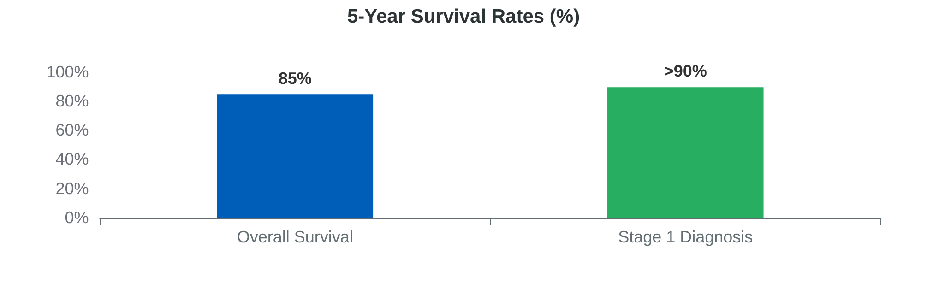

Epidemiology and Significance
CONSULTATION BURDEN & CORE UK STATISTICS
55,000
1 in 7
NEW ANNUAL DIAGNOSES
LIFETIME RISK (UK)
Primary Care Workload
30 consultations per 1,000 patients per year.
High anxiety presentations for patients (fear of cancer).
11,500
62
ANNUAL DEATHS (ENGLAND)
AVERAGE AGE AT DIAGNOSIS
High clinical risk for GPs: missing cancer has serious consequences.
Commonest cancer in UK women.
Bradford VTS - Breast Problems in Primary Care
Page 2

Slide 3

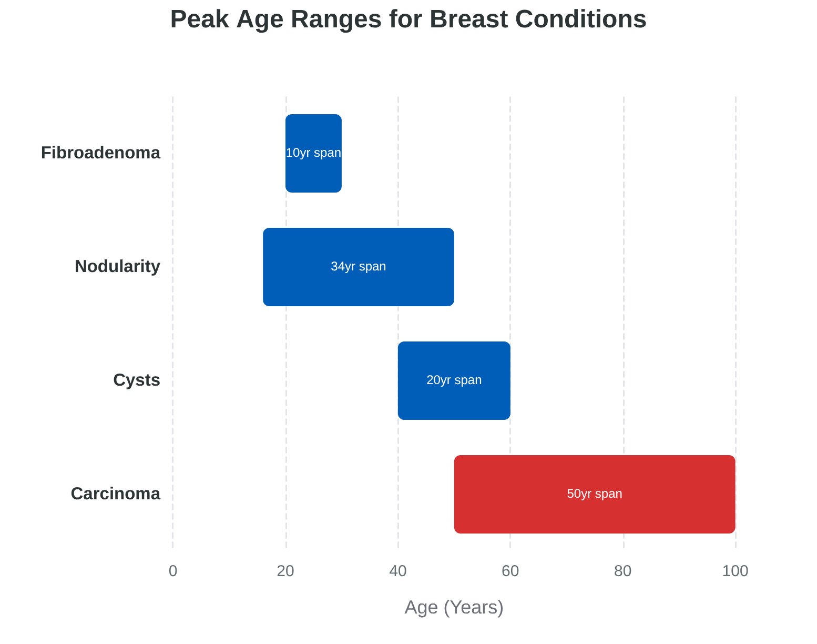




Age-Related Breast Conditions
DISTRIBUTION OF COMMON CONDITIONS BY AGE
Common Benign Presentations
Fibroadenoma: Most common in young women (20–30 years).
Diffuse Nodularity: Cyclical hormonal changes (16–50 years).
Breast Cysts: Most frequent peri-menopausally (40–60 years).
Malignant Presentations
Carcinoma: Incidence increases significantly after 50; rare before 40.
Key Stat: Average age at diagnosis in the UK is 62 years.

Slide 4











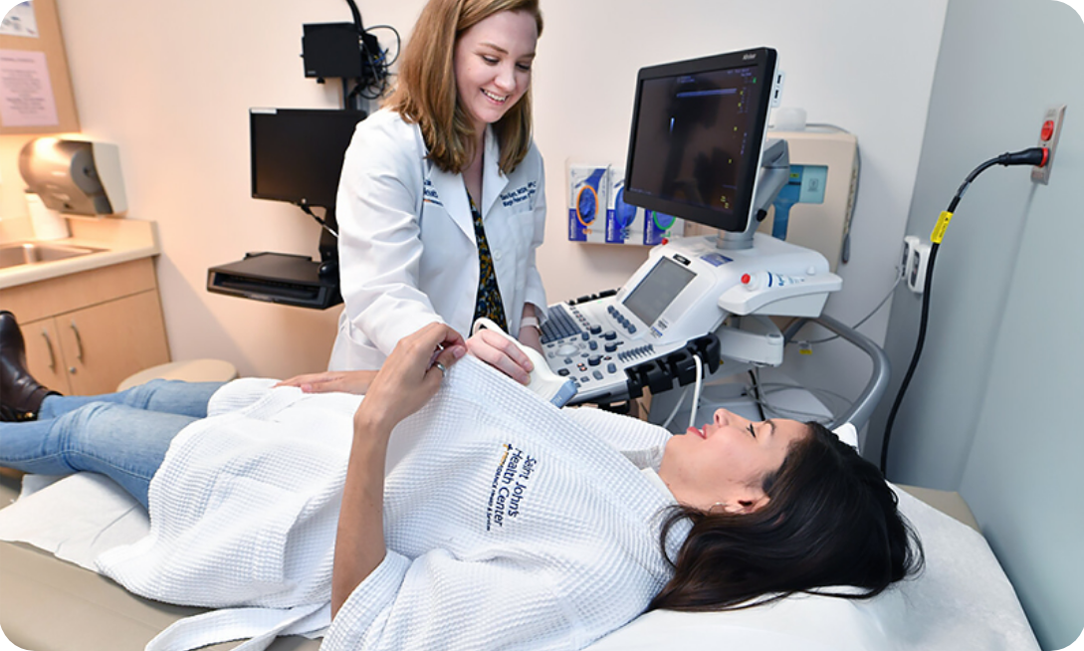


Breast Lump Assessment: Triple Assessment
UNDERSTANDING THE SECONDARY CARE GOLD STANDARD FOR CLINICAL DIAGNOSIS
1. Clinical Exam
2. Imaging
3. Histology
The diagnostic starting point for all primary care referrals.
Mammography: Preferred for women >35 years.
FNAC: Fine Needle Aspiration Cytology (cellular assessment).
Bilateral examination including axillary lymph nodes.
Ultrasound: Preferred for women <35 years (denser breast tissue).
Core Biopsy: Provides tissue architecture (gold standard).
Assessment of size, consistency, mobility, and skin/nipple changes.
Identifies non-palpable lesions and characterizes masses.
Essential to confirm malignancy or confirm a benign diagnosis.
Helps determine the urgency and pathway of referral.
Allows for receptor testing in malignant cases (ER/PR/HER2).
Always document if a chaperone was offered and present.
GP Focus: Triple assessment is performed in secondary care, but GPs must understand the workflow to explain it to patients and address anxiety.

Slide 5














Clinical Examination Findings and Actions
ASSESSMENT & MANAGEMENT PATHWAYS
Normal Findings
Asymmetrical Nodularity
Discrete Lump
Presentation:
Age/History Check:
Presentation:
Symmetrical diffuse nodularity
Age <35 & No Family History
New palpable discrete lump
No palpable discrete lump
Age >35 OR Positive Family History
Any age, regardless of pain
ACTION:
ACTION:
ACTION:
Reassure patient. This is normal physiology, often premenstrual. Reassess if changes occur.
<35: Reassess at 6 weeks (post-cycle). Refer if persistent.
REFER ALWAYS. Do not reassure without triple assessment. All new discrete lumps need referral.
>35/FH: Refer for specialist assessment.
AKT/SCA Tip: Never reassure a patient with a discrete lump based on young age or absence of pain. Fibroadenomas cannot be safely distinguished from Phyllodes or cancer by palpation alone.

Slide 6













NICE NG12 Urgent 2-Week Wait Referrals
SUSPECTED BREAST CANCER REFERRAL CRITERIA (UPDATED 2023)
Palpable Lumps
Skin & Nipple Changes
Inflammatory Signs
Aged ≥ 30: Any unexplained breast lump, with or without pain.
Skin: Dimpling, tethering, or Peau d'orange (suggests lymphoedema/cancer).
Inflammatory Breast Cancer: Presents as a red, hot, swollen breast.
Aged < 30: Any unexplained breast lump (consider 2WW depending on clinical suspicion/local pathway).
Aged ≥ 50: New nipple retraction or distortion.
Critical Rule: If signs do not respond to antibiotics within 48–72 hours, refer urgently via 2WW.
Aged ≥ 50: Unilateral nipple discharge (especially if bloodstained or persistent).
Axilla: Any unexplained lump in the axilla in patients aged ≥ 30.
GP Tip: Do not let the presence of pain or "infection" symptoms delay a cancer referral if there is no rapid response to treatment.

Slide 7





Routine Referrals and Family History
CRITERIA FOR NON-URGENT REFERRALS AND IDENTIFYING HIGH-RISK FAMILY HISTORY PATTERNS THAT REQUIRE THE CANCER GENETICS SERVICE.
Routine Referral Criteria
Cancer Genetics Referrals
Asymmetrical nodularity (<35): Reassess at 6 weeks (different cycle phase). Refer if it persists or worsens.
NICE NG151 Criteria: Refer for genetic counseling if patient meets significant family history thresholds.
Breast Pain: Refer if examination or history suggests a structural cause (unilateral, localized, persistent).
High Risk Patterns: ≥2 first or second-degree relatives with breast cancer (especially if diagnosed <50 yrs).
Nipple Abnormality (<50): Non-urgent referral if there is concern (e.g., distortion or retraction without a palpable mass).
Specific Red Flags: Male breast cancer in a relative or a known BRCA1/BRCA2 mutation carrier in the family.
SCA CONSULTATION TIP: Always document that family history was explored during every breast consultation. Do not reassure a patient with "benign findings" until you have ruled out high-risk familial patterns requiring specialized genetic screening.

Slide 8







Breast Pain: Assessment and Categorisation
HISTORY & THE PAIN CALENDAR
Cyclical Mastalgia
Non-Cyclical Mastalgia
Timing: Peaks during the luteal phase (week before period); resolves after menstruation.
Timing: Constant or random; no relationship to the menstrual cycle.
Location: Frequently unilateral and localized to one specific area.
Location: Usually bilateral and diffuse; often worst in upper outer quadrants.
Demographics: More common in postmenopausal women; exclude structural causes.
Demographics: Most common in premenopausal women (hormone-driven).
The "Essential" Pain Calendar
AKT & SCA HIGH-YIELD
Ask the patient to record pain daily for 2 to 3 full menstrual cycles. This simple tool instantly distinguishes cyclical patterns, avoids unnecessary drugs, and is a medico-legal gold standard before referral or prescribing hormonal treatments.

Slide 9

















Management Ladder for Cyclical Mastalgia
A STEPWISE CLINICAL APPROACH FOR PRIMARY CARE
STEP 1: FIRST LINE
STEP 2: MODIFICATION
STEP 3: PHARMACOLOGICAL
STEP 4: ESCALATION
Conservative
Supplements
Specialist Meds
Referral
Reassurance of benign nature (essential first step)
Review OCP: Consider POP or lower-dose oestrogen
Danazol:100-300mg daily (Licensed)Acne, weight gain, hirsutism
Refer if severe symptoms persist after trial of two options
Well-fitting supportive bra (especially during exercise)
Evening Primrose Oil:Gamolenic acid40mg, 6-8 caps daily
Refer if diagnostic uncertainty persists
Topical NSAIDs:Ibuprofen gel/Diclofenac gel
Bromocriptine:Titrate slowlyNausea, postural hypotension
Trial for 4 months before assessing efficacy
AKT/SCA Pearl: Use a pain calendar for 2 cycles before escalating to Step 3. This confirms the cyclical pattern and provides objective evidence of severity. Note that Danazol, while effective, is often poorly tolerated due to androgenic side effects.

Slide 10











Management of Non-Cyclical Mastalgia
CLINICAL APPROACH TO NON-CYCLICAL PAIN, FOCUSING ON EXCLUDING STRUCTURAL CAUSES AND USING TOPICAL NSAIDS FOR LOCALIZED SYMPTOMS.
Clinical Assessment
Severe or Diffuse Pain
Identify pattern: Pain is unrelated to menstrual cycle; common postmenopausally.
Oral NSAIDs: Consider systemic analgesia if topical treatment is insufficient.
Second-line options: Gamolenic acid, Danazol, or Bromocriptine for refractory cases.
Exclude musculoskeletal causes: Check for Tietze’s syndrome or chest wall pain.
Note side effects: Danazol can cause acne, weight gain, and hirsutism.
Perform full clinical exam: Crucial to rule out underlying structural masses.
When to Refer
Severe Localised Pain: Refer to exclude focal pathology or structural cause.
Mild/Moderate Management
Unresponsive Symptoms: Referral if persistent despite trial of two treatment options.
Reassurance: Explain the benign nature once malignancy is excluded.
Topical NSAIDs: Use Ibuprofen gel first-line for localized pain relief.
Reassess: Review the patient's symptoms after a trial period of 2-3 months.
Always document the presence/absence of a lump before mastalgia management.
SCA Consultation Tip
Use a pain calendar for 2 months. It provides objective evidence to differentiate cyclical from non-cyclical pain, which is vital for AKT knowledge and SCA clinical reasoning.

Slide 11











Nipple Discharge Assessment
CLINICAL EVALUATION BASED ON THE NUMBER OF DUCTS INVOLVED, CHARACTER OF DISCHARGE, AND PATIENT AGE.
PRIORITY 1: Always examine for a lump first. If a lump is present, the patient MUST BE REFERRED immediately via the appropriate pathway, regardless of the discharge characteristics.
Source & Laterality
Discharge Character
Age & Systemic
Number of DuctsSingle duct discharge is more concerning for local pathology (e.g., intraductal papilloma or cancer).
BloodstainedHigh suspicion for malignancy or papilloma. URGENT ACTION
The Age 50 ThresholdAny nipple discharge in women ≥50 is a trigger for referral.
Serous / ClearOften benign but requires investigation if persistent or in older patients.
GalactorrhoeaBilateral milky discharge. Check Prolactin and TFTs. Consider drug-induced causes (e.g., Metoclopramide).
LateralityUnilateral discharge suggests localized breast disease. Bilateral discharge is more likely physiological or systemic.
Coloured (Green/Brown)Typical of duct ectasia; usually benign.
AKT High-Yield Fact: While duct ectasia often produces multicoloured (green/yellow/black) discharge from multiple ducts, always test serous discharge for occult blood. NICE NG12: Unilateral nipple discharge in women ≥50 is an urgent 2WW referral.

Slide 12







Nipple Discharge Management by Age
REFERRAL THRESHOLDS & CLINICAL DECISION MAKING
Women Aged ≥ 50
Women < 50: High-Risk Features
Single Duct: Refer if bloodstained, persistent, or large volume.
Universal Referral Rule:
Multiple Ducts: Refer if bloodstained or serous +ve for blood.
ALL nipple discharge in women over 50 requires specialist referral.
Persistent Discharge: Even if non-bloody, if it impacts quality of life.
Urgent 2WW: Unilateral nipple discharge that is bloodstained or persistent.
High suspicion of underlying pathology (DCIS or malignancy) in this age bracket.
Women < 50: Low-Risk Features
Coloured/Clear: Often physiological or duct ectasia.
Drug Review: Check for Metoclopramide, Antipsychotics, or OCP.
Management: Reassure if small volume and multi-duct.
THE GOLDEN RULE: If a PALPABLE LUMP is present with discharge, refer URGENTLY (2WW) regardless of age or discharge type.

Slide 13




















Galactorrhoea and Drug Causes
INVESTIGATING BILATERAL MILKY DISCHARGE & COMMON DOPAMINE ANTAGONISTS
Clinical Assessment
Common Drug Causes
Presentation: Bilateral milky discharge; usually multi-duct and non-spontaneous (expressible).
ANTIEMETICS
Metoclopramide and Domperidone.
Red Flags: Check for visual field defects (pituitary adenoma) or headache.
ANTIPSYCHOTICS
Physical: Ensure no palpable masses are present (lump + discharge = urgent referral).
Risperidone, Haloperidol, Phenothiazines.
ANTIHYPERTENSIVES
Essential Investigations:
Methyldopa (central action), Verapamil.
Serum Prolactin: Primary test for hyperprolactinaemia.
OTHERS
TFTs: Primary hypothyroidism can lead to TRH-induced prolactin rise.
Opiates, SSRIs, Cimetidine, Combined OCP.
U&Es: Chronic renal failure reduces prolactin clearance.
The Mechanism
AKT High-Yield Fact
Dopamine (from the hypothalamus) acts as the Prolactin-Inhibiting Factor. Drugs that are Dopamine Antagonists block this inhibition, causing the pituitary to secrete excess prolactin, leading to galactorrhoea and potential amenorrhoea.
Pregnancy is the most common physiological cause of galactorrhoea. Always perform a β-hCG test before embarking on extensive endocrine work-ups.

Slide 14











Breast Cancer Risk Factors
ANALYSIS OF NON-MODIFIABLE RISKS LIKE AGE AND GENETICS ALONGSIDE HORMONAL AND LIFESTYLE FACTORS SUCH AS OBESITY AND HRT USE.
Biological & Genetic
Hormonal Drivers
Lifestyle & History
Age & Sex
Estrogen Exposure
Obesity & Inactivity
Female sex (99:1 ratio). Risk increases significantly with age; average diagnosis is 62.
Early menarche (<12) and late menopause (>55) increase lifetime exposure.
Postmenopausal obesity is a major driver due to peripheral estrogen conversion.
Family History
Reproductive History
Alcohol Consumption
BRCA1/BRCA2 mutations account for 5–10% of cases. Lifetime risk up to 85%.
Nulliparity or late first pregnancy (>30 years) increases baseline risk.
Dose-dependent risk increase across all types of alcohol.
Dense Breast Tissue
Exogenous Hormones
Previous Pathology
Higher radiological density correlates with increased risk and lower screening sensitivity.
HRT (Combined >5 years) and OCP (slight transient increase while using).
Personal history of breast cancer or atypical ductal hyperplasia (ADH).
AKT: Lifetime risk for UK women is 1 in 7.
HRT users still follow routine screening intervals.
SCA: Always document a full Family History (FH).

Slide 15











Protective Factors Against Breast Cancer
EVIDENCE-BASED FACTORS THAT REDUCE RISK, INCLUDING BREASTFEEDING DURATION, REGULAR PHYSICAL EXERCISE, AND MAINTAINING A HEALTHY BODY WEIGHT.
Breastfeeding
Physical Exercise
Healthy Weight
Protective effect is duration-dependent.
Aim for 150+ minutes of moderate intensity activity per week.
Critical in postmenopausal women.
Every 12 months of breastfeeding reduces relative risk by 4.3%.
Adipose tissue is the primary source of oestrogen after menopause.
Reduces risk of postmenopausal breast cancer by up to 20%.
Potential mechanism: Delayed ovulation and differentiation of breast cells.
Aim for BMI 18.5–24.9; obesity significantly increases risk post-menopause.
Regular exercise lowers circulating levels of insulin and oestrogen.
SCA Consultation Pearl: Health Promotion
When a patient presents with a benign breast concern, use the opportunity for Primary Care health promotion. Frame it positively: "While your examination today is normal, many women ask what they can do to keep their breasts healthy. Maintaining a healthy weight and regular activity are the two biggest things you can control to reduce your long-term risk."

Slide 16









BRCA1 and BRCA2 Genetic Mutations
STATISTICS ON LIFETIME RISK FOR CARRIERS AND THE IMPACT OF PROPHYLACTIC MEASURES LIKE SURGERY OR TAMOXIFEN ON RISK REDUCTION.
Prevalence & Context (AKT Focus)
Prophylactic Surgery
Responsible for approx. 5–10% of all breast cancers.
Bilateral mastectomy reduces risk by~90%.
Strongest known genetic link for breast and ovarian cancer.
Prophylactic oophorectomy reduces risk by~50%.
Inherited in an autosomal dominant pattern.
Also drastically reduces risk of ovarian cancer.
Lifetime Risk Statistics
Medical Risk Reduction
Up to85% lifetime riskfor carriers.
Chemoprevention (Tamoxifen/Raloxifene) reduces risk by~50%.
Offers a non-surgical alternative for high-risk patients.
Risk varies significantly by specific mutation and family history.
Recommended based on individual risk assessment.
Significantly higher risk of early-onset disease (<40 years).
Primary Care Action: Referral to Cancer Genetics Service
Refer according to NICE NG151 criteria (usually ≥2 first/second-degree relatives with breast cancer, or known BRCA carrier). Always refer new symptoms in known carriers as Urgent 2WW.

Slide 17









NHS Breast Screening Programme
CURRENT ENGLAND GUIDELINES FOR 3-YEARLY MAMMOGRAPHY IN WOMEN AGED 50-71 AND THE IMPACT OF SCREENING ON MORTALITY.
Eligibility & Frequency
Impact on Mortality
~1,300 Lives Saved
Offered to all women aged 50 to 71 in England.
Screening interval: Every 3 years.
Estimated number of breast cancer deaths prevented annually in England through the screening programme.
Age-extension: Rolling out to cover ages 47 to 73 in many areas.
Reduces the risk of dying from breast cancer by ~20%.
The Procedure
AKT / SCA PEARL
HRT & Specific Situations
Standard method: 2-view mammography of each breast.
Aimed at detecting small, non-palpable cancers early.
HRT: Does NOT require additional mammograms. Patients should continue routine 3-yearly screening.
Women over 71 can self-refer every 3 years.

Slide 18
















Inflammatory Breast Cancer
RECOGNISING THE AGGRESSIVE PRESENTATION & MANAGEMENT RULE
Clinical Presentation
The "48-72 Hour" Rule
Rapid Onset: Symptoms develop over days or weeks.
Clinical approach to suspected mastitis:
Prescribe Flucloxacillin 500mg QDS (10 days).
Diffuse Changes: Red, hot, swollen breast; often painful.
Mandatory review in 48–72 hours.
Peau d'orange: Skin dimpling/pitting (resembles orange peel).
If no improvement, do not repeat antibiotics.
Nipple Change: Sudden retraction, inversion, or crusting.
URGENT 2WW REFERRAL REQUIRED
AKT High-Yield Pearl
Common Pitfall
Inflammatory cancer accounts for 1-5% of cases but has a high mortality rate. Peau d'orange is caused by lymphovascular invasion of the dermal lymphatics.
Reassuring postmenopausal or non-lactating women that a red breast is "just mastitis" for weeks. Inflammatory cancer is the top differential in this cohort.
SCA Tip: Explain to the patient: "I'm giving you antibiotics for a possible infection, but we must see you back in 2 days to ensure it's clearing, as we need to rule out more serious causes if it doesn't."

Slide 19


















Mastitis and Breast Abscess
MANAGEMENT OF POSTPARTUM INFECTIONS & SUSPECTED ABSCESSES
Mastitis Management
Breast Abscess
Antibiotics: Flucloxacillin 500mg QDS for 10 days (first line).
Clinical Signs: Localised collection of pus; skin may be fluctuant or pointing.
Symptom Relief: Oral Ibuprofen/Paracetamol; warm compresses before feeding.
Diagnosis: Clinical suspicion confirmed by Ultrasound (USS) scan.
SCA Tip: Address maternal anxiety; infection doesn't mean breastfeeding must stop.
Intervention: Ultrasound-guided drainage (aspiration) + targeted antibiotics.
Referral: Urgent referral to breast clinic for drainage if postpartum abscess suspected.
Crucial Advice
Continue Breastfeeding: Essential to clear the milk duct and resolve infection.
Technique: Feed from the affected side first or express frequently to avoid stasis.
Critical Safety Netting: The 48-72 Hour Rule
Review all mastitis patients within 48–72 hours. If no improvement, arrange an urgent USS to exclude an abscess. AKT Pearl: Inflammatory breast cancer can mimic mastitis—never reassure if symptoms persist.

Slide 20



















Red Flags Summary
HIGH-RISK SYMPTOMS REQUIRING IMMEDIATE URGENT REFERRAL
New Discrete Lump
Skin Changes
Nipple Discharge
Any unexplained breast lump in a patient aged 30 or over, with or without pain.
Peau d'orange, skin dimpling, tethering, or localized thickening of the breast tissue.
Spontaneous bloodstained or persistent single-duct discharge in any patient.
URGENT 2WW REFERRAL
URGENT 2WW REFERRAL
URGENT 2WW REFERRAL
Postmenopausal Lump
Inflammatory Signs
Nipple Retraction
Any new lump in a postmenopausal woman; high risk of malignancy in this cohort.
Red, hot, swollen breast mimicking mastitis but not responding to antibiotics.
New-onset nipple retraction, distortion, or inversion that is persistent.
URGENT 2WW REFERRAL
RULE OUT INFLAMMATORY CANCER
URGENT 2WW REFERRAL (AGE ≥50)
Axillary Mass
Antibiotic Failure
High-Risk History
Unexplained lymphadenopathy in the axilla when associated with any breast symptom.
Failure to improve within 48-72 hours of starting treatment for suspected infection.
Known BRCA1/2 carriers or high-risk family history presenting with any new symptom.
URGENT 2WW REFERRAL
SAFETY NET TRIGGER
GENETICS/CANCER REVIEW
Clinical Pearl: If in doubt, do not wait. The presence of pain does not exclude malignancy. Document your 2WW referral discussion and clinical justification clearly in the patient record.

Slide 21



















Top Tips for Primary Care
PRACTICAL ADVICE ON USING PAIN CALENDARS, FAMILY HISTORY, AND PERSISTENT LUMPS
Pain Does Not Exclude Cancer
The "Non-Resolving" Red Breast
Ask Family History Every Time
Don't let the pain story stop you from referring a lump. While cancer is often painless, pain is neither reassuring nor diagnostic.
A new breast symptom is an opportunity to re-screen for high-risk genes. Identify relatives with breast/ovarian cancer early.
Inflammatory breast cancer is aggressive and mimics mastitis. If a red, swollen breast doesn't improve with antibiotics in 48-72 hours, it is cancer until proven otherwise.
If there is a discrete lump, follow the referral pathway regardless of pain.
Use NICE NG151 criteria for Genetics Service referrals.
Urgent 2WW referral required.
Prescribe a Mastalgia Calendar
Systemic Exam & Documentation
Before making management decisions for breast pain, ask the patient to record symptoms for 2 full menstrual cycles.
Always examine both breasts and the axilla. A systemic approach is essential for both clinical safety and medico-legal protection.
Instantly distinguishes cyclical vs. non-cyclical patterns.
Document: Chaperone, FH, both breasts, lymph nodes, and safety-netting.

Slide 22










Common Pitfalls in Practice
AVOIDING DIAGNOSTIC ERRORS & CLINICAL OVERSIGHTS
Pitfall 1: The "Young Age" Bias
Pitfall 4: Missing Inflammatory Cancer
Reassuring a young woman with a breast lump because "it's likely a fibroadenoma." Clinical Truth: Fibroadenomas cannot be distinguished from Phyllodes tumours or cancer without Triple Assessment. Refer all discrete lumps.
Treating a red, swollen breast as "mastitis" for multiple courses of antibiotics without review. Clinical Truth: If there is no improvement within 48-72 hours of starting antibiotics, refer urgently via 2WW pathway. Inflammatory cancer mimics infection.
Pitfall 2: Misattributing Discharge
Assuming nipple discharge is purely a side effect of Prolactin-raising drugs (e.g., antipsychotics). Clinical Truth: Always examine for a lump first. Lump + Discharge = Urgent Referral, regardless of medication history.
Pitfall 5: "Pain = No Cancer" Myth
Dismissing a patient's concern because their breast lump is painful. Clinical Truth: While most breast cancers are painless, pain does not exclude malignancy. Pain is neither diagnostic nor reassuring. If a lump is present, the pain story is secondary to the need for referral.
Pitfall 3: Poor Documentation
Failing to record the specifics of the referral discussion. Best Practice: Explicitly document the referral urgency (2WW), the clinical rationale, the patient's understanding of risk, and their informed choice.

Slide 23







AKT High-Yield Exam Pearls
ESSENTIAL STATISTICS AND NICE CRITERIA FREQUENTLY TESTED IN THE AKT
Vital AKT Statistics
Urgent 2WW Criteria
Lifetime Risk: 1 in 7 UK women (updated figure).
Lump: Any unexplained lump in patients ≥30 years.
Incidence: ~55,000 new cases/year; commonest UK cancer.
Skin: Peau d'orange, dimpling, tethering or retraction.
Screening: Aged 50–71, every 3 years (England).
Nipple: New discharge, retraction, or distortion in ≥50s.
Genetics: BRCA1/2 carriers have up to 85% lifetime risk.
Axilla: Unexplained lump in the axilla.
Triple Assessment
Management Ladders
Clinical Exam: Always the essential first step.
Mastalgia: Reassurance → Bra → Topical NSAID → Gamolenic Acid.
Imaging: USS if <35 yrs; Mammography if ≥35 yrs.
Inflammatory: If Abx fail at 48–72h, refer urgently for cancer.
Histology: FNAC or Core Biopsy.
Nipple Discharge: All >50 refer; bloodstained any age refer.
Note: 2WW rule for lumps <30 exists but varies locally.
Galactorrhoea: Check Prolactin & TFTs (Dopamine Antagonists).

Slide 24









SCA Consultation Pearls
COMMUNICATION STRATEGIES FOR THE SCA
Addressing Patient Fear
Validate early: Acknowledge anxiety immediately to build rapport."I understand you're worried this might be something serious — let's look at this carefully together."
The "C-Word": Don't be afraid to name the fear (Cancer) rather than avoiding it.
Explaining Referral Positively
Safety Netting & Documentation
Safety Frame: Frame the referral as the gold standard for certainty."I'm referring you not because I think it's cancer, but because specialist assessment is the right way to be 100% sure."
Specific Safety Net: Give clear "Red Flag" return triggers."Return immediately if you notice skin dimpling, nipple shape changes, or the lump grows."
Professional Record: Document Family History, Chaperone offers, and clear patient consent for the management plan.
Normalize: Reassure that most referrals result in benign findings.

Slide 25









Quick Recall Quiz
FINAL REVIEW OF KEY CLINICAL LEARNING POINTS
AKT: Epidemiology & Screening
NICE: 2-Week Wait (2WW)
What is the current lifetime risk of breast cancer for UK women, and what is the standard age range for NHS breast screening?
Which patients with an unexplained breast lump (with or without pain) qualify for an urgent 2WW referral?
1 in 7 lifetime risk; Screening age 50–71 (every 3 years).
Any woman aged ≥30. (Consider non-urgent for <30).
Management: Mastalgia
Safety Net: Inflammatory Signs
List the stepwise pharmacological options for severe cyclical mastalgia after simple measures (bra/NSAIDs) fail.
Within what timeframe should mastitis respond to antibiotics before you must refer urgently for suspected inflammatory cancer?
1. Gamolenic acid (EPO) → 2. Danazol → 3. Bromocriptine.
48–72 hours. Do not wait weeks for review.

