Slide 1


Chlamydia
GP REFERENCE HANDOUT
BRADFORD VTS TEACHING
A clinical reference guide for general practitioners — covering diagnosis, management, and complications of Chlamydia trachomatis infection, updated to BASHH 2023 guidelines.
⚡ Clinical Update: Azithromycin 1g single dose is NO LONGER first-line for chlamydia. Current BASHH 2023 first-line: Doxycycline 100mg BD × 7 days. See Management section below.

Slide 2

What is Chlamydia?
Chlamydia trachomatis is an obligate intracellular bacterium and the most common bacterial sexually transmitted infection in the UK. It is particularly prevalent in those under 25 years of age, and its silent nature makes it a significant public health concern.
Key Facts
Most common bacterial STI in the UK
Obligate intracellular bacterium
~10% prevalence in sexually active women aged 16–25
8% of women seeking TOP are positive
Very common in under-25s
Largely asymptomatic — spreads undetected
Because the organism is intracellular, testing must capture cellular material — this has direct implications for specimen collection technique.
The high prevalence in young people, combined with the largely asymptomatic nature of infection, means that chlamydia spreads widely and undetected through communities — making screening programmes and clinical vigilance essential.

Slide 3


Symptoms in Women
80% of infections in women are ASYMPTOMATIC — the primary reason chlamydia spreads undetected in the community.
Vaginal Discharge
Mucopurulent or altered vaginal discharge may be present, though often subtle or absent entirely.
Abnormal Bleeding
Intermenstrual bleeding (IMB), including breakthrough bleeding on the OCP, and post-coital bleeding (PCB).
Urinary Symptoms
Dysuria may occur and can mimic a urinary tract infection, leading to delayed or missed diagnosis.
Pelvic Symptoms
Pelvic pain and dyspareunia (painful intercourse) may indicate ascending infection and early PID.

Slide 4

Complications in Women
Untreated chlamydia in women carries serious long-term consequences. Many complications are preventable with early detection and treatment.
Pelvic Inflammatory Disease
Ectopic Pregnancy
50% of PID cases are caused by chlamydia. Can lead to chronic pelvic pain and tubal damage.
43% of ectopic pregnancies are linked to chlamydia infection — a potentially life-threatening complication.
Infertility
Reactive Arthritis
Tubal factor infertility resulting from scarring and adhesions caused by repeated or untreated infection.
Reiter's syndrome — a triad of urethritis, conjunctivitis, and arthritis — can follow chlamydial infection.
Complications in Pregnancy
Preterm Labour
Neonatal Conjunctivitis
Neonatal Pneumonitis
Ascending infection may trigger premature onset of labour.
Transmitted to the neonate during delivery through an infected birth canal.
Chlamydial pneumonia in the newborn — can present weeks after birth.

Slide 5
Symptoms & Complications in Men
Symptoms
Complications
Men are more often symptomatic than women, which aids detection but does not eliminate the risk of silent transmission.
If left untreated, ascending infection in men can cause significant morbidity:
Epididymo-orchitis — pain, swelling, and potential impact on fertility
Reactive arthritis (Reiter's syndrome) — as in women
Urethral discharge (often clear or mucoid)
Dysuria
Urethral discomfort or itch

Slide 6
Who Gets Chlamydia? Risk Factors
Age Under 25
New or Multiple Partners
The strongest single risk factor. Approximately 10% of sexually active women aged 16–25 in the UK are infected. Biological and behavioural factors both contribute.
New sexual partner or two or more partners in the past 12 months significantly increases exposure risk.
No Barrier Contraception
OCP Use / Ectropion
Consistent condom use is protective. Absence of barrier contraception is a key modifiable risk factor.
Oral contraceptive pill use promotes cervical ectropion, increasing the surface area of susceptible columnar epithelium.
Other STIs
Seeking TOP
Co-infection with other sexually transmitted infections is common and should prompt comprehensive sexual health screening.
8% of women seeking termination of pregnancy test positive — a high-risk clinical encounter requiring routine screening.

Slide 7

Diagnosis
You cannot diagnose chlamydia on symptoms and signs alone — you must test. Clinical presentation is unreliable due to the high rate of asymptomatic infection.
Test of Choice: NAAT
Important Reminders
Nucleic Acid Amplification Test (NAAT) — near 100% sensitivity and specificity. This is the gold standard for chlamydia diagnosis in all settings.
Always obtain informed consent before testing
First-void urine = first 10–20ml of stream
NOT a midstream urine sample
Endocervical swab must rotate to collect cells
NAAT can be performed on self-taken vulvovaginal swabs
Specimen Collection
Women
1
First-void urine (not MSU) or endocervical swab. Must capture cellular material — the organism is intracellular and will not be detected in acellular specimens.
Men
2
First-void urine is preferred. Urethral swab is an alternative but is uncomfortable and rarely necessary.

Slide 8
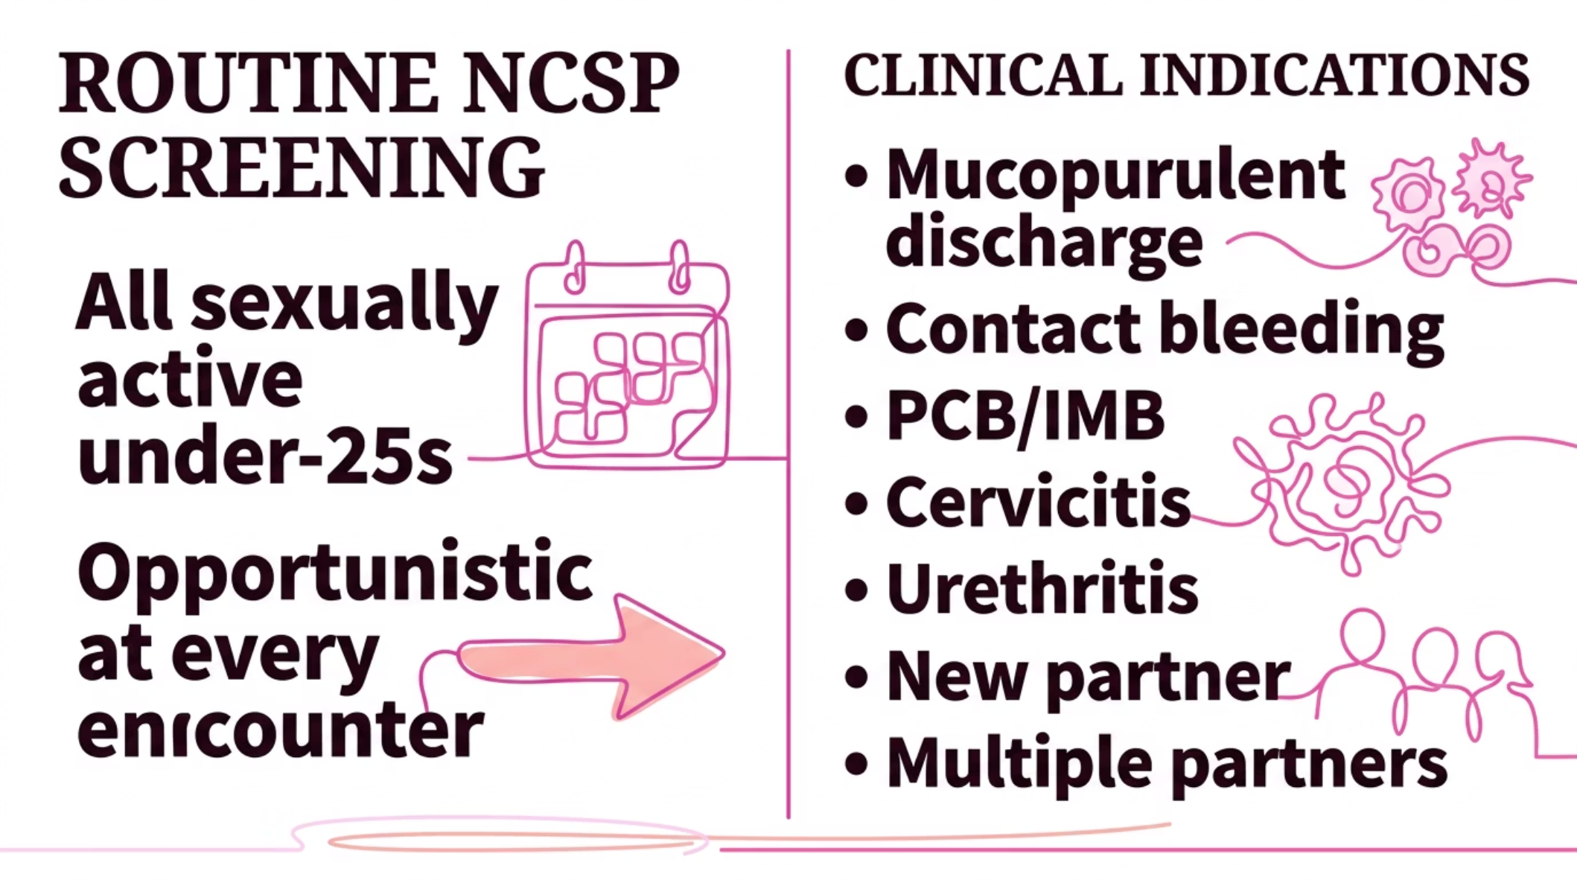

Who to Test? Screening Indications
NCSP — Routine Screening
Clinical Indications for Testing
The National Chlamydia Screening Programme (NCSP) recommends offering testing to all sexually active people under 25, regardless of symptoms or risk history. This is opportunistic screening at every clinical encounter.
Mucopurulent cervical discharge
Contact bleeding / cervical friability
Post-coital bleeding (PCB) or intermenstrual bleeding (IMB)
Cervicitis on examination
Urethritis symptoms
New sexual partner
Two or more partners in past 12 months

Slide 9

Management
⚡ BASHH 2023 Update: Azithromycin 1g single dose is NO LONGER first-line due to suboptimal cure rates and emerging resistance concerns.
🥇 First-Line (BASHH 2023)
Alternative (If Doxycycline Not Tolerated)
Pregnancy & Breastfeeding
Doxycycline 100mg BD × 7 daysPreferred regimen for all non-pregnant adults. Superior cure rates compared to single-dose azithromycin.
Azithromycin 500mg day 1, then 250mg OD days 2–7Or: Ofloxacin 200mg BD × 7 days
Azithromycin (consult specialist) or Erythromycin 500mg QDS × 7 daysDoxycycline is contraindicated in pregnancy.
PID (Suspected Chlamydial Cause)
Mild / Moderate PID
Severe PID
Ofloxacin 400mg BD + Metronidazole 400mg BD × 14 daysOutpatient management is appropriate for mild-to-moderate disease.
Hospital admission for intravenous antibiotics. Indications include systemic illness, inability to tolerate oral therapy, or failure to respond to outpatient treatment.

Slide 10
Contact Tracing, Test of Cure & Prognosis
Contact Tracing
Prognosis & Reinfection
Contact tracing is essential and must not be overlooked. All recent sexual partners should be notified and offered testing and treatment. Involvement of the GUM/CASH service is strongly recommended to facilitate partner notification effectively and confidentially.
Reinfection is common. Key points for follow-up:
Re-test at 3 months after treatment in all under-25s
Most complications (PID, ectopic pregnancy, infertility) are preventable with early detection and treatment
Advise abstinence or condom use until patient and partner(s) have completed treatment
Reinforce barrier contraception and regular STI screening
Test of Cure
Test of cure is not routinely required if the patient has completed the full antibiotic course. If a test of cure is clinically indicated (e.g. pregnancy, ongoing symptoms, or concern about adherence), wait at least 3 weeks after the start of treatment to avoid false-positive NAAT results from residual nucleic acid.
80%
50%
Asymptomatic in Women
PID Caused by Chlamydia
Of all female chlamydia infections — the key driver of undetected spread.
Half of all pelvic inflammatory disease cases are attributable to chlamydial infection.
45%
10%
Ectopic Pregnancies Linked
Prevalence in Under-25s
Nearly half of ectopic pregnancies have a chlamydial aetiology.
Approximately 1 in 10 sexually active women aged 16–25 in the UK are infected.
Bradford VTS — Women's Health | www.bradfordvts.co.uk | Updated 2024 to BASHH 2023 Guidelines

