Slide 1

Hot Flushes — An Easy Peasy Guide
Treating Hot Flushes Specifically · Bradford VTS · July 2024
WOMEN'S HEALTH
BRADFORD VTS TEACHING DECK

Slide 2
Medications for Hot Flushes (Non-HRT)
These options are used when HRT is declined, contraindicated, or in women with breast cancer. SSRIs and SNRIs are the most evidence-based non-hormonal options available in primary care.
When to use non-HRT options
First-line non-hormonal choices
HRT declined by patient
HRT contraindicated
Women with breast cancer
SSRIs and SNRIs carry the strongest evidence base for reducing hot flush frequency and severity. Always discuss side effect profiles with patients before initiating.

Slide 3


SSRIs & SNRIs
Paroxetine 10mg OD
Most effective SSRI for hot flushes. Start low and increase as tolerated. Avoid with tamoxifen.
Venlafaxine 37.5–75mg OD/BD
Best choice for women on tamoxifen — does not inhibit CYP2D6. Safe and effective first-line option in breast cancer patients.
Other SSRIs
Fluoxetine and citalopram have modest evidence for hot flushes. May also help with mood symptoms as an added benefit.
SSRIs/SNRIs may worsen reduced libido — always warn patients before prescribing.

Slide 4


Gabapentin & Clonidine
GABAPENTIN
CLONIDINE
300mg nocte (or TDS)
25 micrograms BD (starting dose)
Effective for both hot flushes and poor sleep. Titrate to effect. Particularly useful if the patient also has neuropathic pain or significant sleep disturbance.
Can increase to 50 micrograms BD after 2 weeks if well tolerated. Modest evidence for hot flushes — not a first choice.
Do NOT stop abruptly — withdraw gradually to avoid rebound hypertension. Watch for dry mouth, drowsiness, and postural hypotension.
Dual benefit: hot flushes + sleep quality

Slide 5
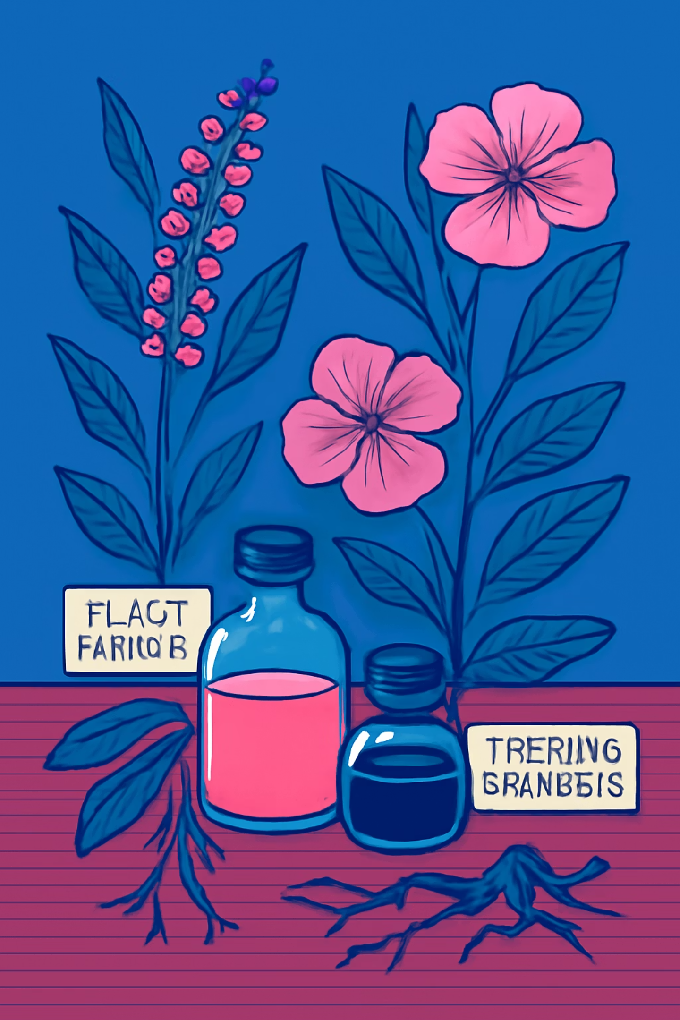
Herbal Remedies
Herbal options are frequently requested by patients. Evidence varies considerably — it is important to counsel patients carefully, particularly regarding interactions.
🌿 Black Cohosh
Modest evidence for hot flushes specifically. Avoid in breast cancer survivors — weakly oestrogenic.
☀️ St John's Wort
Effective for hot flushes and mood. Safe in breast cancer risk — but INTERACTS WITH TAMOXIFEN. Avoid.
🌸 Evening Primrose Oil
Limited evidence for hot flushes. Mainly used for breast pain and PMS. Not a primary recommendation for vasomotor symptoms.

Slide 6
Special Populations: Breast Cancer Survivors
Managing hot flushes in breast cancer survivors requires careful consideration of drug interactions — particularly with tamoxifen metabolism via CYP2D6.
✅ What They CAN Take
❌ What They CANNOT Take
Clonidine 25 micrograms BD (increase to 50 micrograms BD if tolerated)
Venlafaxine — best choice; does not inhibit tamoxifen metabolism via CYP2D6
Gabapentin — also helps sleep and neuropathic pain
Paroxetine — inhibits CYP2D6; reduces tamoxifen conversion to active endoxifen
Fluoxetine — same CYP2D6 interaction as paroxetine
Black cohosh — weakly oestrogenic; avoid in breast cancer survivors
HRT (systemic oestrogen) — avoid; discuss with oncology only in exceptional circumstances

Slide 7

The CYP2D6 Interaction Explained
Understanding why certain SSRIs are unsafe with tamoxifen is key to safe prescribing in breast cancer survivors.
Tamoxifen Taken
CYP2D6 Activation
Endoxifen Effect
Paroxetine and fluoxetine inhibit the CYP2D6 enzyme, preventing tamoxifen from being converted into its active metabolite endoxifen. This significantly reduces the anti-cancer efficacy of tamoxifen — making venlafaxine the preferred SNRI in this population.

Slide 8
Quick Reference: Efficacy & Key Notes
A summary of all non-HRT options for hot flushes, their relative efficacy, and the most important clinical considerations at a glance.
Treatment
Efficacy
Key Notes
Paroxetine 10mg OD
★★★
Avoid with tamoxifen — CYP2D6 inhibitor
Venlafaxine 37.5–75mg OD/BD
★★★
Safe with tamoxifen — 1st choice in breast cancer
Gabapentin 300mg nocte
★★☆
Also helps sleep and neuropathic pain
Clonidine 25–50 micrograms BD
★★☆
Gradual withdrawal required; postural hypotension risk
Black cohosh
★☆☆
Avoid in breast cancer survivors — weakly oestrogenic
St John's Wort
★★☆
Interacts with tamoxifen — avoid in that context
Evening primrose oil
★☆☆
Limited evidence; mainly for breast pain/PMS

Slide 9
Counselling Points for Patients
Set Expectations
Libido Warning
Non-HRT options are generally less effective than HRT. Explain that a reduction in frequency and severity is the realistic goal, not complete resolution.
SSRIs and SNRIs may worsen reduced libido — a common concern in perimenopausal women. Discuss this proactively before initiating treatment.
Herbal Interactions
Review & Titrate
Patients often self-medicate with herbal remedies. Always ask about St John's Wort and black cohosh, especially in women on tamoxifen or with breast cancer history.
Most medications require titration. Schedule a review at 4–6 weeks to assess efficacy and tolerability, and adjust doses accordingly.

Slide 10

Bradford VTS — Women's Health
Created by Bradford VTS · April 2026
Always check the latest BNF/NICE guidance before prescribing. This resource is intended as an educational aide for GP trainees and should not replace clinical judgement.
🌐 Website
📅 Published
📚 Check
www.bradfordvts.co.uk
July 2024
Latest BNF & NICE guidance
This guide covers non-HRT options for hot flushes only. For full HRT prescribing guidance, refer to the Bradford VTS HRT resources and current NICE menopause guidelines (NG23).

