Slide 1

Management of Postcoital Bleeding (PCB)
GP Primary Care Reference Guide — Bradford VTS | Women's Health
UPDATED 2024 · NICE CKS & BASHH 2023 GUIDELINES
BRADFORD VTS TEACHING DECK

Slide 2


What Is PCB?
Definition
The most serious cause of PCB is cervical cancer. This must always be actively excluded.
Postcoital bleeding (PCB) is non-menstrual bleeding occurring following sexual intercourse.
Primary Aim
2024 Update: Azithromycin 1g single dose removed as first-line for chlamydia. Current BASHH 2023 first-line: doxycycline 100mg BD × 7 days.
Exclude cervical malignancy whilst managing benign causes appropriately. Colposcopy for every case of PCB is not indicated.

Slide 3


Causes of PCB
Trauma
Vigorous intercourse, piercings, sex toys
Infection
Chlamydia, gonorrhoea, trichomonas — most important to exclude
Cervical
Ectropion (COCP/pregnancy), polyp, or carcinoma
Other
Atrophic vaginitis, endometrial polyp, clotting disorder
Red Flag: Cervical carcinoma must always be considered and excluded.

Slide 4
Initial Assessment — Before Referral
1
2
History & Examination
Infection Screening
Full sexual and medical history; careful speculum examination of the cervix.
Triple swabs for all ages: endocervical NAAT (chlamydia), gonorrhoea swab, HVS for MC&S + TV.
3
4
Cervical Smear History
Exclude Trauma
If aged ≥25 and not had smear in normal recall interval, take one now. Do not take a smear early if not yet due.
Ask about piercings, sex toys, vigorous intercourse. Treat atrophic vaginitis with topical vaginal oestrogen (Vagifem, Ovestin) or lubricants (Sylk, Replens).

Slide 5
Infection Screening & Treatment
Triple Swab Protocol (All Ages)
2024 First-Line: Chlamydia
Endocervical swab — chlamydia NAAT
Gonorrhoea swab
HVS for MC&S + trichomonas vaginalis (TV)
Doxycycline 100mg BD × 7 days
Azithromycin 1g single dose has been removed as first-line per BASHH 2023 guidelines.
Management
Treat as appropriate; ensure contact tracing
Refer to GUM/CASH if required

Slide 6
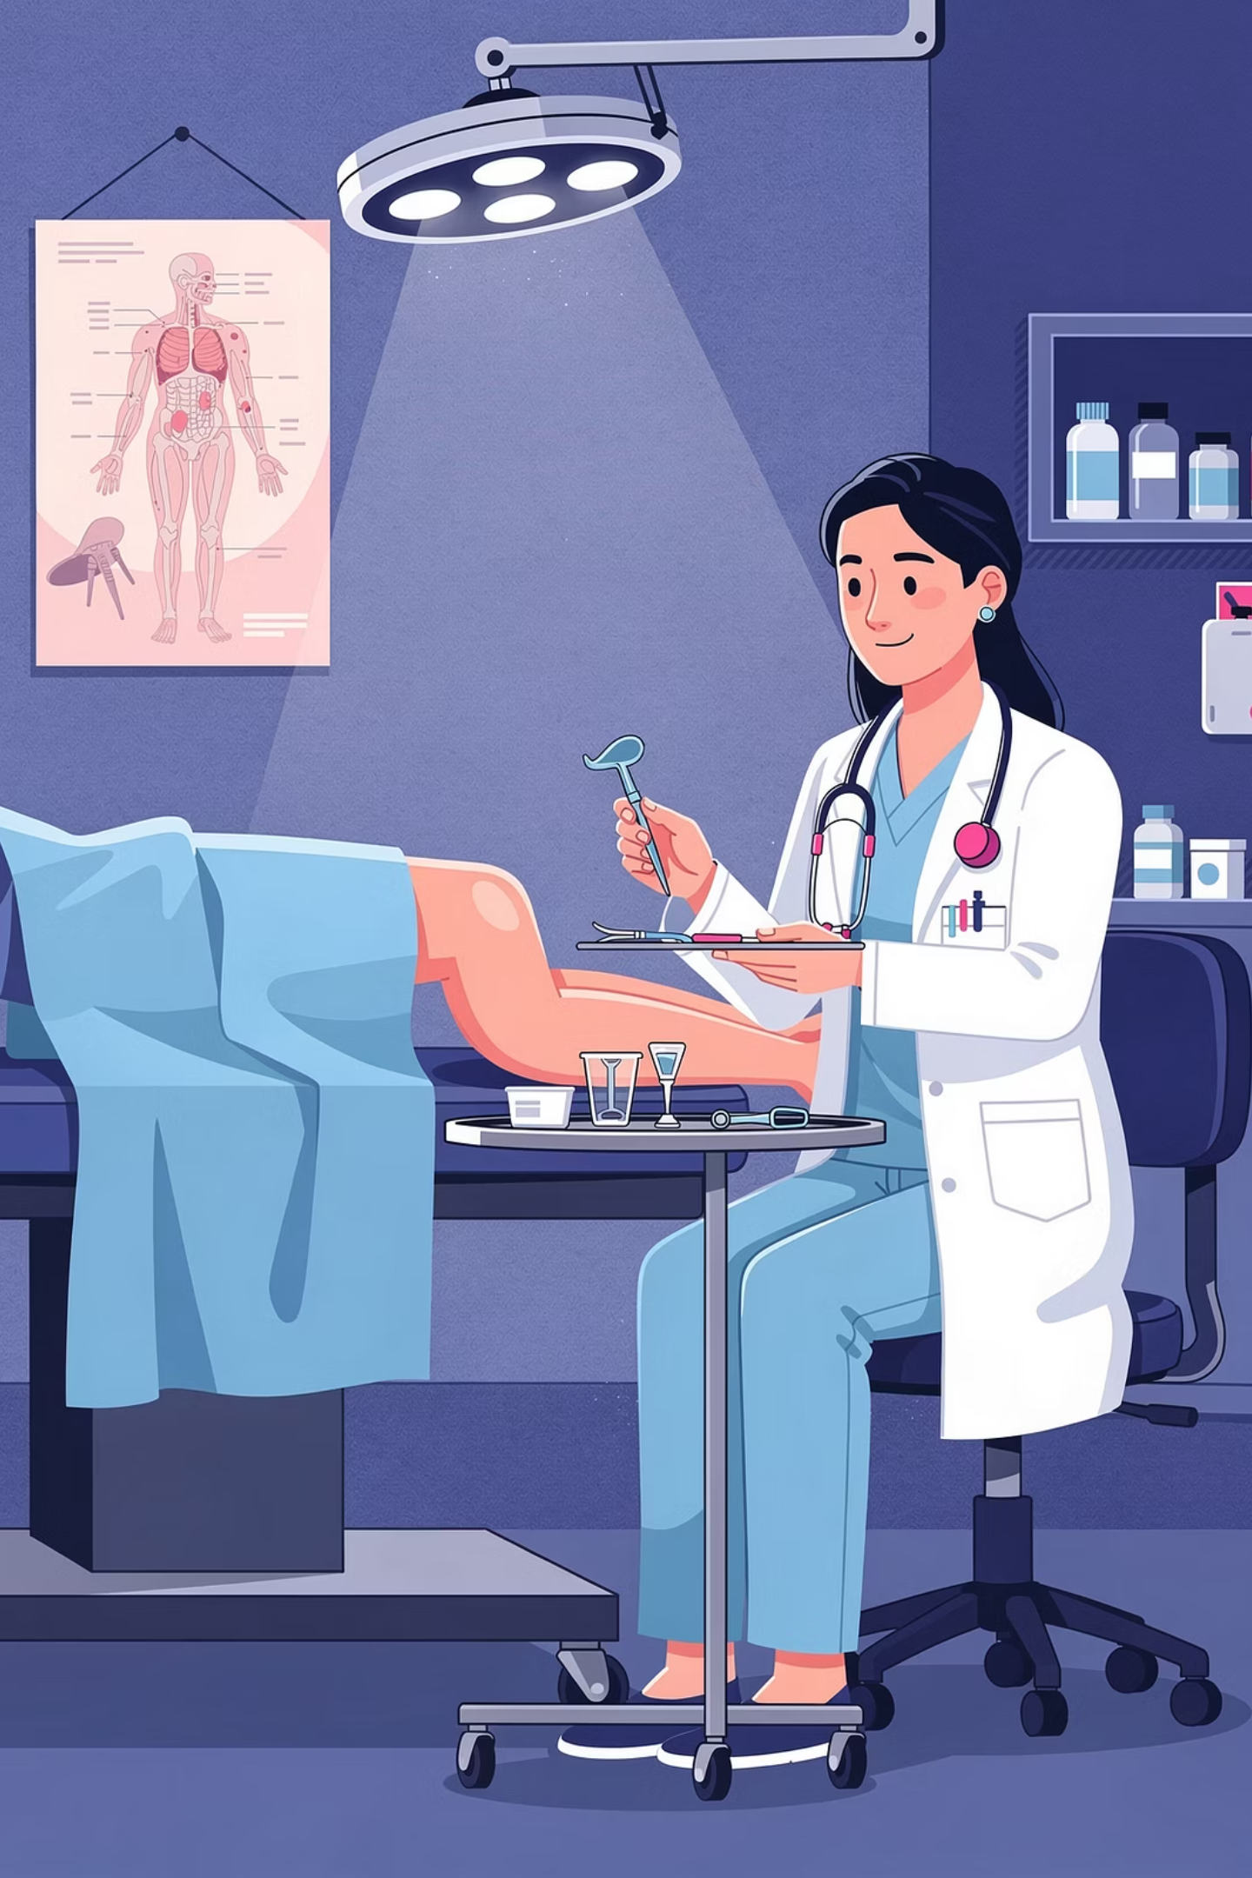


Managing Cervical Ectropion
Exclude infection
Refer & treat
Test for chlamydia and other STIs
Colposcopy with cryo or diathermy
Conservative change
Switch COCP to progestogen-only pill
Abnormal appearance (marked contact bleeding, abnormally vascular cervix): fast-track colposcopy referral immediately — do not wait for smear results.

Slide 7
Cervical & Endometrial Polyps
Pedunculated Polyp (on a stalk)
Broad-Based Polyp
May be avulsed at surgery. Achieve haemostasis with silver nitrate. Always send for histology.
Refer for colposcopy loop diathermy removal — do not attempt avulsion in primary care.
Endometrial Pathology
Postmenopausal Bleeding (PMB)
Endometrial bleeding can present as PCB. Consider hysteroscopy referral, especially in older women with PCB + IMB or menstrual abnormality.
PMB (>12 months after last period in women not on hormones): URGENT fast-track referral always.

Slide 8



🚨 Suspected Cervical Malignancy
Fast-track urgent 2WW colposcopy referral if any of the following are present. Do NOT wait for smear results.
Abnormal Cervical Appearance
Irregular Bleeding
Offensive Discharge
Any visually suspicious or irregular cervical appearance on speculum examination.
Unexplained or persistent irregular bleeding not attributable to a benign cause.
Offensive vaginal discharge in association with PCB warrants urgent investigation.

Slide 9
Special Circumstances
HIV-Positive Patients
Cervical Warts
Annual cervical smears indicated
Lower threshold for colposcopy referral if abnormal appearances are noted
Warts confined to cervix: refer to colposcopy
Vulval/vaginal warts also present: refer to GUM
Clotting Disorders
Unexplained bruising or bleeding elsewhere: refer to haematology or investigate accordingly

Slide 10

Key Takeaways
Always Exclude Malignancy
Cervical cancer is the most serious cause — any abnormal cervical appearance warrants urgent 2WW fast-track referral.
Screen for Infection First
Triple swabs for all patients. First-line chlamydia treatment is now doxycycline 100mg BD × 7 days (BASHH 2023).
Tailor Referral to Findings
Not all PCB requires colposcopy. Manage benign causes in primary care; escalate promptly when red flags are present.
Bradford VTS — Women's Health | www.bradfordvts.co.uk | Updated 2024

