Slide 1

HRT in General Practice
BRADFORD VTS TRAINING DECK
ST1–ST3 Trainer-Led Tutorial | www.bradfordvts.co.uk
Based on original resource by Andrew Crawshaw, Mevagissey (Cornwall Trainers' Web Site)

Slide 2


About This Tutorial
This tutorial explores the management of menopausal and perimenopausal women in primary care. Discuss each question with your trainer, drawing on NICE CKS Menopause 2023 and local guidelines. Updated from the original to reflect current practice — all HRT brand names updated; avoid outdated preparations.
Audience
Guideline Basis
ST1–ST3 GP Registrars in trainer-led tutorial sessions
NICE CKS Menopause 2023 and current local guidelines
Format
Discussion questions with trainer prompts and space for notes

Slide 3
Questions 1 & 2 — Symptoms & Osteoporosis Risk
Q1. Common Presenting Symptoms of Menopause
Q2. Patients Most at Risk of Future Osteoporosis
Trainer prompt: Consider the following risk factors:
Trainer prompt: Think about the following symptom domains:
Early menopause (<45 years)
Premature Ovarian Insufficiency (POI)
Smoking history
Low BMI
Family history of osteoporosis or fragility fracture
Long-term corticosteroid use
Low calcium / vitamin D intake
Immobility or sedentary lifestyle
Vasomotor: hot flushes, night sweats
Urogenital: vaginal dryness, dyspareunia
Mood: anxiety, low mood, irritability
Cognitive: brain fog, poor concentration
Musculoskeletal: joint pains, muscle aches
Skin: dryness, thinning, changes in texture
Notes: _______________________________________________
Notes: _______________________________________________

Slide 4
Question 3 — Managing Hot Flushes & Night Sweats
How do you manage a 54-year-old woman troubled by hot flushes and night sweats in the following scenarios?
1
No period since age 50
Postmenopausal — continuous combined HRT appropriate. No need for cyclical progestogen.
2
Last period 3 months ago
Perimenopausal — cyclical combined HRT to produce regular withdrawal bleeds.
3
As (b) but no HRT-induced bleeds
Consider Mirena IUS for endometrial protection with oestrogen-only patch or gel.
4
Patient has angina
Transdermal route preferred — avoids first-pass hepatic effect; discuss cardiology input.
5
Patient has had a DVT
Transdermal oestrogen (patch/gel) — does not increase VTE risk unlike oral HRT. Seek haematology advice if thrombophilia suspected.
6
Wertheim's hysterectomy + radiotherapy for cervical Ca
Oestrogen-only HRT appropriate (no uterus). Discuss oncology input; cervical cancer is not hormone-sensitive.
7
Had mastectomy
Discuss carefully — depends on tumour type (ER+/ER−). Seek oncology advice. Non-hormonal alternatives (SSRIs, clonidine) may be preferred.
8
Strong family history of stroke
Transdermal route preferred — no increased stroke risk unlike oral oestrogen. Assess individual cardiovascular risk.
9
Patient loves horses (equine vs plant-derived HRT)
Discuss conjugated equine oestrogens (e.g. Premarin) vs plant-derived 17β-oestradiol preparations. Most modern HRT uses bioidentical oestradiol.
Trainer prompt: Work through each scenario systematically — route of administration, type of HRT, contraindications, and need for specialist input are key themes throughout.

Slide 5
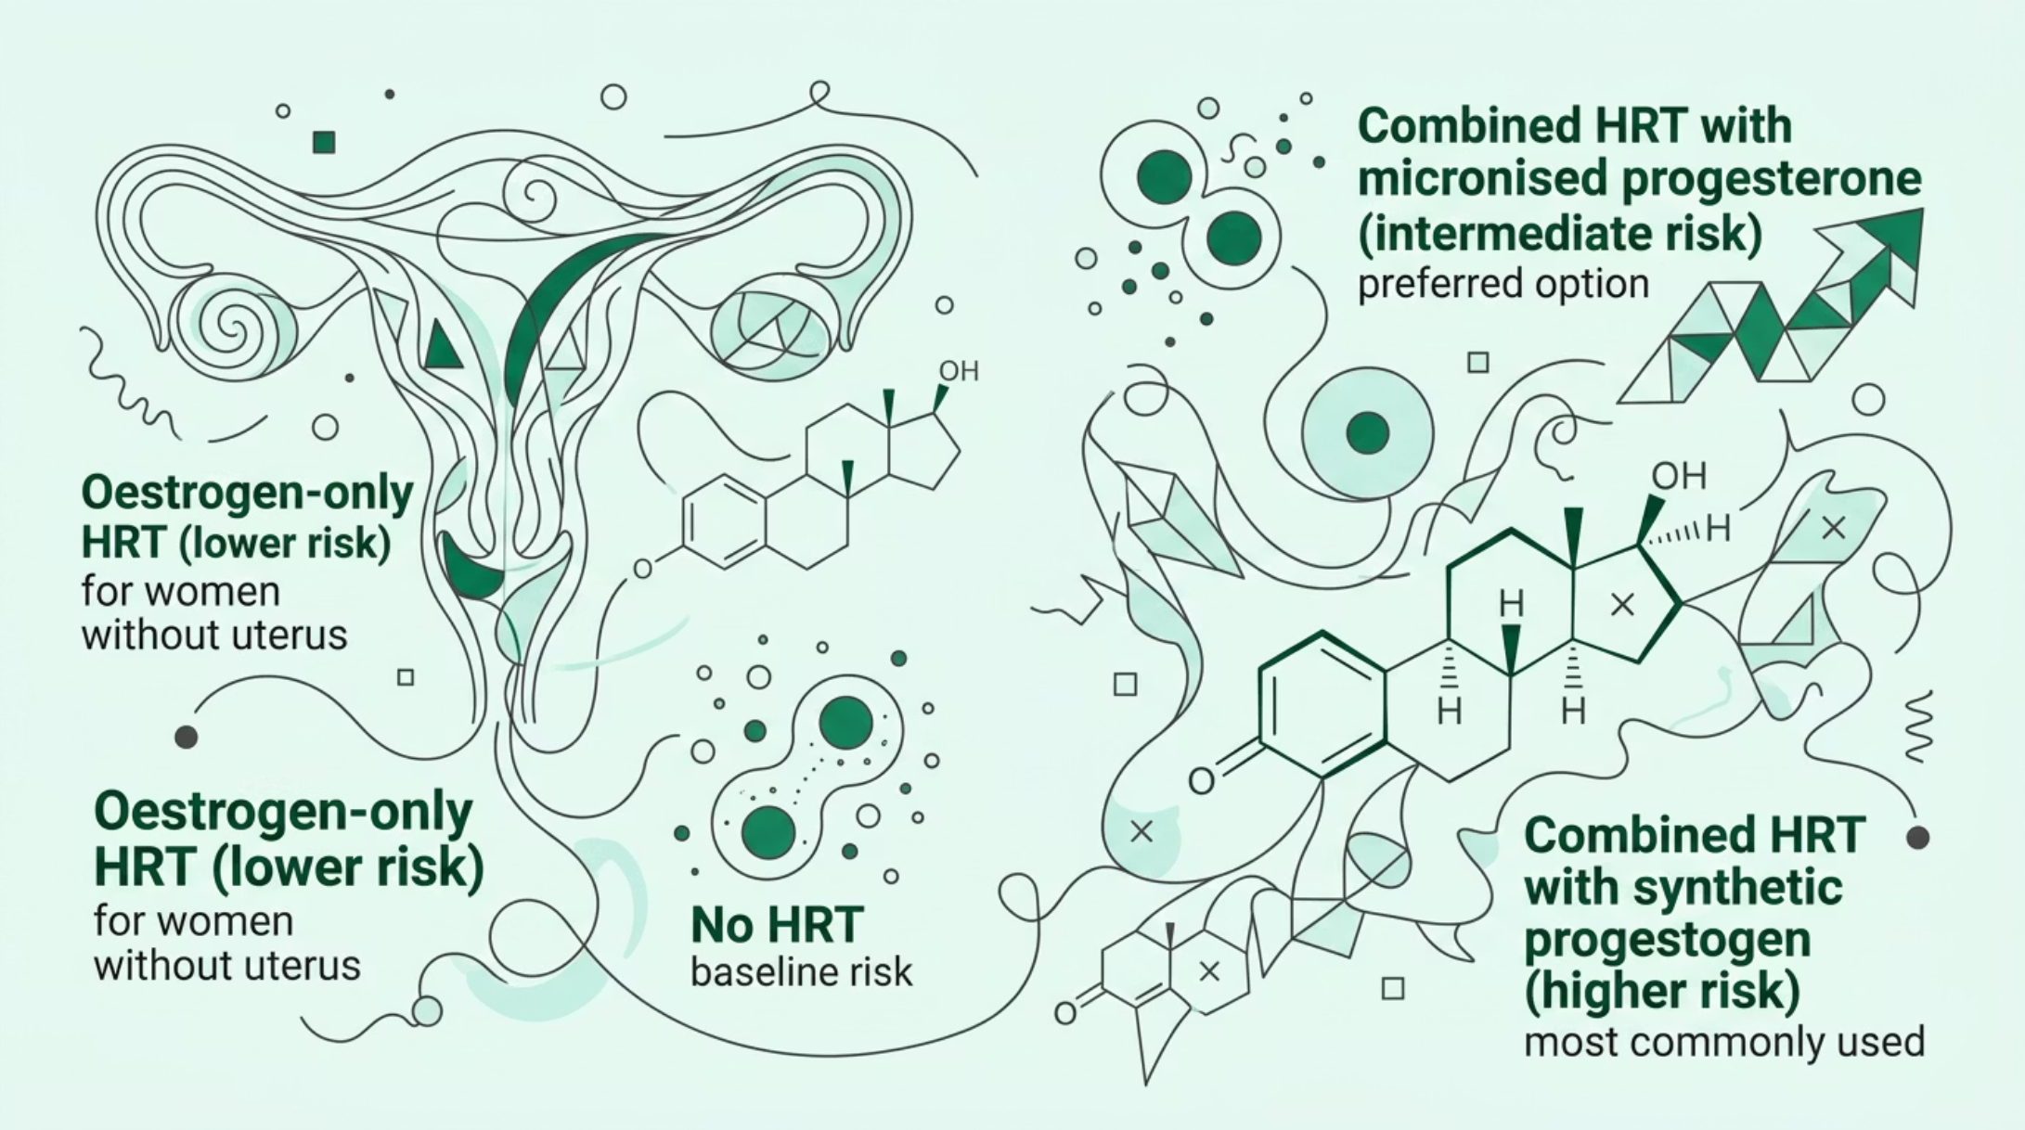

Questions 4 & 5 — Osteoporosis Prevention & Breast Cancer Risk
Q4. HRT to Prevent Future Osteoporosis
Q5. Menopausal Symptoms & Breast Cancer Risk
How do you advise a woman who wants HRT to prevent possible future osteoporosis?
How do you advise a woman interested in HRT but worried about breast cancer risk?
Trainer prompt — key discussion points:
Trainer prompt — key discussion points:
Use the FRAX tool to calculate 10-year fracture risk
Discuss benefits vs risks of HRT in this context
DEXA scan indications — when to refer
Lifestyle advice: weight-bearing exercise, calcium, vitamin D, smoking cessation
Alternatives: bisphosphonates (alendronate, risedronate), denosumab
Use NICE CKS risk tables to contextualise absolute risk
Discuss absolute vs relative risk — numbers needed to harm
Differentiate: combined HRT carries higher risk than oestrogen-only
WHI study context — limitations and how evidence has evolved
Micronised progesterone (Utrogestan) may carry lower breast cancer risk than synthetic progestogens
Shared decision-making and documentation
Notes: _______________________________________________
Notes: _______________________________________________

Slide 6



Question 6 — Progestogen Intolerance
A patient with an intact uterus feels irritable and premenstrual when taking cyclical progestogen. What can you do to help in each scenario?
(a) Oral Cyclical HRT
(b) Hormone Patches
(c) Oestradiol Implants
Switch to micronised progesterone (Utrogestan) — better tolerated. Reduce dose or shorten duration of progestogen phase. Consider changing progestogen type.
Change to a different progestogen in the patch combination. Consider adding Mirena IUS for endometrial protection, allowing oestrogen-only patch use.
Mirena IUS is the preferred solution for endometrial protection — avoids systemic progestogen side effects entirely. Seek specialist input.
Trainer prompt: Key options include micronised progesterone (Utrogestan), changing progestogen type, lowering dose, adjusting timing, or using the Mirena IUS for endometrial protection. The Mirena IUS is increasingly the preferred approach for women who cannot tolerate systemic progestogens.
Notes: _______________________________________________

Slide 7
Questions 7 & 8 — Atrophic Vaginitis & Premenstrual Syndrome
Q7. Severe Atrophic Vaginitis After Uterine Carcinoma Treatment
Q8. Severe Premenstrual Syndrome in a 38-Year-Old
How might you treat a 38-year-old patient with severe premenstrual syndrome?
How do you help an 80-year-old woman with severe atrophic vaginitis who had radical treatment 15 years ago for carcinoma of the body of the uterus?
Trainer prompt:
Trainer prompt:
Confirm cyclical pattern with a symptom diary (at least 2 cycles)
First-line: SSRIs (continuous or luteal phase) — evidence-based
Combined oral contraceptive pill (COCP) — particularly drospirenone-containing
Severe cases: GnRH analogues (with add-back HRT) — specialist referral
Psychological: CBT has good evidence base
Lifestyle: exercise, dietary changes, stress management
Refer to RCOG Green-top Guideline on PMS
Topical vaginal oestrogen (e.g. Vagifem pessaries, Ovestin cream) — very low systemic absorption
Discuss safety in history of endometrial cancer — evidence suggests low-dose topical oestrogen is generally considered safe but seek specialist advice
Distinguish local vs systemic therapy — local oestrogen does not require progestogen cover
Non-hormonal alternatives: lubricants, moisturisers (Replens)
Seek gynaecology/oncology specialist advice before prescribing
Notes: _______________________________________________
Notes: _______________________________________________

Slide 8

Question 9 — Tachyphylaxis with HRT Implants
How do you cope with tachyphylaxis (declining effect of HRT implants over time)?
Important context: Oestradiol implants are now rarely used in UK general practice. This question has historical and educational value for understanding the phenomenon of tachyphylaxis and its management implications.
What is Tachyphylaxis?
The Clinical Problem
A declining response to HRT implants over time, leading patients to request increasingly frequent re-implantation. Oestradiol levels can rise to supraphysiological levels while the patient still reports symptoms.
Dose escalation occurs as patients perceive return of symptoms before oestradiol levels have fallen. This creates a cycle of escalating implant doses and very high serum oestradiol concentrations — potentially unsafe.
Management Approach
Current Practice
Check serum oestradiol levels before re-implanting. Do not re-implant if levels remain elevated. Seek endocrinology input for complex cases. Transition patients to transdermal or oral preparations where possible.
Implants are now rarely used. Modern transdermal preparations (patches, gels, sprays) provide stable oestradiol levels without the tachyphylaxis problem and are the preferred route in current UK practice.
Notes: _______________________________________________

Slide 9
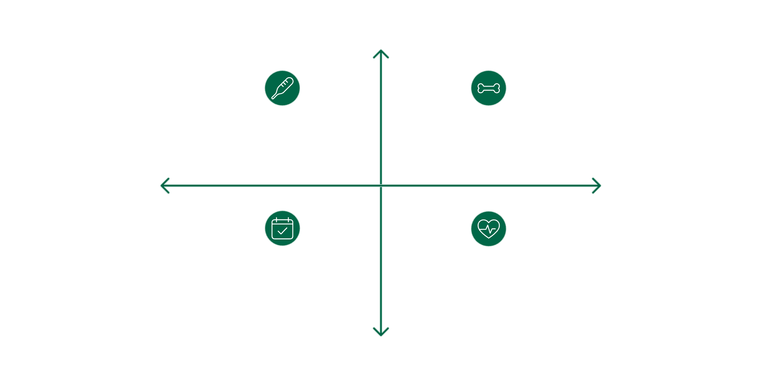

Question 10 — Short-Term vs Long-Term HRT
Discuss the advantages and disadvantages of short-term and long-term HRT use.
Short-Term HRT (up to 5 years)
Long-Term HRT (beyond 5 years)
Advantages: Effective symptom control (vasomotor, urogenital, mood); minimal cumulative risk; widely recommended as first-line approach
Disadvantages: Symptoms may return on cessation; no long-term bone or cardiovascular benefit accrued
Trainer prompt: NICE recommends reviewing at 1 year and then annually; stopping at 5 years is a common benchmark but not absolute
Advantages: Continued symptom control; sustained bone protection (reduces osteoporotic fracture risk); possible cardiovascular benefit if started early in menopause (timing hypothesis)
Disadvantages: Cumulative breast cancer risk increases with duration (especially combined HRT); requires ongoing annual review and shared decision-making
Trainer prompt: Long-term use is appropriate for some women — particularly those with POI or severe symptoms — after informed discussion of risks and benefits
High Symptom Relief
Short-Term HRT: Symptom Control
Long-Term HRT: Bone Protection
Low Cumulative Risk
Long-Term Benefits
Long-Term HRT: Ongoing Review
Short-Term HRT: Minimal Cumulative Risk
Low Symptom Relief
The decision between short- and long-term HRT should always be individualised, based on symptom burden, risk profile, patient preference, and annual shared decision-making review.
Notes: _______________________________________________

Slide 10


Bradford VTS — Women's Health
TUTORIAL COMPLETE
HRT in General Practice | ST1–ST3 Trainer-Led Tutorial
Original Resource
Tutorial by Andrew Crawshaw, Mevagissey, originally published on the Cornwall Trainers' Web Site.
Updated for Bradford VTS 2024
All HRT brand names updated to reflect current UK preparations. Outdated preparations removed. Aligned with NICE CKS Menopause 2023.
Further Resources
Visit www.bradfordvts.co.uk for additional Women's Health tutorials, clinical resources, and GP training materials.
This tutorial is intended as a discussion framework. Always refer to current NICE CKS Menopause guidance, local formulary, and individual patient circumstances when making clinical decisions.

