Slide 1



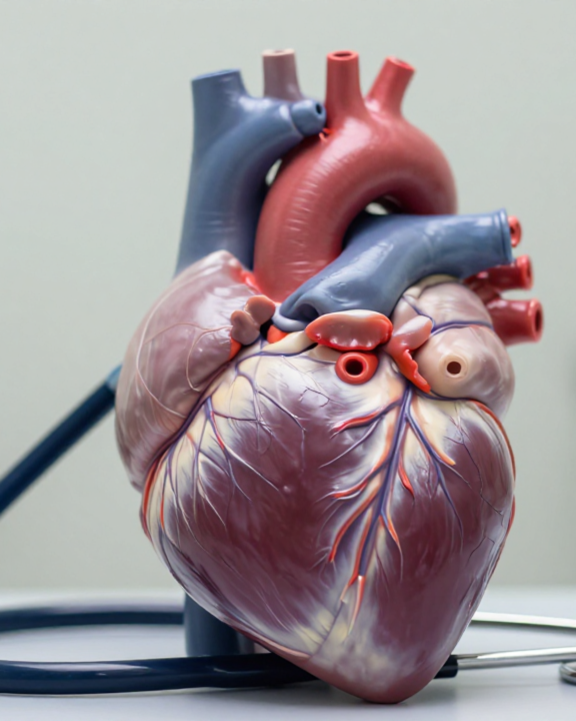


BRADFORD VTS TEACHING DECK
ATRIAL
FIBRILLATION
IN PRIMARY CARE
Clinical Authority: NICE NG196
DIAGNOSIS AND MANAGEMENT • FROM NICE APRIL 2021
MAY 2026
Comprehensive GP Specialty Training module covering diagnostic pathways, risk stratification, rate vs. rhythm control, and high-yield AKT/SCA exam pearls.
DISCLAIMER: Slides provided for educational purposes. Check against latest NICE guidance & BNF

Slide 2












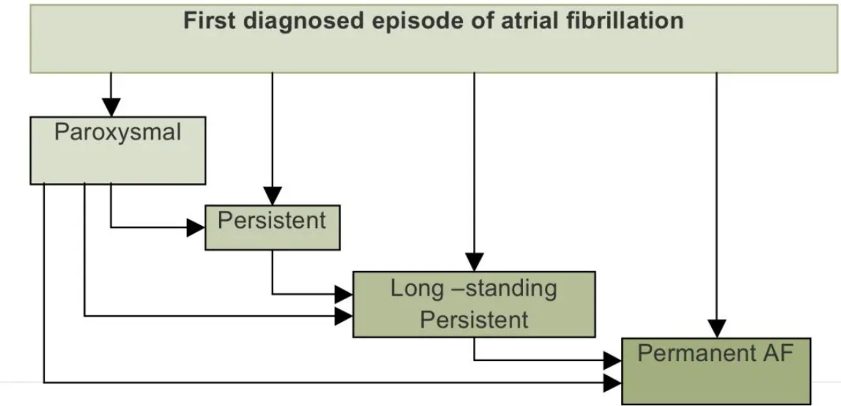
AF:
Definition and Classification
NICE NG196 Guideline Reference / Bradford VTS Teaching
CLASSIFICATION TYPE
DEFINITION (NICE NG196)
What is Atrial Fibrillation?
Paroxysmal AF
Self-terminating episodes, usually <48 hours; always reverts spontaneously within 7 days.
The commonest sustained cardiac arrhythmia. Characterized by chaotic atrial firing (300–600 bpm) with irregular AV conduction, resulting in an irregularly irregular pulse and absent P waves on ECG.
Persistent AF
Episode lasting >7 days OR requiring cardioversion to restore Sinus Rhythm.
Long-standing Persistent
Continuous AF >12 months, where a rhythm control strategy is being pursued.
Causes 5× increased stroke risk; strokes are often severe or fatal.
Permanent AF
Patient and clinician accept AF; no rhythm control strategy attempted.
UK Prevalence & Trends
Diagnosed:
~1.4 Million
in England
Undiagnosed:
~500,000
estimated cases
~5%
Aged 65–74:
prevalence
Aged 75+:
>10%
prevalence
Pathways of AF progression from first diagnosis to permanent stage

Slide 3














AF:
Aetiology and Reversible Causes
NICE NG196 Guideline Reference / Bradford VTS Teaching
Cardiac Aetiology
Systemic & Lifestyle
PIRATES Mnemonic
Hypertension
Thyrotoxicosis
Always check TFTs in new AF
P
Pulmonary (PE, Pneumonia)
Most common reversible cause
Ischaemic Heart Disease & MI
Lifestyle: Alcohol, Obesity, Caffeine, Endurance athletics
I
Infection / Sepsis
Heart Failure & Cardiomyopathy
Respiratory: PE, Pneumonia, OSA, Lung Carcinoma
R
Rheumatic / Valvular
Valvular Disease (esp. Mitral)
A
Anaemia / Alcohol
Electrolytes: Low K⁺ or Mg²⁺
T
Thyrotoxicosis
E
Electrolytes (K+, Mg2+)
S
Structural (HF, IHD)
Focus on modifiable and reversible triggers to improve long-term rhythm stability.

Slide 4


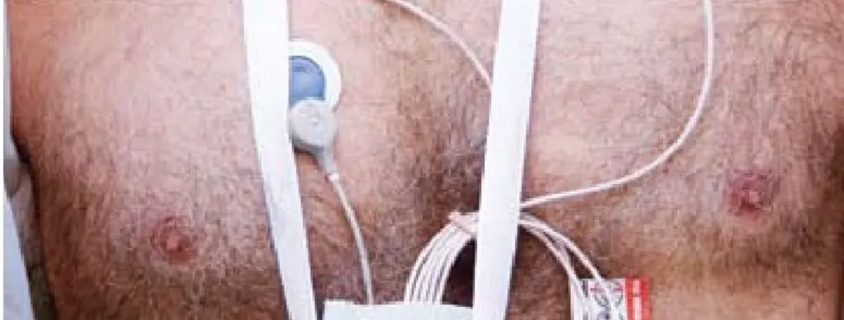












AF:
Detection, Diagnosis, and New Technology
NICE NG196 Guideline Reference / Bradford VTS Teaching
Suspicion and Pulse Check
Perform manual pulse palpation in anyone with: breathlessness, palpitations, dizziness, chest discomfort, or history of TIA/stroke.
Irregular pulse detected? Arrange immediate 12-lead ECG.
New Devices & Remote Tools
AliveCor/KardiaMobile: NICE validated single-lead ECG devices for detection in primary care settings.
ECG Diagnostic Criteria
Atrial Fibrillation: Absent P waves + irregularly irregular QRS complexes.
Smartwatches: Useful for detection but MUST be confirmed with a clinical 12-lead ECG before initiating treatment.
Atrial Flutter: Saw-tooth flutter waves (300 bpm), typically 2:1 or 3:1 regular block.
Validation: Ensure devices meet NICE medical-grade standards for diagnostic accuracy.
Uncertainty: Use ambulatory monitoring (24–48h Holter; 7-day if paroxysmal).

Slide 5















AF:
Mandatory Initial Investigations for New AF
NICE NG196 Guideline Reference / Bradford VTS Teaching
12-LEAD ELECTROCARDIOGRAM
ECHOCARDIOGRAM (TTE)
Mandatory Confirmation: Must be performed to confirm diagnosis (absent P waves, irregularly irregular QRS).
Indication: All newly diagnosed AF.
Purpose: Exclude valve disease, LV dysfunction, or structural heart disease.
CHEST X-RAY (CXR)
Target Groups: Smoker/ex-smokers or patients with suspected Heart Failure.
COMPREHENSIVE BLOOD PANEL
Rationale: Exclude bronchial carcinoma or pulmonary congestion.
FBC:
TFTs:
Exclude anaemia (bleeding risk/trigger).
Rule out thyrotoxicosis (reversible).
U&E / Creatinine:
HbA1c / Glucose:
Essential for DOAC dosing (CrCl).
Screen for Diabetes (CHA₂DS₂-VASc).
LFTs:
Lipid Profile:
EXAM PEARL (AKT)
Baseline for amiodarone/alcohol screen.
Assess overall CVD risk.
Always check TFTs in new AF. Thyrotoxicosis is a classic "easy to miss" reversible cause frequently tested in the AKT. Ensure U&Es are checked to calculate Cockcroft-Gault CrCl for DOAC dosing!

Slide 6















AF:
Stroke Risk Assessment using CHA₂DS₂-VASc
NICE NG196 Guideline Reference / Bradford VTS Teaching
Risk Factor (CHA₂DS₂-VASc)
Points
C — Congestive heart failure
1
H — Hypertension (or treated HTN)
1
A₂ — Age ≥75 years
2
D — Diabetes mellitus
1
S₂ — Stroke / TIA / Thromboembolism
2
OFFER Anticoagulation: Score ≥2 in Men / ≥3 in Women. (DOAC preferred over Warfarin).
V — Vascular disease (MI, PAD, Aortic plaque)
1
CONSIDER Anticoagulation: Score 1 in Men / 2 in Women. Discuss risks vs. benefits.
A — Age 65–74 years
DO NOT OFFER: Score 0 in Men / 1 in Women (where female sex is the only risk factor).
1
ASPIRIN IS NOT RECOMMENDED FOR STROKE PREVENTION IN AF
Sc — Sex category (Female)
1
LIVE CALCULATION CHALLENGE
Maximum Possible Score
9
72yo Female, Hypertension, Type 2 Diabetes.
Score: 4 (Age 1 + Female 1 + HTN 1 + T2DM 1) → Offer Anticoagulation

Slide 7

















AF:
Bleeding Risk Assessment using ORBIT
NICE NG196 Guideline Reference / Bradford VTS Teaching
Risk Interpretation
0 – 2
Low bleeding risk
REPLACES HAS-BLED IN NICE NG196
3
Medium bleeding risk
ORBIT Risk Factor
Points
≥ 4
High bleeding risk
Older age (≥75 years)
1
Reduced haemoglobin / Anaemia
2
Bleeding history
2
Clinical Decision Tool
INR lability (if using Warfarin)
Important: A high bleeding risk score should NOT automatically exclude anticoagulation.
Use the score to identify and manage modifiable bleeding factors and to inform the shared decision-making discussion regarding stroke prevention benefits vs. bleeding risks.
1
Antiplatelet agents or NSAIDs
1

Slide 8



























AF:
Anticoagulation Management: DOACs vs Warfarin
NICE NG196 Guideline Reference / Bradford VTS Teaching
DOAC
Mechanism
Standard Dose
Dose Reduction Criteria
Key Clinical Guidance
Apixaban
Factor Xa Inhibitor
5 mg BD
2.5 mg BD if ≥2 of: Age ≥80, Weight ≤60 kg, Creatinine ≥133 µmol/L
Contraindications: CrCl <15 ml/min, mechanical heart valves, or mod-severe mitral stenosis.
Monitoring: Check renal function (CG) before start, then annually (more if CrCl <60).
Rivaroxaban
Factor Xa Inhibitor
20 mg OD
15 mg OD if CrCl 15–49 ml/min
Reversal: Idarucizumab (Dabigatran); Andexanet alfa (Factor Xa inhibitors).
AKT TIP: Always use Cockcroft-Gault for dosing, NOT eGFR—especially in the elderly.
Dabigatran
Direct Thrombin Inhibitor
150 mg BD
110 mg BD if ≥80 years, high bleeding risk, or concomitant verapamil
Edoxaban
Factor Xa Inhibitor
60 mg OD
30 mg OD if CrCl 15–50 ml/min, Weight ≤60 kg, or P-gp inhibitors
Warfarin
Vitamin K Antagonist
Variable
Target INR 2–3
Switch to DOAC if TTR <65%. Preferred for mechanical valves or moderate-severe mitral stenosis.

Slide 9


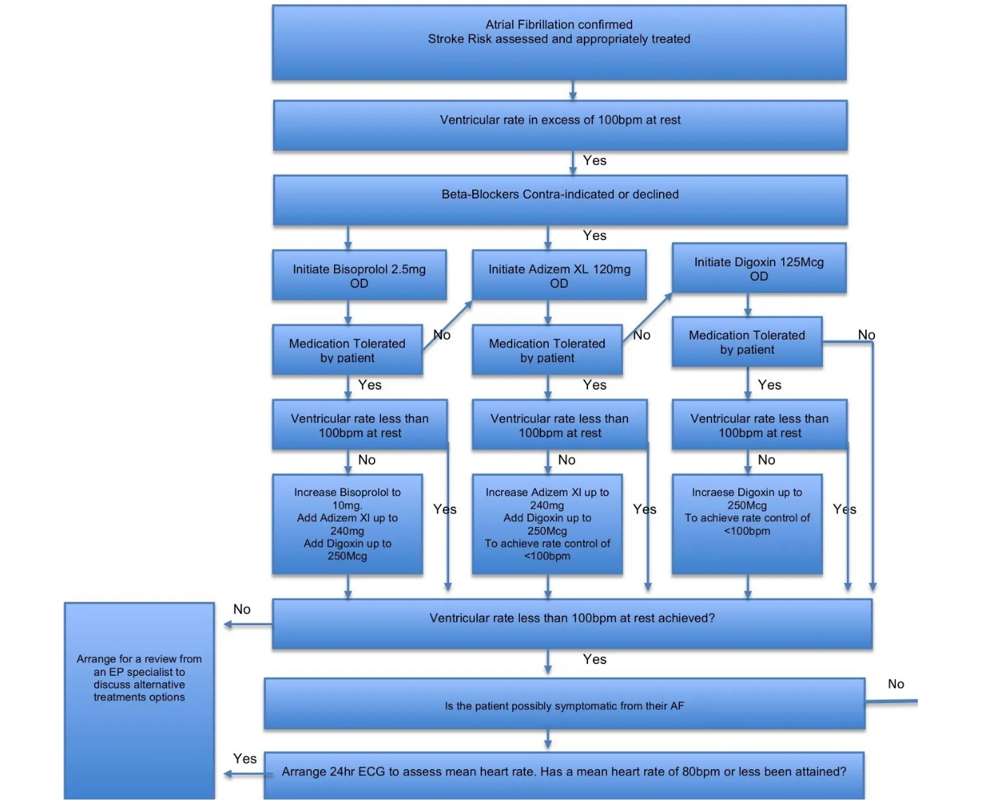













AF:
Rate Control Strategies & Pharmacotherapy
NICE NG196 Guideline Reference / Bradford VTS Teaching
Heart Rate Targets (RACE-II Evidence)
Lenient Rate Control: Resting HR < 110 bpm is acceptable if the patient is asymptomatic.
Strict Rate Control: Aim for < 80 bpm if symptomatic or if the lenient target fails to improve clinical status.
Combination Therapy: Use a beta-blocker + digoxin if monotherapy is insufficient for rate control.
First-line Agent Selection
1. Beta-Blockers: Standard first choice, especially for patients with IHD or Heart Failure.
2. Rate-limiting CCBs: Preferred if beta-blockers are contraindicated (e.g., severe asthma).
Critical Safety Warnings
• NEVER combine a Beta-blocker with Verapamil due to the high risk of complete heart block.
• AVOID Diltiazem/Verapamil in HFrEF (EF < 40%).
• Amiodarone is not recommended for long-term rate control in primary care.
3. Digoxin: Consider for sedentary patients or as an add-on. Monitor levels (target 0.6–1.2 nmol/L).

Slide 10


















AF:
Rhythm Control, Cardioversion, and Ablation
NICE NG196 Guideline Reference / Bradford VTS Teaching
Cardioversion Strategies
Anti-arrhythmic Monitoring (GP Duties)
Pharmacological: Flecainide (if no structural heart disease) or Amiodarone (if structural heart disease present).
Drug
Mandatory Monitoring
DC Cardioversion: If AF >48h, requires anticoagulation for ≥3 weeks before (or TOE) and ≥4 weeks after.
Amiodarone
• 6-monthly: TFTs
• 12-monthly: LFTs
• Annual: 12-lead ECG
Long-term Strategy: Continue anticoagulation based on CHA₂DS₂-VASc regardless of cardioversion success.
Flecainide
• Annual: 12-lead ECG (Check QTc and QRS duration)
Dronedarone
• LFTs: Monthly (first 6m), then 9 & 12m, then annually.
AKT Exam Pearl: Flecainide is strictly contraindicated in patients with structural heart disease or LV dysfunction.
Catheter Ablation (PVI)
NICE RECOMMENDATION
Offer to patients with paroxysmal or persistent AF in whom antiarrhythmic drugs have failed or are not suitable.
Success Rates: ~70% for paroxysmal AF; 50–60% for persistent AF at 1 year.

Slide 11























AF:
Palpitations Assessment and Red Flags
NICE NG196 Guideline Reference / Bradford VTS Teaching
10-STEP ASSESSMENT (WOLFF & COWAN)
URGENT REFERRAL FLAGS
01
Clarify Nature
02
Associated Symptoms
Palpitations during exercise
Fast, slow, regular, pounding, or skipped beats?
History of syncope / near-syncope
Syncope, dizziness, chest pain, or breathlessness?
High-risk structural heart disease
Family Hx of SADS / SCD under 40
03
Contributing Factors
High-degree AV block on ECG
04
Family History
Caffeine, alcohol, anxiety, or specific medications.
Sudden cardiac death or inherited conditions.
SCA TIP: Always safety-net for "unusual bleeding" and "blackouts" when discussing palpitations.
05
Exam + 12-Lead ECG
06
Risk Stratification
Mandatory check; capture symptoms if possible.
Traffic light: Green (Benign) to Red (Urgent).
EMERGENCY (999) CRITERIA
07
Ambulatory Monitoring
08
Clinical Referral
Haemodynamic compromise (BP <90)
24h if daily; 7-day if less frequent episodes.
Electrophysiology for WPW or flutter ablation.
VR >150 bpm + pulmonary oedema
Pre-excited AF (WPW + AF)
09
Patient Support
10
DVLA Advice
New-onset Stroke or TIA
Arrhythmia Alliance & AF Association guidance.
Must stop driving if arrhythmia causes incapacity.
AF + acute onset chest pain (ACS/PE)

Slide 12

















AF:
Management in Special Populations
NICE NG196 Guideline Reference / Bradford VTS Teaching
Heart Failure (HFrEF)
Acute Stroke / TIA
Beta-blockers are preferred first-line for rate control; add Digoxin if monotherapy is insufficient.
Do NOT start immediately after major ischaemic stroke (risk of haemorrhagic transformation).
Avoid CCBs: Do not use Verapamil or Diltiazem if ejection fraction is <40%.
Anticoagulation timing guided by severity:• TIA: Day 4
• Minor Stroke: 3–12 days
• Major Stroke: 12+ days
Chronic Kidney Disease (CKD)
Thyrotoxicosis-Related AF
DOACs require dose adjustment based on Cockcroft-Gault CrCl (not eGFR).
Treat thyrotoxicosis first; ~50% of patients will revert to sinus rhythm spontaneously.
Apixaban is generally preferred in advanced CKD (eGFR 25–50).
Anticoagulate during the thyrotoxic phase due to high thromboembolic risk.
If CrCl <15 ml/min: Avoid DOACs; use Warfarin only under specialist guidance.

Slide 13


























AF:
Lifestyle Modification and the SAFE Framework
NICE NG196 Guideline Reference / Bradford VTS Teaching
Modifiable Risk Factors
The SAFE Management Framework
S
A
Weight Loss
Alcohol Reduction
Every 10% weight loss significantly reduces AF burden and symptom severity.
Alcohol is a direct trigger. Binge drinking ('holiday heart') increases risk.
Symptoms
Anticoagulation
Manage symptoms via rate control (target <110 bpm) or rhythm control strategies.
Stroke prevention based on CHA₂DS₂-VASc. DOACs preferred over warfarin.
Exercise Habits
BP Control
Moderate activity is protective; extreme endurance athletics can increase risk.
Hypertension is the most common modifiable risk factor for AF.
F
E
Factors
End Arrhythmia
Sleep Apnoea
CVD Optimization
Address reversible causes (TFTs, electrolytes) and modifiable CV risk factors.
Restore sinus rhythm if symptomatic despite rate control (cardioversion/ablation).
CPAP therapy reduces AF recurrence post-cardioversion or ablation.
Smoking cessation, diabetes management, and lipid control are essential.
NICE NG196 Focus: Upstream management of cardiovascular risk factors is as critical as rhythm/rate control for long-term outcomes.
Practical Application: Use the SAFE acronym during consultations to ensure all facets of NICE-compliant AF care are covered in 10 minutes.

Slide 14











AF:
Top Tips and Common Pitfalls for GPs
NICE NG196 Guideline Reference / Bradford VTS Teaching
Essential Clinical Pearls
Common Pitfalls to Avoid
Always Check TFTs
Aspirin for Stroke Prevention
Thyrotoxicosis is a key reversible cause and easily missed in elderly patients.
Aspirin has NO role in AF stroke prevention. Switch to DOAC if indicated.
BB + Verapamil Combo
Echo All New AF
Never combine these for rate control due to the risk of complete heart block.
Crucial to exclude structural heart disease, valve issues, or LV dysfunction.
Cockcroft-Gault CrCl
Inadequate Monitoring
Mandatory for DOAC dosing; do NOT rely on eGFR in the elderly or at extremes of weight.
Amiodarone requires 6-monthly TFTs and annual LFTs/ECG in primary care.
ORBIT Over HAS-BLED
Early Post-Stroke Anticoagulation
NICE NG196 now prefers ORBIT for assessing bleeding risk in primary care.
Wait 3–12+ days after ischaemic stroke to avoid haemorrhagic transformation.
Pro-Tip: Female sex alone (score 1) does NOT trigger anticoagulation.
Note: Lenient rate control (< 110 bpm) is safe if the patient is asymptomatic.

Slide 15



















AF:
Exam Pearls and Quick Recall Summary
NICE NG196 Guideline Reference / Bradford VTS Teaching
AKT EXAM FOCUS
QUICK RECALL ESSENTIALS
NG196 Updates: ORBIT score replaces HAS-BLED; DOACs are preferred over warfarin for non-valvular AF.
ECG: Absent P waves + irregularly irregular QRS complexes = AF diagnosis.
Aspirin: Has NO role in AF stroke prevention; replace with anticoagulation if indicated.
Thresholds: Female sex alone (Score 1) does NOT trigger anticoagulation. Score ≥2 in men / ≥3 in women.
Rate Target: Resting heart rate <110 bpm is acceptable if the patient is asymptomatic.
Contraindications: Flecainide is strictly contraindicated in structural heart disease or LV dysfunction.
Echo: Arrange for all newly diagnosed AF patients to exclude structural/valve heart disease.
Dosing: Use Cockcroft-Gault CrCl, not eGFR, for DOAC dosing in elderly; always check renal function before starting.
Amiodarone: Requires 6-monthly TFTs, annual LFTs, and annual ECG monitoring in primary care.
SCA CONSULTATION TIPS
SAFE FRAMEWORK SUMMARY
Patient Education: Explain stroke risk using NNT (e.g., "1 stroke prevented for every 25 people treated").
S
A
F
E
Safety-Netting: Advise immediate contact if unusual bleeding, persistent bruising, or dark/tarry stools occur.
Symptoms
Anticoag.
Factors
End AF
DVLA Advice: If an arrhythmia causes incapacity, the patient must stop driving and notify the DVLA.
Comprehensive AF management requires treating symptoms, preventing strokes, addressing modifiable risk factors (BP, weight, alcohol), and considering rhythm restoration.
"I understand your concerns about bleeding. Let's weigh that against the risk of a major stroke, which can be life-changing."

