Slide 1


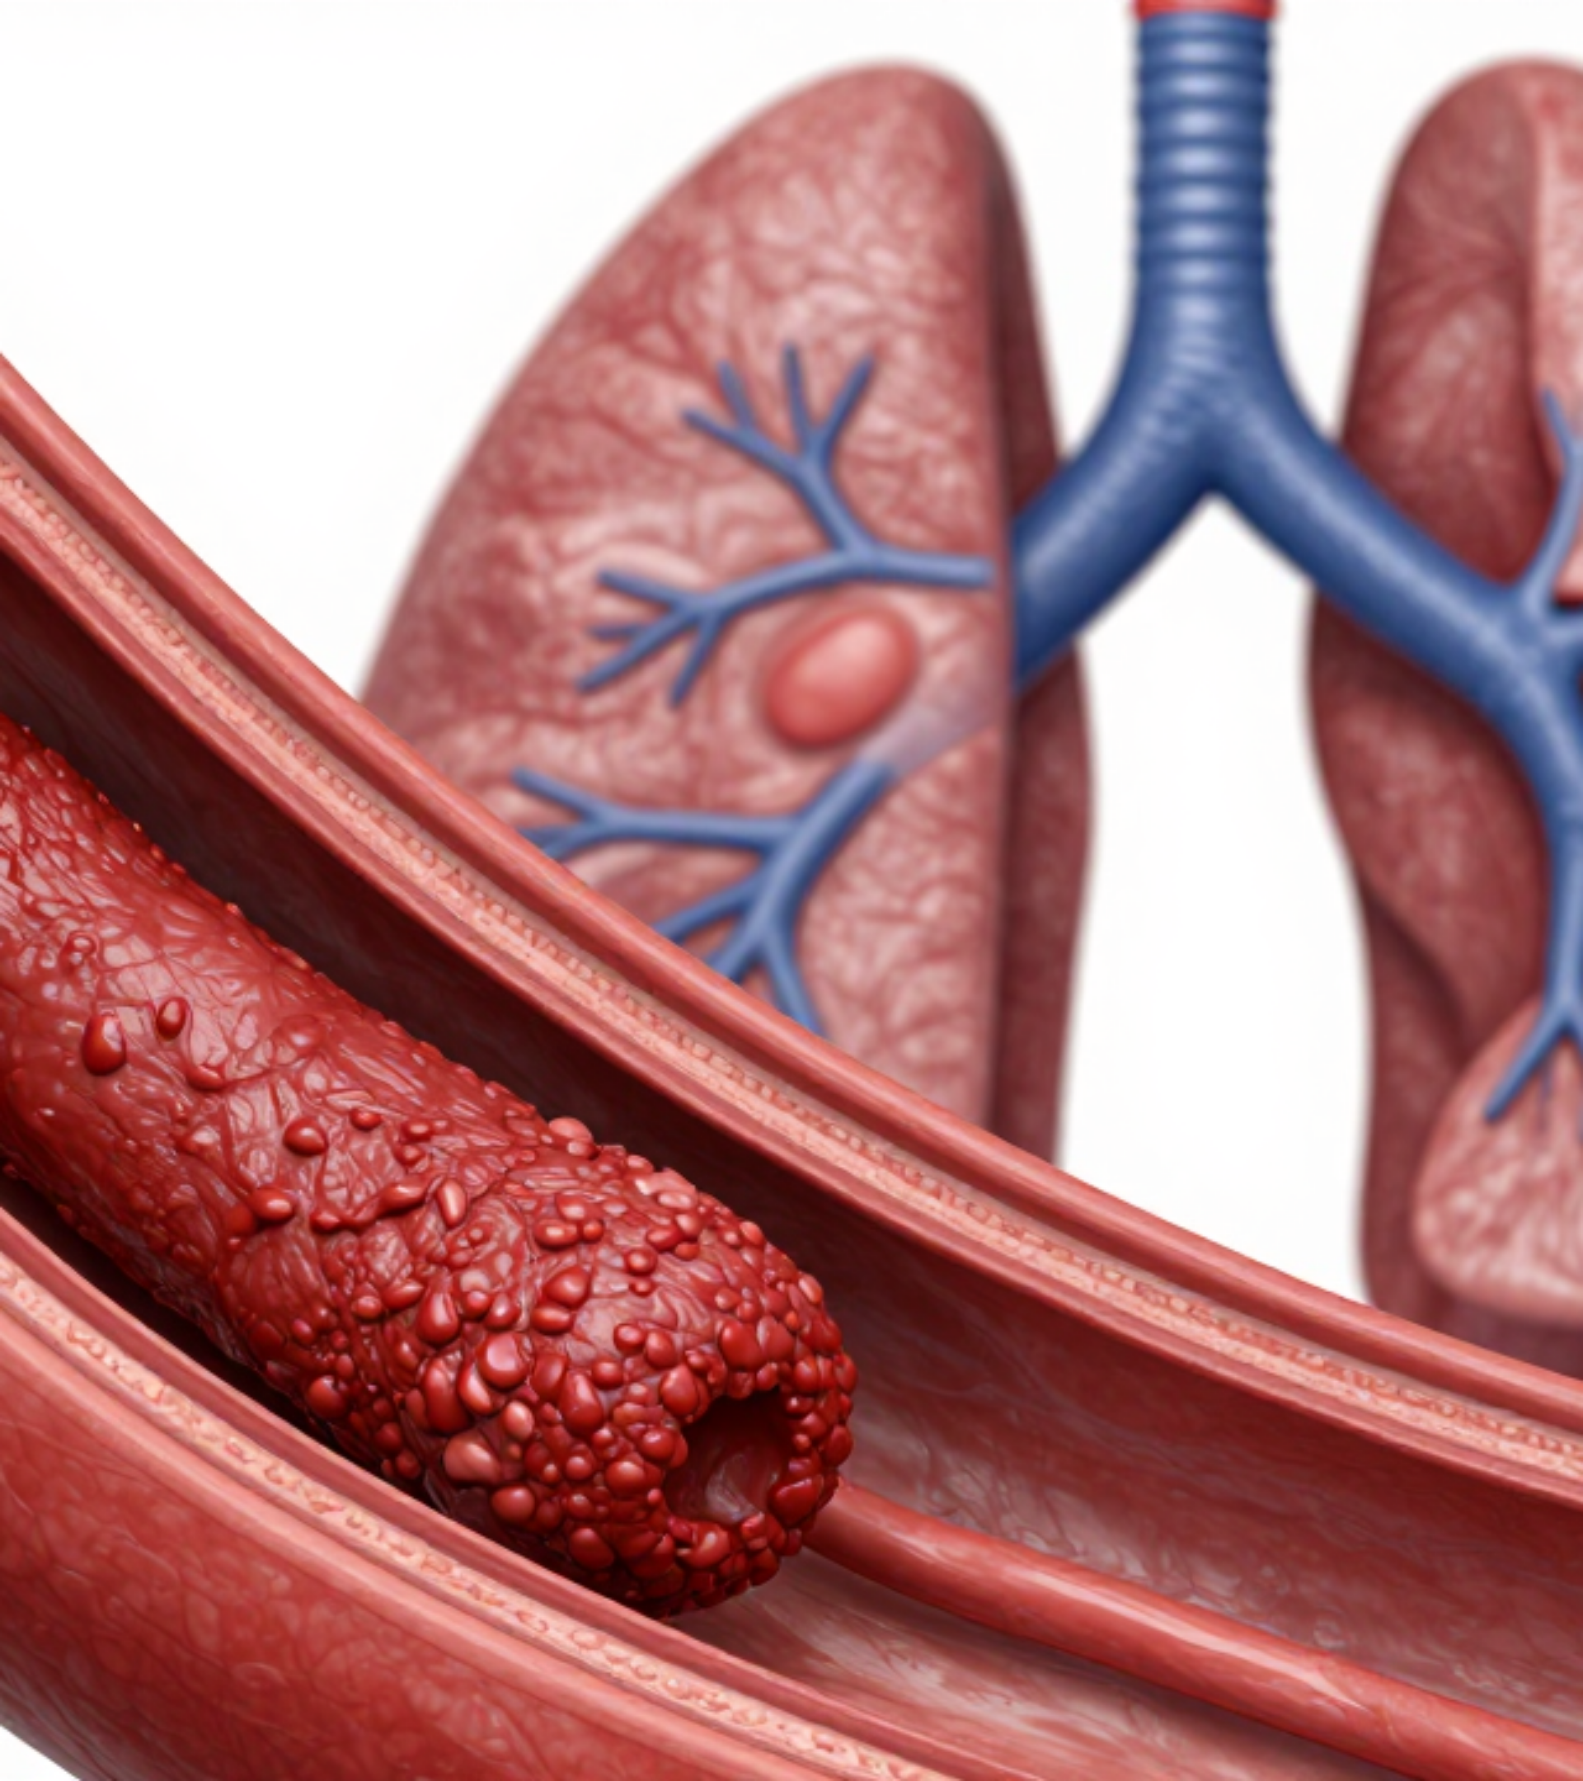

BRADFORD VTS TEACHING DECK
DVT and Pulmonary Embolism
Wells Scoring and VTE Management
DISCLAIMER: Slides provided for educational purposes. Check against latest NICE guidance & BNF
• Epidemiology & Risk Factors (Virchow’s Triad)
• 2-Level Wells Clinical Decision Rules
• Diagnostics: D-dimer, USS, and CTPA
• Anticoagulation: DOACs, LMWH, and Warfarin
NICE GUIDELINE NG158 (2020, UPDATED 2023)
Including AKT Fact-Checks & SCA Communication Skills

Slide 2













Guideline Authority and NICE NG158
BRADFORD VTS: VTE MANAGEMENT MODULE
NICE NG158 Standards
BNF & Pharmacotherapy
Full Title: Venous thromboembolic diseases: diagnosis, management and thrombophilia testing.
Dose Verification: All drug dosages (Apixaban, Rivaroxaban, LMWH) cross-referenced with the latest BNF edition.
Current Status: Published 2020, major updates applied in 2023 for clinical accuracy.
Safety First: Emphasis on renal function (eGFR) and weight-based dosing for LMWH.
Core Focus: Standardizing the 2-level Wells scoring and prioritizing DOACs for first-line treatment.
Interactions: Clinical deck includes BNF-standard monitoring requirements for Warfarin.
These guidelines form the gold standard for UK Primary Care VTE management.
ALWAYS verify patient-specific renal function before initiating DOAC therapy.

Slide 3






Epidemiology of VTE in the UK
BRADFORD VTS: VTE MANAGEMENT MODULE
1 in 1000
25,000
~50%
Annual Incidence
Preventable Deaths
Asymptomatic DVT
Venous Thromboembolism (VTE) affects approximately 1 in 1000 people per year across the UK population. Risk increases significantly with age and comorbid factors.
Pulmonary Embolism (PE) causes roughly 25,000 preventable deaths per year in UK hospitals. It remains the leading cause of avoidable inpatient mortality.
Up to half of Deep Vein Thromboses are clinically silent. Conversely, ~30% of patients with symptomatic DVT have concurrent, asymptomatic PE.
VTE = DVT + PE (One clinical spectrum)
Major cause of Post-Thrombotic Syndrome
High diagnostic index of suspicion required

Slide 4
















Risk Factors and Virchow's Triad
BRADFORD VTS: VTE MANAGEMENT MODULE
Virchow's Triad = Stasis + Endothelial Damage + Hypercoagulability
Stasis
Endothelial Damage
Hypercoagulability
Long-haul travel (>4 hours)
Major surgery or trauma
Malignancy (Active/Recent)
Prolonged bed rest / Immobility
Central venous catheters
Pregnancy or OCP / HRT
Post-operative recovery
Intravenous drug use
Inherited thrombophilia
Previous VTE
Age > 60
Obesity (BMI > 30)
OTHER KEY FACTORS
Heart Failure
Dehydration
Inflammatory Disease

Slide 5









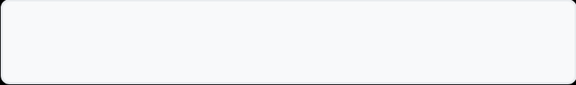

DVT Clinical Presentation
BRADFORD VTS: VTE MANAGEMENT MODULE
Primary Clinical Signs
The Homan's Sign Trap
Unilateral Calf Pain: Often described as a deep ache; tenderness on palpation of calf muscles.
Pain on passive dorsiflexion of the foot is insensitive and non-specific. Evidence suggests it should NOT be relied upon for clinical decision-making.
Swelling & Edema: Distension of the affected leg; may present as pitting edema.
Differential Diagnoses
Inflammatory Changes: Increased warmth and localized erythema.
Cellulitis
Muscle Tear/Strain
Venous Distension: Dilated superficial veins (non-varicose) may be visible.
Baker's Cyst (Ruptured)
Lymphoedema
Superficial Phlebitis
Venous Insufficiency
Note: 50% of DVTs can be asymptomatic; clinical suspicion must remain high in at-risk groups.
Always consider the "Two-Level Wells Score" if DVT is a diagnostic possibility.

Slide 6



















Two-Level Wells Score for DVT
BRADFORD VTS: VTE MANAGEMENT MODULE
CLINICAL CRITERION
SCORE
+1
Active cancer (treatment ongoing, within 6 months, or palliative)
+1
Paralysis, paresis, or recent plaster immobilisation of lower extremity
+1
Recently bedridden ≥3 days OR major surgery within 12 weeks
+1
Localised tenderness along distribution of deep venous system
Entire leg swollen
+1
Calf swelling >3 cm compared with asymptomatic leg
+1
Pitting oedema confined to the symptomatic leg
+1
Collateral superficial veins (non-varicose)
+1
Alternative diagnosis at least as likely as DVT
-2
Score ≥ 2
Score < 2
Use 2-level score for clinical management (NICE NG158)
LIKELY THRESHOLD:
UNLIKELY THRESHOLD:

Slide 7













DVT Wells Score Interpretation
BRADFORD VTS: VTE MANAGEMENT MODULE
Score ≥ 2
DVT LIKELY
Score < 2
DVT UNLIKELY
Immediate Action: Arrange proximal leg ultrasound (USS) to be performed within 4 hours.
First Step: Arrange a D-dimer blood test (result expected within 4 hours).
If USS delayed > 4h: Perform D-dimer blood test AND initiate interim anticoagulation.
If Negative: DVT is excluded. Consider alternative diagnoses (e.g., cellulitis).
USS must then be carried out within 24 hours of the clinical suspicion.
If Positive: Arrange proximal leg USS within 4 hours (or 24h with interim anticoagulation).
DO NOT wait for D-dimer results before arranging USS in likely cases.
D-dimer is used here as a rule-out tool for low-probability patients.
Protocol based on NICE NG158 (2-level DVT Wells Score). Always ensure safety-netting for sudden breathlessness or chest pain while awaiting scan results.

Slide 8








D-dimer Interpretation and Limitations
BRADFORD VTS: VTE MANAGEMENT MODULE
Diagnostic Utility
Low Specificity Pitfalls
High Sensitivity: Primarily used to RULE OUT VTE in patients with a low clinical probability (Wells score).
Physiological: Naturally raised in pregnancy and with advancing age.
Comorbidities: Elevated in infection, malignancy, and chronic inflammation.
Negative Result: If Wells score is "Unlikely" and D-dimer is negative, VTE can be safely excluded.
Injury/Surgery: Raised significantly following trauma or recent surgical intervention.
Age-Adjusted Thresholds
The Golden Rule
For patients over 50 years old, use age-adjusted cut-offs to improve clinical specificity.
Do NOT use D-dimer if clinical probability is high (Likely). Patient requires imaging regardless of the blood result.
Age × 10 μg/L
Upper Limit:

Slide 9











Investigations for DVT
BRADFORD VTS: VTE MANAGEMENT MODULE
Proximal Leg Ultrasound (USS)
Repeat Scanning Protocol
Diagnostic test of choice for suspected DVT; focuses on femoral and popliteal veins.
AKT MUST-KNOW
If initial USS is negative but clinical suspicion remains high, a repeat proximal USS is mandatory in 6–8 days.
Scan within 4 hours of request if Wells Score ≥2 (DVT Likely).
Consider thrombophilia testing only if DVT was unprovoked and you are planning to stop anticoagulation.
If scan not available within 4h: perform D-dimer, start interim anticoagulation, and scan within 24h.
Review differential diagnoses: cellulitis, ruptured Baker’s cyst, or muscle tear if scans remain negative.
Clinical Tip: Proximal USS is highly sensitive for clinically significant DVT but may miss isolated calf vein thrombi.
Safety Netting: Advise patients to return immediately if symptoms worsen or breathlessness develops while awaiting a repeat scan.

Slide 10
















PE Clinical Presentation
BRADFORD VTS: VTE MANAGEMENT MODULE
Common Symptoms
Clinical Signs
Sudden BreathlessnessMOST COMMON
TachycardiaMOST COMMON SIGN
Often abrupt onset; may occur at rest or on exertion.
Heart rate >100 bpm is a key indicator in the Wells score.
Pleuritic Chest Pain
Tachypnoea & Hypoxia
Sharp pain localized to the chest wall, worse on inspiration.
Increased respiratory rate and low oxygen saturations (SpO₂).
Haemoptysis
Signs of DVT
Coughing up blood, typically indicative of pulmonary infarction.
Unilateral leg swelling or calf tenderness (found in ~30% of PE).
URGENT / MASSIVE PE
Raised JVP
Hypotension (SBP <90)
Syncope / Collapse
Signs of Right Heart Strain

Slide 11















PE Differential Diagnoses
BRADFORD VTS: VTE MANAGEMENT MODULE
Pneumothorax
Acute Coronary Syndrome
Musculoskeletal Pain
Sudden onset unilateral chest pain and breathlessness.
Central "heavy" or "crushing" chest pressure.
Localized chest wall pain, often following strain.
Radiation to jaw, neck, or left arm; diaphoresis.
Pain is clearly reproducible on palpation.
Reduced breath sounds & hyper-resonance on percussion.
ECG changes (ST-elevation, T-wave inversion).
No associated tachycardia or hypoxia.
Tracheal deviation if tension (Medical Emergency).
Pneumonia
Aortic Dissection
Pericarditis / Pleuritis
Productive cough, high fever, and systemic malaise.
Sudden onset "tearing" or "ripping" chest pain.
Sharp pain, worse on inspiration or lying flat.
Radiation to the back (interscapular region).
Improved by leaning forward (Pericarditis).
Pleuritic chest pain (mimics PE) but with infective signs.
Blood pressure discrepancy between arms (>20mmHg).
Presence of pericardial or pleural friction rub.
Focal crackles or bronchial breathing on examination.
Clinical Pitfall: Never assume musculoskeletal pain in a patient with risk factors and tachycardia. Tachycardia is the most common sign of PE.

Slide 12

























Two-Level Wells Score for PE
BRADFORD VTS: VTE MANAGEMENT MODULE
CLINICAL CRITERION
SCORE
Clinical signs and symptoms of DVT (leg swelling, deep vein pain)
+ 3.0
Alternative diagnosis less likely than Pulmonary Embolism
+ 3.0
Heart rate > 100 beats per minute
+ 1.5
Immobilisation or surgery in the previous 4 weeks
+ 1.5
Previous documented DVT or PE
+ 1.5
Haemoptysis (coughing up blood)
+ 1.0
Malignancy (active treatment, within 6 months, or palliative)
+ 1.0
HIGH PROBABILITY
LOW PROBABILITY
Clinical Tip: The highest weight is given to the clinical suspicion and DVT signs. Always use the 2-level score for management decisions.
Score > 4: PE Likely
Score ≤ 4: PE Unlikely
Arrange immediate CTPA
Perform D-dimer test first

Slide 13















PE Wells Score Interpretation
BRADFORD VTS: VTE MANAGEMENT MODULE
PE Likely
PE Unlikely
Wells Score > 4
Wells Score ≤ 4
Arrange CTPA (CT Pulmonary Angiography) immediately.
Perform D-dimer test first.
Commence Interim Anticoagulation while awaiting imaging results.
If Negative: PE is excluded. Clinical monitoring only.
Do not wait for D-dimer results if clinical probability is high.
If Positive: Arrange CTPA immediately.
AKT RECALL: Original three-level scoring (useful for exams): High (>6), Moderate (2–6), Low (<2). However, modern clinical management (NG158) uses the 2-level score shown above.

Slide 14

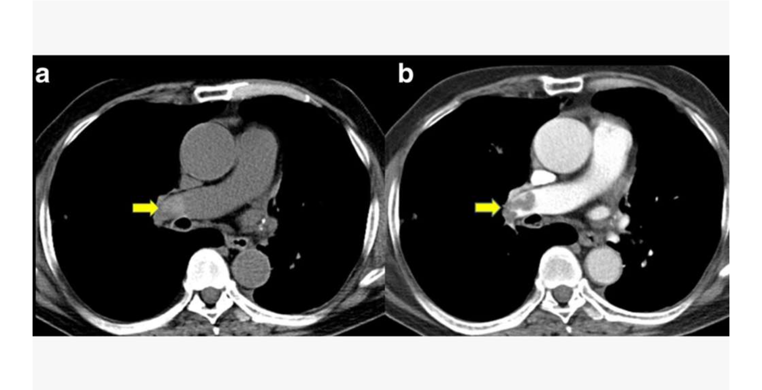














Investigations for PE: CTPA and V/Q Scan
BRADFORD VTS: VTE MANAGEMENT MODULE
CT Pulmonary Angiogram (CTPA)
Gold Standard Investigation: First-line for most patients where PE is likely.
High Accuracy: Excellent visualization of clots in the pulmonary arterial tree.
Sensitivity: ~83%
Specificity: ~96%
Requirements: Uses ionizing radiation and intravenous iodinated contrast.
Incidental Findings: Can identify alternative diagnoses (e.g., pneumonia, malignancy, pleural effusion).
V/Q (Ventilation/Perfusion) Scan
Alternative Investigation: Used when CTPA is contraindicated or unavailable.
Consider interim anticoagulation if CTPA is delayed.
Indications: Preferred in patients with severe renal impairment (eGFR <30) or iodine allergy.
Limitations: Results are often reported as probability; less specific than CTPA if baseline CXR is abnormal.

Slide 15








ECG and CXR Findings in PE
BRADFORD VTS: VTE MANAGEMENT MODULE
ECG Manifestations
Chest X-Ray Signs
Sinus Tachycardia
Often Normal
MOST COMMON
FREQUENT
Present in the majority of symptomatic cases.
A normal CXR in a hypoxic patient is highly suspicious for PE.
S1Q3T3 Pattern
Hampton's Hump
CLASSIC BUT RARE
Deep S in Lead I, Q wave in Lead III, Inverted T in Lead III.
Shallow, wedge-shaped opacity at the lung periphery (infarction).
Right Heart Strain
Westermark Sign
T-wave inversions in V1-V4 and new Right Bundle Branch Block (RBBB).
Focal oligaemia (decreased vascular markings) distal to the clot.
Non-specific Findings
Atelectasis, small pleural effusion, or raised hemidiaphragm.
AKT FOCUS
Don't get caught out: Sinus Tachycardia is the most frequent ECG finding. S1Q3T3 is classically associated but only occurs in ~20% of cases.

Slide 16












Massive PE and Haemodynamic Instability
BRADFORD VTS: VTE MANAGEMENT MODULE
Clinical Identification
Emergency Management
Hypotension: Systolic Blood Pressure < 90 mmHg
Call 999 immediately: Time-critical emergency transfer
Tachycardia: Heart Rate > 100 bpm
Resuscitate using ABCDE approach
Circulatory collapse or sudden unexplained syncope
HOSPITAL INTERVENTION
Right heart strain signs (e.g., raised JVP)
Thrombolysis (e.g. alteplase), surgical embolectomy, or catheter-directed therapy.

Slide 17













First-Line Treatment: DOACs
BRADFORD VTS: VTE MANAGEMENT MODULE
NICE NG158 Recommendation: DOACs are preferred over LMWH + Warfarin for most VTE patients.
Apixaban (Eliquis)
Rivaroxaban (Xarelto)
INITIAL LOADING
INITIAL LOADING
10 mg BD
15 mg BD
Duration: First 7 days
Duration: First 21 days
MAINTENANCE
MAINTENANCE
5 mg BD
20 mg OD
Review duration at 3 months
Must be taken with food
Fixed Dosing
No Monitoring
Fewer Interactions
Rapid Onset
Predictable pharmacokinetics; no need for weight-based titration in most adults.
No routine INR monitoring required, reducing primary care workload and patient visits.
Minimal dietary restrictions and fewer drug-drug interactions than Vitamin K antagonists.
Quickly therapeutic; eliminates the need for LMWH bridging in the majority of cases.
Clinical Tip: Always check eGFR before prescribing. DOACs are generally avoided if eGFR <15.
Source: NICE NG158 / BNF 2024

Slide 18








LMWH and Warfarin Indications
BRADFORD VTS: VTE MANAGEMENT MODULE
LMWH Indications
Warfarin (VKA) Points
Pregnancy: The only safe option. DOACs and Warfarin are strictly contraindicated.
Target INR: Aim for 2.0 – 3.0 for standard DVT or PE management.
Active Cancer: Preferred over DOACs in most guidelines (e.g., Tinzaparin/Dalteparin).
Bridging Therapy: Must be bridged with LMWH until INR is therapeutic for ≥24 hours.
Severe Renal Impairment: Primary choice when eGFR <15 mL/min/1.73m².
Current Status: Now less preferred than DOACs due to monitoring and dietary restrictions.
COMMON EXAMPLES
MONITORING REQUIREMENTS
Dalteparin: Weight-based dosing
Tinzaparin: 175 units/kg OD
Requires regular venous INR monitoring and strict adherence to dose-adjustment schedules.
Source: NICE NG158 & BNF Current Edition. DOACs remain first-line for most non-pregnant, non-cancer patients.

Slide 19









Duration of Anticoagulation
BRADFORD VTS: VTE MANAGEMENT MODULE
Clinical Situation
Recommended Duration (NICE NG158)
First DVT/PE
3 months
With a reversible provoking factor
Minimum 3 months; then consider extension based on risk-benefit discussion.
Unprovoked DVT/PE
No obvious cause identified
Minimum 6 months; continue while cancer is active or treatment ongoing.
Cancer-associated VTE
Active malignancy or treatment
Long-term (Indefinite) anticoagulation typically required.
Recurrent VTE / APS
Antiphospholipid Syndrome
Consider long-term; require specialist haematology input.
High-risk Thrombophilia
e.g., Antithrombin/Protein C deficiency
AKT Exam Point
SCA Skill-Check
Provoked VTE = 3 months duration.
Discussing duration requires Shared Decision Making. Balance the 5% annual risk of recurrence (unprovoked) against the 1–3% annual risk of major bleeding on DOACs.
Unprovoked VTE = Reassess at 3 months for potential indefinite treatment.

Slide 20
















Thrombophilia Testing
BRADFORD VTS: VTE MANAGEMENT MODULE
Who to Test? (NICE NG158)
Timing and Specific Tests
Unprovoked proximal DVT or PE: Offer if considering stopping anticoagulation.
Wait Period: Test at least 4 weeks AFTER stopping anticoagulation.
Standard Thrombophilia Screen:
Recurrent VTE: Essential to identify underlying hypercoagulability.
Family History: First-degree relative with VTE or known high-risk thrombophilia.
Factor V Leiden
Prothrombin Gene
Protein C & S
Antithrombin III
Young Patients: Consider in unprovoked VTE at a young age (<40-50).
Antiphospholipid Ab
Lupus Anticoagulant
GP Management Tip:
If results are abnormal, refer to Haematology. Antiphospholipid syndrome or Antithrombin deficiency often requires lifelong (indefinite) anticoagulation.
THE GOLDEN RULE
Do NOT test while the patient is on anticoagulation. Warfarin and LMWH significantly interfere with results (especially Protein C/S and Antithrombin).

Slide 21











Hospital VTE Prophylaxis (NICE NG89)
BRADFORD VTS: VTE MANAGEMENT MODULE
VTE Risk Assessment
Pharmacological Prophylaxis
Mandatory for all hospital inpatients on admission.
LMWH: Standard dosing (e.g., Enoxaparin 40mg OD or Dalteparin 5000 units OD).
Must be re-assessed at 24 hours to identify dynamic clinical changes.
Adjust for renal impairment (check local trust eGFR thresholds).
Mechanical Prophylaxis
Duration of Prophylaxis
TED Stockings: Graduated compression to reduce venous stasis.
Standard: Typically 10–14 days for general medical/surgical patients.
IPC: Intermittent Pneumatic Compression boots for surgical patients.
Extended: 28–35 days post-hip/knee replacement or lower limb fracture surgery.
Reference: NICE Guideline NG89 (Venous thromboembolism in over 16s: role of hospital-led prophylaxis).

Slide 22












Primary Care VTE Prevention
BRADFORD VTS: VTE MANAGEMENT MODULE
Long-Haul Travel Advice
Post-Thrombotic Syndrome (PTS)
General Measures: Regular calf exercises, frequent walking, and maintaining good hydration. Advise avoiding excessive alcohol and sedatives.
Prevention Protocol: Offer graduated compression stockings for at least 2 years following a proximal DVT.
Clinical Impact: PTS affects 20–50% of patients; stockings significantly reduce chronic pain, swelling, and venous ulcers.
Duration: Risks increase significantly for flights or travel durations exceeding 4 hours.
High-Risk Travellers: Recommend below-knee graduated compression stockings (Class 1 or 2) for patients with risk factors.
LMWH Consideration: For extremely high-risk patients (e.g., active cancer, history of VTE), consider a single dose of LMWH prior to departure.
Guidance: Aspirin is NOT recommended as primary prophylaxis for travel-related VTE (limited evidence).

Slide 23















Post-Thrombotic Syndrome
BRADFORD VTS: VTE MANAGEMENT MODULE
Prevalence & Impact
Prevention Strategy
Affects 20–50% of patients after proximal DVT.
Significant cause of chronic morbidity and disability.
Graduated compression stockings (GCS) are key.
Wear for at least 2 years post-proximal DVT.
Reduces the risk of PTS development significantly.
Clinical Presentation
GP Tip: Early mobilisation and adherence to GCS reduce long-term venous complications.
Chronic leg pain and persistent swelling.
Skin changes: Hyperpigmentation and eczema.
Severe cases: Venous ulceration and varicose veins.

Slide 24
























Top Tips for GP Trainees: Clinical Pearls
BRADFORD VTS: VTE MANAGEMENT MODULE
Two-Level Wells Score
VTE in Pregnancy
Always use the NICE NG158 2-level score. Do not rely on the older 3-level score for clinical management.
LMWH only. Warfarin and DOACs are strictly contraindicated. Immediate obstetric/haematology review required.
D-dimer: Rule OUT Only
Cancer-Associated VTE
D-dimer is highly sensitive but non-specific. Use it to exclude VTE in low-probability patients, never to confirm it.
LMWH (Tinzaparin/Dalteparin) is generally preferred over DOACs. Minimum treatment duration is 6 months.
Likely PE Management
Treatment Duration
If Wells PE score >4, the patient needs a CTPA immediately. Do not wait for a D-dimer result.
3 months for provoked VTE with a reversible factor. Minimum 3 months for unprovoked, then reassess.
ECG Findings
Thrombophilia Testing
Sinus tachycardia is the most common ECG finding in PE. S1Q3T3 is classic but actually rare.
Never test while on anticoagulants. Wait at least 4 weeks after stopping therapy to ensure accurate results.
First-Line DOACs
D-dimer Pitfalls
Apixaban or Rivaroxaban are first-line for most. Avoid in pregnancy or severe renal impairment.
Levels are naturally raised in pregnancy, infection, surgery, and malignancy. Interpret with clinical caution.

Slide 25








Red Flags and Emergency Situations
BRADFORD VTS: VTE MANAGEMENT MODULE
Massive PE / Shock
Pregnancy & VTE
Haemodynamic instability: SBP < 90 mmHg
Any suspected DVT or PE in a pregnant patient
Profound tachycardia (HR > 100) or syncope
Start LMWH immediately while awaiting review
Sudden severe hypoxia / circulatory collapse
Warfarin and DOACs are strictly contraindicated
CALL 999 IMMEDIATELY & RESUSCITATE
IMMEDIATE OBSTETRIC/HAEMATOLOGY REVIEW
Clinical Warning Signs
Recurrence & Occult Risk
Bilateral DVT + breathlessness: High PE risk
Unexplained VTE in young patients (no provoking factors)
Haemoptysis + pleuritic pain + tachycardia
Recurrent VTE despite adequate anticoagulation
Suspect VTE until proven otherwise (Urgent CTPA)
Screen for occult malignancy or thrombophilia
URGENT SECONDARY CARE ASSESSMENT
SPECIALIST HAEMATOLOGY ADVICE

Slide 26












AKT Exam Focus: Clinical Decision Rules
BRADFORD VTS: VTE MANAGEMENT MODULE
2-Level Wells DVT Score
2-Level Wells PE Score
Score ≥ 2 (Likely): Arrange proximal leg ultrasound scan within 4 hours.
Score > 4 (Likely): Arrange immediate CTPA and interim anticoagulation.
Score < 2 (Unlikely): Offer D-dimer test first.
If ultrasound is unavailable within 4h, perform D-dimer and interim anticoagulation.
Score ≤ 4 (Unlikely): Offer D-dimer test. If positive, arrange CTPA.
D-dimer negative with low Wells score rules out PE (no imaging needed).
Exam Tip: Proximal leg USS is the diagnostic test of choice for DVT.
Exam Tip: CTPA is the gold standard investigation for suspected PE.
D-DIMER ROLE
SENSITIVITY
COMMON ECG
STANDARD
Rule OUT only
High (95%+)
Sinus Tachycardia
NICE NG158

Slide 27





















AKT Exam Focus: Management & Special Groups
BRADFORD VTS: VTE MANAGEMENT MODULE
Anticoagulation Duration (NICE NG158)
Clinical Scenario
Standard Duration
Key AKT Consideration
Provoked VTE (Reversible factor)
Stop after 3 months if factor resolved
3 Months
Unprovoked VTE
Minimum 3 Months
Discuss long-term risk vs benefit at review
Active Cancer-Associated VTE
Minimum 6 Months
Continue anticoagulation while cancer is active
Cancer-Associated VTE
VTE in Pregnancy
AKT Quick Recall
First-line Choice: LMWH (e.g., Tinzaparin or Dalteparin) is traditionally preferred.
LMWH: The safe treatment. Dosing is weight-based.
First-line DVT/PE: Apixaban or Rivaroxaban for most.
Alternative: DOACs (Apixaban/Rivaroxaban) are now options unless GI malignancy.
Contraindicated: Warfarin and DOACs (teratogenic/unsafe).
Renal: LMWH if eGFR <15.
AKT Fact: Minimum treatment duration is 6 months for any cancer-provoked clot.
Action: Urgent Obstetric/Haematology referral for all suspected cases.
"Do not test for thrombophilia while on anticoagulation."

Slide 28











SCA Exam Focus: Communication and ICE
BRADFORD VTS: VTE MANAGEMENT MODULE
Ideas (Exploration)
SCA Skill-Check Prompt
“What made you think something might be wrong today?
“Have you ever had anything like this before?
Role Play: One trainee explains the need for an urgent CTPA to a patient who is worried about radiation and "just wants a blood test."
Focus: Validating concerns while explaining clinical necessity (Wells Score >4).
Concerns (Fears)
“Are you worried it might be something serious — like a clot?
Professional Consultation Tips
“Is there anything in particular you've been reading or hearing about?
Avoid Jargon: Use "blockage in the lung" instead of "pulmonary embolism" during initial explanation.
Normalizing: "It’s very common for people with a swollen leg to worry about clots; let’s see if we can rule that out."
Expectations (Goals)
Chunk & Check: Provide information in small pieces and check for understanding before moving to management.
“What were you hoping we could do for you today?
Shared Decision: Discuss why certain tests (like D-dimer) are or are not appropriate based on clinical probability.
“What are you hoping the tests will show?

Slide 29










SCA Exam Focus: Explaining Treatment and Safety Netting
BRADFORD VTS: VTE MANAGEMENT MODULE
Explaining Anticoagulation
Safety Netting (Low-Risk)
Use the "thins the blood" analogy for clarity."It stops the clot getting bigger and gives your body time to break it down naturally."
Reassure regarding D-dimer reliability when negative."If the blood test is normal, we are very confident there is no clot."
Emergency Safety Netting:
Explicitly address the main side effect: Bleeding.
"If you develop sudden breathlessness or chest pain, call 999 immediately."
Discussing Duration
Shared Decision-Making
Focus on the 3-month review milestone."After 3 months, we'll review the risk. If there was a clear cause (like a long flight), we may stop it safely."
Handle refusal by exploring the patient's ICE.
Balance the Bleeding Risk vs. the Risk of PE.
Always document the shared decision and rationale.
Link treatment length to the "provoking factor" concept.

Slide 30















Quick Recall Summary
BRADFORD VTS: VTE MANAGEMENT MODULE
Foundations & Logic
Anticoagulation First-Lines
Virchow's Triad
Standard (DVT/PE)
Stasis + Endothelial Damage + Hypercoagulability.
DOACs: Apixaban or Rivaroxaban.
D-dimer Rule
Pregnancy
High Sensitivity (Rules OUT) but Low Specificity (Cannot Rule IN).
LMWH (Dalteparin/Tinzaparin). DOACs/Warfarin contraindicated.
Pitfall
Active Cancer
Do NOT perform D-dimer if clinical probability is Likely.
LMWH preferred over DOACs (NICE NG158).
Provoked VTE
Minimum 3 months duration.
Two-Level Wells Thresholds
Essential Clinical Findings
DVT Score≥ 2
PE Gold Standard
Likely: Arrange Proximal Leg Ultrasound (USS).
CT Pulmonary Angiography (CTPA).
DVT Score< 2
Most Common ECG Sign
Unlikely: Perform D-dimer test first.
Sinus Tachycardia (NOT S1Q3T3).
PE Score> 4
PTS Prevention
Likely: Arrange immediate CTPA.
Compression stockings for ≥ 2 years post-DVT.
PE Score≤ 4
Thrombophilia Testing
Unlikely: Perform D-dimer test first.
Wait ≥ 4 weeks AFTER stopping anticoagulation.

