Slide 1


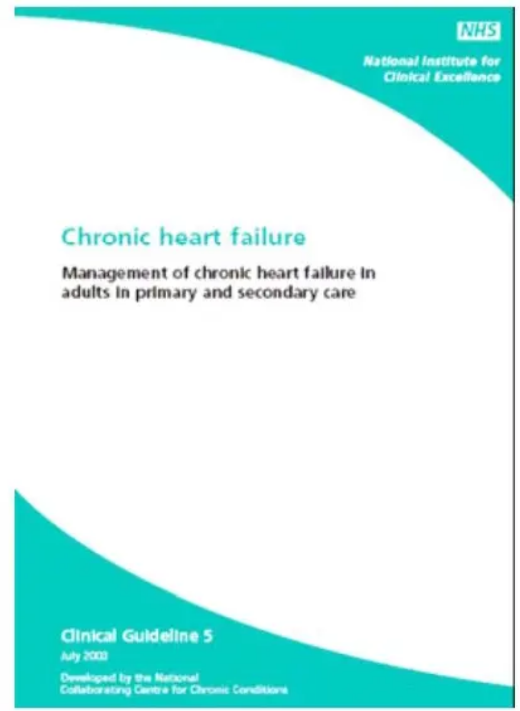





BRADFORD VTS TEACHING DECK
Heart Failure in Primary Care
COMPREHENSIVE GP TRAINEE MODULE • NICE NG106 (2025)
CLINICAL UPDATE
NICE NG106 Standards
Last updated: September 2025
Covering the "Four Pillars" of treatment, diagnostic pathways, and the full spectrum of HFrEF, HFmrEF, and HFpEF management.
MEDICAL DISCLAIMER
This presentation is intended for educational purposes for GP trainees and healthcare professionals. Clinical decisions should always be based on the most current national guidelines (NICE/BNF) and tailored to the individual patient's clinical context. The authors accept no responsibility for clinical outcomes resulting from the use of this material.
Reference: NICE NG106 (2025) Clinical Management Standards
www.bradfordvts.co.uk

Slide 2


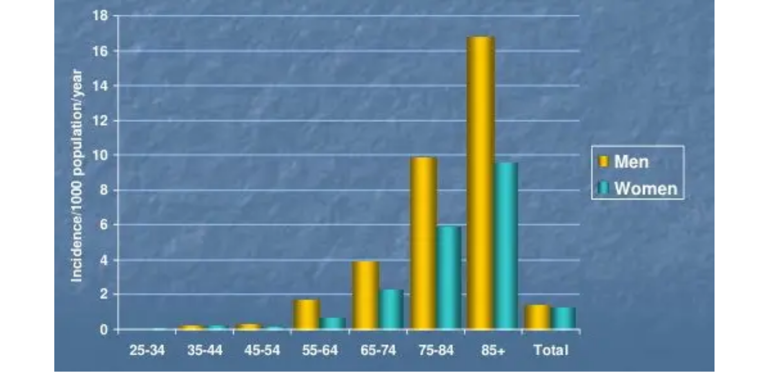











Heart Failure: Overview and Epidemiology
HEART FAILURE IN PRIMARY CARE • NICE NG106 (2025)
Clinical Definition
A complex clinical syndrome where the heart is unable to pump sufficient blood to meet the body's metabolic demands. It is characterized by typical symptoms (e.g. breathlessness, ankle swelling) and signs (e.g. raised JVP, pulmonary crackles).
UK Prevalence
Systemic Impact
Affects 1–2% of the UK adult population (~900,000 people).
Annual NHS cost exceeds £2 billion.
Approximately 200,000 new diagnoses per year.
Accounts for 5% of all acute medical admissions.
Incidence rises steeply with age: over 10% in those aged >70.
Admissions predicted to rise by 50% over the next 25 years.
www.bradfordvts.co.uk
Bradford VTS GP Teaching Deck • 2025 Update

Slide 3


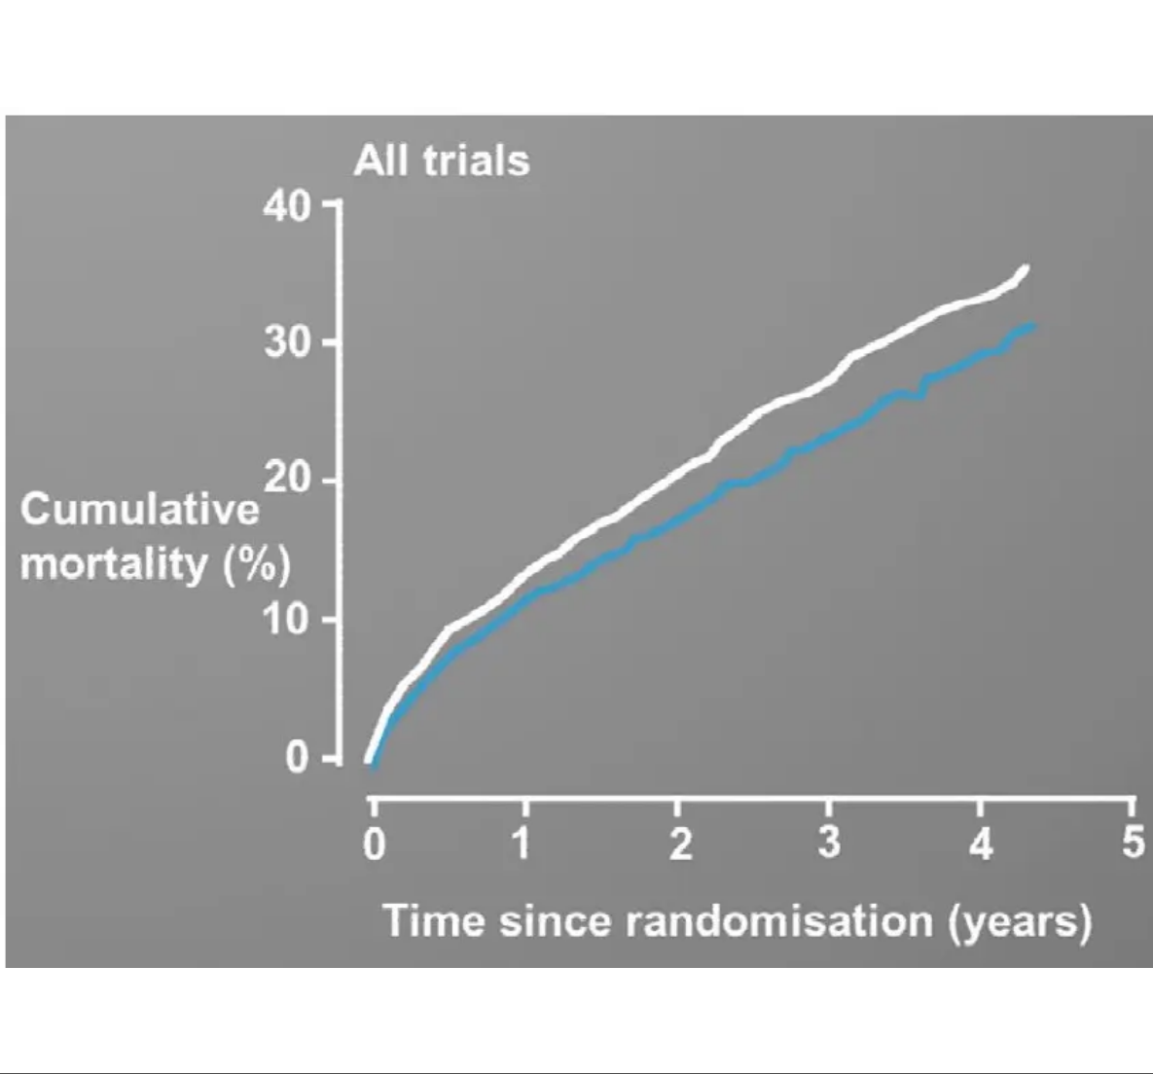







Mortality and Prognosis
HEART FAILURE IN PRIMARY CARE • NICE NG106 (2025)
5-year mortality is approximately 50% — significantly worse than many common cancers (breast, prostate, bowel).
Heart failure accounts for 5% of all acute medical admissions to UK hospitals.
Admissions are projected to rise by 50% over the next 25 years due to an aging population.
The annual cost to the NHS exceeds £2 billion, mostly driven by hospitalisation.
AKT PEARL
HF prognosis is often poorer than common cancers. Remember the 50% 5-year mortality figure for clinical risk stratification.
Figure: Cumulative mortality (%) over 5 years across all major heart failure trials.
www.bradfordvts.co.uk

Slide 4















NYHA Functional Classification
HEART FAILURE IN PRIMARY CARE • NICE NG106 (2025)
Class I
Class II
Class III
Class IV
No limitation. Ordinary physical activity does not cause fatigue, breathlessness, or palpitations.
Slight limitation. Comfortable at rest. Ordinary activity results in fatigue or breathlessness.
Marked limitation. Comfortable at rest. Less than ordinary activity causes symptoms.
Symptoms at rest. Inability to carry out any physical activity without discomfort.
SCA EXAM PEARLQOF REQUIREMENT HF007
"How has your breathing been affecting what you can do day-to-day?" – Use this opener to assess functional capacity and accurately document NYHA class at every review.
www.bradfordvts.co.uk

Slide 5















Pathophysiology: The Basics for Primary Care
HEART FAILURE IN PRIMARY CARE • NICE NG106 (2025)
1. The Initial Trigger
3. The Vicious Cycle
LV dysfunction (e.g., post-MI) leads to reduced cardiac output. This triggers a compensatory cascade designed to maintain perfusion.
Maladaptation results in progressive damage, creating a self-perpetuating cycle of decline:
Reduced Stroke Volume & Cardiac Output
Cardiac Remodelling: LV hypertrophy, dilation, and fibrosis
Baroreceptor sensing of low pressure
Fluid Overload: Increased preload causes pulmonary and peripheral congestion
Increased Afterload: Vasoconstriction forces the failing heart to pump harder
2. Neurohormonal Activation
Initially helpful, but chronic activation becomes the driver of the disease:
RAAS: Renin → Angiotensin II (vasoconstriction) → Aldosterone (salt/water retention)
AKT EXAM PEARL
Heart Failure is a neurohormonal disease, not just a plumbing issue. Modern medical management (The Four Pillars) targets these specific pathways to interrupt the vicious cycle of remodelling and clinical decline.
Sympathetic System: ↑ Heart rate and contractility, further peripheral vasoconstriction
www.bradfordvts.co.uk
Bradford VTS Teaching Deck • Slide 6

Slide 6










Mechanisms of Dysfunction: HFrEF vs HFpEF
HEART FAILURE IN PRIMARY CARE • NICE NG106 (2025)
SYSTOLIC DYSFUNCTION
DIASTOLIC DYSFUNCTION
HFrEF (Reduced)
HFpEF (Preserved)
Ejection Fraction < 40%
Ejection Fraction ≥ 50%
Impaired ContractionThe heart muscle is thin, weak, or damaged, failing to pump blood effectively out to the body.
Impaired RelaxationThe heart muscle is thick and stiff; it cannot relax properly to allow the ventricles to fill with blood.
Structural RemodellingOften involves ventricular dilatation and "eccentric" hypertrophy (thinning of the walls).
Concentric HypertrophyIncreased wall thickness with a smaller or normal-sized ventricular cavity.
Common AetiologyPost-MI (Pump failure), Valvular disease, or Dilated Cardiomyopathy.
Typical Patient ProfileCommon in elderly, hypertensive, and diabetic women; often associated with obesity and AF.
AKT PEARL: NICE 2025 emphasizes the "Four Pillars" of treatment specifically for HFrEF patients.
SCA TIP: Don't assume "Preserved" means "Normal". HFpEF carries significant mortality and morbidity.
www.bradfordvts.co.uk

Slide 7













Common Causes: The PIRATE Mnemonic
HEART FAILURE IN PRIMARY CARE • NICE NG106 (2025)
P
I
R
PUMP FAILURE
INFECTIONS
RHYTHM
Most common cause is ischaemia/infarction (Post-MI) leading to LV dysfunction.
Viral myocarditis or other systemic infections causing acute myocardial stress.
Atrial Fibrillation (AF) or sustained tachy/bradyarrhythmias causing reduced filling/output.
A
T
E
ALCOHOL & TOXINS
THYROID DISEASE
EXTREME PRESSURE
Direct cardiotoxicity from excessive alcohol or chemotherapy (e.g. anthracyclines).
Both hyperthyroidism (tachycardia-induced) and hypothyroidism can impair function.
Hypertension and valvular heart disease (Aortic Stenosis/Mitral Regurgitation).
COMMON PITFALL
Don't assume "ankle oedema" is just age or gravity. Always assess for heart failure causes before prescribing diuretics, and check for NSAID use which can precipitate acute decompensation.
www.bradfordvts.co.uk
For educational purposes only. Refer to full NICE guidelines for clinical decisions.

Slide 8












NICE Classification (NG106 2025)
HEART FAILURE IN PRIMARY CARE • NICE NG106 (2025)
HFrEF
HFmrEF
HFpEF
Reduced EF < 40%
Mildly Reduced EF 40–49%
Preserved EF ≥ 50%
Classic Systolic Dysfunction where the pump is failing.
The clinical "Grey Zone" between reduced and preserved.
Primarily Diastolic Dysfunction (impaired filling/relaxation).
Strongest evidence base for "The Four Pillars" of treatment.
Recently recognised as a distinct entity in NICE 2025.
Most common in elderly, hypertensive, and diabetic women.
NICE NG106 (2025) Note: The classification is based on Left Ventricular Ejection Fraction (LVEF) as determined by Echocardiography. While HFrEF has the most established pharmacological evidence, the 2025 update significantly expands treatment recommendations for HFmrEF and HFpEF, particularly with SGLT2 inhibitors.
www.bradfordvts.co.uk

Slide 9













Step 1: Suspecting Heart Failure in the Clinic
HEART FAILURE IN PRIMARY CARE • NICE NG106 (2025)
Breathlessness (Dyspnoea)
SCA EXAM PEARL: FUNCTIONAL OPENER
"How has your breathing been affecting what you can do day-to-day?"
Assessing NYHA class and functional capacity is a mandatory QOF requirement.
Exertional or at rest; often the earliest sign.
Orthopnoea & PND
RED FLAG: ACUTE PRESENTATION
Needing extra pillows; waking up gasping for air.
If patient presents with acute breathlessness, raised JVP, and basal crackles, suspect acute pulmonary oedema.
Action: 999 / Immediate hospital admission.
Ankle Swelling
Bilateral dependent oedema; may extend to legs/sacrum.
Less Typical Signs:
Fatigue & Exercise Intolerance
Nocturnal cough / Wheeze ("Cardiac Asthma")
Weight gain (>2kg in 2 days)
Reduced cardiac output leading to systemic tiredness.
Abdominal bloating / Anorexia (Congestion)
www.bradfordvts.co.uk

Slide 10














Step 2: The Natriuretic Peptide Pathway
HEART FAILURE IN PRIMARY CARE • NICE NG106 (2025)
Step 1: Clinical Suspicion
AKT EXAM PEARL
Identify red flag symptoms: breathlessness, orthopnoea, PND, and ankle swelling. Assess for risk factors (ischaemic heart disease, hypertension).
NT-proBNP is always the first investigation. Do not jump straight to an echocardiogram in primary care. NP levels drive the urgency of the 2-week vs. 6-week referral pathway.
Step 2: NP Testing (First-Line)
PRIMARY CARE SAFE
Request NT-proBNP (or BNP) in primary care. This is the "gatekeeper" test with high negative predictive value.
If NT-proBNP is <400 ng/L, heart failure is highly unlikely. You can safely investigate alternative causes (COPD, anaemia, obesity) without an immediate cardiology referral.
CLINICAL CAVEATNP levels can be falsely low in acute pulmonary oedema. If HF is strongly suspected and the patient is acutely unwell, refer urgently regardless of NP result.
Step 3: Referral Logic
Referral for specialist assessment and echocardiography is mandatory only if NP is raised. Low NP usually excludes HF.
www.bradfordvts.co.uk

Slide 11









Interpreting NT-proBNP Levels
HEART FAILURE IN PRIMARY CARE • NICE NG106 (2025)
NT-proBNP Level
Interpretation
Clinical Action
< 400 ng/L
Heart Failure Unlikely
Investigate other causes (e.g. respiratory, obesity, anaemia).
400 – 2,000 ng/L
Raised – HF Possible
Refer for specialist assessment and echocardiography within 6 weeks.
> 2,000 ng/L
Very High – HF Probable
Urgent Referral: specialist assessment and echocardiography within 2 weeks.
AKT EXAM PEARL
CLINICAL RED FLAG
Memorise the thresholds exactly: >2,000 ng/L triggers the 2-week urgent pathway. NT-proBNP is the preferred first-line test in primary care for suspected heart failure.
Natriuretic peptide levels may be low in acute pulmonary oedema. If the clinical presentation is acute and HF is strongly suspected, refer urgently regardless of the NP result.
*Note: NT-proBNP levels can be influenced by factors such as age, obesity (lowers NP), and renal failure (raises NP).
Bradford VTS Teaching Deck: Heart Failure
www.bradfordvts.co.uk

Slide 12














Interpreting BNP Levels
HEART FAILURE IN PRIMARY CARE • NICE NG106 (2025)
BNP Level
Interpretation
Action / Referral
AKT EXAM PEARL
< 100 pg/ml
HF Unlikely
Investigate other causes for symptoms.
Memorize the 2-week vs 6-week thresholds. This is high-yield for clinical management questions. For BNP, the magic "urgent" number is 400. (For NT-proBNP, it is 2,000).
100 – 400 pg/ml
Raised
Refer for Specialist Assessment + Echo within 6 weeks.
CLINICAL PRIORITY
> 400 pg/ml
High
Urgent Referral — Specialist + Echo within 2 weeks.
NP levels can be falsely low in acute pulmonary oedema. If HF is strongly suspected clinically (e.g., acute breathlessness, JVP elevation), refer urgently regardless of the NP result.
www.bradfordvts.co.uk

Slide 13












Step 3: Echocardiography
HEART FAILURE IN PRIMARY CARE • NICE NG106 (2025)
The Clinical Gold Standard
Structural & Functional Analysis
Definitive Diagnosis
Wall Motion Abnormalities
Mandatory investigation to confirm heart failure when Natriuretic Peptides are raised.
Identifies regional dysfunction suggesting previous MI or underlying ischaemia.
EF Quantification
Chamber Geometry
Measures Left Ventricular Ejection Fraction (LVEF) to classify HFrEF, HFmrEF, or HFpEF.
Assesses Left Ventricular hypertrophy (hypertension) or dilation (dilated cardiomyopathy).
Therapeutic Roadmap
Valvular Integrity
Provides the physiological evidence required to initiate "Four Pillar" therapy.
Grades stenosis or regurgitation (e.g., Aortic Stenosis/Mitral Regurgitation).
PRIMARY CARE MANDATE
Echocardiography is mandatory for all patients with raised NT-proBNP. Referral timing (2 vs 6 weeks) is determined strictly by the NP level and clinical history.
www.bradfordvts.co.uk

Slide 14























Interpreting Echocardiography Reports
HEART FAILURE IN PRIMARY CARE • NICE NG106 (2025)
Ejection Fraction (EF) Categories
Valvular & Structural Findings
Type
EF Range
Clinical Label
Grading: Reported as Mild, Moderate, or Severe.
HFrEF
< 40%
Reduced
Referral Threshold: Refer patients with Moderate-Severe valve disease if symptomatic.
HFmrEF
40 – 49%
Mildly Reduced
Diastolic Dysfunction: Graded I–III. Common in HFpEF; indicates impaired ventricular filling/relaxation.
HFpEF
≥ 50%
Preserved / Normal
Wall Motion Abnormality: Suggests ischaemic cause or previous MI (e.g., Hypokinesia, Akinesia).
LV Hypertrophy: Suggests chronic hypertensive heart disease or aortic stenosis.
GP Interpretation Checklist
Is the EF recorded? Use it to classify the HF type.
Are there signs of atrial enlargement? (High risk of AF).
Is there RV dysfunction? (Suggests advanced disease or pulmonary HTN).
Compare with previous echoes to assess progression.
COMMON PITFALL
Do not assume HFpEF means a "normal heart." It is a serious clinical syndrome with mortality rates comparable to HFrEF.
www.bradfordvts.co.uk

Slide 15


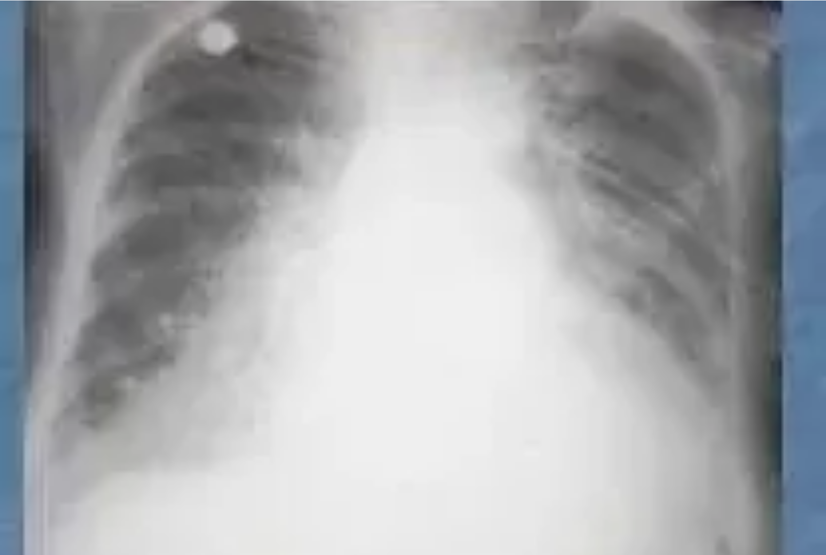





ECG and Chest X-Ray Findings
HEART FAILURE IN PRIMARY CARE • NICE NG106 (2025)
ECG Findings
LV Hypertrophy: Common in hypertensive heart disease; high voltage QRS.
Pathological Q Waves: Indicates previous MI (suggests ischaemic cause).
LBBB: Left Bundle Branch Block strongly suggests LVSD and structural disease.
Atrial Fibrillation: Common comorbidity; can be a trigger or consequence of HF.
Chest X-Ray Findings
Cardiomegaly: Cardiothoracic ratio >50% on PA film.
Figure: CXR showing cardiomegaly and interstitial congestion
Pulmonary Venous Congestion: "Upper lobe diversion" of blood vessels.
AKT FOCUS
High-Yield Diagnostic Tip
Pleural Effusions: Fluid in costophrenic angles (usually bilateral).
A normal ECG is highly sensitive for excluding heart failure (high negative predictive value). If the ECG is normal, LVSD is unlikely. LBBB is a major indicator for CRT referral if EF ≤35%.
Kerley B Lines: Short horizontal lines at periphery (interstitial oedema).
www.bradfordvts.co.uk
Bradford VTS Teaching Deck • HF Module 2025

Slide 16














Essential Bloods and Urinalysis
HEART FAILURE IN PRIMARY CARE • NICE NG106 (2025)
Full Blood Count (FBC)
Exclude anaemia as a cause of breathlessness or a factor exacerbating HF. Check for infection (WCC).
Lipids & HbA1c / Glucose
Assessment of cardiovascular risk and diabetes status. Essential for holistic management.
U&Es and eGFR
Crucial baseline for renal function and potassium before initiating Four Pillars (ACEi/MRA/SGLT2i).
Urinalysis
Screen for proteinuria or haematuria to exclude primary renal disease as the cause of fluid retention.
Liver Function Tests (LFTs)
Detect congestive hepatopathy (raised bilirubin/ALT) or rule out hepatic causes of oedema.
PRIMARY CARE BASELINE SCREEN
Thyroid Function Tests (TFTs)
Perform these investigations at the same time as the NT-proBNP test. This ensures all data is ready for the specialist when the diagnosis is confirmed by echo.
Thyroid dysfunction (both hypo- and hyper-) can cause or precipitate heart failure and AF.
www.bradfordvts.co.uk

Slide 17










The 2025 Paradigm Shift: Four Pillar Therapy
HEART FAILURE IN PRIMARY CARE • NICE NG106 (2025)
The NICE NG106 (September 2025) update marks a fundamental shift in managing HFrEF.
Rather than the traditional sequential "step-wise" titration, primary care is now directed to initiate all four classes as first-line combination therapy as rapidly as tolerated.
RAS Inhibitor
Beta-Blocker
ACEi (Ramipril) or ARB (Candesartan). Consider ARNI (Sacubitril-valsartan) early.
Bisoprolol, Carvedilol, or Metoprolol. Start once patient is euvolaemic.
AKT EXAM PEARL
The "Four Pillars" are now simultaneous first-line therapy. This is the most significant change from the 2018 guidance and a high-yield topic for MRCGP exams.
MRA
SGLT2 Inhibitor
Spironolactone or Eplerenone. Essential for blocking remodelling.
Dapagliflozin or Empagliflozin. Powerful reduction in CV death/hospitalisation.
www.bradfordvts.co.uk

Slide 18


















Pillar 1: Renin-Angiotensin System Inhibitors
HEART FAILURE IN PRIMARY CARE • NICE NG106 (2025)
ACE Inhibitors
ARBs
ARNI
First choice for all patients with HFrEF unless contraindicated.
Alternative for patients who are intolerant to ACE inhibitors.
Sacubitril-valsartan: The modern standard for symptomatic HFrEF.
Prevents conversion of Angiotensin I to II, reducing vasoconstriction.
Primary reason for switch: Intractable dry cough (bradykinin related).
Combines neprilysin inhibition with an ARB for dual action.
Robust evidence for reducing mortality and hospital admissions.
Blocks AT1 receptors directly; similar outcomes to ACEi.
Consider switching if symptoms persist on ACEi/ARB + Beta-blocker.
Examples: Ramipril, Enalapril, Lisinopril.
Examples: Candesartan, Valsartan, Losartan.
Requires 36-hour washout period from ACEi to avoid angioedema.
SAFE TO MANAGE IN PRIMARY CARE
AKT PEARL
Initiate ACEi/ARB in most patients with confirmed LVSD. Start low and up-titrate every 2 weeks. Monitor U&Es and BP 1-2 weeks after every dose change.
NICE 2025 emphasizes starting all four pillars early. ARNI is no longer just "specialist only" territory—GPs should be familiar with the switch protocol.
www.bradfordvts.co.uk

Slide 19















Pillar 1: BNF Dosing and ARNI Transition
HEART FAILURE IN PRIMARY CARE • NICE NG106 (2025)
The "Step-Up" Strategy
FIRST-LINE ACE INHIBITORS (ACEI)
Consider switching to ARNI if symptoms persist on ACEi/ARB + Beta-blocker.
Drug
Starting Dose
Target Dose
Initiation usually occurs in specialist or heart failure clinics.
1.25 – 2.5 mg OD
10 mg OD
Primary care provides long-term titration and renal monitoring.
Ramipril
Enalapril
2.5 mg BD
10 – 20 mg BD
Lisinopril
2.5 – 5 mg OD
35 mg OD
AKT PEARL: The Washout Period
A mandatory 36-hour washout period is required when switching FROM an ACE inhibitor TO sacubitril-valsartan. This is a high-yield exam fact.
ARNI (ANGIOTENSIN RECEPTOR-NEPRILYSIN INHIBITOR)
Drug
Starting Dose
Target Dose
24/26 mg BD* or 49/51 mg BD
Sacubitril-valsartan
97/103 mg BD
COMMON PITFALL
*24/26mg BD used if ACEi/ARB naive or on low-dose previous therapy.
Skipping the washout period significantly increases the risk of life-threatening angioedema due to excessive bradykinin accumulation.
Bradford VTS Teaching Deck: Heart Failure
www.bradfordvts.co.uk

Slide 20














Pillar 2: Beta-Blockers
HEART FAILURE IN PRIMARY CARE • NICE NG106 (2025)
Clinical Principles
Start only when euvolaemic: Do not initiate in acute decompensation (patient must be "dry").
Drug (BNF)
Starting Dose
Target Dose
Start low, go slow: Up-titrate doses every 2 weeks as tolerated by the patient.
Bisoprolol
1.25 mg OD
10 mg OD
Monitor vitals: Check BP and HR at each titration step; aim for target heart rate 50-60 bpm.
Carvedilol
3.125 mg BD
25 mg BD
(50 mg BD if >85 kg)
Metoprolol Succinate
12.5–25 mg OD
200 mg OD
COMMON PITFALL
Starting beta-blockers in wet/decompensated HF → worsens congestion and risk of acute failure.
www.bradfordvts.co.uk

Slide 21
























Pillar 3: Mineralocorticoid Receptor Antagonists
HEART FAILURE IN PRIMARY CARE • NICE NG106 (2025)
Clinical Indications & Choice
Monitoring & Safety Protocol
Competitive aldosterone antagonists; standard first-line for all HFrEF.
U&E + eGFR: Check at baseline, 1 week, and 4 weeks post-initiation or dose increase.
Spironolactone: Most common choice in primary care.
Hyperkalaemia Risk: High risk if K+ >5.0 mmol/L at baseline. Seek advice if K+ rises >5.5 mmol/L.
Eplerenone: Preferred post-MI or if spironolactone causes gynaecomastia.
BNF Medication
Starting Dose
Target Dose
Renal Function: Monitor closely if eGFR <30 ml/min/1.73m². Potential for acute kidney injury.
12.5 – 25 mg OD
Spironolactone
50 mg OD
Adverse Effects: Gynaecomastia and breast pain are common with spironolactone (eplerenone is more selective).
Eplerenone
25 mg OD
50 mg OD
AKT PEARL
COMMON PITFALL
Eplerenone is specifically preferred over spironolactone in the post-MI setting based on EPHESUS trial evidence.
Forgetting to check K+ before starting/up-titrating spironolactone → significant risk of life-threatening hyperkalaemia.
BRADFORD VTS TEACHING DECK
Slide 22 of 40
www.bradfordvts.co.uk

Slide 22




















Pillar 4: SGLT2 Inhibitors (The New Pillar)
HEART FAILURE IN PRIMARY CARE • NICE NG106 (2025)
Core Agents & Dosage
Renal Safety (eGFR Thresholds)
Dapagliflozin: 10 mg once daily
Check renal function before initiation. Licensed for HF down to:
Empagliflozin: 10 mg once daily
Medication
eGFR Limit
Fixed Dose: No titration required, unlike Pillars 1-3.
Dapagliflozin
25 ml/min/1.73m²
Primary Care: Start at the target dose immediately.
Empagliflozin
20 ml/min/1.73m²
*Doses do not need adjustment for renal function, only initiation checks.
Clinical Evidence
Significant reduction in HF hospitalisation.
AKT Exam Pearl: NICE 2025 Update
Proven reduction in Cardiovascular death.
SGLT2i are now first-line combination therapy for HFrEF. Offer all four pillars simultaneously to improve outcomes.
Effective across the full spectrum (HFrEF, HFmrEF, HFpEF).
www.bradfordvts.co.uk

Slide 23
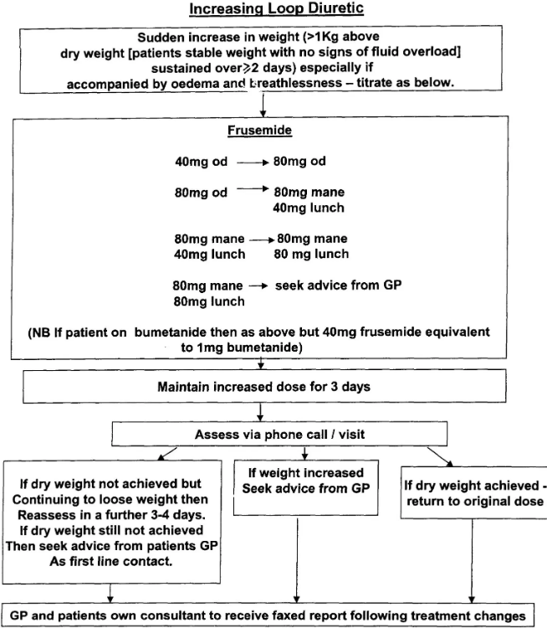




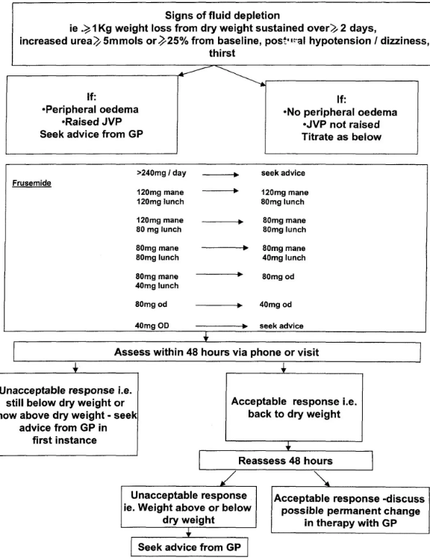








Diuretics for Congestion Management
HEART FAILURE IN PRIMARY CARE • NICE NG106 (2025)
Key Principles
Primary role is symptom relief through congestion control.
Not disease-modifying: They do not reduce mortality (unlike the Four Pillars).
Titrate dose up or down based on symptoms, weight, and fluid status.
Common Agents & Dosing
DRUG
STARTING
NOTES
Furosemide
20–40 mg OD
Standard loop diuretic
Bumetanide
0.5–1 mg OD
Higher bioavailability
Safe to Manage in Primary Care
GPs should adjust loop diuretics independently for stable patients. Always review U&Es and BP after significant changes to avoid dehydration or electrolyte imbalance.
Bradford VTS Teaching Deck: Heart Failure
www.bradfordvts.co.uk

Slide 24













Management of HFmrEF (EF 40–49%)
HEART FAILURE IN PRIMARY CARE • NICE NG106 (2025)
NICE 2025: Consider Four Pillar Combination Therapy
AKT PEARL
HFmrEF (40–49%) is the "Grey Zone". Historically managed like HFpEF, the 2025 update aligns its management more closely with HFrEF (<40%) due to shared benefit from modern neurohormonal blockade.
RAS Inhibitors
Beta-Blockers
ACEi or ARB (e.g. Ramipril, Candesartan). ARNI if already on therapy.
Evidence-based BB (Bisoprolol, Carvedilol). Use when euvolaemic.
MRA
SGLT2 Inhibitors
SAFE TO MANAGE
Spironolactone or Eplerenone. Reduces CV death and hospitalisation.
Dapagliflozin or Empagliflozin 10mg OD. Major evidence for EF >40%.
Management of HFmrEF can be led in Primary Care once the diagnosis is confirmed by Echo/Specialist. Focus on titrating the four pillars to target doses and monitoring renal function/potassium.
* Diuretics should still be used as needed for clinical symptoms of congestion.
Bradford VTS Teaching Deck
www.bradfordvts.co.uk

Slide 25











Management of HFpEF (EF ≥50%)
HEART FAILURE IN PRIMARY CARE • NICE NG106 (2025)
SGLT2 Inhibitors (The Breakthrough)
The Cornerstone: Comorbidities
NICE 2025: Offer Dapagliflozin (10mg) or Empagliflozin (10mg) to all patients with HFpEF.
Aggressive Management: Hypertension, AF, Diabetes, and Obesity (addressing these is the primary strategy).
Strong evidence for reducing heart failure hospitalisations and cardiovascular death in preserved EF.
Optimal BP control is vital to reduce LV wall stress and improve filling.
Consider MRAs (Spironolactone) if K+ and renal function allow.
Congestion Management
The "Traditional Pillars"
Diuretics: Essential for symptom relief (Furosemide or Bumetanide) but do not modify disease progression.
No evidence for ACEi, ARB, or Beta-blockers in improving mortality for pure HFpEF.
Titrate to achieve euvolaemia; monitor renal function and weight regularly.
Only use these classes if specifically indicated for other conditions (e.g., angina, AF, or hypertension).
PRIMARY CARE FOCUSManagement of HFpEF is largely about meticulous primary care: managing BP, heart rate in AF, and weight loss.
COMMON PITFALLAssuming HFpEF means a "normal heart." It carries a similar mortality risk to HFrEF; do not downplay the diagnosis to patients.
www.bradfordvts.co.uk

Slide 26















Monitoring in Primary Care: Clinical Reviews
HEART FAILURE IN PRIMARY CARE • NICE NG106 (2025)
Functional Status (NYHA)
Vitals & Tolerability
NYHA Classification: Record functional class (I-IV) at every routine review.
Observations: BP (sitting/standing) and HR (check rhythm for new AF).
Symptom History: Assess fatigue, breathlessness, and palpitations during daily activity.
Medication Check: Confirm compliance and screen for side effects (e.g., cough, dizziness).
Exercise Tolerance: Monitor changes in walking distance or stairs ability.
Titration Status: Review if target doses of the Four Pillars have been achieved.
Fluid Status Assessment
SCA EXAM PEARL
Weight Monitoring: Check for rapid weight gain (>2kg in 3 days) or loss.
Assessing functional capacity is a QOF HF007 requirement. In your consultation, use a patient-centered opener:"How has your breathing been affecting what you can do day-to-day since we last met?"Ensure you document the NYHA Class clearly in the medical record.
Peripheral Oedema: Inspect ankles, shins, and sacrum for pitting oedema.
Volume Indicators: Assess Jugular Venous Pressure (JVP) and lung bases.
www.bradfordvts.co.uk

Slide 27










Monitoring: Bloods and Titration Protocol
HEART FAILURE IN PRIMARY CARE • NICE NG106 (2025)
Annual Blood Monitoring
"Start Low, Go Slow" Protocol
U&E + eGFR
1
Initiate at lowest BNF starting dose (e.g. Ramipril 1.25mg).
Mandatory for all Four Pillars. Monitor for hyperkalaemia (MRA/ACEi) and renal function decline.
Full Blood Count (FBC)
2
Up-titrate every 2 weeks as tolerated by patient.
Anaemia is common in HF and significantly worsens symptoms and functional capacity.
3
Assess BP, Heart Rate, and Symptoms at each step.
Natriuretic Peptides
Target BNP/NT-proBNP monitoring at baseline and after major medication changes.
4
Aim for Target BNF Doses, not just symptom control.
5
Re-check U&Es within 1-2 weeks of any dose increase.
PRIMARY CARE SAFE
A stable patient on optimized therapy only requires annual bloods, but titration phases require frequent 1-2 week monitoring of U&Es.
TITRATION TIP
SGLT2 inhibitors (Dapagliflozin/Empagliflozin) are fixed-dose (10mg OD) and do not require titration, making them the easiest "pillar" to initiate.
www.bradfordvts.co.uk

Slide 28











QOF Indicators for Heart Failure 2024/25
HEART FAILURE IN PRIMARY CARE • NICE NG106 (2025)
INDICATOR
REQUIREMENT DESCRIPTION
POINTS
HF001
Maintain a register of patients with Heart Failure.
4
HF008
Diagnosis confirmed by echocardiogram or specialist assessment (within 3m before or 6m after diagnosis).
6
HF003
Percentage of LVSD patients currently treated with an ACE inhibitor or ARB.
6
HF006
Percentage of LVSD patients currently treated with a Beta-blocker.
6
HF007
Annual review including functional capacity assessment (NYHA class) and medication review.
7
Primary Care Practice Tip
SCA Exam Pearl
Income Protection: While HF001 is often income-protected, accurate clinical coding of HFrEF vs HFpEF is vital for ensuring patients are pulled into the correct treatment indicators (HF003/HF006).
Functional Assessment: QOF (HF007) and NICE both mandate NYHA classification. In your clinical exam, use the specific opener: "How does your breathing limit what you can do day-to-day?"
www.bradfordvts.co.uk

Slide 29















Referral Criteria: Urgent vs Routine
HEART FAILURE IN PRIMARY CARE • NICE NG106 (2025)
Urgent Referral (2 Weeks)
Routine Referral (6 Weeks)
EMERGENCY ADMISSION (999)
NT-proBNP > 2,000 ng/L (or BNP > 400 pg/ml)
Refer acutely if:
NT-proBNP 400 – 2,000 ng/L (or BNP 100 – 400 pg/ml)
Acute pulmonary oedema
Previous Myocardial Infarction with new heart failure symptoms
Severe hypotension / Syncope
Refer for specialist assessment and echocardiogram within 6 weeks
Decompensation not responding to oral diuretics
Refer for specialist assessment and echocardiogram within 2 weeks
Clinical Nuance
HF UNLIKELY (NT-PROBNP <400)
Natriuretic peptide levels may be low in acute pulmonary oedema. If clinical suspicion is high, refer urgently regardless of NP level.
AKT EXAM PEARL
If NT-proBNP is <400 ng/L, heart failure is unlikely. Investigate other causes of breathlessness (e.g. COPD, anaemia, obesity).
The 2,000 ng/L NT-proBNP threshold is a high-yield exam fact. If >2,000, it is always an urgent 2-week referral.
www.bradfordvts.co.uk
Medical Disclaimer: For educational purposes only. Always refer to latest NICE guidance and local protocols.

Slide 30



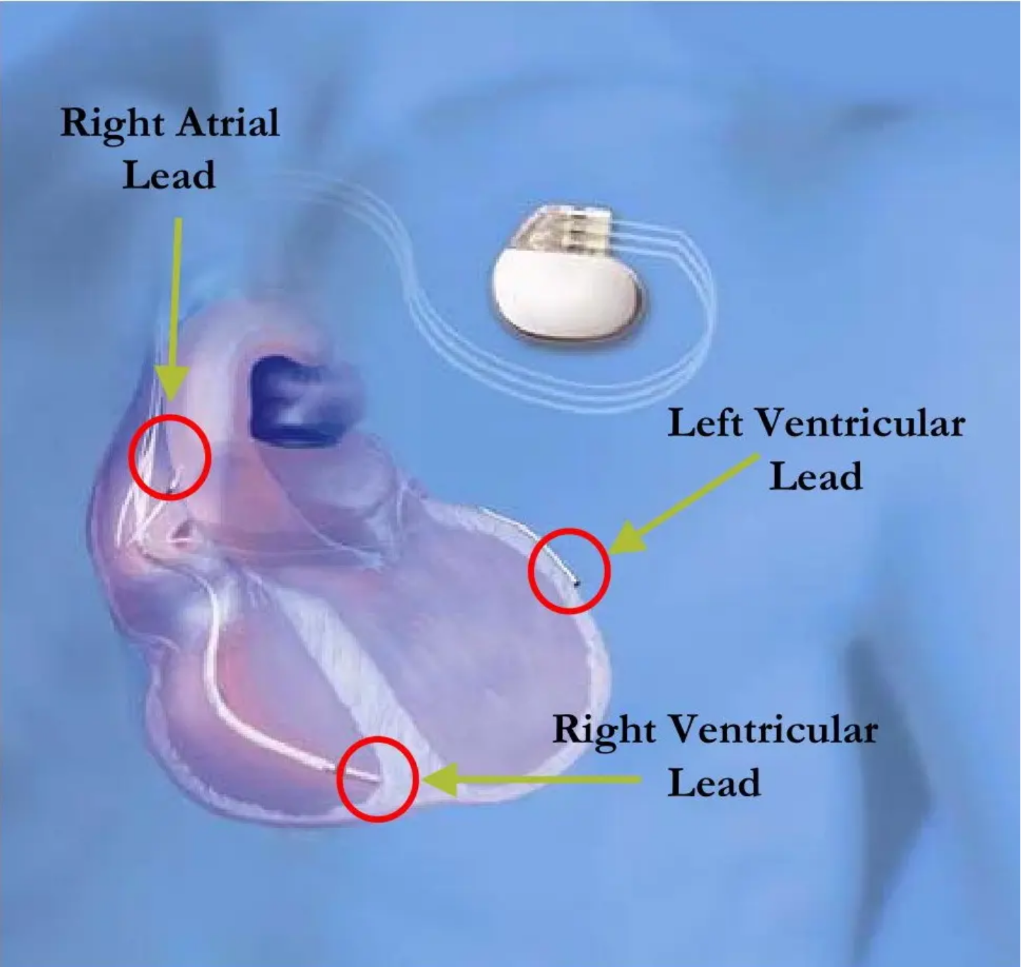







Device Therapy: ICD and CRT
HEART FAILURE IN PRIMARY CARE • NICE NG106 (2025)
ICD (Implantable Cardioverter Defibrillator)
LVEF ≤35% (confirmed by echocardiography)
NYHA Class I, II, or III symptoms
Patient must be on optimal medical therapy
Primary prevention post-MI (wait 4 weeks) or secondary prevention
CRT (Resynchronisation Therapy)
LVEF ≤35% and NYHA Class II, III, or IV
Evidence of dyssynchrony: QRS duration ≥120 ms
Strongest benefit seen in patients with LBBB morphology
CRT-P (Pace) or CRT-D (Defibrillator) options available
AKT EXAM PEARL
NICE criteria for device referral are high-yield. Remember the magic number: EF ≤35% is the threshold for both, but CRT specifically requires a wide QRS (≥120ms).
www.bradfordvts.co.uk
For educational purposes only. Refer to full NICE NG106 (2025) guidance for clinical decisions.

Slide 31













Palliative Care: Principles and GSF
HEART FAILURE IN PRIMARY CARE • NICE NG106 (2025)
Integrating Palliative Care
Advance Care Planning (ACP)
HF is a life-limiting condition; 5-year mortality is ~50%.
DNACPR:Discuss CPR outcomes in context of HF.
Integrate palliative principles early, not just at end-of-life.
Preferences:Document Preferred Place of Care (PPC) and Death (PPD).
Use Gold Standards Framework (GSF) to identify patients.
Legal:Lasting Power of Attorney (LPA) for health/finance.
THE SURPRISE QUESTION
Symptom Control:Opioids for breathlessness; anxiolytics.
"Would you be surprised if this patient died in the next 12 months?"
MDT Approach
Shared care: GP, HF Specialist Nurse, and Palliative Care.
Community input: District nurses and hospice-at-home.
SCA COMMUNICATION PEARL
Broach ACP by linking to current health: "We've updated your medications to protect your heart, but it's also important to talk about what you'd want if your health took a turn for the worse."
Bradford VTS Teaching Deck: Heart Failure
www.bradfordvts.co.uk
Slide 32 of 40

Slide 32













End of Life: Symptom Control and ICD Deactivation
HEART FAILURE IN PRIMARY CARE • NICE NG106 (2025)
Symptom Management
ICD Deactivation Discussion
Breathlessness: Low-dose opioids (e.g., Morphine 2.5mg) are effective. Consider fans and positioning.
Essential Requirement: Discussion must occur before the terminal phase. It is not "giving up" but preventing harm.
Anxiety/Agitation: Use anxiolytics like Midazolam or Lorazepam if breathlessness causes distress.
The Process: Involves the HF MDT and pacing clinic. A magnet can be used as a temporary measure in the community.
Congestion: Use subcutaneous Furosemide via syringe driver if oral route is no longer viable.
Pacing vs Shocking: Clarify that deactivating the "shocker" (ICD) does not usually mean deactivating the "pacer" (CRT-P).
SCA PEARL: COMMUNICATION
"The device is designed to restart your heart, but as things change, those shocks can become distressing. We should talk about when we might turn that function off."
RED FLAG: DISTRESSING SHOCKS
COMMON PITFALL
Up to 20% of patients with an active ICD receive painful, inappropriate shocks in their final weeks. This is a medical emergency for the family's distress.
Assuming the hospital or HF nurse has already had this talk. Always check and document the discussion in the GP record and ACP.
www.bradfordvts.co.uk
Heart Failure in Primary Care • Slide 33

Slide 33












Incidental Findings: Coronary Calcium Scoring
HEART FAILURE IN PRIMARY CARE • NICE NG106 (2025)
Defining the Finding
Management Pathway (NICE CG95/TA394)
Often identified as an incidental finding on a CT Thorax (e.g., for lung nodules or cough).
Risk Assessment: Calculate QRISK3 score to establish 10-year cardiovascular risk profile.
Agatston Score >0: Indicates that calcified coronary artery disease is physically present.
Statin Therapy: Offer Atorvastatin 20mg (NICE NG238) for primary prevention if CAD is present or QRISK3 ≥10%.
Higher scores correlate with increased risk of future myocardial infarction and cardiovascular events.
Antiplatelet Therapy: Offer Aspirin 75mg only if there is established clinical CVD (e.g., previous MI/Stroke/PAD).
Symptom Review: Specifically ask about exertional chest pain or breathlessness (Angina).
Further Investigation: Arrange CT Coronary Angiography (CTCA) or stress imaging if angina is suspected.
Lifestyle: Standard advice on smoking cessation, BMI, diet, and aerobic exercise.
PRIMARY CARE MANAGEMENT
Most incidental calcium scores can be managed entirely in primary care without specialist cardiology referral, unless the patient is symptomatic or has severe established disease.
www.bradfordvts.co.uk
Bradford VTS Teaching Deck • Section 11

Slide 34










Top Tips for GP Trainees
HEART FAILURE IN PRIMARY CARE • NICE NG106 (2025)
NT-proBNP is Your First Test
ACEi → ARNI Upgrade
Don't jump straight to echo; NP drives the pathway and determines referral urgency.
Consider switching to Sacubitril-valsartan if symptoms persist on ACEi/ARB + Beta-blocker.
SGLT2i: The New Pillar
36-Hour Washout Period
Dapagliflozin/Empagliflozin provide significant benefits in HFrEF, HFmrEF, and HFpEF.
Crucial 36-hour gap required when switching from an ACEi to ARNI to prevent angioedema.
Eplerenone Post-MI
Annual Monitoring
Specifically prefer Eplerenone over Spironolactone for patients with a recent MI.
Check U&Es, eGFR, and FBC annually; all four pillars can impact renal function/potassium.
Beta-Blocker Caution
ICD Deactivation
Never start BBs in decompensated HF; wait until the patient is stable and euvolaemic.
Always discuss device deactivation before end-of-life to prevent distressing shocks.
Bradford VTS Teaching Deck: Heart Failure
www.bradfordvts.co.uk

Slide 35









Red Flags: When to Act Urgently
HEART FAILURE IN PRIMARY CARE • NICE NG106 (2025)
LIFE-THREATENING EMERGENCY: CALL 999
Acute Pulmonary Oedema: Acute onset breathlessness + raised JVP + bilateral basal crackles. Immediate hospital admission required.
New Symptoms + Post-MI
Syncope in Known HF
New onset HF symptoms in a patient with a history of Myocardial Infarction.URGENT REFERRAL (2-WEEK PATHWAY)
Loss of consciousness in a patient with established heart failure. High risk of Ventricular Tachycardia (VT).SAME-DAY SPECIALIST ASSESSMENT
Refractory Worsening
Symptomatic Hypotension
Worsening symptoms (oedema/breathlessness) despite increase in oral diuretic doses.SAME-DAY HF NURSE / CARDIO ADVICE
Severe symptomatic hypotension on HF medications preventing essential titration or causing falls.SAME-DAY CLINICAL REVIEW
Bradford VTS Teaching Deck: Heart Failure
www.bradfordvts.co.uk

Slide 36










Common Pitfalls in Heart Failure
HEART FAILURE IN PRIMARY CARE • NICE NG106 (2025)
AVOIDABLE CLINICAL ERRORS
Beta-Blockers in Decompensated HF
Diuretic "Reflex" Treatment
Never start in "wet" patients; worsens congestion and symptoms.
Treating ankle oedema with furosemide without investigating for HF.
Inappropriate NSAID Prescribing
Dismissing HFpEF Severity
Can precipitate acute decompensation and worsen renal function.
Assuming "normal heart" because EF is ≥50%; mortality remains high.
Missing MRA Monitoring
Neglecting ICD Deactivation
Always check K+ and eGFR before starting or up-titrating spironolactone.
Failing to discuss deactivation near end-of-life results in distressing shocks.
www.bradfordvts.co.uk
BRADFORD VTS TEACHING DECK

Slide 37









Exam Pearls: AKT Focus
HEART FAILURE IN PRIMARY CARE • NICE NG106 (2025)
REFERRAL THRESHOLDS
NICE 2025: FOUR PILLARS
NT-proBNP >2000
Urgent Referral (2-week wait)
1. RAS Inhibitor: ACEi (or ARB / ARNI)
400–2,000
Routine Referral (6-week wait)
2. Beta-Blocker: Start when euvolaemic
3. MRA: Spironolactone (Eplerenone post-MI)
<400 ng/L
Heart Failure Unlikely
4. SGLT2i: Dapa/Empa (Licensed down to eGFR 20-25)
DEVICE CRITERIA (LVEF ≤35%)
HIGH-YIELD "GOTCHAS"
ARNI Washout: Must wait 36 hours between stopping ACEi and starting Sacubitril-valsartan.
ICD: NYHA Class I–III (Sudden death prevention)
CRT: NYHA Class II–IV + QRS duration ≥120 ms
HFpEF Update: SGLT2 inhibitors are now recommended for patients with LVEF ≥50%.
Monitoring: Check U&Es 1–2 weeks after initiation or dose changes of any Pillar medication.
www.bradfordvts.co.uk

Slide 38














Exam Pearls: SCA Focus
HEART FAILURE IN PRIMARY CARE • NICE NG106 (2025)
Functional Capacity (NYHA)
Shared Decision-Making
Mandatory QOF requirement (HF007). You must document the NYHA class during clinical reviews.
Explain the "Four Pillars" as a collective shield. Focus on prognostic benefits (living longer/staying out of hospital).
"How has your breathing been affecting what you can do day-to-day?"
"This new tablet protects your heart and works best when used alongside your other medications."
Safety-Netting & Red Flags
Sensitive Conversations (ACP)
Clear, actionable instructions for acute decompensation are essential for patient safety.
Address device management (ICD) and Advance Care Planning early. Use the "Surprise Question" as a prompt.
"If your breathing gets suddenly worse, or you find you can't lie flat at night, you must call 999."
"The device could give you a shock; we need to talk about what you'd want if your health declines."
Bradford VTS Teaching Deck: Heart Failure
www.bradfordvts.co.uk
Slide 39

Slide 39





Quick Recall and Final Disclaimer
HEART FAILURE IN PRIMARY CARE • NICE NG106 (2025)
Epidemiology & Diagnosis
EF Classification & SGLT2i
Affects 1–2% UK adults; 50% mortality at 5 years.
HFrEF (<40%), HFmrEF (40–49%), HFpEF (≥50%).
NT-proBNP >2,000 = Urgent 2-week referral.
SGLT2 inhibitors are now recommended for ALL EF types.
NT-proBNP 400–2,000 = Routine 6-week referral.
Benefit: Reduced hospitalisation and cardiovascular death.
Medication Safety & Titration
Long-term Care
The Four Pillars: ACEi/ARNI + BB + MRA + SGLT2i.
Refer for ICD/CRT if EF ≤35% on optimal therapy.
36-hour washout required when switching ACEi to ARNI.
Annual Monitoring: U&E, eGFR, FBC, and NYHA status.
Only start Beta-blockers when patient is euvolaemic.
Always discuss ICD deactivation as part of EoL care.
MEDICAL DISCLAIMER
This teaching deck is for educational purposes for GP trainees and should be used alongside clinical judgement and the latest NICE guidelines. While every effort has been made to ensure accuracy based on NICE NG106 (September 2025), the authors and Bradford VTS do not accept liability for any errors, omissions, or clinical outcomes resulting from the use of this material.
WWW.BRADFORDVTS.CO.UK

