Slide 1


Heart Murmurs — Which One is Which?
A Quick Reference Guide · Bradford VTS · May 2026
Heart murmurs are produced by turbulent blood flow through the heart. In primary care, the key skill is recognising the pattern of each murmur and knowing which valvular conditions produce them. This guide covers the four most important murmurs.
Always double-check this advice and drug doses with the latest NICE/BNF guidance. This document is for educational purposes only.

Slide 2
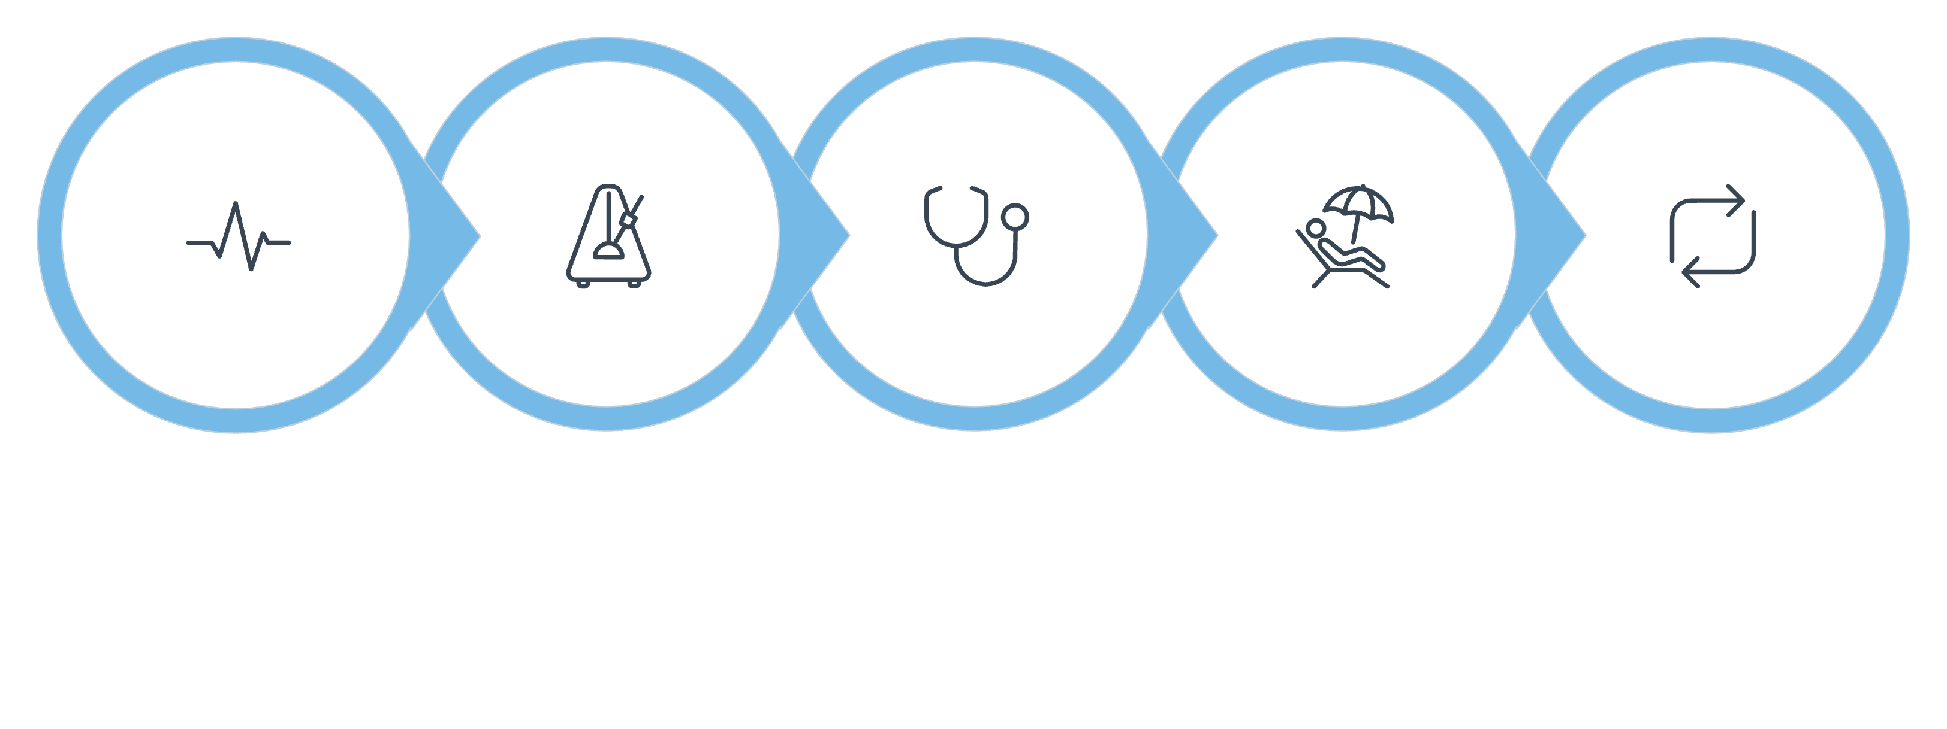

Timing Essentials
Understanding when a murmur occurs in the cardiac cycle is the first step to identification.
Systolic Murmurs
Diastolic Murmurs
Occur between S1 (lub) and S2 (dub) — when the ventricle is contracting.
Occur between S2 and the next S1 — when the ventricle is filling.
Aortic Stenosis — ejection systolic
Mitral Regurgitation — pansystolic
Mitral Stenosis — mid-diastolic
Aortic Regurgitation — early diastolic
Systole
S1→S2
AS & MR
Diastole
S2→S1

Slide 3
The Four Key Murmurs at a Glance
Feature
Mitral Stenosis
Mitral Regurgitation
Aortic Stenosis
Aortic Regurgitation
Timing
Mid-diastolic
Pansystolic
Ejection systolic
Early diastolic
Quality
Low-pitched, rumbling
High-pitched, blowing
Harsh, crescendo-decrescendo
High-pitched, blowing
Best Heard
Apex with BELL
Apex with DIAPHRAGM
Aortic area / R 2nd ICS
Left sternal edge (LSE)
Radiation
None
To axilla
To carotids
None
Memory Aid
"Wheelbarrow bumping"
"Blowing" to axilla
"Buzzy bee" to carotids
Like breath sounds

Slide 4

The Four Key Murmurs at a Glance
Heart sounds and added features help distinguish each condition.
Feature
Mitral Stenosis
Mitral Regurgitation
Aortic Stenosis
Aortic Regurgitation
S1
Loud ↑
Quiet/absent ↓
Normal
Normal
S2
A2 louder (pulm. HTN)
Normal
Soft A2 ↓
Loud A2 ↑
Added Sounds
Opening snap (after S2)
Sometimes MVP click
Systolic click (esp. children)
None
Opening snap in MS moves closer to S2 as stenosis becomes more severe — a useful severity marker.

Slide 5
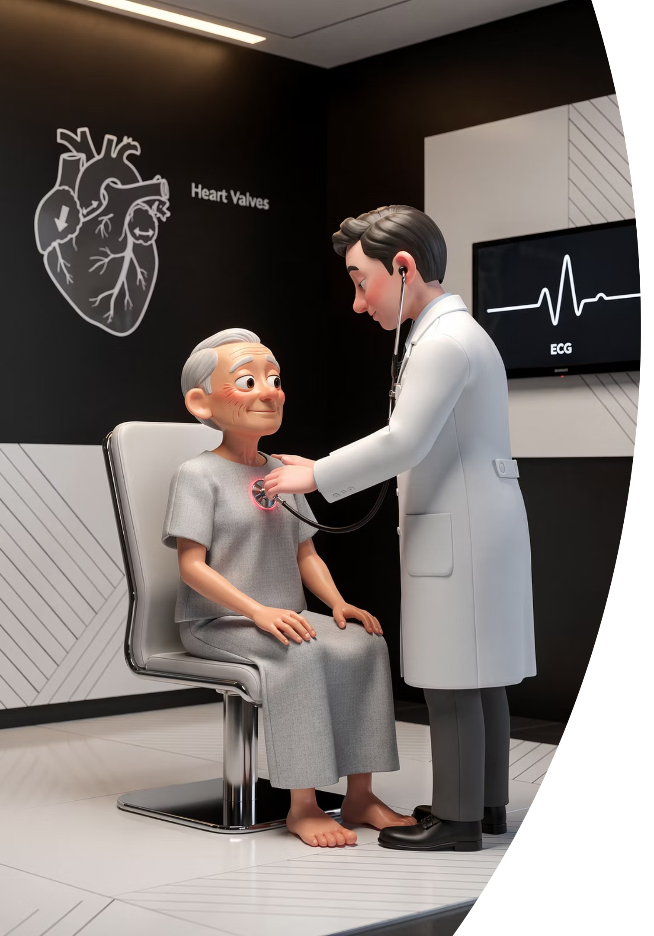
Aortic Stenosis (AS)
The most common valvular condition in the UK, especially in the elderly. Causes progressive LV outflow obstruction.
SAD Symptom Triad (Late AS)
Murmur & Signs
Syncope on exertion — median survival 3 yrs
Angina on exertion — median survival 5 yrs
Dyspnoea on exertion → then at rest — median survival 2 yrs
Ejection systolic, harsh — "buzzy bee"
Heard at aortic area (R 2nd ICS); radiates to carotids (left louder)
Slow-rising pulse (pulsus parvus et tardus); absent A2 in severe AS
Refer When
Any symptom appears, or asymptomatic severe AS with BP drop on exercise ETT.

Slide 6
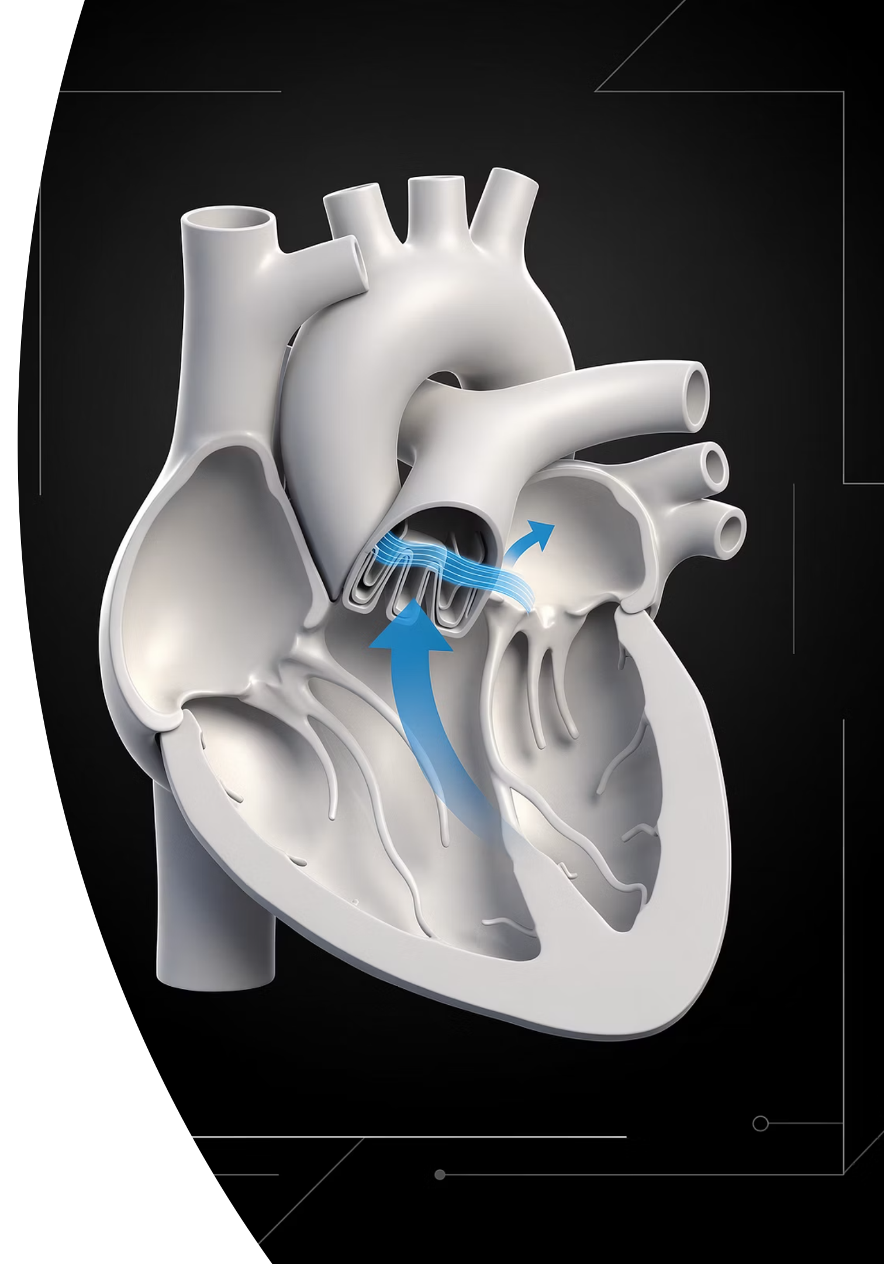
Aortic Regurgitation (AR)
A leaking aortic valve allows regurgitant blood during diastole to fill the LV, causing progressive LV enlargement over time.
Murmur Character
Early diastolic, high-pitched, blowing. Best heard at the left sternal edge (LSE) with the patient leaning forward, holding breath in expiration.
The Key Trick
Sounds like breath sounds — even when the patient is holding their breath. This distinguishes AR from a respiratory artefact.
Referral Criteria
Refer if LV failing or dilating, marked aortic root dilation, or patient is symptomatic.

Slide 7
Mitral Regurgitation (MR)
Common condition; causes include MVP, rheumatic disease, ischaemia (papillary muscle dysfunction), and infective endocarditis.
Murmur Character
Referral Criteria
Examination Tip
Pansystolic (throughout systole), high-pitched, blowing. Heard at the apex with the diaphragm; radiates to the axilla.
Refer if severe MR plus any of: symptoms, LV dysfunction, LVESD >45 mm, new AF, or PAP >50 mmHg.
Use the diaphragm of the stethoscope at the apex. Radiation to the axilla is a hallmark distinguishing feature.

Slide 8
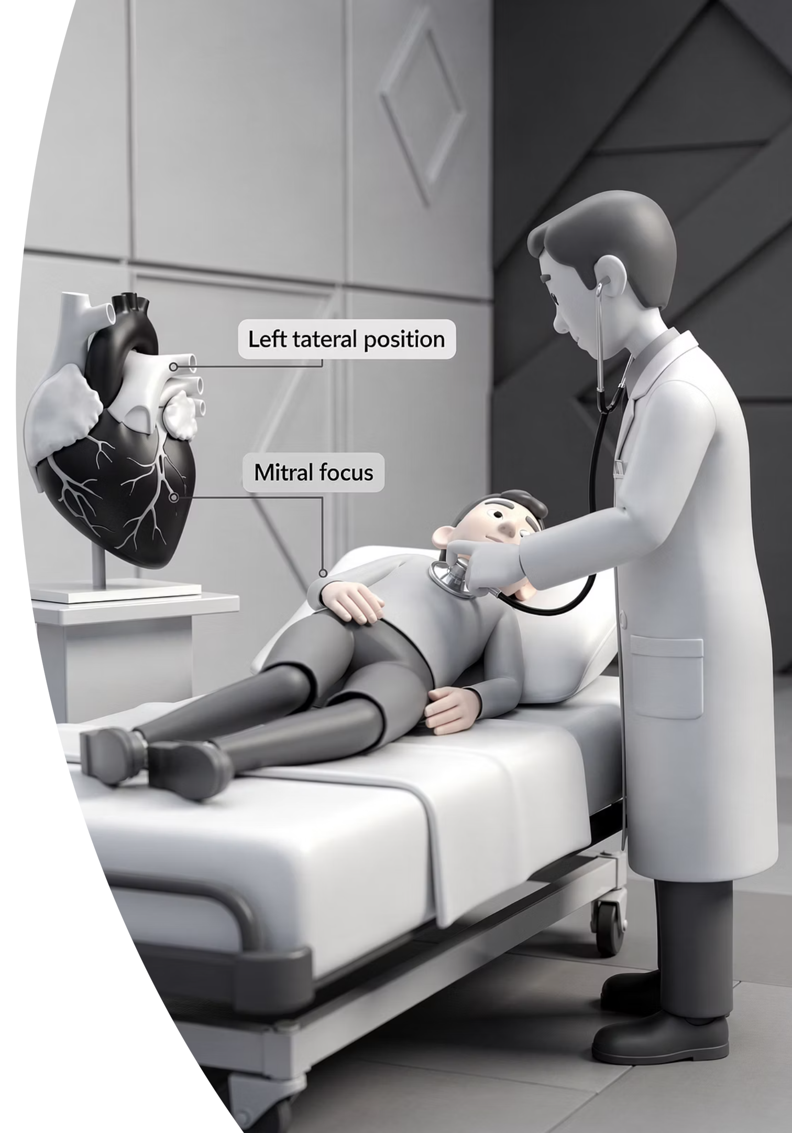
Mitral Stenosis (MS)
Usually caused by rheumatic heart disease. Leads to LA enlargement, AF, and pulmonary hypertension.
Murmur Character
Referral Criteria
Low-pitched, rumbling, mid-diastolic
Best heard at apex with BELL
Left lateral position + expiration
Loud S1 (elevated LA pressure)
Opening snap after S2 — closer to S2 = more severe
Refer if valve area ≤1.5 cm² — significant enough for intervention.
Memory Aid
"Wheelbarrow bumping" — bumpty-bumpty-bump. Low, rumbling quality at the apex.
Bell for MS; Diaphragm for MR — a classic exam distinction.

Slide 9
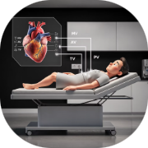

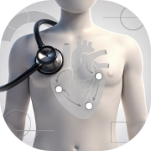
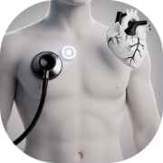
Examination Technique Summary
Positioning and technique are critical to hearing each murmur clearly.
Mitral Stenosis
Aortic Regurgitation
Mitral Regurgitation
Aortic Stenosis
Bell at apex · Left lateral position · Expiration · Listen for low rumble + opening snap
Diaphragm at R 2nd ICS · Radiates to carotids · Harsh crescendo-decrescendo buzz
Diaphragm at LSE · Lean forward · Hold breath in expiration · Sounds like breath sounds
Diaphragm at apex · Radiates to axilla · Pansystolic blowing quality

Slide 10
Exam Quick Recall
Key mnemonics and rules to lock in before your exam.
Timing
Radiation
Systolic: AS (ejection) + MR (pan)
Diastolic: AR (early) + MS (mid)
AS → carotids
MR → axilla
AR + MS → no radiation
Stethoscope
Heart Sounds
Bell → MS
Diaphragm → MR
Left lateral + expiration → MS
Lean forward + hold breath → AR
Loud S1 → MS
Absent/soft A2 → AS
Opening snap → MS (closer to S2 = worse)
Always double-check advice and drug doses with the latest NICE/BNF guidance. For educational purposes only.

