Slide 1


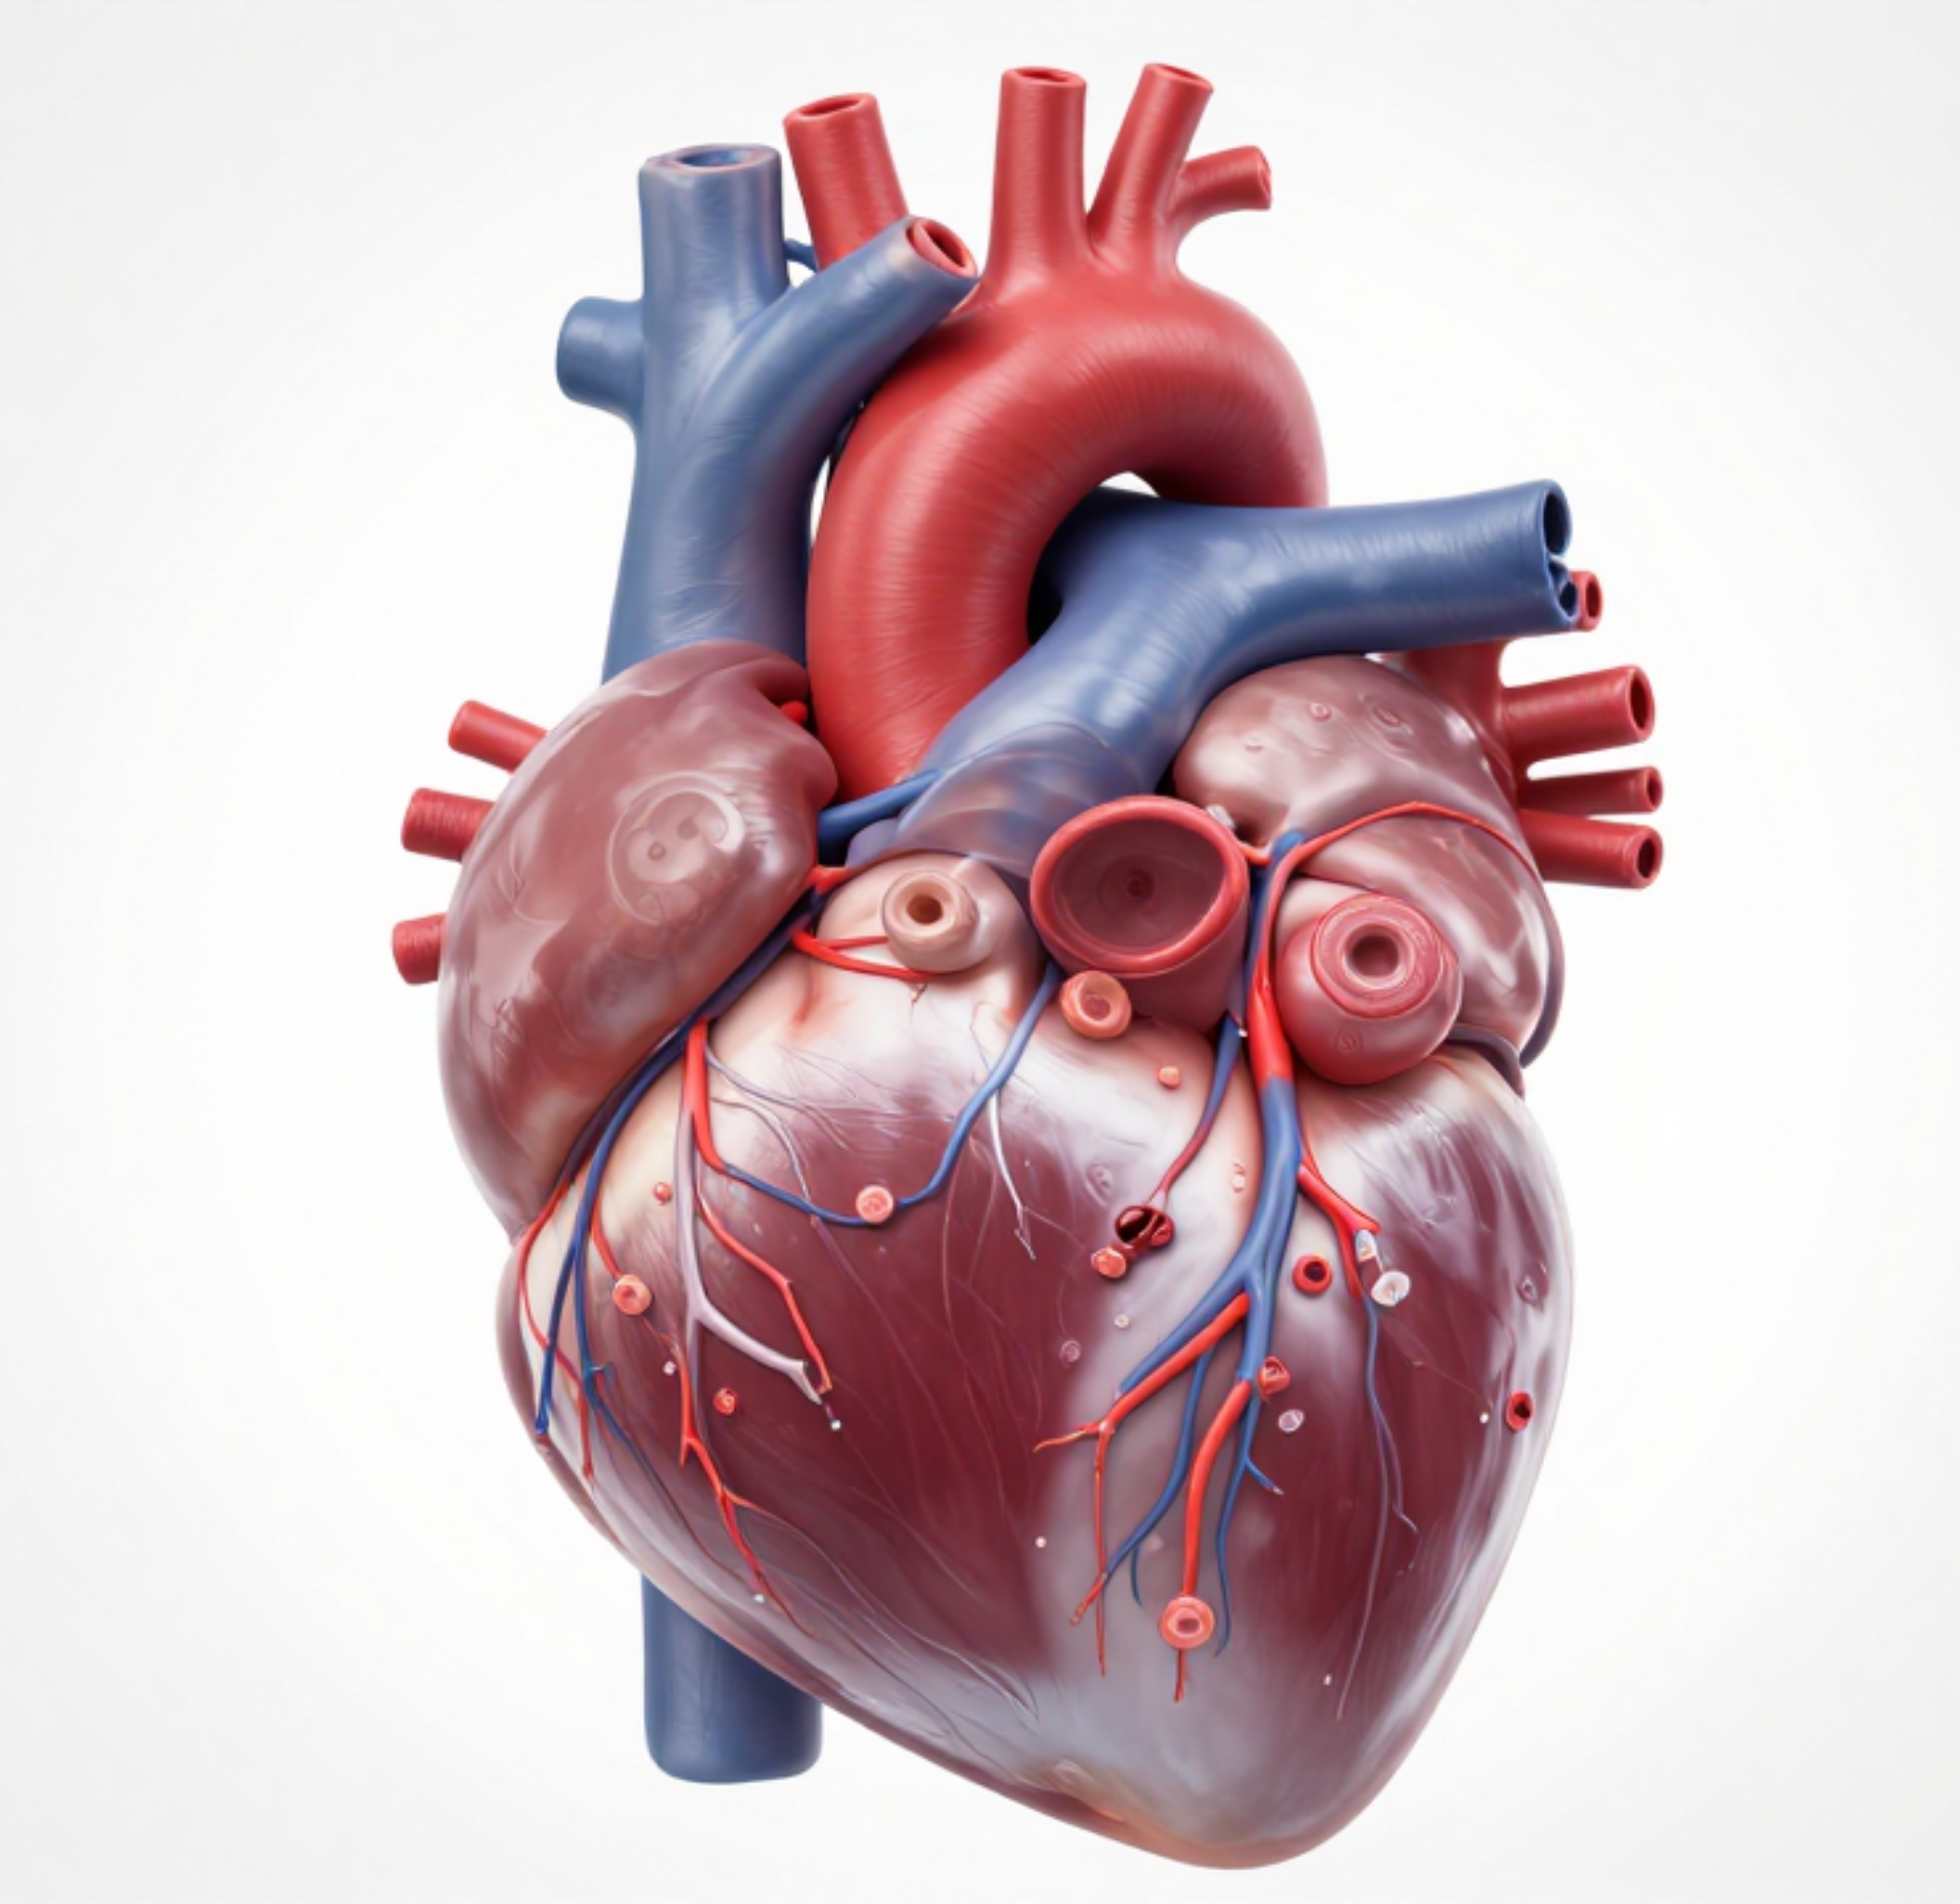


BRADFORD VTS TEACHING DECK
Lipids, Statins & CVD Prevention
CLINICAL AUTHORITY
NICE NG238 (December 2023 Update)
Created May 2026
Clinical Context: Primary & Secondary Prevention
DISCLAIMER: Slides provided for educational purposes.
Check against latest NICE guidance & BNF

Slide 2














Why Lipids Matter and Physiology
NICE NG238 GUIDELINE UPDATE
THE CLINICAL BURDEN
THE ATHEROGENIC PROCESS
Dyslipidaemia is a major modifiable risk factor for CVD.
01
LDL enters arterial wall & becomes oxidised
CVD (MI, Stroke, PVD) is the leading cause of premature death in the UK.
02
Macrophage uptake creates Foam Cells
~40%
of all UK deaths are attributed to Cardiovascular Disease
03
Atherosclerotic Plaque formation
04
Plaque Rupture → Thrombosis → MI/Stroke
LIPOPROTEIN CONCEPTS
FULL LIPID PROFILE
LDL: 'Bad' cholesterol; deposits in arterial walls to form plaques.
Non-fasting acceptable for initial screening
HDL: 'Good' cholesterol; reverse transport and protective.
Total Cholesterol
HDL Cholesterol
Non-HDL: Total Minus HDL. Better predictor of CV risk than LDL alone.
Triglycerides
Non-HDL (Calc)
LDL (Calc/Direct)

Slide 3



















CVD Risk Assessment and QRISK3
NICE NG238 GUIDELINE UPDATE
QRISK3 — The Preferred Tool
When NOT to use tools
Recommended for adults aged 25–84 without CVD.
Type 1 Diabetes: Treat regardless of risk score (specific criteria apply).
Includes adults with Type 2 Diabetes in same age range.
Chronic Kidney Disease: eGFR < 60 ml/min or albuminuria = automatically high risk.
ENHANCED RISK FACTORS (VS QRISK2):
SLE, Severe Mental Illness, HIV, Antipsychotics, Steroids, ED, Migraine, and OSA.
Familial Hypercholesterolaemia: Genetic high risk; refer to specialist.
Adults ≥ 85 years: Age alone places patient at increased risk.
MORE COMPREHENSIVE THAN QRISK2
TOOLS UNDERESTIMATE RISK IN THESE GROUPS
Treatment Threshold
Prioritisation Strategy
Systematic screening of electronic records for CVD risk factors.
Primary Prevention Statin Offer:
QRISK3 Score ≥ 10%
Prioritise formal assessment if estimated 10-year risk is ≥ 10%.
NICE NG238 (2023) maintains the 10% threshold, which significantly expanded the eligible population.
Opportunistic assessment is secondary to systematic strategies.

Slide 4



















Lipid Targets and Statin Intensity
NICE NG238 GUIDELINE UPDATE
Statin Intensity Classifications
Primary Prevention
Intensity
Reduction
Drug & Dose Examples
Aim for >40% reduction in non-HDL cholesterol from baseline.
HIGH
≥ 40%
Atorvastatin 20–80 mg
Rosuvastatin 10–40 mg
No specific numerical LDL target specified for primary prevention.
MEDIUM
30–40%
Atorvastatin 10 mg, Simvastatin 20–40 mg
Rosuvastatin 5 mg, Fluvastatin 80 mg
LOW
< 30%
Simvastatin 10 mg
Pravastatin 5–40 mg, Fluvastatin 20–40 mg
Note: NICE NG238 prioritizes percentage reduction for primary prevention and numerical targets for secondary prevention.
Secondary Prevention
LDL ≤ 2.0 mmol/L OR non-HDL ≤ 2.6 mmol/L.
Escalate treatment if target not met on maximum tolerated dose.

Slide 5






Statins for Primary Prevention
NICE NG238 GUIDELINE UPDATE
QRISK3 Threshold & Initiation
Special Populations
Offer Atorvastatin 20 mg to adults with a 10-year QRISK3 score ≥10%.
Type 1 Diabetes: Offer if >40 years, OR DM duration >10 years, OR nephropathy.
Prioritise electronic records screening for systematic risk assessment strategy.
Adults ≥85 years: Consider Atorva 20mg, balancing frailty and preference.
Note: NICE NG238 (2023) maintained the 10% threshold set previously in CG181.
CKD: Automatically high risk if eGFR <60 or albuminuria (Statin recommended).
Clinical Considerations
Lifestyle & Support
Consider statin if QRISK3 <10% but patient has an informed preference.
Discuss lifestyle alongside statins, not as a reason to delay treatment.
Treat if risk is likely underestimated (e.g., severe mental illness, HIV, OSA).
Offer formal support for smoking cessation and weight management.
Address exercise referral and dietary modifications as key modifiable factors.
Use Shared Decision-Making: Balance potential benefits vs. harms (NNT data).
Clinical Tip: Aspirin has NO role in primary CVD prevention per NICE NG238.

Slide 6















Statins for Secondary Prevention
NICE NG238 GUIDELINE UPDATE
Established CVD Indications
Lipid Targets (2–3 Months)
Ischaemic Heart Disease: Angina, MI, Post-ACS, Post-CABG
Achieve targets on maximum tolerated high-intensity statin:
Cerebrovascular Disease: Ischaemic Stroke, TIA
Peripheral Vascular Disease: (PVD)
≤2.0
≤2.6
Aortic Aneurysm: Clinical diagnosis
LDL (MMOL/L)
NON-HDL (MMOL/L)
If targets not met on max statin, consider escalation (e.g., Ezetimibe).
The Secondary Prevention Regimen
Major Guideline Shift
Offer Atorvastatin 80 mg to all eligible adults
Transitioning away from older protocols:
Do NOT delay treatment: Lifestyle advice given concurrently
FIRST-LINE CHOICE
Acute Coronary Syndrome: Start statin on admission; measure lipids then and at 2-3 months
Simvastatin 40 mg
Atorvastatin 80 mg
Simvastatin is no longer first-line for secondary prevention.
Atorvastatin is now recommended throughout the CVD pathway.

Slide 7





Monitoring Statin Treatment
NICE NG238 GUIDELINE UPDATE
Pre-Treatment Baseline
Managing Muscle Symptoms
Clinical Profile: Smoking, Alcohol, BP, BMI, Diabetes
Measure CK: Only if persistent, unexplained muscle pain
Biochemistry: Renal function (U&E), ALT (Transaminase)Do not exclude if ALT < 3x Upper Limit Normal
CK > 5x ULN Stop statin; re-measure in 1 week.
CK < 5x ULN Explore other causes; consider dose reduction.
Indicated Tests: TSH if symptomatic (exclude secondary causes)
Do NOT routinely measure Creatine Kinase (CK) in asymptomatic patients.
Follow-up Schedule
NICE Safety Essentials
2–3 Months: Full lipid profile + Liver ALTAim for >40% non-HDL reduction (Primary)
Diabetes Risk: Do NOT stop statins for raised glucose or HbA1c; benefits outweigh the risk.
12 Months: Measure ALT againOnly repeat thereafter if clinically indicated
Intercurrent Illness: Remind patients to restart statins after acute illness or drug interactions.
LFT Protocol: Only stop if ALT ≥ 3x ULN; investigate for underlying liver disease.
Annual Review: Adherence, lifestyle, and CVD risk

Slide 8














Statin Adverse Effects and Interactions
NICE NG238 GUIDELINE UPDATE
Myopathy & Muscle Safety
Liver & Metabolic Risks
Risk Factors: Renal impairment, hypothyroidism, high doses, and elderly age.
ALT Elevation: Common and transient. If ALT <3x ULN, continue and monitor at 2-3 months.
CK >5x ULN: Stop statin immediately; re-measure in 1 week. Do not restart if persistent.
New-Onset T2DM: Small risk (NNH ~255). Do NOT stop statin for rising HbA1c.
CK <5x ULN: Explore other causes (e.g., exercise); consider lower dose or alternative statin.
Long-term Monitoring: No routine LFTs required after 12 months unless symptomatic.
Red Flag: Unexplained severe myalgia + CK >10x ULN = Rhabdomyolysis. Admit to hospital.
AKT Pearl: Cardiovascular benefits far outweigh the small risk of new-onset diabetes.
Major Drug Interactions
Contraindications & Warnings
Increased statin levels (via CYP3A4 inhibition):
Pregnancy: Teratogenic. Stop 3 months before conception; restart only after breastfeeding.
Amiodarone
Verapamil
Diltiazem
Macrolides
Active Liver Disease: Statins are contraindicated in acute hepatitis or cirrhosis.
Azole Antifungals
Fibrates
Intercurrent Illness: Advise patients to restart if stopped during acute infection.
Grapefruit Juice: Avoid with Atorvastatin and Simvastatin as it inhibits CYP3A4.
Note: Simvastatin + Ciclosporin is a strict contraindication.

Slide 9


















Statin Intolerance and Ezetimibe
NICE NG238 GUIDELINE UPDATE
Stepwise Management of Adverse Effects
Ezetimibe 10mg OD (First-Line Alternative)
1
Stop & Retry: Discontinue statin temporarily; retry same statin at same or lower dose once symptoms resolve.
NPC1L1 Transporter Inhibitor (Small Intestine)
INDICATIONS
LDL REDUCTION
2
Switch Statin: Change to a different agent within the same intensity group (e.g., Atorvastatin to Rosuvastatin).
Monotherapy or Add-on
~18% – 20%
MONITORING
SECONDARY GOAL
3
Reduce Intensity: Titrate down to a lower-intensity statin if high-intensity options are not tolerated.
No routine LFTs needed
Add if targets not met
4
Max Tolerated: Aim for the maximum intensity and dose the patient can comfortably sustain.
Escalation & Specialist Options
Bempedoic Acid + Ezetimibe: Fixed-dose combo if statins contraindicated and ezetimibe alone is insufficient.
Inclisiran (PCSK9 inhibitor): Twice-yearly injection for secondary prevention if targets remain unmet.
DO NOT ROUTINELY OFFER
"Any statin at any dose reduces CVD risk."
Fibrates
Nicotinic Acid
Bile Acid Sequestrants
Coenzyme Q10

Slide 10















Familial Hypercholesterolaemia (FH)
NICE NG238 GUIDELINE UPDATE
Simon Broome Criteria
DEFINITE
Clinical Management
Lipids: Total Cholesterol >7.5 mmol/L or LDL >4.9 mmol/L (Adults)
Specialist Referral: Mandatory for all suspected FH patients to a lipid clinic
Clinical: Evidence of Tendon Xanthomata in patient or 1st/2nd degree relative
Treatment: High-intensity statin (Atorvastatin 40–80mg)
Cascade Screening: Genetic testing and lipid profiles for all 1st-degree relatives
Note: FH is a genetic condition affecting 1 in 250 people in the UK.
Simon Broome Criteria
POSSIBLE
NICE Treatment Target
Lipids: Same threshold (TC >7.5 or LDL >4.9 mmol/L)
≥50% Reduction
Family History: MI under 50 (2nd degree) or under 60 (1st degree)
Family History: Elevated TC in relatives (>7.5 adult / >6.7 child)
in LDL cholesterol from untreated baseline
Escalate to Ezetimibe or PCSK9 inhibitors if target not met on max statin

Slide 11

















Hypertriglyceridaemia and NNT
NICE NG238 GUIDELINE UPDATE
Triglyceride Management Thresholds
NNT: Communicating Benefit
Level (mmol/L)
Clinical Action (NICE NG238)
Primary Prevention (QRISK3 ~20%)
Optimise lifestyle & CVD risk factors; Specialist if non-HDL >7.5 mmol/L.
NNT ≈ 30 – 50 over 5 years
4.5 – 9.9
Repeat fasting test; Seek specialist advice if persistent.
Secondary Prevention (Post-MI)
10.0 – 20.0
NNT ≈ 20 – 30 over 5 years
> 20.0
URGENT specialist referral required (Risk of acute pancreatitis).
Shared Decision Framing
Screen for Secondary Causes
THE "100 PEOPLE" RULE
"Out of 100 people like you taking this tablet for 5 years, about 3 would avoid a heart attack compared to those not taking it. Most people tolerate it well, though we monitor for rare muscle symptoms."
Alcohol excess
Type 2 Diabetes
Obesity / Metabolic Syn.
Hypothyroidism
Chronic Kidney Disease
Drugs (Steroids, Thiazides)
Balance benefits with potential harms (NNH for myopathy/diabetes).
Frame risk reduction relative to baseline absolute risk.

Slide 12










Top Tips for GP Trainees
NICE NG238 GUIDELINE UPDATE
First-Line Therapy
Monitoring Schedule
Atorvastatin is now first-line for both primary (20mg) and secondary (80mg) prevention; simvastatin is no longer recommended.
Check lipids and ALT at 2–3 months; perform a final ALT check at 12 months. Do not routinely monitor LFTs thereafter.
Risk Thresholds
Statin Intolerance
Offer atorvastatin 20mg for primary prevention to any adult with a 10-year QRISK3 score of ≥10%.
Ezetimibe 10mg is the first-choice alternative if statins are contraindicated or not tolerated by the patient.
Aspirin Removal
Familial HC (FH)
Aspirin has NO role in primary CVD prevention according to NICE NG238 (2023) — focus on lipid modification instead.
Refer all suspected FH cases to a specialist lipid clinic and ensure cascade screening for all first-degree relatives.
BRADFORD VTS TEACHING DECK
Clinical Authority: NICE NG238

Slide 13
















AKT and SCA Exam Pearls
NICE NG238 GUIDELINE UPDATE
AKT: Clinical Knowledge
SCA: Shared Decision Making
NG238 Update: QRISK3 ≥10% is the threshold for primary prevention with Atorvastatin 20mg.
Non-Paternalistic Approach: Offer the statin as a tool for protection rather than a command.
Secondary Targets: Aim for LDL ≤2.0 mmol/L or non-HDL ≤2.6 mmol/L using Atorvastatin 80mg.
"Your heart risk score is above 10%, which means a daily tablet could help protect you from heart attacks. Would you like to explore this?"
Monitoring: Check lipids + ALT at 2–3 months; repeat ALT at 12 months. Do not stop for mild ALT rise (<3x ULN).
Lifestyle Integration: Always discuss diet and exercise concurrently, not as a delay to treatment.
AKT: FH & Alternatives
SCA: Managing Concerns
Familial Hypercholesterolaemia: Use Simon Broome criteria; refer all and aim for ≥50% LDL reduction.
Side Effect Framing: Reassure that severe muscle pain is rare (1 in 10,000) and most tolerate treatment well.
Ezetimibe 10mg: First-choice if statins are contraindicated or not tolerated.
Diabetes Risk: Explicitly state that benefits of CV protection far outweigh the small risk of rising HbA1c.
Exclusions: Do not routinely offer fibrates, niacin, or bile acid sequestrants.
Safety Netting: Advise reporting unexplained muscle pain for a CK check.

Slide 14










Red Flags and Common Pitfalls
NICE NG238 GUIDELINE UPDATE
Urgent Red Flags
Common Clinical Pitfalls
Extremely High LipidsREFER FH
Outdated Prescribing (Simvastatin)
TC > 9.0 mmol/L or non-HDL > 7.5 mmol/L. Refer for FH or secondary causes.
Prescribing Simvastatin 40mg as 1st line. Atorvastatin 20mg is now the standard for primary prevention.
Inaccurate Risk Tools (QRISK2)
Triglycerides > 20 mmol/LURGENT
Using QRISK2 instead of QRISK3, which underestimates risk in SLE, HIV, and mental illness groups.
High risk of acute pancreatitis. Urgent specialist referral required.
Unnecessary Statin Cessation
Severe Myalgia + CK > 10x ULN
Stopping therapy for mild ALT rise (< 3x ULN) or rising HbA1c. Benefits usually far outweigh these risks.
Suspect rhabdomyolysis. Admit to hospital and stop statin immediately.
Aspirin for Primary Prevention
ALT > 3x Upper Limit Normal
Prescribing aspirin solely for primary CVD prevention; NICE NG238 no longer recommends this practice.
Neglecting FH Cascade Screening
Stop statin and investigate for underlying liver disease.
Clinical Signs of FH
Failing to organize screening for 1st-degree relatives of FH patients (each has a 50% risk).
Tendon xanthomata or xanthelasma in a young patient or with strong family history.
Missing Grapefruit Interaction
Forgetting to advise patients that grapefruit juice inhibits CYP3A4, raising Atorvastatin/Simvastatin levels.

Slide 15














Quick Recall
NICE NG238 GUIDELINE UPDATE
Thresholds & Initiation
Lipid Targets
Primary Prevention: QRISK3 score ≥ 10%
Primary Aim: > 40% reduction in non-HDL
Primary Dose: Atorvastatin 20 mg OD
Secondary Target: LDL ≤ 2.0 mmol/L
Secondary Dose: Atorvastatin 80 mg OD
Secondary (Non-HDL): Aim for ≤ 2.6 mmol/L
Simvastatin: No longer first-line for CVD prevention
FH Target: ≥ 50% reduction in LDL cholesterol
Note: QRISK3 preferred over QRISK2
Ezetimibe if target not met
Non-fasting lipids OK
Monitoring Timeline
Referral Thresholds
Baseline: Lipids, ALT, Renal Function, BP, HbA1c
Triglycerides > 20 mmol/L: Urgent referral (Pancreatitis)
2–3 Months: Full Lipid Profile + ALT
Non-HDL > 7.5 mmol/L: Possible FH or secondary cause
12 Months: ALT (only if clinically indicated thereafter)
Total Cholesterol > 9.0 mmol/L: Urgent specialist review
ALT < 3x ULN: Do not routinely stop statin
FH Diagnosis: Refer all to Specialist Lipid Clinic

