Slide 1



BRADFORD VTS TEACHING DECK
Palpitations — Assessment and Management in Primary Care
Clinical Guidance for GP Trainees: AKT & SCA Preparation
Updated: May 2026
References: NICE CKS 2023 | NICE NG196 AF 2021 | DVLA 2026
Medical Disclaimer: This presentation is for educational use only for GP trainees. Clinical decisions must be based on current national guidelines, individual patient assessment, and clinical judgment at the time of consultation.
www.bradfordvts.co.uk
Current as of 2026-05-07

Slide 2









BRADFORD VTS TEACHING DECK
Introduction and Epidemiology
Clinical Guidance Section
Clinical Definition
The Primary Care Challenge
Palpitations are defined as an abnormal awareness of one's own heartbeat.
Palpitations are one of the most common presentations in General Practice, often causing significant anxiety for both the patient and the clinician.
Descriptions vary significantly: heartbeats may be felt as fast, slow, irregular, or simply unusually strong.
The primary skill in primary care is to risk-stratify: identifying the small group with significant underlying arrhythmia from the large group with benign causes.
Key Statistics
16%
Prevalence in the general population at some point in their lives.
Most presentations are benign, but a structured approach is essential to ensure high-risk patients are not missed.
<50%
Proportion of cases actually caused by a cardiac arrhythmia.
www.bradfordvts.co.uk
Educational use only | Based on NICE CKS 2023 & NICE NG196

Slide 3
















BRADFORD VTS TEACHING DECK
What Do Patients Actually Mean?
Assessment Phase
"Heart racing or pounding"
Suggests tachyarrhythmia (AF, SVT, Sinus Tach)
SCA CONSULTATION TIP
"Skipping or fluttering"
Suggests ectopics (premature contractions)
Don't rely solely on verbal descriptions. Patient terminology for "irregularity" varies wildly.
"Chest flip or heavy thud"
"Can you tap out the rhythm with your hand on the desk for me?"
Suggests ventricular ectopics (often benign)
"Irregular heartbeat"
Often associated with Atrial Fibrillation
This is the most useful single question to distinguish regular from irregular rhythms in primary care.
"Heart going too slowly"
Suggests bradyarrhythmia or heart block
www.bradfordvts.co.uk

Slide 4


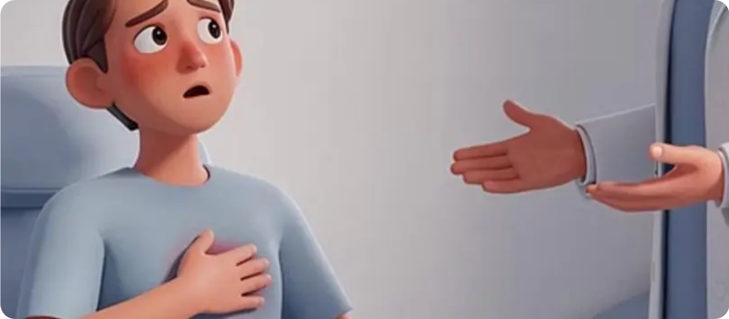













BRADFORD VTS TEACHING DECK
History Taking — The 10-Step Approach (Part 1)
Clinical Guidance Section
Step 1: Description
Ask "What exactly do you feel?" (Racing, pounding, skipping, fluttering, or thudding).
Step 2: Rate
Is it too fast to count? A very fast rate suggests a tachyarrhythmia.
Step 3: Rhythm
Is it regular or irregular? Irregularly irregular suggests Atrial Fibrillation (AF).
SCA: CONSULTATION TIP
Step 4: Onset and Offset
The "Tapping" Technique: Ask the patient to tap the rhythm on the desk with their finger. This is the most useful single diagnostic tool to distinguish regular from irregular rhythms.
Sudden "light switch" termination suggests SVT; gradual suggests sinus tachycardia.
Step 5: Duration & Frequency
CLINICAL PITFALL
Never assume palpitations are purely anxiety-driven until an arrhythmia has been excluded, especially if the history suggests a sudden onset or offset.
How long does each episode last? How often do they occur?
For more clinical resources, visit www.bradfordvts.co.uk

Slide 5












BRADFORD VTS TEACHING DECK
History Taking — The 10-Step Approach (Part 2)
Steps 6 to 10: Risk Stratification
6. Triggers
9 & 10. Family & Meds
Exercise: RED FLAG if occurs solely during exertion.
FHx: Sudden Cardiac Death (SCD) < 40 years.
Substances: Caffeine, alcohol, "party drugs".
Prescriptions: Salbutamol, Levothyroxine, Digoxin.
Positional: Swallowing cold drinks or lying down.
QT-Prolongers: Clarithromycin, Citalopram, etc.
7. Associated Symptoms
Syncope/Presyncope: Suggests cerebral hypoperfusion.
Chest Pain: Rule out ischaemia or structural disease.
Breathlessness: May indicate heart failure/AF.
SCA PEARL: EXPLORE ICE"What do you think is causing your racing heart?" vs "What worries you most about it?" Helps distinguish anxiety from organic concerns.
8. Past Medical History
Previous MI or known Ischaemic Heart Disease.
URGENT REFERRAL REQUIRED IF:
• Syncope or near-syncope during palpitations
• Palpitations occurring during exercise
• Family history of SCD in 1st degree relative < 40
Structural disease: Valve issues, Cardiomyopathy.
Previous documented arrhythmias (AF/Flutter).
www.bradfordvts.co.uk
© Bradford VTS | NICE CKS 2023 | Palpitations Assessment

Slide 6

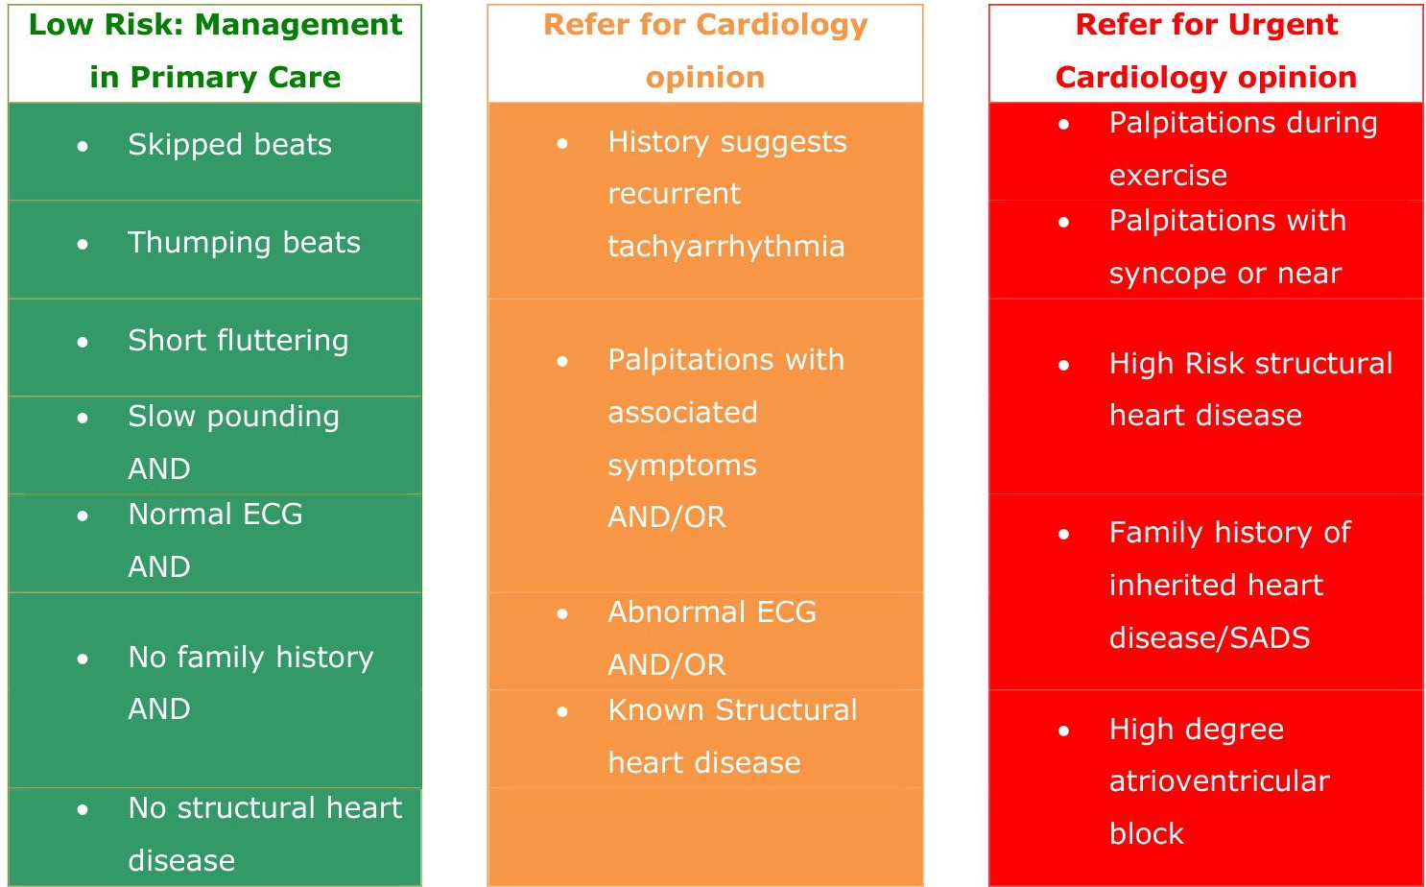








BRADFORD VTS TEACHING DECK
Red Flags — Urgent Cardiology Referral
Clinical Guidance Section
Palpitations + Syncope or PresyncopeNear-syncope is equally significant for risk.
Exertional PalpitationsRule out exercise-induced VT or Long QT Syndrome.
Palpitations + Chest PainSuggestive of myocardial ischaemia.
Family History of Sudden Cardiac DeathOccurring in a first-degree relative under age 40.
Known Structural Heart DiseaseNew palpitations in patients with previous MI or valve disease.
RED FLAG: Arrange immediate or same-day cardiology referral for any patient meeting these criteria.
www.bradfordvts.co.uk
Content based on NICE CKS (2023) & NICE NG196 (2021)

Slide 7














BRADFORD VTS TEACHING DECK
Red Flags — High-Risk ECG Findings
Clinical Guidance Section
Heart Block
WPW Pattern
Prolonged QT
2nd Degree (Mobitz II)
Short PR interval (<120ms)
Men: >440ms
3rd Degree (Complete)
Delta wave (slurred QRS)
Women: >460ms
High risk of asystole/syncope
Risk of pre-excited AF
Risk of Torsades de Pointes
Brugada Pattern
ST/T Changes
LBBB
Coved ST elevation in V1-V3
Significant ST depression/elevation
New Left Bundle Branch Block
T-wave inversion
Pathological Q waves
Always requires investigation
Risk of sudden cardiac death
Suggests ischemia or structural disease
Structural heart disease risk
URGENT CARDIOLOGY REFERRAL REQUIRED
Patients with palpitations and any of the above ECG findings require immediate or same-day specialist assessment. Do not wait for routine Holter results if these findings are present on a resting 12-lead ECG.
WWW.BRADFORDVTS.CO.UK

Slide 8

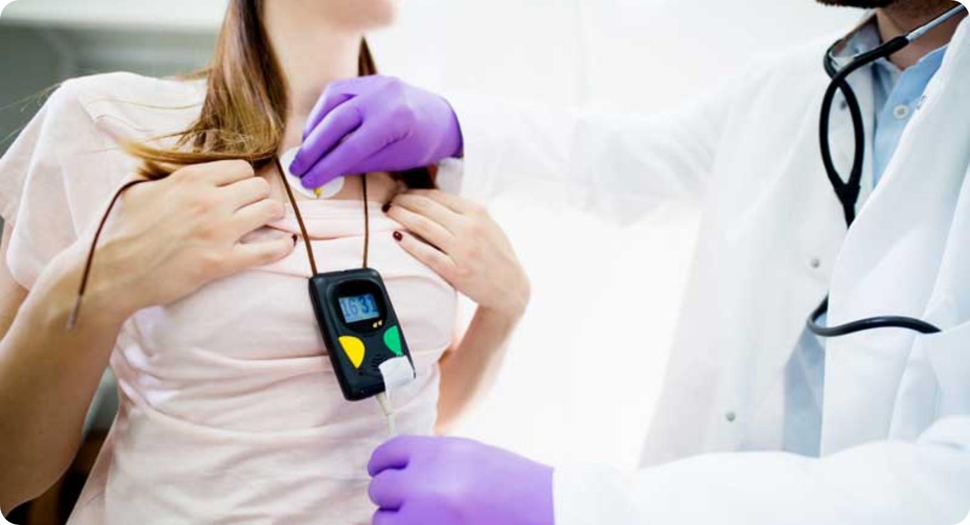



BRADFORD VTS TEACHING DECK
Investigations — The 12-Lead ECG
Clinical Guidance Section
The First-Line Essential
The mandatory first investigation for all patients presenting with palpitations.
Rhythm: Assess for regularity (AF, Flutter, sinus).
Rate: Check for bradycardia or tachycardia.
P Waves: Presence, morphology, and relationship to QRS.
PR Interval: Look for WPW (short) or Heart Block (long).
QRS Width: Distinguish narrow vs. wide complex.
QT Interval: Measure to exclude LQTS (Men >440ms, Women >460ms).
COMMON PITFALL
A normal resting ECG between episodes does NOT exclude a paroxysmal arrhythmia. Capture during symptoms is the gold standard.
www.bradfordvts.co.uk

Slide 9













BRADFORD VTS TEACHING DECK
Key ECG Features to Recognize
Diagnostic Interpretations
ECG Finding
Interpretation & Risk
RED FLAG ALERT
WPW Syndrome
Risk of AF with fast conduction; refer urgently.
Urgent Referral (Cardiology) required for:
Delta wave, short PR
WPW pattern on baseline ECG
LQTS (>440ms ♂ / >460ms ♀)
Risk of Torsades de Pointes; check electrolytes.
Prolonged QT interval
Long QT Interval
Brugada pattern or LBBB
Any 2nd or 3rd degree heart block
Atrial Fibrillation (AF)
Absence of P waves. Assess CHA₂DS₂-VASc.
Irregularly irregular
Atrial Flutter
Classic 2:1 conduction block; narrow complex.
AKT EXAM PEARL
Regular, 150 bpm
A regular, narrow-complex tachycardia at exactly 150 bpm is Atrial Flutter with 2:1 block until proven otherwise. Look for "sawtooth" waves in inferior leads (II, III, aVF).
VT UNTIL PROVEN OTHERWISE
Treat as medical emergency if unstable.
Wide complex tachycardia
www.bradfordvts.co.uk

Slide 10












BRADFORD VTS TEACHING DECK
Ambulatory ECG Monitoring Selection
Matching Frequency to Investigation
Daily Symptoms
Weekly Symptoms
Rare Symptoms
EVERY 24 HOURS
2–3 TIMES PER WEEK
MONTHLY OR INFREQUENT
24-hour Holter
7-day Ambulatory ECG
Event Recorder
Standard first-line for frequent daily episodes.
Use 48–72h Holter or 7-day patch monitors.
Patient-activated devices or Kardia/AliveCor apps.
SCA EXAM PEARL
"Shared decision-making on Holter: 'Wearing a heart monitor for a week will help us catch what your heart is doing during an episode, rather than just a snapshot in the clinic.'"
Note: If the ECG is normal between episodes, it does not exclude a paroxysmal arrhythmia. The most valuable recording is one performed during an episode.
www.bradfordvts.co.uk

Slide 11








BRADFORD VTS TEACHING DECK
Other Essential Investigations
Clinical Guidance Section
Blood Tests (Excluding Secondary Causes)
Echocardiography Indications
FBC: Screen for anaemia (high-output state) which can exacerbate underlying arrhythmias.
Abnormal 12-lead ECG: Left bundle branch block (LBBB), pathological Q waves, or LVH.
TFTs: Exclude hyperthyroidism, a common trigger for sinus tachycardia and Atrial Fibrillation.
Structural Heart Disease: Known history of MI, valvular disease, or cardiomyopathy.
U&Es: Check for electrolyte disturbances (hypokalaemia/hypomagnesaemia) that lower the threshold for ectopics.
Clinical Signs: Presence of a heart murmur or signs of heart failure (orthopnoea, basal crackles).
Blood Glucose: Exclude hypoglycaemia or diabetic autonomic neuropathy as potential drivers.
High Burden: Ventricular ectopics (VEs) >20% on Holter monitoring.
AKT EXAM PEARL
Low Magnesium (Mg²⁺) is a frequent but overlooked cause of persistent palpitations. NICE CKS suggests checking Mg²⁺ if standard U&Es are normal but symptoms persist.
COMMON PITFALL
Do not order an Echo for simple, benign ectopics in patients with a normal ECG and no history of structural disease.
www.bradfordvts.co.uk

Slide 12








BRADFORD VTS TEACHING DECK
Common Causes — Benign Ectopics
Clinical Guidance Section
Clinical Presentation
Triggers & Lifestyle
Described as "missed beats", "thuds", or "flip-flopping" in the chest.
Common triggers: Caffeine, alcohol, nicotine, fatigue, and emotional stress.
Often most noticeable at rest or when lying down in bed.
Epidemiology: Extremely common; found in ~60% of adults on 24-hr Holter monitoring.
Management: Reassurance is the mainstay ("Heart is extra-sensitive but not dangerous").
Consider low-dose beta-blocker (e.g., Bisoprolol) only if symptoms are severely affecting quality of life.
SAFE TO MANAGE
Primary care management is appropriate if the 12-lead ECG is normal, there are no red flag symptoms (syncope/exertion), and no history of structural heart disease.
REFER TO CARDIOLOGY IF:
Ventricular Ectopic (VE) burden is >20% on Holter monitoring OR symptoms remain poorly tolerated despite lifestyle changes.
www.bradfordvts.co.uk
Educational content based on NICE CKS 2023. Clinical judgment required.

Slide 13











BRADFORD VTS TEACHING DECK
Common Causes — Supraventricular Tachycardia (SVT)
Clinical Guidance Section
Clinical Presentation & Mechanisms
Sudden Onset/Offset: Often described as a "light switch" being flicked on and off.
Rate & Rhythm: Regular, fast narrow-complex tachycardia (typically 140–280 bpm).
Common Types: AVNRT (60% - nodal re-entry) and AVRT (30% - accessory pathway e.g., WPW).
Management Principles
Acute Termination: Vagal manoeuvres (Valsalva, Carotid Sinus Massage). Refer if persistent.
Medical Prevention: Beta-blockers (e.g., Bisoprolol) or Verapamil for symptomatic episodes.
SCA CONSULTATION TIP
Definitive Treatment: Refer to cardiology for consideration of catheter ablation if recurrent.
Teach the Modified Valsalva Technique: Blow into a 10ml syringe for 15s while sitting, then immediately lie flat with legs raised to 45° for 15s. This increases success rates from 17% to 43%.
PITFALL: Never combine Verapamil and Beta-blockers (risk of fatal bradycardia).
www.bradfordvts.co.uk

Slide 14













BRADFORD VTS TEACHING DECK
Common Causes — Atrial Fibrillation (AF)
NICE NG196 (2021) Standards
Clinical Presentation
"Irregularly irregular" pulse is the classic finding.
ECG: Absence of P waves and irregular RR intervals.
Management Strategy
Rate Control: First-line for most. Use Beta-blocker (Bisoprolol) or diltiazem/verapamil.
May present as racing, fluttering, or shortness of breath.
Anticoagulation: DOAC preferred over Warfarin (Apixaban, Rivaroxaban, etc.).
CHA₂DS₂-VASc Stroke Risk
Target Rate: Rest heart rate <110 bpm.
Criteria
Points
Congestive HF / LV dysfunction
1
AKT EXAM PEARL: THRESHOLDS
Hypertension (even if controlled)
1
Anticoagulate if:
Age ≥75 years
2
Score ≥2 in Men
Diabetes Mellitus
1
Score ≥3 in Women
Consider if 1 (Men) or 2 (Women)
Stroke / TIA / Thromboembolism
2
Vascular disease (MI, PAD)
1
Drug Interaction Pitfall: NEVER combine verapamil or diltiazem with a beta-blocker. Risk of severe bradycardia or fatal heart block.
Age 65–74 years
1
Sex category (Female)
1
www.bradfordvts.co.uk

Slide 15













BRADFORD VTS TEACHING DECK
Common Causes — Ventricular Tachycardia (VT)
High-Risk Arrhythmia Identification
Clinical Profile
RED FLAG: THE GOLDEN RULE
Wide Complex Tachycardia: QRS duration >120ms at a rate >100 bpm.
TREAT ANY WIDE COMPLEX TACHYCARDIA AS VT UNTIL PROVEN OTHERWISE.
Usually associated with structural heart disease (previous MI, cardiomyopathy, valve disease).
Never assume SVT with aberrancy in primary care; the risk of misdiagnosis is too high.
Can be sustained (>30s) or non-sustained (NSVT).
Important: Most patients with VT have an underlying substrate of myocardial scarring.
Management & Referral
Unstable: If haemodynamically compromised (BP <90, chest pain, syncope) → Dial 999 immediately.
Stable/Self-terminating: Refer urgently to cardiology for assessment (EP studies, ICD consideration).
DVLA: Must stop driving and notify DVLA (usually 6-month ban).
www.bradfordvts.co.uk

Slide 16








BRADFORD VTS TEACHING DECK
Common Causes — Anxiety and Panic Disorder
Clinical Guidance Section
Clinical Presentation
Management Strategy
Sinus Tachycardia: Regular rhythm, typically 90–120 bpm.
Psychological: CBT, mindfulness, and regular exercise.
Normal Examination: No murmurs, clear chest, normal BP.
Pharmacological: Propranolol (10–40 mg) PRN or TDS for somatic symptoms.
Normal 12-lead ECG: Aside from tachycardia, no pathological changes.
Address Root Cause: Screen for GAD or Panic Disorder.
Associated Symptoms
SAFE TO MANAGE IN PRIMARY CARE
Chest tightness and breathlessness.
Reassurance is appropriate if:
Clear correlation with psychological stress.
Paresthesia (tingling in fingers/around mouth).
Normal physical exam and baseline 12-lead ECG.
Sweating, tremor, and "feeling of doom".
No red flags (syncope, family history of SCD).
Normal TFTs and FBC to exclude organic causes.
www.bradfordvts.co.uk

Slide 17












BRADFORD VTS TEACHING DECK
Management — Ectopics & Lifestyle
Clinical Guidance Section
Lifestyle Modifications
SAFE TO MANAGE: REASSURANCE
Reduce Stimulants: Cut down on caffeine (coffee, tea, energy drinks, cola) and nicotine.
Reassurance is the mainstay of treatment for benign ectopics.
Explain that these are "hiccups of the heart"—they are extremely common (~60% of adults) and do not indicate a failing heart. Confidence in your reassurance reduces the anxiety that worsens symptoms.
Alcohol Moderation: Excess alcohol is a potent trigger for both atrial and ventricular ectopics.
Fatigue & Stress: Prioritize sleep hygiene and stress management techniques (CBT/Mindfulness).
Dehydration: Ensure adequate fluid intake to maintain electrolyte balance.
Pharmacological Options
Indications: Only if symptoms are severe, debilitating, or poorly tolerated despite reassurance.
First-line: Low-dose Beta-blockers (e.g., Bisoprolol 2.5mg OD or Propranolol 10-40mg TDS).
Specialist Referral: Required if VE burden is >20% on Holter or if structural heart disease is suspected.
www.bradfordvts.co.uk

Slide 18









BRADFORD VTS TEACHING DECK
Management — SVT Acute and Prevention
Clinical Guidance Section
Acute Termination
Long-term Prevention
Vagal Manoeuvres: First-line approach for stable patients.
Beta-blockers: Bisoprolol 2.5mg – 10mg OD. First-line for symptom control.
Standard Valsalva: 15s strain against closed glottis.
Calcium Channel Blockers: Verapamil 40mg – 120mg TDS or Diltiazem.
Carotid Sinus Massage: Avoid if carotid bruits or recent TIA/Stroke.
Hospital Management: IV Adenosine (6mg → 12mg → 12mg).
Catheter Ablation: Highly effective (>90% success). Refer if symptoms are recurrent or poorly tolerated.
Pill-in-the-pocket: Flecainide (Specialist advice only).
Referral Criteria
SCA FOCUS: MODIFIED VALSALVA
Explain the Modified Supine Technique: 15s strain in sitting position, then immediately lie flat and have an assistant raise legs to 45° for 15s. Significantly higher success rate (43% vs 17%).
Refer all patients with pre-excitation (WPW) on ECG.
Refer if medical therapy fails or patient prefers definitive cure.
CRITICAL PITFALL — SAFETY ALERT
NEVER COMBINE Verapamil (or Diltiazem) with a Beta-blocker. This carries a high risk of profound bradycardia, heart block, or asystole.
www.bradfordvts.co.uk

Slide 19



















BRADFORD VTS TEACHING DECK
Management — AF Rate Control and Anticoagulation
NICE NG196 (2021) Standards
Rate Control Strategy
Anticoagulation Selection
First-line: Monotherapy with Beta-blocker (e.g., Bisoprolol 2.5mg OD).
Alternative: Rate-limiting CCB (Diltiazem or Verapamil).
DOACs preferred over Warfarin for Non-Valvular AF.
Target Heart Rate: <110 bpm at rest (NICE 2021).
Apixaban, Edoxaban, Rivaroxaban, or Dabigatran.
Avoid: Combining Verapamil and Beta-blockers (risk of heart block).
Assess bleeding risk using ORBIT (preferred) or HAS-BLED.
Review annually: Modifiable bleeding risk factors.
CHA₂DS₂-VASc Thresholds
Gender
Score 1
Score ≥2
AKT PEARL
SCA PEARL
NICE NG196 (2021) recommends DOACs for all new AF diagnoses if CHA₂DS₂-VASc thresholds are met. Aspirin is NOT for stroke prevention in AF.
Shared Decision Making: Use visual aids to explain "1 stroke prevented vs 1 bleed caused". Document if a patient declines treatment.
Men
Consider Anticoagulation
Offer Anticoagulation
N/A (Score 1 is Gender)
Score 2: Consider /
Score ≥3: Offer
Women
www.bradfordvts.co.uk
Source: NICE NG196 (2021) Atrial Fibrillation: Diagnosis and Management

Slide 20













BRADFORD VTS TEACHING DECK
Management — QT Prolongation
Clinical Guidance Section
Immediate Clinical Actions
Common QT-Prolonging Culprits
Medication Review: Identify and stop all offending agents immediately. Consult crediblemeds.org.
Antibiotics: Macrolides (Clarithromycin, Erythromycin), Quinolones (Ciprofloxacin).
Electrolyte Correction: Check and correct Hypokalaemia (K+), Hypomagnesaemia (Mg2+), and Hypocalcaemia (Ca2+).
Psychotropics: Haloperidol, Quetiapine, Risperidone, Citalopram, Tricyclics.
Urgent Referral: Refer to Cardiology if QTc >440ms (men) or >460ms (women) or if symptomatic.
Others: Methadone, Ondansetron, Domperidone, Amiodarone.
AKT EXAM PEARL
Torsades de Pointes: This is a life-threatening polymorphic VT associated with a long QT interval. The first-line emergency treatment is IV Magnesium Sulphate.
PITFALL: Not accounting for synergistic effects of multiple QT-prolonging drugs (e.g., SSRI + Antibiotic).
www.bradfordvts.co.uk
20 / 30

Slide 21

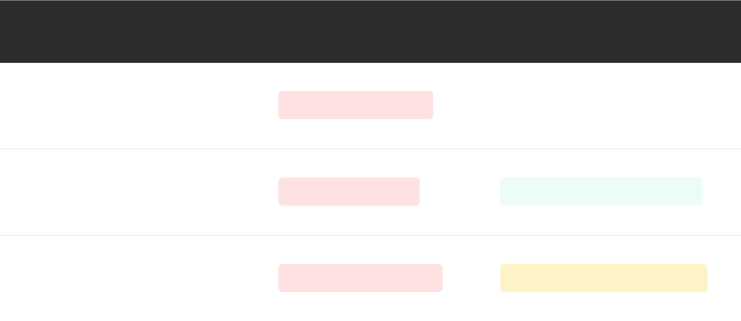










BRADFORD VTS TEACHING DECK
DVLA Guidance — Group 1 Licences
Cars and Motorcycles (2026 Standards)
Condition
Driving Restriction
DVLA Notification
COMMON PITFALL
Failure to discuss driving is a major safety oversight. Always document that you have advised the patient to stop driving while investigations for syncope or incapacitating palpitations are pending.
Must notify if symptoms continue or recur
Arrhythmia
STOP FOR 4 WEEKS
Causing or likely to cause incapacity
Post-Ablation
STOP FOR 2 DAYS
NO NOTIFICATION NEEDED
For non-VT arrhythmias
SCA CONSULTATION TIP
Use shared decision-making and empathy: "I understand how frustrating losing your licence for 4 weeks is, but my priority is keeping you and others safe until we have more answers from the ECG."
Ventricular Tachycardia (VT)
STOP FOR 6 MONTHS
MANDATORY NOTIFICATION
Regardless of symptoms
www.bradfordvts.co.uk

Slide 22














BRADFORD VTS TEACHING DECK
DVLA Guidance — Group 2 Licences
Vocational Driving Standards (LGV/PCV)
Vocational Restrictions
Relicensing Post-VT
Incapacitating Arrhythmia: Any episode causing or likely to cause incapacity results in immediate revocation of the Group 2 licence.
Requirements for relicensing following Ventricular Tachycardia treatment:
Higher Duty of Care: Standards are significantly stricter than Group 1 due to vehicle size and passenger responsibilities.
Criteria
Requirement (Group 2)
Notification: Drivers must notify the DVLA immediately of any arrhythmia diagnosis.
Symptom-Free
Minimum 3 months since last episode
Cardiac Function
LVEF must be ≥ 40%
EP Study
No inducible VT at Electrophysiology study
Medication
Stability on treatment for 3 months
SCA CONSULTATION TIP
Discussing the impact on livelihood is crucial. For vocational drivers, a diagnosis isn't just medical—it's professional. Offer support with letters and clear timelines for potential relicensing.
www.bradfordvts.co.uk

Slide 23






BRADFORD VTS TEACHING DECK
Top Tips for Primary Care (Part 1)
Clinical Practice Pearls
SCA PEARL
RED FLAG
RED FLAG
TAP THE RHYTHM
EXERTION RISK
ASSUME VT
The most effective bedside diagnostic tool in a primary care consultation.
Palpitations occurring during physical activity are high-risk until proven otherwise.
Clinical safety rule for ECG interpretation and emergency triage.
Ask patients to tap the rhythm with their finger on the desk.
Wide complex tachycardia is VT until proven otherwise.
Exertional palpitations = High Risk.
This is the most useful way to distinguish regular from irregular rhythms.
Must be referred urgently to Cardiology.
Never assume it is "SVT with aberrancy" in primary care.
Do NOT reassure based on a normal resting ECG; further testing is mandatory.
Treat as an emergency (999) if the patient is symptomatic or unstable.
Helps differentiate between simple ectopics and Atrial Fibrillation.
NICE CKS 2023 | NICE NG196 2021
www.bradfordvts.co.uk

Slide 24








BRADFORD VTS TEACHING DECK
Top Tips for Primary Care (Part 2)
Clinical Best Practice & Safety
AKT: QT MONITORING
SCA: DIGITAL DIAGNOSTICS
Always check for QT-prolonging medications. Visit www.crediblemeds.org for a definitive, searchable list.
Utilize patient-held ECG devices (e.g., Kardia AliveCor) for capturing infrequent or monthly symptoms.
SAFE TO MANAGE: REASSURANCE
PITFALL: AF + WPW WARNING
Reassure confidently for benign ectopics. Clear communication reduces patient anxiety and secondary care burden.
Never assume a fast irregular rhythm is "just AF" if there is evidence of pre-excitation (WPW syndrome).
www.bradfordvts.co.uk
Updated to NICE CKS 2023 | Slide 24 of 30

Slide 25












BRADFORD VTS TEACHING DECK
Common Pitfalls in Management
Clinical Guidance & Safety Alerts
Missing WPW
AF Assumption
PITFALL
PITFALL
Failing to spot a short PR interval (<120ms) and Delta wave on baseline ECG. WPW patients with AF are at risk of VF if treated with standard AV-node blockers.
Assuming irregular palpitations = AF without ECG confirmation. Frequent ectopics can feel identical but require very different management and anticoagulation strategy.
Drug Interactions
PITFALL
Exertional Risk
PITFALL
Combining Verapamil and Beta-blockers. This is a high-risk error that can cause profound bradycardia or fatal asystole. Never prescribe them together for rate control.
Reassuring a patient with exertional palpitations without investigation. These are red flags for exercise-induced VT or structural disease—refer urgently.
Long QT Neglect
PITFALL
Flecainide Use
PITFALL
Not checking the medication list for QT-prolonging drugs (e.g., Clarithromycin, Quetiapine). Always check crediblemeds.org in palpitations cases.
Prescribing Flecainide for AF without an Echocardiogram. It is contraindicated in structural or ischaemic heart disease due to pro-arrhythmic risks.
www.bradfordvts.co.uk
Slide 25 of 30

Slide 26







BRADFORD VTS TEACHING DECK
AKT Exam Pearls
High-Yield Clinical Data
SVT: Acute Management
AF Anticoagulation (NG196)
Modified Valsalva: Supine position with passive leg raise after strain phase is more effective than standard.
CHA₂DS₂-VASc ≥ 2 (Men) / ≥ 3 (Women): Offer anticoagulation.
CHA₂DS₂-VASc 1 (Men) / 2 (Women): Consider anticoagulation.
Adenosine Dosing: First-line for hospital termination. Rapid IV bolus: 6mg → 12mg → 12mg.
DOACs (e.g., Apixaban) are preferred over Warfarin for non-valvular AF.
Warn patients about the transient "feeling of impending doom" during administration.
First-line rate control: Bisoprolol.
Torsades de Pointes
The WPW + AF Danger
A polymorphic VT caused by QT prolongation.
Pre-excited AF (WPW) allows rapid conduction down the accessory pathway.
Management: Immediate treatment is IV Magnesium Sulphate.
CRITICAL CONTRAINDICATION: Avoid AV node blockers: Adenosine, Verapamil, Beta-blockers.
Identify and stop offending medications (e.g., Macrolides, Antipsychotics).
These can precipitate VT/VF. Use DC cardioversion or Flecainide instead.
www.bradfordvts.co.uk

Slide 27







BRADFORD VTS TEACHING DECK
SCA Exam Pearls — Communication
Clinical Guidance Section
THE ICE FRAMEWORK
SAFETY-NETTING
Ideas (Patient Perspective)
Critical Safety Message
"What do you think is causing your racing heart?"
Concerns (Fear Exploration)
"If your heart ever races and you feel faint, lightheaded, or lose consciousness, you must call 999 immediately."
"What worries you most about these sensations?"
Expectations (Desired Outcome)
"What would help you feel most reassured today?"
CONSULTATION TIPS
Normalization
Acknowledge that palpitations cause significant anxiety for patients.
Patient-Friendly Metaphors
"These extra beats are like a harmless hiccup in the heart."
www.bradfordvts.co.uk

Slide 28














BRADFORD VTS TEACHING DECK
SCA Exam Pearls — Shared Decision-Making
Consultation Excellence
SCA FOCUS: Navigating Shared Decision-Making in Palpitations
Explaining Holter Monitoring
Lifestyle & Ectopics
AF Anticoagulation
Explain the "Why": To capture symptoms that are too fleeting for a standard 10-second ECG.
Use the "Hiccup" analogy to normalize the sensation without dismissiveness.
Explore Concerns: Why is the patient hesitant? (Fear of bleeding vs. fear of stroke).
Address logistics: Non-invasive, can be worn during daily activities (except bathing).
Identify triggers together: Caffeine, alcohol, stress, or poor sleep.
Use decision aids to visualize the Benefit vs. Risk balance clearly.
"Wearing a heart monitor for a week will help us 'catch' what your heart is doing exactly when you feel that racing sensation."
"These extra beats are like a hiccup in the heart — very common and harmless in your case, though I know they feel unsettling."
Always document the discussion, even if treatment is declined.
www.bradfordvts.co.uk
Educational content based on NICE CKS 2023. Always apply clinical judgment and check current local guidelines.

Slide 29


















BRADFORD VTS TEACHING DECK
Summary and Quick Recall
Final Review
The Big Picture
Condition Quick Recall
DIAGNOSTIC GOLD STANDARD
Most palpitations are benign; fewer than 50% are caused by an arrhythmia.
A 12-lead ECG recorded DURING an episode is the most valuable diagnostic tool.
Ectopics are the most common cause — reassure confidently.
AF:
Irregularly irregular. Use CHA₂DS₂-VASc for anticoagulation (DOAC preferred).
SVT:
Sudden onset/offset. Regular/Fast. Try modified Valsalva first.
AKT & Exam Pearls
VT:
Wide complex tachycardia. Emergency until proven otherwise.
Never combine Verapamil and Beta-blockers (bradycardia risk).
Red Flag Priorities
Syncope or Presyncope associated with palpitations.
WPW:
Delta wave + Short PR. Avoid AV blockers if AF present.
Torsades: Long QT + polymorphic VT; treat with IV Magnesium.
Anxiety:
Exertional symptoms require urgent investigation.
Sinus tachycardia. Focus on the underlying psychological trigger.
DVLA: 4 weeks off for incapacitating arrhythmia (Group 1).
Family history of SCD <40 years.
www.bradfordvts.co.uk

Slide 30










BRADFORD VTS TEACHING DECK
Conclusion and Resources
Final Summary & Next Steps
Top 5 Takeaways
Clinical Resources
1
Risk Stratify Early: Always screen for syncope, exertional symptoms, and family history of SCD.
NICE CKS: Palpitations (2023)
cks.nice.org.uk/topics/palpitations/
2
Capture the Rhythm: 12-lead ECG is mandatory; aim for monitoring during an active episode.
NICE NG196: Atrial Fibrillation (2021)
www.nice.org.uk/guidance/ng196
3
AF Management: Use CHA₂DS₂-VASc for anticoagulation and follow NICE NG196 for rate control.
DVLA: Assessing Fitness to Drive (2026)
www.gov.uk/dvla-guidance-for-medical-professionals
4
Reassure Confidently: Benign ectopics are common; focus on lifestyle and "hiccup" analogy.
CredibleMeds: QT Drugs
www.crediblemeds.org
5
Safety First: Check DVLA status and review QT-prolonging medications at every review.
Patient Tools:
Kardia AliveCor, BHF Heart Rhythm leaflets.
Medical Disclaimer: This teaching deck is for educational use by GP trainees only. It is based on NICE 2023 and 2021 guidelines. Clinical judgment must be applied to individual patient cases. Guidelines may change; always refer to the latest national standards and local protocols before making management decisions.
www.bradfordvts.co.uk
Slide 30 of 30

