Slide 1

10 Steps Before You Refer for: Palpitations
BRADFORD VTS TEACHING DECK
A practical guide for primary care clinicians on the assessment, investigation, and risk stratification of patients presenting with palpitations — before making a cardiology referral.
Created May 2026, based on an 2009 article by…
ANDREAS WOLFF, GPSI IN CARDIOLOGY
CAMPBELL COWAN, CONSULTANT CARDIOLOGIST & ELECTROPHYSIOLOGIST

Slide 2

Introduction
Common but Often Benign
The Clinical Challenge
Palpitations are a frequent reason for GP consultations and cardiology referrals. Yet fewer than half of patients with palpitations have an arrhythmia, and not every identified arrhythmia is clinically significant. There is also a high incidence of anxiety disorders among these patients.
The skill lies in identifying patients with a significant heart rhythm abnormality who can be helped by treatment or are at risk of adverse outcome. This can be achieved through careful history-taking and simple investigations in primary care.
The National Service Framework for CHD (Chapter 8) recognises the need for timely access to appropriate clinicians and patient support for arrhythmic illness.

Slide 3

Step 1: What Does the Patient Actually Mean?
Palpitations refer to an abnormally perceived heartbeat — not necessarily a fast rate, but possibly a slow rate, irregularity, or unusual pounding. Always clarify what the patient means, as chest discomfort is sometimes described instead.
Rate & Rhythm
Onset & Offset
Ask the patient to tap the heartbeat with their hands to clarify rate and regularity. Regular palpitations are more likely to be arrhythmic; short-lived irregularities suggest ectopy.
Most patients recall sudden onset. Sudden termination suggests paroxysmal SVT. Mode of termination provides valuable diagnostic clues.
Circumstances
Palpitations during exertion are alarming. Triggered by cold drinks may suggest atrial flutter; stopped by coughing or breath-holding suggests AV re-entrant tachycardia.

Slide 4


Steps 2 & 3: Associated Symptoms & Contributing Factors
Associated Symptoms
Contributing Factors
Pre-syncope and blackouts are alarm symptoms. Serious arrhythmias often present with syncope alone. Breathlessness may indicate tachyarrhythmia or even heart failure (e.g. AF with fast ventricular response). Chest pain can occur even in structurally normal hearts at very fast rates.
Anxiety, depression, somatisation disorders
High caffeine intake and alcohol abuse
Illicit drugs: ecstasy, amphetamines, cocaine
Prescription drugs: beta-agonists, theophyllines, levothyroxine, calcium channel blockers
Class I anti-arrhythmic drugs (pro-arrhythmic effect)
QT-prolonging drugs — especially combinations in mental health or drug substitution patients
Full QT drug list: www.sads.org.uk/drugs_to_avoid.htm
Recurrent unexplained syncope, syncope with injury, and syncope during exertion require careful assessment by an experienced physician.

Slide 5


STEP 4
FAMILY HISTORY
Step 4: Family History
A careful family history can alert the clinician to a potentially inheritable cardiac condition. Enquire about heart muscle diseases, early-onset atrial fibrillation, premature coronary disease, and ICD use in young relatives.
A careful family history can alert the clinician to a potentially inheritable cardiac condition. Enquire about heart muscle diseases, early-onset atrial fibrillation, premature coronary disease, and ICD use in young relatives.
Sudden Cardiac Death (SCD)
Epilepsy & SUDEP
Inheritance Pattern
Deaths under age 40 are significant — arrhythmic death from an inherited condition is far more likely than in older patients. Ask broadly: "Was there any unexplained sudden death in your family?" Include fatal accidents (road traffic, drowning) that may masquerade as SCD.
Up to one in three patients diagnosed with epilepsy may be misdiagnosed. Many suffer from reflex seizures caused by arrhythmic conditions. Always ask about family history of epilepsy and sudden unexpected death in epilepsy (SUDEP).
The vast majority of inheritable cardiac conditions are autosomal-dominantly inherited. The history can therefore focus on first-degree relatives.

Slide 6

Step 5: Examination & Simple Investigations
Physical Examination
The 12-Lead ECG
Most patients are asymptomatic at consultation. Assess pulse rate, rhythm, and blood pressure. Look for signs of heart failure, abnormal heart sounds, murmurs, thyrotoxicosis, and anaemia.
The 12-lead ECG is the most important investigation — often more helpful than a 24-hour Holter. Many patients are referred without one. Key findings to look for:
Blood Tests
Atrial fibrillation
Second- and third-degree AV block (urgent referral)
Signs of previous myocardial infarction
Left ventricular hypertrophy / strain
Left bundle branch block
Abnormal T-wave inversion / ST changes
Pre-excitation (short PR interval, delta waves)
Abnormal QTc interval and T-wave morphology
Full blood count, thyroid function, and electrolytes are essential to exclude anaemia, thyroid dysfunction, and electrolyte disturbance.
Significant ECG abnormalities can be subtle. Every practice performing ECGs should have at least one clinician with enhanced ECG interpretation skills.

Slide 7
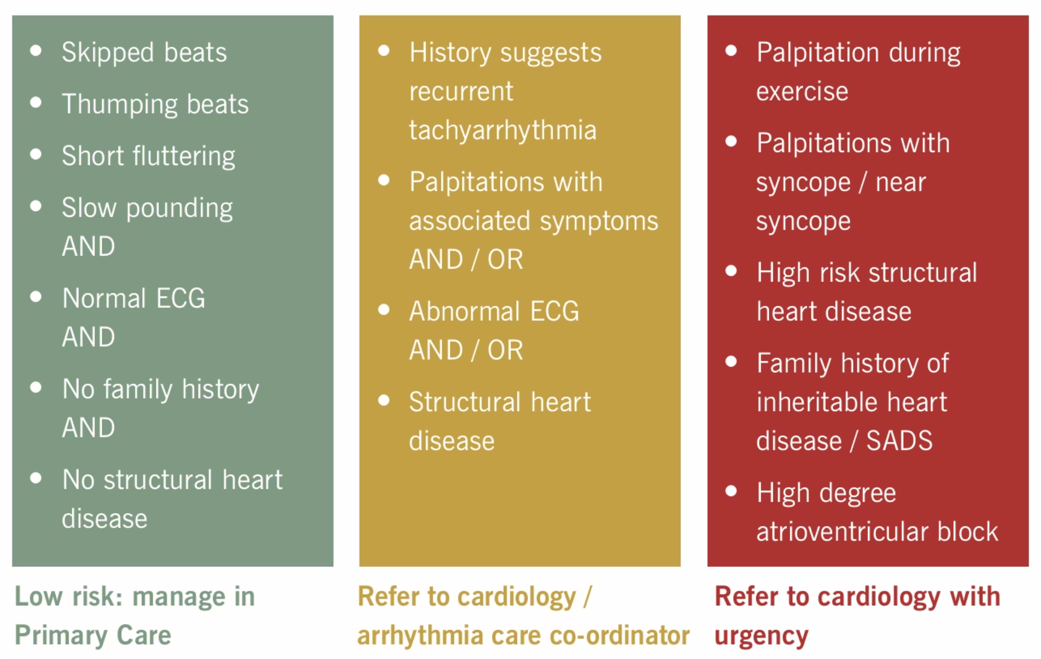
Step 6: Risk Stratification — The Traffic Light System
Adapted from Dr Michael Cooklin's traffic light system, this framework identifies which patients need urgent referral, routine referral, or can be safely managed in primary care.

Slide 8
Steps 7 & 8: Ambulatory Monitoring & Who to Refer To
Ambulatory Rhythm Monitoring (ARM)
Referral Pathways
Not all patients need ARM. The aim is to correlate symptoms with an ECG trace — the recording period must match symptom frequency. 24-hour recordings are often insufficient; patients need symptoms at least 3–4 times per week to justify this. For infrequent symptoms, a patient-activated loop recorder is preferable. ARM in primary care should not delay referral for red-flag patients.
Arrhythmia care coordinators can help signpost patients. Options include:
Community cardiology clinics — for conditions such as AF
Secondary care — for most arrhythmia referrals
Regional electrophysiology centres — for atrial flutter, accessory pathways (e.g. Wolff-Parkinson-White), requiring ablation
Inherited cardiac conditions clinic — for SCD under age 40 in first-degree relatives; requires MDT including geneticists

Slide 9
Step 9: Patient Support
Palpitations cause considerable distress. Tailored written information and access to specialist support can make a significant difference to patient experience and outcomes.
Arrhythmia Alliance
Atrial Fibrillation Association
Patient support groups, helplines, and expert-endorsed information resources for arrhythmia patients.
Dedicated resources for patients and clinicians managing atrial fibrillation.
www.heartrhythmcharity.org.uk
www.atrialfibrillation.org.uk
Sudden Adult Death Trust
Cardiac Risk in the Young
Support for families affected by sudden cardiac death and awareness of SADS.
Screening, support, and information for young people at risk of sudden cardiac death.
www.sadsuk.org
www.c-r-y.org.uk

Slide 10

Step 10: Occupational & Driving Advice
DVLA Regulations
Practical Perspective
If an arrhythmia has caused or is likely to cause incapacity, driving must cease. It is the clinician's responsibility to advise the patient and document this. Patients awaiting specialist assessment with disabling symptoms should be advised not to drive.
Only a small number of patients with palpitations will have a dysrhythmia that disqualifies them from driving. Road traffic accidents caused by medical conditions account for less than 1% of all accidents, and accident rates in treated serious arrhythmias do not exceed the general population.
www.dvla.gov.uk/medical/ataglance.aspx
Occupational Considerations
Working at height or with dangerous machinery may be affected. Common sense advice is required pending specialist assessment.

