Slide 1
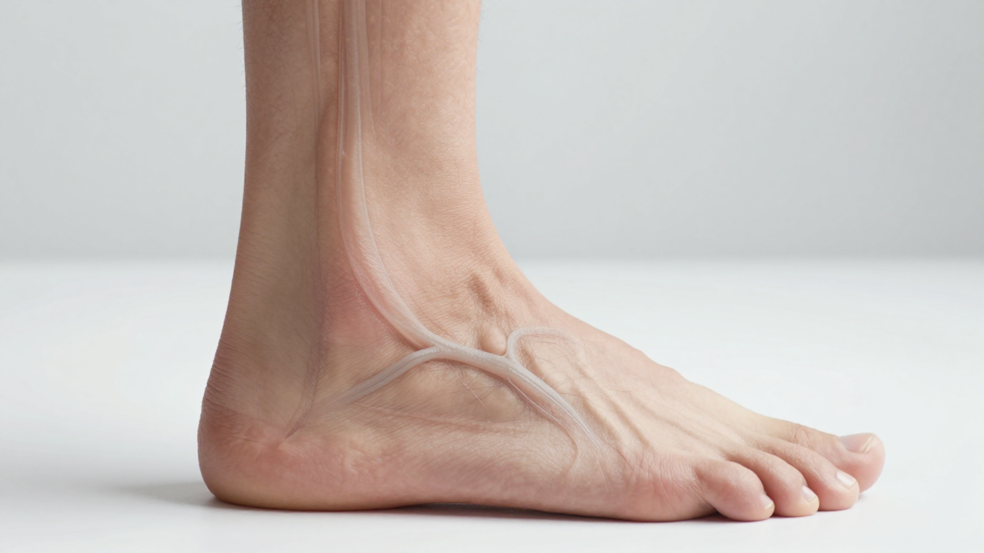


BRADFORD VTS TEACHING DECK
Peripheral Arterial Disease — Diagnosis and Management in Primary Care
GP Trainee Clinical Framework | NICE CG147 (Updated 2021) | AKT & SCA Preparation
Disclaimer: This teaching material is for GP trainees and healthcare professionals. It serves as a guide based on NICE clinical standards and should not replace clinical judgment or local protocols. Clinical responsibility remains with the practitioner.
www.bradfordvts.co.uk

Slide 2











BRADFORD VTS TEACHING DECK
Introduction to Peripheral Arterial Disease (PAD)
Definition and Clinical Significance
Pathophysiology
Systemic Marker
PAD is primarily caused by atherosclerosis narrowing the arteries that supply the lower limbs.
3–6x
Increased risk of cardiovascular death (MI, Stroke).
PAD is an established marker of widespread atherosclerosis across all vascular beds.
Key Message for GPs
Clinical Priority
The "silent majority": Only ~25% of patients are symptomatic. Most cases remain under-diagnosed and under-treated despite the high risk.
Managing PAD is not just about leg symptoms; it is about aggressive secondary prevention to reduce mortality.
www.bradfordvts.co.uk

Slide 3













BRADFORD VTS TEACHING DECK
Epidemiology and Risk Factors
Prevalence and Systemic Risk in Primary Care Populations
UK Prevalence Trends
Risk Factors for PAD
10-20%
Of adults aged over 65 years in the UK are affected by PAD.
Smoking
Most important modifiable factor
>20%
Prevalence in the diabetic population; significantly higher risk of limb loss.
Diabetes Mellitus
Major driver of severity
Hypertension
Secondary prevention target
25%
Only one-quarter of patients are symptomatic; the "silent majority" remains at high risk.
Hyperlipidaemia
Statin therapy indicated
Key Message: PAD is a marker of systemic atherosclerosis. Patients have a 3–6× increased risk of cardiovascular death (MI, stroke).
Non-Modifiable
Age, Male sex, CKD
AKT TIP: Risk factors for PAD are identical to those for Ischaemic Heart Disease (IHD).
www.bradfordvts.co.uk

Slide 4








BRADFORD VTS TEACHING DECK
Spectrum of PAD Severity
Fontaine Classification & Clinical Progression
STAGE I
STAGE II
STAGE III
STAGE IV
Asymptomatic
Intermittent Claudication
Rest Pain
Tissue Loss
Reduced ABPI present but patient reports no clinical symptoms.
Reproducible cramping pain on exertion, relieved by rest. (IIA: >200m; IIB: <200m)
Nocturnal burning pain in foot; relieved by hanging the leg out of bed.
Critical ischaemia with presence of ulceration or gangrene. High risk of amputation.
RED FLAG: ACUTE LIMB ISCHAEMIA
Sudden onset arterial occlusion. Emergency (999) Referral. Look for the 6 Ps: Pain, Pallor, Pulseless, Paralysis, Paraesthesia, and Perishing Cold.
Source: NICE CG147 (2021)
www.bradfordvts.co.uk

Slide 5










BRADFORD VTS TEACHING DECK
Clinical Presentation: Intermittent Claudication
Fontaine Stage II: Reproducible Ischaemic Muscle Pain
Key Characteristics
SCA CONSULTATION PEARL
Reproducibility: Consistent pain triggered by walking a fixed distance (claudication distance).
"How far can you walk before the pain comes on? Is it always roughly the same distance? When you stop, does the pain clear away completely?"
Nature of Pain: Described as "cramping," "aching," or "heavy fatigue" in the affected muscle group.
Relief Mechanism: Pain is relieved within 5–10 minutes by simply stopping and standing still (rest).
Progression: Declining walking distance indicates worsening arterial narrowing or plaque instability.
Pain Location vs. Arterial Site
Calf Pain (Commonest)
Superficial Femoral Artery
Thigh Pain
Common Femoral Artery
Buttock / Hip Pain
Aorto-iliac Disease
Foot Pain (Rare in IC)
Infrapopliteal Disease
www.bradfordvts.co.uk

Slide 6









BRADFORD VTS TEACHING DECK
Clinical Presentation: Rest Pain
Fontaine Stage III: Severe Limb-Threatening Ischaemia
Key Characteristics
The "Gravity Trick"
Nature: Constant, burning or aching pain, typically in the foot or toes.
Patients find relief by hanging the leg out of bed or sleeping in a chair.
Nocturnal Pattern: Worsens at night due to drop in BP and loss of gravitational assistance when supine.
Gravity increases hydrostatic pressure, aiding perfusion to the distal tissues.
Localization: Forefoot and toes are most common; often wakes the patient from sleep.
RED FLAG: STAGE III PAD
Rest pain indicates perfusion is inadequate for basal metabolic needs. This is a surgical emergency requiring same-day urgent vascular referral.
Source: NICE CG147 (2021)
www.bradfordvts.co.uk

Slide 7




















BRADFORD VTS TEACHING DECK
Red Flag: Acute Limb Ischaemia and the 6 Ps
Vascular Surgical Emergency — Time is Tissue
Pallor
RED FLAG ALERT
Pain
Pale, mottled, or "white" appearance
Acute Limb Ischaemia is a surgical emergency. Delay leads to irreversible tissue loss and potential amputation.
Sudden onset, severe, unrelenting
Pulseless
Paraesthesia
Absent pedal and popliteal pulses
Numbness/tingling (Early sign)
Immediate 999 Referral: Do not wait for GP-based assessment.
Time Window: Irreversible damage occurs within 4-6 hours.
Paralysis
Perishing Cold
Poikilothermia (Limb matches room temp)
Direct Admission: Refer straight to the on-call Vascular Surgeon.
Loss of motor function (Late sign)
www.bradfordvts.co.uk

Slide 8








BRADFORD VTS TEACHING DECK
Differential Diagnosis: Vascular vs. Neurogenic
Distinguishing Intermittent Claudication from Spinal Stenosis
Feature
Vascular Claudication (PAD)
Neurogenic Claudication
Pain Character
Cramping, tightness, aching. Usually distal (calf).
Weakness, burning, tingling. Proximal to distal distribution.
Onset
Consistent distance walked; worse uphill.
Variable distance; worse with prolonged standing.
Relief Mechanism
Stopping: Standing still for 2–5 minutes.
Sitting/Flexion: Leaning forward, sitting down.
Posture Effect
No significant effect from trunk posture.
Relieved by lumbar flexion (e.g. leaning on trolley).
Clinical Clue
Pulses often absent or weak; bruits present.
Pulses usually present; abnormal neuro exam.
COMMON PITFALLDon't assume leg pain on exertion is always vascular. Patients often lean on a shopping trolley to increase the spinal canal space—this is a classic sign of neurogenic claudication. Remember: Vascular patients can stand still for relief; Neurogenic patients need to sit or bend.
Peripheral Arterial Disease: Diagnosis & Management
www.bradfordvts.co.uk

Slide 9

















BRADFORD VTS TEACHING DECK
Diagnosis: The Ankle Brachial Pressure Index (ABPI)
Step-by-step procedure for Primary Care assessment
1. Patient Preparation
Required Equipment
Ensure the patient rests in a supine position for at least 10 minutes prior to measurement.
Hand-held Doppler
Ultrasound Gel
Sphygmomanometer
8MHz Probe
2. Brachial Pressures
Measure bilateral brachial systolic BP using a cuff and Doppler. Use the higher of the two readings.
The ABPI Formula
ABPI =
3. Ankle Pressures
Highest Ankle Systolic Pressure
Measure systolic BP in both dorsalis pedis and posterior tibial arteries using a hand-held Doppler.
Highest Brachial Systolic Pressure
www.bradfordvts.co.uk

Slide 10
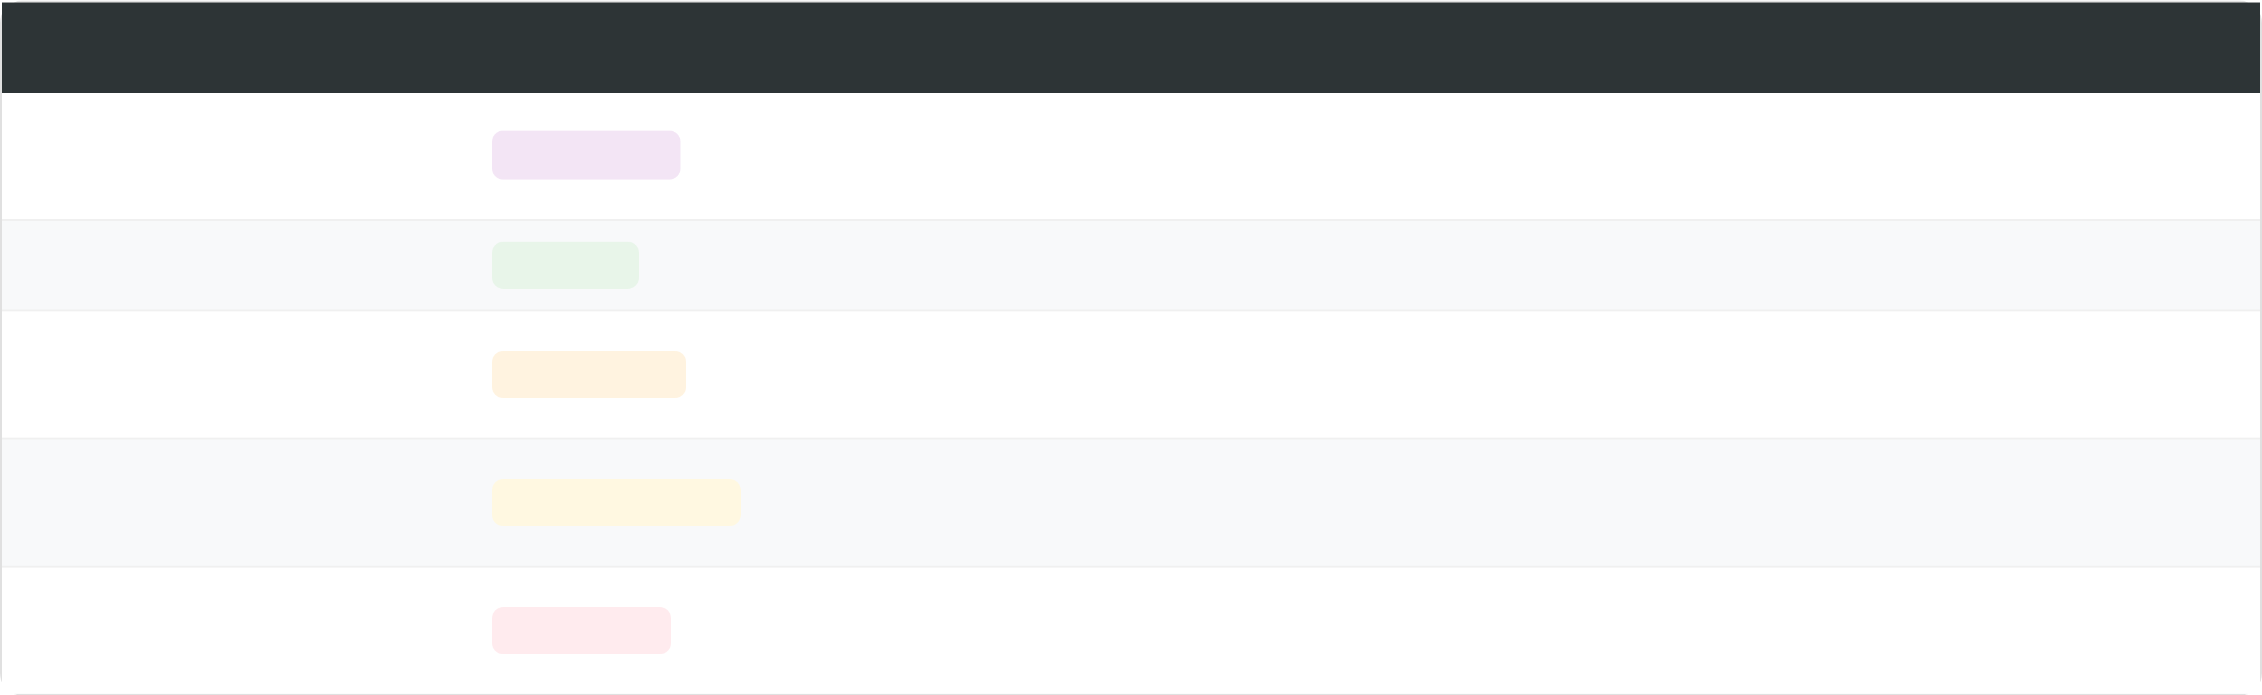


















BRADFORD VTS TEACHING DECK
ABPI Interpretation Guidelines
Standardized Diagnostic Thresholds per NICE CG147
ABPI Range
Interpretation
Clinical Significance & Action
Calcified, incompressible arteries. Common in Diabetes and CKD. Consider Toe-Brachial Index (TBI).
> 1.4
UNRELIABLE
1.0 – 1.4
NORMAL
Healthy arterial flow. PAD unlikely.
May be asymptomatic at rest but symptomatic on heavy exercise. Monitor cardiovascular risk factors.
0.9 – 0.99
BORDERLINE
Claudication Range. Refer for vascular assessment. Commence aggressive secondary prevention.
0.5 – 0.89
SIGNIFICANT PAD
Rest pain or critical limb ischaemia likely. Urgent referral to vascular surgery required.
< 0.5
SEVERE PAD
AKT EXAM TIPMemorize the 0.5 threshold. Above 0.5 is usually managed with supervised exercise and medical therapy first; below 0.5 is a red flag for critical ischaemia and requires urgent intervention.
www.bradfordvts.co.uk
Source: NICE CG147 (Updated 2021)

Slide 11








BRADFORD VTS TEACHING DECK
Pitfall: Calcified and Incompressible Arteries
Limitations of ABPI in High-Risk Primary Care Populations
The Mechanism
Medial Calcinosis: Calcium deposits in the arterial wall make vessels rigid and non-compressible.
PITFALL: ABPI > 1.4
False Elevation: The Doppler cuff cannot occlude the artery, resulting in a spuriously high pressure reading.
An ABPI result greater than 1.4 is UNRELIABLE. It does not mean the circulation is "extra healthy"—it means the test has failed to measure true arterial pressure.
At-Risk Populations
RECOMMENDED ACTION
Diabetes Mellitus: Very common complication; vessel hardening is often extensive.
Request a Toe-Brachial Index (TBI). Digital arteries in the toes are rarely calcified and provide an accurate assessment.
Chronic Kidney Disease (CKD): Accelerated vascular calcification is a hallmark of advanced renal failure.
www.bradfordvts.co.uk

Slide 12














BRADFORD VTS TEACHING DECK
Cardiovascular Risk: The Main Priority
PAD as an Established Marker of Systemic Atherosclerosis
Systemic Risk Equivalent
Aggressive Prevention Goals
PAD is not just a "leg problem." It is a potent marker of generalized atherosclerosis. The majority of patients are asymptomatic in their limbs but face significant life-threatening risks.
Antiplatelet therapy: Reduce risk of vascular events.
Lipid modification: High-intensity statin therapy.
BP Control: Target <140/90 mmHg.
Smoking Cessation: Single most effective intervention.
Prognostic Significance
3–6× increased risk of cardiovascular death (MI or Stroke).
AKT EXAM PEARL
Secondary prevention is mandatory for ALL diagnosed patients.
NICE CG147: PAD is a cardiovascular disease equivalent. Always initiate secondary prevention regardless of baseline lipid levels or limb symptoms.
www.bradfordvts.co.uk

Slide 13












BRADFORD VTS TEACHING DECK
Mandatory Pharmacotherapy for PAD
Secondary Prevention Strategy (NICE CG147 / Updated 2021)
Antiplatelet Therapy
BP & ACE Inhibitors
Clopidogrel 75mg OD is the preferred first-line choice (NICE recommendation).
ACE Inhibitor / ARB: Recommended for all, especially if hypertensive or diabetic.
Reduces combined risk of MI, stroke, and vascular death.
Target BP: <140/90 mmHg (Primary Care).
Aspirin 75mg OD is only 2nd line if clopidogrel is contraindicated or not tolerated.
Target BP (Diabetics): <130/80 mmHg.
Lipid Modification
Atorvastatin 80mg OD for ALL patients with PAD.
Prescribe as high-intensity statin regardless of baseline cholesterol levels.
AKT PEARL
High-Yield Exam Fact
NICE CG147 specifically prioritizes Clopidogrel over Aspirin for PAD. This differs from stable IHD where Aspirin is often 1st line.
Follow-up: 3-month non-HDL cholesterol check (aim for >40% reduction).
Do not wait for a "high" lipid result to start Atorvastatin 80mg; PAD is an established CVD marker.
www.bradfordvts.co.uk
Source: NICE CG147 (2021) | BNF Recommendations

Slide 14









BRADFORD VTS TEACHING DECK
Safe to Manage: Lifestyle and Smoking Cessation
NICE CG147: Primary Prevention and Symptom Management
Smoking Cessation
Supervised Exercise
The Single Most Important Intervention: Essential for reducing risk of MI, stroke, and limb loss.
NICE First-Line: Offer to ALL patients with intermittent claudication before invasive options.
3–6x Increased Risk: PAD patients who smoke carry significantly higher cardiovascular mortality risk.
The Protocol: Minimum of 2 hours per week for a period of 3 months.
Refer Early: Offer referral to smoking cessation services at every clinical encounter.
Mechanism: Encourages collateral vessel growth and improves metabolic efficiency.
Diet & Weight Management
SAFE TO MANAGE
Healthy Diet: Recommend a Mediterranean-style diet (fruits, vegetables, whole grains, pulses).
Lifestyle optimization is the cornerstone of primary care PAD management. Aggressive risk reduction through smoking cessation and supervised exercise must be established before surgical referral for stable claudication.
Weight Loss: Aim for BMI <25 kg/m² to reduce the mechanical load on lower limbs.
www.bradfordvts.co.uk

Slide 15












BRADFORD VTS TEACHING DECK
First-line Management: Supervised Exercise
NICE CG147 Clinical Standards for Intermittent Claudication
GP Counseling Strategy
NICE Programme Requirements
Explain the "Collateral Circulation" concept: Regular exercise stimulates the body to grow new, smaller blood vessels that bypass the narrowed major artery.
Duration: Minimum of 3 months of supervised sessions.
Intensity: At least 2 hours of supervised exercise per week.
Address the "Pain Paradox": Patients naturally stop when it hurts. We must explain that walking through the discomfort is what triggers the healing response.
Instruction: Exercise to the point of maximal pain (claudication distance).
Evidence: Significantly improves walking distance and quality of life compared to unsupervised advice.
"I know it feels counterintuitive to walk when it hurts, but this pain is not damaging your leg—it's actually the signal your body needs to build new pathways for blood to reach your muscles."
SAFE TO MANAGE IN PRIMARY CARE
When Supervised Exercise Fails?
Supervised exercise is the most effective intervention for claudication. It MUST be offered before considering invasive revascularisation.
If supervised exercise does not result in satisfactory improvement after 3 months, consider Naftidrofuryl oxalate or vascular referral for angioplasty.
www.bradfordvts.co.uk

Slide 16












BRADFORD VTS TEACHING DECK
Medications for Claudication Symptoms
NICE CG147 Pharmacotherapy Guidance (Updated 2021)
Medications NOT Recommended
Naftidrofuryl Oxalate
Cilostazol: Not recommended by NICE due to limited cost-effectiveness and side effects (palpitations, diarrhea). Contraindicated in Heart Failure.
Indication: Offer ONLY if supervised exercise has failed to improve symptoms or if the patient declines referral for revascularisation.
Pentoxifylline: Not recommended due to lack of evidence for clinical benefit in PAD.
Dose: 100mg to 200mg TDS (Three times daily).
Mechanism: A 5-HT2 receptor antagonist that improves muscle metabolism and reduces blood viscosity.
Benefit: Improves pain-free walking distance; review progress after 3–6 months.
AKT EXAM PEARL
Naftidrofuryl is the only drug therapy recommended by NICE for the symptomatic relief of intermittent claudication. It is a frequent high-yield question in the AKT regarding second-line management after exercise.
Peripheral Arterial Disease — Diagnosis and Management
www.bradfordvts.co.uk

Slide 17










BRADFORD VTS TEACHING DECK
Red Flag: Critical Limb Ischaemia (CLI)
Clinical Recognition and Immediate Primary Care Actions
URGENT RED FLAG
Ischaemic Rest Pain
CLI is a limb-threatening emergency. Rapid deterioration can lead to amputation or sepsis.
Constant, aching pain in the foot (Stage III).
Worse at night; patient hangs leg out of bed.
SAME-DAY URGENT REFERRAL TO VASCULAR SURGERY
Relieved by gravity-dependent blood flow.
Diagnostic Indicator: ABPI typically < 0.5
Tissue Loss (Stage IV)
Ischaemic Ulcers: Punched-out, painful, no granulation.
Gangrene: Tissue necrosis (wet or dry).
Immediate Safety Netting
Typically located on digits or pressure points.
Do NOT elevate the limb (reduces perfusion).
Protect the foot from pressure and trauma.
www.bradfordvts.co.uk

Slide 18













BRADFORD VTS TEACHING DECK
Diabetic Foot and PAD Screening
QOF requirements for annual diabetic foot examinations to prevent limb loss.
Annual Foot Review (QOF)
Diabetes + PAD = Extremely high risk of limb loss. Early detection is clinical priority.
InspectionSkin integrity, nail health, structural deformity, and active ulceration.
Pulse PalpationManual check of Dorsalis Pedis and Posterior Tibial pulses.
Refer to Diabetic Foot Team if:
Any active foot ulceration (Urgent)
Neuropathy Screening10g Monofilament test (sensation at 10 sites on the foot).
Significant PAD (ABPI < 0.8)
Vascular StatusABPI measurement (or clinical assessment if ABPI unreliable).
Suspected Charcot Joint (Redness/Swelling)
New gangrene or rest pain (Same-day)
www.bradfordvts.co.uk

Slide 19
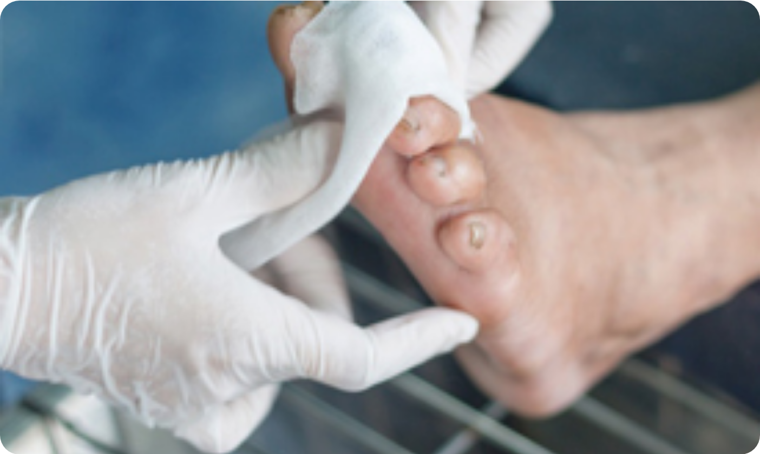






BRADFORD VTS TEACHING DECK
Principles of Ischaemic Wound Care
Management while awaiting urgent vascular assessment
Limb Protection & Environment
Protect the affected limb from any trauma or pressure (e.g., pressure-relieving heel boots).
Maintain a warm environment for the limb, but avoid direct heat (risk of thermal injury).
Ensure footwear is well-fitting and does not cause friction or pressure points.
Dressing & Immediate Care
Regular wound dressings to protect from infection; avoid occlusive/tight bandaging.
PITFALL: LEG ELEVATION
Involve urgent podiatry services for expert debridement and foot care.
Do NOT elevate the limb or use compression bandaging. Unlike venous ulcers, elevating an ischaemic limb reduces gravity-dependent perfusion and significantly worsens tissue hypoxia and pain.
Monitor closely for signs of sepsis or rapidly spreading gangrene (admission criteria).
www.bradfordvts.co.uk • NICE CG147 Management Standards

Slide 20





BRADFORD VTS TEACHING DECK
Referral Criteria: Emergency vs. Urgent
NICE CG147 Pathway & Urgency Thresholds for Primary Care
URGENCY LEVEL
CLINICAL INDICATIONS
Acute Limb Ischaemia: Any of the 6 Ps (Pain, Pallor, Pulseless, Paralysis, Paraesthesia, Perishing cold)
EMERGENCY (999)
Do not send to GP-based assessment; call 999 immediately.
RED FLAGRest Pain: Nocturnal foot pain relieved by gravity
Same-Day / Urgent
Ischaemic ulcers or Gangrene (wet or dry)
Rapidly deteriorating claudication or ABPI < 0.5
Lifestyle-limiting claudication not responding to supervised exercise
Routine Referral
Failure of medical therapy (Naftidrofuryl / Risk reduction)
Diagnostic uncertainty or surgical revascularisation planning
www.bradfordvts.co.uk

Slide 21










BRADFORD VTS TEACHING DECK
Common Pitfalls in PAD Management
Avoidable Clinical & Prescribing Errors in Primary Care
ABPI INTERPRETATION
ANTIPLATELET CHOICE
Assuming ABPI > 1.4 is a healthy result. Pitfall: These are calcified, incompressible vessels (common in diabetics). Action: Document as unreliable; consider Toe-Brachial Index (TBI).
Prescribing Aspirin 75mg as first-line secondary prevention. Pitfall: NICE CG147 specifically recommends Clopidogrel 75mg. Action: Switch to Clopidogrel 75mg OD unless contraindicated.
SILENT PRESENTATION
POSITIONING ADVICE
Only screening patients who report leg pain. Pitfall: 75% of PAD patients are asymptomatic but still carry a 3–6x higher risk of MI/Stroke. Action: High index of suspicion for smokers and diabetics.
Advising leg elevation for foot ulcers or pain. Pitfall: Elevation reduces arterial perfusion (gravity helps PAD). Action: Keep legs horizontal or dependent; elevation is for venous disease only.
ACUTE ISCHAEMIA
STATIN STEWARDSHIP
Treating sudden leg weakness or pain as a routine musculoskeletal issue. Pitfall: Missing the "6 Ps" of acute limb ischaemia. Action: Any sudden onset = Surgical Emergency (Call 999).
Withholding statins if the patient's lipid profile is "normal." Pitfall: PAD is established CVD; lipids are secondary. Action: Atorvastatin 80mg is mandatory for ALL PAD patients.
Source: NICE CG147 (2021) | Clinical Knowledge Summaries
www.bradfordvts.co.uk

Slide 22






















BRADFORD VTS TEACHING DECK
AKT Exam Pearls: Diagnosis and ABPI
High-yield facts for the Applied Knowledge Test (NICE CG147)
Secondary Prevention
ABPI Value
Interpretation
AKT Key Point
Clopidogrel 75mg OD is the NICE preferred first-line antiplatelet (not Aspirin).
1.0 – 1.4
Normal
Baseline for comparison.
Use Aspirin 75mg only if Clopidogrel is contraindicated/not tolerated.
0.9 – 0.99
Borderline
May have symptoms on exertion.
0.5 – 0.89
Significant PAD
Typical claudication range.
< 0.5
Severe PAD
Diagnostic Essentials
Critical ischaemia; Urgent Referral.
> 1.4
Incompressible
Calcified vessels (Diabetes/CKD); Unreliable.
ABPI Calculation: Ankle Systolic BP ÷ Highest Brachial Systolic BP.
In Diabetes/CKD with ABPI >1.4, use Toe-Brachial Index (TBI) for accuracy.
www.bradfordvts.co.uk

Slide 23
















BRADFORD VTS TEACHING DECK
AKT Exam Pearls: Management Steps
Evidence-Based Treatment Pathways & Pharmacotherapy
First-Line: Supervised Exercise
High-Yield AKT Pharmacology
NICE Requirement: Must be offered to ALL patients with intermittent claudication before revascularisation.
First-Choice Antiplatelet: Clopidogrel 75mg OD is preferred over Aspirin (per NICE CG147).
The "2/3 Rule": Minimum of 2 hours per week for a period of 3 months.
Drug
Status
Typical Dose
Clinical Goal: Encourage patients to walk until symptoms occur, then rest, then repeat to stimulate collateral circulation.
NICE Recommended
100–200mg TDS
Naftidrofuryl oxalate
Cilostazol
NOT Recommended
N/A
Pentoxifylline
NOT Recommended
N/A
Secondary Prevention Essentials
AKT TIP: Naftidrofuryl is only considered if supervised exercise fails to improve symptoms and the patient prefers not to have surgery.
Statins: Atorvastatin 80mg OD for all patients regardless of baseline lipid levels.
*Note: Cilostazol is excluded due to limited evidence and side-effect profile (palpitations, HF contraindication).
Blood Pressure: Aim for <140/90 mmHg (or <130/80 mmHg in diabetics).
Smoking: The single most important modifiable risk factor.
www.bradfordvts.co.uk

Slide 24











BRADFORD VTS TEACHING DECK
SCA Exam Pearls: ICE and Communication
Patient-Centered Consultation & Lifestyle Counseling
Exploring History & ICE
The "Walking Through Pain" Pearl
Quantify Function: "How far can you walk before the pain comes on?" (Fixed distance is key).
Patient Perspective: Patients often stop walking because they fear they are causing damage to the tissues.
Ideas & Concerns: "Are you worried something serious is happening with your legs?"
Clinical Logic: Walking through the discomfort creates a physiological stimulus for "angiogenesis."
Expectations: "What would help you most today?" (Focus on walking vs. pain relief).
Use this specific phrasing in SCA:"I know it sounds counterintuitive when exercise causes pain, but walking through the discomfort actually helps grow new blood vessels — we can refer you to a supervised programme."
Lifestyle Brief: "Stopping smoking is the single most important thing you can do for your arteries."
www.bradfordvts.co.uk

Slide 25














BRADFORD VTS TEACHING DECK
SCA Exam Pearls: Safety Netting
Effective Patient Communication for Ischaemic Risks
THE SCA APPROACH: "PLAIN ENGLISH"
Acute Limb Ischaemia (999)
Translate the "6 Ps" into patient-friendly symptoms (Cold, Numb, Weak, Pale).
"If your foot ever starts to feel suddenly cold, turns pale or blue, or if you lose the feeling or strength in your leg—that's a medical emergency. You must call 999 straight away."
Explicitly state 999—do not suggest calling the GP or 111 for these symptoms.
Exam Tip: Examiners look for clear, unambiguous instructions for surgical emergencies.
"If the pain starts to happen while you are resting, or if it wakes you up at night and you have to hang your leg out of bed to get relief, please contact us for an urgent same-day review."
Critical Ischaemia (Same-Day)
Identify Nocturnal Rest Pain as the trigger for urgent vascular referral.
Instruct patient to check for non-healing sores or ulcers on the toes or heels.
Focus on functional impact: Ask how the pain affects their daily routine to provide context for the safety netting.
www.bradfordvts.co.uk

Slide 26








BRADFORD VTS TEACHING DECK
Safe to Manage: Primary Care Checklist
Clinical Management & Monitoring in General Practice
SAFE TO MANAGE: PRIMARY CARE GUIDANCE
Secondary Prevention
Monitoring & QOF
Antiplatelet: Clopidogrel 75mg OD (preferred over aspirin)
Diabetes: Annual foot check (pulses, sensation, skin integrity)
Statins: High-intensity Atorvastatin 80mg for all patients
Glycaemia: Target HbA1c <48 mmol/mol for diabetics
BP Control: ACE inhibitors / ARBs for target <140/90 mmHg
Renal: Monitor U&Es regularly if on ACEi/ARB therapy
Symptom Management
Lifestyle & Safety
Exercise: Refer to supervised programme (2h/week for 3m)
Smoking: Direct referral to smoking cessation services
Medication: Naftidrofuryl if exercise alone is insufficient
Safety-Net: Educate on 6 Ps of acute ischaemia and rest pain
www.bradfordvts.co.uk

Slide 27








BRADFORD VTS TEACHING DECK
Summary and Quick Recall
High-Yield Clinical Pearls for GP Trainees (NICE CG147)
DIAGNOSIS & ABPI
MANAGEMENT PATHWAY
0.9 – 1.4: Normal range; symptoms only on heavy exercise if borderline.
Exercise First: Supervised programme (min 2h/week for 3 months).
0.5 – 0.89: Significant PAD; typical intermittent claudication range.
Medication: Naftidrofuryl oxalate if exercise alone is inadequate.
< 0.5: Severe ischemia; urgent referral for rest pain/critical limb risk.
Cilostazol: NOT recommended by NICE for claudication.
> 1.4: Unreliable result; common in diabetics due to calcified vessels.
SECONDARY PREVENTION
URGENT RED FLAGS
Antiplatelet: Clopidogrel 75mg OD is preferred over Aspirin.
Acute Ischaemia (999): 6 Ps (Pain, Pallor, Pulseless, Paralysis, Paraesthesia, Perishing cold).
Statin: High-intensity Atorvastatin 80mg for all PAD patients.
Critical Ischaemia: Rest pain (nocturnal), ulcers, or gangrene.
Smoking: The single most important modifiable risk factor.
Positioning: Never elevate a critically ischaemic limb.
Targets: BP <140/90 mmHg and HbA1c <48 mmol/mol in diabetes.
www.bradfordvts.co.uk
Educational material for GP trainees based on NICE CG147 guidelines.

Slide 28












BRADFORD VTS TEACHING DECK
Conclusion and Disclaimer
Final Summary & Medical Disclaimer
PAD = Cardiovascular Risk: Aggressive secondary prevention with Clopidogrel and high-intensity statins is mandatory for all patients.
Clinical Resources
Bradford VTS Resources: www.bradfordvts.co.uk
NICE CG147: Peripheral Arterial Disease
Exercise First: Supervised exercise programmes (2 hours/week for 3 months) are first-line before revascularisation.
NICE CKS: PAD Diagnosis & Management
Red Flags: Promptly identify the 6 Ps of acute ischaemia and rest pain to ensure life- and limb-saving referrals.
MANDATORY MEDICAL DISCLAIMER
This teaching deck is for educational purposes only. While content aligns with NICE CG147 (2021) and current BNF standards, clinical practice and guidelines evolve. Healthcare professionals must exercise independent clinical judgement and refer to the most up-to-date national protocols and individual patient assessments when making management decisions.
Exam Readiness: Master ABPI interpretation (0.5–0.9 range) and the preference for Clopidogrel over Aspirin for AKT/SCA success.
www.bradfordvts.co.uk

