Slide 1




BRADFORD VTS TEACHING DECK
CVD Risk Assessment and Primary Prevention
A comprehensive clinical training module bridging the gap between NICE guidelines and practical primary care application.
Based on NICE NG238 (December 2023)
May 5, 2026
DISCLAIMER: Slides provided for educational purposes. Check against latest NICE guidance & BNF

Slide 2












BRADFORD VTS | CVD PREVENTION
Guideline Authority
The Document
Core Clinical Scope
NICE NG238: Cardiovascular disease: risk assessment and reduction, including lipid modification.
Systematic Risk Identification: Strategies for identifying high-risk adults aged 40+.
Tool Selection: Mandating QRISK3 as the UK primary care standard.
This document serves as the primary clinical framework for General Practice in the UK, integrating risk assessment with actionable management steps.
Lipid Modification: Updated thresholds for statin initiation and targets.
Lifestyle Interventions: Specific advice on diet, activity, and weight.
AKT EXAM FOCUS
AKT & SCA Relevance
All AKT questions and SCA marking criteria regarding CVD prevention in GP training are now benchmarked against NG238. It replaces previous disparate guidance on lipids and primary prevention.
CURRENT STATUS
Gold-Standard UK Guideline
Published: 14 December 2023

Slide 3




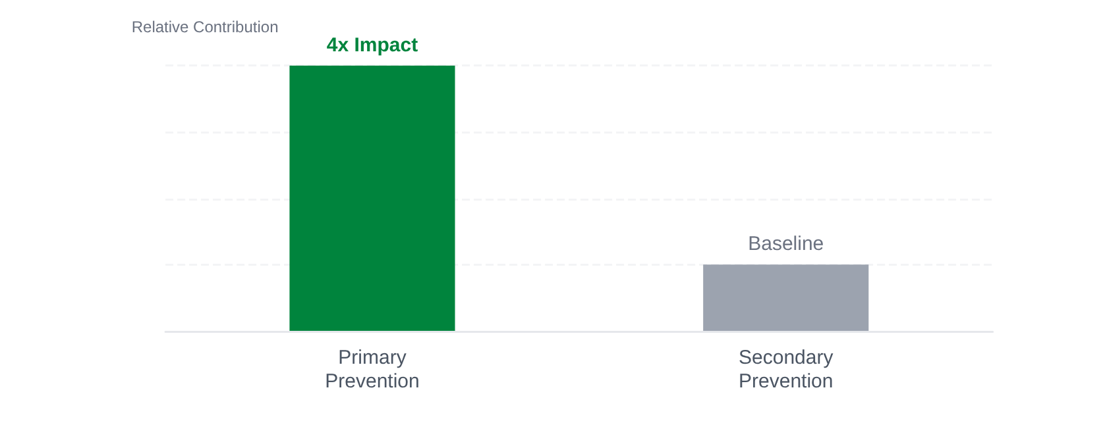








BRADFORD VTS | CVD PREVENTION
Epidemiology and Background
Relative Impact on CHD Mortality Fall (1981-2000)
UK Mortality Landscape
CVD is one of the leading causes of death in the UK.
25%of all UK deaths are attributed to Coronary Heart Disease (CHD).
40%total CVD mortality (MI, CVA, and CCF combined).
Premature Mortality Impact
CVD accounts for~1/3of premature deaths in men.
CVD accounts for~1/4of premature deaths in women.
Modern Challenges
CHD deaths continue to fall but remain the leading cause of mortality.
Rising prevalence ofObesity and Diabetes.
Persistent physical inactivity and sedentary lifestyles.
Primary prevention achieved a 4× larger reduction in deaths than secondary prevention strategies (1981–2000).
Widening health inequalities and socio-economic deprivation.

Slide 4









BRADFORD VTS | CVD PREVENTION
Definitions of Prevention
Primary Prevention
Secondary Prevention
Target: Individuals with no prior history of cardiovascular disease.
Target: Patients with established cardiovascular disease.
Goal: Systematic identification of risk factors to prevent the initial onset of clinical events.
Goal: Aggressive management to reduce further events and mortality.
Includes Established History of:
Key Tool: Formal risk assessment using QRISK3 for adults aged 25–84.
• Myocardial Infarction
• TIA / Stroke
• Angina
• Heart Failure
• PVD / Claudication
• Revascularisation
AKT KEY FACT The Diabetes Exception
All patients with Type 1 or Type 2 Diabetes are managed according to Secondary Prevention targets, regardless of whether they have a prior history of CVD events. Do not use QRISK3 to decide treatment for these groups.

Slide 5
















BRADFORD VTS | CVD PREVENTION
Identifying People for Formal Risk Assessment
NICE NG238 guidelines for systematic identification of high-risk adults
Assessment Strategy
Systematic Approach: Use practice databases to proactively identify high-risk cohorts for review.
Who to Assess
Systematically identify all adults aged ≥40 without established cardiovascular disease (CVD).
Targeted Screening: Focus resources on those most likely to benefit from lifestyle or lipid modification.
Include adults with Type 2 Diabetes for formal QRISK3 scoring (aged 25–84).
Do NOT use purely opportunistic assessment as the main strategy for unselected people.
Review CVD risk estimates on an ongoing basis for everyone over 40 years old.
Ongoing Frequency
AKT FACT
Prioritize formal risk assessments where the estimated 10-year CVD risk is ≥10%. This is the threshold for offering pharmacological intervention.
CVD risk is not static; it increases with age and changing lifestyle factors.
NICE recommends regular reviews of risk factors to capture patients crossing the 10% threshold.

Slide 6

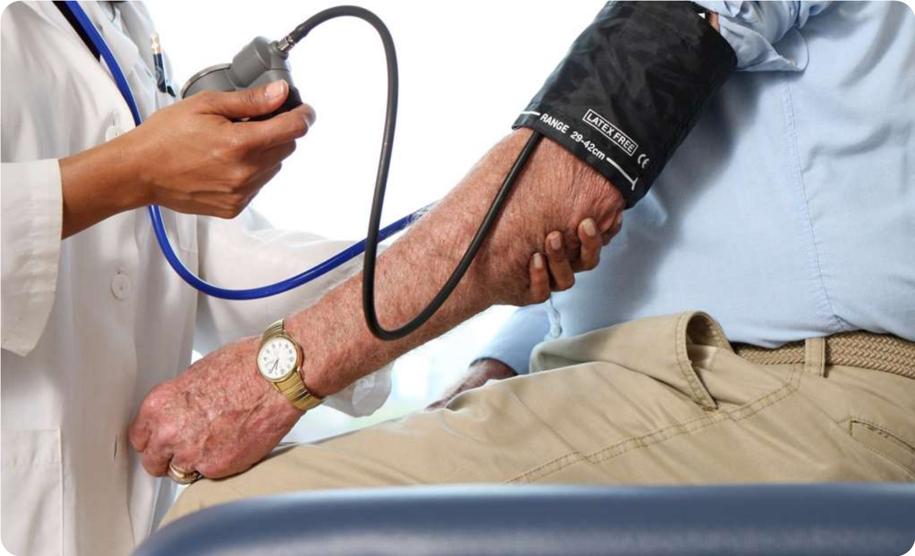







BRADFORD VTS | CVD PREVENTION
Groups Not Requiring Risk Tool Assessment
Type 1 Diabetes
Patients with Type 1 diabetes should be treated as high-risk automatically. Do not use QRISK3; follow specific lipid targets for secondary prevention.
Chronic Kidney Disease (CKD)
People with eGFR <60 ml/min/1.73m² and/or albuminuria are already at high risk. They require clinical management rather than standard risk scoring.
Inherited Lipid Disorders
AKT EXAM FACT
Suspected Familial Hypercholesterolaemia (FH) or other inherited disorders require specialist referral (NICE CG71). QRISK3 underestimates risk in these groups.
Risk tools like QRISK3 are not appropriate for individuals already identified as high-risk through specific conditions. Using them in these groups will underestimate the clinical need for intervention.

Slide 7





































BRADFORD VTS | CVD PREVENTION
QRISK3 — The UK Standard Tool
Primary Application
QRISK3 Input Variables
Calculate 10-year CVD risk for adults aged 25–84 without established CVD.
A multi-factorial algorithm validated on 1.28 million UK patients.
Age and Sex
Smoking Status
NICE NG238 (2023) standard for Type 2 Diabetes (aged 25–84).
Cholesterol:HDL Ratio
Systolic BP (Treated?)
QRISK3-lifetime: Consider for <40s with risk factors to motivate lifestyle changes.
Body Mass Index (BMI)
Social Deprivation
Ethnicity
Family History (CHD)
Chronic Kidney Disease
Atrial Fibrillation
Preferred Groups
Diabetes Status
SLE & SMI
QRISK3 is superior to QRISK2 for patients with:
Corticosteroids
Severe Mental Illness
AKT Fact: QRISK3 corrects for ethnicity automatically.
Do not manually apply a 1.4x correction factor for South Asian patients when using QRISK3.
SLE / Autoimmune
Migraine
Erectile Dysfunction
Atypical Antipsychotics

Slide 8


















BRADFORD VTS | CVD PREVENTION
Advantages of QRISK3 over Framingham
The Framingham Model
The QRISK3 Standard
Based on data from white, middle-class Americans in 1980s Massachusetts.
Developed and validated on 1.28 million UK primary care patients for maximum relevance.
Lacks representation for UK ethnic diversity and modern social deprivation factors.
Includes ethnicity and the Townsend score (social deprivation) to address health inequalities.
Evidence shows it overestimates UK risk by ~35%, leading to potential over-medicalisation.
NICE NG238 preference: accurately identifies high-risk groups missed by older tools.
AKT FACT
QRISK3 is the NICE-recommended tool for adults aged 25–84.
MODERN RISK VARIABLES UNIQUE TO QRISK3
Corticosteroids
Severe Mental Illness
Erectile Dysfunction
SLE / Autoimmune
Social Deprivation
Migraine History
Antipsychotics
BMI & Ethnicity

Slide 9





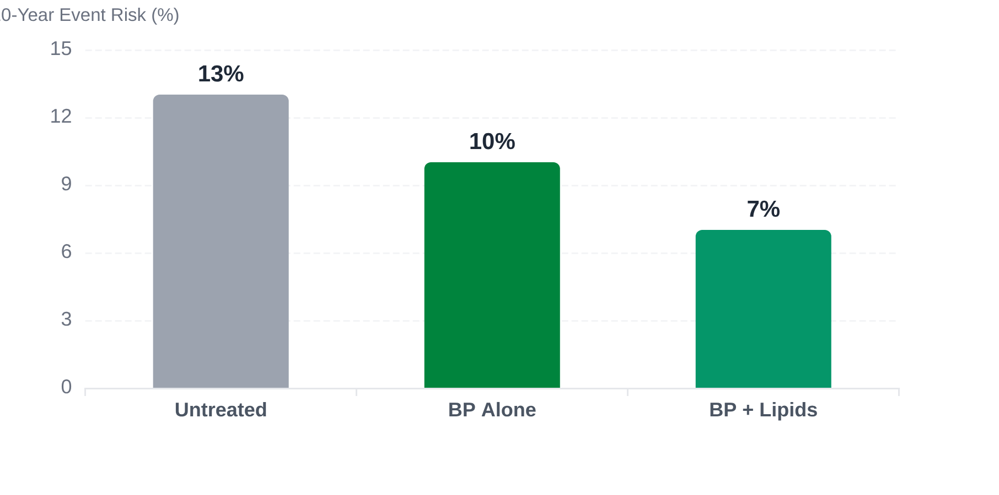





BRADFORD VTS | CVD PREVENTION
Risk Factors: Age, Sex, and Hypertension
Impact of aging, gender differences, and preventable mortality in primary care.
ASCOT Trial Evidence
10-year Coronary Event Risk in Hypertensive Patients (≥3 Risk Factors)
Age & Sex Dynamics
CVD risk increases linearly with age; it is the strongest predictor in QRISK3 models.
CVD is more prevalent in men; however, it is often under-diagnosed and under-treated in women.
Women often present with non-traditional symptoms, leading to delays in primary prevention interventions.
AKT HIGH-YIELD FACT
Treating hypertension reduces the risk of strokes and heart failure by approximately 50%. It accounts for 20,000 preventable CVD deaths annually in England.
33
16
NNT (BP TREATMENT ALONE)
NNT (BP + LIPID TREATMENT)

Slide 10









BRADFORD VTS | CVD PREVENTION
Risk Factors: Smoking
Morbidity and Mortality Impact
Cessation Recovery Timeline
Cigarette smoking approximately doubles the risk of morbidity and mortality from Ischaemic Heart Disease (IHD).
Immediate
CVD risk begins to fall immediately upon stopping. Blood pressure and heart rate stabilize.
Risk is directly proportional to both duration of smoking and the amount smoked daily.
1 Year
Excess risk of coronary heart disease is reduced by half compared to a smoker.
Smoking compounds other risk factors like hypertension and dyslipidaemia, creating synergistic harm.
15 Years
Risk of coronary heart disease is similar to that of a person who has never smoked.
NICE Guideline (NG209)
AKT EXAM FOCUS
High-Yield Recovery Fact
Always advise and support cessation as the single most effective lifestyle intervention.
While CVD risk drops quickly, it can take up to 20 years of abstinence for the risk profile to fully revert to that of a non-smoker.
Offer a combination of pharmacotherapy (Varenicline/NRT) and behavioural support for best outcomes.
Recent ex-smokers (within 1 year) should still be treated with high clinical suspicion in risk tools.

Slide 11







BRADFORD VTS | CVD PREVENTION
Risk Factors: BMI and Central Obesity
Measurement & Identification
Metabolic Associations
Waist Circumference is the most practical marker for abdominal (central) obesity in clinical practice.
Obesity is strongly associated with: Raised LDL, low HDL, and Raised Triglycerides.
Central obesity is a more accurate predictor of CVD risk than BMI alone for many populations.
Direct links to Insulin Resistance and elevated systolic blood pressure.
Gender-Specific Impact
Intervention & Management
Obese women have a 4× higher risk of CHD compared to non-obese women.
Weight reduction lowers BP, LDL, and TGs while significantly raising HDL.
Refer to weight management services per NICE protocols.
Abdominal fat distribution is particularly pathogenic in post-menopausal women.
NICE GUIDELINE NG246

Slide 12










BRADFORD VTS | CVD PREVENTION
Risk Factors: Diabetes
Management Targets
SECONDARY PREVENTION
Clinical Context
Patients with Type 2 Diabetes and no CHD history have a similar CVD risk to non-diabetics who have survived a prior MI.
BLOOD PRESSURE
SMOKING STATUS
< 130/75 mmHg
Non-Smoker
Diabetes accelerates atherosclerosis through multiple pathways: insulin resistance, elevated BP, and lipid abnormalities.
TOTAL CHOLESTEROL
LDL CHOLESTEROL
NICE NG238 mandates managing all T1 and T2 diabetics under Secondary Prevention targets regardless of QRISK3.
< 5.0 mmol/L
< 2.5 mmol/L
GLYCAEMIC CONTROL
HBA1C PERCENTAGE
HbA1c < 53 mmol/mol
7.0%
AKT FACT: Do not rely solely on QRISK3 for diabetic patients when setting targets; they are automatically high-risk.
Targets must be personalized via shared decision-making.

Slide 13












BRADFORD VTS | CVD PREVENTION
Risk Factors: Family History
Impact on CVD Risk
Defining "Significant" FH
Paternal FH (Male Risk)
x 1.40
A family history is considered clinically significant when a first-degree relative experiences a cardiovascular event at a young age:
Both Parents (Male Risk)
x 1.85
Both Parents (Female Risk)
x 2.05
< 55 Years
< 65 Years
MALE RELATIVE
FEMALE RELATIVE
Note: Maternal FH also confers significant risk, though paternal data is more robustly cited in traditional primary care teaching.
Includes first-degree relatives (Parents, Siblings).
Applies to MI, Stroke, or Angina events.
AKT EXAM FACT
QRISK3 automatically adjusts for family history. Do not manually multiply risk scores if using the QRISK3 tool.

Slide 14




















BRADFORD VTS | CVD PREVENTION
Risk Factors: Dyslipidaemia
Screening Protocol
Urgent Specialist Referral
Measure Total Cholesterol (TC) AND HDL Cholesterol for the most accurate CVD risk estimate.
Triglycerides > 20 mmol/L AKT
If not clearly due to acute alcohol excess or poor glycaemic control.
The TC:HDL ratio is used by QRISK3 to better reflect atherogenic risk than TC alone.
High risk of Acute Pancreatitis; requires immediate specialist input.
Non-HDL Cholesterol (TC minus HDL) is the primary target for monitoring treatment efficacy.
Always exclude secondary causes: Hypothyroidism, excess alcohol, renal/liver disease. AKT
Familial Hypercholesterolaemia (FH)
Routine Specialist Referral
Suspect FH in patients with very high cholesterol and a strong family history of early-onset CHD.
Total Cholesterol > 9.0 mmol/L AKT
Non-HDL Cholesterol > 7.5 mmol/L AKT
Use NICE CG71 for clinical suspicion criteria (Simon Broome or Dutch Lipid Clinic Network scores).
Refer regardless of the QRISK3 score as these values indicate high probability of genetic lipid disorders.
Do NOT use QRISK3 for patients with confirmed or suspected FH; refer for genetic testing.
GP Action: Fasting lipid profile should be repeated to confirm before referral if TC is borderline.

Slide 15






BRADFORD VTS | CVD PREVENTION
Risk Factors: Ethnicity
South Asian Origin
African/Caribbean Origin
~1.4× higher CVD risk compared to predicted general charts.
Predisposition to severe hypertension and earlier onset of diabetes.
Significantly higher prevalence of Hypertension and Type 2 Diabetes.
Increased incidence of strokes compared to other ethnic groups.
Higher rates of central obesity and coronary heart disease (CHD).
Higher risk of renal failure secondary to CVD risk factors.
AKT EXAM FOCUS: QRISK3 ADJUSTMENT
QRISK3 includes automated ethnicity adjustment based on UK primary care data.
Do NOT manually add a 1.4× correction factor to QRISK3 scores. This was a practice used with older tools (like Framingham) but is now built into the algorithm.
GP Awareness: Social factors and cultural dietary patterns often compound biological risk. When assessing risk, explore family attitudes toward medication and acknowledge the higher baseline risk in these populations with sensitivity.

Slide 16















BRADFORD VTS | CVD PREVENTION
Risk Factors: Social Deprivation
The Black Report (1982)
The Townsend Score
This seminal report established the clear link between social class and health inequality in the UK. It highlighted that despite the NHS, CVD mortality rates remained significantly higher in deprived areas.
Integrated into QRISK3, this composite measure of social deprivation uses four key census-based variables:
Demonstrated an "inverse care law" where those most in need often had the least access to quality preventative care.
Unemployment
Overcrowding
Social factors (housing, employment, education) act as the "causes of the causes" of cardiovascular disease.
Non-car Ownership
Non-home Ownership
Bradford Context: Wide variations in life expectancy across the district correlate strongly with deprivation deciles.
GP Implementation
QRISK3 Integration: Postcode data automatically pulls Townsend scores to adjust the 10-year CVD risk.
CLINICAL AWARENESS
Holistic View: Do not just "treat the score"—consider the patient's ability to afford healthy food or safe exercise spaces.
Social deprivation compounds biological risk; a QRISK3 score of 9% in a highly deprived area may clinically warrant earlier intervention than in an affluent area.
Health Literacy: Adapt counseling to the patient's educational background to improve statin adherence.

Slide 17















BRADFORD VTS | CVD PREVENTION
Factors Leading to Underestimated Risk
While QRISK3 is robust, it may not fully capture the risk profile for certain populations. Clinical judgment should supersede the tool in these high-risk scenarios.
HIV & Medications
Severe Mental Illness
People treated for HIV or those on medicines causing dyslipidaemia face higher metabolic risks.
Significant link between severe mental health conditions and premature cardiovascular mortality.
Recent Ex-Smokers
Autoimmune Disorders
Risk remains significantly elevated for years; tools may over-adjust for "non-smoker" status too early.
Systemic inflammatory conditions (SLE, RA) accelerate atherosclerosis beyond standard risk metrics.
CVD Risk Modifiers
Clinical Judgment
Patients already taking medicines for existing CVD risk factors may have masked baseline risks.
If a patient sits just below the 10% threshold but has these factors, consider offering a statin.
AKT FACT
NICE recommends using clinical judgment to interpret risk scores in those with multi-morbidity or systemic inflammation.

Slide 18













BRADFORD VTS | CVD PREVENTION
Lifestyle Interventions: Cardioprotective Diet
Fat Composition Targets
Strategic Replacements
Total Fat ≤ 30%
Limit total fat intake to 30% or less of total energy intake.
Replace saturated fats with mono- and poly-unsaturated alternatives.
Saturated Fat ≤ 7%
Saturated fats should contribute no more than 7% of total energy.
RECOMMENDED CHOICES
Olive Oil
Rapeseed Oil
Spreads based on these
Evidence-Based: Reducing saturated fat significantly lowers LDL cholesterol and CV events.
NICE NG238 Specific Advice
Do NOT advise the use of plant stanols or sterols for the prevention of cardiovascular disease.
*This is a common AKT exam trap and a frequent question in SCA consultations.

Slide 19














BRADFORD VTS | CVD PREVENTION
Lifestyle Interventions: Physical Activity
Following UK Chief Medical Officers' guidelines for aerobic activity and muscle strengthening to reduce cardiovascular risk.
Aerobic Exercise
Strength & Balance
Clinical Practice
At least 150 minutes of moderate intensity activity per week (e.g., brisk walking, cycling).
Muscle strengthening activities on at least 2 days a week.
AKT HIGH YIELD
Offer exercise referral schemes for sedentary patients with other CVD risk factors.
Should involve all major muscle groups (legs, hips, back, abdomen, chest, shoulders, arms).
OR 75 minutes of vigorous intensity activity (e.g., running, swimming laps).
Agree specific goals: Focus on small, achievable changes to build confidence.
Activity can be spread across the week in smaller bouts (e.g., 30 mins x 5 days).
Examples: weights, resistance bands, heavy gardening, or carrying heavy shopping.
Provide written information about local opportunities for physical activity.
Moderate = breathing faster, heart beating faster, but can still carry on a conversation.
Reduces CVD risk, improves metabolic profile, and supports weight maintenance.
Shared Decision Making
"What kind of activities do you enjoy? How could we build 10 minutes into your daily routine?"

Slide 20









BRADFORD VTS | CVD PREVENTION
Lifestyle Interventions: Weight and Alcohol
Weight Management
Alcohol Consumption
NICE NG246: Refer overweight or obese patients to lifestyle weight management services.
CMO Guidelines: Advise both men and women to not regularly drink more than 14 units per week.
Waist Circumference: The most practical marker for abdominal obesity (central adiposity).
Distribution: If drinking as much as 14 units, spread this evenly over 3 or more days.
Gender Risk: Obese women have 4x the CHD risk compared to non-obese women.
Binge Drinking: Avoid heavy drinking sessions; these significantly increase cardiovascular event risk.
Physiological Impact of Weight LossLower Blood Pressure • Reduced LDL & Triglycerides • Increased HDL • Improved Insulin Sensitivity
Clinical ConsiderationsExcessive alcohol contributes to hypertension, weight gain, and raised triglycerides. Always screen for alcohol-related liver disease (ARLD) before specialist lipid referral.
AKT FACT
AKT FACT
Obesity is associated with raised LDL/Triglycerides and low HDL. Weight reduction remains a cornerstone of lipid profile improvement.
UK Chief Medical Officers (CMO) low-risk guidelines: ≤14 units/week for all adults. This is a common exam target for counseling questions.

Slide 21








BRADFORD VTS | CVD PREVENTION
Aspirin for Primary Prevention
NICE recommendation against routine aspirin use for primary prevention due to the balance of harms and benefits.
NICE NG238 (January 2023) Guidance
Clinical Exceptions
Do NOT routinely offer aspirin for the primary prevention of cardiovascular disease (CVD).
Established CVD (Secondary Prevention).
Certain high-risk groups (e.g., Lynch Syndrome) — follow specific specialty guidance.
*This remains a significant change from historical practices.
Aspirin is not a substitute for statin therapy in primary prevention.
The Risk-Benefit Paradox
Meta-analyses demonstrate that the risk of major gastrointestinal (GI) bleeding outweighs the modest CVD reduction.
AKT EXAM FOCUS
Evidence shows no significant reduction in all-cause mortality when used for primary prevention.
Expect questions comparing old vs new guidelines. The "Bottom Line" for AKT: Routine aspirin use in a patient without prior MI, Stroke, or PVD is incorrect management.
Bleeding risks are significantly compounded in older adults (aged >70) and those with comorbidities.

Slide 22















BRADFORD VTS | CVD PREVENTION
Statin Therapy for Primary Prevention
STEP 1
STEP 2
STEP 3
Optimise & Discuss
Reassess QRISK3
The Clinical Offer
Discuss lifestyle benefits and optimise other modifiable factors (BP, smoking, diet) before initiating therapy.
Offer reassessment of QRISK3 after lifestyle changes have been attempted to see if risk remains high.
If lifestyle changes are ineffective or inappropriate, offer pharmacological intervention with a statin.
AKT EXAM FACT
NICE NG238 (2023) lowered the primary prevention threshold from 20% to 10%. Atorvastatin 20mg is the cost-effective first-line high-intensity option.
Implementing the Offer
Threshold: 10-year QRISK3 score ≥10%.
First-line Choice: Atorvastatin 20mg (High-intensity).
Shared Decision Making: Use decision aids to discuss absolute risk vs. absolute benefit.
Clinical Considerations
Always document if a patient declines treatment after a shared decision-making discussion. Ensure baseline tests are completed before the first prescription.
Source: NICE Guideline NG238 (Published 14 Dec 2023)

Slide 23











BRADFORD VTS | CVD PREVENTION
Statin Choice and Threshold
Primary Prevention Threshold
Offer high-intensity statin to adults with a 10-year QRISK3 score ≥ 10%.
NICE NG238 (Dec 2023) maintained this 10% threshold (reduced from 20% in older guidelines).
Always prioritize lifestyle modification and risk factor optimization before reassessing for statin therapy.
First-Line Statin Choice
Atorvastatin 20mg daily is the recommended high-intensity starting dose for primary prevention.
AKT EXAM FACT
For primary prevention, NICE recommends Atorvastatin 20mg. Do NOT start at lower doses (e.g., 10mg) unless clinical contraindications or interactions exist. Threshold is QRISK3 ≥ 10%.
High-intensity statins lower LDL-C by > 40%, offering superior risk reduction.
Cost-effectiveness: Atorvastatin is the preferred generic choice in the UK NHS primary care setting.

Slide 24



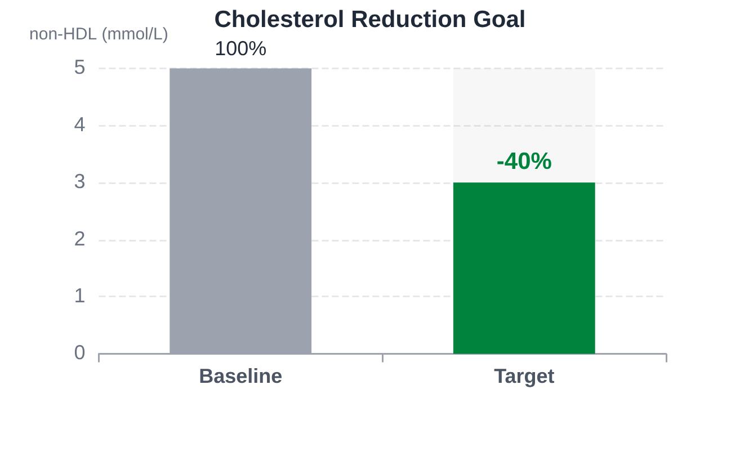





BRADFORD VTS | CVD PREVENTION
Lipid Target for Primary Prevention
The NICE Primary Target
> 40%
Aim for a greater than 40% reduction in non-HDL cholesterol levels from baseline.
Measure non-HDL cholesterol 3 months after starting high-intensity statins.
If target not met: Discuss adherence, timing of dose, and lifestyle.
Consider dose titration if well tolerated and lifestyle is optimized.
Calculation of Non-HDL
Visualizing the >40% Reduction Target
Non-HDL includes all atherogenic lipoproteins (LDL, VLDL, IDL). It does not require a fasting sample.
AKT FOCUS FACT
Primary prevention targets are defined as a percentage reduction (>40%).
In contrast, secondary prevention (established CVD) uses absolute targets (LDL ≤2.0 or non-HDL ≤2.6).
Non-HDL = Total Chol - HDL Chol

Slide 25







BRADFORD VTS | CVD PREVENTION
Pre-statin Baseline Tests
Essential clinical and laboratory assessments required before initiating statin therapy to ensure patient safety.
Clinical & Lifestyle Assessment
Laboratory Investigations
Smoking Status: Current/Ex-smoker and intensity.
Full Lipid Profile: Total, HDL, Non-HDL, and Triglycerides.
Alcohol Intake: Units per week (identifying secondary causes).
Glycaemic Status: HbA1c or fasting glucose (to exclude DM).
Blood Pressure: Confirming hypertension status.
Organ Function: eGFR (Renal) and Transaminase (ALT/AST).
BMI: Recording weight and height for obesity assessment.
Thyroid Function (TSH): If symptoms of hypothyroidism exist.
Transaminase Rule: Do NOT exclude from statins if ALT/AST is raised but <3× Upper Limit of Normal (ULN).
Creatine Kinase (CK): Check ONLY if unexplained muscle pain exists. Do NOT start if CK >5× ULN.

Slide 26


















BRADFORD VTS | CVD PREVENTION
Statins in Pregnancy
Absolute Contraindication
Pre-conception Planning
Statins are strictly contraindicated during pregnancy due to potential teratogenic risks to the developing fetus.
Advise women of childbearing age to use effective contraception while taking statins.
Cholesterol and its derivatives are essential for fetal development; inhibiting synthesis may cause congenital anomalies.
Statins must be stopped 3 months before attempting to conceive (wash-out period).
If a patient becomes pregnant while on a statin, stop the medication immediately and provide reassurance.
Rule of 3: Stop 3 Months Before Conception
Post-Pregnancy & Breastfeeding
Statins should not be restarted until breastfeeding has completely finished.
AKT Exam High-Yield Facts
The safety profile of statins in human breast milk is not well-established; avoidance is the standard precaution.
Timeline: The "3-month" pre-conception rule is a frequent AKT question target.
Contraindication: Pregnancy is one of the few absolute contraindications for lipid-lowering therapy.
NICE NG238 | Cardiovascular disease: risk assessment and reduction
GP TRAINING MODULE

Slide 27















BRADFORD VTS | CVD PREVENTION
Key Evidence Base for Statins
WOSCOPS (1995)
PRIMARY PREVENTION
CARDS (2004)
DIABETES TYPE 2
6,595 men with mean cholesterol 7.0 mmol/L treated with Pravastatin 40mg.
T2DM patients with 1+ risk factor given Atorvastatin 10mg.
31% Relative Reduction in coronary events.
48% reduction in strokes; 36% fewer coronary events.
22% Reduction in total mortality over 5 years.
Demonstrated benefit even with relatively "normal" baseline LDL.
CTT Meta-analysis
GOLD STANDARD EVIDENCE
HPS (2002)
HIGH-RISK GROUPS
Comprehensive analysis of multiple statin trials (>170k patients).
Every 1 mmol/L reduction in LDL-C yields a ~21% relative reduction in major vascular events.
Simvastatin 40mg in 20,536 patients (DM, PVD, prior Stroke).
1/3 reduction in MI and strokes.
Key takeaway: Benefit was independent of starting LDL-C level.
AKT FACT
This linear relationship underpins the NICE non-HDL % reduction targets.
Bradford VTS | Clinical Training Module 2026 | Slide 27 of 40

Slide 28










BRADFORD VTS | CVD PREVENTION
Lipid Targets at a Glance (NICE NG238)
POPULATION / SCENARIO
CLINICAL TARGET OR ACTION
Primary Prevention
> 40% reduction in non-HDL cholesterol
Secondary Prevention
LDL ≤ 2.0 mmol/L OR non-HDL ≤ 2.6 mmol/L
Specialist Referral: Total Cholesterol
> 9.0 mmol/L
Specialist Referral: Non-HDL
> 7.5 mmol/L
Urgent Referral: Triglycerides
> 20 mmol/L (if not alcohol/glucose related)
AKT High-Yield Fact: The secondary prevention target was tightened in the December 2023 update. Aim for LDL ≤ 2.0 mmol/L. If triglycerides are > 20 mmol/L, refer urgently due to the risk of acute pancreatitis, not just CVD risk.

Slide 29








BRADFORD VTS | CVD PREVENTION
Population Strategy vs High-Risk Strategy
High-Risk Strategy
Population Strategy
Focuses on individuals at the top end of the risk distribution (QRISK3 ≥ 10%).
Aims to shift the whole risk distribution curve to the left for the entire society.
Clinically efficient and cost-effective for specific interventions (e.g., statins).
Includes: Smoking bans, salt/sugar reduction, and trans-fat removal.
Limitation: 30–50% of CVD events occur in people with a 10-year risk <10%.
Small individual benefits, but massive collective impact on public health.
ROSE'S PARADOX
"A large number of people at a small risk may give rise to more cases of disease than the small number who are at a high risk."
Implication: Relying solely on high-risk screening misses the majority of future cases. Successful CVD prevention requires both targeted clinical care and broad societal policy.
NICE NG238 (10% threshold) bridges the gap by widening the "High Risk" net
The "Polypill" Concept: Mass medication vs. targeted assessment

Slide 30













BRADFORD VTS | CVD PREVENTION
Case Study: Ian Hart
Patient Background
Clinical Findings & Labs
Patient: Ian Hart, 56-year-old male, Retired Professional Footballer.
BLOOD PRESSURE
TOTAL CHOLESTEROL
Social: Heavy smoker (40 cigarettes/day); High-fat "athlete's retirement" diet.
180/100
6.5
mmHg (Avg of 3 readings)
mmol/L
Family History: Brother suffered a Myocardial Infarction at age 50 (Significant FH).
HDL CHOLESTEROL
FASTING GLUCOSE
3.2
7.1
Presentation: Attends for a routine "over 40s" health check. No current symptoms of chest pain or SOB.
mmol/L (Ratio: 2.03)
mmol/L (Possible Prediabetes)
The Mental QRISK Challenge
Before using the tool, what is your clinical "gut feeling" of this patient's 10-year CVD risk? How would you frame this to Ian?

Slide 31












BRADFORD VTS | CVD PREVENTION
Case Study: Management Discussion
Ian Hart, 56
1. Risk & Lifestyle Optimization
Retired Footballer • High-Fat Diet
Formal QRISK3 assessment (mandatory for primary prevention).
Smoking cessation: Refer to NICE NG209 services immediately.
BLOOD PRESSURE
SMOKING STATUS
Cardioprotective diet: Total fat ≤30%, replace saturates.
180/100 mmHg
40 Cigarettes/Day
TOTAL CHOL : HDL
FASTING GLUCOSE
2. Pharmacological Strategy
6.5 : 3.2 (Ratio 2.0)
7.1 mmol/L (IFG)
FAMILY HISTORY
QRISK3 SCORE
Hypertension:Aim for <140/90 (initial target).
Brother MI @ age 50
Lipids:Offer 20mg Atorvastatin (QRISK3 ≥10% threshold).
Very High Risk
Diabetes:Recheck HbA1c to confirm pre-diabetes/T2DM.
AKT FACT
If T2DM confirmed, switch to secondary prevention targets.
3. Shared Care & Safety-Net
Discuss absolute risk reduction vs side-effect profiles.
Safety-net for statins: Unexplained muscle pain or dark urine.
SCA TIP
Calculate QRISK3 in front of patient to visualize risk.
Document decision-making if statin is declined.

Slide 32

















BRADFORD VTS | CVD PREVENTION
Communication and Shared Decision-Making
Emphasizing patient beliefs, readiness for change, and the use of decision aids in CVD risk discussions.
Understanding the Patient (ICE)
Readiness for Change
Explore beliefs about future health, life expectancy, and concerns about long-term medication.
Assess confidence (0-10 scale) for lifestyle modifications before initiating pharmacotherapy.
Identify current knowledge: "What do you already know about how your heart health is measured?"
QRISK3-lifetime: Use as a motivational tool for <40s or those with high risk factors but <10% 10-year score.
Acknowledge cultural context and family attitudes towards preventive treatment.
Risk Communication Mastery
Implementation & Recording
Absolute vs. Relative: Always discuss absolute risk (e.g., 15 in 100) rather than relative reductions.
AKT / SCA FOCUS
Document all shared decisions, especially if the patient declines statins after informed discussion.
Use 10-year risk percentages to provide a tangible timeframe for the patient.
Safety-net: Advise re-assessment in the future if lifestyle or circumstances change.
NICE NG238: Use the patient decision aid for statins to visualize benefits and side-effect profiles.
Encourage a "lifestyle first" attempt (when appropriate) before reassessing QRISK3.

Slide 33









BRADFORD VTS | CVD PREVENTION
SCA Consultation Phrases
ICE & PERMISSION
PROPOSING MEDICATION
"I’d like to calculate your heart risk score using a tool called QRISK3. Would that be okay with you?"
"Statins can reduce that 12% risk by about 40%. What are your initial thoughts about taking a daily tablet long-term?"
EXPLAINING ABSOLUTE RISK
ADDRESSING SIDE EFFECTS
"Your score is 12%. This means if there were 100 people exactly like you, 12 would have a heart attack or stroke in the next 10 years."
"Most people have no issues, but some report muscle aches. The risk of any serious problem is actually very small."
LIFESTYLE MOTIVATION
SHARED DECISION-MAKING
"Even small changes—like stopping smoking or walking more—can make a significant difference to that number."
"There is no rush to decide today. Here is a decision aid to read at home, and we can chat again next week."

Slide 34










BRADFORD VTS | CVD PREVENTION
Top Tips for GP Trainees
Risk Assessment Essentials
Statin Therapy & Targets
Always use QRISK3 as the gold standard for UK primary care. AKT FACT
Primary prevention threshold is QRISK3 ≥ 10%. Use Atorvastatin 20mg first-line. AKT FACT
Do not QRISK3 patients with Type 1 DM, established CKD (eGFR <60), or Familial Hypercholesterolaemia.
Aim for a >40% reduction in non-HDL cholesterol. Baseline CK is only needed if unexplained muscle symptoms exist.
For South Asian patients, use the built-in QRISK3 ethnicity selector; do not manually apply external multipliers.
Remember: Statins are contraindicated in pregnancy. Counsel women of childbearing age to stop 3 months pre-conception.
Lipid Referral Criteria
Consultation & Documentation
Refer if Total Cholesterol > 9.0 mmol/L or non-HDL > 7.5 mmol/L, regardless of the QRISK3 score.
Shared Decision-Making: Always document that lifestyle was discussed and absolute risk benefits were explained.
URGENT: Triglycerides > 20 mmol/L (not due to alcohol/glucose) requires immediate specialist review.
Aspirin: Do not offer for primary prevention. The GI bleeding risk generally outweighs the cardiovascular benefit.
Use the QRISK3-lifetime tool to motivate younger patients (<40) with risk factors but low 10-year scores.
Source: NICE NG238 (Lipid Modification, Dec 2023)
Bradford VTS - ST Training Module

Slide 35














BRADFORD VTS | CVD PREVENTION
Red Flags in CVD Risk Assessment
Hypertriglyceridaemia
Extreme Cholesterol
Suspected FH
Triglycerides >20 mmol/L (not related to alcohol or poor glycaemic control). Significant risk of acute pancreatitis.
Total cholesterol >9.0 mmol/L or non-HDL cholesterol >7.5 mmol/L, regardless of QRISK3 score.
Young patients with high cholesterol and a strong family history of premature CVD. Use Simon Broome or Dutch Lipid Clinic criteria.
URGENT SPECIALIST REFERRAL
ROUTINE SPECIALIST REVIEW
REFER PER NICE CG71
Hypertensive Crisis
Statin Toxicity
BP >220/120 mmHg. Check for end-organ damage (fundoscopy, urine dip, ECG). Malignant hypertension is a medical emergency.
Unexplained muscle pain, tenderness, or weakness associated with Creatine Kinase (CK) >5× Upper Limit of Normal (ULN).
IMMEDIATE TREATMENT/ADMIT
STOP STATIN IMMEDIATELY
AKT Focus: In the exam, the threshold for urgent triglyceride referral is >20 mmol/L. Do not confuse this with the >10 mmol/L threshold which requires non-urgent review and secondary cause assessment.

Slide 36














BRADFORD VTS | CVD PREVENTION
Common Pitfalls in Practice
Outdated Risk Tools
Over-Testing (Routine CK)
Using Framingham or JBS2 charts which overestimate risk by up to 35% in the UK population.
Checking Creatine Kinase (CK) routinely before starting statins in asymptomatic patients.
Use QRISK3 (NICE NG238 standard)
Only check CK if unexplained muscle symptoms
Inappropriate Aspirin Use
Statins in Pregnancy
Routinely offering aspirin for primary prevention. Risks of GI bleeding outweigh the benefits.
Failing to advise women of childbearing age that statins are contraindicated in pregnancy.
Do NOT offer aspirin for primary prevention
Stop 3 months before attempting conception
Diabetic Risk Miscalculation
Documentation Failure
Applying QRISK3 to Type 1 diabetics or ignoring that Type 2 diabetics need secondary targets.
Not recording shared decision-making (SDM) when a patient declines a statin after discussion.
DM patients = Secondary prevention targets
Always document SDM and the patient's choice
Critical Note: Always exclude secondary causes of dyslipidaemia (hypothyroidism, excess alcohol, renal disease) before specialist referral or labelling as primary hyperlipidaemia.

Slide 37













BRADFORD VTS | CVD PREVENTION
AKT Exam Focus
RISK TOOLS
THRESHOLDS
LIPID TARGETS
Use QRISK3 for adults aged 25–84.
Primary threshold: QRISK3 ≥ 10%.
Primary: >40% reduction in non-HDL.
Do NOT use QRISK3 for Type 1 DM or FH.
First-line: Atorvastatin 20mg.
Secondary: LDL ≤ 2.0 or non-HDL ≤ 2.6.
CKD (eGFR <60) is automatically high risk.
Offer lifestyle modification first.
Targets apply to all Diabetics (T1 & T2).
REFERRAL CRITERIA
CONTRAINDICATIONS
SAFETY & LABS
Urgent: Triglycerides > 20 mmol/L.
Statins are contraindicated in pregnancy.
Aspirin: NOT recommended for primary prevention.
Routine: Total Chol > 9.0 or non-HDL > 7.5.
Stop 3 months before attempting conception.
Liver: Okay to start if Transaminase < 3x ULN.
Suspected FH: Use NICE CG71 criteria.
Do not restart until breastfeeding finished.
CK: Check only if muscle symptoms present.
AKT PEARL: South Asian ethnicity is accounted for within QRISK3. Do not manually apply a 1.4x multiplier to the score—this is a common exam distractor.

Slide 38











BRADFORD VTS | CVD PREVENTION
SCA Exam Focus: Consultation Mastery
Mastering ICE
Safety & Sensitivity
Opening Frames
Shared Decision-Making
Statin Safety-Net
Explore what the patient already knows about cardiovascular health.
Crucial for SCA: Advise stopping if muscle pain/weakness/dark urine occurs.
Absolute vs Relative
"What do you know about your heart health?"
Avoid percentages; use natural frequencies (e.g., "10 in 100 people").
Cultural Competence
Acknowledge higher risk in South Asian patients with empathy, not just data.
Identifying Fears
Visual Aids
Address the "Concern" directly—is it about a family history or fear of medication?
Mention the use of NICE patient decision aids or Cates plots.
Pre-Conception
Always check pregnancy status/plans for women of childbearing age.
"What worries you most about this risk score?"
Autonomy
Respect the right to decline. Document the discussion, not just the refusal.
Lifestyle First
Negotiate changes before clinical interventions to build rapport.
Lifetime Tools
Use QRISK3-lifetime for younger patients (<40) to illustrate long-term impact.
AKT Tip: Lifestyle change is the first mandatory discussion in NG238.
SCA Red Flag: Forgetting to warn about rhabdomyolysis symptoms.

Slide 39













BRADFORD VTS | CVD PREVENTION
Cultural Sensitivity in Risk Assessment
South Asian Risk Profile
Family & Medication Attitudes
Approximately 1.4x higher CVD risk compared to white populations.
Multi-generational households: Health decisions often involve family elders.
Higher prevalence of Type 2 Diabetes, hypertension, and central obesity.
Preference for diet/natural remedies over a "tablet for life" approach.
Increased coronary event rates even at lower "standard" BMI levels.
Explore patient concerns about side effects on daily activities or religious fasts.
AKT FACT
QRISK3 automatically adjusts for ethnicity. Do NOT apply a manual multiplier (like 1.4x) on top of the QRISK3 score.
SCA Focus: Communication
African & Caribbean Profile
Acknowledge higher baseline risk without causing alarm or stigmatization.
Significantly higher risk of hypertension, stroke, and renal failure.
Use absolute risk (e.g., "1 in 10 chance") rather than relative percentages.
CVD events often occur at a younger age than in other demographics.
Tendency for sodium-sensitive hypertension requiring specific drug choices.
Utilize NICE patient decision aids, available in multiple languages.
SCA TIP
Ask: "How does your family feel about you taking long-term medicine?"

Slide 40
















BRADFORD VTS | CVD PREVENTION
Quick Recall Summary
The Core Rules
Lipids & Diabetes
Red Flags & Safety
QRISK3: Use for adults aged 25–84. Preferred over Framingham.
First-line: Atorvastatin 20mg (High-intensity).
Triglycerides: Urgent referral if >20 mmol/L.
Primary Target: >40% reduction in non-HDL cholesterol.
Cholesterol: Refer if Total >9.0 or non-HDL >7.5.
Threshold: Offer statins if 10-year risk is ≥10%.
Diabetes: All Type 1 & 2 diabetics follow secondary prevention targets.
Statins: Contraindicated in pregnancy; stop 3 months pre-conception.
Aspirin: Do NOT routinely offer for primary prevention.
AKT FACT
RED FLAG
AKT FACT
Secondary Target: LDL ≤2.0 mmol/L or non-HDL ≤2.6 mmol/L.
If muscle pain + CK >5x ULN, stop statin and seek specialist advice.
Auto-refer FH & CKD (eGFR <60); do not use risk tools for these groups.
3 Things to Do Tomorrow:
Audit 10% QRISK patients
Use NICE Decision Aids
Update Diabetes care plans

