Slide 1

BRADFORD VTS TEACHING DECK
The Great Aspiring U-Turn:
A humorous take on medical statistics
When "Absolutely Essential" Becomes "Absolutely Forbidden" — a journey through one of medicine's most instructive U-turns, and what it teaches us about the fragile, evolving, deeply human nature of research.
By Dr Ramesh Mehay, GP Trainer Bradford (Former TPD Bradford Scheme)
May 2026

Slide 2
Picture This: It's 2005
You are a doctor sitting in a clinic room with a patient who has hypertension, diabetes, raised cholesterol, and a packet of cigarettes peeking out of their jacket pocket.
What guidelines said then
What guidelines say now
Many guidelines and experts would strongly encourage you to prescribe low-dose aspirin. Not "consider it carefully." Not "perhaps." But almost: "Why on earth would you not prescribe aspirin?"
Prescribing aspirin routinely to all hypertensive diabetic patients today would be an absolute “no-no”, and likely earn you criticism for outdated practice. What was once considered almost life-saving is now actively discouraged in primary prevention — because the bleeding risks outweigh the benefits.
Research is powerful. But research is also fragile, evolving, and deeply human.

Slide 3

The Great Aspirin U-Turn
For years, doctors believed aspirin should routinely be given to many patients with diabetes, hypertension, or high cardiovascular risk. The reasoning sounded entirely logical.
The Risk Profile
The Defining Phrase
The Momentum
People with diabetes have a far higher risk of heart attacks, strokes, and vascular disease — making them obvious candidates for preventive treatment.
Researchers began describing diabetes as "a coronary heart disease equivalent" — a phrase that changed everything and sent aspirin prescribing into overdrive.
From there, momentum built rapidly. Guidelines shifted. Prescribing habits changed. An entire generation of clinicians was trained to see aspirin as a near-universal tool.
The Haffner Study (1998) was hugely influential — it suggested a person with diabetes but no previous heart attack could have a cardiovascular risk similar to someone without diabetes who had already suffered a heart attack. The medical world collectively went: "Blimey."

Slide 4
The Studies That Shaped an Era
Three landmark publications drove the aspirin-for-everyone philosophy deep into clinical practice. Each one added another brick to a wall of apparent certainty.
HOT Trial (1998)
1
The Hypertension Optimal Treatment Trial examined blood pressure targets and aspirin use. The aspirin arm suggested fewer heart attacks, modest cardiovascular benefit, and apparently acceptable bleeding risk. Doctors read this and thought: "Excellent. Aspirin helps high-risk hypertensive patients." Especially diabetic ones.
2
Antithrombotic Trialists' Collaboration (2002)
This enormous meta-analysis pooled data from many studies. It suggested aspirin reduced serious vascular events in high-risk groups. Clinicians interpreted this as: "High cardiovascular risk? Give aspirin." And diabetes plus hypertension screamed high cardiovascular risk.
ALLHAT Trial (2002)
3
Primarily examining antihypertensive treatments, ALLHAT reinforced the aggressive cardiovascular risk-reduction philosophy of the era. Doctors increasingly believed that aggressively reducing every possible risk factor would produce major benefits.

Slide 5
The Problem with Meta-Analyses
Meta-analyses are often treated like the "final boss" of evidence. The logic is: "Surely combining lots of studies must give us the truth." But that is not always so.
Imagine blending together rotten apples, bruised apples, fresh apples, and a banana someone accidentally dropped in. You still do not magically get perfect apple juice.
What can go wrong
What meta-analyses can amplify
What they do well
If you combine imperfect studies, older studies, biased studies, or studies from a different medical era, you may simply create a very large, very confident mistake.
Meta-analyses can be brilliant when the underlying studies are robust, contemporary, and comparable. The tool is powerful — but it is not magical.
Hidden flaws do not disappear when you pool data — they can be amplified. Population selection biases, outdated contexts, and statistical quirks all survive the blending process.

Slide 6
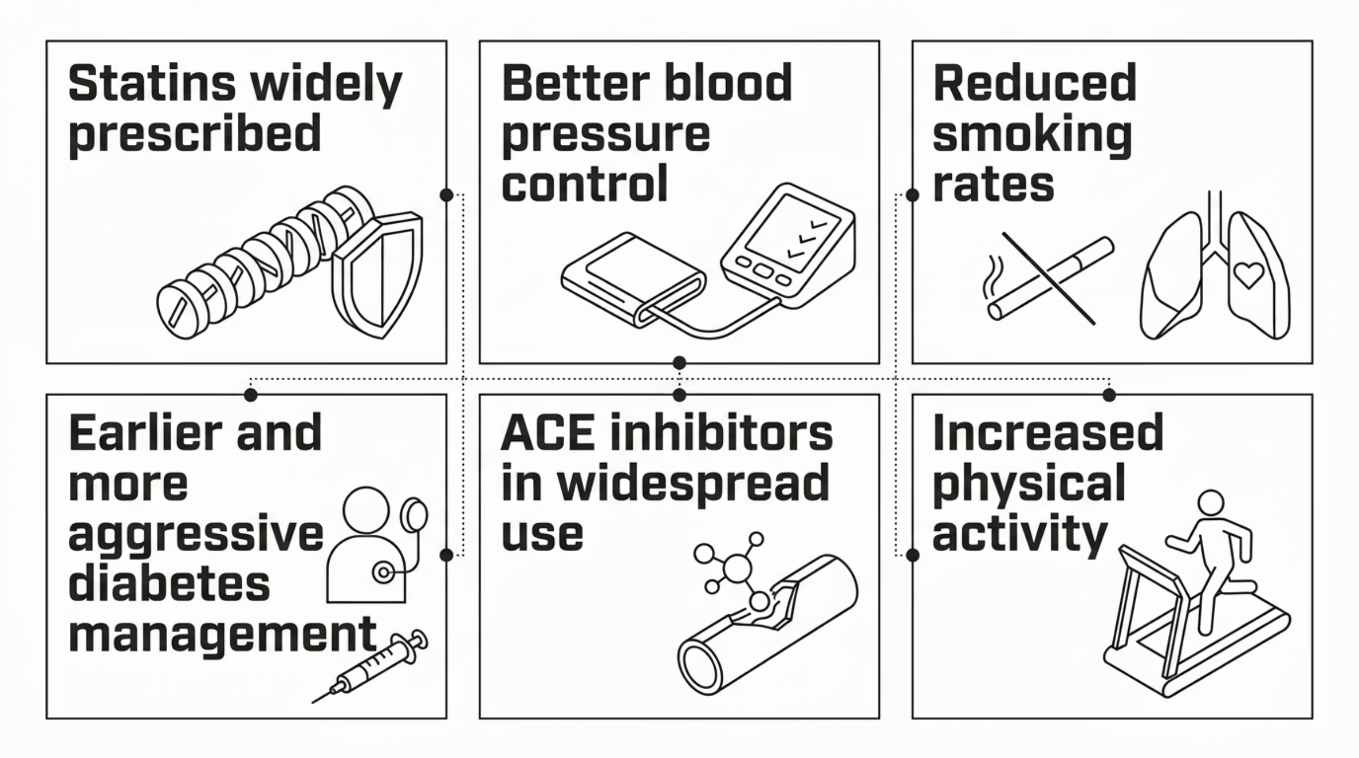

The Medical Pendulum Swings
Then something fascinating happened. Medicine improved. And that improvement changed everything about how we should interpret the old aspirin data.
Researchers began asking a crucial question: "Does aspirin still add enough extra benefit to justify the bleeding risk?" That question changed everything. The baseline cardiovascular risk had fallen so dramatically that the modest benefit of aspirin was now dwarfed by its harms.

Slide 7

The ASCEND Trial (2018): A Seismic Moment
Then came the heavyweight modern study that made the medical world pause. The ASCEND Trial — A Study of Cardiovascular Events in Diabetes — specifically examined aspirin in diabetics without established cardiovascular disease.
The Benefits Found
The Harms Found
Aspirin reduced serious vascular events slightly
Some reduction in non-fatal heart attacks
Statistically measurable cardiovascular protection
Aspirin also increased major bleeding significantly
Gastrointestinal bleeds were notably elevated
Benefits and harms nearly cancelled each other out
The ASCEND results were awkward. The benefits and harms nearly cancelled each other out — and suddenly medicine realised: we may have overestimated the benefits for years.

Slide 8
So… Were the Old Researchers Wrong?
Not exactly. The earlier researchers were interpreting the best evidence available at the time. But there are several crucial lessons buried in this story — lessons that apply far beyond aspirin.
1
2
Research Is Time-Dependent
One Big Study Is Never "The Truth"
A study from 1998 exists in a completely different medical universe from a study in 2025. Back then, fewer people took statins, blood pressure control was worse, smoking rates were higher, and diabetes care was poorer. Aspirin may genuinely have appeared more beneficial in that environment. Modern medicine changed the baseline risk dramatically.
A single impressive paper can dominate headlines, influence guidelines, change national practice — and later be overturned. Even huge studies can mislead through population selection, outdated context, hidden biases, statistical quirks, or overinterpretation.
3
4
Meta-Analyses Are Powerful, Not Magical
Medicine Is Humbling
Combining imperfect studies does not produce perfect conclusions. The quality of the inputs determines the quality of the outputs — no matter how large the collaboration or how impressive the pooled sample size.
One of the healthiest attitudes in medicine is intellectual humility. Not cynicism. Not conspiracy thinking. Not "all research is fake." But healthy caution — because history repeatedly shows us dramatic reversals.

Slide 9




A History of Dramatic Reversals
Aspirin in primary prevention is far from the only example. Medicine has a long and humbling track record of confident certainties that later crumbled under better evidence.
Hormone Replacement Therapy
Anti-Arrhythmic Drugs Post-MI
Once widely promoted for cardiovascular protection in post-menopausal women. Later trials revealed increased risks of breast cancer and cardiovascular events in certain populations (e.g. women > age 60).
Suppressing abnormal heart rhythms after a heart attack seemed logical. The CAST trial revealed these drugs actually increased mortality. A landmark lesson in surrogate endpoints.
Tight Glucose Control in ICU
Aspirin in Primary Prevention
Aggressive blood sugar control in critically ill patients seemed beneficial. Later evidence showed it increased hypoglycaemia and mortality. Tight control became dangerous control.
The story told throughout this document. A generation of prescribing built on evidence that later proved insufficient to justify the bleeding risks in a modern medical context.
Today's certainty can become tomorrow's embarrassment. Very badly.

Slide 10

The Real Golden Rule
Be evidence-informed, not evidence-blinded.
Read studies critically. Question assumptions. Look at who was studied, when they were studied, what treatments existed at the time, and whether the findings still apply today.
Ask who was studied
Ask when it was studied
Were the trial participants representative of your patient? Different populations, ages, comorbidities, and baseline treatments can make findings entirely inapplicable to your clinic.
A trial conducted before statins were widespread, before modern blood pressure targets, or before smoking cessation programmes existed may be describing a world that no longer exists.
Ask whether it still applies
Never switch off your curiosity
Medicine evolves. Background treatments change. Baseline risks shift. A finding that was true in 1998 may be irrelevant — or even harmful — when applied in 2025.
Never let one paper — however famous, however large, however confidently cited — completely extinguish your critical thinking. Because in medicine, certainty ages very badly indeed.
The aspirin story is not a tale of failure. It is a tale of science working exactly as it should — slowly, imperfectly, humbly, and ultimately honestly. That is something worth celebrating.

