Slide 1

Atrial Fibrillation
Who is at risk?
Dr Matthew Fay
Westcliffe Medical Practice
National Clinical Lead NHS Improvement

Slide 2
Declaration of interests
Funding has be variously given by: Bayer, Boehringer-Ingelheim, Bristol Myers Squibb, INRStar, Medtronic, Pfizer, Roche, Sanofi-Aventis
I am an advisor to: AF Association, Arrhythmia Alliance, National Stroke Association, SPAF Academy, Syncope Trust

Slide 3
Who is at Risk-1

Slide 4






Slide 5
Prevalence AF by practice

Slide 6
Prevalence AF a linear Relationship to over 65yrs

Slide 7
Expected Prevalence AF by practice

Slide 8
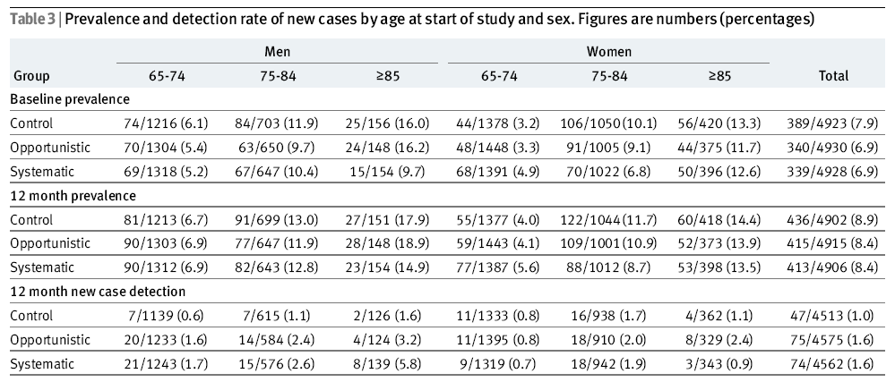
SAFE Study
Fitzmaurice, D. A et al. BMJ 2007;335:383

Slide 9
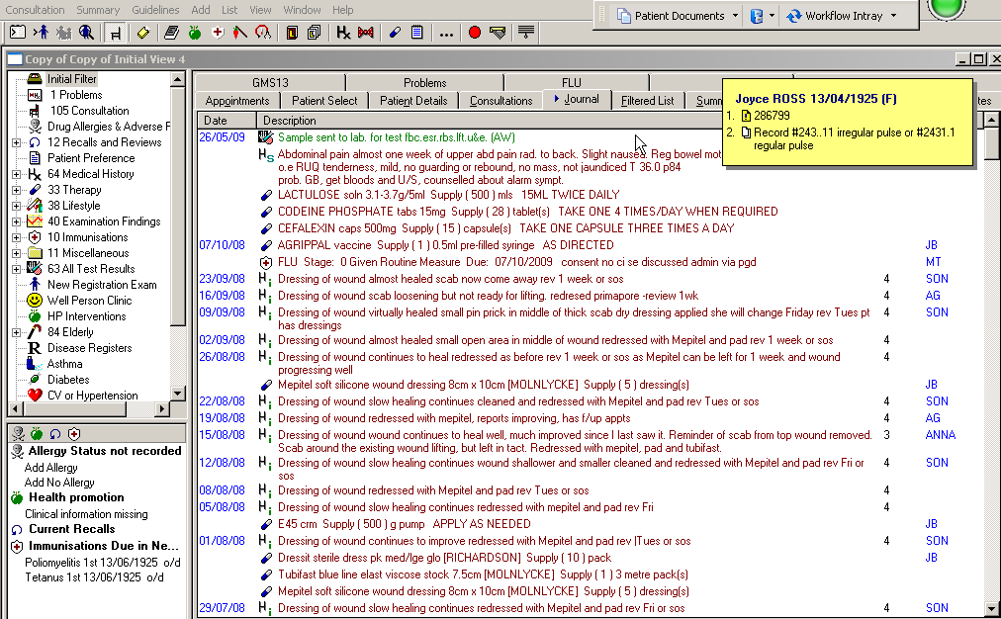

Slide 10
Key Facts
83.3% screened opportunistically
13% with irregular pulse
6.3% had ECGs
36% had AF on ECG
Number needed to screen 43
Change in prevalence 1.32 -> 1.82%
Prevalence of 65ys and older: 10.9%
Notes:
More AF dgn than SAFE. Possible explanations more screened 83.3% vs 69% in SAFE, more irreg.pulses 13 vs 11%, fewer patient not consenting to ECG 24% vs 34%. Also many patients had pulse taken on more than one occasions whilst only once in SAFE.

Slide 11
CHART Online data
Data on 10th December 2012:
  Number of practices uploading data: 2307
  Number of patients with AF: 296,455
  Prevalence of AF: 1.78%

Slide 12
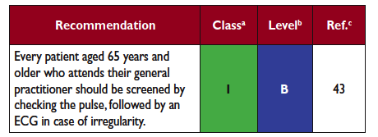

Slide 13
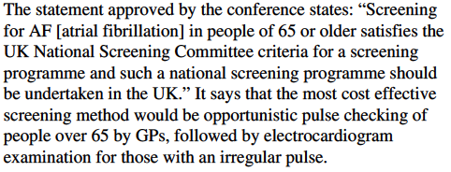
Screening
No national screening
BMJ 5/3/2012
  Consensus conference (RCP)

Slide 14
Who is at Risk-1
The unknown person with AF

Slide 15
Who is at Risk-2

Slide 16
Stroke risk persists even in asymptomatic/paroxysmal AF
The risk of stroke with asymptomatic or paroxysmal AF is comparable to that with permanent AF^{1,2}
Observed rate of ischaemic stroke¹
14
Intermittent AF
12
Sustained AF
10
8
Annual risk of stroke (%)
6
4
2
0
Low
Moderate
High
Stroke risk category
1. Hart RG et al. J Am Coll Cardiol 2000;35:183–7; 2. Flaker GC et al. Am Heart J 2005;149:657–63

Slide 17
Who is at Risk-2
The unknown person with AF when
it comes in Paroxysms

Slide 18
Who is at Risk-3

Slide 19
Warfarin better
Placebo better
AFASAK
SPAF
BAATAF
CAFA
SPINAF
EAFT
RRR 64%*, ARR 2.7%
(95% CI: 49–74%)
All trials
100
50
0
–50
–100
RRR (%)†
Compared to a 19% RRR,
0.7% ARR for aspirin
Random effects model;
Error bars = 95% CI;
* p>0.2 for homogeneity;
† Relative risk reduction (RRR) for all strokes (ischaemic and haemorrhagic)
Hart RG et al. Ann Intern Med 2007;146:857–67.
Notes:
19

Slide 20
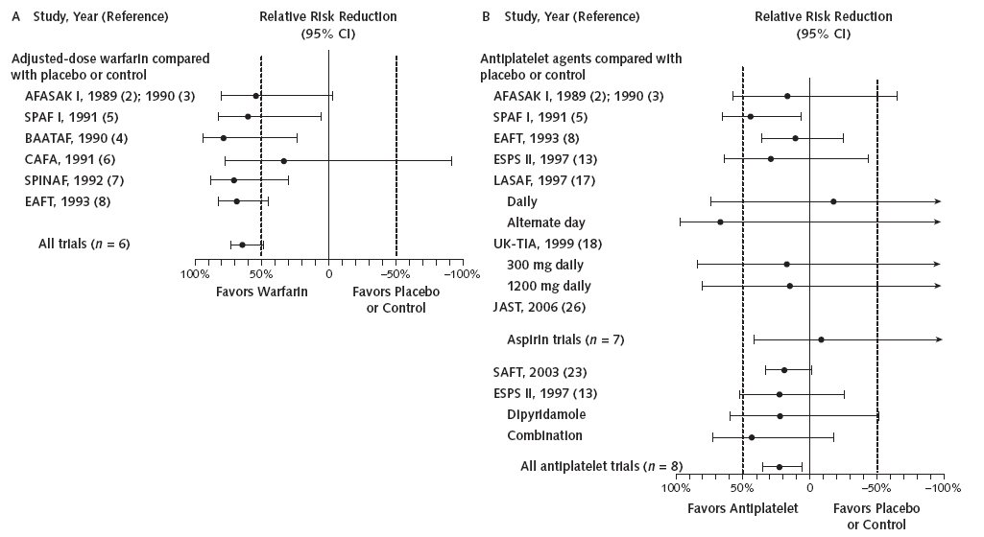
Antithrombotic Therapy to Prevent Stroke in Patients Who Have Nonvalvular AF Hart et al Ann Intern Med. 2007;146:857-867.
Comparison RRR
OAC vs control 64%
APT vs control 22%
Aspirin vs placebo: 3990 participants in 7 trials ≡ 19% (CI, -1% to 35%) reduction in all strokes; also, 13% (CI, -18% to 36%) reduction in disabling strokes and a 29% (CI, -6% to 53%) reduction in nondisabling strokes

Slide 21
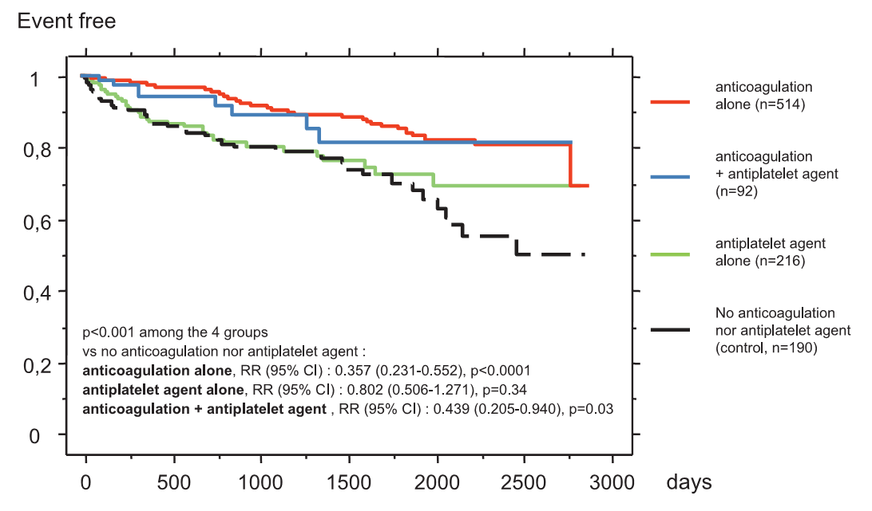
Antithrombotic treatment and risk of stroke and death in patients with AF at intermediate risk [CHADS₂ score=1]
Gorin et al Thromb Haemostat 2010;103(4):833-40.
Combined endpoint (death or stroke) in patients with a CHADS₂ =1 according to their antithrombotic treatment. A total of 1,012 patients, 949 ± 777 days FU, 124 events.

Slide 22
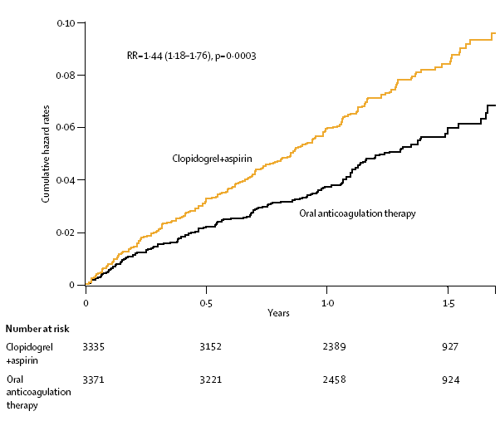
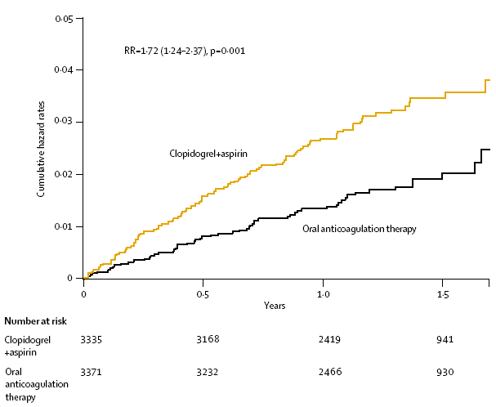
Clopidogrel +aspirin vs OAC for AF in the AF Clopidogrel Trial with Irbesartan for prevention of Vascular Events (ACTIVE W)
Lancet 2006; 367: 1903–12
Stroke, non-CNS SE, MI or vascular death.
Stroke
Haemorrhage risk | A+C (% per year) | OAC | A+C vs OAC RR (95%CI) | p
Major (incl. severe & fatal) | 2.42 | 2.21 | 1.10 (0.83-1.45) | 0.53
Severe | 1.70 | 1.57 | 1.09(0.78-1.52) | 0.62
Fatal | 0.17 | 0.26 | 0.62 (0.25-1.66) | 0.36
Minor | 13.58 | 11.45 | 1.23(1.09-1.39) | 0.0009

Slide 23
Who is at Risk-3
Those with AF treated with Aspirin

Slide 24
Who is at Risk-4

Slide 25
CHADS₂
 | Score
Congestive heart failure/left ventricular systolic dysfunction | 1
Hypertension | 1
Age ≥75 | 1
Diabetes | 1
Stroke / TIA | 2
Lip G et al. Chest 2010; 137 (2): 263–272

Slide 26
Stroke risk assessment with CHADS₂
Adjusted stroke risk
20
16
12
NRAF adjusted stroke rate
per 100 patient years, without aspirin²
8
4
0
0
1
2
3
4
5
6
CHADS₂ score
1 Gage BF et al. JAMA 2001;285:2864–70.
2 Based on data from Gage BF et al. JAMA 2001;285:2864–70.
Notes:
NOTES PAGE 8
The CHADS2 is a validated and user-friendly risk assessment tool, where patients scoring 2 or above should receive an oral anticoagulant.
The graph on the right highlights how stroke risk rises with the CHADS2 score, with those with a CHADS2 score of 2 having a stroke risk of 4% expected stroke rate per 100 patient years.
Note that current NICE guidance (2006) on the management of AF, uses a stroke risk assessment that has the following high/medium/low categories:¹
High risk:
• previous ischaemic stroke/TIA or thromboembolic event
• age ≥75 with hypertension, diabetes or vascular disease
• clinical evidence of valve disease or heart failure, or impaired left ventricular function on echocardiography.
Moderate risk:
• age ≥65 with no high risk factors
• age <75 with hypertension, diabetes or vascular disease.
Low risk:
• age <65 with no moderate or high risk factors.
Reference:
1. National Institute for Health and Clinical Excellence (NICE). Atrial fibrillation: the management of atrial fibrillation. NICE Clinical Guideline 36. June 2006.

Slide 27
CHADS₂
Score | NNT | Adjusted annual Stroke Rate
0 | 53 | 1.9
1 | 36 | 2.8
2 | 25 | 4.0
3 | 17 | 5.9
4 | 12 | 8.5
5 | 8 | 12.5
6 | 5 | 18.2

Slide 28
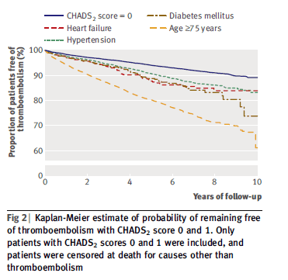
Validation of risk stratification schemes for predicting stroke
and thromboembolism in patients with atrial fibrillation
Olesen J et al. BMJ 2011;342:d124

Slide 29
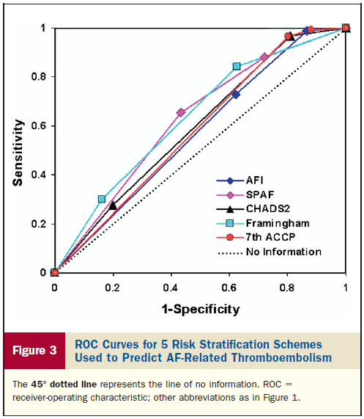
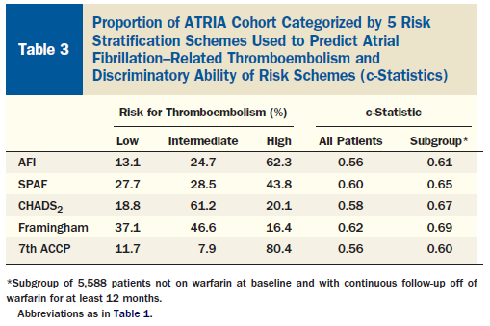
Comparison of Risk Stratification Schemes to Predict Thromboembolism in People With Nonvalvular Atrial Fibrillation
Fang FC et al. JACC 2008;51:810-815

Slide 30
Fang FC et al. JACC 2008;51:810-815
Notes:
NB CHADS2 intermediate risk is for a score of 1 and 2. The revised CHADS2 intermediate risk is a score of 1 only which equates to about 25%.

Slide 31
CHA₂DS₂VASc
 | Score
Congestive heart failure/left ventricular systolic dysfunction | 1
Hypertension | 1
Age ≥75 | 2
Diabetes | 1
Stroke / TIA | 2
Vascular disease | 1
Age 65–74 | 1
Sex (female) | 1
Lip G et al. Chest 2010; 137 (2): 263–272

Slide 32
CHA₂DS₂VASc
Validated: The Euro Heart Survey on Atrial Fibrillation
Score | Percent AF population | Adjusted TE rate
0 | 9.2 | 0%
1 | 15.1 | 0.7%
2 | 17 | 1.9%
3 | 18.7 | 4.7%
4 | 19.2 | 1.9%
5 | 8.7 | 3.2%
6 | 5.3 | 3.6%
7 | 2.3 | 10.1%
8 | 0.8 | 14.2%
9 | 0.01 | 100%

Slide 33
Reclassification
CHADS₂ | 0 |  | CHA₂DS₂VASc | 0 | 38.6%
 |  |  |  | 1 | 29.7%
 |  |  |  | ≥ 2 | 21.7%
CHADS₂ | 1 |  | CHA₂DS₂VASc | 1 | 7.3%
 |  |  |  | ≥ 2 | 92.7%
Olesen J et al. BMJ 2011;342:d124

Slide 34
C statistics based on Cox regression models in a large real world cohort with long-term follow up based on categorisation of patients into risk groups
 | 1 year | 5 year | 10 year
CHADS₂ | 0.722 | 0.796 | 0.812
CHA₂DS₂VASc | 0.850 | 0.880 | 0.888
Confidence intervals did not overlap between CHADS₂ and CHA₂DS₂VASc
Olesen J et al. BMJ 2011;342:d124

Slide 35
Who is at Risk-4

Slide 36
Who is NOT at Risk-4
Those without any risk factors

Slide 37
Who is at Risk-5

Slide 38
Guidance on Risk Assessment and Stroke Prevention for Atrial Fibrillation: GRASP-AF
Tools to support data collection and analysis for GRASP AF
Acknowledgement:
Keith Tyndall, Leeds AF clinic
James Barrett, Primis+
West-Yorkshire Cardiovascular Network

Slide 39
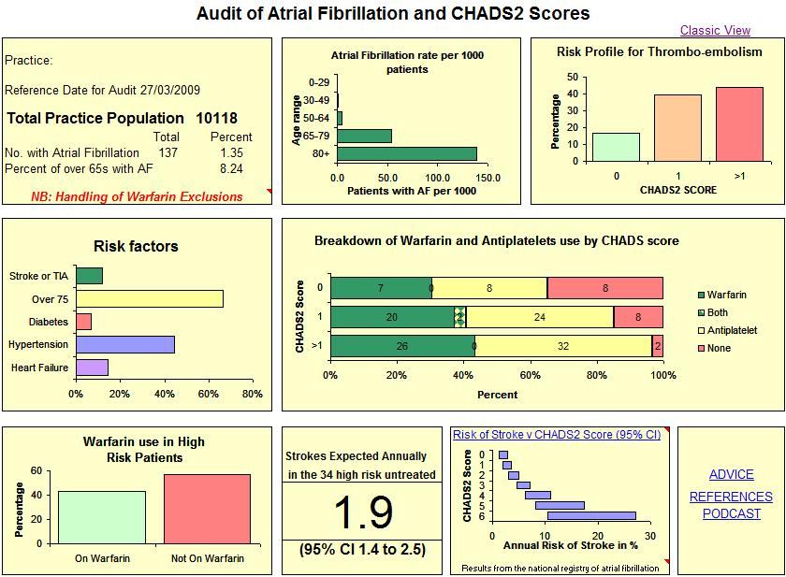
CHART GRASP-AF: Dashboard

Slide 40
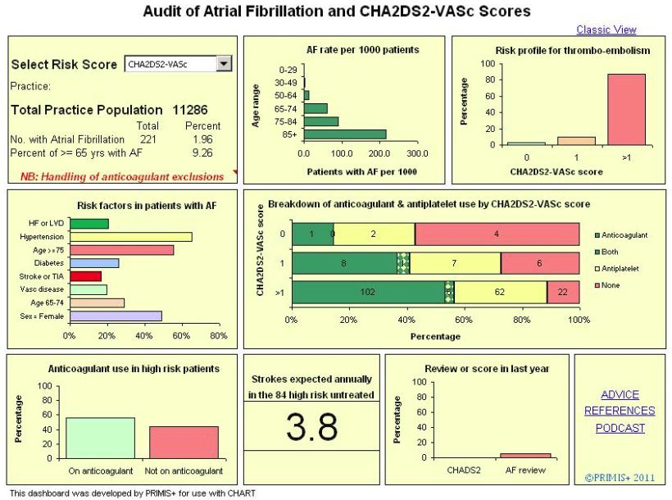

Slide 41
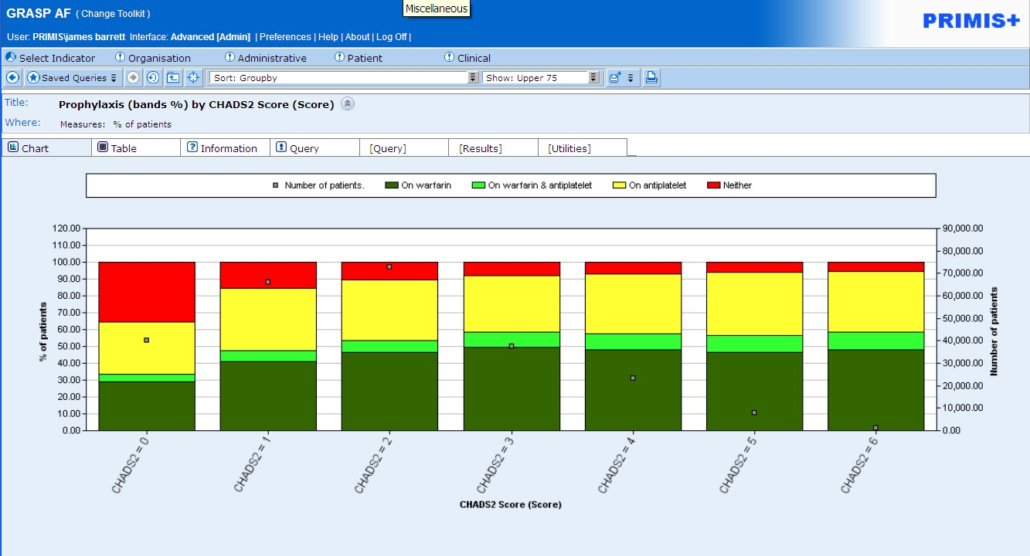
GRASP-AF Dataset May 2012

Slide 42
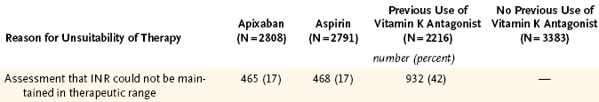

Slide 43
AVERROES: Stroke or SEE
5600 patients, 36 countries, 522 centres
ASA 81-324 mg/d
RR= 0.46
95%CI= 0.33-0.64
p<0.001
0.05
Cumulative Risk
0.03
Apixaban 2.5-5 mg bd
0.01
0.0
0
3
6
9
12
18
21
No. at Risk
Months
ASA
2791
2720
2541
2124
1541
626
329
Apix
2809
2761
2567
2127
1523
617
353
Notes:
43

Slide 44
AVERROES - Major Bleeding
0.020
RR= 1.14
95%CI= 0.74-1.75
P= 0.56
Apixaban
0.015
Cumulative Risk
0.010
ASA
0.005
0.0
0
3
6
9
12
18
21
Months
No. at Risk
ASA
2791
2744
2572
2152
1570
642
340
Apix
2809
2763
2567
2123
1521
622
357
N Engl J Med. 2011;364:806-817

Slide 45
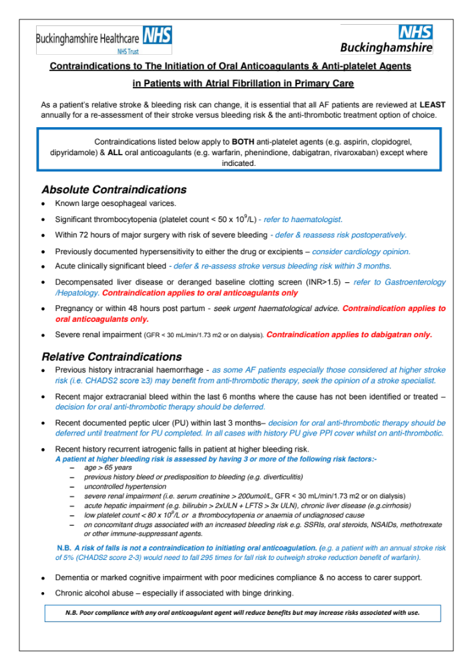

Slide 46
CHART Online Data
Number of practices | Strokes saved | Strokes saved if warfarin was 85%
879 | 90 | 588
8,256 | 845 | 5,523

Slide 47
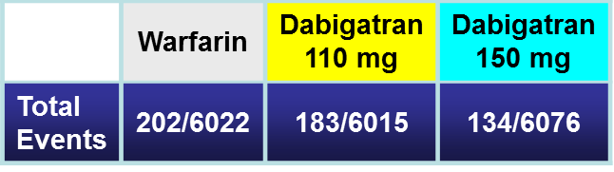
How does Pradaxa® compare to warfarin?
Time to first stroke / SSE
0.05
RR 0.90
(95% CI: 0.74–1.10)
p<0.001 (NI)
p=0.30 (Sup)
RRR
35%
ARR
0.60%
0.04
0.03
Cumulative hazard rates
0.02
RR 0.65
(95% CI: 0.52–0.81)
p<0.001 (NI)
p<0.001 (Sup)
0.01
0.0
0
0.5
1.0
1.5
2.0
2.5
Years
ARR, absolute risk reduction; RR, relative risk; CI, confidence interval; NI, non-inferior; Sup, superior
Connolly SJ et al. N Engl J Med 2009;361:1139–1151

Slide 48
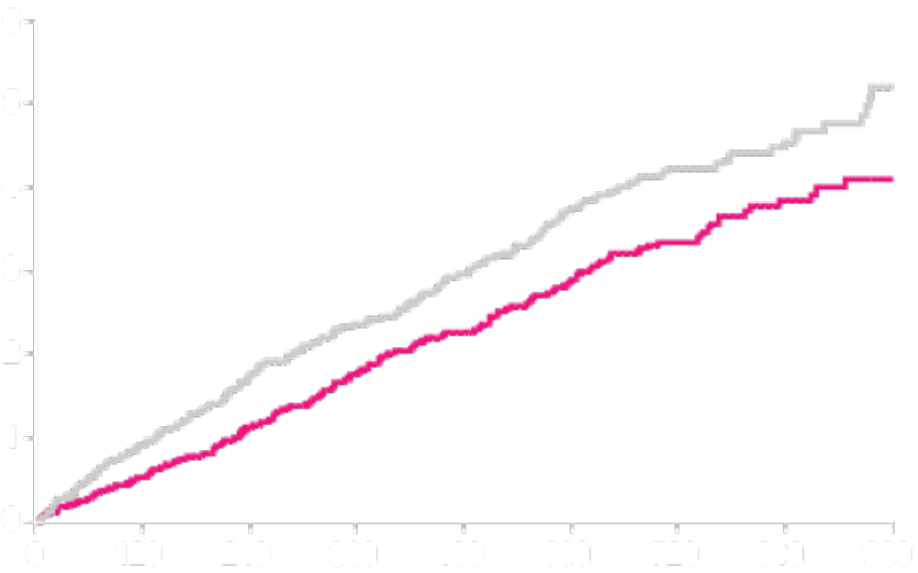
Primary Efficacy Outcome
Stroke and non-CNS Embolism
 | Rivaroxaban | Warfarin
Event Rate | 1.71 | 2.16
Warfarin
Cumulative event rate (%)
Rivaroxaban
HR (95% CI): 0.79 (0.66, 0.96)
P-value Non-Inferiority: <0.001
Days from Randomization
No. at risk:
Rivaroxaban 6958 6211 5786 5468 4406 3407 2472 1496 634
Warfarin 7004 6327 5911 5542 4461 3478 2539 1538 655
Event Rates are per 100 patient-years
Based on Protocol Compliant on Treatment Population

Slide 49
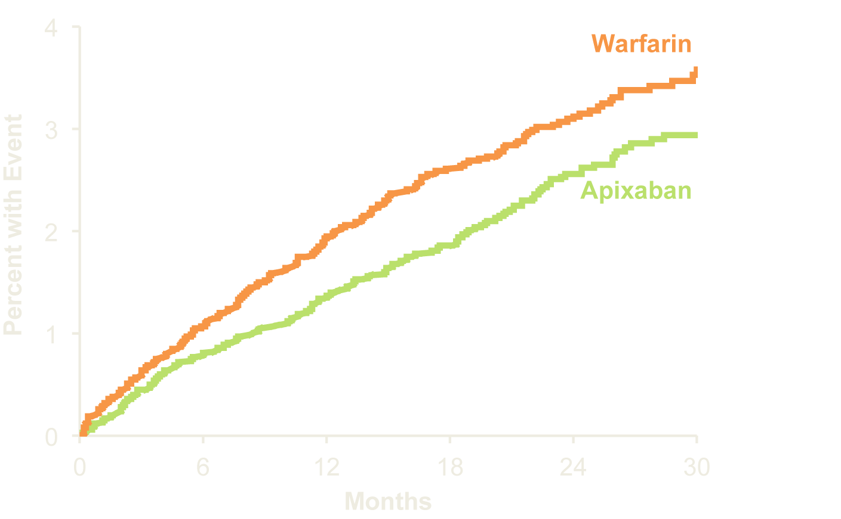
Primary Outcome
Stroke (ischemic or hemorrhagic) or systemic embolism
P (non-inferiority)<0.001
21% RRR
Apixaban 212 patients, 1.27% per year
Warfarin 265 patients, 1.60% per year
HR 0.79 (95% CI, 0.66–0.95); P (superiority)=0.011
No. at Risk
Apixaban 9120 8726 8440 6051 3464 1754
Warfarin 9081 8620 8301 5972 3405 1768

Slide 50
Who is at Risk-5
Those with risk factors but not anticoagulated

Slide 51
Who is at Risk-6

Slide 52
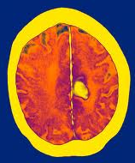
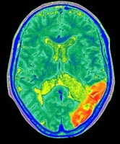
Stroke Prevention in AF
Bleeding risk
Stroke risk
Balancing the benefits and risks

Slide 53
Differences between perspectives of physicians and patients on anticoagulation in patients with atrial fibrillation: observational study
50
40
Physicians (n=63)
30
Patients (n=61)
Number of
physicians or patients
20
10
0
1
2
3
4
5
6
7
8
9
10
11
40
Minimum number of strokes necessary to prevent
30
Number of
physicians or patients
20
10
0
1
2
3
4
5
6
7
8
9
10
11
12
13
14
15
16
17
18
19
20
21
22
Maximum acceptable number of excess bleeds
Devereaux PJ et al. BMJ 2001;323:1–7

Slide 54
Risk of bleeding and stroke in AF patients
HR (95% CI)
1 [Reference]
0.93 (0.88–0.98)
1.06 (0.87–1.29)
1.66 (1.34–2.04)
1.83 (1.72–1.96)
3.08 (2.32–3.91)
3.70 (2.89–4.76)
Warfarin monotherapy
Aspirin monotherapy
Clopidogrel monotherapy
Aspirin + clopidogrel
Warfarin + aspirin
Warfarin + clopidogrel
Triple therapy
Risk of fatal
and non-fatal bleeds
0.1
1.0
10.0
Hazard Ratio (95% CI)
Hansen MLet al. Arch Intern Med 2010

Slide 55
Risk factors for stroke and thrombo-embolism in non-valvular AF
Major risk factors
Previous stroke
TIA or systemic embolism
Age ≥75 years
Clinically relevant non-major risk factors
CHF or moderate to severe LV systolic dysfunction [e.g. LV EF ≤40%)
Hypertension
Diabetes mellitus
Age 65–74 years
Female sex
Vascular disease
AF= atrial fibrillation; EF = ejection fraction (as documented by echocardiography, radionuclide ventriculography, cardiac
catheterization, cardiac magnetic resonance imaging, etc.); LV = left ventricular; TIA = transient ischaemic attack.
European Heart Journal 2010;31:2369–2429
Notes:
55

Slide 56
Risk factors for stroke and thrombo-embolism in non-valvular AF
Risk factors for bleeding =
Major risk factors
Previous stroke
TIA or systemic embolism
Age ≥75 years
Clinically relevant non-major risk factors
CHF or moderate to severe LV systolic dysfunction [e.g. LV EF ≤40%)
Hypertension
Diabetes mellitus
Age 65–74 years
Female sex
Vascular disease
AF= atrial fibrillation; EF = ejection fraction (as documented by echocardiography, radionuclide ventriculography, cardiac
catheterization, cardiac magnetic resonance imaging, etc.); LV = left ventricular; TIA = transient ischaemic attack.
European Heart Journal 2010;31:2369–2429
Notes:
56

Slide 57
ESC guidelines 2012 – bleeding risk assessment using HAS-BLED
HAS-BLED score:
  allows clinicians to make informed assessment of bleeding risk
  makes clinicians think of the correctable risk factors for bleeding
  has been validated in several independent cohorts
  correlates well with ICH risk
High HAS-BLED score per se should not be used to exclude patients from OAC therapy
ESC = European Sociiety of Cardiology; ICH = intracranial haemorrhage; OAC = oral anticoagulation
2012 focused update of the ESC Guidelines for the management of atrial fibrillation.

Slide 58
Clinical characteristics comprising the HAS-BLED bleeding risk score
HAS-BLED risk criteria | Points awarded
Hypertension (i.e. Uncontrolled BP) | 1
Abnormal renal and liver function (1 point each) | 1 or 2
Stroke | 1
Bleeding | 1
Labile INRs | 1
Elderly (e.g. age >65 years, frail condition) | 1
Drugs or alcohol (1 point each) | 1 or 2
 | Maximum 9 points
INR = international normalised ratio
ESC Guidelines for the management of atrial fibrillation 2010.
Adapted from Pisters R et al. Chest 2010 Nov;138(5):1093–100.

Slide 59
Risk of intracranial bleeding by HASBLED
2.0
OAC only
Aspirin only
1.6
1.2
% / year
0.8
0.4
0
0
1
2
3
4
5
6
Risk of major bleeding by HASBLED
25
20
15
% / year
10
5
0
0
1
2
3
4
5
6
Friberg, Rosenquist & Lip Eur H J 2012

Slide 60
Net clinical benefit for OAC in patients with HASBLED ≥3
CHA₂DS₂-VASc and HASBLED ≥3
CHA₂DS₂-VASc = 1
Warfarin
D110
D150
Rivaroxaban
Apixaban
CHA₂DS₂-VACs = 2-9
Warfarin
D110
D150
Rivaroxaban
Apixaban
-1.0
0
1.0
2.0
3.0
Net clinical benefit favours drug
Banerjee A et al. Thromb & Haem 2012

Slide 61
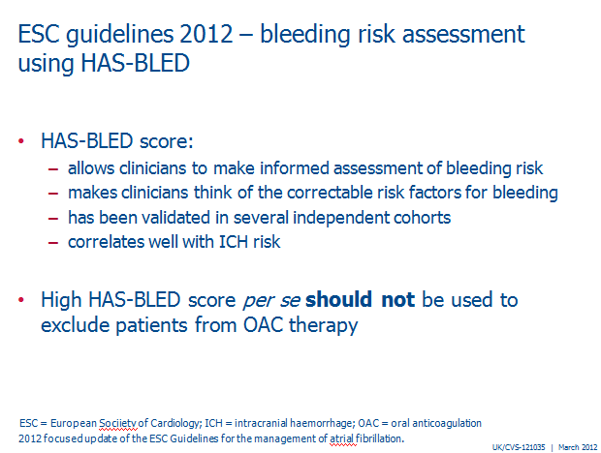
What might a patient with a high HASBLED score look like (=5)?
Uncontrolled hypertension
+
Severe renal impairment
+
History of bleeding
+
Heavy drinker
+
65 years
= @1% of patients

Slide 62
Who is at Risk-6
Those with risk factors but not anticoagulated due to an over sensitivity to bleeding risk

Slide 63
Who is at Risk of AF related stroke
The unknown AF patient
The paroxysmals assumed to be low risk
The aspirin treated
Those with risk factors
Those known and not treated
Those were bleeding is over estimated

Slide 64
Thank you for your attention
Question
matthew.fay@bradford.nhs.uk

