Slide 1
Cardiovascular Outcome Strategy
Implications for Primary Care
Westcliffe Medical Practice
Shipley
Westcliffe Cardiology Service
Dr Matthew Fay
Westcliffe Medical Practice
National Clinical Lead NHS Improvement

Slide 2
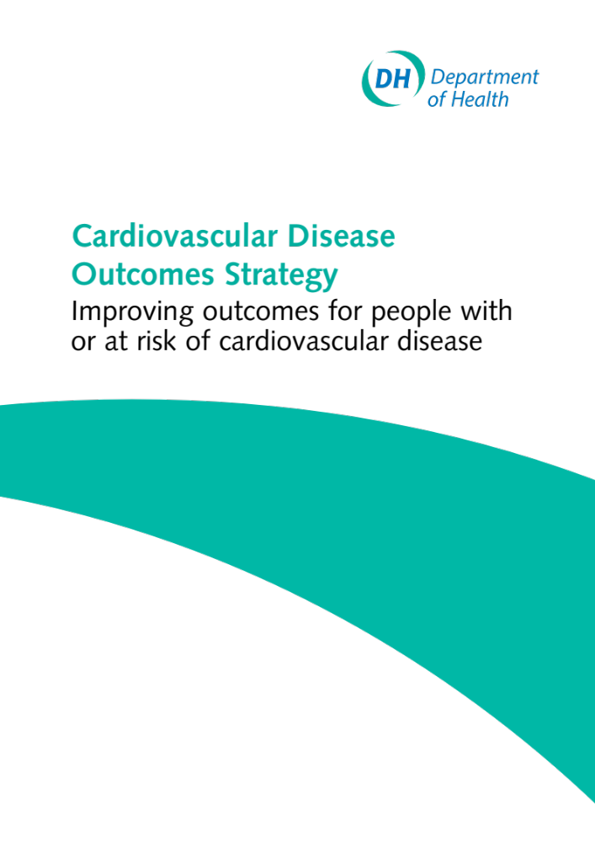
Westcliffe Medical Practice
Shipley
Westcliffe Cardiology Service

Slide 3
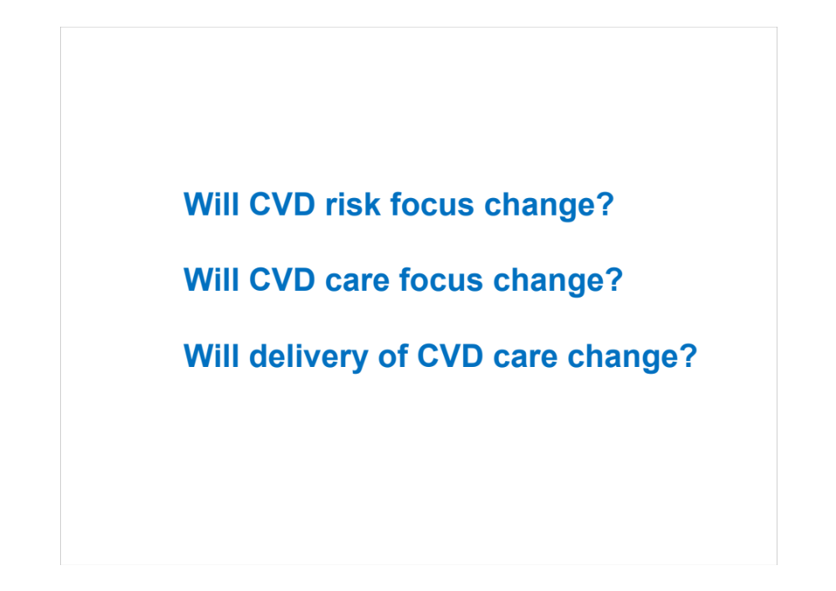
Westcliffe Medical Practice
Shipley
Westcliffe Cardiology Service

Slide 4
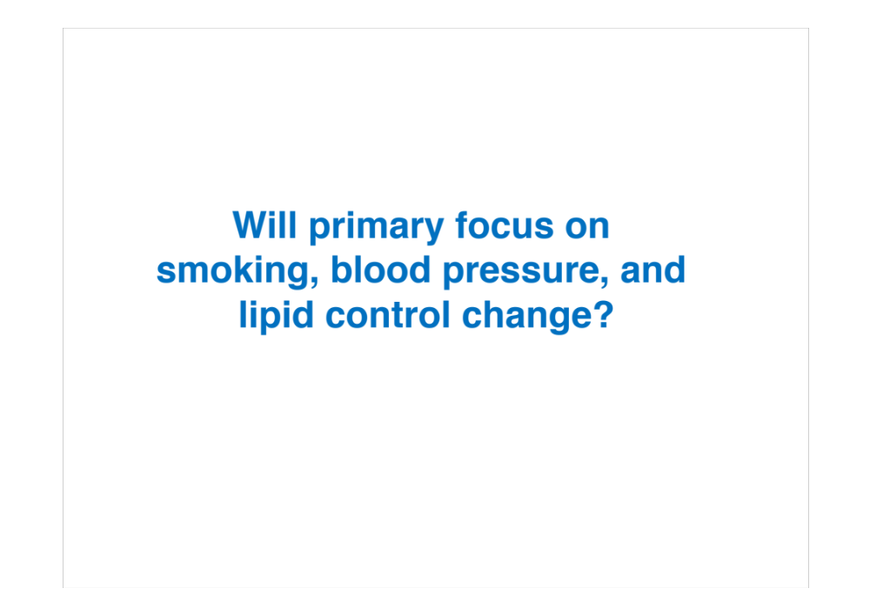
Westcliffe Medical Practice
Shipley
Westcliffe Cardiology Service

Slide 5
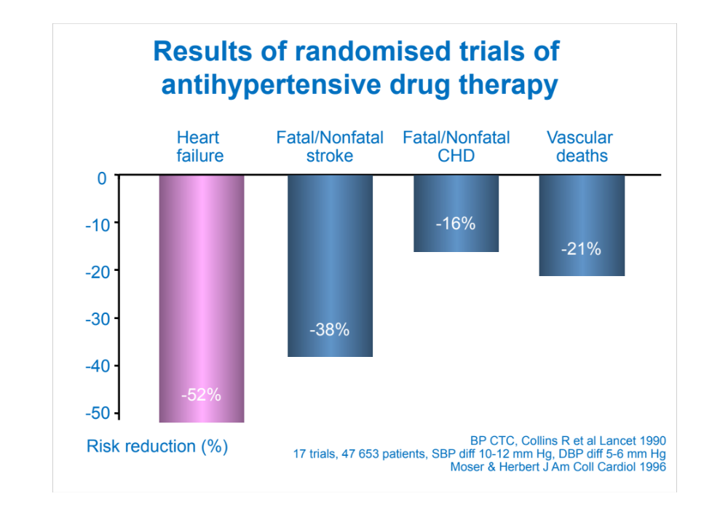
Westcliffe Medical Practice
Shipley
Westcliffe Cardiology Service

Slide 6
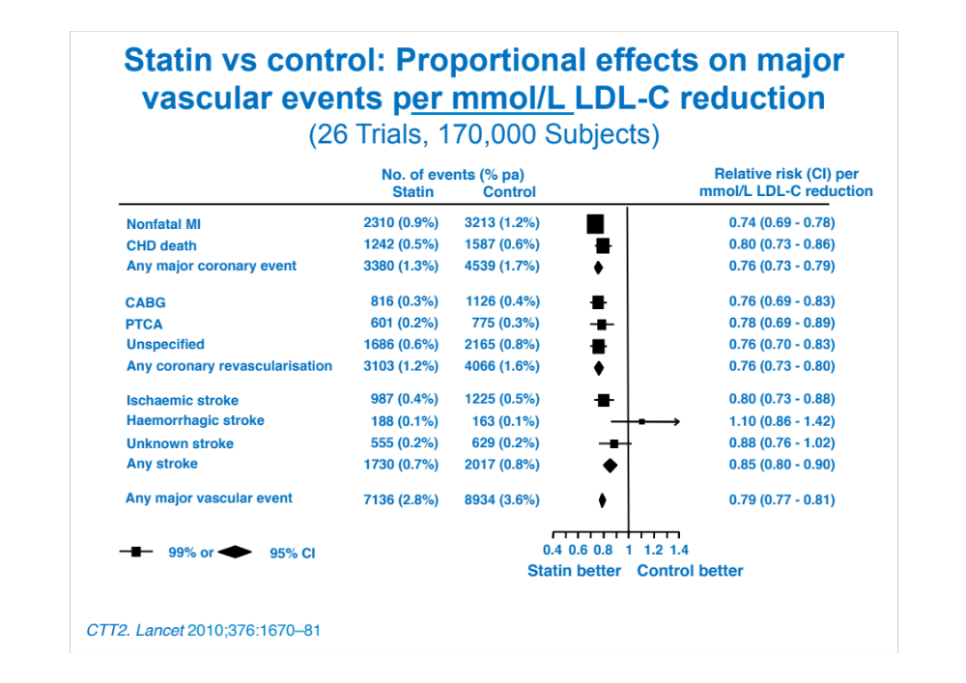
Westcliffe Medical Practice
Shipley
Westcliffe Cardiology Service

Slide 7
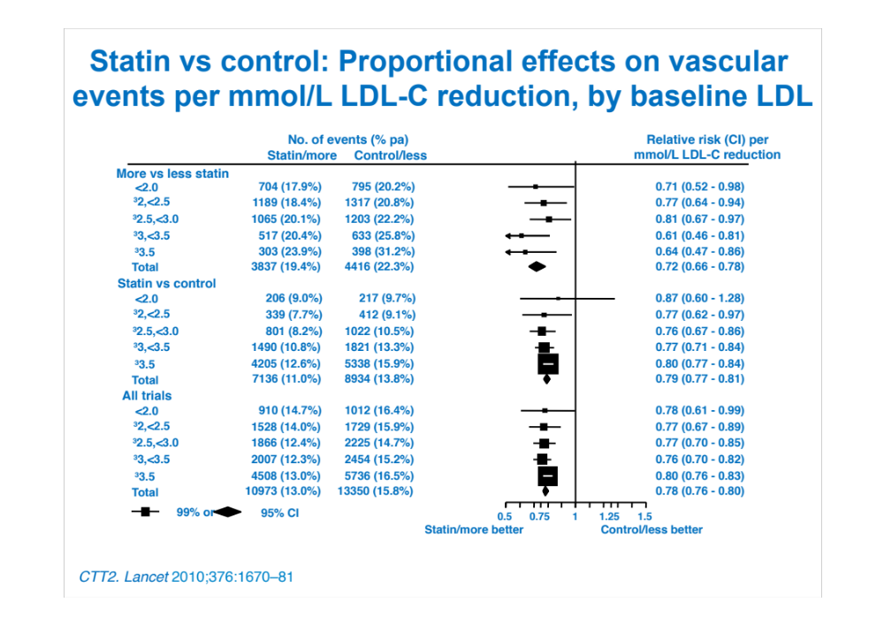
Westcliffe Medical Practice
Shipley
Westcliffe Cardiology Service

Slide 8
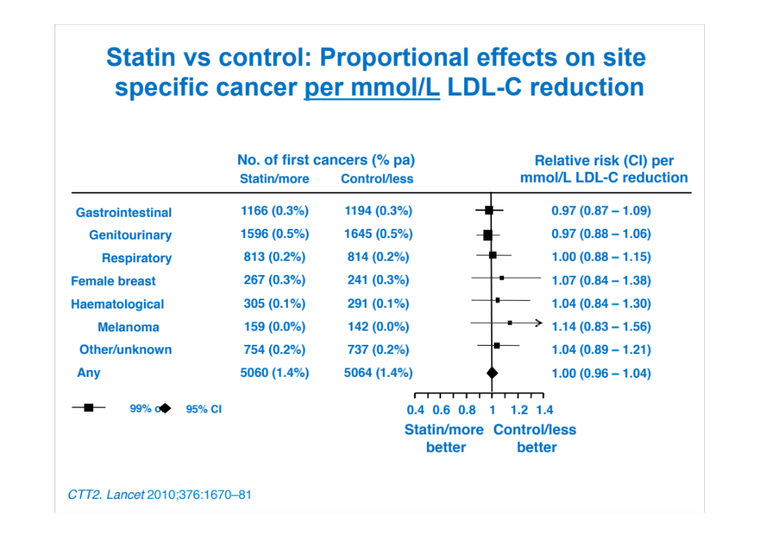
Westcliffe Medical Practice
Shipley
Westcliffe Cardiology Service

Slide 9
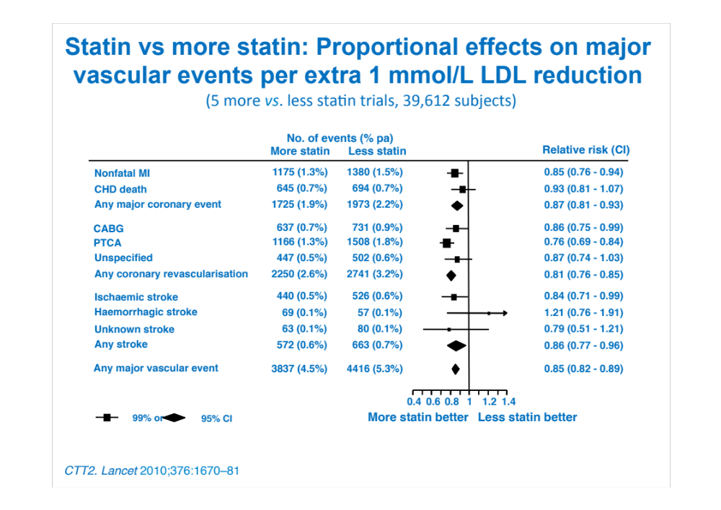
Westcliffe Medical Practice
Shipley
Westcliffe Cardiology Service

Slide 10
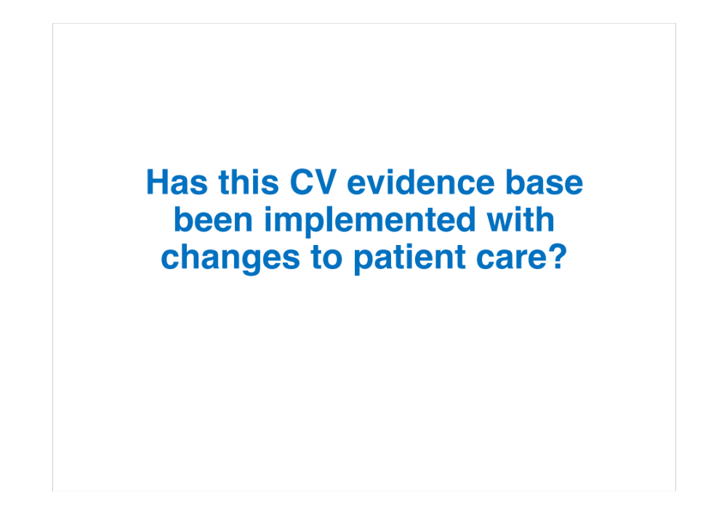
Westcliffe Medical Practice
Shipley
Westcliffe Cardiology Service

Slide 11
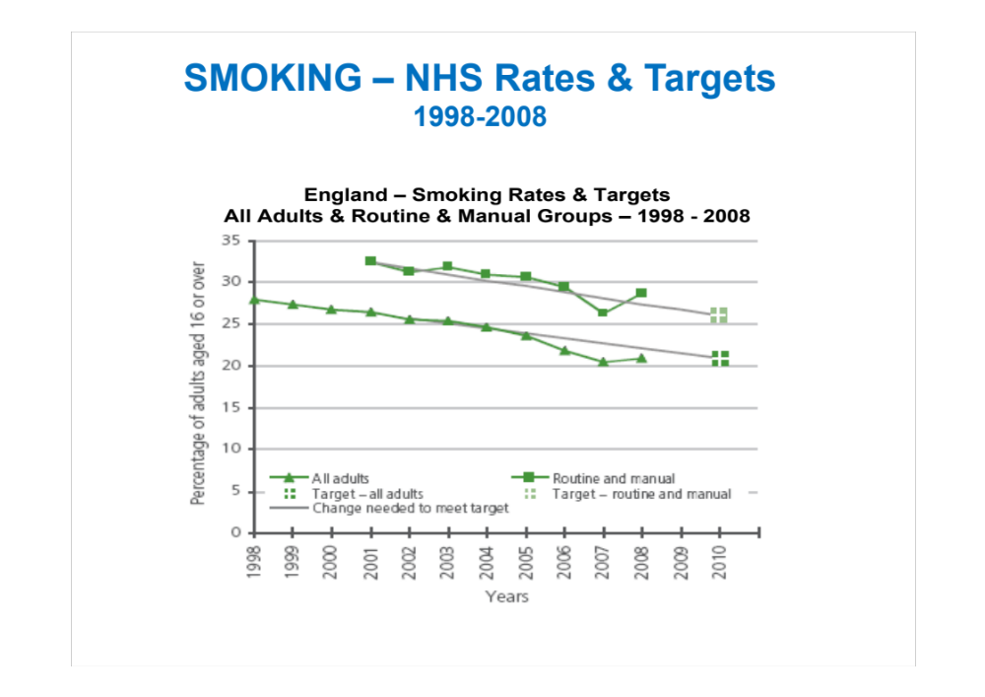
Westcliffe Medical Practice
Shipley
Westcliffe Cardiology Service

Slide 12
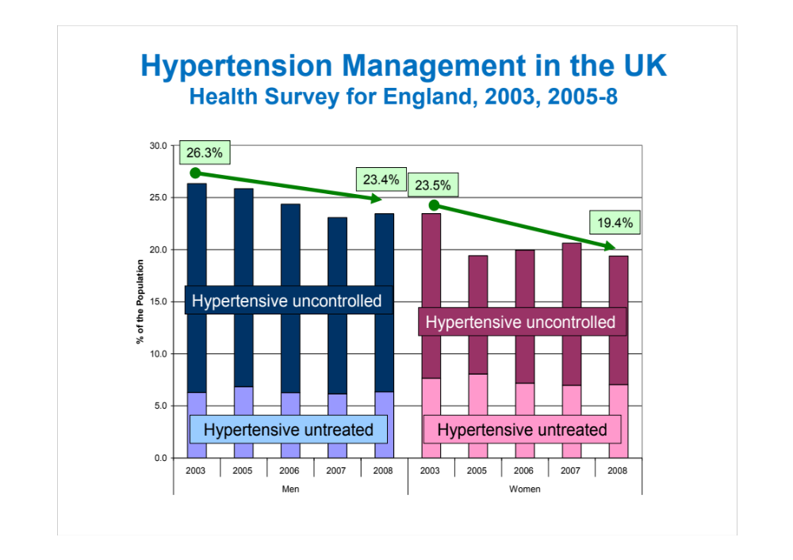
Westcliffe Medical Practice
Shipley
Westcliffe Cardiology Service

Slide 13
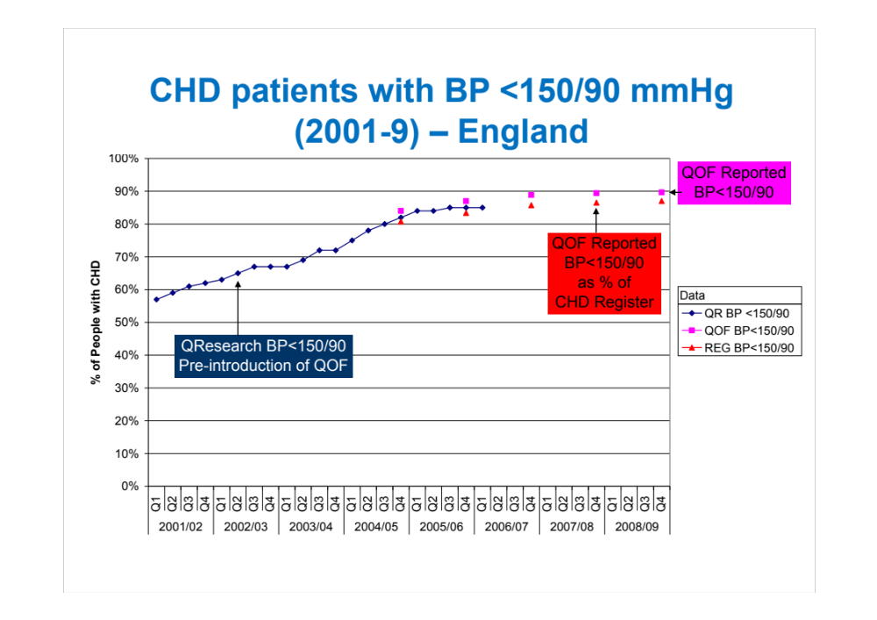
Westcliffe Medical Practice
Shipley
Westcliffe Cardiology Service

Slide 14
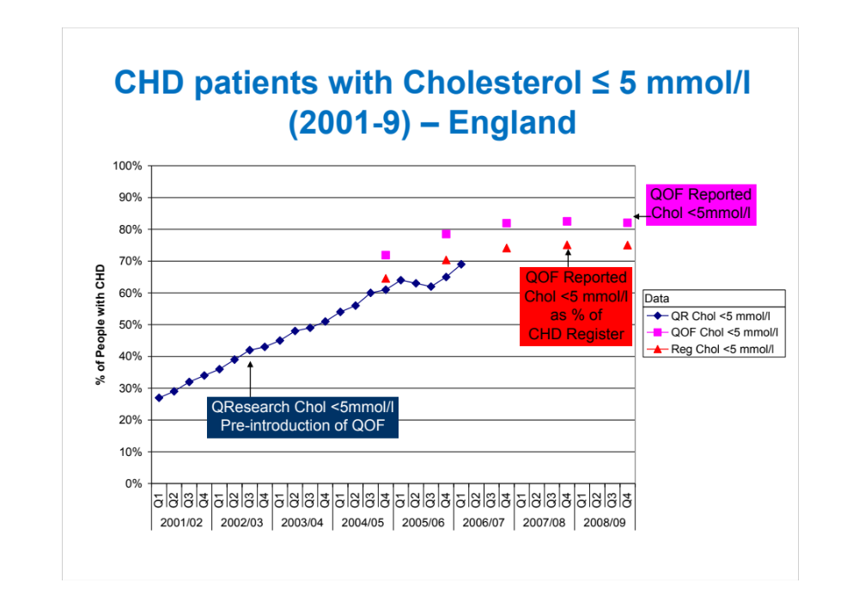
Westcliffe Medical Practice
Shipley
Westcliffe Cardiology Service

Slide 15
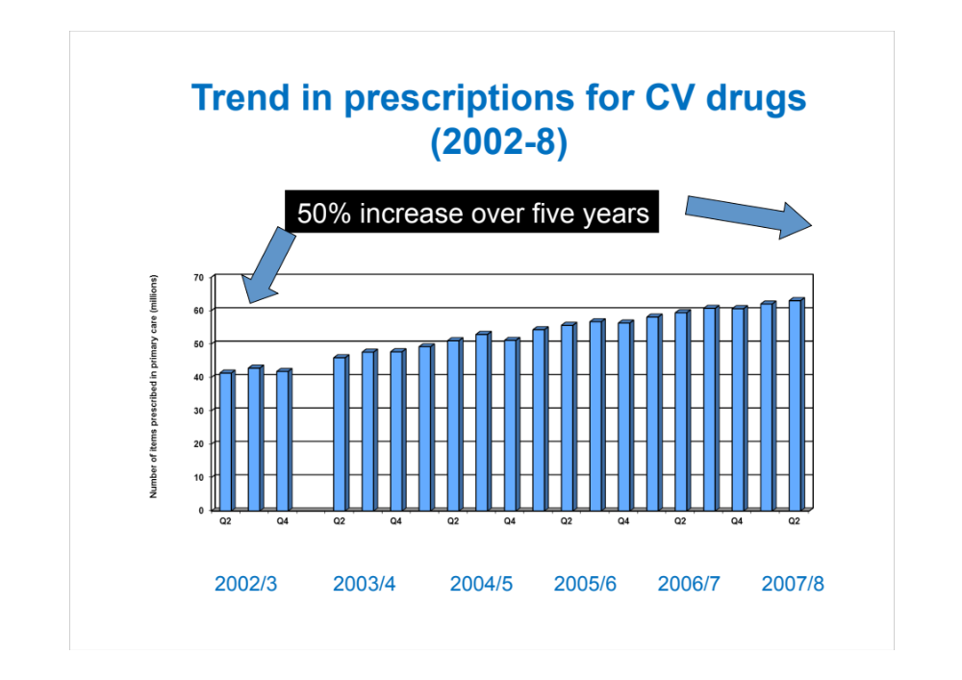
Westcliffe Medical Practice
Shipley
Westcliffe Cardiology Service

Slide 16
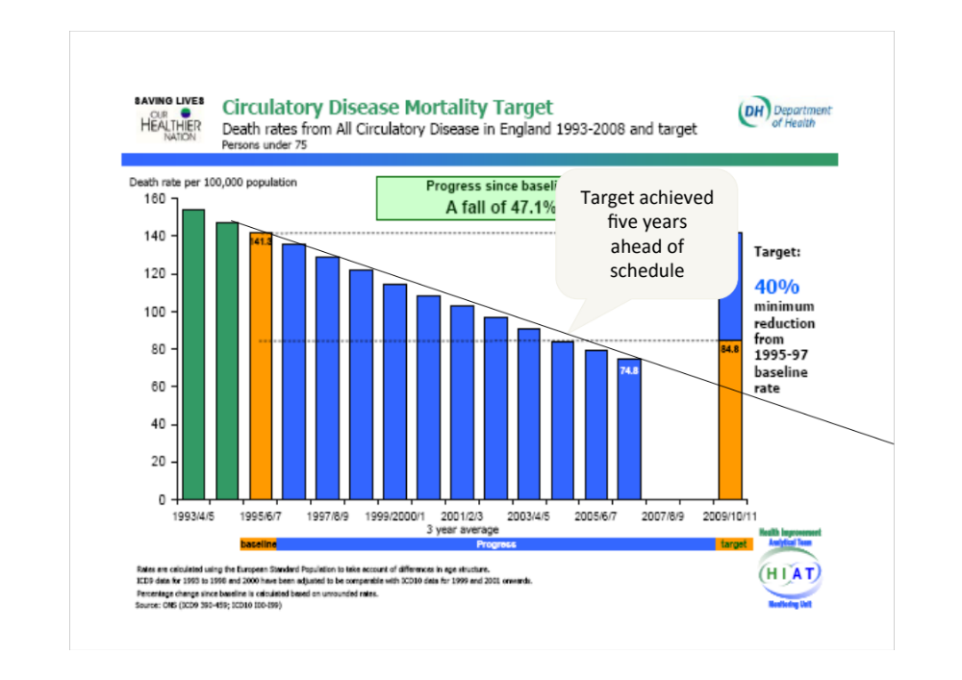
Westcliffe Medical Practice
Shipley
Westcliffe Cardiology Service

Slide 17
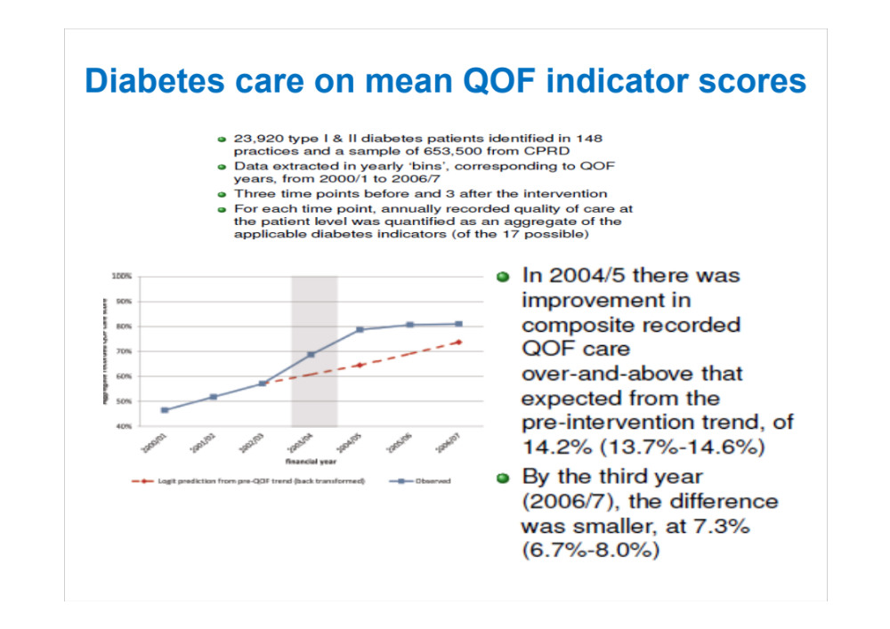
Westcliffe Medical Practice
Shipley
Westcliffe Cardiology Service

Slide 18
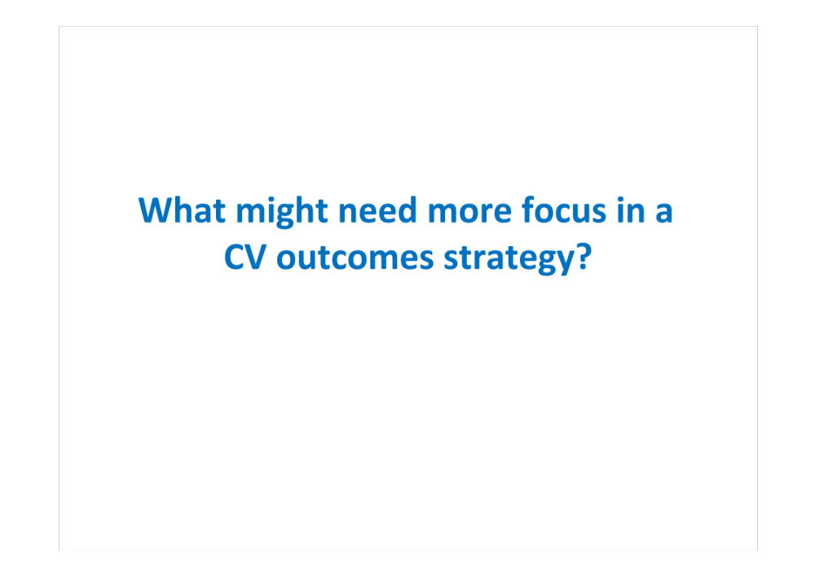
Westcliffe Medical Practice
Shipley
Westcliffe Cardiology Service

Slide 19
Explaining the fall in CHD deaths
in England 1980-2000
Risk factors worse +13%
Obesity +3.5%
Diabetes +4.8%
Less physical activity +4.4%
0
Risk factors better -71%
Smoking -41%
Cholesterol -9%
Popul’n BP fall -9%
Deprivation -3%
Other factors -8%
-20,000
-40,000
68,230 fewer deaths
in 2000
Treatments -42%
AMI treatments -8%
Secondary prevention -11%
Heart failure -12%
Angina: CABG/PCI -4%
Angina: drugs -5%
BP treatment -3%
-60,000
IMPACT model; Redrawn from
Unal, Critchley & Capewell
Circulation 2004;109(9):1101-7
-80,000
1980
2000
Notes:
Reduction in CHD deaths 1980-2000 was 42% due to “treatments”, 71% due to improved risk factors, but offset by a negative 13% effect of worsening obesity, diabetes and inactivity (a trend that has continued)

Slide 20
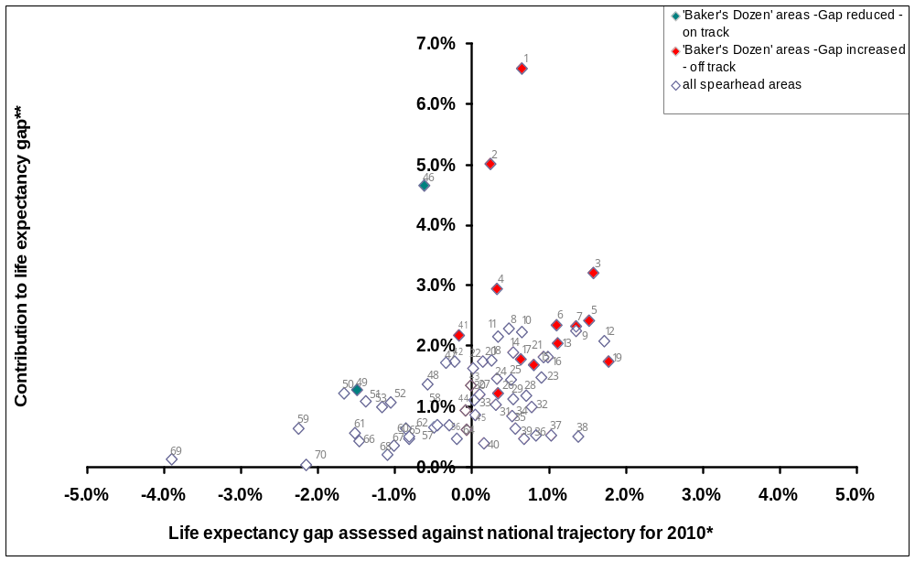
The size of the gap - Males
Westcliffe Medical Practice
Shipley
Westcliffe Cardiology Service
Bradford

Slide 21
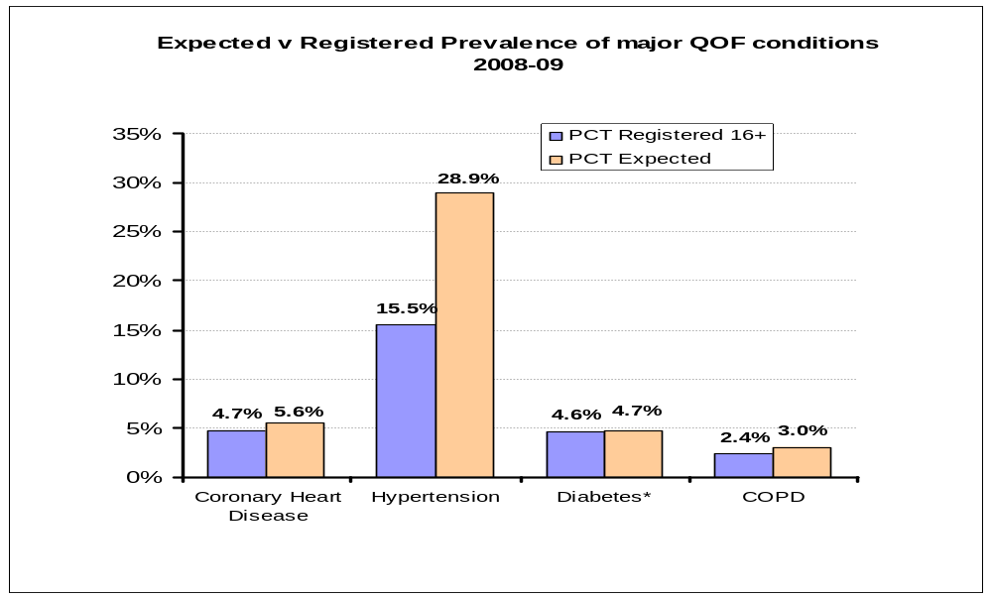
Westcliffe Medical Practice
Shipley
Westcliffe Cardiology Service
Expected prevalence

Slide 22
Expected prevalence
Notes:
Another key theme of the National Support Team – and one which resonates with us as GPs, is the issue of early diagnosis of long term conditions. This slide shows the picture across the PCT of our actual prevalence as demonstrated by QOF registers – in blue – and the expected prevalence for a district like Bradford. Don’t pay too much attention to the hypertension difference – we’re not sure that the model works so well – but you can see that potentially we should be finding more individuals with CHD and COPD to get them onto preventative treatment. The next slide shows AF prevalence against expected prevalence at practice level.

Slide 23
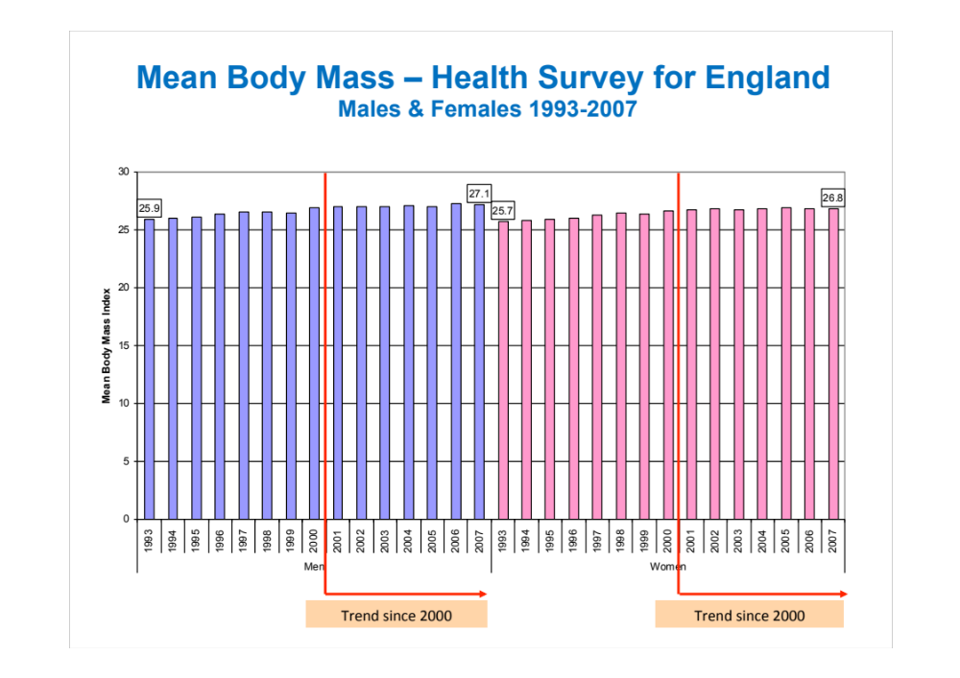
Westcliffe Medical Practice
Shipley
Westcliffe Cardiology Service

Slide 24
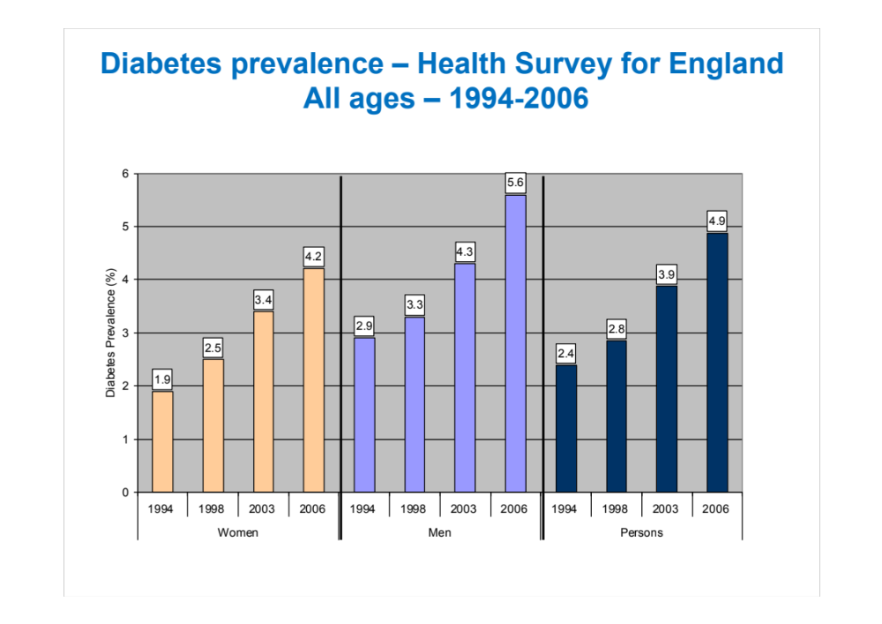
Westcliffe Medical Practice
Shipley
Westcliffe Cardiology Service

Slide 25
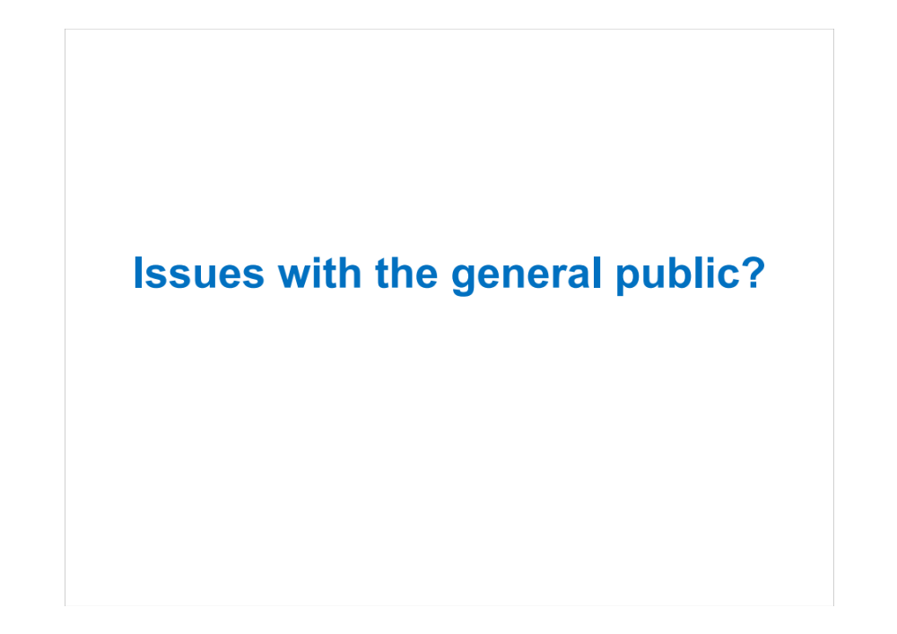
Westcliffe Medical Practice
Shipley
Westcliffe Cardiology Service

Slide 26
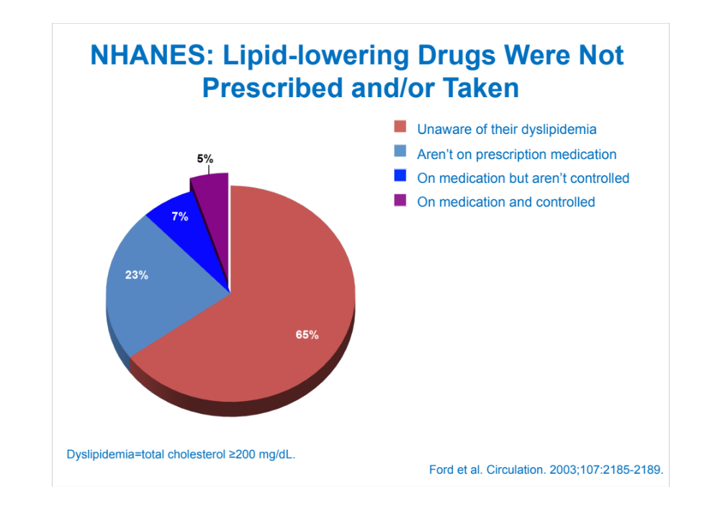
Westcliffe Medical Practice
Shipley
Westcliffe Cardiology Service

Slide 27
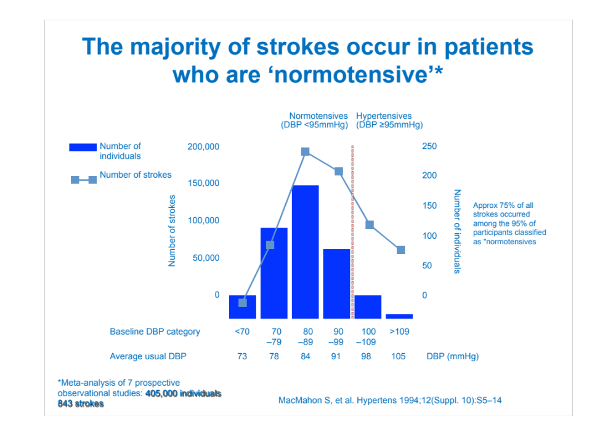
Westcliffe Medical Practice
Shipley
Westcliffe Cardiology Service

Slide 28
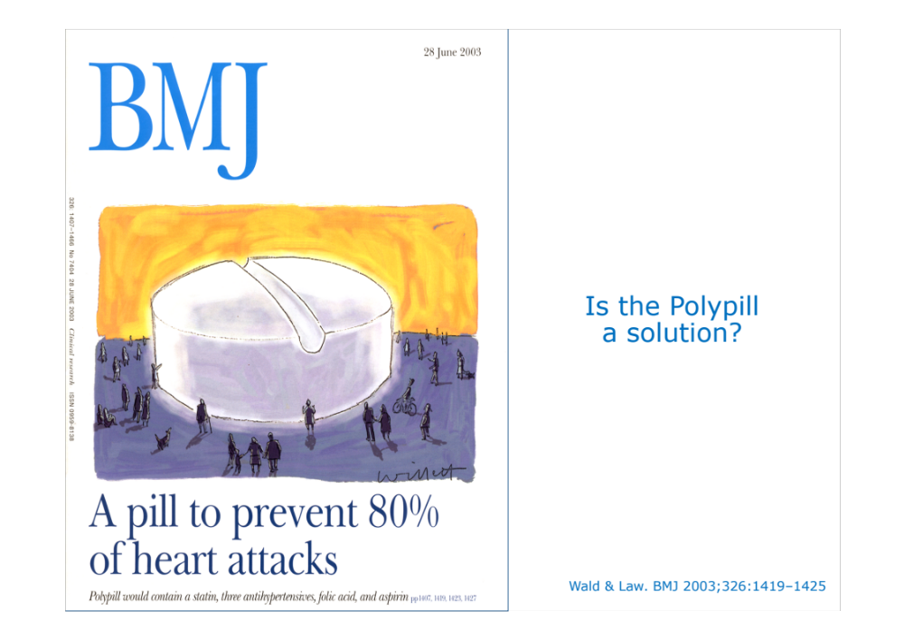

Slide 29
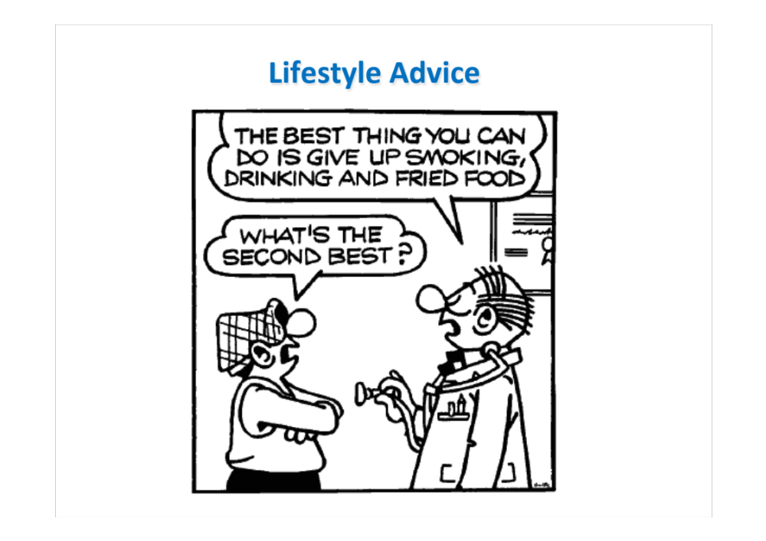

Slide 30
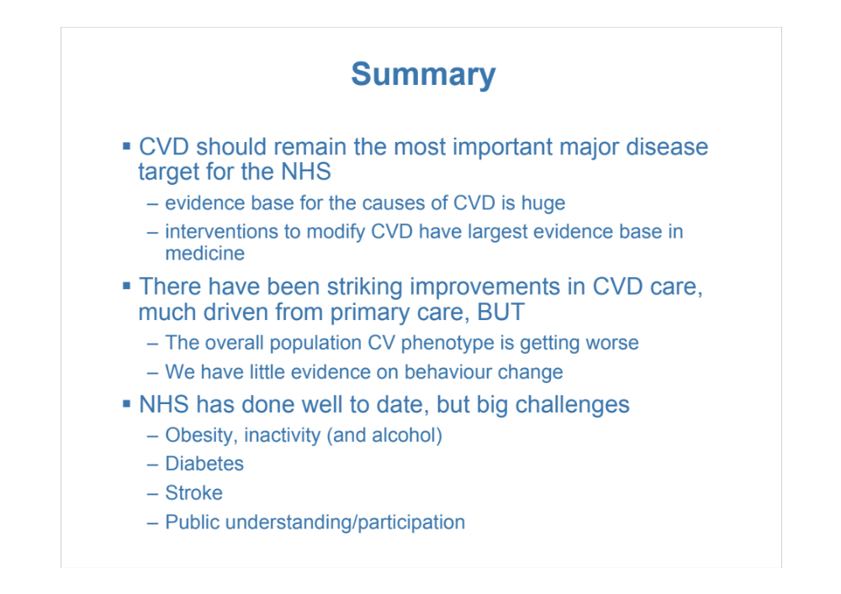
Westcliffe Medical Practice
Shipley
Westcliffe Cardiology Service

