Slide 1






BRADFORD VTS
Vocational Training Scheme for General Practice
Chronic Disease Management in General Practice
GP Training Teaching Deck
NICE NG56 & QOF 2025/26 Standards | May 2026
AKT REVISION
SCA PREPARATION
CLINICAL EXCELLENCE
Disclaimer: This presentation is designed for educational purposes specifically for GP trainees (ST1-ST3) as part of the Bradford VTS curriculum. The clinical information, management principles, and Quality and Outcomes Framework (QOF) indicators contained herein reflect the standards applicable as of May 2026, including NICE NG56 (Multimorbidity). This material serves as a guide for training and examination preparation (AKT/SCA) and should not be used as the sole basis for clinical decision-making. Clinicians must always exercise professional judgment and consult the most current NICE guidelines, British National Formulary (BNF), and local Integrated Care Board (ICB) protocols for individual patient care.
WWW.BRADFORDVTS.CO.UK

Slide 2
















CHRONIC DISEASE MANAGEMENT
BRADFORD VTS
MAY 2026
GP Training: NICE NG56 & QOF 2025/26 Standards
Defining LTCs and Multimorbidity
Long-Term Condition (LTC)
Multimorbidity (NICE NG56)
A health problem that cannot currently be cured but can be managed with treatment or therapy. The primary focus is to improve quality of life and slow disease progression.
Defined as a person having two or more long-term conditions simultaneously. This includes physical/mental conditions, learning disabilities, frailty, chronic pain, and sensory impairment.
COMMON LTC CATEGORIES IN PRIMARY CARE
Cardio & Resp
Metabolic & Renal
MSK & Neuro
Mental & Others
CHD, HF, Hypertension
Diabetes (Type 1 & 2)
OA, RA, SLE, PMR
Depression & Bipolar
AF, Stroke/TIA, PAD
CKD & Hypothyroidism
Epilepsy & Parkinson's
Schizophrenia & ASD
Asthma & COPD
Obesity & Gout
Dementia & MS
Eczema, IBD, Glaucoma
AKT Pearl: The NICE NG56 Scope
NICE emphasizes that LTCs aren't just physiological diseases; they explicitly include symptom complexes (frailty, chronic pain), sensory impairments, and alcohol/substance misuse.
www.bradfordvts.co.uk
For educational use only. Information current as of May 2026.

Slide 3
















CHRONIC DISEASE MANAGEMENT
BRADFORD VTS
MAY 2026
GP Training: NICE NG56 & QOF 2025/26 Standards
Management Principles at Diagnosis
Breaking the News
Staged Information
NICE NG56 Approach
Use a structured approach (e.g., SPIKES) to deliver information sensitively.
Avoid information overload; deliver key details in stages over several visits.
Prioritise the individual’s goals and values over generic clinical targets.
Promote self-management and signpost to reliable sources (NHS.uk, charities).
Acknowledge the cumulative treatment burden of polypharmacy and reviews.
Assess the patient's prior knowledge and start from their understanding.
Acknowledge the broader impact on family dynamics and carer support needs.
Embed shared decision-making to ensure management plans are sustainable.
Use clear, jargon-free language appropriate for a reading age of 12.
www.bradfordvts.co.uk
Excellence in GP Training: Empowering the next generation of General Practitioners.

Slide 4

















CHRONIC DISEASE MANAGEMENT
BRADFORD VTS
MAY 2026
GP Training: NICE NG56 & QOF 2025/26 Standards
Structured Reviews: The Disease Perspective
Dimensions of Clinical Assessment: Monitoring, Adherence, and Prevention
DISEASE MONITORING
EFFECTIVENESS & SAFETY
Patient Understanding: Re-assess comprehension of the condition's nature and typical trajectory.
Symptom Review: Evaluate patient-reported effectiveness versus experienced side effects.
Progression Tracking: Review objective clinical trends (e.g., HbA1c in Diabetes, BP in Hypertension).
Adverse Effect Monitoring: Schedule mandatory biochemical tests (e.g., U&Es for ACEi, LFTs for Statins).
TREATMENT ADHERENCE
SECONDARY PREVENTION
Concordance Check: Explore barriers such as side effects, complex regimens, cost, or personal beliefs.
Modifiable Risks: Systematic assessment of BMI, smoking status, alcohol intake, and physical activity.
WHO Data Insight: Approximately 50% of patients with LTCs do not take medicines as prescribed.
Risk Reduction: Align clinical interventions with the latest NICE primary prevention guidelines.
Avoid "compliance" — use "adherence" or "concordance" to reflect shared decision-making.
www.bradfordvts.co.uk
Slide 4 of 15 | Structured Clinical Review Framework

Slide 5










CHRONIC DISEASE MANAGEMENT
BRADFORD VTS
MAY 2026
GP Training: NICE NG56 & QOF 2025/26 Standards
Structured Reviews: The Patient Perspective
Psychological & Emotional Health
Sick Role & Identity: Move from passive identity to active self-management.
Stigma & Self-Esteem: Address conditions with high social stigma (e.g., SMI, obesity).
Mood Screening: Anxiety/depression are major LTC comorbidities (NICE NG56).
Illness Perception: Explore ICE to understand patient-specific health beliefs.
Daily Life & Socio-Economics
The Carer's Perspective
Carer Burden: Assess physical, emotional, and financial strain.
Work & Employment: Impact on career, role of Occupational Health.
Carer Health: GPs have a duty to screen for the carer's own health needs.
Financial Impact: Benefits entitlement (PIP, ESA) and reduced income.
NICE NG56: Explicitly include carers in the shared decision-making process.
Mobility & Environment: Need for home adaptations or OT assessments.
Social Prescribing: Refer to local support groups and voluntary agencies.
DVLA Restrictions: Consider driving safety (e.g., Epilepsy, Vision, Stroke).
www.bradfordvts.co.uk
Holistic reviews focus on what matters to the person, not just the disease targets.

Slide 6









CHRONIC DISEASE MANAGEMENT
BRADFORD VTS
MAY 2026
GP Training: NICE NG56 & QOF 2025/26 Standards
The Multidisciplinary Team (MDT) in LTC Care
THE PRACTICE TEAM
PCN & COMMUNITY SUPPORT
GP:
Overall clinical responsibility, complex reviews, and prescribing.
Clinical Pharmacist:
Polypharmacy, adherence, and medication reviews.
Practice Nurses:
Manage majority of QOF clinics (Asthma, DM, COPD).
Social Prescriber:
Non-clinical needs, isolation, and benefits advice.
HCA:
Routine monitoring (BP, Phlebotomy, ECGs, BMI checks).
District Nurses:
Housebound patients, wound care, and complex frailty.
SPECIALISTS & AHPS
COMMUNITY SECTOR
Secondary Care:
Consultants and Specialist Nurses for escalation.
Social Services:
Care packages, home adaptations, and safeguarding.
AHPs:
Physiotherapists, OTs, Dietitians, and Podiatrists.
Voluntary Sector:
Disease charities (BHF, Diabetes UK) and local support.
Mental Health:
CPNs, Counsellors, and IAPT for psychological support.
Community Pharmacy:
Dispensing, MURs, and self-care advice.
NICE NG56 Principle: Care coordination is essential for people with multimorbidity. A named lead professional should be responsible for the overall care plan to prevent fragmented management.
www.bradfordvts.co.uk

Slide 7













CHRONIC DISEASE MANAGEMENT
BRADFORD VTS
MAY 2026
GP Training: NICE NG56 & QOF 2025/26 Standards
QOF 2025/26: Major Framework Changes
The "Great Retirement"
TOTAL POINTS
564
32 Indicators Retired: Permanently removed from the framework to reduce administrative burden.
Reduced from 776 in 2024/25
Registers Defunded: Disease registers (Cancer, COPD, Asthma, Diabetes DM017, etc.) no longer carry QOF points.
QI Modules Gone: All 6 Quality Improvement modules have been removed and points redistributed.
POINT VALUE
£225.49
Per point for the 2025/26 cycle
Outcome-Based Achievement
CVD Focus: 141 points redistributed into 9 specific Cardiovascular Disease prevention indicators. AKT KEY
Clinical vs Administrative: Shift from simply "registering" patients to achieving tight BP and Cholesterol targets.
AVG PRACTICE INCOME
£127,176
Measurable Improvements: Box-ticking is inadequate; success is now measured by physiological outcomes.
Estimated average achievement value
www.bradfordvts.co.uk
Chronic Disease Management — May 2026

Slide 8

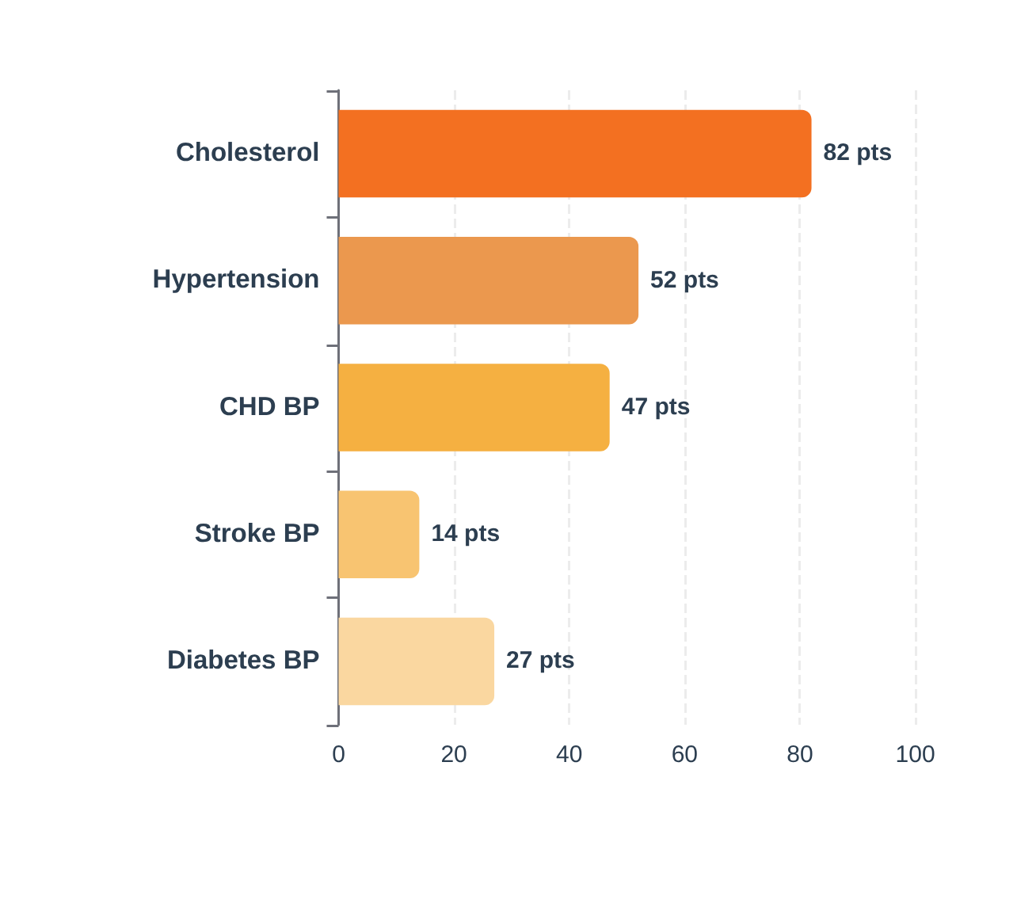




















QOF 2025/26: FOCUS ON CVD PREVENTION
BRADFORD VTS
MAY 2026
GP Training: NICE NG56 & QOF 2025/26 Standards
Points Weighting by Category
Indicator
Description (CVD Prevention Focus)
Target
Points
HYP008
Hypertension BP ≤140/90 (Age ≤79)
85%
38 pts
CHD015
CHD patients BP ≤140/90 (Age ≤79)
90%
33 pts
CHOL003
Statin prescribing (CHD/PAD/Stroke)
95%
38 pts
CHOL004
Cholesterol ≤2.0 mmol/L LDL (Secondary)
50%
44 pts
DM036
Diabetes BP ≤140/90 (Age ≤79, No Frailty)
90%
27 pts
STIA014
Stroke/TIA BP ≤140/90 (Age ≤79)
90%
8 pts
Note: 141 points were redistributed into 9 CVD prevention indicators for 2025/26. The focus has moved from registration to measurable clinical outcomes.
Points emphasize Cholesterol and Hypertension management as primary drivers of practice income.
www.bradfordvts.co.uk
For educational purposes only. Always consult latest NICE/NHSE guidelines.

Slide 9














THE QOF DEBATE AND MODELS OF CARE
BRADFORD VTS
MAY 2026
Analysis of box-ticking versus quality care
"Are we treating the patient or the computer screen?"
POLYCLINIC MODEL
Systematic, protocol-driven, and high recall efficiency for large disease registers.
Fragmentation risk; loss of relational continuity and holistic oversight in complex care.
THE QOF DEBATE
Evidence of Efficacy: Narrowed the deprivation gap (Lancet 2008) and improved care beyond pre-incentive trends.
"QOF Creep": Consultations dominated by alerts; risk of neglecting non-QOF conditions (Inverse Care Law).
NG56 Tension: Focus on single-disease targets vs. the holistic multimorbidity approach required for complex patients.
GENERALIST MODEL
Patient-centered and NICE NG56-aligned; ideal for managing multimorbidity and polypharmacy.
Highly time-intensive; harder to ensure consistent population-level coverage of targets.
www.bradfordvts.co.uk
Disclaimer: This deck is for educational purposes for GP trainees and reflects guidelines current as of May 2026. Clinical decisions remain the responsibility of the treating practitioner.

Slide 10





GOVERNANCE: REGISTERS, PROTOCOLS AND AUDIT
BRADFORD VTS
MAY 2026
GP Training: NICE NG56 & QOF 2025/26 Standards
DISEASE REGISTERS & RECALL
PRACTICE PROTOCOLS
2025/26 Shift: Registers are no longer directly incentivized by QOF but remain clinically essential for proactive care.
Evidence-Based: Protocols must be referenced to NICE/BNF standards and owned by the clinical team.
Use registers for risk stratification and automated recall systems to ensure no patient "falls between the stools."
Clear Triggers: Specify exactly who performs which task and what results trigger an onward referral to the GP.
Accuracy is paramount: Inaccurate registers lead to missed clinical reviews and QOF under-claiming.
Avoid "GOBSAT": Protocols should rely on clinical evidence rather than just "Good Old Boys Sitting Around a Table."
SNOMED CT & CODING
CLINICAL AUDIT
Mandatory Standard: SNOMED CT coding is required for all clinical entries; avoid using local or free-text codes.
Measurement Driver: "What gets measured gets managed." Use audit to identify gaps in CVD outcome achievement.
EHR Optimization: Ensure templates are updated to the latest 2025/26 QOF coding requirements (e.g., BP and lipid targets).
Closing the Loop: The most critical step is the change in practice following the initial data collection.
Data Integrity: Historical paper-to-digital conversion errors require ongoing clinical validation during reviews.
PCN Collaboration: Utilize ICB/PCN-level audit support to benchmark performance against regional standards.
www.bradfordvts.co.uk
Governance ensures that clinical excellence is systematic, not accidental.

Slide 11



















CHRONIC DISEASE MANAGEMENT
BRADFORD VTS
MAY 2026
GP Training: NICE NG56 & QOF 2025/26 Standards
NICE NG56: Multimorbidity and Polypharmacy
IDENTIFYING COMPLEXITY
TREATMENT BURDEN & TARGETS
Multimorbidity Definition: Presence of 2 or more long-term conditions (Physical/Mental/Sensory).
The Burden of Care: Consider the cumulative impact of appointments, medications, and lifestyle changes on QoL.
Validation Tools: Use validated frailty tools (Clinical Frailty Scale) and identify patients with high appointment frequency.
Individualized Targets: Reduce intensity if benefits are unlikely (e.g., relax HbA1c in frail/elderly).
Holistic Approach: Identify people who might benefit from a multimorbidity consultation based on treatment burden.
Shared Decisions: Discuss trade-offs between longevity and current quality of life explicitly.
AKT PEARL: NG56 emphasizes Deprescribing.
THE MULTIMORBIDITY CONSULTATION
POLYPHARMACY & DEPRESCRIBING
Person-Centred Goals: Focus on what matters to the person, not just single-disease clinical targets.
Polypharmacy Definition: Routine use of 5+ medications; High-risk polypharmacy involves 10+ medications.
Coordination: Ensure a named lead professional and create a shared written care plan with the patient.
Clinical Deprescribing: Systematic process of identifying and discontinuing drugs where harms outweigh benefits.
Continuity of Care: Prioritize seeing the same clinician to reduce fragmentation and improve safety.
Review Frequency: Regular medication reviews are essential for frail patients with multiple conditions.
SCA TIP: Focus on "What Matters to You".
www.bradfordvts.co.uk
Disclaimer: This teaching deck is for educational purposes for GP trainees. Clinical management must be based on the latest NICE guidelines, BNF, and local protocols. Updated to 2025 standards.

Slide 12















THE BIOPSYCHOSOCIAL MODEL AND TOP TIPS
BRADFORD VTS
MAY 2026
GP Training: NICE NG56 & QOF 2025/26 Standards
Top Tips for GP Trainees
The Biopsychosocial Model
Adherence not compliance: Explore barriers (beliefs, side effects, forgetting) before assuming non-compliance.
BIOLOGICAL
PSYCHOLOGICAL
SOCIAL
Multimorbidity is the norm: Manage the whole person, not just isolated QOF indicators.
• Pathophysiology
• Mood & Anxiety
• Employment/Finance
• Clinical Monitoring
• Illness Perception
• Housing/Mobility
Deprescribing is good medicine: In frail/elderly patients, fewer medicines often yield a better quality of life.
• Drug Treatments
• Health Beliefs
• Relationships
• Secondary Prevention
• Motivation levels
• Carer Dynamics
Carer assessment: Always ask about carer burden; they have their own healthcare needs.
ICE
Ideas, Concerns, Expectations: Use at every review. A patient's perception of their chronic condition evolves significantly over time.
Safety-netting: Provide clear action plans for acute deterioration (e.g., heart failure/COPD).
Beyond the numbers: QOF targets are minimum standards, not a ceiling for holistic care.
www.bradfordvts.co.uk

Slide 13













RED FLAGS IN CHRONIC DISEASE REVIEWS
BRADFORD VTS
MAY 2026
Identifying urgent clinical triggers requiring immediate action
Hypertensive Urgency
Diabetes Emergency
HF Decompensation
Status Epilepticus
BP ≥180/120 mmHg with symptoms
Glucose ≥20 mmol/L persistently
Rapidly worsening breathlessness
Seizure duration >5 minutes
Headache, visual change, chest pain
DKA symptoms: ketones, vomiting
New orthopnoea or PND
Incomplete recovery between fits
New confusion or focal neurology
HHS: profound dehydration, confusion
Rapidly increasing ankle oedema
SAME-DAY ASSESSMENT / ADMISSION
URGENT CLINICAL ASSESSMENT
URGENT HOSPITAL ADMISSION
CALL 999 / RESCUE MEDS
Chest Pain (CHD)
Renal Deterioration
COPD Exacerbation
Unstable AF
New or accelerating angina symptoms
Acute rise in Creatinine >25%
Acute functional deterioration
New AF with fast ventricular rate
eGFR fall >25% from baseline
Purulent sputum & high NEWS2 score
Haemodynamic compromise (BP drop)
Pain at rest or increasing frequency
HOLD NEPHROTOXICS & URGENT REVIEW
URGENT ACS ASSESSMENT
ASSESS & TREAT / ADMISSION
URGENT HOSPITAL ADMISSION
www.bradfordvts.co.uk
Teaching purposes only. Refer to current local pathways and NICE guidelines for clinical decisions.

Slide 14















EXAM PEARLS AND COMMON PITFALLS
BRADFORD VTS
MAY 2026
High-Yield AKT Facts & SCA Communication Strategy
AKT: NICE & QOF Mastery
SCA: Holistic Communication
NICE NG56: The gold standard for Multimorbidity (2+ LTCs) — prioritize patient goals over single-disease targets.
ICE Integration: Explore Ideas, Concerns, and Expectations at every review; LTC perceptions change over time.
QOF 2025/26: Total 564 points (£225.49/pt). 32 indicators retired to focus heavily on CVD outcomes.
Biopsychosocial: Always ask about mood (depression common in LTCs) and impact on work/finances.
Term: Use "Adherence" or "Concordance" rather than "Compliance" to reflect shared decision-making.
Safety-Netting: Give specific, actionable advice for acute deterioration (e.g., worsening breathlessness in HF).
AKT: Vital Clinical Targets
Common Pitfalls to Avoid
Hypertension: Target ≤140/90 mmHg for age <80; ≤150/90 mmHg for age ≥80 (QOF HYP008/9).
Box-Ticking: Focusing on computer alerts rather than the patient's agenda (SCA fail).
Lipids: Secondary prevention LDL target is ≤2.0 mmol/L (or non-HDL ≤2.6 mmol/L) per CHOL004.
Ignoring Carers: Failing to assess carer burden or physical/emotional needs of the family unit.
Renal: Stop Metformin if eGFR <30; reduce dose if 30-45. Monitor U&Es post-ACEi initiation.
Polypharmacy: Hesitating to deprescribe in frail patients where treatment burden outweighs benefit.
www.bradfordvts.co.uk

Slide 15










QUICK RECALL & FINAL SUMMARY
BRADFORD VTS
MAY 2026
GP Training: NICE NG56 & QOF 2025/26 Standards
3
KEY QOF SHIFTS
Rapid-Fire Recall (AKT/SCA)
Retired 32 register indicators; focused on CVD outcomes (BP/Lipids); point value increased to £225.49.
Q1: What is the BP target for a 72-year-old with hypertension and no frailty? (≤140/90 mmHg)
Q2: How many long-term conditions define "multimorbidity" per NICE NG56? (Two or more)
2
NICE NG56 PRINCIPLES
Q3: What is the secondary prevention LDL cholesterol target in QOF 2025/26? (≤2.0 mmol/L)
Prioritise patient-centered goals over disease targets; actively identify and reduce treatment burden (deprescribing).
Q4: At what medication count is "high-risk polypharmacy" defined? (10+ medicines)
Q5: Which term is now preferred over "compliance" or "concordance"? (Adherence)
1
CLINICAL GOAL
Move from fragmented "box-ticking" to holistic multimorbidity care using the biopsychosocial model and ICE.
DISCLAIMER: This teaching deck is designed for educational purposes for GP trainees and is based on NICE NG56 (2016, current 2025) and QOF 2025/26 standards. While every effort has been made to ensure accuracy, clinical guidelines are subject to change. Clinicians must exercise independent professional judgement and refer to the latest national and local protocols when making individual patient care decisions. The Bradford VTS and authors accept no liability for clinical outcomes based on this summary material.
www.bradfordvts.co.uk
© BRADFORD VTS - CHRONIC DISEASE MANAGEMENT SERIES 2026

