Slide 1

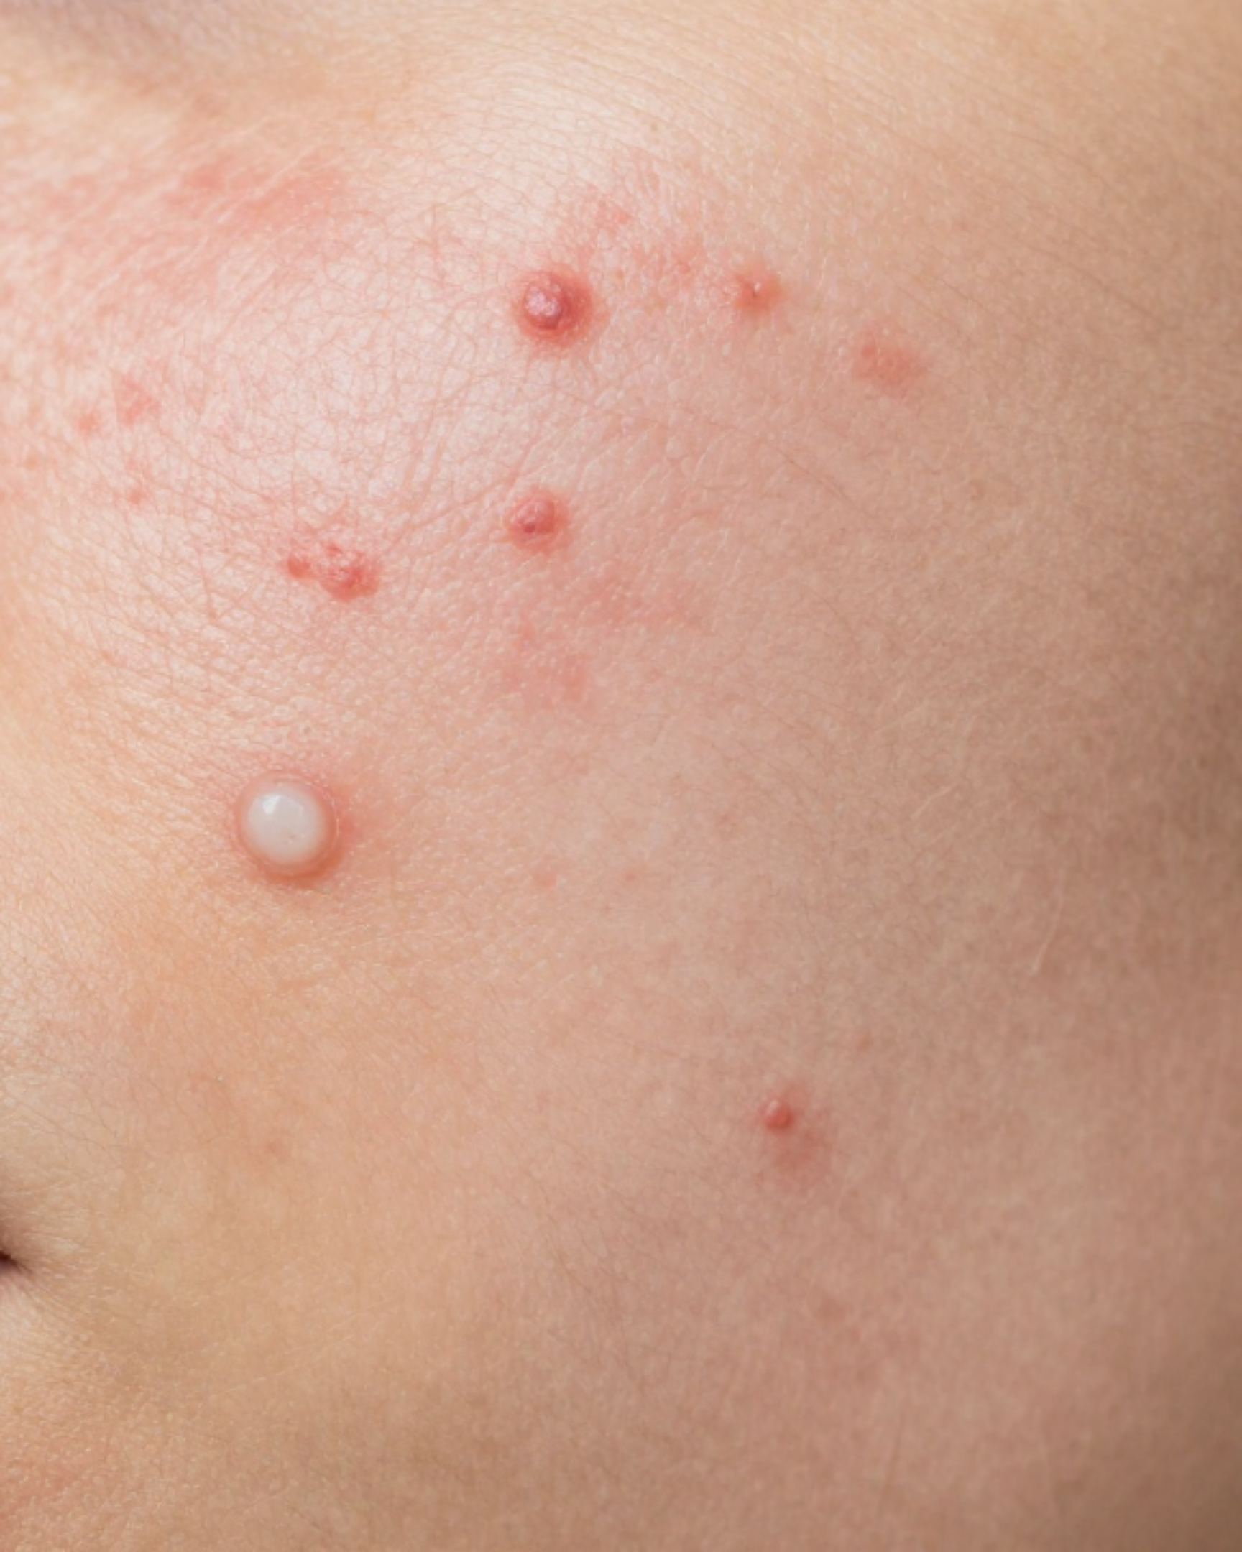



Bradford VTS Teaching Deck
GP CLINICAL MODULE
Acne Vulgaris
A Comprehensive Guide to Primary Care Management
Evidence-Based Standards
Updated to NICE NG198 (2026 Standards)
& PCDS Acne Pathway (2024 Update)
MAY 2026

Slide 2






CLINICAL MODULE
Definition and Epidemiology
Clinical Definition
Persistence into Adulthood
Acne vulgaris is a chronic inflammatory disorder of the sebaceous gland-hair follicle unit.
Persists in ~12% of women and ~3% of men over age 25.
Adult women often experience equal or higher severity due to hormonal components.
It is the most common skin condition encountered in primary care consultations.
Adolescent Prevalence
Psychological Burden
Affects ~85% of adolescents (aged 12–25 years) at some point.
Significant impact on mental health: depression and anxiety.
Leads to social isolation and reduced self-esteem in school or work environments.
Peak incidence occurs during puberty due to androgen-driven sebum changes.
Severity of acne does not always correlate with the degree of psychological distress.

Slide 3









PATHOPHYSIOLOGY
Acne Vulgaris: The SCCC Model
Acne is a chronic inflammatory disorder of the sebaceous gland-hair follicle unit. The SCCC mnemonic outlines the four interlocking processes that drive lesion development.
S
C
C
C
Sebum Overproduction
Increased Cornification
Keystone Organism - Cutibacterium
Cutaneous Inflammation
•Driven by circulating androgens
•Follicular duct hyperkeratosis
•Cutibacterium acnes overgrowth
•Innate immune response trigger
•Keratinocyte "stickiness"
•Hyper-responsive sebaceous glands
•Leads to microcomedone plugs
•Proliferates in anaerobic follicles
•Cytokine release & neutrophil influx
•Creates a lipid-rich environment
•Metabolises sebum into irritants
•Formation of papules/pustules
Note: These processes occur simultaneously and reinforce one another, requiring multi-modal treatment strategies.

Slide 4


















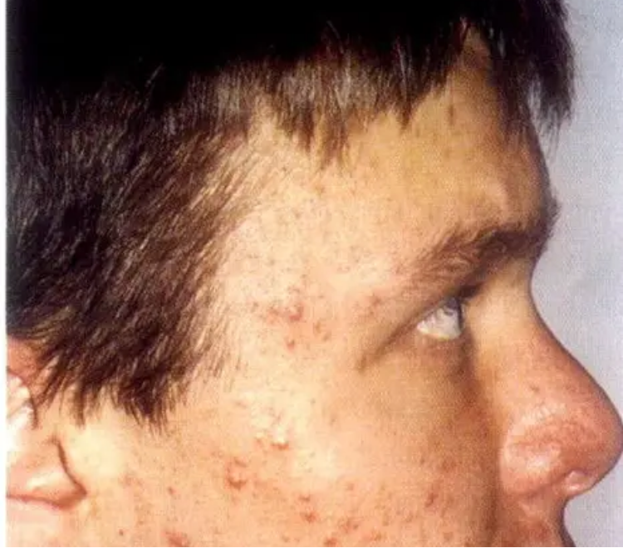

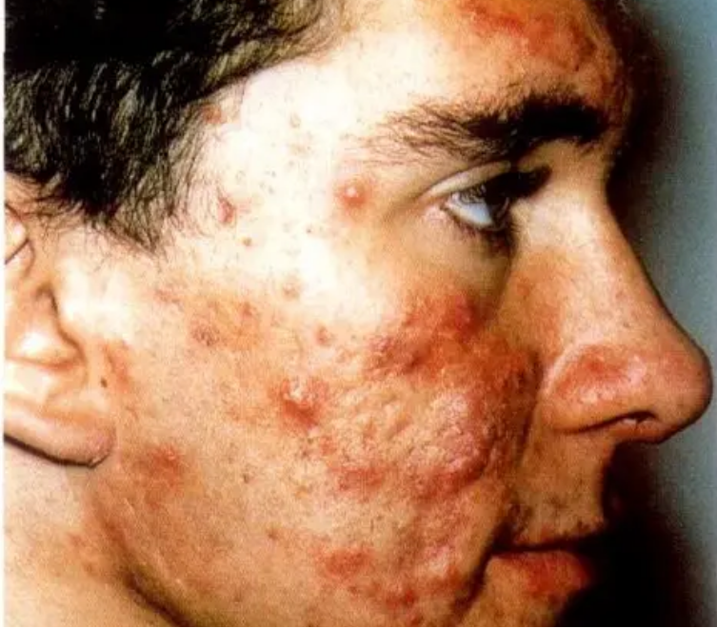
CLINICAL MODULE
Lesion Types and Leeds Revised Grading
Primary Lesions
Comedones: Non-inflammatory. Open (blackhead) = oxidized melanin; Closed (whitehead) = sebum-filled.
GRADE
CLINICAL DESCRIPTION
Papules & Pustules: Raised inflammatory lesions (<5mm). Pustules contain visible pus.
Mild
Comedones only (or predominantly); localised to the face.
Severe Features
Nodules & Cysts: Large (>5mm), deep, painful lesions. Cysts are fluctuant; both carry high scarring risk.
Mild/Moderate
Comedones + scattered inflammatory papules; localised to face.
Scarring: Ice-pick, rolling, box-car, or keloid. PIH is common in darker skin types.
Moderate
Widespread inflammatory lesions; face ± back/chest; no significant scarring.
Moderate/Severe
Numerous inflammatory pustules; limited scarring; small number of nodules/cysts.
Severe
Widespread pustules, nodulocystic lesions, often with significant active or old scarring.

Slide 5












CLINICAL MODULE
Clinical Assessment and History
Patient History & Impact
Physical Examination
Duration & Previous Treatments: Review OTC (cleansers, BPO) and prescribed attempts (min. 12 weeks each).
Distribution: Face, back, chest, and shoulders. Involvement of the trunk often necessitates systemic therapy.
Psychological Burden: Screen for depression, anxiety, and social isolation (school/work impact).
Lesion Morphology: Ratio of non-inflammatory (comedones) to inflammatory (papules, pustules, nodules).
Family History: Particularly relevant for severe or early-onset cases.
Inflammation: Presence of deep, painful, fluctuant cysts or abscesses.
Always assess self-esteem; acne severity does not always correlate with psychological impact.
Long-term Sequelae
Systemic & Drug History
Scarring: Identify active vs. old scars (ice-pick, rolling, box-car, or keloid). Scarring = prompt escalation.
Female-Specific: Menstrual cycle link, PCOS symptoms (hirsutism), and current contraception.
PIH: Post-inflammatory hyperpigmentation; highly significant in Fitzpatrick types IV-VI.
Iatrogenic Acne: Steroids, Lithium, Anticonvulsants can trigger or worsen lesions.
Virilisation: In females, look for signs of androgen excess (clitoromegaly, rapid hirsutism).
Presence of scarring is a major clinical driver for early referral to dermatology.
Pregnancy Status: Critical for prescribing retinoids or tetracyclines.

Slide 6















CLINICAL MODULE
General Treatment Principles & Skin Care
The 12-Week Rule
Patient Skin Care Advice
Counsel patients that treatments take 8-12 weeks to show full clinical effect.
Gentle Cleansing
Sun Protection
Scheduled review at 12 weeks is essential to reassess and escalate if needed.
Twice daily; fragrance-free; avoid aggressive scrubbing.
Retinoids/Tetracyclines cause photosensitivity.
Premature cessation is the leading cause of treatment "failure" in primary care.
Cosmetics
Dietary Advice
Use "non-comedogenic" products only.
Reassure hygiene/diet aren't causes; consider low GI.
Antibiotic Stewardship
EXAM PEARL: SCA COMMUNICATION
MANDATORY RULE
"This treatment works by changing how your skin cells behave; it's a slow process. We need to stick with it for 3 months before we judge the results."
Topical or oral antibiotics must NEVER be prescribed as monotherapy.
Always combine with a topical retinoid and/or Benzoyl Peroxide (BPO).
Do NOT prescribe topical and oral antibiotics simultaneously.

Slide 7















TOPICAL THERAPY
Topical Treatments: Retinoids, BPO, and Azelaic Acid
Topical Retinoids
Benzoyl Peroxide
Azelaic Acid
Adapalene (Differin 0.1%): First-line, best tolerated, comedolytic agent.
Mechanism: Antibacterial + comedolytic; effective against C. acnes.
Skinoren 20%: Antibacterial, comedolytic, and anti-inflammatory.
Tretinoin: Highly effective but significantly more irritant than Adapalene.
No Resistance: Unlike antibiotics, resistance does not develop to BPO.
Hyperpigmentation: Preferred for Post-Inflammatory Hyperpigmentation (PIH).
CONTRAINDICATED: Strictly avoid in pregnancy due to teratogenicity.
Application: Apply once daily in morning (reduces C. acnes load).
Pregnancy Safe: The primary alternative when retinoids are contraindicated.
GP Tip: Counsel on "Short-contact therapy" (1-2 hours then wash off) to build tolerance.
GP Tip: Warn patients that BPO will bleach towels, bedding, and clothing.
GP Tip: Particularly useful in darker skin types to treat both acne and dark spots.
Retinoids: TERATOGENIC (Avoid Pregnancy)
Azelaic Acid: SAFE in Pregnancy & Breastfeeding
Timeline: Counsel for 8–12 weeks for full effect

Slide 8













CLINICAL MODULE
Topical Antibiotics & Combination Therapy
Preferred Fixed-Dose Combinations
The Stewardship Rules
Duac® Gel
COMMONLY PRESCRIBED
NEVER use topical antibiotics as monotherapy (e.g. clindamycin alone).
Clindamycin 1% + BPO (3% or 5%)
Apply once daily in the evening. Antibacterial + reduces resistance.
Always combine with Benzoyl Peroxide (BPO) or a Topical Retinoid to minimize resistance.
Treclin® Gel
Review efficacy at 12 weeks; consider escalation or change if response is insufficient.
Clindamycin 1.2% + Tretinoin 0.025%
Broad spectrum: Antibacterial + Comedolytic. Apply once daily (evening).
ABSOLUTE CONTRAINDICATION
Epiduo® Gel
NON-ANTIBIOTIC OPTION
Do NOT prescribe topical and oral antibiotics simultaneously. This provides no clinical benefit and significantly increases bacterial resistance risk.
Adapalene 0.1% or 0.3% + BPO 2.5%
Highly effective combo; ideal for avoiding antibiotic stewardship concerns.
*Note: Erythromycin is less preferred due to high C. acnes resistance rates.

Slide 9


















ORAL PRESCRIBING
Oral Antibiotics for Moderate to Severe Acne
First-Line Tetracyclines
Tetracycline Contraindications
Lymecycline 408mg OD: Preferred choice due to once-daily dosing and better adherence.
Children under 12: Risk of tooth discoloration and bone growth effects.
Pregnancy/Breastfeeding: Teratogenic risks; use Erythromycin 500mg BD instead.
Doxycycline 100mg OD: Alternative first-line option; similar clinical efficacy.
Photosensitivity: Advise patients to use daily sun protection.
Duration: Minimum 12-week course; reassess at 12 weeks; max ~6 months.
Prescribing Rules (NICE NG198)
PCDS 2024 Alert: Minocycline
Always combine with topical retinoid and/or BPO to reduce bacterial resistance.
Recommendation: Should NOT normally be used in primary care.
Higher Risks: Lupus-like reactions, hepatotoxicity, and irreversible hyperpigmentation.
NEVER prescribe topical and oral antibiotics together.
Review treatment at 12 weeks to assess response and step down if controlled.
If used, baseline LFTs are mandatory.
AKT PEARL: Antibiotic stewardship is key. Never use antibiotics as monotherapy. If the patient is pregnant or under 12, Erythromycin is the licensed first-line alternative.

Slide 10







CLINICAL MODULE
Hormonal Treatments for Female Patients
Role of Combined Oral Contraceptives, Co-cyprindiol (Dianette), and off-label Spironolactone in managing acne with a hormonal component.
Combined Oral Contraceptives
Co-cyprindiol (Dianette)
Spironolactone (Off-label)
Useful when hormonal component is suspected (cyclical worsening pre-menstrually, PCOS).
Combines ethinylestradiol + cyproterone acetate (potent anti-androgen).
Anti-androgen; increasingly used in adult female acne (50-200mg daily).
NICE NG198: Use for moderate-severe acne where other treatments have failed.
PCDS 2024: Moderate recommendation for adult females with persistent acne.
2nd and 3rd generation COCs are generally preferred for acne management.
Discontinue 3-4 months after acne is controlled (not for long-term use).
Safety: Monitor potassium levels; strictly avoid in pregnancy (teratogenic).
Mechanism: Increases sex hormone-binding globulin (SHBG), reducing free testosterone levels.
Increased VTE risk vs standard COC; inform patient and monitor.
Not licensed for acne in the UK but widely supported by clinical evidence.
CRITICAL PRESCRIBING NOTE: PROGESTOGEN IMPACT
Unopposed progestogens (including the Progestogen-only pill, IUS/Mirena, and Implants) can WORSEN acne. Always consider current contraception methods when assessing female patients with new-onset or flare-up of acne.

Slide 11































CLINICAL MODULE
Management Pathway by Severity
Step-by-step treatment options for mild, moderate, and severe acne based on NICE NG198 and PCDS 2024 pathways.
Mild Acne
Moderate Acne
Severe / Nodular
Option 1: Topical Retinoid monotherapy (e.g., Adapalene 0.1% gel/cream).
Oral Antibiotic: Lymecycline 408mg OD or Doxycycline 100mg OD.
Derm Referral: Urgent if Acne Fulminans; Routine for Isotretinoin.
Option 2: Benzoyl Peroxide (BPO) monotherapy.
PLUS Topical: Retinoid (PM) + Benzoyl Peroxide (AM).
Indications: Nodulo-cystic lesions, scarring, or failing 2 ABX courses.
Option 3: Azelaic Acid (Skinoren) – useful in pregnancy or PIH.
Alternative: Topical combination (Duac/Treclin/Epiduo) + Oral Antibiotic.
Treatment: Oral Isotretinoin (Specialist only). Maintain ABX until seen.
Option 4: Fixed-dose combination (Epiduo: Adapalene + BPO).
Females: Consider COC or Co-cyprindiol if hormonal link.
Psychology: Assess impact & risk of suicide at every visit.
Review response at 12 weeks
Change ABX if no response at 12w
Refer if failed 2 antibiotic courses
NO Antibiotic Monotherapy
NO Topical + Oral ABX Together
8-12 Weeks for Full Effect
Avoid Minocycline (PCDS 2024)

Slide 12













CLINICAL MODULE
Specialist Referral and Isotretinoin
DERMATOLOGY REFERRAL CRITERIA
ORAL ISOTRETINOIN MANAGEMENT
Severe Nodulocystic Acne: Immediate referral to prevent extensive permanent scarring.
Pregnancy Prevention Programme (PPP)
Treatment Failure: Failed two adequate courses of oral antibiotics (12 weeks each).
Mandatory for all females of childbearing potential. Requires highly effective contraception, 2 negative tests before starting, and monthly tests throughout.
Psychological Impact: Significant distress, depression, or body dysmorphia regardless of physical severity.
2026 NICE UPDATE
Regulatory requirement for 2 independent healthcare professionals to approve treatment for under-18s has been removed.
Diagnostic Uncertainty: Suspected acne fulminans (urgent) or atypical presentations.
Mucocutaneous: Dry lips/skin
Mental Health: Mood monitoring
Labs: LFTs & Triglycerides
Photosensitivity: SPF 50+

Slide 13













LONG-TERM MANAGEMENT
Maintenance Therapy and Scarring
Relapse Prevention Strategy
Scar Classification
Topical Retinoid Monotherapy: Adapalene 0.1% is the gold standard for long-term maintenance.
Atrophic: Ice-pick (narrow/deep), Boxcar (defined), and Rolling (undulating) scars.
Application: Continue for months or years to prevent new comedone formation.
Hypertrophic: Keloid scars (raised, often outside original wound boundary).
Counseling: Acne is chronic; successful clearance requires ongoing suppression.
Prevention is paramount: Treat inflammatory lesions early and aggressively to limit tissue damage.
Antibiotic Stewardship
Clinical Management
Cessation: Stop oral/topical antibiotics at 12 weeks or once clinical control is achieved.
Hyperpigmentation: Azelaic acid is particularly effective for post-inflammatory hyperpigmentation (PIH).
Never use antibiotics as maintenance therapy due to the risk of bacterial resistance.
Specialist Referral: Consider for laser, chemical peels, or microneedling if scarring is severe.
NICE NG198: Switch to topical retinoids or BPO immediately after stopping systemic treatment.
Sun Protection: Essential to prevent PIH from darkening during treatment.

Slide 14









CLINICAL SAFETY
Red Flags and Common Pitfalls
URGENT CLINICAL RED FLAGS
PRESCRIBING PITFALLS
Acne Fulminans: Sudden severe inflammatory acne with systemic features (fever, joint pain) — URGENT referral.
Antibiotic Monotherapy: Never prescribe topical or oral antibiotics alone; always combine with BPO or a topical retinoid.
Psychological Distress: Rapid decline in mental health or suicidal ideation requires immediate psychiatric risk assessment.
Dual Antibiotics: Never prescribe topical and oral antibiotics simultaneously due to high risk of bacterial resistance.
Androgen Excess: Rapid onset acne in females with signs of virilisation (hirsutism, clitoromegaly) requires urgent endocrine investigation.
Minocycline Usage: Avoid minocycline as first-line due to risks of lupus-like reactions and hepatotoxicity (PCDS 2024).
DERMATOLOGY REFERRAL THRESHOLDS
MANAGEMENT GAPS
Nodulo-cystic Acne: High risk of permanent scarring; refer early for consideration of specialist oral isotretinoin.
Age/Pregnancy Restrictions: Do not use tetracyclines in children under 12 or during pregnancy (risk of tooth/bone staining).
Treatment Failure: Failure to respond to two separate adequate antibiotic courses (minimum 12 weeks each).
Expectation Management: Failing to counsel patients that results take 8-12 weeks often leads to premature treatment cessation.
Referral is essential where acne is causing significant psychological distress, regardless of physical severity.
Contraceptive Choices: Progestogen-only methods (IUS/implant) can worsen acne; ensure this is discussed in female patients.

Slide 15




















CLINICAL MODULE
Exam Pearls for AKT and SCA
High-yield clinical facts for the AKT and essential communication points for the SCA to manage patient expectations and adherence.
AKT: KNOWLEDGE & GUIDELINES
SCA: EXPECTATION MANAGEMENT
Stewardship: Never prescribe topical and oral antibiotics simultaneously; avoid monotherapy.
The 12-Week Rule: Counsel that skin takes time to regenerate and show improvement."It will take at least 8 to 12 weeks to see a real difference — this is normal."
Dosage: Lymecycline 408mg OD is the licensed dose; Erythromycin is 1st line in pregnancy.
Contraindications: Tetracyclines are strictly avoided in patients under 12 years or during pregnancy.
Resistance Logic: Explain why combination therapy is essential for long-term health."We use two gels together to stop the bacteria from becoming resistant to treatment."
AKT: 2026 REGULATORY UPDATES
SCA: ADHERENCE & SUPPORT
Isotretinoin: Under-18s no longer require two independent HCP approvals to start treatment.
Irritation Warning: Anticipate retinoid side effects to prevent early cessation."The cream may cause redness initially; try washing it off after an hour at first."
Co-cyprindiol: Higher VTE risk than standard COC; must stop 3–4 months after control.
PCDS 2024: Minocycline is no longer recommended due to risk of lupus-like reactions.
Hormonal Screening: Always screen females for menstrual cycles and PCOS indicators."If your spots worsen before your period, we can discuss hormonal options."

