Slide 1
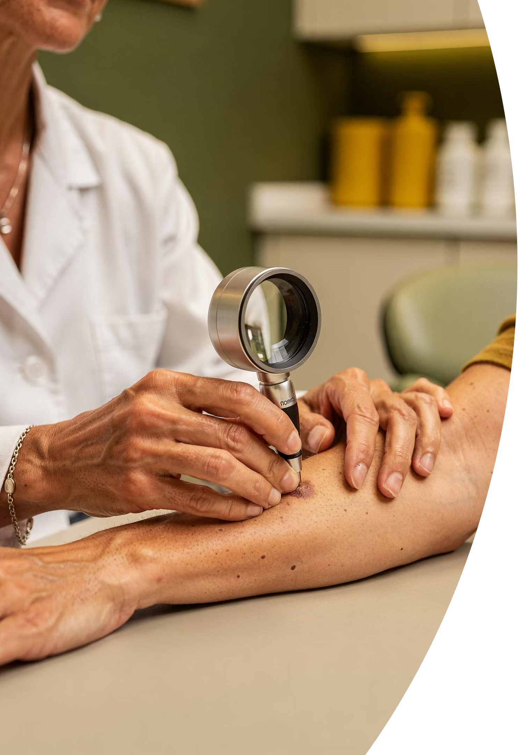
BRADFORD VTS TEACHING DECK
Assessing Skin Lesions
Clinical Reference Guide · Bradford VTS · May 2026

Slide 2
The Systematic Approach: The 7S Framework
Use the 7S approach when describing or documenting any skin lesion. A complete, structured description increases diagnostic accuracy and aids communication with specialists.
Site
Size
Shape
Exact location and distribution pattern
Measure in mm or cm
Round, oval, irregular, annular, linear, serpiginous
Surface
Shades
Sensation
Smooth, rough, scaly, crusted, warty, ulcerated
Erythematous, pigmented, hypopigmented, violaceous
Tender, itchy, painful, burning, anaesthetic
Surroundings
Normal skin? Erythematous halo? Satellite lesions?

Slide 3
Primary Lesions: Flat & Raised
Term
Definition
Example
Macule
Flat, colour change, <1cm
Freckle, viral exanthem
Patch
Flat, colour change, >1cm
Port wine stain, vitiligo
Papule
Raised, solid, <1cm
Acne papule, wart, molluscum
Plaque
Raised, flat-topped, solid, >1cm
Psoriasis, lichen planus
Nodule
Solid, >1cm, deep dermal/SC
Lipoma, SCC nodule, dermatofibroma

Slide 4

Primary Lesions: Fluid-Filled & Other
Term
Definition
Example
Vesicle
Clear fluid-filled blister, <1cm
Herpes simplex, chickenpox, pompholyx
Bulla
Large blister, >1cm
Bullous pemphigoid, burn, impetigo
Pustule
Pus-filled lesion
Acne, folliculitis, impetigo
Wheal
Transient raised area, surrounding flare
Urticaria — resolves <24 hours
Cyst
Enclosed cavity, fluid/semisolid
Epidermoid cyst, dermoid cyst
Wheals are transient — a key distinguishing feature. If a lesion persists beyond 24 hours, reconsider the diagnosis.

Slide 5
Secondary Lesions
Secondary lesions arise from evolution of primary lesions or external factors such as scratching, infection, or treatment.
Term
Definition
Example
Scale
Flaking stratum corneum
Psoriasis, tinea, eczema
Crust
Dried exudate (serum/blood/pus)
Impetigo, eczema
Erosion
Superficial epidermal loss
HSV, eczema
Ulcer
Full-thickness skin loss
Leg ulcer, vasculitis, melanoma
Fissure
Linear crack in skin
Chronic eczema, tinea pedis
Lichenification
Thickened skin, exaggerated markings
Chronic eczema, neurodermatitis
Excoriation
Scratch mark
Scabies, pruritus
Atrophy
Thinning of skin
Chronic topical steroid overuse
Scar
Fibrous tissue replacing skin
Post-wound, surgery, acne
Keloid
Hypertrophic scar beyond wound boundary
Post-injury, acne, darker skin

Slide 6
Colour Descriptions: Blanching vs. Non-Blanching
Blanching (Erythematous)
Non-Blanching (Purpuric)
Erythematous — Red/pink, blanches on pressure. Suggests inflammation or vasodilation.
Petechiae — Pinpoint haemorrhages <2mm. Consider ITP, meningococcal sepsis.
Violaceous — Purple-red. Consider lichen planus, dermatomyositis, Kaposi's sarcoma.
Purpura — 2mm–1cm. Consider vasculitis, thrombocytopenia.
Ecchymosis — >1cm bruise. Consider trauma, coagulopathy.
Hyperpigmented
Hypopigmented
Depigmented
Darker than surrounding skin — post-inflammatory, melasma, Addison's
Lighter than surrounding (not fully white) — post-inflammatory, tinea versicolor
Completely white — no melanin. Classic presentation: vitiligo

Slide 7
Distribution Patterns
Where a rash appears is often as diagnostically important as how it looks. Recognising distribution patterns narrows the differential significantly.
Flexural
Extensor
Antecubital/popliteal fossae — think atopic eczema
Elbows and knees — think psoriasis
Dermatomal
Photodistributed
Unilateral, one dermatome — think herpes zoster
Face/V-neck/dorsal forearms, spared under watch strap — think lupus, polymorphic light eruption
Intertriginous
Symmetry
Flexures, submammary, groin — think candida, flexural psoriasis, seborrhoeic dermatitis
Symmetrical bilateral — most inflammatory conditions. Asymmetrical — more likely contact/fungal/trauma

Slide 8
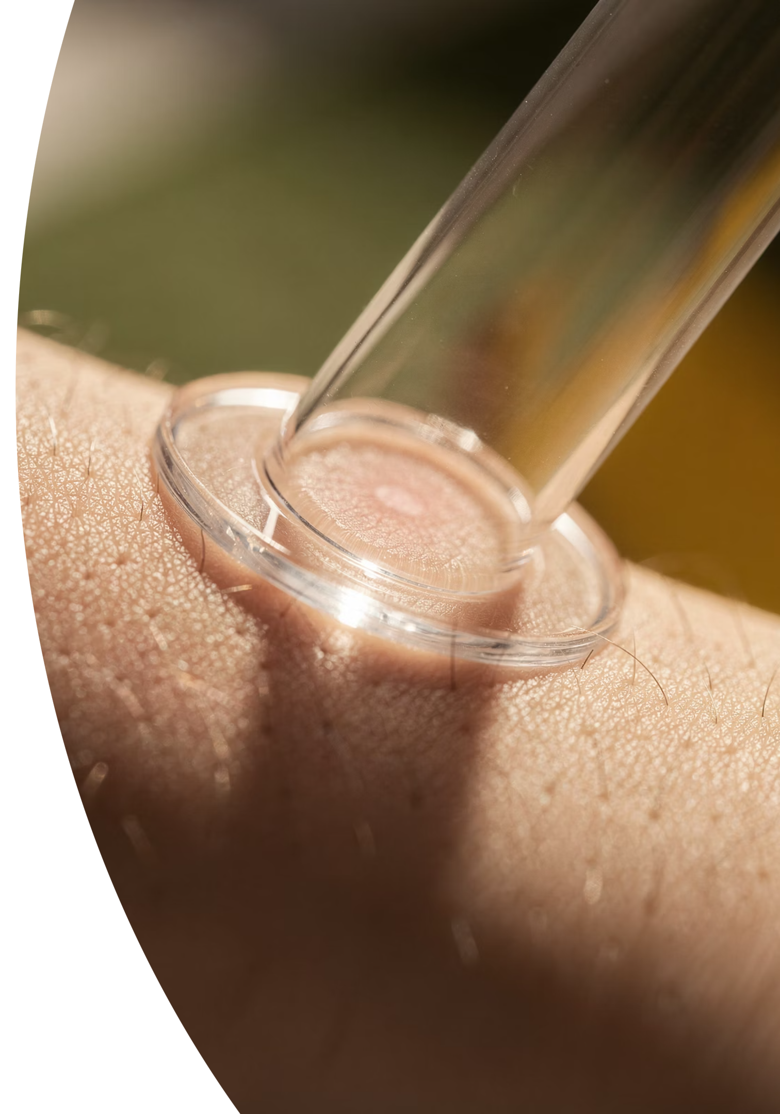


The Glass (Blanch) Test
🔴 NON-BLANCHING + systemically unwell = 999 EMERGENCY until meningococcal sepsis excluded.
Press Glass
Interpret
Apply firm pressure over lesion
Observe
Blanches = vascular; Non‑blanch = consider emergency
Note if lesion fades under pressure
The glass test is a rapid, essential bedside assessment. A non-blanching rash in an unwell patient must be treated as a medical emergency until meningococcal sepsis is excluded.

Slide 9
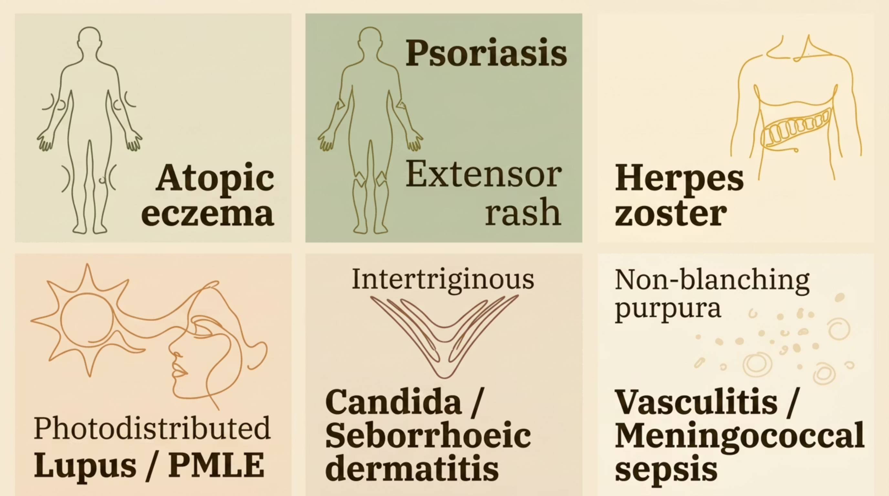

Quick Reference: Key Differentials at a Glance
These pattern-to-diagnosis associations form the backbone of rapid clinical reasoning in dermatology. Always correlate with history, systemic features, and the full 7S description.

Slide 10


Key Takeaways
1
Use the 7S Framework
Site, Size, Shape, Surface, Shades, Sensation, Surroundings — for every lesion, every time.
2
Know Your Primary vs. Secondary Lesions
Accurate terminology improves specialist communication and diagnostic precision.
3
Blanching Is Critical
Non-blanching rash in an unwell patient = 999 emergency until meningococcal sepsis excluded.
4
Distribution Guides Diagnosis
Where the rash is tells you as much as what it looks like — always note the pattern.
⚠ Disclaimer: Always double check this advice and drug doses with the latest NICE/BNF guidance. This document is for educational purposes only.

