Slide 1

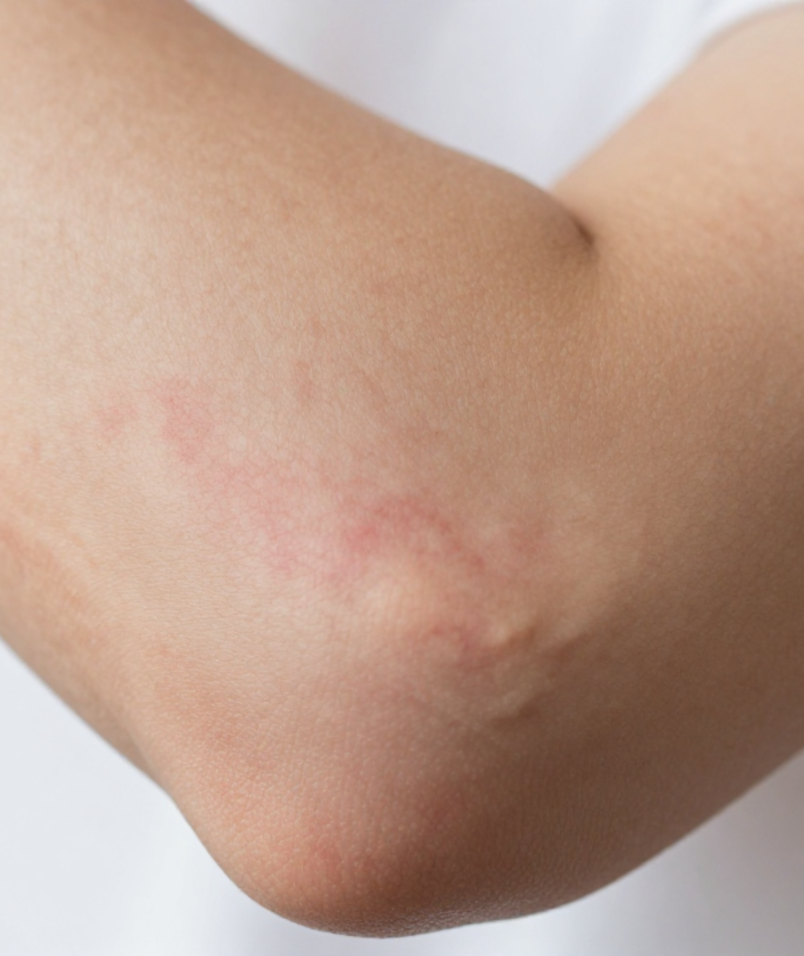


BRADFORD VTS GP TRAINING DECK
ATOPIC ECZEMA
IN PRIMARY CARE
A Complete Guide for GP Trainees
BRADFORD VTS TEACHING DCK
www.bradfordvts.co.uk
Created May 2026
Updated to Current NICE 2024/2025 Standards
⚠ Disclaimer: Always double check this advice and drug doses with the latest NICE/BNF guidance. This document is for educational purposes only and follows the 2024 NICE Clinical Knowledge Summaries.

Slide 2


















Definition and Pathophysiology
NICE CKS 2024 | BRADFORD VTS GP TEACHING
What is Atopic Eczema?
Pathophysiology
Definition: A chronic, relapsing inflammatory skin condition characterized by severe pruritus.
Skin Barrier Defect: Filaggrin gene mutations (present in ~30%) lead to transepidermal water loss.
Cardinal Symptom: Pruritus (itch) is essential for diagnosis.
Immunology: Th2-driven inflammatory response and IgE-mediated sensitisation to allergens.
Clinical Features: Dry skin and characteristic flexural distribution (neck, elbows, knees).
The Cycle: Barrier defect → Allergen penetration → Inflammation → Further barrier damage.
Epidemiology (UK)
The Atopic Triad
~20%
~5%
Family history of atopy is present in 60–70% of cases.
of Children
of Adults
Eczema
Asthma
Allergic Rhinitis
+
+
80% of cases start before age 5.
70% of children improve significantly by adolescence.

Slide 3

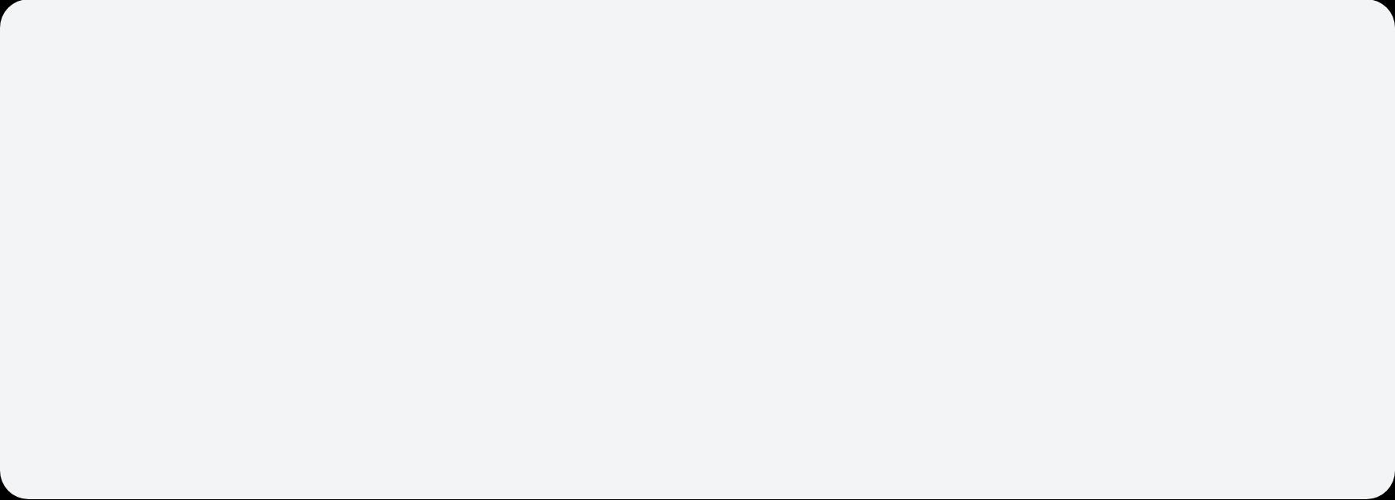





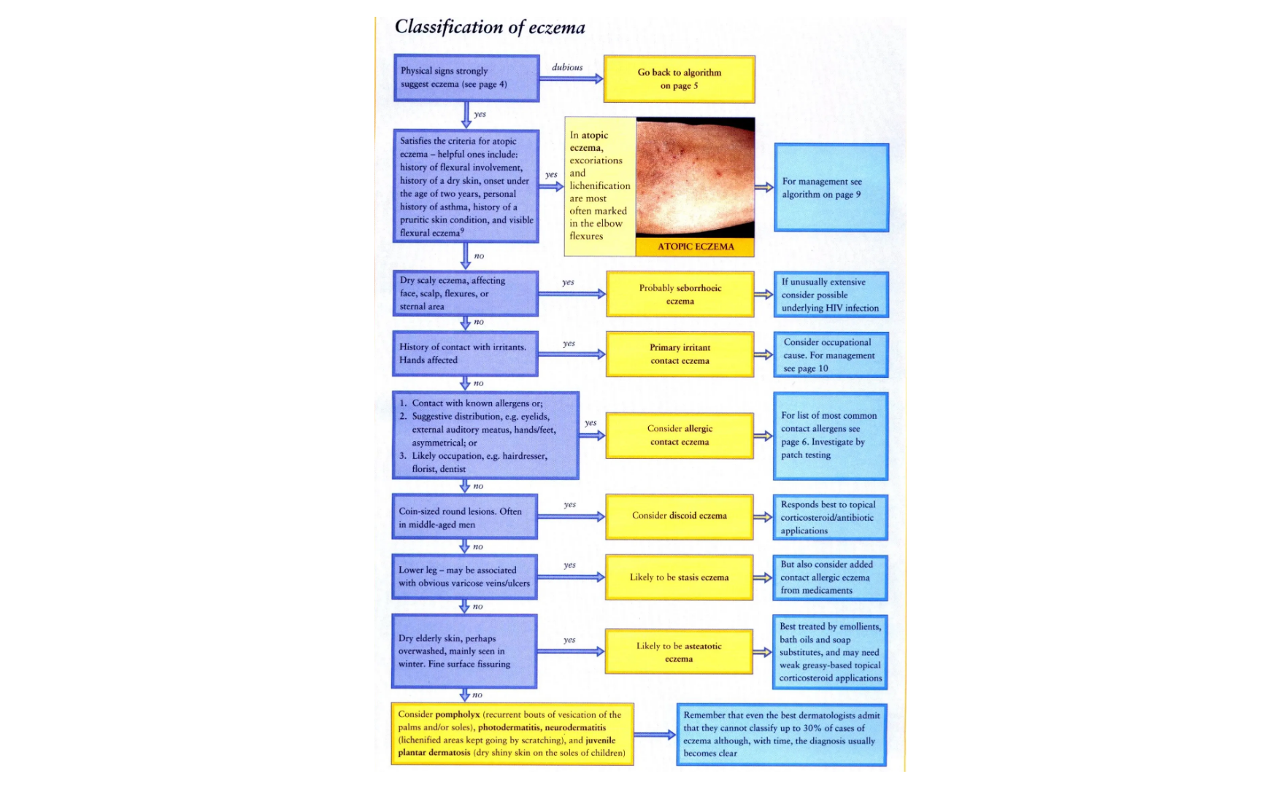


Classification of Eczema
NICE CKS 2024 | BRADFORD VTS GP TEACHING
Endogenous (Constitutional)
Exogenous (Contact)
Atopic Eczema: Most common type; genetic predisposition (filaggrin defect).
Irritant Contact: Most common exogenous type (e.g., detergents, hand washing).
Seborrhoeic Eczema: Scalp, eyebrows, and nasolabial folds.
Allergic Contact: Type IV hypersensitivity (e.g., nickel, fragrances, rubber).
Discoid Eczema: Well-demarcated, coin-shaped plaques.
Pompholyx: Itchy vesicles on palms and soles.
Photodermatitis: Triggered by UV exposure on sensitized skin.
Gravitational/Varicose: Lower legs, associated with venous insufficiency.
Clinical Note: Endogenous types are often chronic and relapsing. Atopic eczema accounts for the majority of primary care cases, often presenting with the classic atopic triad.

Slide 4















Diagnosis and Severity Assessment
NICE CKS 2024 | BRADFORD VTS GP TEACHING
NICE 2024 Criteria
Clinical Severity
POEM Measure
MAJOR CRITERION (ESSENTIAL)
MILD
Patient-Oriented Eczema Measure:
A practical tool for primary care based on 7 symptom questions over the past week.
Pruritus (Itching)
Dry skin, infrequent itching, little impact on daily activities and sleep.
PLUS ≥3 MINOR CRITERIA:
MODERATE
0 – 2
Clear / Almost Clear
Dry skin, frequent itching, redness (erythema), limited impact on sleep/activities.
History of flexural involvement (folds of skin)
3 – 7
Mild Eczema
History of generally dry skin
8 – 16
SEVERE
Moderate Eczema
History of atopy (Asthma, Hayfever, Eczema)
Widespread dry skin, incessant itching, redness, bleeding, crusting, cracking. Sleep/activities severely limited.
17 – 24
Visible flexural eczema on examination
Severe Eczema
Onset before age 2 (caution if child under 4)
25 – 28
Very Severe Eczema
Clinical grading guides the Stepwise Management approach (Steps 1, 2, and 3).
Note: SCORAD and EASI tools are primarily used in secondary care settings.

Slide 5

















Stepwise Management Approach
NICE CKS 2024 | BRADFORD VTS GP TEACHING
THE CORNERSTONE: All Patients at All Steps
Liberal Emollients (500g/week for adults) + Identify/Avoid Triggers + Patient & Carer Education
1
Mild Eczema
2
Moderate Eczema
3
Severe Eczema
Mild TCS: Hydrocortisone 1% for flares.
Moderate/Potent TCS: e.g., Betnovate-RD or Eumovate.
Advanced Topicals: Bandaging/Wet wraps & TCIs.
Manage in Primary Care.
Focus on emollient technique.
TCIs: Tacrolimus or Pimecrolimus if TCS not suitable.
Systemics: Ciclosporin, Methotrexate, Azathioprine.
Regular review every 3-6 months.
Biologics: Dupilumab (IL-4/13) or Tralokinumab.
Refer for Phototherapy/Systemics

Slide 6


















Emollients: NICE 2024 Guidance
NICE CKS 2024 | BRADFORD VTS GP TEACHING
The Foundation
KEY NICE 2024 UPDATE
Aqueous cream should NOT be used as a leave-on emollient. Sodium lauryl sulphate (SLS) causes significant skin irritation. Use only as soap substitute.
Cornerstone of treatment: All patients at all steps of the care model.
Mechanism: Restore skin barrier, reduce water loss, and decrease itch/inflammation.
Selecting the Right Product
Frequency: Must be used CONTINUOUSLY (daily), not just during flares.
Type
Properties
Examples
Ointments
Most occlusive & effective; best for very dry or thickened skin.
White soft paraffin, Emulsifying ointment.
Creams
Less greasy, better tolerated; ideal for daytime use.
Diprobase, E45, Cetraben.
Lotions
Least occlusive; useful for hairy areas or mild disease.
Aveeno Lotion, Oilatum.
TYPICAL ADULT PRESCRIPTION
500g / Week
*Choice should be based on patient preference, site, and severity.
LIBERAL APPLICATION ESSENTIAL
Prescribing Tip: Always prescribe large quantities to ensure adequate treatment and avoid rationing. Patient education on "liberal use" is vital.

Slide 7












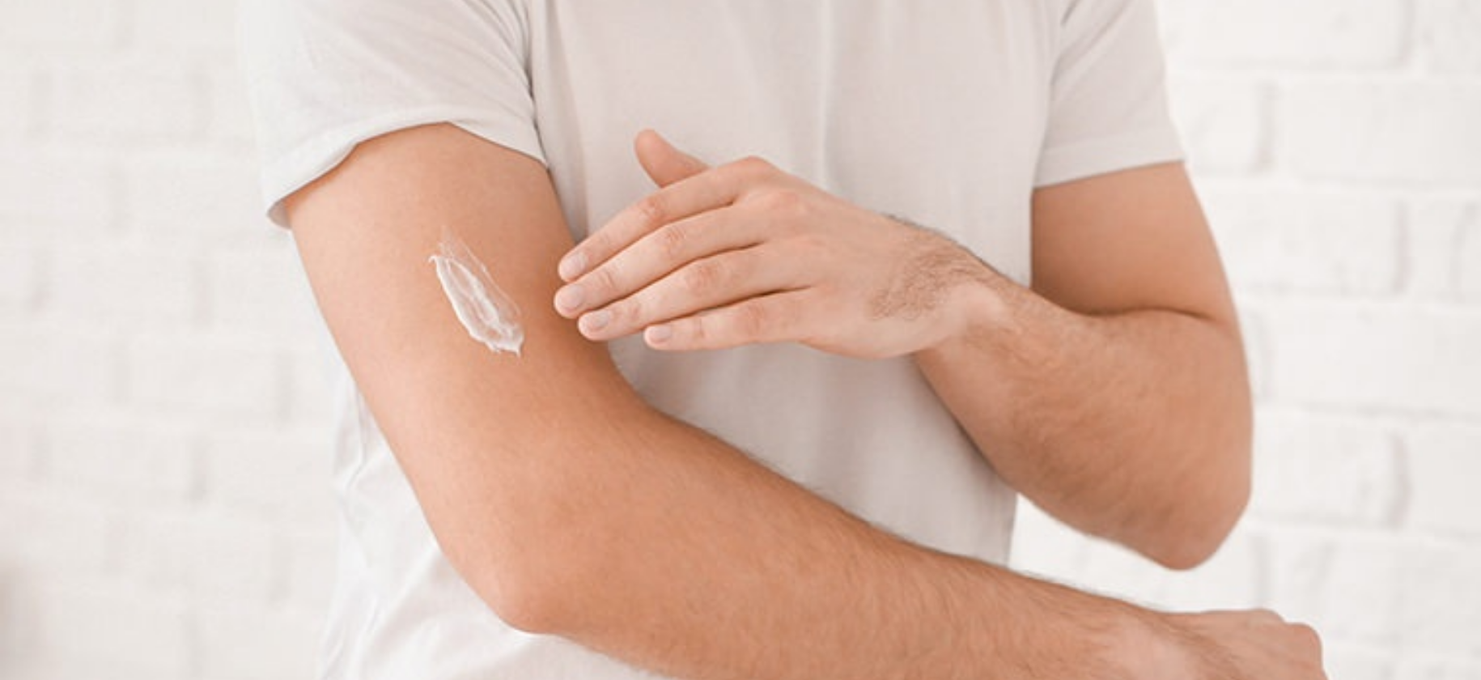
Emollient Application and Fire Safety
NICE CKS 2024 | BRADFORD VTS GP TEACHING
Best Practice Application (NICE 2024)
CRITICAL FIRE SAFETY WARNING
Direction: Apply gently in the direction of hair growth. Do not rub vigorously as this can block hair follicles (folliculitis).
Paraffin-based emollients absorbed into clothing, bandages, or bedding are HIGHLY FLAMMABLE.
Hygiene: Use a clean spoon or pump dispenser to remove emollient from large pots to prevent bacterial contamination.
GP Responsibility: You MUST counsel all patients and carers about the risk of smoking or being near naked flames.
Frequency: Apply liberally at least 2–3 times daily. Adults typically require 500g per week for full body coverage.
Washing clothes at high temperatures reduces but does not completely remove paraffin residue.
Timing: Most effective when applied immediately after patting skin dry following a bath or shower (traps moisture).
Soap Substitutes:
Avoid standard soaps/detergents. Use Emulsifying Ointment BP, Dermol 500 lotion, or Oilatum bath additives instead.

Slide 8
















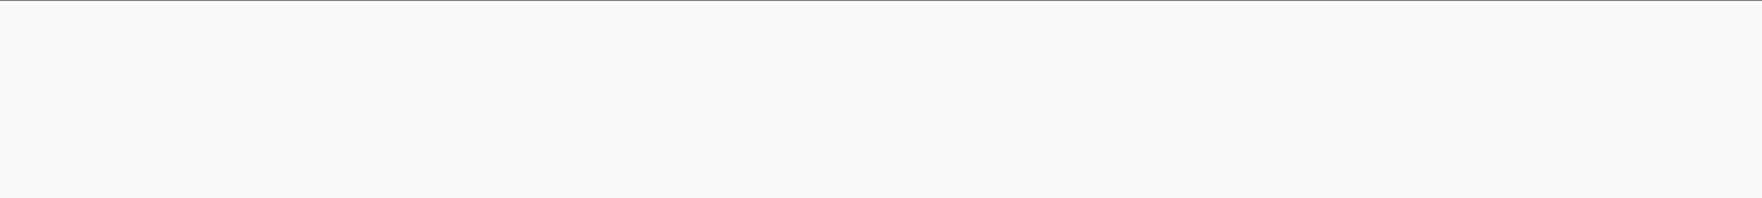










Topical Corticosteroids: Potency and FTUs
NICE CKS 2024 | BRADFORD VTS GP TEACHING
Steroid Potency Ladder
Dosing: The Finger Tip Unit (FTU)
Potency
Examples
Clinical Use
1 FTU = Amount from 5mm nozzle (crease to tip) ≈ 0.5g
Mild
Hydrocortisone 0.5%, 1%, 2.5%
Face, neck, flexures (axillae, groin); infants
Body Area
Adult FTUs
Child (1-2y)
Face and Neck
2.5
1.5
Moderate
Clobetasone butyrate 0.05% (Eumovate)
Trunk and limbs; moderate flares
Arm and Hand
3.0
1.5
Potent
Betamethasone valerate 0.1% (Betnovate)
Mometasone (Elocon)
Trunk and limbs; significant flares
Leg and Foot
6.0
2.0
Trunk (Front & Back)
14.0
3.0(approx)
Very Potent
Clobetasol propionate 0.05% (Dermovate)
Short-term use; thick plaques, scalp; adults only
TAPER POTENT STEROIDS - DO NOT STOP ABRUPTLY

Slide 9


















TCS Rules and Proactive Therapy
NICE CKS 2024 | BRADFORD VTS GP TEACHING
Core Rules for Safe Use
NICE 2024 UPDATE
Proactive Maintenance Therapy
Use the lowest potency required to achieve clinical control.
Avoid potent/very potent TCS on face, flexures, or in children without specialist advice.
For frequent relapsers (moderate-severe): Apply TCS twice weekly to previously affected areas after the flare has cleared. This significantly reduces relapse frequency.
Apply once daily (for most modern types) for 7–14 days during an active flare.
Taper potent steroids gradually rather than abrupt cessation to prevent rebound.
Mon
Tue
Wed
Thu
Fri
Sat
Sun
Addressing Steroid Phobia: Reassure patients that when used correctly for short bursts, systemic absorption and skin thinning risks are negligible.
Do not use proactive therapy on infected skin. Ensure concurrent emollient use continues daily.

Slide 10














Topical Calcineurin Inhibitors (TCIs)
NICE CKS 2024 | BRADFORD VTS GP TEACHING
Clinical Role & Indications
Specific Agents & Dosage
Steroid-Sparing Agents: Second-line treatment for moderate-to-severe eczema when steroids are unsuitable.
Agent
Preparation
Age License
Tacrolimus
(Protopic)
0.1% Ointment
Adults (16+)
Sensitive Areas: Ideal for face, neck, and flexures where skin thinning is a risk.
Mechanism: Inhibits T-lymphocyte activation via calcineurin blockade.
Tacrolimus
(Protopic)
0.03% Ointment
Children (2-15 yrs)
Key Advantage: No risk of skin atrophy or striae (unlike steroids).
Pimecrolimus
(Elidel)
1% Cream
3 months +
GP TRAINEE TIP
Use TCIs to "bridge" a patient off potent steroids in sensitive areas, or as long-term maintenance in areas prone to frequent flares.
Note: Pimecrolimus is generally used for mild-to-moderate eczema on the face/neck.
Safety & Counseling
Application Guidelines
Transient Burning: Stinging/burning common on application; usually settles within 1 week of use.
Quantity: Apply a thin layer to affected areas only.
Frequency: Twice daily for flares; can be used twice weekly for "proactive" maintenance.
Infection: NEVER apply to actively infected skin (bacterial or viral).
UV Safety: Advise sun protection; theoretical concern regarding UV sensitivity.
Spacing: Leave 30–60 minutes between applying emollient and TCI to prevent dilution.
Pregnancy: Generally avoided; specialist decision only.
AKT PEARL
TCIs are specifically mentioned in NICE guidance as a steroid-sparing option for the face and flexures in both children and adults.

Slide 11










Managing Infected Eczema
NICE CKS 2024 | BRADFORD VTS GP TEACHING
Clinical Presentation
Stepwise Treatment (NICE 2024)
Honey-coloured crusting or weeping of lesions
MILD / LOCALISED INFECTION
Sudden worsening of the eczema state
Topical Fusidic Acid 2% (with or without hydrocortisone e.g., Fucidin H).
Limit to 1–2 weeks to prevent bacterial resistance.
Pustules, painful skin, or small erosions
Regional lymphadenopathy
Pathogen: Staphylococcus aureus colonises >90% of eczema patients
EXTENSIVE / SPREADING INFECTION
Oral Flucloxacillin:
Adults: 500mg QDS for 7 days.
Children: 125mg–250mg QDS based on age/weight.
PENICILLIN ALLERGY ALTERNATIVE
Oral Erythromycin:
Adults: 500mg QDS for 7 days.
Children: 250mg QDS based on age/weight.
When to swab? Not routinely for first flare. Swab if infection is recurrent, fails to respond, or MRSA is suspected.
Clinical Pearl: Most eczema flares are non-infective. Only use antibiotics when clinical signs of infection are present to avoid driving resistance.

Slide 12


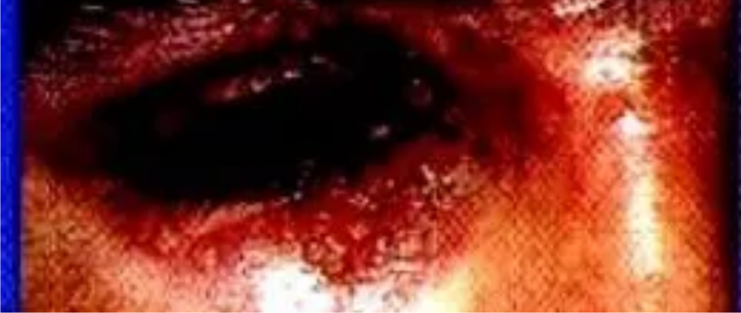











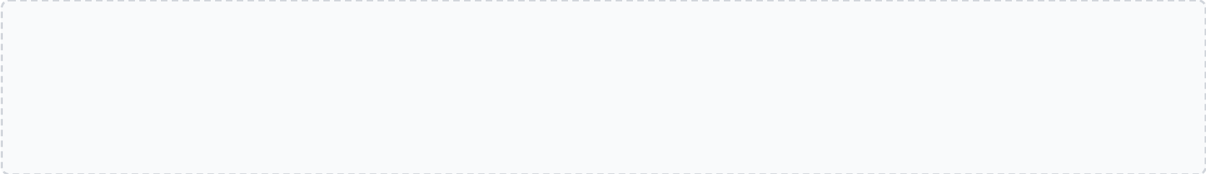


Emergency: Eczema Herpeticum
NICE CKS 2024 | BRADFORD VTS GP TEACHING
MEDICAL EMERGENCY — DO NOT MISS
Clinical Presentation
Punched-out monomorphic erosions: Circular, 1–3mm sores, often crusting.
Sudden deterioration: Rapid spread of lesions in a patient with known atopic eczema.
Distribution: Most common on face, neck, and upper trunk.
Immediate Management
Systemic features: High fever, malaise, and regional lymphadenopathy.
Ocular Involvement: Risk of permanent corneal scarring and vision loss.
SAME-DAY Urgent Dermatology Referral
Commence Systemic Aciclovir Immediately
BNF 2025 Dosage (Adult):
Aciclovir 400mg five times daily for 5–10 days.
(Severe or pediatric cases usually require IV admission)
Secondary bacterial infection is common (Staph aureus); treat with antibiotics if suspected.
SCA Tip: "If the eczema suddenly gets much worse, develops blisters or punched-out sores, you must contact us or A&E the same day."

Slide 13
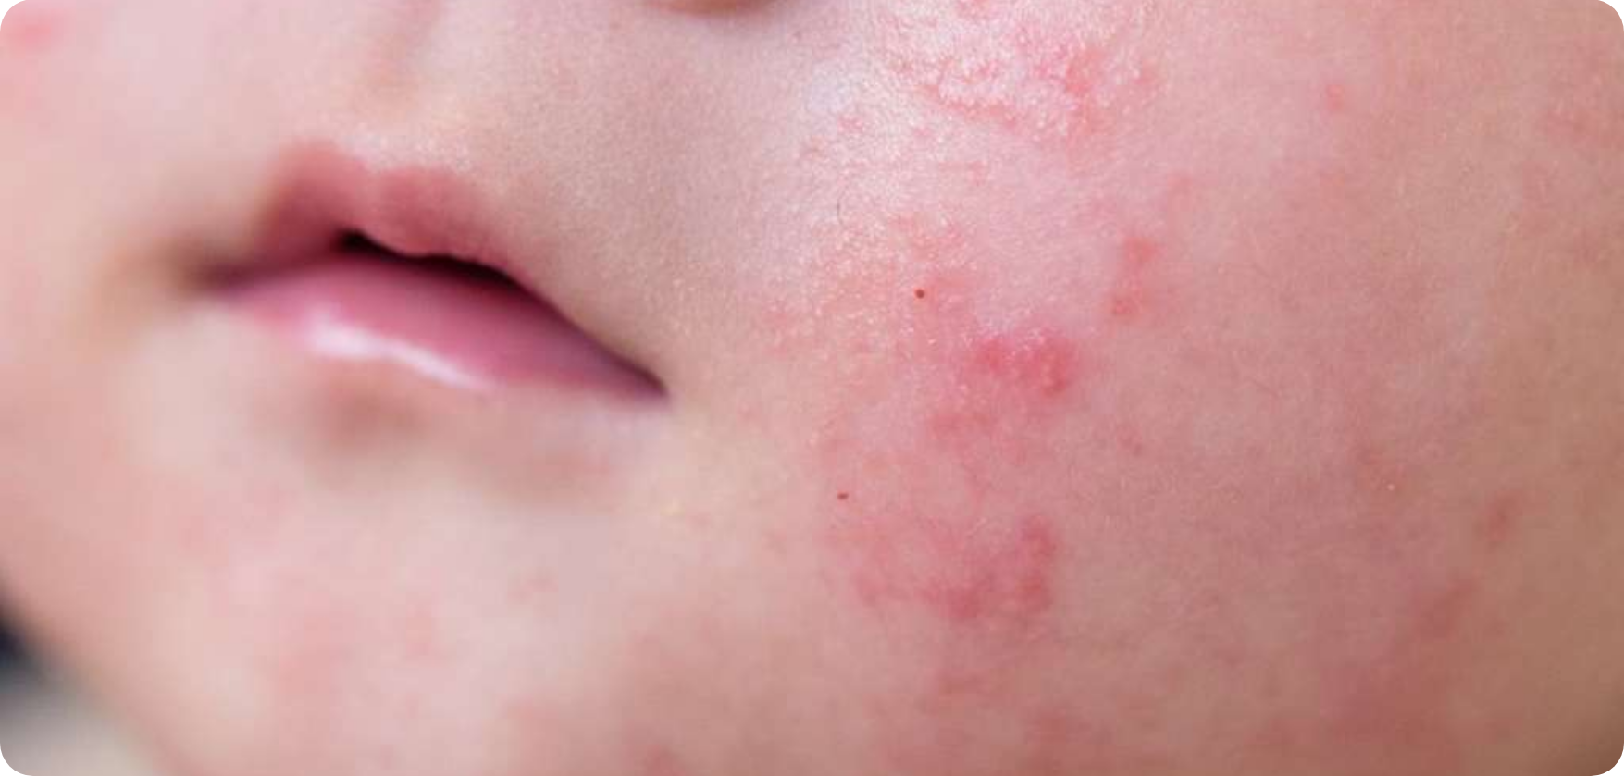






Childhood Eczema and Special Situations
NICE CKS 2024 | BRADFORD VTS GP TEACHING
Pregnancy & Breastfeeding
Management:Emollients are safe. Mild-to-moderate TCS are generally safe for short courses.
Avoid Tacrolimus (TCIs)during pregnancy; refer for systemic decisions.
NICE 2024 Update:Breastfeeding is beneficial but NOT proven to prevent eczema.
Do NOT recommend maternal dietary restriction during pregnancy/breastfeeding to prevent eczema.
Paediatric Presentation
Occupational Considerations
INFANCY (<2 YEARS) Distribution: Face, scalp, and extensor surfaces (cheeks, forehead).
High-Risk Roles:Healthcare, catering, and hairdressing (irritant contact dermatitis).
GP Role:Provide early career advice for affected teenagers.
Less flexural involvement at this age;Avoid SLS productsand bubble baths.
SCHOOL-AGE CHILDREN Classic flexural distribution (antecubital and popliteal fossae).
Prevention:Cotton-lined protective gloves + barrier creams; consider patch testing if allergic contact is suspected.
Assess psychological impact and quality of life at every review.
Dietary Factors:Refer for testing ONLY if genuine food allergy is clinically suspected.

Slide 14







Referral Criteria and Red Flags
NICE CKS 2024 | BRADFORD VTS GP TEACHING
Dermatology Referral Criteria
Urgent Clinical Red Flags
Diagnostic uncertainty: Atypical presentation or suspected alternative diagnosis.
Eczema Herpeticum: Sudden worsening, punched-out monomorphic erosions, fever. SAME-DAY EMERGENCY
Failure to respond: Inadequate control despite optimal use of appropriate potency steroids.
Erythroderma: Generalized erythema involving >90% body surface area. Potentially life-threatening.
Severe or extensive: Widespread involvement causing significant functional impact.
Systemic Infection: Widespread secondary infection with systemic features (fever, malaise, spreading cellulitis).
Infection issues: Recurrent secondary bacterial infections or suspected MRSA.
Suspected Malignancy: Atypical features or failure to resolve in older patients (e.g., Mycosis Fungoides).
Specialist Interventions: Consideration for phototherapy, systemic immunosuppressants, or biologics.
Severe Psychological Distress: Significant impact on mental health, including suicidal ideation.
Ocular involvement: Eczema affecting eyelids or near eyes (risk of cataracts/keratoconus).
Note: Eczema Herpeticum requires immediate Aciclovir and urgent specialist admission/referral.
Allergy testing: Suspected allergic contact dermatitis requiring patch testing.
Bradford VTS: GP Registrar Teaching Resource
Ref: NICE CKS 2024 | NICE CG57

Slide 15







Exam Pearls and Quick Recall
NICE CKS 2024 | BRADFORD VTS GP TEACHING
AKT High-Yield Pearls
Common GP Pitfalls
Quick Recall Summary
Aqueous Cream Trap: Never leave-on; SLS causes skin irritation. Common AKT trick.
Under-prescribing: Adults need ~500g/week of emollient. Small tubes lead to failure.
Emollients: Cornerstone of care; use daily, even when the skin looks clear.
Steroid Ladder: Know HC 1% (Mild) vs. Eumovate (Mod) vs. Betnovate (Potent) vs. Dermovate (Very Potent).
Steroid Phobia: Failing to reassure patients that short bursts of potency are safer than chronic mild flares.
Proactive Rx: Apply TCS twice-weekly to previously affected areas to prevent relapse.
Infection: Flucloxacillin for bacteria; Aciclovir + Same-day Referral for Herpeticum.
Dupilumab: Biologic (IL-4/IL-13 inhibitor) for mod-severe eczema in adults.
Safety Gaps: Failing to warn about Fire Risk with paraffin-based products.
FTU: 1 Finger Tip Unit ≈ 0.5g. Adult face/neck = 2.5 FTUs.
Primary vs. Secondary: POEM is for primary care; SCORAD/EASI for dermatology clinics.
Missed Emergency: Treating Eczema Herpeticum with antibiotics instead of Aciclovir.
RED FLAGS: Eczema Herpeticum (Emergency Referral), Erythroderma (>90% BSA), or Systemic Sepsis.

