Slide 1
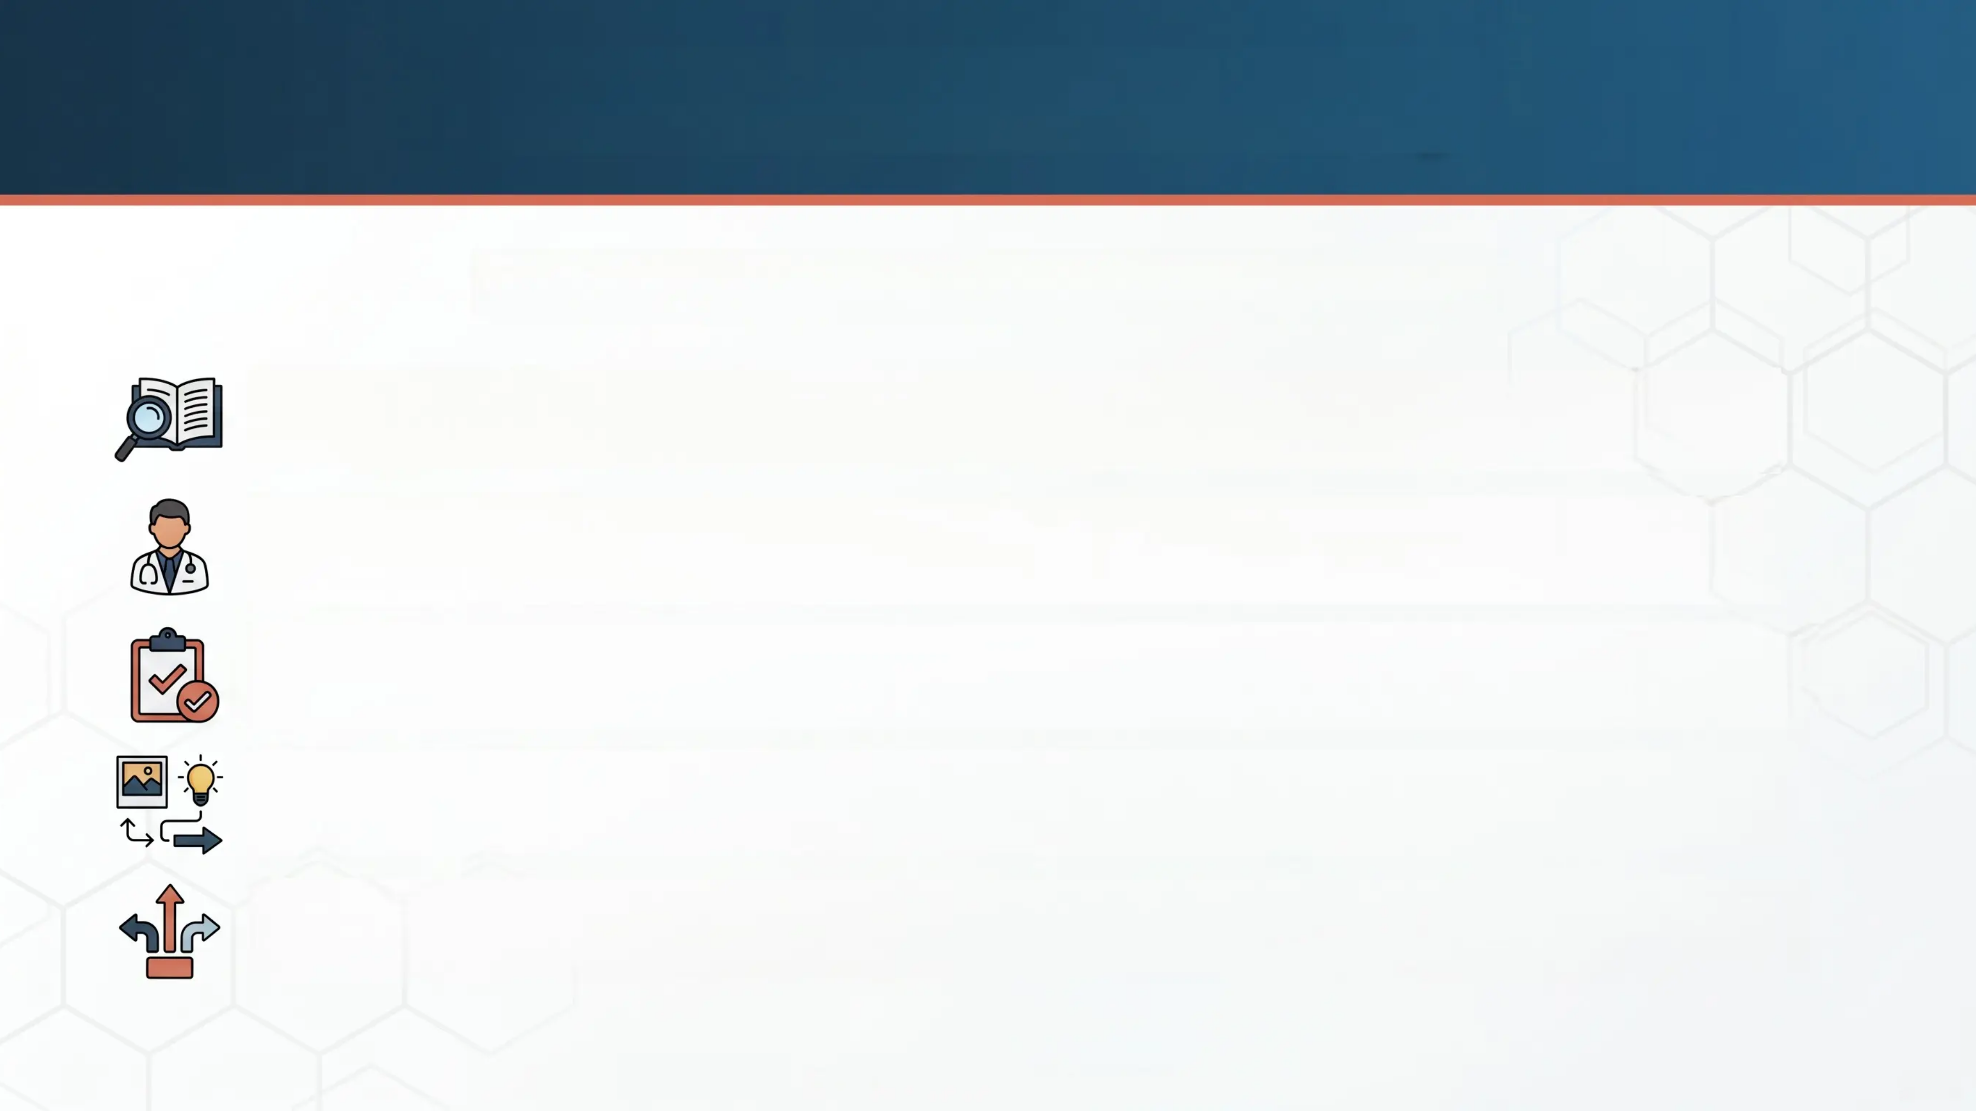
Psoriasis Made Easy
BRADFORD VTS TEACHING DECK
A Practical Guide for Clinicians
A practical, clinically focused guide designed for everyday practice —
not a textbook.
Author: Ramesh Mehay — Programme Director, Bradford VTS (trusted
educator in primary care clinical teaching).
Updated to NICE & BNF 2024 — All content verified against current NICE
guidelines, PCDS pathways, and BNF 2024 standards.
Practical. Visual. Memorable. — Reorganised for logical flow, with real
clinical photos and concise teaching pearls throughout.
5 Types. 3 Challenges. 1 Clear Framework. — Covers all psoriasis types
plus psoriatic arthritis, scalp disease, and unstable psoriasis.
Ramesh Mehay | Bradford VTS May 2026
1/20

Slide 2


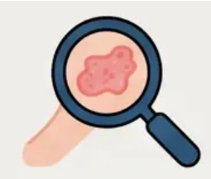
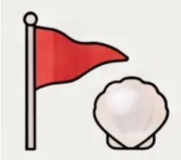
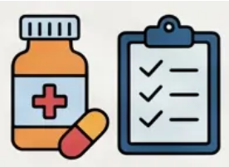

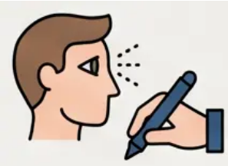
Session Scope and Objectives
NOT about theory or pathogenesis
Textbooks cover aetiology and epidemiology — this session skips that entirely.
PRACTICAL clinical recognition
Learn to identify each psoriasis type quickly and confidently in everyday practice.
Key pearls and red flags per type
Each type has specific clinical clues and warning signs you must not miss.
Up-to-date management guidance
All treatment advice is aligned with current NICE, PCDS, and BNF 2024 guidance.
Recognise dermatological emergencies
Two psoriasis types are life-threatening — this session ensures you spot them fast.
Describe what you SEE — always
Systematic morphology description: shape, colour, scale, distribution leads to diagnosis.

Slide 3
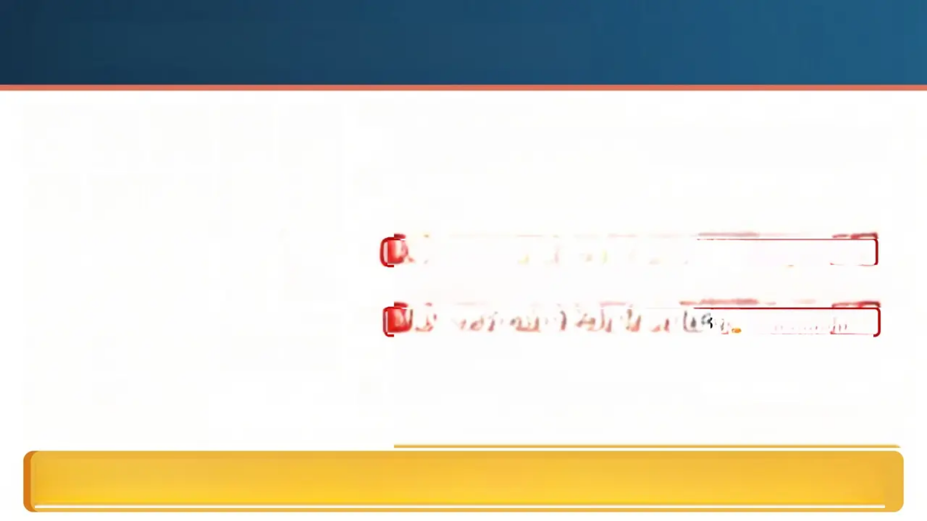
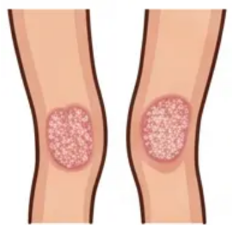

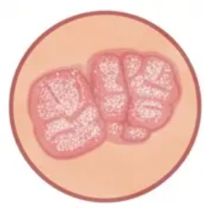
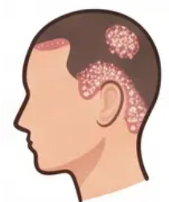
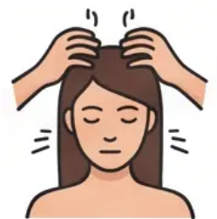

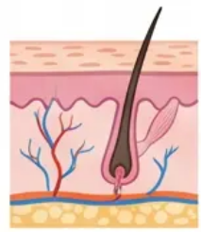
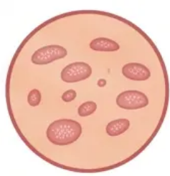
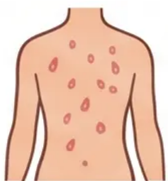
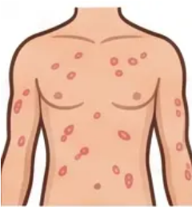
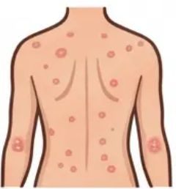

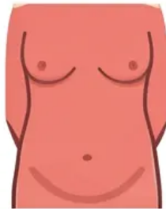
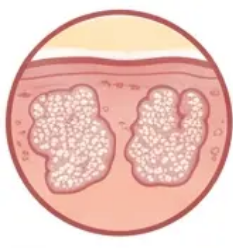
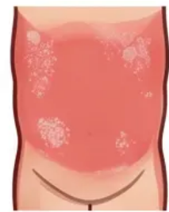
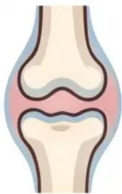
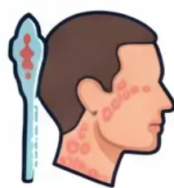


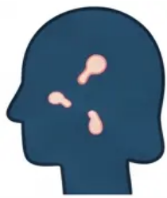
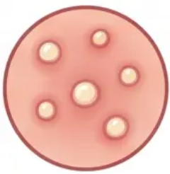
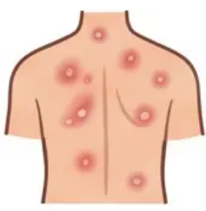
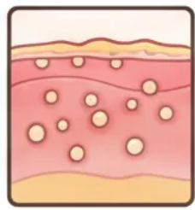
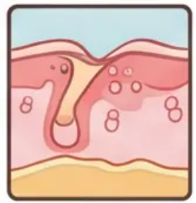


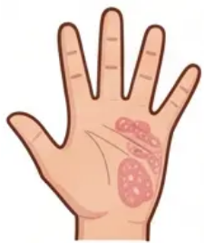
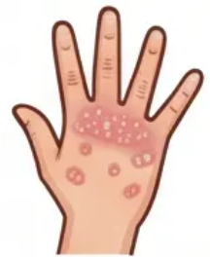
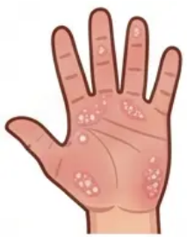

Five Key Types of Psoriasis
Type 1: Chronic Plaque
- Most common; salmon-pink plaques with silvery scale
on elbows, knees, scalp, and lumbosacral region.
Type 2: Guttate Psoriasis
- Drop-shaped lesions suddenly erupting across trunk;
triggered by strep infection; often self-limiting.
Type 3: Erythrodermic Psoriasis 🚨 EMERGENCY
- > 75% BSA involved; fiery red confluent erythema; risk of
cardiac failure, sepsis, hypothermia.
Type 4: Acute Pustular Psoriasis 🚨 EMERGENCY
- Sterile pustules on erythematous skin; high swinging
fever; systemically unwell; life-threatening.
Type 5: Palmoplantar Psoriasis
- Affects palms/soles; hyperkeratotic plaques or pustules;
notoriously difficult to treat; linked to smoking.
Recognise Emergencies Fast: Types 3 and 4 are dermatological emergencies. In them easolved
Never manage erythrodermic or pustular psoriasis in the community alone. 🚨

Slide 4
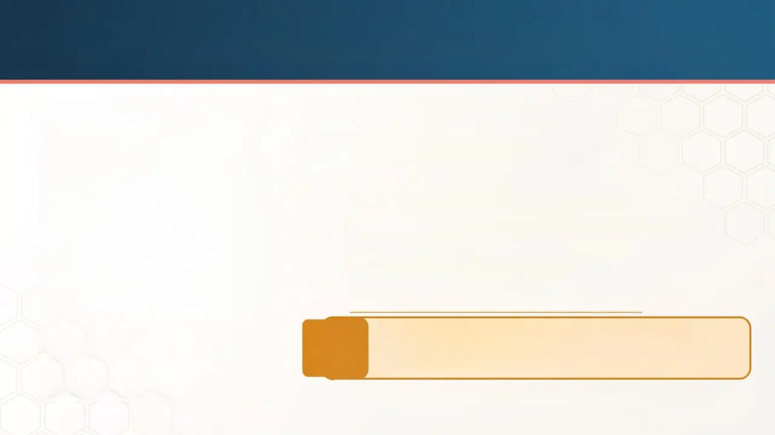
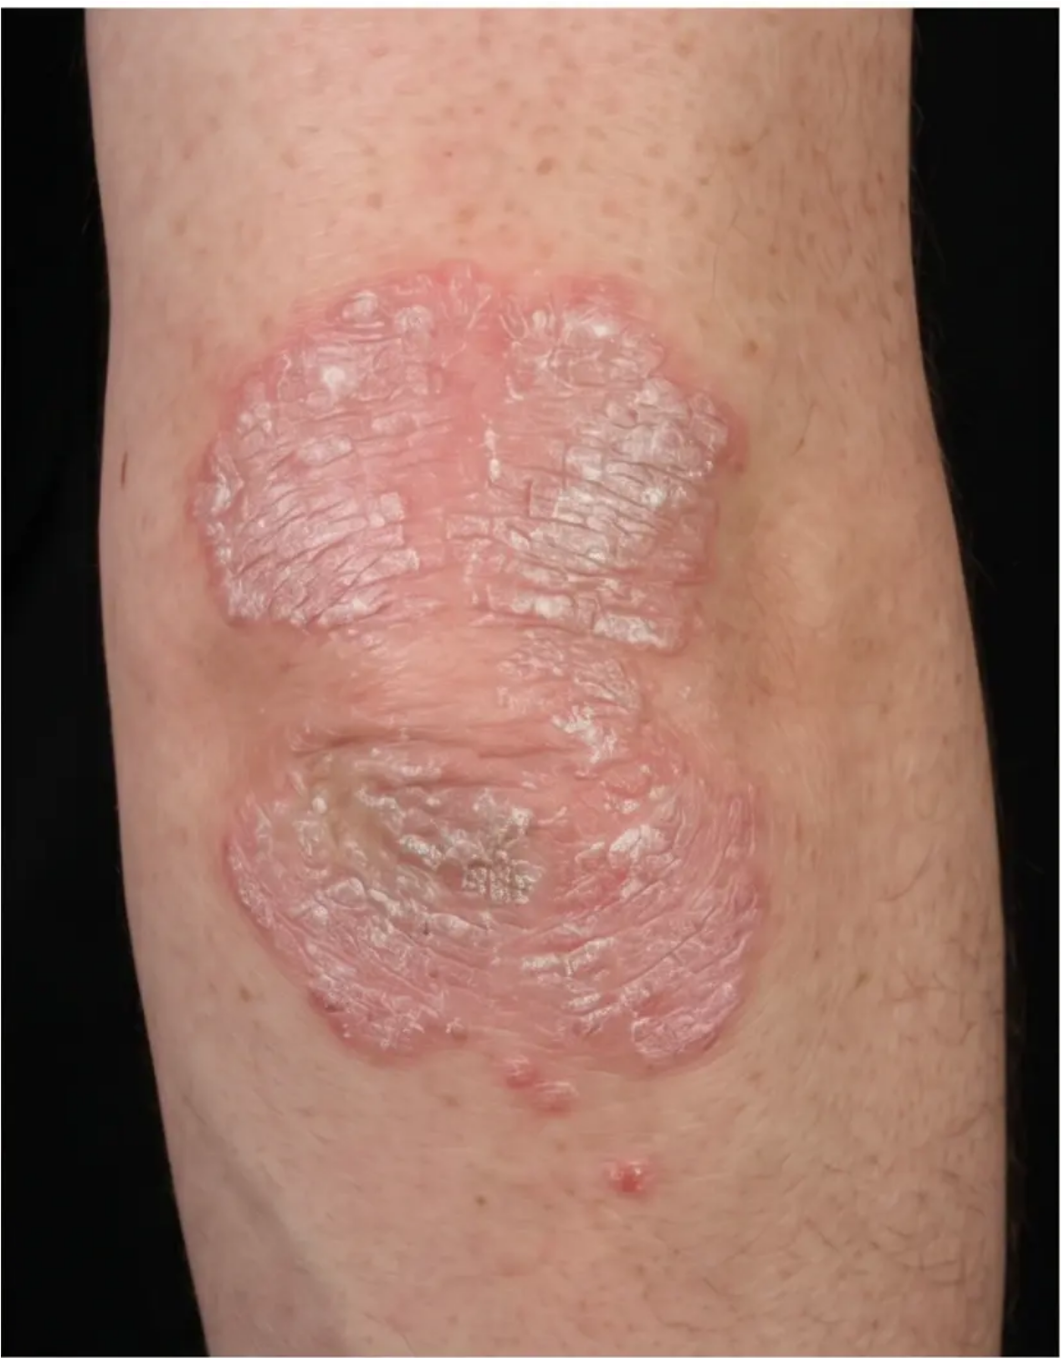

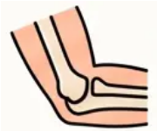
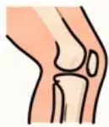

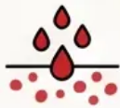

Chronic Plaque Psoriasis Recognition
Classic Clinical Features
Most Common Type: Psoriasis Vulgaris
• Accounts for ~90% of all cases
Classic Extensor Sites
• Elbows, knees, scalp, lumbosacral region
Morphology - Systematically Describe What You SEE
• Well-defined
• Raised, Erythematous Plaques
• Salmon-Pink Colour
• Thick Silvery-White Scale (lifts easily)
Clinical Pearl: Description leads to diagnosis:
Well-defined → Raised → Salmon-pink → Silver
scale → Bleeds on scraping
Auspitz Sign: Pinpoint bleeding on scale removal
Pruritus (Itch): Variable, NOT prominent

Slide 5
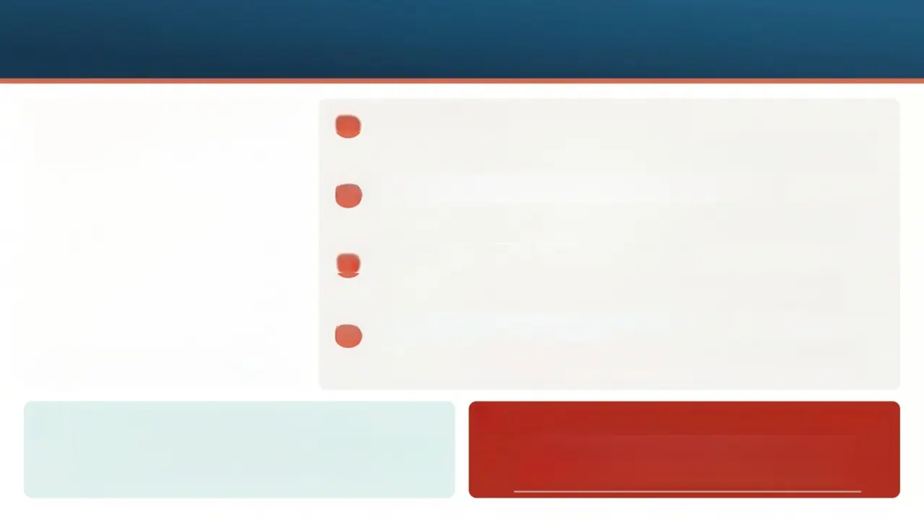
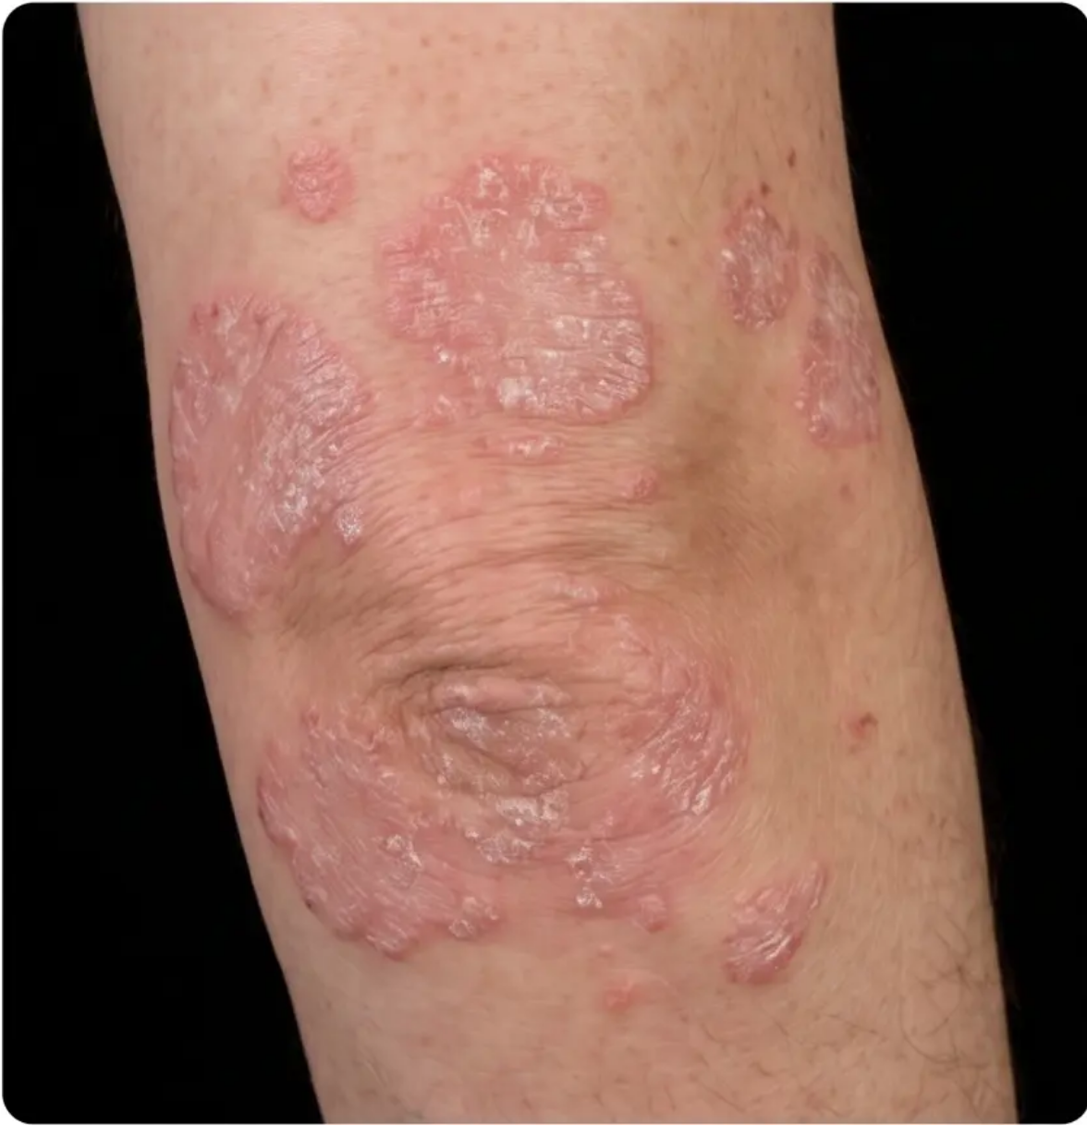



Plaque Psoriasis Management
1
Step 1: Emollients for ALL patients
Prescribe liberally — 500g/week; use as soap substitute to reduce
scaling, dryness, and cracking.
2
Step 2: First-line topical combination therapy
Calcipotriol + betamethasone dipropionate (Enstilar foam or
Dovobet gel) once daily — max 4-8 weeks until plaques flatten.
3
Step 3: Second-line topical adjuncts
Salicylic acid 2-6% keratolytic to descale first, then coal tar or
short-contact dithranol preparations.
4
Step 4: Referral criteria to Dermatology
Refer if BSA >10%, PASI >10, or DLQI >10; or poor response after
8 weeks of optimal topical therapy.
Scalp: descale then treat actively
Emergency / Safety Warning: avoid systemic steroids
Use Xamiol gel (calcipotriol + betamethasone) once
daily; medicated shampoos (ketoconazole, coal
tar) for maintenance.
Systemic corticosteroids risk triggering rebound
erythroderma or pustular flare — NEVER USE
ROUTINELY in psoriasis.

Slide 6

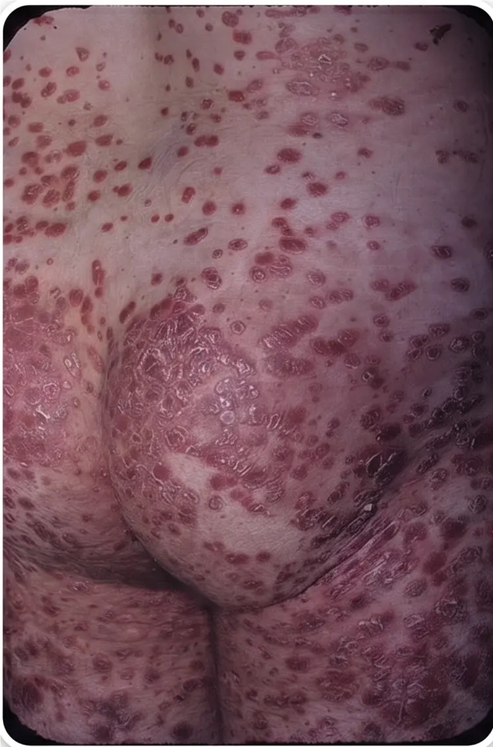
Guttate Psoriasis Recognition
Drop-shaped plaques — sudden onset
Small 0.5–1.5 cm salmon-pink, scaly lesions erupt suddenly across
trunk and limbs
Streptococcal throat — classic trigger
Group A β-haemolytic Streptococcal pharyngitis is the hallmark
trigger — always ask about recent sore throat
Younger patients most affected
Typically presents in children, teenagers, and young adults — often
first presentation of psoriasis
Usually self-limiting: 3-4 months
Most cases resolve spontaneously; reassure patients — but ~12.5%
progress to chronic plaque psoriasis
Throat swab + ASOT to confirm
Investigate for active streptococcal infection; treat only if confirmed
— antibiotics not routinely recommended per NICE
Watch for erythrodermic progression
If lesions rapidly spread or coalesce with systemic features —
consider erythroderma and admit urgently
Clinical Pearl: recent sore throat?
Consider throat swab and ASOT.

Slide 7


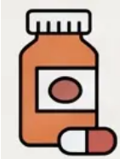
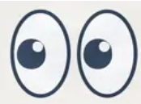

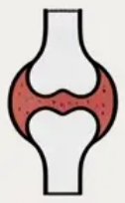

Guttate Psoriasis Management
Confirm the trigger first: Throat swab and ASOT to confirm Group A streptococcal
pharyngitis before antibiotics.
Antibiotics only if infection confirmed: Phenoxymethylpenicillin 500mg QDS for 10 days (or
erythromycin if allergic). Do NOT prescribe routinely (NICE guidance).
Watch and wait is the default: Most cases self-resolve in 3-4 months. Reassure that first
episode often clears.
Topical therapy if plaques persist: Calcipotriol +/- potent topical steroid for stable or
non-resolving lesions.
ENT referral for recurrence: Recurrent
tonsillitis linked to recurrent guttate flares.
Tonsillectomy can reduce future flares.
First episode guttate often clears completely
without active treatment, but recurrent
tonsillitis might warrant tonsillectomy.
Widespread, rapidly spreading disease with systemic symptoms may signal
erythroderma. ADMIT IMMEDIATELY!

Slide 8
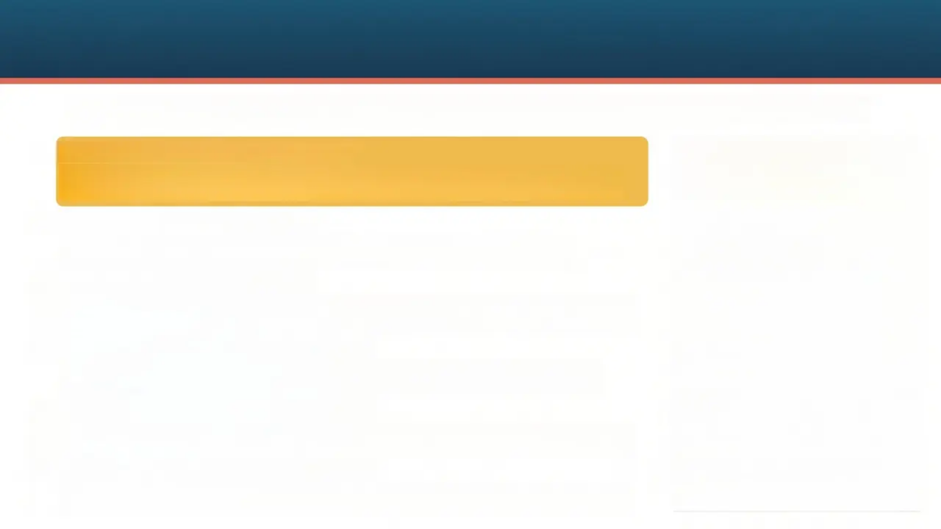

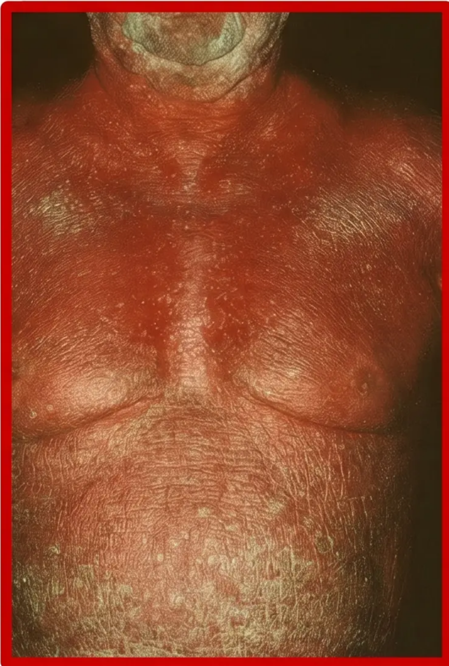
Erythrodermic Psoriasis Emergency
⚠️ DERMATOLOGICAL EMERGENCY — ADMIT SAME DAY
1.
Definition: >75-90% BSA affected
Confluent fiery-red erythema with fine generalised scale covering nearly the
entire body surface — a dramatic and unmistakable presentation.
2.
⚠️ Systemic instability signs
Fever, shivering, tachycardia, and peripheral oedema signal systemic
compromise — this is NOT a purely dermatological problem.
3.
Skin barrier completely lost
Loss of barrier function causes massive fluid, heat, and protein loss — leading
to dehydration, hypoalbuminaemia, and hypothermia or hyperthermia.
4.
⚠️ High-output cardiac failure risk
Vasodilation across the failing skin surface dramatically increases cardiac
output — always auscultate the chest and monitor cardiovascular status.
5.
Septicaemia: a lethal complication
Breached skin barrier creates an open portal for bacterial entry — secondary
infection and septicaemia are life-threatening risks requiring urgent vigilance.
ADMIT SAME DAY — no exceptions
This is a dermatological emergency. Do not manage in primary care. Arrange
immediate same-day hospital admission with urgent dermatology review.

Slide 9

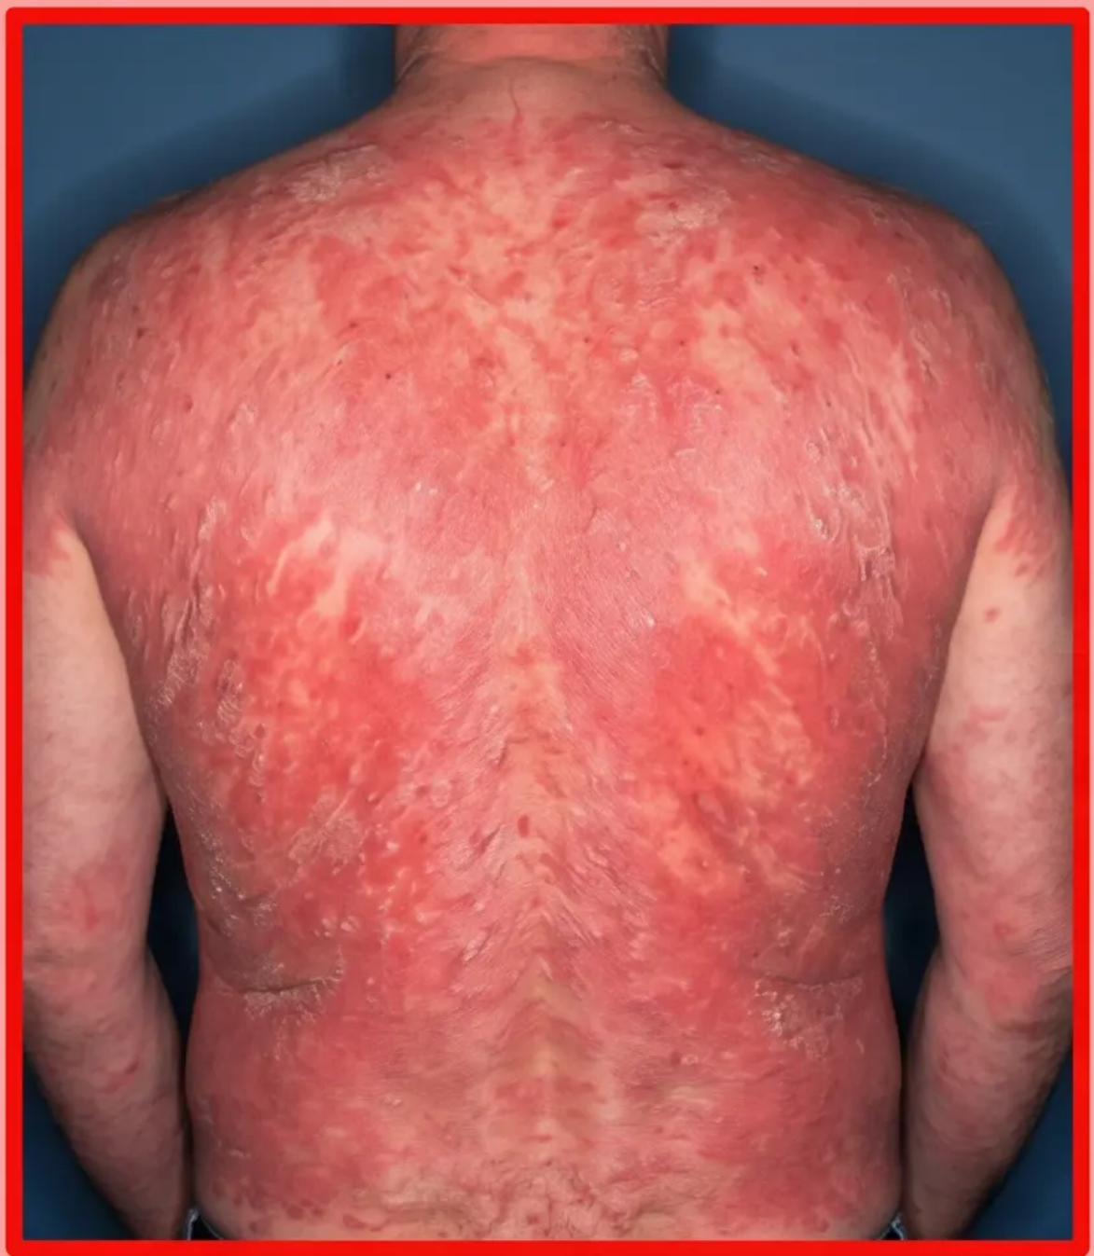
Erythrodermic Psoriasis Management
Immediate Admission
⚠️ ADMIT SAME DAY — No Exceptions. Erythrodermic psoriasis is
life-threatening. Same-day emergency admission is mandatory.
Supportive Care
Fluid resuscitation, electrolyte monitoring, nutritional support
Careful temperature regulation with a controlled ward environment,
continuous temperature monitoring, warm blankets, thermoregulatory
CRITICAL: Contraindication
❌ NEVER Use Systemic Corticosteroids ROUTINELY
Systemic steroids risk severe rebound pustular flare. This is an absolute
contraindication in erythrodermic psoriasis per NICE guidance.
Targeted Therapy & Triggers
Acute Systemic Therapy Choices
Unstable: Cyclosporin/IV Infliximab
Stable: Acitretin/Methotrexate/Biologics
Identify & Remove Triggers Infection, drugs, abrupt steroid withdrawal

Slide 10

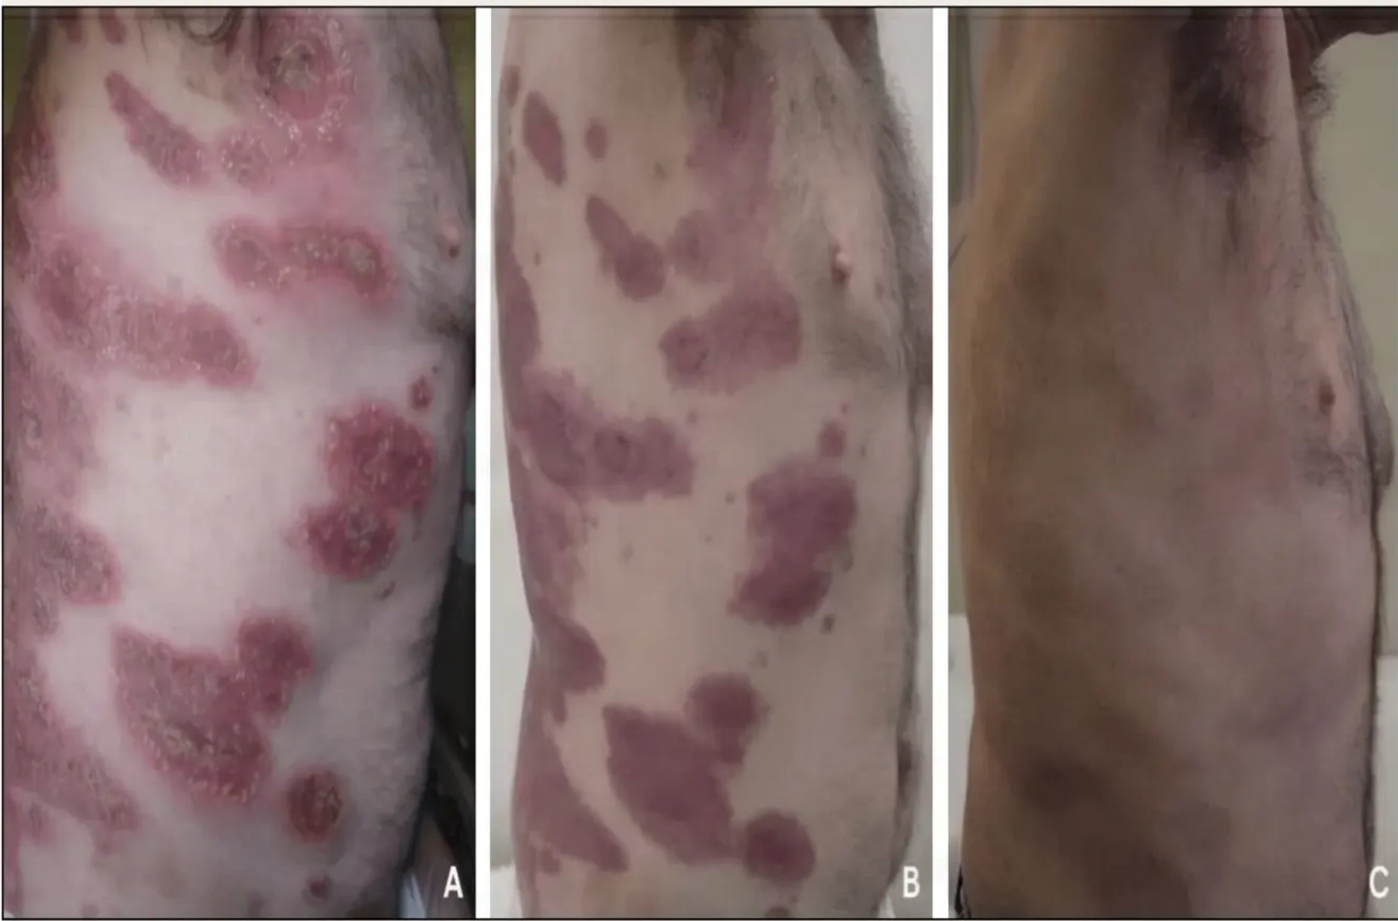
Acute Generalised Pustular Psoriasis
⚠️ Dermatological Emergency — Admit Same Day
GPP (Von Zumbusch) is life-threatening. Patient is systemically unwell with
fever, rigors, and malaise. Never manage as outpatient.
🔍 Sterile Pustules on Erythematous Skin
Widespread sterile, non-infectious pustules coalesce into sheets on fiery red
skin. Swab pustules to confirm sterile — secondary infection is potentially lethal.
🤒 Systemic Features: Fever, Rigors, Joint Pain
High swinging fever (non-infective in origin), malaise, anorexia, and arthralgia.
This is NOT just a skin condition — multi-system involvement.
⚡️ Key Triggers to Identify Immediately
Streptococcal infection, abrupt corticosteroid withdrawal, drugs (lithium,
antimalarials, NSAIDs), pregnancy (impetigo herpetiformis variant), and psych...
❌⚠️ NEVER Use Systemic Corticosteroids
Systemic steroids risk catastrophic rebound pustular flare. Use Cyclosporin or
Infliximab for acute unstable disease; Acitretin or Methotrexate for stable
cases.
💊 Spesolimab — New Targeted Therapy for GPP
Anti-IL-36R monoclonal antibody, MHRA-approved for GPP flares. Achieves rapid
pustule clearance. Represents a significant advance in targeted GPP management.
Clinical Pearl: GPP is a medical emergency requiring rapid
intervention. Avoid rebound triggers and use targeted
therapy like Spesolimab when appropriate.

Slide 11







Acute Pustular Psoriasis Management
ADMIT Same Day — No Exceptions
GPP is a medical emergency. Admit immediately for inpatient monitoring, fluid balance,
infection screening, and systemic therapy initiation.
First-line: Cyclosporin 3-5 mg/kg/day
Cyclosporin provides rapid disease control in acute unstable GPP flares. Monitor renal function
and blood pressure closely during treatment.
Spesolimab — Targeted IL-36R Therapy
Anti-IL-36R monoclonal antibody. MHRA-approved for GPP flares. Achieves rapid pustule
clearance. Use under specialist dermatology guidance.
Infliximab IV for Rapid Stabilisation
IV biologic option for acute severe GPP unresponsive to cyclosporin. Very rapid onset.
Administered in hospital under specialist supervision.
NEVER Give Systemic Corticosteroids
Systemic steroids are absolutely contraindicated. Withdrawal triggers catastrophic rebound
pustular flares and potential erythrodermic conversion.
Identify and Remove Precipitating Triggers
Stop offending drugs immediately: lithium, antimalarials, NSAIDs. Treat confirmed infections.
Address abrupt steroid withdrawal as a key precipitant.

Slide 12

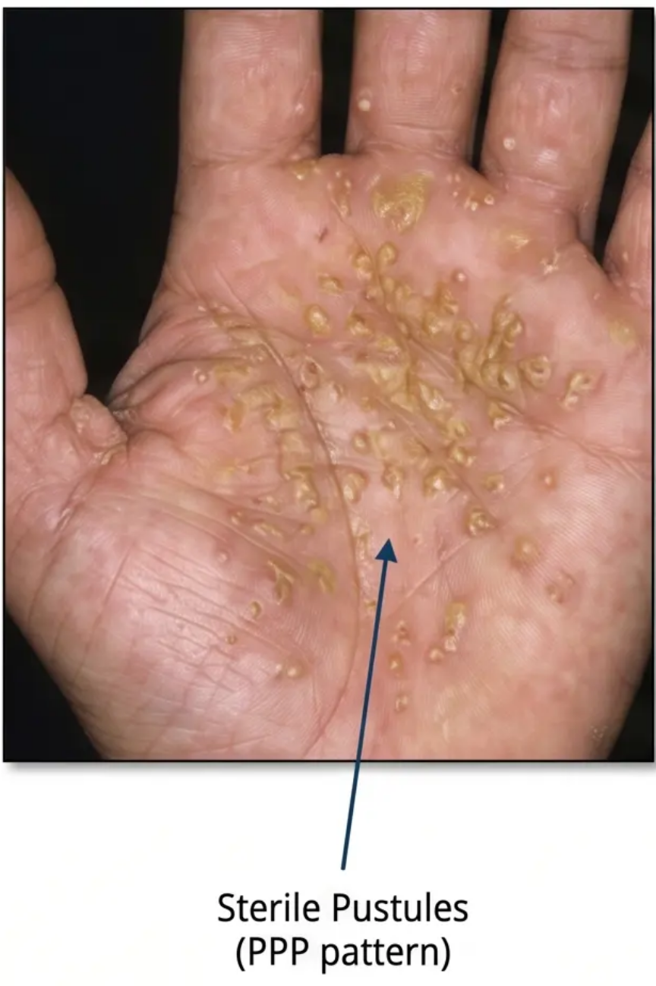
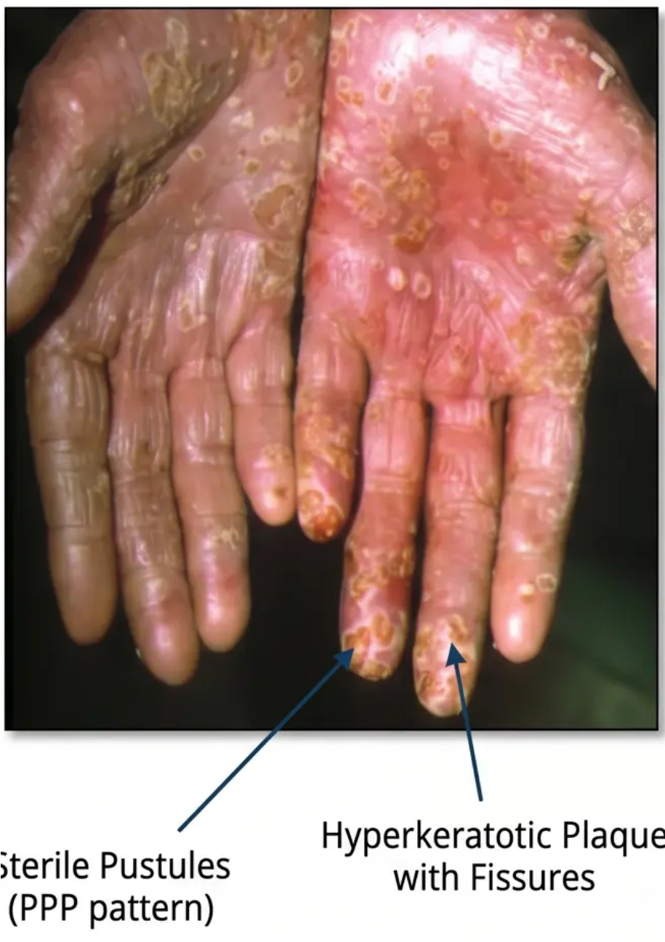




Palmoplantar Psoriasis Recognition
Clinical Presentation & Key Associations
Two Distinct Clinical Patterns
• Hyperkeratotic: Thick red scaly plaques with painful
fissures.
• Pustular (PPP): Sterile yellow-brown pustules on
palms/soles - distinct entity.
Strong Smoking Association
• Smoking strongly linked to PPP variant.
• Advise all patients on active smoking cessation as part
of management.
Significant Functional Impact
• Affects walking, working, and daily activities.
• Do not underestimate the severe disability; often very
high DLQI impairment.
Treatment Considerations
• Notoriously difficult due to thick skin reducing
penetration.
• Descale first with keratolytics before active treatments.

Slide 13







Palmpoplantar Psoriasis Management
Step 1: Descale First
• Apply salicylic acid 2-6% or urea cream (e.g., Calmurid, Eucerin) to remove thick hyperkeratosis
before active treatment. Emphasizing, improved drug penetration
Step 2: Potent Topical Steroids
• Use Betamethasone valerate (Betnovate ointment) or Clobetasol (Dermovate) under occlusion
(e.g. polyethene gloves/socks overnight) to enhance penetration
Step 3: Add Calcipotriol
• Vitamin D analogue reduces epidermal proliferation, combined with steroids for enhanced effect
Oral Retinoid: Acitretin
• the preferred systemic for refractory cases, sdall reminder to avoid confusion 4-tcorrecting
isotretinoin is NOT recommended – acitretin is the preferred choice.
Second-Line Options
• Methotrexate, PUVA phototherapy and biologics for
disabling disease or when conventional treatment fails
⚠️ Recognize these distinct clinical
patterns from the recognition slide!
(Refers back to hand/foot photos shown
earlier in deck).
Lifestyle: Smoking Cessation
• Strong link to PPP, Cessation advice is non-optional.
Remember to treat hyperkeratosis
and inflammation separately!

Slide 14

Major Areas of Clinical Difficulty
Unstable Psoriasis
Rapidly spreading or morphology-changing disease. Avoid dithranol and UV. Use bland
emollients, and refer any urgently if any erythroderma threatens.
Psoriatic Arthritis
Affects ~30% of patients: PEST score screening & seeming (refer to rheumatology if score ≥3).
Early treatment is to prevent irreversible joint damage.
Scalp Involvement
Often mistaken for dandruff. Descale first with oils or salicylic acid. Then apply calcipotriol +
plus betamethasone combination for best results.
Why These Areas Matter
These three areas are most commonly mismanaged in primary care. Recognising them early
improves outcomes and reduces unnecessary specialist delay.
Teaching Pearl: Early Recognition & Management of These Key Areas are Crucial

Slide 15






Managing Unstable Psoriasis
What Is Unstable Psoriasis?
Rapidly spreading, changing morphology, or escalating severity — watch for transition to erythrodermic or
pustular patterns requiring urgent action.
The Koebner Phenomenon
New psoriasis lesions appear at sites of skin trauma — scratches, scars, surgery, sunburn, or vaccination
sites trigger fresh plaques in unstable disease.
Avoid Irritant Treatments
During unstable phases, AVOID dithranol and strong UV light — both can worsen spread. Use bland
emollients and gentle topical steroids only.
Safe First-Line Approach
Start with liberal emollients and mild-to-moderate topical corticosteroids. Stabilise the skin before
introducing stronger active therapies.
Know When to Refer Urgently
If psoriasis is rapidly spreading toward erythroderma or pustular disease, refer urgently to dermatology —
do not manage alone in primary care.
Clinical Rule: Stabilise First - Never escalate to irritant treatments during active spread. Stabilise
first, reassess morphology, then step up therapy safely under specialist guidance if needed.

Slide 16
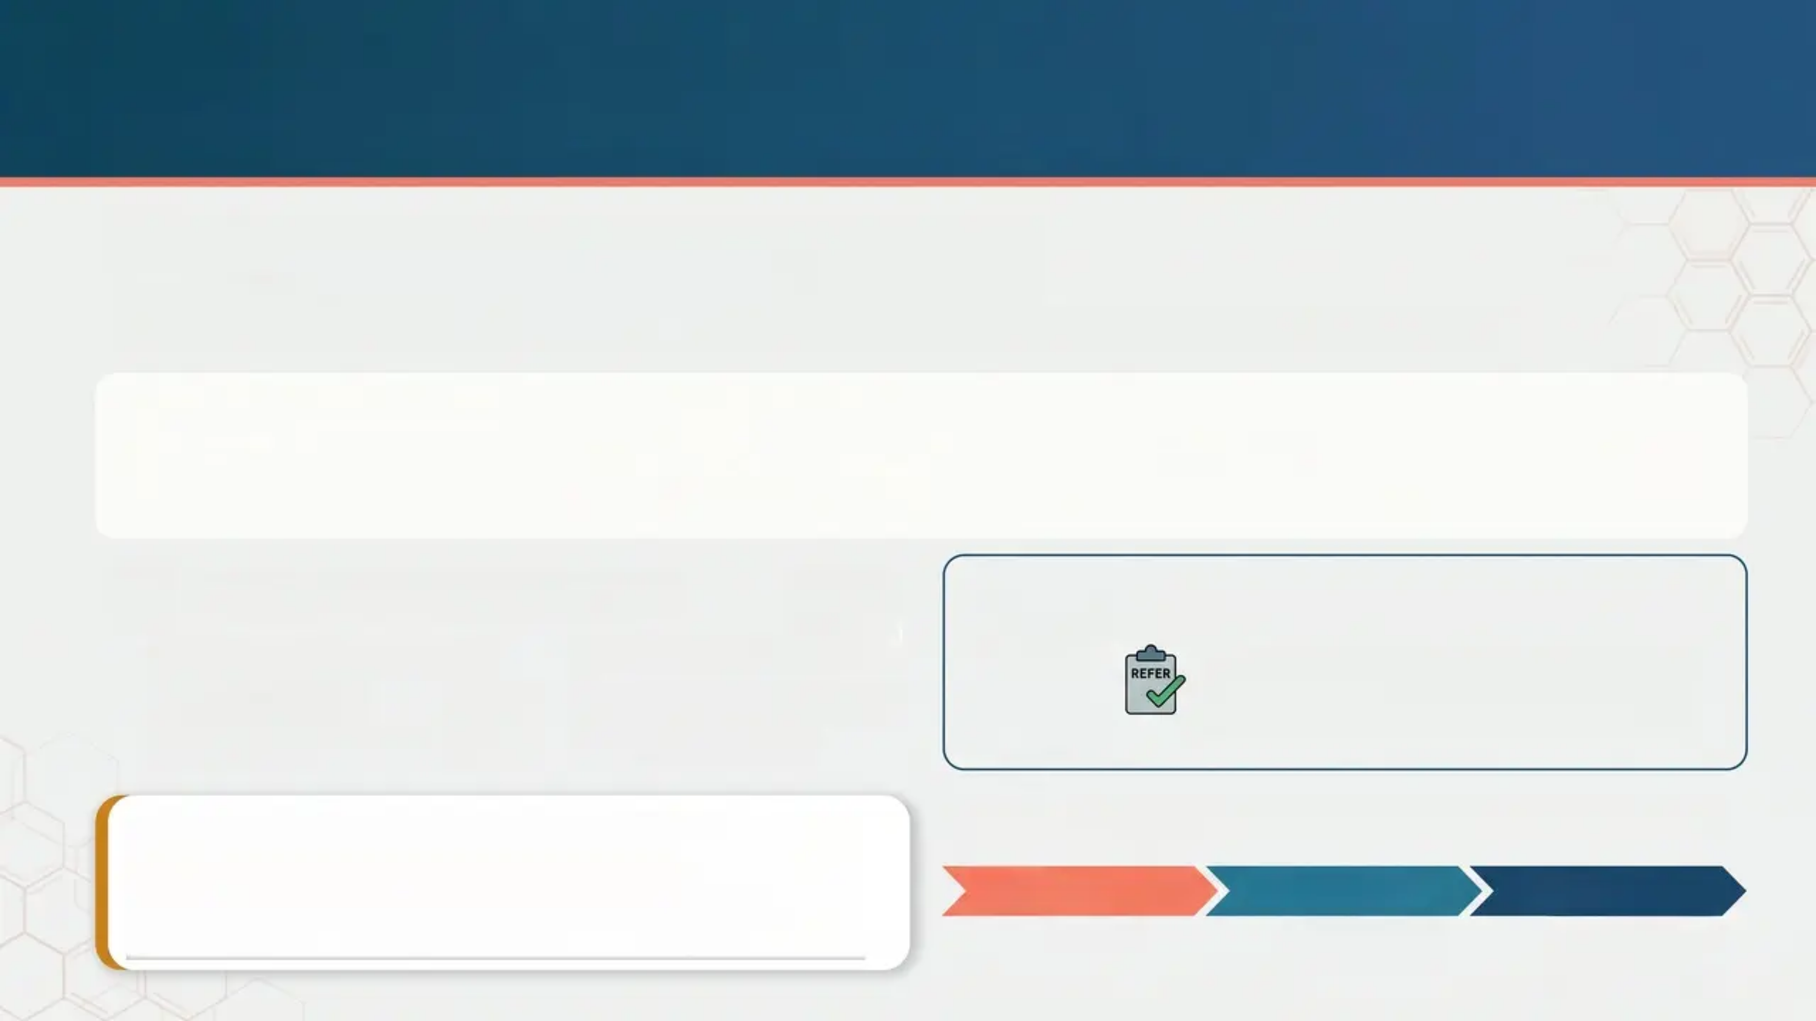


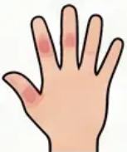
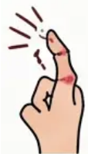
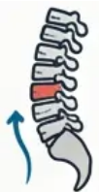
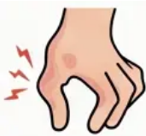





Psoriatic Arthritis Screening
Why We Screen: High Prevalence & Impact
• ~30% of psoriasis patients develop Psoriatic Arthritis (PsA)
• Early recognition is key to preventing irreversible joint damage — screen actively at every consultation.
Know the 5 Patterns of Joint Involvement
1. Asymmetric oligoarthritis
2. Symmetric polyarthritis
3. DIP joint involvement
5. Arthritis mutilans
4. Axial disease
5. Arthritis
Watch for PsA Red Flags
PEST score ≥3 = Rheum Referral
Dactylitis & Enthesitis
• Sausage digit
• Heel/Achilles pain
Nail Disease
Pitting and onycholysis
– strong markers
• Use the PEST tool in primary care
• A validated, quick screening tool.
Clinical Pearl: Don't miss nail changes!
Severe pitting or onycholysis is a major
indicator of PsA risk.
Treatment Pathway: Step-Up Approach
1. NSAIDs
2. DMARDs
3. Biologics
first-line
methotrexate,
leflunomide
NICE-approved
TNF-alpha or
IL-17 inhibitors

Slide 17







Scalp Psoriasis Assessment and Treatment
Assessment: Recognizing Scalp Features
Thick scaly red plaques, often very itchy
Extends beyond hairline; mimics severe dandruff
Causes significant psychological distress
Management: A Stepped Approach
Step 1: Descale before treating
Soften scale: Overnight application of oil (e.g., coconut/olive) or
salicylic acid shampoo under shower cap.
Step 2: Active Treatment & Maintenance
Most effective first-line combination: Xamiol gel (calcipotriol +
betamethasone dipropionate scalp solution) once daily.
(NICE/PCDS recommended)
Potent steroids (short courses): Clobetasol propionate shampoo
(Etrivex) or betamethasone valerate (Betacap/Bettamousse).
Maintenance Shampoos: Ketoconazole (Nizoral) or coal tar
(Capasal/T-Gel) 2-3 times weekly to maintain remission.
Refractory Disease: Escalate
Consider narrowband UVB via scalp comb applicator or systemic
therapy if optimized topicals fail.
Clinical Pearl: Successful management starts with descaling.
Active treatments cannot reach the scalp through thick scale.

Slide 18

















General Treatment Principles
Patient Education &
Lifestyle Triggers
Emollients — Always
& For Everyone
Topical Active Therapy —
Mild to Moderate
Psoriasis is chronic, not contagious.
Avoid key triggers: stress, alcohol,
smoking, infections, lithium, beta-
blockers, antimalarials, NSAIDs.
Weight loss and smoking cessation
significantly reduce disease severity.
Prescribe 500g/week for adults.
Use soap substitute daily.
Reduces scale, itch, and flare frequency.
Emollients are the foundation of ALL
psoriasis management, regardless of severity.
• First-line: Calcipotriol +
betamethasone dipropionate
(Enstilar foam or Dovobet gel) once
daily up to 8 weeks.
• Twice-weekly maintenance
prevents relapse.
• Monotherapy alternatives if
combination not tolerated.
Teaching Pearl: Clinical Pearl: Start with
high-potency topical combination for maximal
efficacy, then de-escalate for maintenance.
Phototherapy —
Moderate to Severe
Systemic & Biologic Therapy
— Severe/Refractory
Assess Comorbidities
Routinely
Narrowband UVB (NBUVB) three times
weekly — effective for plaque and
guttate psoriasis.
PUVA reserved for palmoplantar disease.
Requires dermatology referral.
Avoid in unstable psoriasis.
Screen every patient: use PEST score
for psoriatic arthritis (score ≥3 → refer
rheumatology), assess cardiovascular
risk, metabolic syndrome, depression,
and anxiety.
DLQI >10 supports dermatology referral.
Biologics (TNF-alpha, IL-17, IL-23 inhibitors)
achieve PASI90 in up to 88%. NEVER use
systemic corticosteroids (rebound risk).
⚠️ DERMATOLOGICAL EMERGENCY RISK:
AVOID SYSTEMIC CORTICOSTEROIDS

Slide 19

Treatment Summary Reference
⚠️ DERMATOLOGICAL EMERGENCY — ADMIT SAME DAY (Erythrodermic & Pustular)
• Emergencies: Erythrodermic & Pustular: Contrainanootron indicants, in differenteatement info, risk
• Plaque Psoriasis Treatment (Steps):
• First-line Treatment (drug, full-line plaque psoriasis)
• Second-line Treatment (Vencor-inormal bcnyotian abisdividinis)
• Systemic Treatment (Hrotherma to severe requires!) onPASI/DLQI >10
• Guttate & Scalp Management (Stepwise):
• Stepwise: Guttate & Scalpagement before, guttatie psoriasis
• Stepwise& Scalp Management (steps action, & anc scalp VDL
• Systemic Treatment → furimarforant action | guttate & scalpatriol
• Palmoplantar Psoriasis (Descale First):
• Step 1: Keratolytics (Steroic keratolics)
• Step: Steroids/Calcipotriol (Passianic calcipotriol, treatment,-calcipotriol)&
• Refractory Treatments: Rulionak steroids/treatments or reaulable
• Psoriatic Arthritis: DMARD Escalation
• First-Line NSAIDs (-thumb forlive drug)
• Escalate to DMARDs (nosvann'a NSAIDs ≫ DMARDIs, plux, arthritis> joint)
• Escalate to biologics (PEST score referral logic score to falolog, for PEST score in EUlogic)
• ⚠️ Golden Rule: No Systemic Steroids:
Contraindications — kristix mtnriem.py:indness main avoid rebound/pustular risk upon withdrawal

Slide 20














Key Clinical Pearls
1
Describe what you SEE to reach diagnosis
diagnosis
4
Screen every patient for
psoriatic arthritis
Systematic morphology description — shape, colour,
scale, distribution — guides accurate psoriasis type
identification every time.
Use the PEST questionnaire at every review. Score
≥3 warrants urgent rheumatology referral to
prevent irreversible joint damage.
2
Erythrodermic and Pustular =
SAME-DAY ADMIT
5
Calcipotriol + betamethasone is
modern first-line
Both are life-threatening emergencies. Never
manage as outpatient. Risk includes cardiac failure,
sepsis, and thermoregulatory collapse.
Combination therapy (Enstilar or Dovobet) replaces
steroid monotherapy. Use once daily for up to 8
weeks, then twice-weekly maintenance.
3
NEVER prescribe systemic
corticosteroids
6
Use DLQI to guide referral and
treatment escalation
Systemic steroids risk catastrophic rebound —
triggering erythroderma or pustular flare. This
rule applies to ALL psoriasis types.
DLQI >10 indicates severe quality-of-life impact.
Combine with PASI >10 or BSA >10% to support
timely dermatology referral.
2026-05-10

