Slide 1

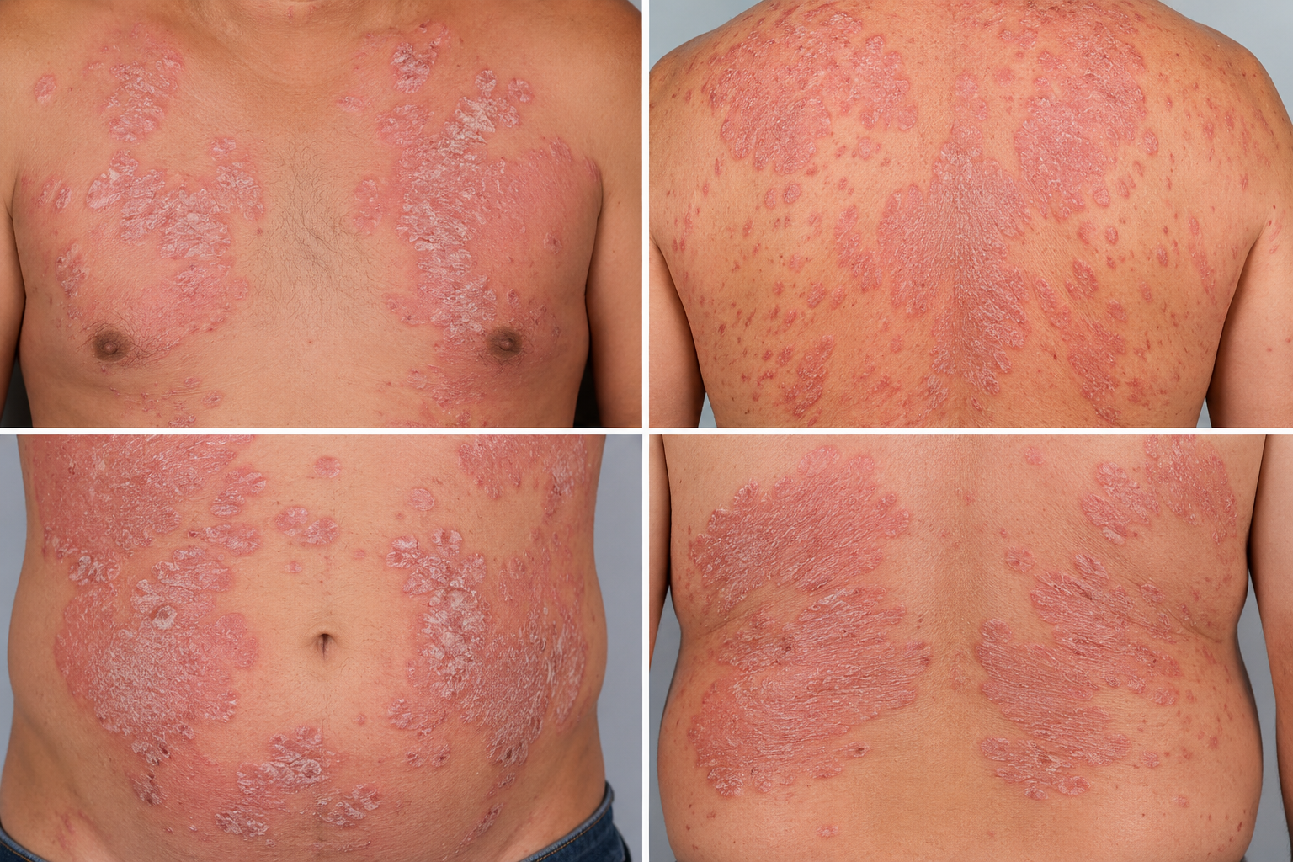


BRADFORD VTS TEACHING DECK
Psoriasis in Primary Care
Bradford VTS Teaching Deck
A comprehensive clinical guide for GP trainees covering diagnosis, site-specific management, systemic therapies, and cardiovascular risk assessment. NICE CG153 2025 UPDATED
AUDIENCE:
GP Registrars (ST1-ST3)
FOCUS:
AKT / SCA Exam Pearls & Clinical Pathways
DATE:
7th May 2026

Slide 2













UNDERSTANDING PSORIASIS: DEFINITION AND PATHOPHYSIOLOGY
NICE CG153 (2025 Update) • Pathological Foundations
CLINICAL DEFINITION
IMMUNE MECHANISM
Chronic, immune-mediated inflammatory skin condition.
T-cell mediated autoimmune response drives disease.
Characterized by well-demarcated, erythematous plaques with silvery-white scale.
Key Cytokines: TNF-α, IL-17, and IL-23 (Targets for biologics).
Triggered by stress, streptococcal infection, or medications.
Course is typically relapsing-remitting with systemic inflammation.
EPIDEMIOLOGY & GENETICS
CELLULAR CHANGES
Keratinocyte turnover reduced from ~28 days to 3-4 days.
Affects ~2% of the UK population (~1.3 million).
Histology: Munro microabscesses (neutrophil accumulation).
Bimodal Onset: Peak 1 (15-25y); Peak 2 (50-60y).
Systemic impact: Cardiovascular risk and metabolic syndrome.
Strong genetic link: HLA-C*06:02 association.
AKT PEARL: Psoriasis is a systemic inflammatory condition, not just a skin disease—screen for comorbidities annually.

Slide 3




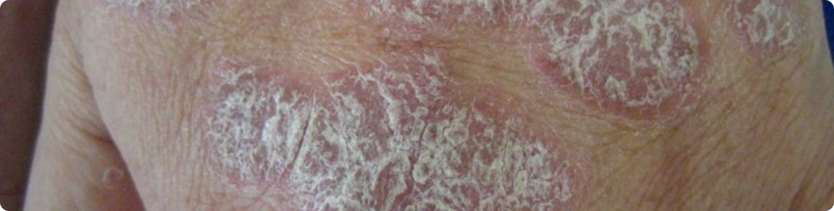







CLINICAL PRESENTATIONS & TYPES OF PSORIASIS
NICE CG153 (2025 Update) • Morphological & Severity Classification
Chronic Plaque (Psoriasis Vulgaris)
Scalp & Palmoplantar
Scalp: Adherent scale extending beyond hairline; very common.
Palmoplantar: Hyperkeratotic plaques on palms/soles; often disabling.
Most common type (~90%); thick, well-demarcated erythematous plaques.
Nail Psoriasis
Characterized by adherent silvery-white scale; typical on extensor surfaces.
Key signs: Pitting, onycholysis, and "oil-drop" sign.
Strong predictor of Psoriatic Arthritis (PsA) development.
Guttate Psoriasis
Raindrop-shaped papules; common in young people.
Classic trigger: Streptococcal throat infection; often self-limiting (3-4 months).
Dermatological Emergencies
Flexural (Inverse) Psoriasis
Erythrodermic: >90% Body Surface Area involvement; unstable; high risk of sepsis/hypothermia.
Smooth red plaques in skin folds (axillae, groin, submammary).
Generalised Pustular: Sterile pustules + fever + systemic illness; requires same-day admission.
Lacks scale due to moisture; high risk of steroid atrophy.

Slide 4













ASSESSMENT AND SEVERITY TOOLS
History, Physical Examination, and NICE Clinical Scoring Systems
History Taking
NICE Severity Metrics
Triggers: Stress, infections (Strep throat), medications (Beta-blockers, Lithium, ACEi, NSAIDs).
BSA
DLQI
PASI
PATIENT PALM = 1%
IMPACT ON QUALITY OF LIFE
CLINICAL GOLD STANDARD
Joint Symptoms: Screen ~30% for psoriatic arthritis (PsA) using the PEST tool.
Quality of Life: Impact on work, relationships, and psychological wellbeing.
DLQI Interpretation: 0-1 (No effect); 6-10 (Moderate); 11-20 (Very large effect).
Family History: Strong genetic link (HLA-C*06:02).
Clinical Examination
AKT HIGH YIELD
Categorization (NICE)
Distribution: Extensor surfaces, scalp, nails, flexures, and genitalia (often missed).
Mild Disease
Morphology: Well-demarcated erythematous plaques with silvery-white scale.
PASI < 10 OR BSA < 10% AND DLQI ≤ 10. Usually managed in primary care.
PsA Screening: Check for dactylitis (sausage digit) and enthesitis (heel/elbow).
Moderate-Severe Disease
PASI > 10 OR BSA > 10% OR DLQI > 10. Requires specialist referral.

Slide 5

















THE ANNUAL REVIEW AND CARDIOVASCULAR RISK
Mandatory annual checklist covering cardiovascular risk factors, metabolic syndrome screening, alcohol consumption, and mental health wellbeing for all psoriasis patients.
NICE CG153 Review Checklist
Clinical Rationale
Cardiovascular Screen: Measure BP, BMI, Lipids, and HbA1c annually MANDATORY
Independent CV Risk Factor
Psoriasis increases risk of MI and stroke, comparable to Type 2 Diabetes in severe disease.
Lifestyle Assessment: Alcohol consumption and Smoking cessation advice.
Metabolic Syndrome
Joint Screening: Use PEST Tool (Psoriatic Arthritis Screening Tool) — refer if score ≥3.
3-4x increased risk of obesity, hypertension, dyslipidaemia, and insulin resistance.
Systemic Inflammation
Skin inflammation is a marker for internal vascular inflammation.
Wellbeing & Monitoring
GP Exam Pearls (AKT/SCA)
Mental Health: Screen for Depression and Anxiety (2-3x increased risk).
Proactive Management: "Heart risk is elevated — let's check BP and cholesterol."
DLQI Tool: Assess psychological impact on quality of life.
Treatment Review: Assess compliance, technique, and satisfaction.
Drug Interactions: Avoid Beta-blockers and Lithium as triggers.
Alcohol Warning: Increases hepatotoxicity risk if on Methotrexate.

Slide 6




FIRST-LINE MANAGEMENT: EMOLLIENTS & VITAMIN D ANALOGUES
NICE CG153 (2025 Update) • Cornerstone & Primary Therapy
Emollients: The Cornerstone
Vitamin D Analogues
Essential for ALL patients: Reduces scaling, pruritus, and dryness.
Calcipotriol (Dovonex): Apply OD/BD. Avoid face and flexures.
Max: 100g/week (Adults)
Application: Use liberally and frequently; replace soap with soap substitutes.
Calcitriol (Silkis): Alternative that is better tolerated on face and flexures.
Clinical Benefit: Softens plaques to enhance absorption of active topicals.
Tacalcitol (Curatoderm): Once-daily application for improved compliance.
Max: 35g/week
AKT PEARL: Vitamin D analogues are FIRST-LINE for plaque psoriasis. Topical steroids alone are NOT recommended as first-line monotherapy.

Slide 7












POTENT STEROIDS & COMBINATION THERAPIES
NICE CG153 (2025 Update) • Pharmacological Management Strategies
Potent Topical Steroids
Combination: Vit D + Steroid
Examples: Betamethasone valerate 0.1% or dipropionate 0.05%.
Agents: Calcipotriol + Betamethasone (Dovobet / Enstilar).
Usage Limit: Strict maximum of 4 weeks continuously.
Protocol: Apply once daily for 4 weeks; then switch to maintenance as needed.
Indications: Short-term use for scalp, flexures (with caution), or limited stubborn plaques.
Max Dosage: Adults max 15g/day or 100g/week.
Helps settle acute inflammation rapidly before maintenance therapy.
Enstilar Foam: Particularly effective for scalp and large plaque areas.
SAFETY PRECAUTIONS & AKT EXAM PEARLS
NO FACE/FLEXURES: Do not use potent steroid combinations on face or skin folds due to skin atrophy risk. Monitor for steroid rebound (flaring after sudden cessation) and potential destabilisation into pustular psoriasis.

Slide 8









SITE-SPECIFIC CARE: SCALP, FLEXURES, AND FACE
NICE CG153 (2025 Update) • Site-Specific Protocols
Scalp Psoriasis
Flexural Psoriasis
Facial Psoriasis
Mild to Moderate
First-line Therapy
Conservative Approach
Calcipotriol scalp solution or Enstilar foam once daily. Combine with coal tar shampoo.
Vitamin D analogues (Tacalcitol often preferred as less irritant) once daily.
Mild to moderate steroids for short periods (max 1-2 weeks). Avoid fluorinated steroids.
Thick Scaling (Descaling)
Inflamed / Fissured
Steroid-Sparing Options
Coal tar + Salicylic acid ointment under occlusion (shower cap) overnight. Wash off in morning.
Mild/moderate steroid + antifungal (e.g. Trimovate or Daktacort) for short course.
Calcipotriol or Tacalcitol. Tacrolimus 0.1% ointment (off-label) is effective for long-term.
Second-line
Safety Warning
Monitoring
Potent topical steroid scalp application for short-term control (max 4 weeks).
Avoid Potent Steroids in flexures due to high risk of rapid skin atrophy.
Review every 2 weeks if using steroids to prevent perioral dermatitis or thinning.
PCDS: Flexural lesions often lack scale due to moisture; look for smooth red plaques.
AKT: Check for adherent scale; thick scale prevents absorption of steroids.
AKT: Calcineurin inhibitors (Tacrolimus) are key steroid-sparing alternatives.

Slide 9










MANAGING NAIL PSORIASIS AND GUTTATE FLARES
NICE CG153 (2025 Update) • Site-Specific Protocols
Nail Psoriasis
Guttate Flares
Diagnosis: Assess for pitting, onycholysis, and "oil-drop" signs.
Trigger: Rapid onset "raindrop" papules 2–3 weeks after Strep throat infection.
FOLD Apply Vitamin D analogue cream or solution to the proximal nail fold.
Infection: Perform throat swab; treat with 10 days of Penicillin V (or Erythromycin) if positive.
BED Apply Potent Steroid gel/ointment under the distal nail edge.
Topicals: Use Vitamin D analogues or short-course potent steroids to settle inflammation.
Patient Advice: Keep nails short; avoid trauma or "cleaning" under nails.
Prognosis: Usually self-limiting (3–4 months); counsel that it may trigger chronic plaque disease.
AKT PEARL: FUNGAL EXCLUSIONAlways take nail clippings to exclude onychomycosis before starting steroids; fungal infection is a common mimic.
SCA TIP: ESCALATIONIf not responding to topicals within 6 weeks, refer for Phototherapy (NBUVB), which is highly effective for Guttate.

Slide 10














REVIEWING TREATMENT RESPONSE
NICE CG153 (2025 Update) • Compliance Assessment & Escalation
Initial Review (6–8 Weeks)
Full or Partial Response
Full: Plan maintenance; reduce TCS frequency to weekends or as needed.
Minimum Timeframe: Allow 6-8 weeks to assess pharmacological response before switching.
Partial: Alternate Vitamin D analogue with potent steroid for limited periods.
Thick Scale: Add Salicylic Acid to enhance penetration of other topicals.
Compliance & Technique: Review FTU (Finger Tip Unit) application and frequency of use.
Maintain liberal use of Emollients as the cornerstone.
Prescription Amounts: Check if quantities used match the body surface area (BSA) affected.
Patient Satisfaction: Compare clinical improvement against the patient's initial expectations.
Failed Response
SCA TIP: Address "steroid phobia" early. Explain that intermittent use prevents the "rebound flare" seen with abrupt stopping.
Re-verify compliance and correct application technique.
Consider Coal Tar or Dithranol preparations (if patient is motivated).
Assess DLQI: If QoL impact is high (>10), escalation is required.
Referral: Consider hospital/day-unit if unable to manage with complex topicals.

Slide 11










SECONDARY CARE: SYSTEMICS AND PHOTOTHERAPY
Overview of specialist-initiated treatments including methotrexate, ciclosporin, biologics targeting TNF-α or IL-17, and the use of narrowband UVB phototherapy.
CONVENTIONAL SYSTEMICS
BIOLOGIC THERAPY
Methotrexate: Most common; weekly oral/SC; requires monitoring of FBC and LFTs.
Anti-TNF-α: Adalimumab, Etanercept; standard biologic for moderate-to-severe disease.
Ciclosporin: Rapid response for short-term control; monitor BP and Renal Function.
Anti-IL-17/23: Secukinumab, Risankizumab; highly effective targeted cytokine inhibition.
Acitretin: Retinoid; highly teratogenic (avoid in females of childbearing age).
Administration: Subcutaneous injections; specialist screening for TB/infections required.
GP SHARED CARE ROLE
PHOTOTHERAPY
Monitoring: Adherence to shared care protocols for bloods (FBC/LFTs/U&Es).
Narrowband UVB (NBUVB): First-line phototherapy; safe in pregnancy; useful for guttate flares.
Vigilance: Monitoring for side effects, live vaccine contraindications, and infections.
PUVA: Psoralen + UVA; used less frequently now due to increased skin cancer risk.
Liaison: Prompt communication with Dermatology if disease flares or complications arise.
Requirement: Administered in hospital day-units; requires strict specialist referral.
Note: GPs should not initiate systemics but are vital for ongoing safety monitoring.

Slide 12




















SCREENING FOR PSORIATIC ARTHRITIS
Identifying joint involvement in 30% of patients using the PEST screening tool and recognizing red flags like dactylitis and enthesitis.
Epidemiology & Context
PEST Screening Tool
~30%
Ever had a swollen joint?
Ever told by a doctor you have arthritis?
PREVALENCE IN PSORIASIS PATIENTS
Ever had fingernail/toenail pits?
Usually seronegative (RF negative)
Precedes skin disease in ~15% of cases
Ever had pain in your heel?
Screen at every annual psoriasis review
Ever had a "sausage finger or toe"?
PEST SCORE ≥ 3 → REFER TO RHEUMATOLOGY
Clinical Patterns
Red Flags & Key Features
Oligoarticular: Asymmetric, large joints (Commonest)
Inflammatory: Swollen, warm, tender joints
Polyarticular: Symmetric small joints (RA mimic)
Stiffness: Morning stiffness > 30 minutes
DIP Joint: Distal involvement (Unique to PsA)
Dactylitis: "Sausage digits" (Hallmark sign)
Spondyloarthropathy: Spinal involvement
Enthesitis: Heel (Achilles) or elbow pain

Slide 13








MANAGING COMORBIDITIES & DRUG INTERACTIONS
NICE CG153 (2025 Update) • Mental Health, Cardiovascular Risk & Medication Safety
Mental Health Wellbeing
Drug-Induced Exacerbations
Elevated Risk: 2-3x increased risk of clinical depression and anxiety disorders.
AVOID OR SWITCH IF CLINICALLY POSSIBLE
Beta-blockers: Known to worsen plaque morphology; consider switching for HTN.
Suicide Risk: Significantly elevated suicidal ideation; mandatory screening at review.
Lithium: Potent trigger; always discuss with psychiatry before medication changes.
DLQI Utility: Use the Dermatology Life Quality Index to guide psychological referrals.
Others: ACE inhibitors, Antimalarials, and NSAIDs can all cause significant flares.
Metabolic & CV Risk
Alcohol & Shared Care
Metabolic Syndrome: 3-4x increased risk (obesity, hypertension, dyslipidaemia).
Disease Severity: High alcohol intake directly correlates with poorer treatment response.
CV Assessment: Annual QRISK3 for all; psoriasis is an independent risk factor.
Methotrexate Risk: Synergistic hepatotoxicity; strictly monitor LFTs in shared care.
Lifestyle: Prioritise smoking cessation and weight loss in management plans.
Mental Health Link: Alcohol often used as a coping mechanism for skin-related distress.

Slide 14





REFERRAL CRITERIA: ROUTINE VS EMERGENCY
Distinguishing between routine specialist referrals for treatment failure and emergency same-day admissions for unstable erythrodermic or pustular psoriasis.
Routine Specialist Referral
Emergency / Same-Day Admission
Diagnostic uncertainty or atypical presentation.
Erythrodermic Psoriasis: Widespread disease (>90% BSA) with systemic instability.
Treatment failure after adequate topical trial (6-8 weeks).
Generalised Pustular Psoriasis: Sterile pustules, fever, and systemic toxicity.
Significant impact on Quality of Life (DLQI > 10).
Disfiguring or disabling nail disease.
High risk of cardiovascular collapse and thermoregulatory failure.
Consideration for Phototherapy or oral systemics.
Management: Admit immediately via on-call dermatology or medical team.
Joint Involvement: If PEST Score ≥ 3 or suspected Psoriatic Arthritis (dactylitis, morning stiffness), refer directly to Rheumatology.

Slide 15






EXAM PEARLS AND COMMON PITFALLS
High-yield points for AKT and SCA exams, focusing on first-line treatments, steroid rebound risks, and proactive cardiovascular risk management.
AKT HIGH-YIELD POINTS
COMMON CLINICAL PITFALLS
Using steroids alone as first-line (without Vitamin D).
First-line: Vit D analogue (Calcipotriol) + Betamethasone combination.
Long-term continuous potent steroid use (causes skin atrophy).
Koebner Phenomenon: New lesions appearing at sites of skin trauma.
Treating nail psoriasis without excluding fungal infection.
Nail Signs: Pitting (commonest), onycholysis, and "oil-drop" sign.
Missing Flexural Psoriasis (often mistaken for Intertrigo/Thrush).
Guttate Trigger: Streptococcal pharyngitis (check throat swabs).
Neglecting the Annual Review for cardiovascular risk factors.
PEST Score: Score ≥3 requires Rheumatology referral (PsA).
SCA COMMUNICATION SKILLS
DERMATOLOGICAL EMERGENCIES
De-stigmatize: "Psoriasis is not contagious."
ADMIT SAME DAY IF:
Holistic: "Your heart risk is higher; let's check BP and cholesterol."
Erythrodermic: >90% BSA involvement or unstable.
Safety Netting: Explain steroid rebound if stopped abruptly.
Generalized Pustular: Sterile pustules + fever + systemic illness.
Joint Check: Proactively ask about morning stiffness and "sausage digits".
*Failure to diagnose Mycosis Fungoides or Parapsoriasis mimics can lead to delayed specialist care.

