Slide 1
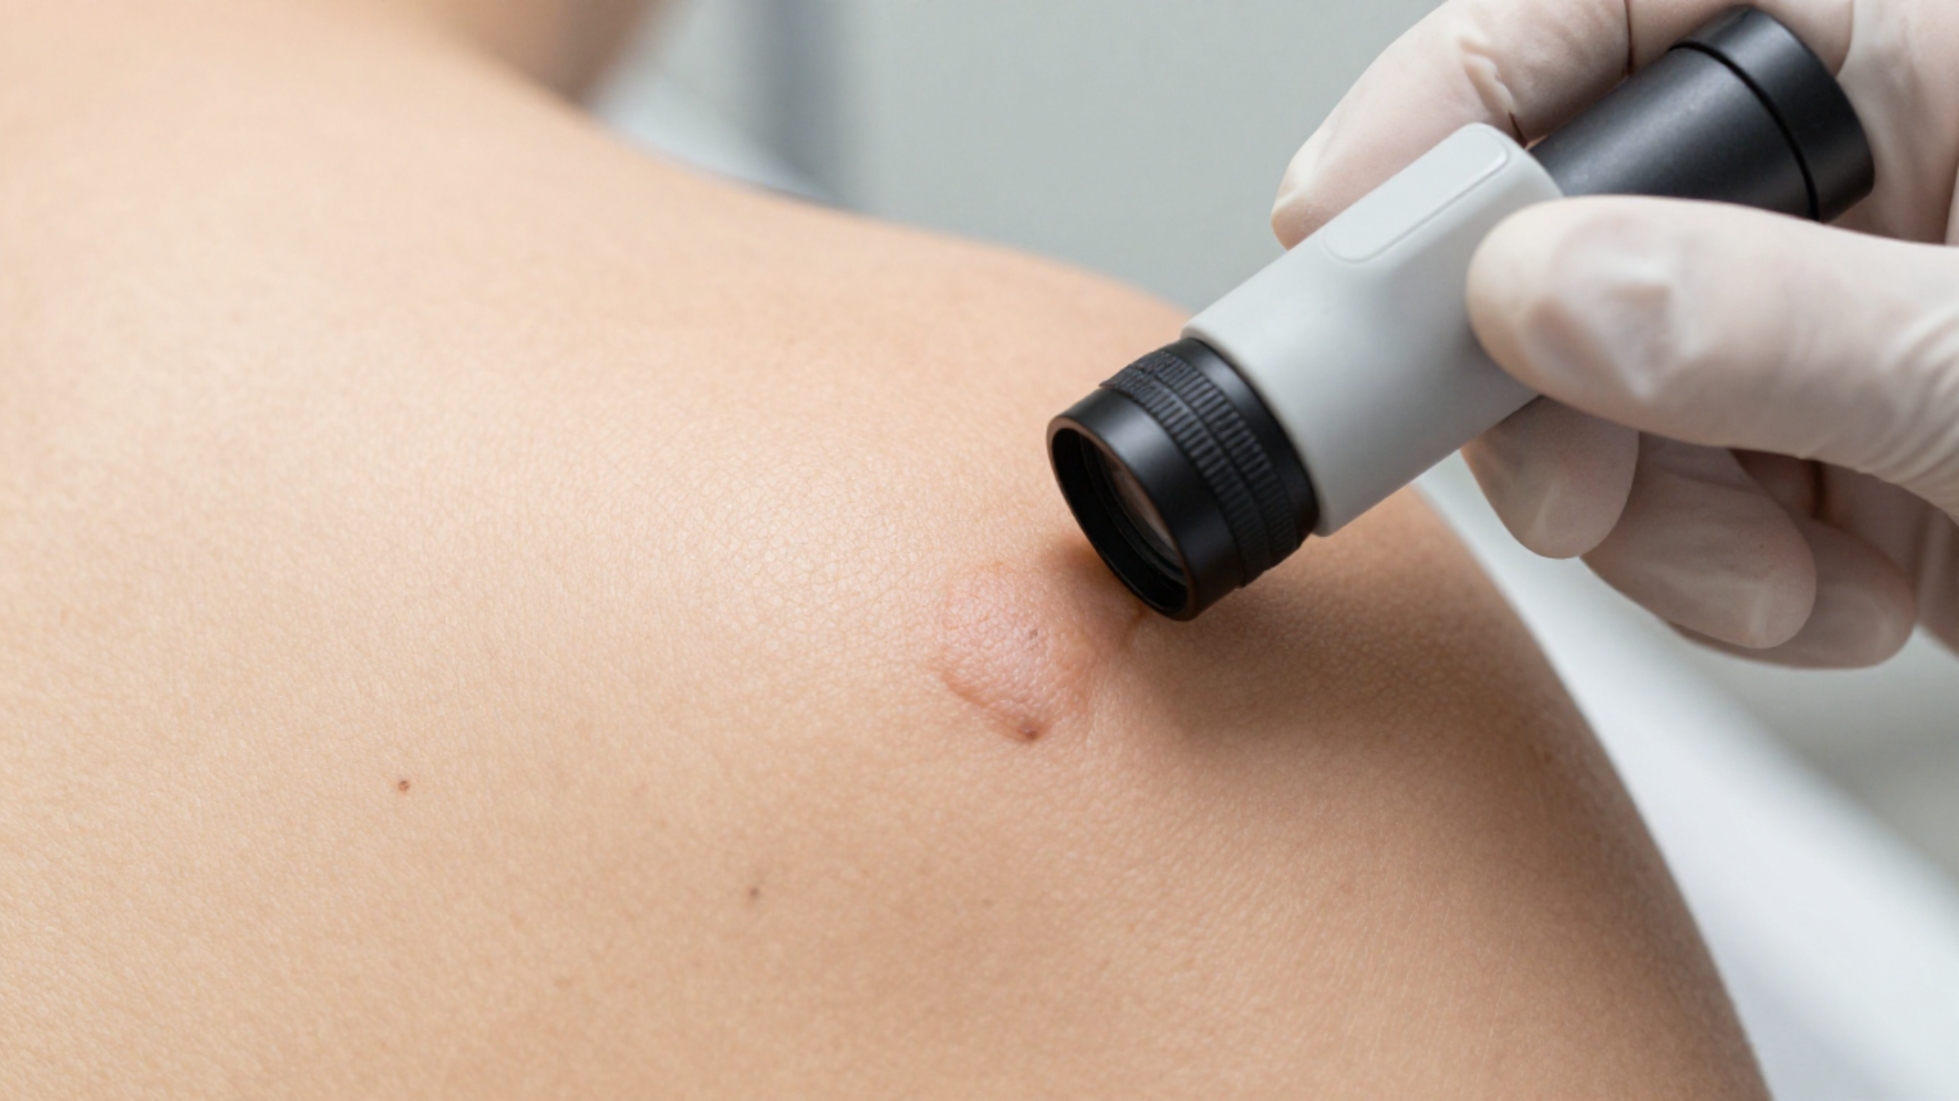

BRADFORD VTS TEACHING DECK
Skin Cancer & Precancer
in Primary Care
A comprehensive guide to clinical recognition, 7-point checklist scoring, and updated NICE NG12 (2023) referral pathways for GP trainees.
May 2026
NICE NG12 (2023) UPDATES
NHS ENGLAND 2024 TELEDERMATOLOGY
AKT / SCA PREPARATION
May 2026

Slide 2





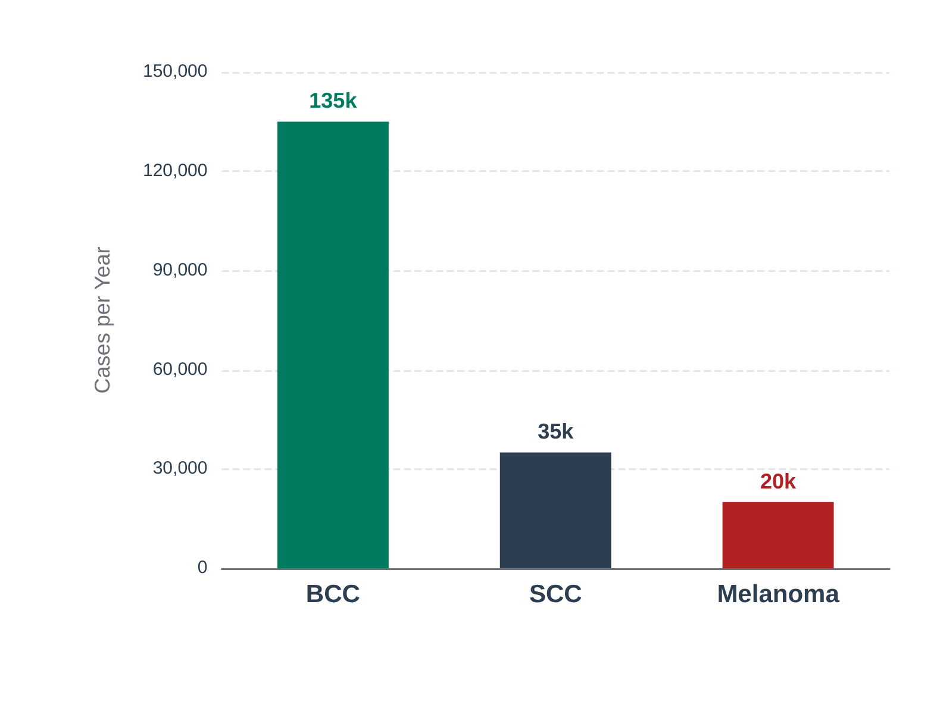






BACKGROUND & CLINICAL SIGNIFICANCE
Overview of UK Incidence & The Critical Role of GPs in Early Diagnosis
The GP as the Gatekeeper
Annual Incidence in the UK (~190,000 Total Cases)
Most skin cancers are first encountered in Primary Care consultations.
Correct use of NICE NG12 2-week wait pathways is essential for outcomes.
UV radiation remains the primary modifiable risk factor for all types.
Survival & Early Diagnosis
Early diagnosis is the key determinant of patient survival.
Melanoma 5-year survival: 90-99% for Stage I/II.
Survival drops markedly if detected at Stage III or IV.

Slide 3











MELANOMA: TYPES AND RISK FACTORS
Clinical Guidance & NICE NG12 Compliance
Phenotype & UV Exposure
Common Clinical Variants
Skin Type: Fair skin, red/blonde hair, blue eyes, poor tanning ability.
Superficial Spreading: Most common type; initial radial growth phase.
UV Impact: Extensive exposure and blistering sunburns (esp. in childhood).
Nodular Melanoma: Vertical growth; highly aggressive and grows rapidly.
Naevi: Large number of benign naevi (>50) or any atypical naevi.
Lentigo Maligna: Slow-growing; typically on sun-exposed areas in elderly.
History & Genetic Factors
Special & Atypical Types
Family History: Personal history of melanoma or CDKN2A gene mutation.
Acral Lentiginous: Occurs on palms, soles, or subungual (all skin types).
Immune Status: Immunosuppression significantly increases risk.
Amelanotic: Lacks pigment; frequently misdiagnosed and easy to miss.
Age: Risk increases with age, though melanoma is common in young adults.
Uveal/Mucosal: Rare variants involving the eye or mucous membranes.
Women: Lower Leg (50%)
COMMON ANATOMICAL SITES
Men: Back (33%)
Early diagnosis is the key determinant of survival

Slide 4






NON-MELANOMA SKIN CANCER: SCC AND BCC
Clinical Guidance & NICE NG12 Compliance
Squamous Cell Carcinoma (SCC)
Basal Cell Carcinoma (BCC)
Features: Indurated (palpable depth), >1cm, crusting, or non-healing ulceration.
Features: Pearly/translucent nodule, telangiectasia, "rodent ulcer" with rolled edges.
Growth: Rapid expansion over 1-2 months; typically sun-exposed areas.
Growth: Very slow (months to years); locally invasive but rarely spreads.
Metastasis: Significant risk, especially if poorly differentiated or on high-risk sites (ear, lip).
Variants: Nodular (common), Morphoeic (scar-like, aggressive), Pigmented (mimics melanoma).
NICE NG12: URGENT 2-WEEK WAIT (2WW)
ROUTINE REFERRAL (WITHIN 18 WEEKS)
*Transplant patients: High risk of aggressive, fatal SCC.
*Exception: 2WW only if eye/nose involvement or diagnostic doubt.

Slide 5













PRECANCEROUS & PRE-MALIGNANT LESIONS
Clinical Guidance & NICE NG12 Compliance
Actinic Keratosis (AK)
Bowen's Disease
Keratoacanthoma
UV-induced intraepidermal dysplasia. Presents as rough, scaly patches on sun-exposed areas. Low individual risk but significant in field change.
SCC in situ: full-thickness epidermal dysplasia. Typically well-demarcated erythematous scaly plaques on lower legs of elderly women.
Rapidly growing dome-shaped nodule with a central keratin plug. Reaches full size in 4-6 weeks. May regress but mimic SCC.
MANAGEMENT OPTIONS
MANAGEMENT OPTIONS
NICE NG12 GUIDANCE
Cryotherapy (isolated lesions)
Topical 5-FU (Efudix)
Clinically difficult to distinguish from SCC
5-FU cream (Efudix) for field change
Cryotherapy
Treat as SCC Variant
Imiquimod (Aldara) / Diclofenac
Curettage or Excision
Requires surgical excision
Photodynamic Therapy (PDT)
3-5% risk of progression to SCC
REFER: If lesion becomes thickened, indurated, or >1cm (suspect SCC).
REFER: If the lesion becomes palpable or indurated (suggests invasive SCC).
URGENT 2WW REFERRAL: Mandatory due to rapid growth and SCC risk.

Slide 6














THE WEIGHTED SEVEN-POINT CHECKLIST
Clinical Guidance & NICE NG12 Compliance
Major Features
ABCDE Aide-Memoire
2 POINTS EACH
A
Asymmetry: Half unlike the other
Change in Size
Irregular Shape
B
Border: Irregular, scalloped, poorly defined
Recent growth or expansion
Asymmetry or notched border
C
Colour: Varied shades (brown, black, red, blue)
Irregular Colour
D
Diameter: Usually >6mm
Variegated pigmentation
E
Evolution: Changing in size, shape, or colour
Minor Features
1 POINT EACH
Diameter ≥7mm
Inflammation
Largest dimension check
Redness or swelling
Oozing / Crusting
Sensation Change
Bleeding or serum loss
Itch, tingling, or pain
Systematic use of the 7-point checklist is mandated by NICE to minimize "clinical gut feeling" bias.
URGENT ACTION TRIGGER
SCORE ≥ 3
Refer on 2-Week Wait Pathway

Slide 7















NICE NG12 REFERRAL CRITERIA: 2-WEEK WAIT
Clinical Guidance & NICE NG12 Compliance
Suspected Melanoma (2WW)
Suspected SCC (2WW)
Suspicious pigmented lesion with 7-point checklist score ≥ 3
Non-healing lesion with significant induration (palpable depth component)
Any suspicious skin lesion where melanoma cannot be excluded
Amelanotic lesions with concerning features (irregular, growing, evolving)
Expansion documented over 1–2 months; commonly on face, scalp, or hands
Squamous Cell Carcinoma confirmed from a biopsy in primary care
Rapidly growing new pigmented lesion in an adult
Lesion >1cm in size or showing signs of ulceration/bleeding
CRITICAL: Refer ALL suspected melanomas INTACT. Do NOT biopsy in primary care.
IMMUNOSUPPRESSED: Any growing skin lesion in a transplant patient = URGENT 2WW.
Bradford VTS Note: Ensure high-quality photos are attached to 2WW referrals where possible. Documenting the duration of change and palpable induration is essential for secondary care triage.

Slide 8




















ROUTINE REFERRALS AND TELEDERMATOLOGY
Clinical Guidance & NICE NG12 Compliance
BCC Standard Pathway
Teledermatology (NHS 2024)
Suspected BCC requires routine referral (within 18 weeks) rather than 2WW.
GPs should utilize teledermatology before formal referral where locally available.
Metastasis is exceptionally rare; urgent referral is clinically unnecessary in most cases.
Enables remote specialist triage without the need for an initial face-to-face appointment.
NICE NG12 COMPLIANT
NHS ENGLAND 2024 UPDATE
Clinical Exceptions
Pathway Efficiency
BCC near critical sites (e.g., inner canthus, nose) may require prioritized surgical planning.
Significant reduction in unnecessary 2WW referrals for benign or routine lesions.
Morphoeic BCC: Flat, scar-like lesions that often require Mohs micrographic surgery.
Improves clinical speed and outcomes for confirmed high-risk malignancies.

Slide 9








DERMOSCOPY PRINCIPLES IN PRIMARY CARE
Clinical Guidance & NICE NG12 Compliance
Why Use Dermoscopy?
Chaos and Clues Method
Improves diagnostic accuracy for pigmented lesions vs naked eye.
Chaos: Asymmetry of pattern or color distribution.
Reduces unnecessary 2WW referrals for benign lesions.
Clues: Atypical network, blue-white veil, or irregular vessels.
Increases sensitivity for early melanoma (PCDS/RCGP endorsed).
ANY Chaos + ANY Clue = URGENT 2WW REFERRAL
Initial Assessment Steps
Recognizing Benign Mimics
Step 1: Determine if lesion is Melanocytic.
Seborrhoeic Keratosis Milia-like cysts, comedo-like openings, and "brain-like" fissures.
Look for specific markers: Pigment network, globules, or blotches.
Solar Lentigo "Moth-eaten" border, faint brown fingerprint-like lines.
If non-melanocytic, look for "stuck-on" features or vascular patterns.
Dermatofibroma Central white scar-like patch with peripheral network.

Slide 10


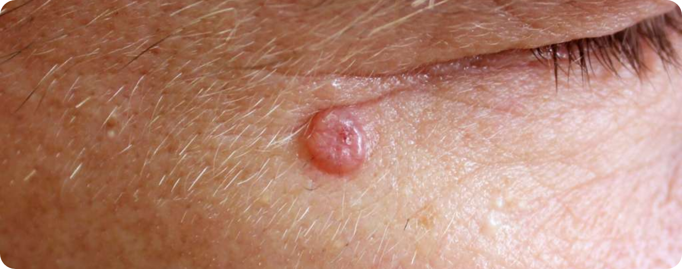














CLINICAL RECOGNITION OF SPECIFIC LESIONS
Visual Cues & Morphological Features for GP Triage
Melanoma: The ABCDE Rule
Typical BCC: Inner Canthus
A Asymmetry
B Border (Notched)
C Colour (Variegated)
D Diameter (>6mm)
E Evolution (Changing Size/Shape/Sensation)
Look for the "Ugly Duckling" lesion that stands out.
Basal Cell Carcinoma (BCC)
Pearly Appearance: Translucent/shiny nodule
Squamous Cell Carcinoma (SCC)
Telangiectasia: Visible surface blood vessels
Induration: Palpable depth/thickness KEY SIGN
Growth: Rapidly expanding (weeks to months)
Seborrhoeic Keratosis (Benign)
Ulceration: Non-healing, may have keratin plug (Keratoacanthoma)
"Stuck-on": Looks like it could be picked off
Surface: Warty, matt, often greasy texture
Feature: Milia-like cysts/comedo-like openings

Slide 11




















PRIMARY PREVENTION AND SUN SAFETY ADVICE
Clinical Guidance & NICE NG12 Compliance
UV Protection & SPF
Physical Risk Phenotypes
Use SPF 30+ broad-spectrum sunscreen (SPF 50 for high-risk patients)
Type I/II skin: Fair-skinned, red/blonde hair, blue eyes, poor tanning ability
Avoid midday sun between 11am and 3pm; seek shade when your shadow is shorter than you
Large number of naevi: >50 typical moles or any atypical/dysplastic naevi
Wear protective clothing, wide-brimmed hats, and UV-rated sunglasses
Personal or strong family history of melanoma or multiple NMSC
Clinical & Occupational Risk
Critical Warnings
Immunosuppressed patients: Especially organ transplant recipients (high SCC risk)
Strictly avoid sunbeds: Classified as a Group 1 carcinogen (IARC)
Childhood protection is vital: Blistering sunburns in youth significantly increase lifetime risk
Outdoor workers: Farmers, builders, and those with chronic occupational UV exposure
Patients with significant Actinic Keratosis field change
GP Counseling Tip: Proactively identify high-risk patients during routine consultations (e.g., medication reviews for immunosuppressants) to provide targeted sun safety advice.

Slide 12



















TOP TIPS FOR GP TRAINEES
Clinical Pearls & Safety Guidance for Skin Lesion Management
Referral & Malignancy
Precancer & Benign
7-Point Checklist: A weighted score of ≥3 requires an urgent 2-week wait (2WW) referral.
AK Field Change: Treat multiple actinic keratoses proactively with topical 5-FU or imiquimod.
No Primary Biopsy: Never biopsy suspected melanoma in primary care; refer with the lesion completely intact.
Seborrhoeic Keratosis: Benign "stuck-on" appearance; reassure the patient and avoid unnecessary referral.
BCC Pathway: Routine referral (18-week wait) is appropriate as BCC rarely metastasises.
Bowen’s Disease: Manage topically initially; refer if the lesion becomes indurated or palpable.
High-Risk Scenarios
Diagnostic Tools
Transplant Patients: Any growing lesion in immunosuppressed patients warrants an urgent 2WW referral.
Teledermatology: Utilize NHS England 2024 guidance for triage before making formal 2WW referrals.
Amelanotic Melanoma: Do not miss non-pigmented lesions; look for rapid growth and irregular borders.
Documentation: Always record precise measurements and note any induration or expansion over 1-2 months.
Note: Dermoscopy training significantly improves referral accuracy. Always consult latest NICE/BNF guidelines for drug dosages.

Slide 13


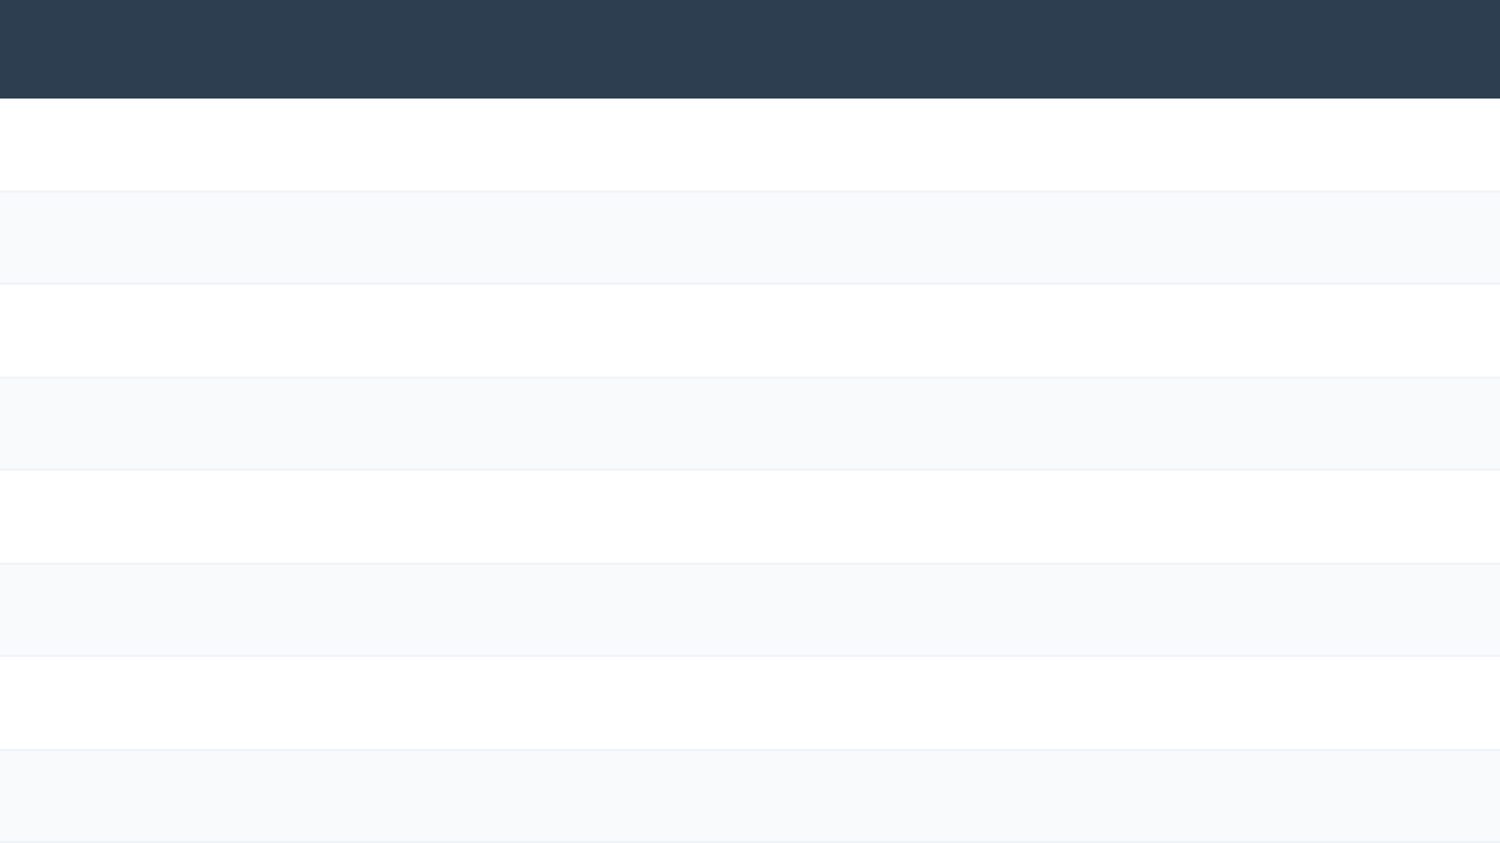








EXAM PEARLS FOR AKT AND SCA
Clinical Guidance & NICE NG12 Compliance
2WW Communication
HIGH YIELD TOPIC
KEY EXAM FACT / REFERRAL ACTION
Explain the 2WW clearly: "I want a specialist to check this within the next 2 weeks."
Melanoma Referral
Weighted 7-point checklist score ≥ 3 = 2WW referral.
BCC Management
Routine referral only; BCC very rarely metastasises (not 2WW).
Transplant Patients
Any growing lesion in immunosuppressed = Urgent 2WW for SCC.
Prevention Advice
Primary Care Biopsy
Do NOT biopsy suspected melanoma; refer with lesion intact.
Advise daily SPF 30+ even in winter and on cloudy days for high-risk patients.
Nodular Melanoma
Rapid vertical growth; often dark nodule; very poor prognosis.
Amelanotic Type
No pigment; look for shape/size/evolution clues; easy to miss.
AK Field Change
Treat with topical 5-FU (Efudix) or Imiquimod; refer if indurated.
NICE: Manage as SCC (Refer), despite rapid growth/regression.
Keratoacanthoma
Benign vs. Malignant
Distinguish "stuck-on" Seborrhoeic Keratosis (benign) from indurated SCC (malignant).

Slide 14










RED FLAGS AND COMMON PITFALLS
Clinical Guidance & NICE NG12 Compliance
Clinical Red Flags (Urgent 2WW)
Common Diagnostic Pitfalls
Checklist Score ≥3
BCC Referral Urgency
Any pigmented lesion meeting the weighted 7-point criteria.
Referring BCC on 2WW. Use Routine Pathway (18 weeks) as BCC rarely metastasises.
Immunosuppressed Growth
Amelanotic Presentation
Any new or growing lesion in transplant patients; risk of aggressive SCC.
Rapidly Growing Nodules
Missing melanoma due to lack of pigment. Look for irregular border and rapid growth.
Suspect Nodular Melanoma or Keratoacanthoma (manage as SCC).
The "Biopsy It First" Error
Metastatic Indicators
Never biopsy suspected melanoma in primary care. Refer intact for specialist excision.
Satellite lesions around primary site or palpable regional lymph nodes.
Subungual Oversight
Missing Hutchinson’s sign (pigment on nail fold). Nail melanoma is high-risk.
Size Reassurance
Reassuring patients because a lesion is <6mm. Small lesions can still be malignant.

Slide 15












SUMMARY AND QUICK RECALL
Clinical Guidance & NICE NG12 Compliance
CORE CLASSIFICATIONS
7-POINT CHECKLIST
REFERRAL PATHWAYS
Malignant: Melanoma (Melanocytes), SCC (Keratinocytes), BCC (Basal Layer).
Major (2 pts): Change in Size, Irregular Shape, Irregular Colour.
2WW: Suspected Melanoma, suspected SCC, or ANY growing lesion in Transplant patients.
Pre-Malignant: Actinic Keratosis (AK), Bowen's Disease (SCC in situ).
Minor (1 pt): Diam ≥7mm, Inflammation, Oozing, Sensation change.
Routine: Basal Cell Carcinoma (BCC) - rarely metastasises; treat AK field change in GP.
Special Case: Keratoacanthoma (Manage as SCC — refer).
SCORE ≥ 3: URGENT 2-WEEK WAIT (2WW)
Teledermatology: Use for triage and advice/guidance before formal referral.
CRITICAL SAFETY PEARL: Never biopsy a suspected melanoma in primary care — refer with the lesion intact. Always document growth over 1-2 months for suspected SCC. BCC near the eye or morphoeic types may require Mohs surgery.

