Slide 1
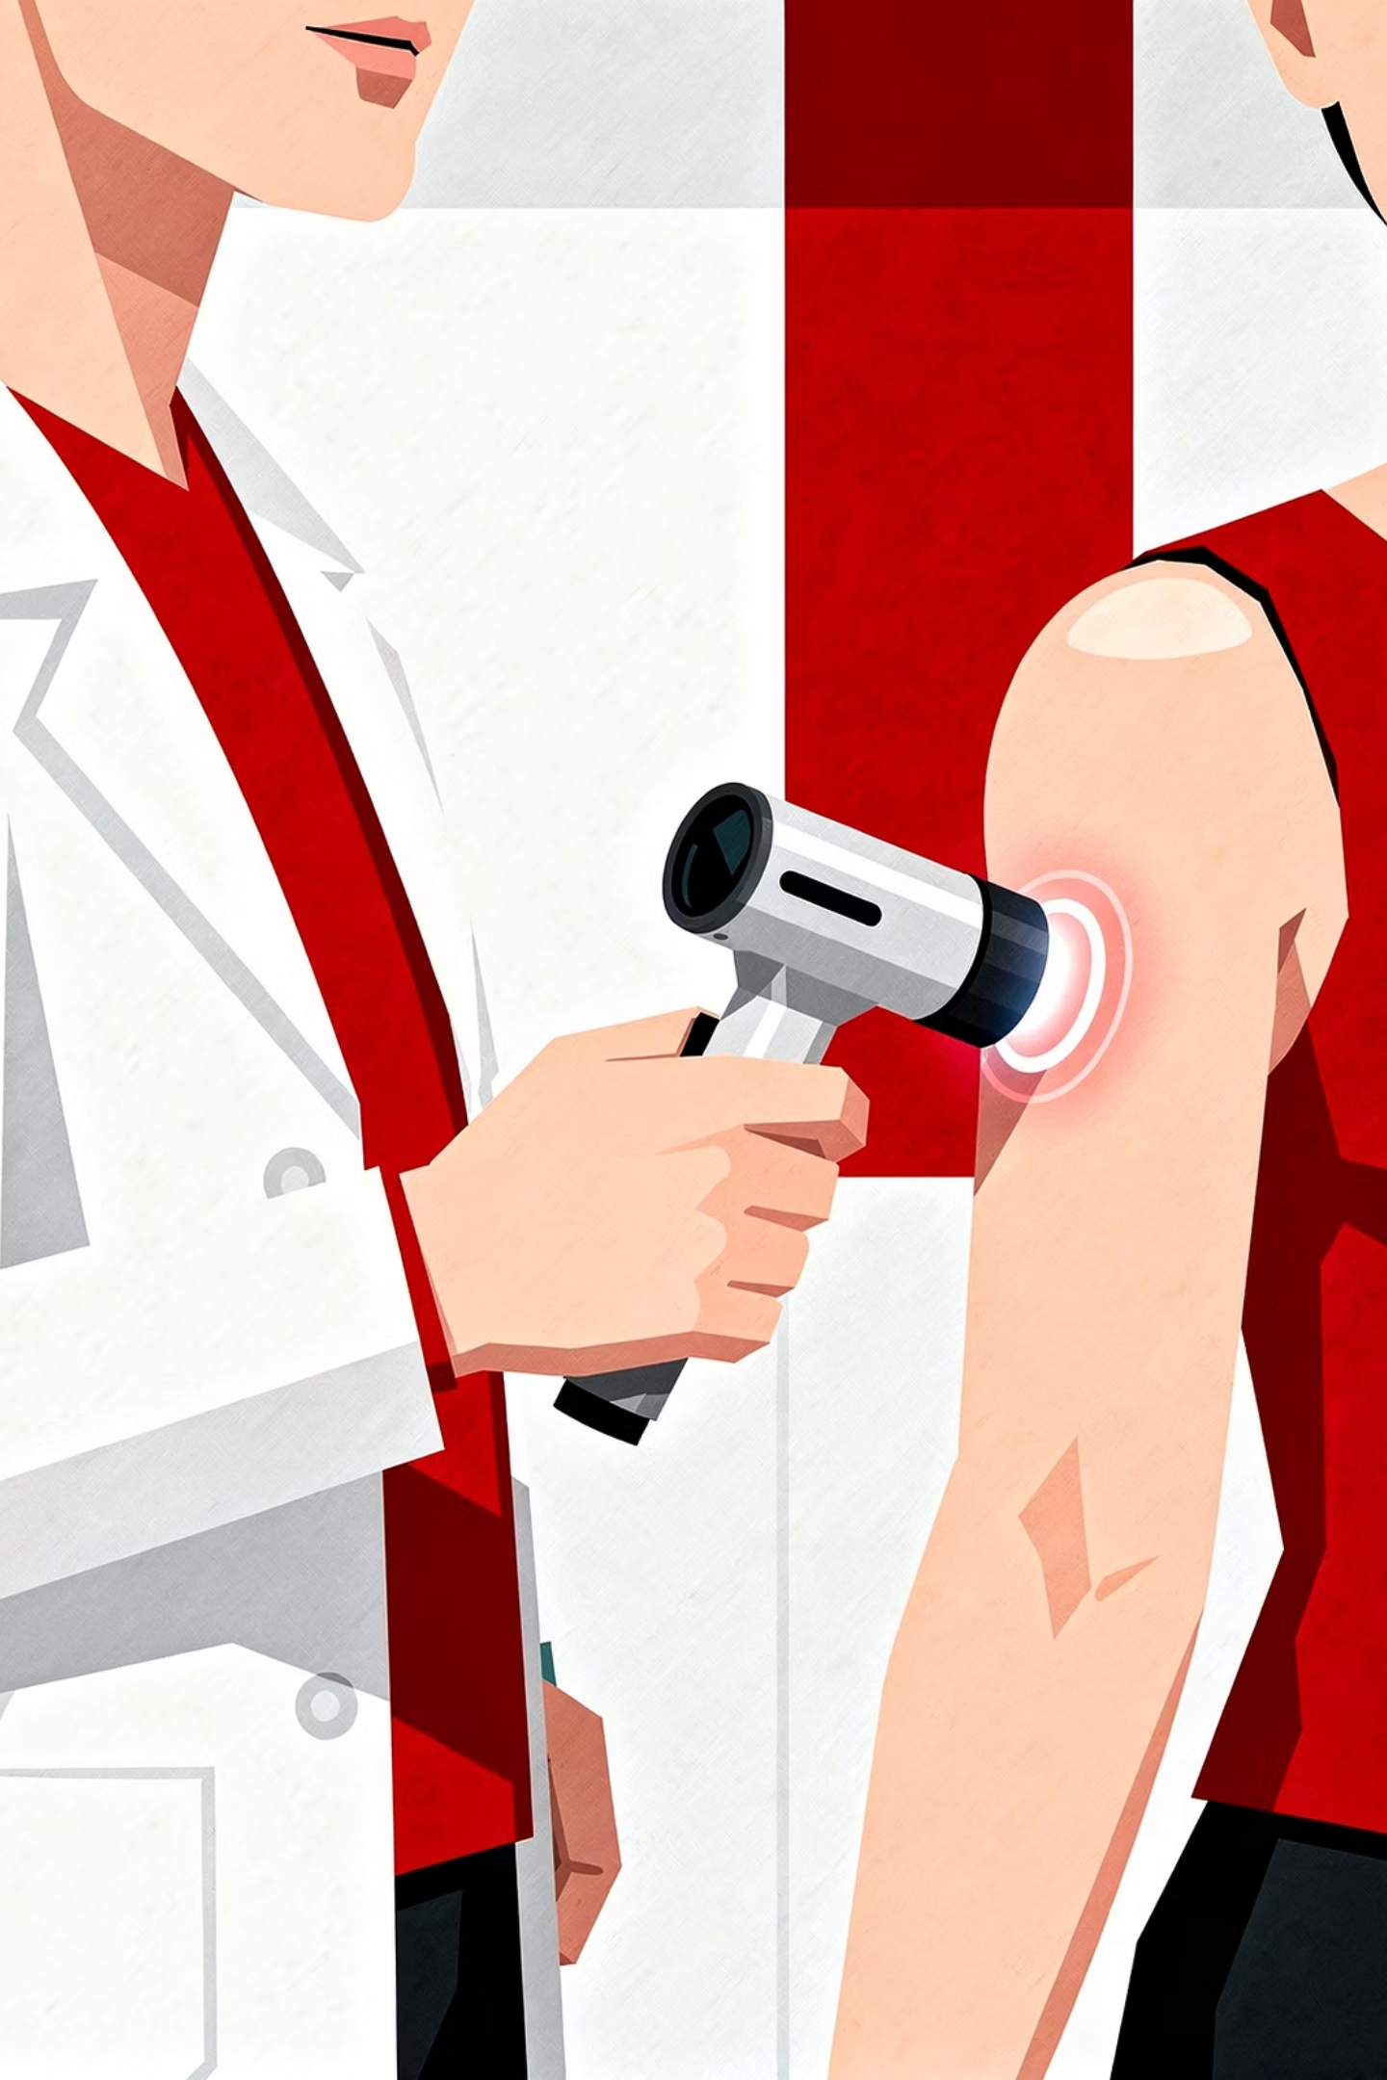
BRADFORD VTS TEACHING DECK
Dermatology Basics for UK GP Trainees
Updated and combined from legacy teaching documents. Clinically updated for UK practice using current NICE and BNF-aligned principles (2026).
BASED ON AN ORIGINAL ARTICLE BY DR BRUCE DAVIES, YORKSHIRE, ADAPTED BY DR R MEHAY

Slide 2
A Structured Approach to Dermatology
Dermatology becomes much easier with a structured approach rather than relying solely on pattern recognition. If you can accurately describe the rash, you are already halfway to the diagnosis.
01
02
03
History
Examination
Morphology
Onset, spread, symptoms, triggers, drug history
Distribution, pattern, colour, surface changes
Accurately describe the primary lesion type
04
05
Investigations
Management
Targeted tests where clinically indicated
Evidence-based, NICE-aligned treatment plan

Slide 3

History Taking in Dermatology
Key Questions
Symptoms to Explore
When did it start and where did it begin?
Has it spread? Is it intermittent or continuous?
Any previous similar episodes?
New medications, cosmetics, or occupational exposures?
Sunlight, stress, or contact allergens?
Itch — eczema, scabies, urticaria, lice, dermatitis herpetiformis
Pain — infection, shingles, vasculitis, ulcers
Bleeding or weeping
Fever or systemic symptoms
General History
Atopy, joint symptoms (psoriasis), bowel symptoms (IBD)
Family history, drug history, sexual history where appropriate
Scalp, nails, and mucous membranes

Slide 4

Examination Principles
Always examine in good lighting. Assess distribution, pattern, colour, surface changes, edges, hair, nails, and mucous membranes.
What to Assess
Skin Cancer Warning Signs
Distribution — symmetrical, flexural, extensor, dermatomal, seborrhoeic, sun-exposed
Pattern — linear, annular, clustered, target lesions
Surface — scale, crusting, lichenification, ulceration
Edges — well or poorly defined
Non-healing lesions
Rapid growth
Bleeding lesions
Pigment change
Asymmetry or irregular borders
Always include skin cancer assessment in every skin examination.

Slide 5
Primary Skin Lesions
Accurate lesion description is the foundation of dermatological diagnosis. Learn these terms precisely.
Macule
Papule
Nodule
Flat colour change, no elevation
Raised lesion <1 cm
Raised deeper lesion >1 cm
Plaque
Vesicle
Bulla
Broad raised lesion >1 cm; typical of psoriasis
Small fluid-filled blister <0.5 cm
Large fluid-filled blister >0.5 cm
Pustule
Weal
Cyst
Pus-filled lesion; not always infected
Transient raised itchy lesion; typical of urticaria
Deeper sac-like lesion containing fluid or keratin

Slide 6
Secondary Changes, Redness & Vascular Terms
Secondary Skin Changes
Vascular & Redness Terms
Scale
Crust
Erythema
Purpura
Excess keratin on surface
Dried serum, blood or pus
Vasodilation redness — blanches
Bleeding into skin — does not blanch
Excoriation
Lichenification
Petechiae
Telangiectasia
Scratch marks from itching
Thickened skin from chronic rubbing
Tiny pinpoint purpura
Visible dilated superficial vessels
Fissure
Erosion / Ulcer
Angioma
Linear crack in skin
Partial or full thickness skin loss
Benign blood vessel growth

Slide 7
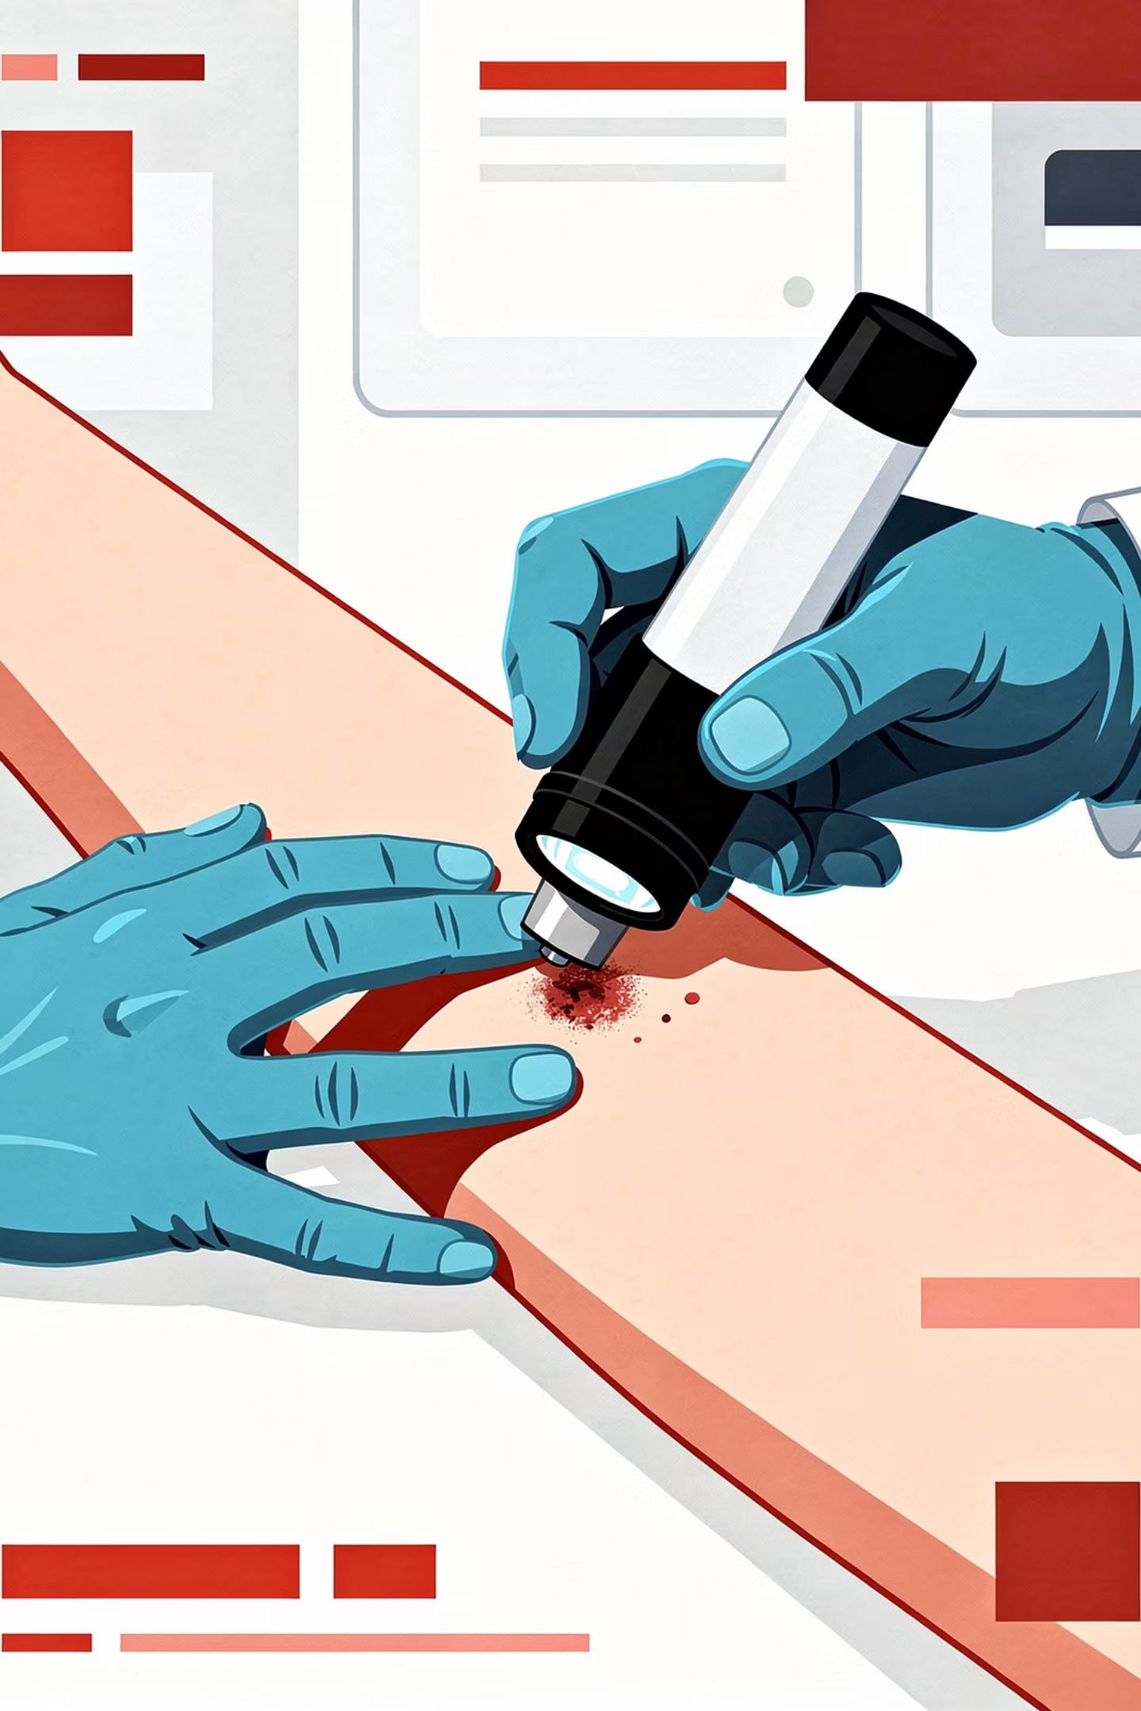
Investigations
Microbiology
Skin scrapings for fungal microscopy and culture. Swabs only if infection is suspected.
Dermoscopy
Essential for pigmented lesions. Now a core part of modern skin lesion assessment in UK practice.
Biopsy & Patch Testing
Biopsy where diagnosis is uncertain. Patch testing for allergic contact dermatitis.
Blood Tests
If systemic disease is suspected. Wood's lamp now used less commonly in primary care.

Slide 8

Topical Steroids & Vehicles
Potency Ladder
Key Principles (NICE/BNF)
1
Use the weakest effective steroid
Avoid prolonged use on face and flexures
Use fingertip unit guidance
Review long-term steroid use regularly
Avoid under-treating eczema due to steroid fear
Combination steroid-antifungal creams: short term only
2
3
4
Vehicles
1
Mild
Ointments — most occlusive; best for dry skin
Creams — easier for daytime use
Lotions/Solutions — hairy areas and scalp
Hydrocortisone
2
Moderate
Clobetasone
3
Potent
Betamethasone valerate
4
Very Potent
Clobetasol propionate
NICE does not routinely recommend bath additives for eczema. Emollients remain central — apply regularly, continue when skin improves, and consider soap substitutes.

Slide 9

Diagnosing Rashes & Melanoma Recognition
Simple Diagnostic Approach
ABCDE — Melanoma Recognition
1
Well or unwell?
2
Itchy, painful or neither?
A — Asymmetry
B — Border irregularity
3
What is the primary lesion?
4
What is the distribution?
C — Colour variation
D — Diameter
5
Mucosal or systemic features?
6
Drug-related or skin cancer?
E — Evolving change
Urgent suspected skin cancer referrals must follow current NICE suspected cancer guidance.

Slide 10

Key Modern Updates & Disclaimer
Emollients over Bath Additives
Melanoma & Skin Cancer
Steroid Safety
ABCDE approach and urgent NICE referral pathways now explicitly included.
Fingertip unit guidance, review of long-term use, and caution in children added.
NICE guidance: routine bath additives are generally not recommended for eczema.
Antimicrobial Stewardship
Combination Creams
Long-term oral antibiotics for acne should be reviewed regularly and combined with topical therapy.
Steroid-antifungal combination creams should only be used short term where clearly indicated.
This resource is for UK healthcare professionals and trainees. Always check the latest NICE guidance, BNF, local prescribing guidance, and specialist advice before making clinical decisions.

