Slide 1

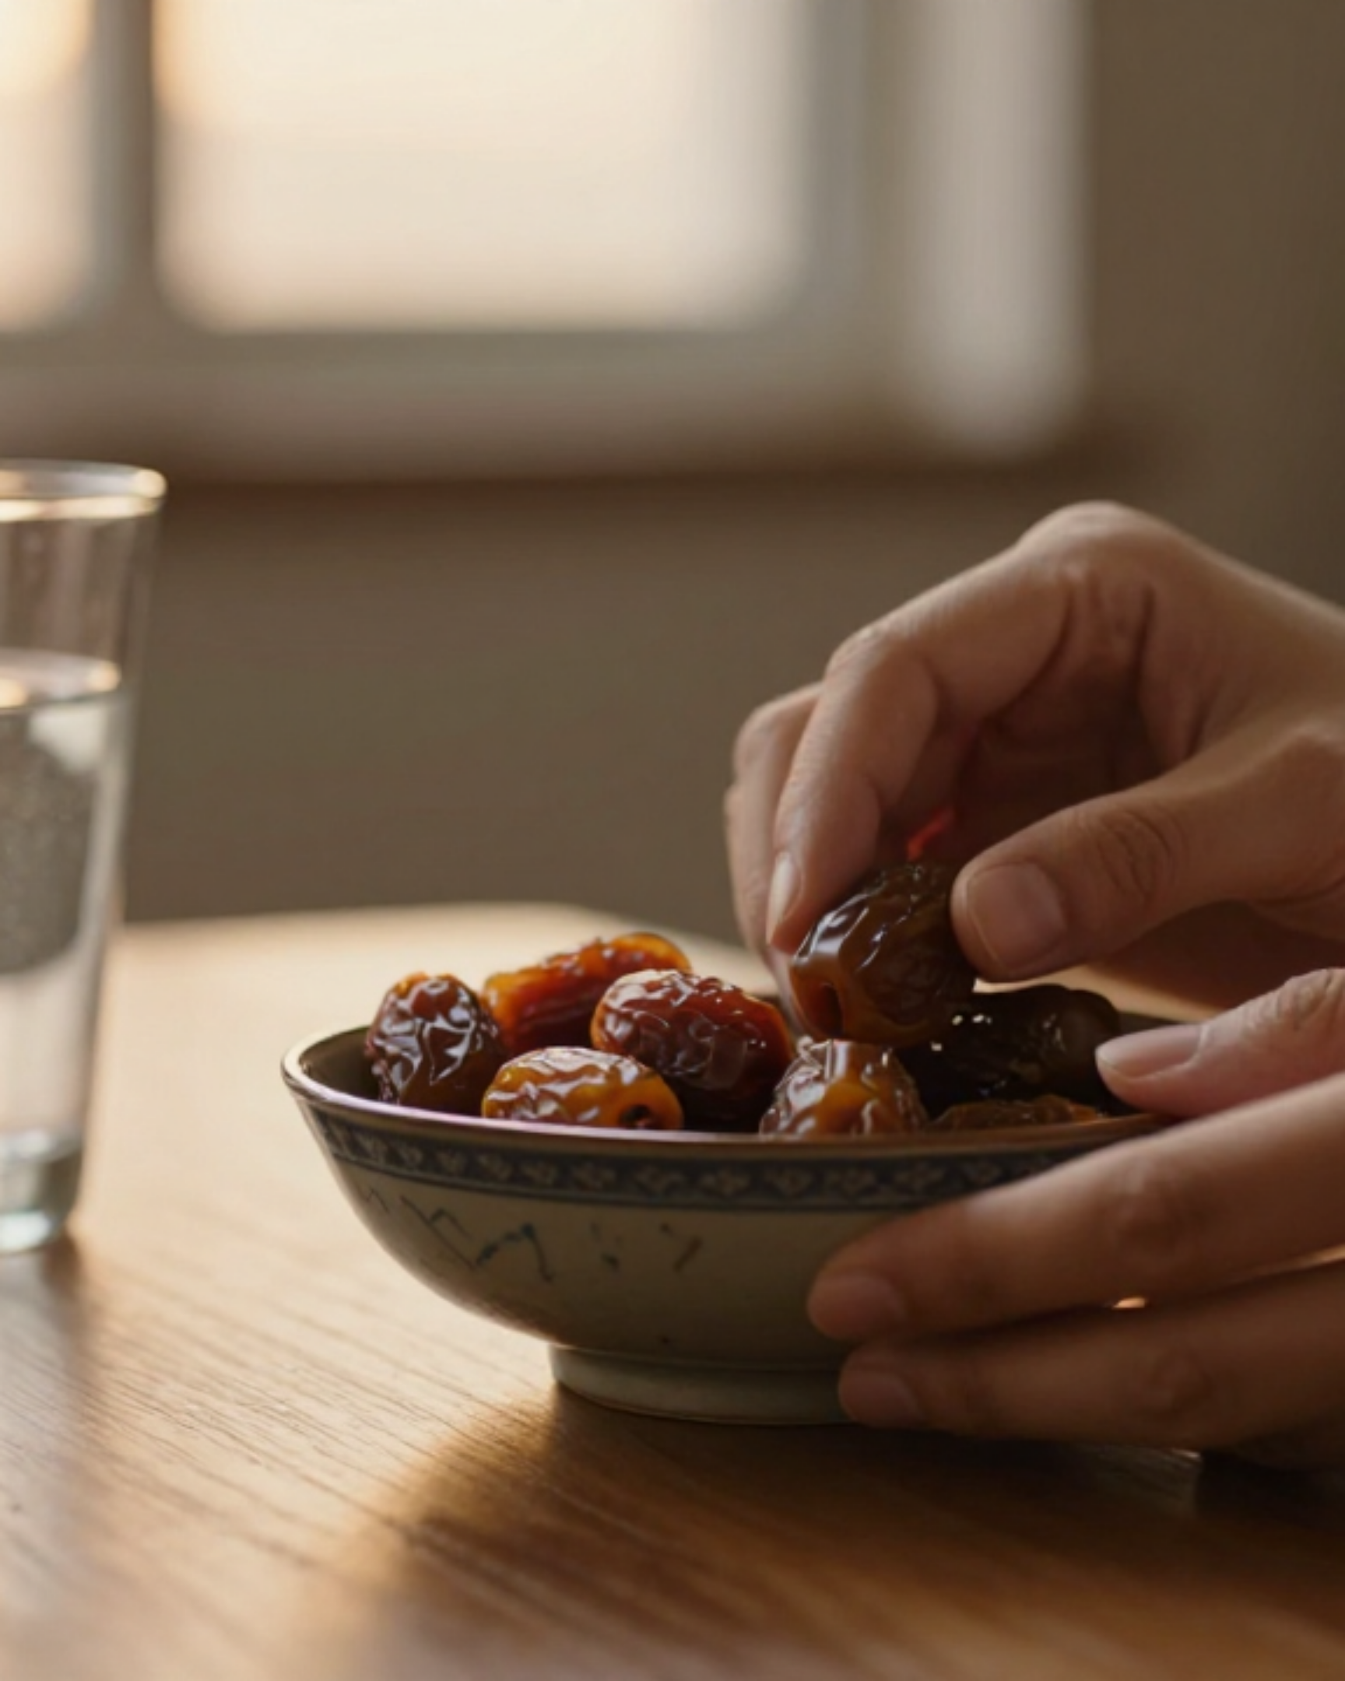

BRADFORD VTS TEACHING DECK
Diabetes During Ramadan: A Clinical Guide
Essential Management and Communication Strategies for GP Trainees
May 2026
Clinical Currency: NICE NG28 (Feb 2026) | IDF-DAR Practical Guidelines 2021
Bradford VTS
www.bradfordvts.co.uk
Disclaimer: This deck is for educational use only. Clinical decisions remain the sole responsibility of the practitioner. Information is accurate as of March 2026.

Slide 2












LEARNING OBJECTIVES AND CLINICAL CURRENCY
www.bradfordvts.co.uk
Clinical Guide: Diabetes & Ramadan (NICE NG28 / IDF-DAR 2021)
Disclaimer: For educational use only. Clinical decisions remain the responsibility of the practitioner.
Key Learning Objectives
Clinical Currency & Evidence
Master Risk Stratification
IDF-DAR 2021 & TREND-UK
Accurately categorize patients into High, Moderate, or Low risk groups using IDF-DAR 2021 criteria.
The global gold standard for fasting management, risk scores, and patient education materials.
Safely Titrate Medications
NICE NG28 (Updated Feb 2026)
Apply dose adjustments for all T2DM drug classes and insulin based on NICE 2026 guidelines.
Latest UK-specific consensus on Type 2 Diabetes management and continuous monitoring.
Enhance Consultation Skills
Bradford Local Resources
Develop culturally sensitive shared decision-making strategies essential for SCA exam success.
Localised clinical pathways and the 2026 BNF pharmacological updates for primary care.

Slide 3

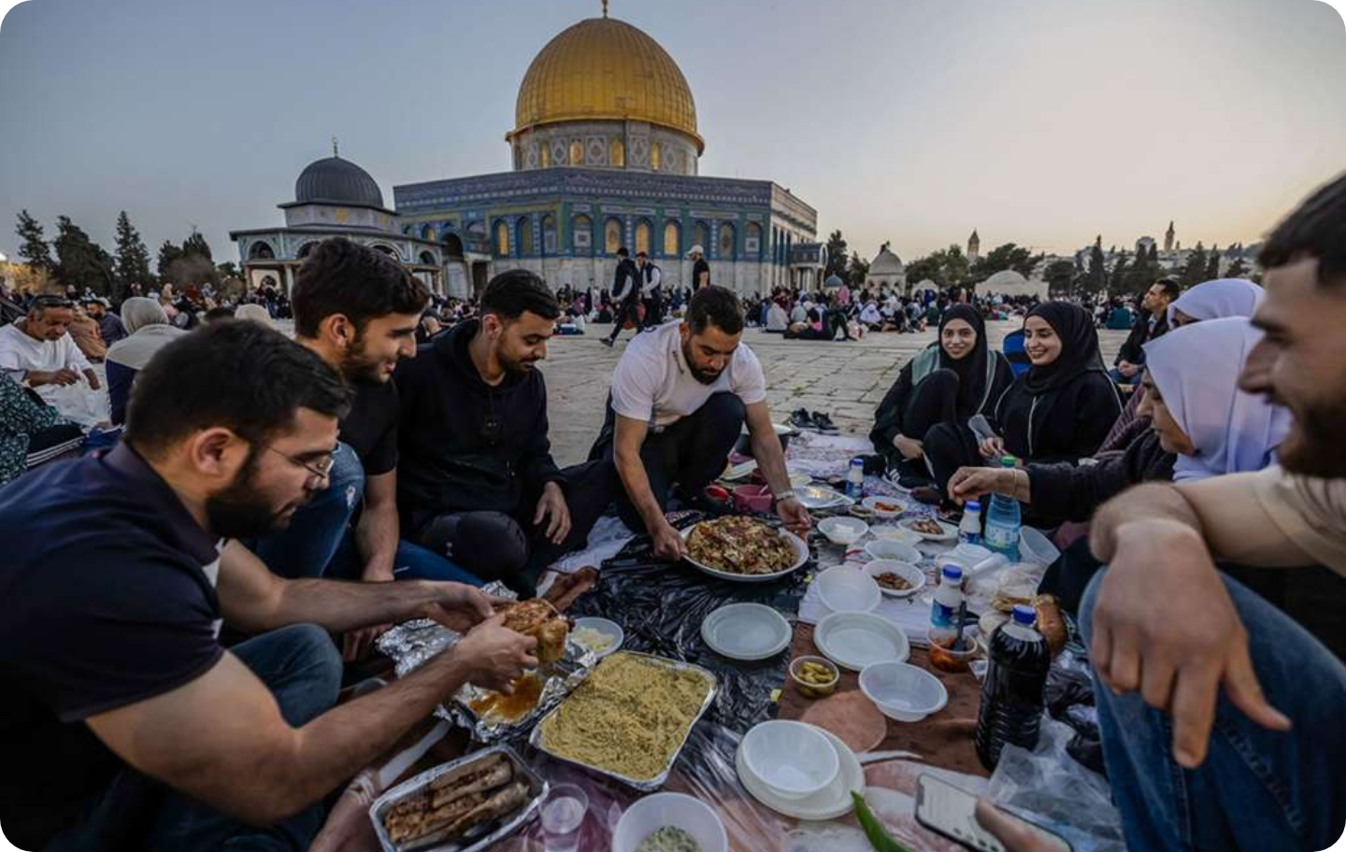






UNDERSTANDING RAMADAN AND THE ISLAMIC CONTEXT
www.bradfordvts.co.uk
Clinical Guide: Diabetes & Ramadan (NICE NG28 / IDF-DAR 2021)
Disclaimer: For educational use only. Clinical decisions remain the responsibility of the practitioner.
Spiritual Significance
One of the Five Pillars of Islam — an obligatory act of worship for healthy adults.
The 9th month of the Islamic lunar calendar (29–30 days).
A time for spiritual reflection, self-discipline, and increased charity.
THE LUNAR CALENDAR IMPACT
Ramadan moves forward approx. 11 days each year. Daylight hours (and thus fast duration) vary significantly based on the season.
The Nature of the Fast
Shared Iftar meal at sunset — a significant social and spiritual event.
Duration: From dawn (Fajr/Suhoor) to sunset (Maghrib/Iftari).
Key Daily Events
Abstinence: No food, no drink (including water), no smoking, and no sexual activity.
Medications: Oral, inhaled, and injected meds are traditionally avoided during daylight.
Suhoor/Sehri: Pre-dawn meal. Essential for glucose stability.
Iftari: Fast-breaking meal at sunset. Often calorie-dense.
Taraweeh: Extra evening prayers. 1–2 hours of significant physical activity.

Slide 4


















SCALE OF THE ISSUE IN BRADFORD AND PRIMARY CARE
www.bradfordvts.co.uk
Clinical Guide: Diabetes & Ramadan (NICE NG28 / IDF-DAR 2021)
Disclaimer: For educational use only. Clinical decisions remain the responsibility of the practitioner.
UK National Landscape (2021-2024)
The GP's Management Role
3.9 Million Muslims in England and Wales (2021 Census), representing a significant patient cohort.
Core Competency: Managing patients who want to fast is a fundamental skill for GPs in diverse urban areas like Bradford.
4.6 Million People diagnosed with diabetes in the UK (2024), with rising prevalence in ethnic minorities.
Clinical Goal: To enable safe fasting where possible through proactive risk stratification and education.
A large proportion of Muslim patients with diabetes will choose to fast, regardless of clinical risk or exemption status.
Shared Decision-Making: The GP’s role is to provide medical evidence while respecting religious and spiritual autonomy.
AKT/SCA Tip: Do not simply "prohibit" fasting. The focus must be on harm reduction and patient safety within the context of their faith.
The Bradford Context
Bradford has one of the largest South Asian Muslim communities in England, where diabetes risk is significantly higher.
South Asian heritage is associated with a 4-6x higher risk of developing Type 2 Diabetes at a lower BMI.

Slide 5














ISLAMIC EXEMPTIONS FROM FASTING
www.bradfordvts.co.uk
Clinical Guide: Diabetes & Ramadan (NICE NG28 / IDF-DAR 2021)
Disclaimer: For educational use only. Clinical decisions remain the responsibility of the practitioner.
Who is Exempt?
The Concept ofAmanah
The Sick and Ill: Both acute and chronic conditions where fasting poses a significant health risk.
Islam teaches that health is a Sacred Trust (Amanah) from God. A person is required to protect their life and well-being.
Pregnant/Breastfeeding Women: If they fear for their own health or that of the child.
Muslim scholars state it is not sinful (Haram) to skip the fast if a medical professional deems it dangerous. In fact, ignoring medical advice and causing self-harm is contrary to Islamic principles.
Travelers: Those undertaking a journey (Musafir) over a specific distance.
Elderly and Frail: Those who find fasting excessively difficult due to age or weakness.
Children: Those who have not yet reached the age of puberty (Bulugh).
Harmful Conditions: Any medical state where fasting is likely to cause worsening or harm.
The Clinical Reality
Despite valid exemptions, many Muslims with diabetes choose to fast for spiritual and communal reasons.
GP Role: Enable safe fasting where possible; do not simply "forbid" it.
Compensation: Fast can be made up later (Qadha) or compensated by charity (Fidya).

Slide 6










IDF-DAR RISK STRATIFICATION: HIGH RISK
www.bradfordvts.co.uk
Clinical Guide: Diabetes & Ramadan (NICE NG28 / IDF-DAR 2021)
Disclaimer: For educational use only. Clinical decisions remain the responsibility of the practitioner.
Glycaemic & Clinical Status
Severe Chronic Complications
Type 1 Diabetes (especially poorly controlled or high hypo risk)
Advanced CKD / ESRD or on Dialysis
HbA1c >10% (86 mmol/mol) at the start of Ramadan
Unstable Angina or Active Cardiovascular Disease (CVD)
History of recurrent Diabetic Ketoacidosis (DKA)
Advanced Liver Disease or Cognitive Impairment
Pregnancy & Acute Illness
Medication & Frailty Profiles
Pregnancy with pre-existing Diabetes or Gestational Diabetes
Type 2 on mixed insulins (e.g. Humulin M3, NovoMix 30)
Any acute illness or intercurrent illness during Ramadan
Elderly + Frail + on Insulin or Sulfonylurea
Severe hypoglycaemia or hypo unawareness in last 3 months
Very tight HbA1c control with high hypoglycaemia risk
ADVICE: STRONGLY RECOMMEND NOT TO FAST
Speaker Notes:High-risk patients are those where fasting poses a significant threat to health. Per IDF-DAR 2021, we must strongly advise against fasting. If they insist, they require intensive education, CGM, and specialist review. Note that T1DM and Mixed Insulin users are high risk due to the mismatch between fixed insulin peaks and the long daylight fast.

Slide 7





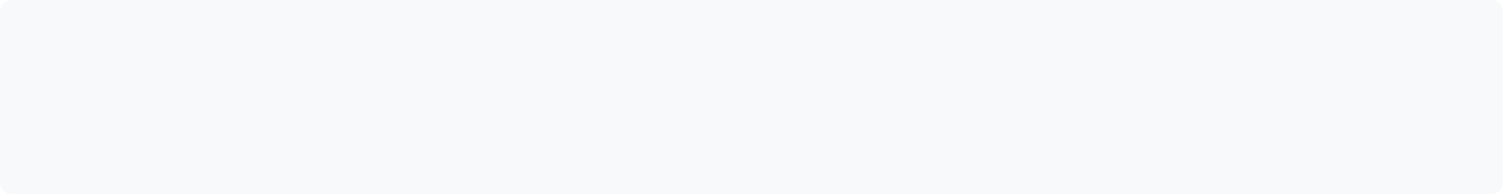
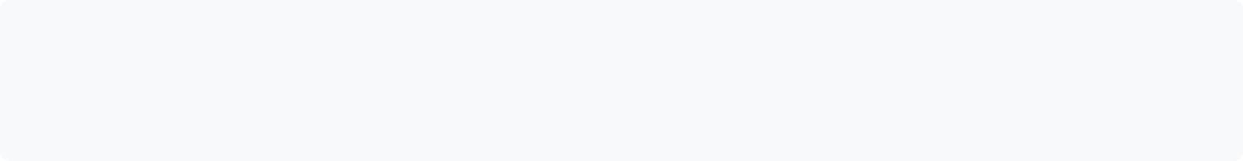









IDF-DAR RISK STRATIFICATION: MODERATE AND LOW RISK
www.bradfordvts.co.uk
Clinical Guide: Diabetes & Ramadan (NICE NG28 / IDF-DAR 2021)
Disclaimer: For educational use only. Clinical decisions remain the responsibility of the practitioner.
Moderate Risk
Low Risk
Advice: Consider fasting with adjusted medication and close monitoring.
Advice: Generally safe to fast with dietary and timing adjustments.
Type 2 on Sulfonylureas (Gliclazide, Glimepiride)
Type 2 on Diet alone (Low hypo risk)
Type 2 on Basal Insulin only (Background dose)
Type 2 on Metformin alone (Adjust timing)
Well-controlled T2DM (HbA1c <7.5% / 58 mmol/mol) on the above
Type 2 on SGLT2 inhibitors (Watch hydration)
Type 2 on DPP-4 inhibitors or GLP-1 RAs
Well-controlled T1DM on MDI + CGM (Strict case-by-case)
AKT Tip: Unlike high risk, these patients can often fast, but require active dose titration (usually 50% reduction for SUs).
SCA Tip: Focus on "Safe Fasting" education. Reassure that these meds have low hypoglycemia risk compared to SUs or Insulin.

Slide 8












THE PRE-RAMADAN REVIEW: TIMING AND GOALS
www.bradfordvts.co.uk
Clinical Guide: Diabetes & Ramadan (NICE NG28 / IDF-DAR 2021)
Disclaimer: For educational use only. Clinical decisions remain the responsibility of the practitioner.
6–8 Weeks Before
Core Consultation Goals
The Gold Standard Timing for Clinical Success
Assess Risk: Use IDF-DAR tools to categorize as High, Moderate, or Low risk (Crucial AKT knowledge).
Clarify Intention: Discuss the religious exemption and explore the patient's individual desire to fast.
Rationale for Early Review
Medication Stabilization: Allows dose adjustments (e.g., Metformin MR switch or SGLT2i timing) to settle before the fast begins.
Monitoring Plan: Agree on frequency of BG checks and confirm that testing does not break the fast.
Baseline Monitoring: Establishes a clear picture of current control (HbA1c, BP, UACR) to inform risk stratification.
"Break Fast" Thresholds: Define clear safety limits (BG <3.9 or >16.6 mmol/L) for immediate action.
Proactive Education: Gives the patient sufficient time to process nutritional changes and practice glucose monitoring routines.
AKT PEARL
The 6-8 week window is the standard guideline answer for pre-fasting intervention.
Avoiding Crises: Prevents last-minute consultations where high-risk patients may fast without a safe plan.
SCA Tip: Shared Decision Making
"I want to support you to fast safely" is more effective than "You shouldn't fast." Use the 6-8 week review to build a partnership, not just to issue directives.

Slide 9












PRE-RAMADAN REVIEW CHECKLIST
www.bradfordvts.co.uk
Clinical Guide: Diabetes & Ramadan (NICE NG28 / IDF-DAR 2021)
Disclaimer: For educational use only. Clinical decisions remain the responsibility of the practitioner.
1. Risk Assessment
4. Dietary Counselling
7. Sick Day Rules
Categorise using IDF-DAR tool: High / Moderate / Low. Identify those advised not to fast.
Emphasise Suhoor (complex carbs) and Iftari portion control. Advise 2–3L hydration during non-fasting hours.
Specific context for Ramadan. Manage vomiting/diarrhoea. When to stop "SADMAN" drugs and seek medical help.
2. Intention & Exemptions
5. Glucose Monitoring
8. Emergency Contacts
Clarify patient goals. Discuss Islamic exemptions (sick, frail, elderly) while respecting the final choice to fast.
Reassure: Testing does NOT break the fast. Set frequency based on medication risk (e.g. insulin/SU).
Provide contact details for the surgery, DSN, and Out-of-Hours. Ensure patient has hypo treatment ready.
3. Medication Review
6. Breaking the Fast
9. Annual Review Items
Adjust timings and doses (e.g., 50% SU reduction). Move most doses to Iftari. Switch to MR preparations where needed.
Clear thresholds: <3.9 mmol/L or >16.6 mmol/L. Review hypo/hyper symptoms.
Coincide annual check: HbA1c, BP, UACR, lipids, and foot check. Ensure clinical currency before the month starts.

Slide 10

















MEDICATION ADJUSTMENTS: METFORMIN
www.bradfordvts.co.uk
Clinical Guide: Diabetes & Ramadan (NICE NG28 / IDF-DAR 2021)
Disclaimer: For educational use only. Clinical decisions remain the responsibility of the practitioner.
Metformin is generally safe with low hypoglycaemia risk. The primary goal is adjusting timing to match nutrient intake between Iftari and Suhoor.
OD & BD Dosing
Three Times Daily
Modified Release (MR)
Once Daily (OD): Move the entire dose to Iftari (sunset meal).
Morning Dose: Reduce by 50% and take at Suhoor.
Clinical Preference: MR preparations are preferred for Ramadan.
Twice Daily (BD): Take one dose at Suhoor and one at Iftari.
Lunchtime Dose: Omit entirely (no midday meal).
Timing: Take the full daily dose once daily at Iftari.
Adjustment: Consider reducing Suhoor dose by 50% if GI side effects occur.
Evening Dose: Full dose at Iftari.
Switching: Ideally switch to MR 6–8 weeks before Ramadan starts.
AKT PEARL
SCA TIP
CLINICAL NOTE
Standard release metformin should not be taken during the daylight fast; always shift to meal times.
Consolidate doses to Suhoor and Iftari to simplify the regimen and improve compliance.
MR reduces the frequency of dosing and minimizes GI upset during the fasting period.

Slide 11















MEDICATION ADJUSTMENTS: SGLT2 INHIBITORS
www.bradfordvts.co.uk
Clinical Guide: Diabetes & Ramadan (NICE NG28 / IDF-DAR 2021)
Disclaimer: For educational use only. Clinical decisions remain the responsibility of the practitioner.
LOW HYPO RISK
Adjustment & Timing
Key Clinical Risks
Dose Timing: Move once-daily dose to Iftari (sunset meal) to minimize daytime volume depletion.
Volume Depletion: Osmotic diuresis increases dehydration risk during long fasting hours.
Hydration Strategy: Advise 2–3 litres of water intake between Iftari and Suhoor to maintain renal perfusion.
Euglycemic DKA: Risk of ketoacidosis even with near-normal glucose if dehydrated or acutely unwell.
Monitoring: No dose reduction usually needed, but monitor for symptoms of hypotension or DKA.
Genitourinary Infections: Slightly higher thrush risk due to glycosuria and reduced daytime hygiene/hydration.
Patient Counseling (SCA)
Explain that the medication works by removing sugar through urine, which takes water with it.
Instruct the patient to break the fast immediately if they feel excessively thirsty, dizzy, or nauseated.
AKT EXAM PEARL
SGLT2 inhibitors should be withheld if a patient becomes acutely unwell during Ramadan to prevent Euglycemic DKA. Remember the SADMAN acronym for sick day rules.

Slide 12







MEDICATION ADJUSTMENTS: DPP-4I AND GLP-1 RA
www.bradfordvts.co.uk
Clinical Guide: Diabetes & Ramadan (NICE NG28 / IDF-DAR 2021)
Disclaimer: For educational use only. Clinical decisions remain the responsibility of the practitioner.
DPP-4 Inhibitors (Gliptins)
GLP-1 Receptor Agonists
Risk Profile: Very low hypoglycaemia risk when used as monotherapy.
Risk Profile: Low hypoglycaemia risk; well-suited for the Ramadan fast.
Timing: Once-daily preparations should be moved to Iftari.
Weekly Injections: (e.g., Semaglutide, Dulaglutide) No timing or dose adjustment needed.
Dosing: Generally no dose change is required for Ramadan.
Daily Injections: (e.g., Liraglutide) Move injection timing to Iftari.
CLINICAL CONTEXT
Ideal for fasting patients due to glucose-dependent mechanism. Includes Sitagliptin, Linagliptin, Saxagliptin, and Alogliptin.
WEIGHT MANAGEMENT
Continue as normal. Be mindful of nausea which may impact the ability to consume Suhoor adequately.
AKT PEARL: These agents are "Ramadan-friendly." If a patient is on these PLUS a Sulfonylurea, it is the Sulfonylurea that needs the dose reduction, not the Gliptin or GLP-1.

Slide 13












MEDICATION ADJUSTMENTS: SULFONYLUREAS
www.bradfordvts.co.uk
Clinical Guide: Diabetes & Ramadan (NICE NG28 / IDF-DAR 2021)
Disclaimer: For educational use only. Clinical decisions remain the responsibility of the practitioner.
Safety Protocols
Gliclazide MR (Once Daily)
Check BG 2–4 hours after Suhoor (peak drug effect).
Action: Reduce dose by 50%.
Timing: Move to Iftari (sunset meal). Do not take at Suhoor.
Must have hypo treatment (glucose tablets) available at all times.
Advise patient to break the fast immediately if BG < 3.9 mmol/L.
Glimepiride
Action: Reduce dose by 50%.
Timing: Take at Iftari.
AKT / SCA PEARLSulfonylureas are the most common cause of drug-induced hypoglycemia in Ramadan. Glibenclamide is the classic "wrong answer" for Ramadan prescribing due to its long duration of action.
Glipizide (Short-acting)
Action: If twice daily, reduce each dose by 25–50%.
Timing: Take at Suhoor (reduced) and Iftari (normal or reduced).
Glibenclamide
STRICTLY AVOID during Ramadan.
High risk of prolonged hypoglycemia due to long half-life. Switch to Gliclazide MR weeks before.

Slide 14




















MEDICATION ADJUSTMENTS: BASAL INSULIN
www.bradfordvts.co.uk
Clinical Guide: Diabetes & Ramadan (NICE NG28 / IDF-DAR 2021)
Disclaimer: For educational use only. Clinical decisions remain the responsibility of the practitioner.
Once-Daily Protocol
Alternative: Split Dosing
Reduce Dose by 15% – 30%
Iftari Dose: Administer the larger portion of the total daily dose at sunset.
Shift injection timing to Iftari (sunset meal) to cover post-meal spike and overnight stability.
Suhoor Dose: Administer a smaller, reduced portion (e.g., 20-30% reduction) before dawn.
Apply reduction if pre-dawn (Suhoor) BG target is <7.0 mmol/L to avoid daytime hypoglycaemia.
Consider for patients with high Suhoor BG or those already on twice-daily regimens.
Never Stop Insulin: Background insulin must continue even while fasting to prevent ketosis.
DVLA & Safety Mandates
Applicable Agents
Check BG: Patients MUST test blood glucose levels immediately before driving.
Glargine (Lantus, Abasaglar, Toujeo)
No Drive Zone: Do NOT drive if BG is <5.0 mmol/L during the fast.
Detemir (Levemir) - often requires split dosing
Carry hypo treatments (glucose tabs/gel) in the vehicle at all times.
Degludec (Tresiba) - stable, long half-life profile

Slide 15

















MEDICATION ADJUSTMENTS: COMPLEX INSULIN REGIMENS
www.bradfordvts.co.uk
Clinical Guide: Diabetes & Ramadan (NICE NG28 / IDF-DAR 2021)
Disclaimer: For educational use only. Clinical decisions remain the responsibility of the practitioner.
Pre-mixed Insulins (High Risk)
Basal-Bolus / MDI Adjustments
Advise Against Fasting: High risk of severe hypoglycaemia due to fixed ratios and unpredictable meal timings.
Omit Midday Dose: No meal is taken at lunch; the rapid-acting bolus must be omitted.
Examples: Humulin M3, NovoMix 30. Pharmacokinetics often do not match the long Ramadan fast.
Mealtime Bolus: Administer bolus doses at Suhoor and Iftari only. Adjust based on carbohydrate content.
Management: If the patient insists on fasting, urgent specialist or DSN review is mandatory.
Basal Reduction: Consider a 20% reduction in background insulin to avoid prolonged fasting hypos.
Regimen Optimization
Monitoring & Safety
Switching: Ideally switch to basal-bolus or basal-only well before Ramadan starts to stabilize control.
CGM/Flash: Strongly recommended for all MDI users (e.g., FreeStyle Libre) to track trends during the fast.
Specialist Input: Complex titration and intensive education required for safe transition.
Frequency: Check blood glucose every 2–4 hours during the day if not using CGM.
DVLA Considerations: Patients driving during Ramadan must check BG before every journey. Do NOT drive if blood glucose is <5.0 mmol/L. This is critical for safety and insurance validity.

Slide 16






BLOOD GLUCOSE MONITORING: MYTH-BUSTING
www.bradfordvts.co.uk
Clinical Guide: Diabetes & Ramadan (NICE NG28 / IDF-DAR 2021)
Disclaimer: For educational use only. Clinical decisions remain the responsibility of the practitioner.
THE PATIENT CONCERN (MYTH)
THE CLINICAL & RELIGIOUS REALITY
"I cannot check my blood sugar during the day because pricking my finger or drawing blood will break my fast."
"Wearing a sensor (CGM) means something is constantly entering my body, which must invalidate the fast."
Testing blood glucose does NOT break the fast.
Finger-prick testing is permitted as a medical necessity.
CGM and Flash sensors (e.g., Libre) do NOT break the fast.
Monitoring is essential for safety to prevent severe hypos.
AKT & SCA PEARL
Islamic Scholarly Consensus (Fiqh)
Major Islamic bodies (including the Muslim Council of Britain and international Fiqh academies) have confirmed that medical procedures which do not provide nutrition—such as blood tests, finger-pricks, and subcutaneous sensors—do not invalidate the fast. It is a religious duty to maintain one's health (Amanah).

Slide 17













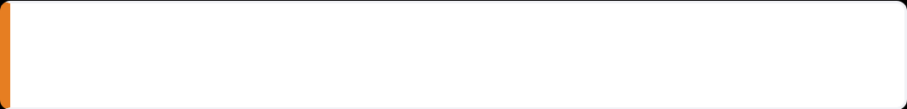



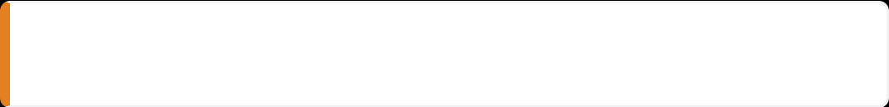

RECOMMENDED MONITORING SCHEDULE BY RISK
www.bradfordvts.co.uk
Clinical Guide: Diabetes & Ramadan (NICE NG28 / IDF-DAR 2021)
Disclaimer: For educational use only. Clinical decisions remain the responsibility of the practitioner.
LOW RISK
MODERATE RISK
HIGH RISK
Diet-controlled T2DM
Sulfonylureas (Gliclazide)
Type 1 Diabetes (MDI)
Metformin / DPP-4i
Once-daily Basal Insulin
Mixed Insulins (M3, NovoMix)
GLP-1 RA / SGLT2i
Controlled T1DM (Case-by-case)
Severe complications / Pregnancy
Suhoor
Pre-dawn check
Suhoor
Pre-dawn baseline
Frequent
Check every 2–4 hours throughout day and night
Iftari
At sunset meal
Mid-Day
2–4 hours after start of fast
CGM HIGHLY RECOMMENDED
Anytime
If symptoms of hypo/hyper occur
Iftari
Before sunset meal
Post-Iftar
2 hours after breaking fast
KEY PATIENT MESSAGE: Blood glucose testing (finger-prick or CGM) does NOT break the fast. This is confirmed by Islamic scholars and is a clinical necessity for safety.

Slide 18















THE ROLE OF CGM AND FLASH MONITORING
www.bradfordvts.co.uk
Clinical Guide: Diabetes & Ramadan (NICE NG28 / IDF-DAR 2021)
Disclaimer: For educational use only. Clinical decisions remain the responsibility of the practitioner.
Clinical Benefits during Fasting
Eligibility & Implementation
Trend Arrows: Predicts hypoglycaemia before it happens, allowing for early intervention.
NICE NG28/NG17: All T1DM and T2DM on MDI (Multiple Daily Injections) with high risk.
Hypo Alerts: Critical for those with reduced hypo awareness during long fasting hours.
FreeStyle Libre: Strongly recommended for high-risk patients to improve safety and adherence.
Time in Range (TIR): Provides a holistic view of glycemic stability between Suhoor and Iftari.
Type 1 DM
T2DM on Insulin
High Risk (IDF-DAR)
AKT/SCA CLINICAL PEARL
Start CGM/Flash 6–8 weeks before Ramadan. This allows the patient to understand their glucose patterns and for the GP to adjust basal insulin doses based on trend data before the fast begins.
Patient Education
Advise checking sensor readings every 2-4 hours. Reassure that the adhesive and sensor do not interfere with ritual purity (Wudu).
Religious Consensus: Blood glucose testing (finger-prick, CGM, or Flash) does NOT break the fast.

Slide 19











WHEN TO BREAK THE FAST: ABSOLUTE THRESHOLDS
www.bradfordvts.co.uk
Clinical Guide: Diabetes & Ramadan (NICE NG28 / IDF-DAR 2021)
Disclaimer: For educational use only. Clinical decisions remain the responsibility of the practitioner.
Hypoglycaemia Risk
Hyperglycaemia Risk
< 3.9 mmol/L
> 16.6 mmol/L
Must break fast immediately
Mandatory fast-breaking & rehydration
Treat with 15g fast-acting carb
Check ketones (blood/urine)
Symptoms: Sweating, shaking, hunger
Symptoms: Extreme thirst, polyuria
Dizziness or confusion (Neuroglycopenia)
Vomiting, confusion, or drowsiness
Acute Medical Contraindications
"Your body has a right over you... Health is a sacred trust (Amanah) and must not be harmed."
Regardless of blood glucose readings, the fast must be terminated if the patient experiences acute illness, severe dehydration, persistent vomiting, or diarrhoea. "Sick Day Rules" must be initiated immediately, including the suspension of SADMAN medications.
— Islamic Medical Ethics

Slide 20
















DIETARY ADVICE: THE SUHOOR MEAL
www.bradfordvts.co.uk
Clinical Guide: Diabetes & Ramadan (NICE NG28 / IDF-DAR 2021)
Disclaimer: For educational use only. Clinical decisions remain the responsibility of the practitioner.
THE FOUNDATION: LOW-GI CARBS
HYDRATION STRATEGY
Slow-Release Energy: Essential to sustain glucose levels throughout the 14-16 hour daylight fast.
Volume: Aim for 2–3 glasses of water specifically during the Suhoor period.
Key Examples: Porridge oats, wholegrain breads, basmati rice, lentils (daal), and chickpeas.
Avoid Caffeine: Tea and coffee are diuretics; they increase fluid loss and risk of dehydration.
Satiety & Stability: Include protein and healthy fats (eggs, Greek yogurt, nuts/seeds) to slow digestion further.
Limit Salt: High salt intake at Suhoor increases thirst throughout the following day.
SUHOOR MEAL COMPOSITION
CLINICAL SAFETY: THE "MUST-EAT" RULE
Protein: Eggs, beans, or lean meat help prevent muscle breakdown and maintain fullness.
Hypo Risk: Skipping Suhoor is a major risk factor for severe hypoglycemia in patients on insulin or SUs.
Fiber: Fruits with skin and vegetables to prevent constipation, common during Ramadan.
AKT PEARL: Advise patients that skipping the pre-dawn meal significantly increases the risk of "ending the fast" early due to hypos.

Slide 21







DIETARY ADVICE: THE IFTARI MEAL
www.bradfordvts.co.uk
Clinical Guide: Diabetes & Ramadan (NICE NG28 / IDF-DAR 2021)
Disclaimer: For educational use only. Clinical decisions remain the responsibility of the practitioner.
Breaking the Fast (The Start)
Foods to Limit or Avoid
Traditional Opening: 1–2 dates + plenty of water. Dates are high-GI; limit quantity to manage glucose spikes.
Fried Snacks: Samosas, pakoras, and spring rolls are calorie-dense and cause significant post-prandial hyperglycemia.
Hydration First: Drink 2 glasses of water before the main meal to aid satiety and rehydration.
Sugary Drinks: Avoid mango lassi, fruit syrups (Rooh Afza), and fizzy drinks. Opt for water, milk, or unsweetened tea.
Slow Release: Include a small bowl of soup (lentil/vegetable) to provide warmth and initial fluids.
High-GI Starches: Reduce large portions of white rice, white bread, and refined flour desserts (Jalebi/Mithai).
The Healthy Iftari Plate
Fluid Management Strategy
Balance: 1/2 plate salad/vegetables, 1/4 lean protein (chicken/fish/lentils), 1/4 complex carbohydrates.
Total Intake: Aim for 2–3 litres total between Iftari and Suhoor to prevent dehydration-linked AKI/DKA.
Cooking Method: Grill, bake, or steam instead of frying. Use healthy oils (olive/rapeseed) in moderation.
Salt Control: Avoid excess salt at Iftari; high sodium increases thirst and dehydration risk the following day.
Bowel Health: Keep skins on fruits and vegetables; ensure high fiber intake to prevent common Ramadan constipation.
Caffeine: Limit tea and coffee; caffeine acts as a diuretic and increases fluid loss during fasting hours.

Slide 22








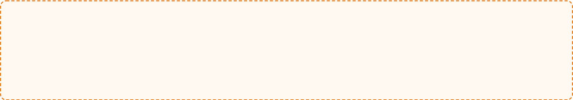




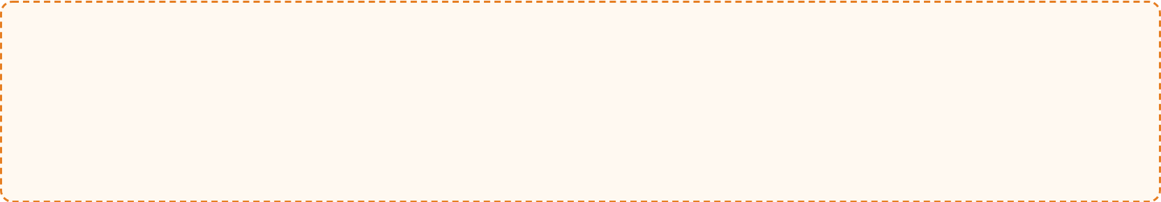
EXERCISE AND TARAWEEH PRAYERS
www.bradfordvts.co.uk
Clinical Guide: Diabetes & Ramadan (NICE NG28 / IDF-DAR 2021)
Disclaimer: For educational use only. Clinical decisions remain the responsibility of the practitioner.
Taraweeh (Evening Prayers)
Physical Activity Levels
Counts as significant physical activity (1–2 hours of standing, bowing, and prostrating).
Light-to-moderate: Walking or gentle yoga is appropriate during fasting hours.
Strenuous exercise: Avoid during daylight hours due to dehydration and hypo risk.
Occurs 2 hours after Iftari; often coincides with peak post-prandial glucose levels.
Encourage maintaining normal daily activities but avoiding over-exertion just before Iftari.
High exertion may increase risk of late-night hypoglycaemia, especially if on insulin or SUs.
SCA COMMUNICATION TIP
Advise patients to treat Taraweeh like a gym session: check blood glucose before and after, and always carry hypo treatment/water.
Optimal Exercise Timing
Best Time: 1–2 hours AFTER Iftari
Energy stores are replenished and hydration is possible.
Monitoring & Safety
Helps manage post-Iftari glucose spikes.
Ensures safer physiological response to insulin/medications.
Test BG before and after any planned physical activity.
AKT PEARL
Remind patients: Testing BG does NOT break the fast.
Exercise during fasting hours increases risk of dehydration and euglycaemic DKA in SGLT2i users.
Break the fast immediately if BG <3.9 mmol/L during activity.

Slide 23


















COMMUNICATION SKILLS AND CULTURAL SENSITIVITY
www.bradfordvts.co.uk
Clinical Guide: Diabetes & Ramadan (NICE NG28 / IDF-DAR 2021)
Disclaimer: For educational use only. Clinical decisions remain the responsibility of the practitioner.
"A patient with a HbA1c of 75 mmol/mol insists on fasting for the full 30 days. What is your first question?"
Cultural Literacy & Language
Suhoor / Sehri
Iftari / Maghrib
The pre-dawn meal before the fast begins.
The meal at sunset to break the fast.
Shared Decision-Making
Taraweeh
Qadha / Fidya
Avoid Directives: Do not simply forbid fasting. Explore the spiritual significance for the individual first.
Evening prayers (counts as physical activity).
Ways to make up or compensate for missed fasts.
Inform, Don't Command: Use the IDF-DAR risk tool to provide objective safety data to inform their decision.
Myth-Busting: Explicitly state that finger-prick blood glucose testing does not break the fast.
Supportive Framing: Shift from "You shouldn't fast" to "I want to help you fast as safely as possible."
SCA Key Phrase:
Checking Understanding
"I understand how important this month is for you spiritually. My goal is to work together to ensure your health is protected while you observe your faith."
"What time is sunset in your area? That will be your Iftari time."
"What is your plan if you feel dizzy or shaky during the afternoon?"
"How often do you plan to check your sugars during the day?"

Slide 24









AKT EXAM PEARLS
www.bradfordvts.co.uk
Clinical Guide: Diabetes & Ramadan (NICE NG28 / IDF-DAR 2021)
Disclaimer: For educational use only. Clinical decisions remain the responsibility of the practitioner.
Timing & Risk Assessment
Critical Safety Thresholds
Pre-Ramadan Review: Conduct 6–8 weeks before the fast starts.
Break Fast immediately if: BG < 3.9 mmol/L or > 16.6 mmol/L.
Risk Tool: Use IDF-DAR (High / Moderate / Low) to guide advice.
Myth-Busting: Finger-prick BG testing and CGM do NOT break the fast.
Oral Medication Adjustments
Insulin & Specialized Care
Sulfonylureas: Reduce dose by 50% and move to Iftari (sunset).
Pre-mixed Insulin: Advise against fasting due to unpredictable peaks.
Metformin: Move dose to Iftari. MR preparation is preferred.
Basal Insulin: Reduce dose by 15–30% at Iftari if BG target < 7.0.
SGLT2i: Generally safe but high dehydration/DKA risk in hot weather.
AVOID Glibenclamide (High hypo risk)
T1DM: Very high risk; must have DSN/specialist review before fasting.
Speaker Notes: This slide captures high-yield AKT points. Key takeaways: 1. The 6-8 week lead time for reviews is a frequent exam question. 2. Sulfonylurea dose reduction (50%) and timing (Iftari) is the standard answer. 3. Memorize the 3.9 and 16.6 thresholds—these are the "red lines" for patient safety. 4. Always clarify that BG monitoring is religiously permissible during fasting. 5. T1DM and Mixed Insulins are "High Risk" categories—exams often test the appropriate referral pathway.

Slide 25








SCA EXAM PEARLS AND CASE SCENARIOS
www.bradfordvts.co.uk
Clinical Guide: Diabetes & Ramadan (NICE NG28 / IDF-DAR 2021)
Disclaimer: For educational use only. Clinical decisions remain the responsibility of the practitioner.
Consultation Framing
SCA CASE SCENARIO
Risk Identification
"A patient with a HbA1c of 75 mmol/mol insists on fasting for the full 30 days. What is your first question?"
Patient: 62yo Male, T2DM on Gliclazide 80mg BD. HbA1c 68 mmol/mol. Desires to fast. Task: Stratify risk and identify "Red Flags" in his current regimen.
Explore Intentions: Use shared decision-making. Acknowledge the spiritual significance before discussing risk.
Risk Level: Moderate Risk (Sulfonylurea). Needs 50% dose reduction and move to Iftari.
Safe Fasting Language: Frame advice as "How can we make this safe for you?" rather than "You are forbidden from fasting."
Cultural Terms: Use Suhoor/Sehri (pre-dawn), Iftari (sunset), and Taraweeh (evening prayers) correctly.
Essential Safety Netting
Verify understanding using specific safety-netting phrases:
"When exactly would you break your fast if you felt unwell?"
"What would you do if your sugar was 3.8 before Iftari?"
"Can you show me your hypo treatment kit?"

Slide 26








RED FLAGS AND EMERGENCY SITUATIONS
www.bradfordvts.co.uk
Clinical Guide: Diabetes & Ramadan (NICE NG28 / IDF-DAR 2021)
Disclaimer: For educational use only. Clinical decisions remain the responsibility of the practitioner.
Severe Hypoglycaemia
Dehydration & Renal Risk
Symptoms: Confusion, sweating, palpitations, tremors, or seizure.
Symptoms: Severe dizziness, syncope, or significantly reduced urine output.
Hypo Unawareness: High risk in T1DM or long-duration T2DM.
SGLT2i Warning: High risk of volume depletion in hot weather.
Action: Immediate fast termination + 15g fast-acting glucose.
Complication: Potential Acute Kidney Injury (AKI) if fasting continues.
ABSOLUTE THRESHOLD: BG < 3.9 mmol/L
Hyperglycaemia & DKA
Acute Illness Management
Symptoms: Extreme thirst, polyuria, vomiting, or abdominal pain.
Intercurrent Illness: Vomiting or diarrhoea mandates stopping the fast.
DKA Risk: Elevated ketones (>1.5 mmol/L) in T1DM/SGLT2i users.
SADMAN Drugs: Stop SGLT2i, ACEi, Diuretics, Metformin, ARBs, NSAIDs.
Euglycaemic DKA: Potential with SGLT2i even if BG is near normal.
"Health is a Sacred Trust (Amanah) — Do Not Harm"
ABSOLUTE THRESHOLD: BG > 16.6 mmol/L

Slide 27





















COMMON PITFALLS TO AVOID
www.bradfordvts.co.uk
Clinical Guide: Diabetes & Ramadan (NICE NG28 / IDF-DAR 2021)
Disclaimer: For educational use only. Clinical decisions remain the responsibility of the practitioner.
Identifying frequent clinical errors and misconceptions that compromise safety during the holy month.
Medication Inertia
Process Failures
Monitoring Myths
!
Leaving Sulfonylurea doses unchanged (high risk of fasting hypoglycaemia).
!
Reactive management: waiting for the patient to initiate the review.
!
Not clarifying that finger-prick blood glucose testing does NOT break the fast.
!
Prescribing NSAIDs to dehydrated patients (Acute Kidney Injury risk).
!
Timing: holding the review too late (should be 6–8 weeks before).
!
Patient avoiding CGM/Libre due to perceived ritual impurity.
AKT: 50% SU reduction is key.
Insulin Mismanagement
Cultural Assumptions
Nutritional Neglect
!
Failing to switch pre-mixed insulins (Humulin M3) to safer regimens.
!
Issuing a "directive" not to fast without exploring individual values.
!
Skipping the Suhoor (pre-dawn) meal, causing severe daytime hypoglycaemia.
Stopping basal insulin entirely (risk of DKA in T1DM).
!
!
Assuming all South Asian patients are fasting or are Muslim.
!
Ignoring the hydration risk in SGLT2i users (Volume depletion).
SCA: Focus on shared decision-making.

Slide 28



















TOP 10 TIPS FOR GP TRAINEES
www.bradfordvts.co.uk
Clinical Guide: Diabetes & Ramadan (NICE NG28 / IDF-DAR 2021)
Disclaimer: For educational use only. Clinical decisions remain the responsibility of the practitioner.
1. Proactive Review Timing
6. Critical Break-Fast Threshold
Schedule reviews 6–8 weeks before Ramadan starts to allow for medication stabilization.
If BG <3.9 mmol/L or patient is symptomatic, they MUST break the fast and treat immediately.
2. Use Risk Stratification
7. Dehydration & SGLT2i
Apply the IDF-DAR tool (High/Mod/Low) to guide safety advice rather than personal opinion.
Advise 2–3L of hydration during non-fasting hours to mitigate volume depletion risks.
3. BG Testing is Permitted
8. Account for Taraweeh
Reassure patients that finger-prick testing does NOT break the fast (Medical necessity).
Evening prayers involve 1–2 hours of physical activity; consider this when titrating Iftari doses.
4. Sulfonylurea Safety
9. Never Skip Suhoor
Reduce dose by 50% and move to Iftari. Completely avoid Glibenclamide due to high hypo risk.
The pre-dawn meal is critical for preventing daytime hypoglycaemia. Focus on low-GI carbs.
5. Insulin Red Flags
10. Health as a Trust (Amanah)
Pre-mixed insulins (NovoMix/M3) are high risk; require specialist review or switch to basal-bolus.
Use religious context: Islam permits breaking fast for health. Health is a sacred trust to be preserved.

Slide 29












QUICK RECALL QUIZ
www.bradfordvts.co.uk
Clinical Guide: Diabetes & Ramadan (NICE NG28 / IDF-DAR 2021)
Disclaimer: For educational use only. Clinical decisions remain the responsibility of the practitioner.
Sulfonylurea Dose Adjustment?
Hypoglycaemia Break Threshold?
Reduce dose by 50% and move timing to Iftari (sunset meal). Avoid Glibenclamide.
The fast MUST be broken if blood glucose drops below 3.9 mmol/L, regardless of symptoms.
Does BG Testing Break the Fast?
Hyperglycaemia Break Threshold?
NO. Finger-prick testing and CGM sensors are medically necessary and do not invalidate the fast.
The fast MUST be broken if blood glucose exceeds 16.6 mmol/L to prevent DKA and dehydration.
Timing of Pre-Ramadan Review?
Which Insulin is "High Risk"?
Ideally 6–8 weeks before the start of Ramadan to allow for medication titration and education.
Pre-mixed insulins (e.g., Humulin M3, NovoMix 30) carry the highest risk of unpredictable hypos.
AKT Tip: Remember that Metformin generally requires no dose change, just a shift in timing to Iftari/Suhoor.

Slide 30

















SUMMARY AND BRADFORD VTS RESOURCES
www.bradfordvts.co.uk
Clinical Guide: Diabetes & Ramadan (NICE NG28 / IDF-DAR 2021)
Disclaimer: For educational use only. Clinical decisions remain the responsibility of the practitioner.
IDF-DAR Global Guidelines
Ready for Ramadan: Closing Checklist
Full 2021 Practical Guidelines & Risk Assessment Tool.
Schedule Early: Conduct pre-Ramadan reviews 6–8 weeks prior to the start of the fast.
TREND-UK Patient Leaflets
Risk Stratify: Use the IDF-DAR tool to identify high-risk patients who should be advised against fasting.
Multilingual resources for patients with Type 1 & Type 2.
Safety First: Reassure patients that BG testing does NOT break the fast and is essential for safety.
Bradford Diabetes Pathways
Local referral criteria for DSNs and specialist clinics.
Clear Thresholds: Ensure patients know to break the fast if BG <3.9 or >16.6 mmol/L.
Shared Decisions: Respect the spiritual choice to fast while providing clinical safeguards.
Access Teaching Materials & Exam Prep
Download the full Ramadan Slide Deck, AKT Flashcards, and SCA Case Scenarios on the Bradford VTS portal.
www.bradfordvts.co.uk

