Slide 1

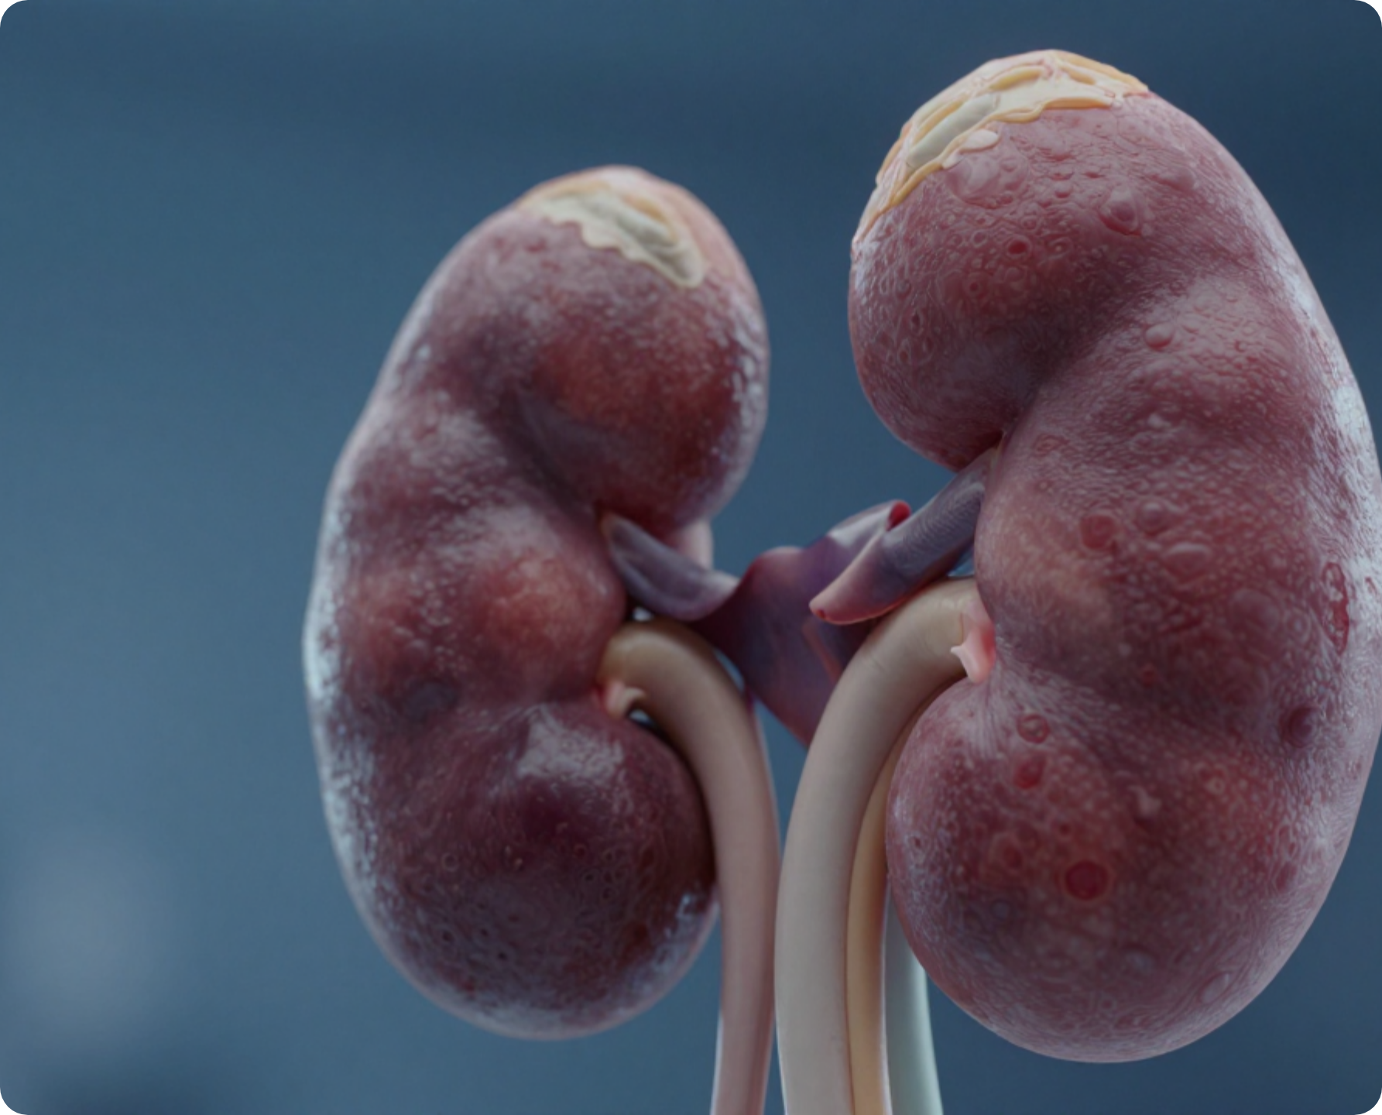


Diabetes and Renal Disease
www.bradfordvts.co.uk
BRADFORD VTS TEACHING DECK
High-Yield Exam Focus
Comprehensive preparation for RCGP AKT and SCA exams, bridging pathophysiology with frontline primary care management.
CLINICAL CURRENCY & GUIDELINES
NICE NG28: Type 2 Diabetes Management (Feb 2026 Update)
NICE NG203: Chronic Kidney Disease Assessment (2021)
NICE TA877: Finerenone for DKD (March 2023)
NICE TA775/942: SGLT2i in Chronic Kidney Disease
BNF 2026: Current Pharmacological Thresholds
Disclaimer: This teaching deck is an educational resource for GP trainees. Clinical decisions must be based on the most recent NICE, local guidelines, and BNF data at the time of patient contact. Ensure you verify eGFR thresholds for SGLT2i and Metformin prior to prescribing.
GPST Curriculum • May 2026

Slide 2










BRADFORD VTS TEACHING
www.bradfordvts.co.uk
Disclaimer and Clinical Currency
Disclaimer: Educational resource for GP trainees. Clinical decisions must be based on the most recent NICE/local guidelines at the time of patient contact.
AKT/SCA Exam Pearl
Clinical Currency & References
Important Note
NICE NG28 (Updated February 2026)
Type 2 Diabetes Management & New CKD Pathway
This deck is specifically designed for AKT/SCA Exam Preparation.
While current as of May 2026, clinical guidelines are subject to rapid change.
Clinical Practice: Always cross-reference with the live NICE Pathways and local Bradford/West Yorks Formularies during patient consultations.
NICE NG203 (2021 + SGLT2i 2023 Update)
Chronic Kidney Disease: Assessment and Management
NICE TA877 (March 2023)
Finerenone for treating CKD in Type 2 Diabetes
BNF 2026 Edition
Current Pharmacological Dosing & eGFR Thresholds
West Yorkshire CKD Guidelines (July 2025)
Regional Shared Care & Initiation Protocols

Slide 3









BRADFORD VTS TEACHING
www.bradfordvts.co.uk
Epidemiology of Diabetic Kidney Disease
Disclaimer: Educational resource for GP trainees. Clinical decisions must be based on the most recent NICE/local guidelines at the time of patient contact.
AKT/SCA Exam Pearl
The Bradford Context
The Scale of the Problem
Bradford has a significantly high South Asian population compared to the UK average.
20-40%
40%
T2DM and CKD disproportionately affect South Asian communities (earlier onset and faster progression).
of T2DM patients develop DKD
of all new dialysis patients
DKD is the most common cause of end-stage renal disease (ESRD) in the UK.
Health inequalities: Higher prevalence of metabolic syndrome and genetic predisposition.
Significant burden on primary care screening and secondary care renal services.
SCA Tip: When discussing management in Bradford, consider cultural dietary habits and the importance of early aggressive screening in high-risk ethnic groups.
Cardiovascular Connection
Up to 20×
AKT Knowledge Focus
Increased CV risk compared to general population
Understand that DKD = Albuminuria + Declining eGFR.
Patients with T2DM and CKD are more likely to die from cardiovascular events than to reach end-stage renal failure.
Recognize mortality risk is driven by CV disease.
Recall: 40% of dialysis patients have diabetes.

Slide 4







BRADFORD VTS TEACHING
www.bradfordvts.co.uk
Pathophysiology: How Diabetes Damages the Kidneys
Disclaimer: Educational resource for GP trainees. Clinical decisions must be based on the most recent NICE/local guidelines at the time of patient contact.
AKT/SCA Exam Pearl
1. METABOLIC INSULT
2. HAEMODYNAMIC STRESS
Chronic Hyperglycaemia: Non-enzymatic glycation of basement membrane proteins.
Hyperfiltration: Early GFR increase due to afferent dilatation and efferent constriction.
AGEs: Formation of Advanced Glycation End-products (AGEs).
RAAS Activation: Local Angiotensin II increases intraglomerular pressure.
Result: Increased basement membrane permeability and oxidative stress.
Key: This pressure leads to mechanical stretching and mesangial expansion.
3. STRUCTURAL DAMAGE
4. CHRONIC PROGRESSION
Podocyte Loss: Effacement and detachment of glomerular epithelial cells.
Tubular Injury: Proteinuria triggers inflammatory pathways in renal tubules.
Basement Membrane: Thickening and loss of negative charge.
Interstitial Fibrosis: Progressive scarring and irreversible nephron loss.
Clinical Sign: Albuminuria (protein leakage) begins here.
Final Stage: Declining eGFR and eventually End-Stage Renal Disease.
AKT Tip: Remember that Hyperfiltration is an early feature—a high eGFR in a newly diagnosed diabetic is not necessarily "good" kidneys; it may be the start of the damage process.

Slide 5











BRADFORD VTS TEACHING
www.bradfordvts.co.uk
Pathognomonic Lesions: Kimmelstiel-Wilson Nodules
Disclaimer: Educational resource for GP trainees. Clinical decisions must be based on the most recent NICE/local guidelines at the time of patient contact.
AKT/SCA Exam Pearl
Mechanism of Formation
Histological Hallmark
The nodules result from long-term metabolic and haemodynamic stress on the renal microvasculature:
Kimmelstiel-Wilson (KW) nodules are the pathognomonic histological finding in **Diabetic Nephropathy** (specifically Diabetic Glomerulosclerosis).
Chronic Hyperglycaemia → Glycation of basement membrane proteins.
Increased mesangial matrix production and basement membrane thickening.
Nodular Mesangial Expansion: Spherical, laminated ovoid hyaline masses in the periphery of the glomerulus.
Leads to progressive compression of glomerular capillaries.
Location: Within the mesangium of the glomerular capillary loops.
Staining: PAS-positive (Periodic Acid-Schiff) nodules.
"Nodular Glomerulosclerosis"
AKT EXAM RECALL
If a question mentions "nodular mesangial expansion" or "Kimmelstiel-Wilson nodules" on a renal biopsy, the diagnosis is always Diabetic Nephropathy. It is rarely seen in other conditions (though occasionally mimicked by light-chain deposition disease).

Slide 6
















BRADFORD VTS TEACHING
www.bradfordvts.co.uk
Annual Screening: eGFR and UACR
Disclaimer: Educational resource for GP trainees. Clinical decisions must be based on the most recent NICE/local guidelines at the time of patient contact.
AKT/SCA Exam Pearl
Serum eGFR Screening
Urine ACR Screening
Use first morning urine (most reproducible/concentrated).
Frequency: At least annually for ALL people with Type 1 and Type 2 Diabetes.
Category
UACR (mg/mmol)
Clinical Status
Equation: Use the CKD-EPI creatinine-based equation (standard in UK labs).
Stability: CKD is defined as eGFR <60 ml/min/1.73m² persistent for >3 months.
A1
< 3
Normal to mildly increased
A2
3 – 30
Microalbuminuria (Significant)
Variables: Be aware of factors affecting creatinine (muscle mass, diet, certain drugs).
A3
> 30
Macroalbuminuria (Severe)
Confirmation Protocol (AKT High-Yield)
If UACR is ≥3 mg/mmol: Confirm on two of three samples over 3–6 months.
Crucial: Always exclude Urinary Tract Infection (UTI) or other transient causes (exercise, fever) before diagnosing albuminuria.

Slide 7

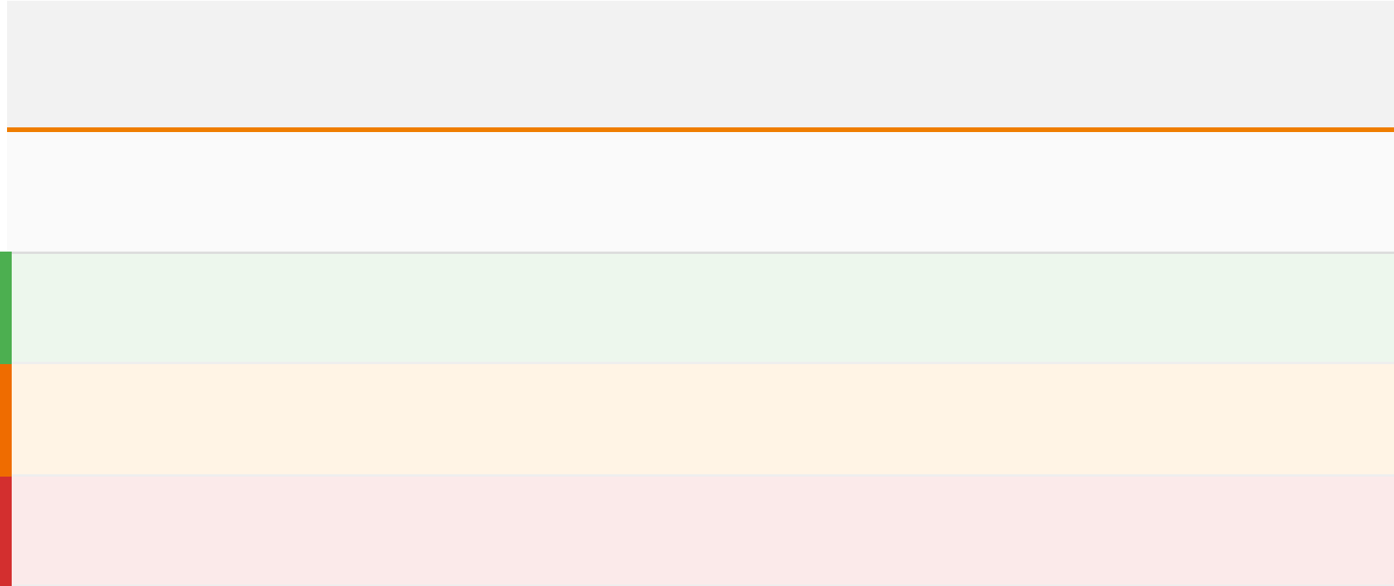

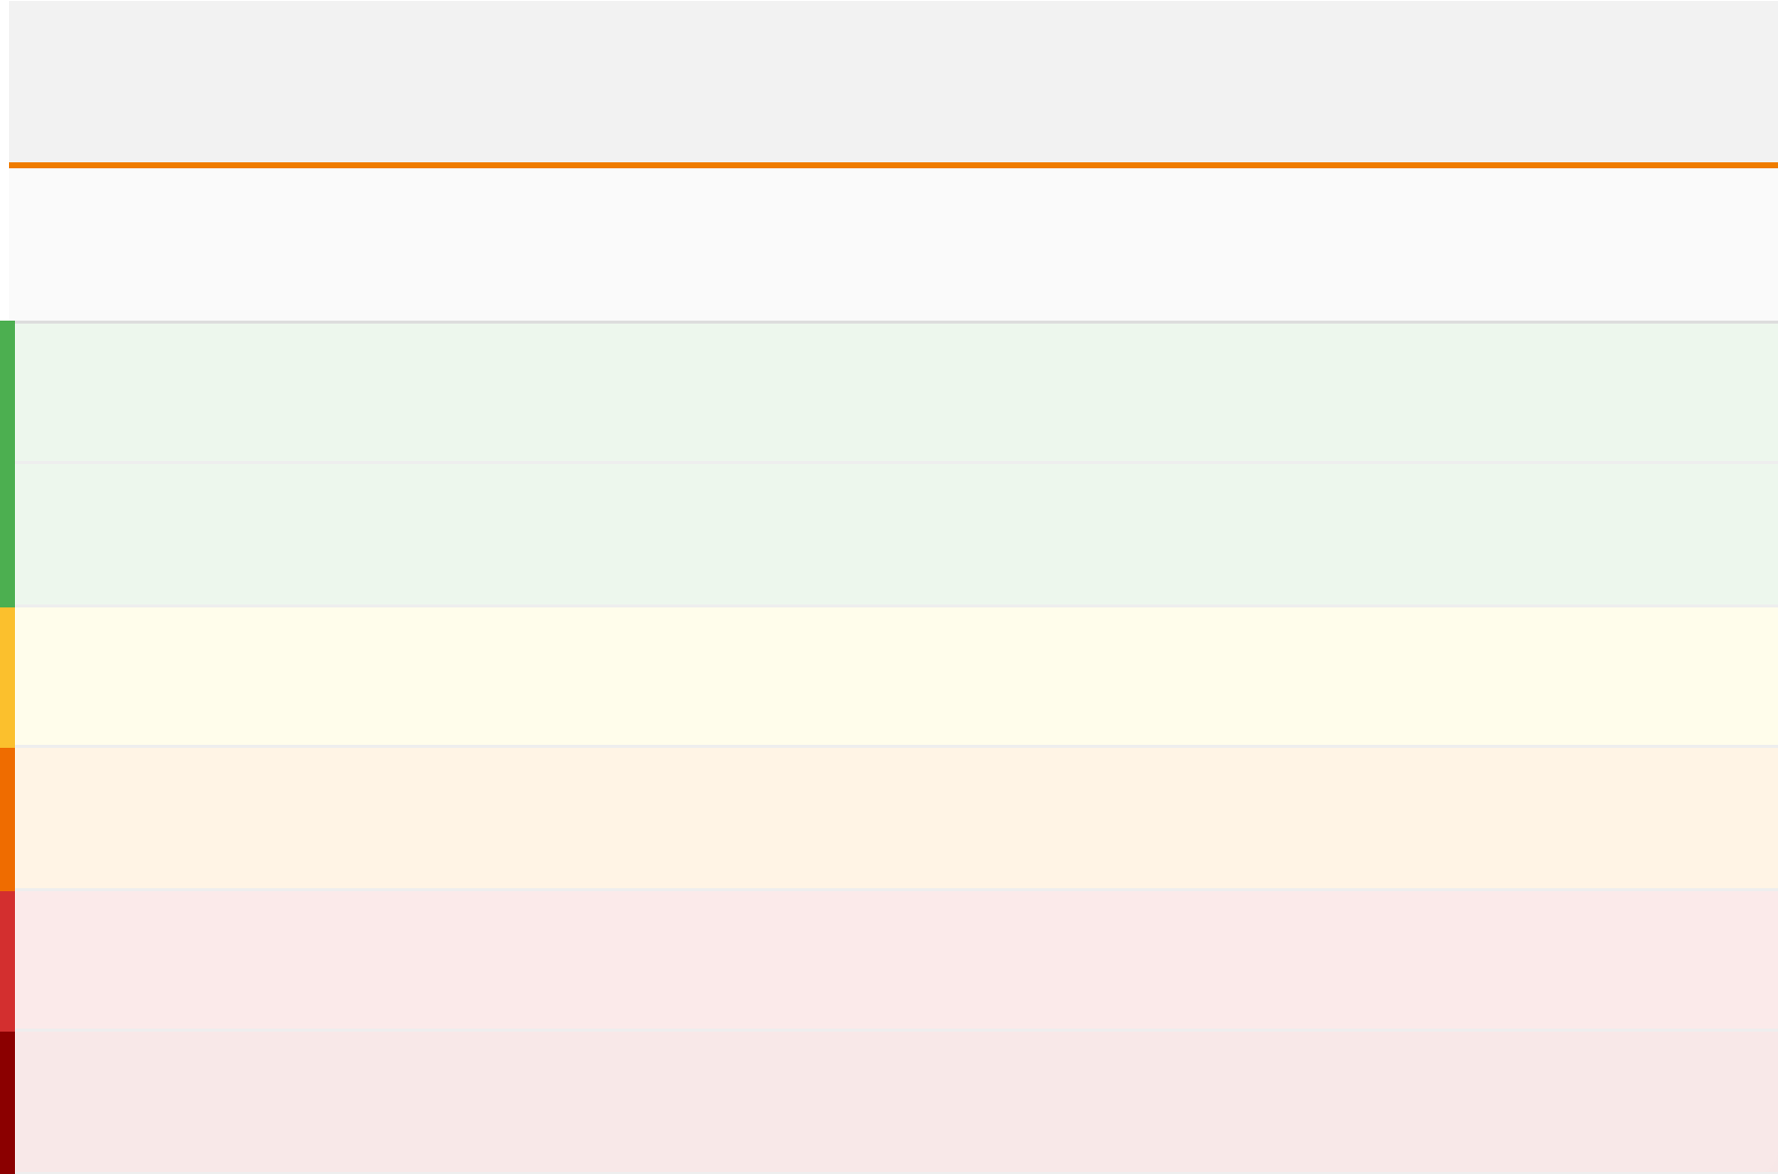

























BRADFORD VTS TEACHING
www.bradfordvts.co.uk
CKD Staging and Albuminuria Categories
Disclaimer: Educational resource for GP trainees. Clinical decisions must be based on the most recent NICE/local guidelines at the time of patient contact.
AKT/SCA Exam Pearl
Diagnostic Criteria: CKD = eGFR <60 ml/min OR Albuminuria (UACR ≥3 mg/mmol) sustained for >3 months.
Albuminuria (A-Categories)
eGFR Staging (G-Categories)
Category
UACR (mg/mmol)
Description
Stage
eGFR (ml/min)
Description
<3
Normal to mildly increased
A1
G1
≥90
Normal or high*
3–30
Moderately increased (Microalbuminuria)
A2
G2
60–89
Mildly decreased*
>30
Severely increased (Macroalbuminuria)
A3
G3a
45–59
Mildly to moderately decreased
G3b
30–44
Moderately to severely decreased
Risk Progression Logic
G4
15–29
Severely decreased
Risk of CVD, AKI, and ESRD increases as G-stage rises (1→5) AND as A-category rises (1→3).
G5
<15
Kidney failure (ESRD)
A patient with G2 A3 is at higher risk than G3a A1.
AKT Pearl: Always confirm UACR on 2 of 3 samples (first morning urine preferred) to exclude transient proteinuria.
*G1 and G2 require markers of kidney damage (e.g., UACR ≥3) to diagnose CKD.

Slide 8








BRADFORD VTS TEACHING
www.bradfordvts.co.uk
Identifying Non-Diabetic CKD
Disclaimer: Educational resource for GP trainees. Clinical decisions must be based on the most recent NICE/local guidelines at the time of patient contact.
AKT/SCA Exam Pearl
When to Suspect Other Causes
Rapid Decline & Referral
Significant Haematuria: Microscopic or macroscopic haematuria in the absence of significant proteinuria.
Rapid eGFR Fall: Decline of >5 ml/min/1.73m² within 1 year or >10 ml/min within 5 years.
Mismatch with Retinopathy: Heavy proteinuria (Nephrotic range) but no diabetic retinopathy (DKD usually co-exists with eye disease).
Primary Care Action: Refer to Nephrology for specialist assessment and consideration of Renal Biopsy.
Atypical Onset: Significant proteinuria within <5 years of diabetes diagnosis (especially in Type 1 DM).
Systemic Symptoms: Fever, rash, or joint pains suggesting vasculitis or systemic lupus erythematosus (SLE).
Management Strategy
If non-diabetic CKD is suspected:
Exclude UTI and heart failure first.
AKT Recall: Diabetic Kidney Disease (DKD) is a microvascular complication. If a patient has advanced CKD but perfectly clear fundi, your "non-diabetic" alarm should be ringing!
Perform Immunology screen (ANA, ANCA, Complement).

Slide 9













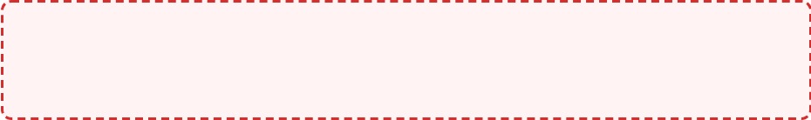


BRADFORD VTS TEACHING
www.bradfordvts.co.uk
Drug Management: NICE NG28 February 2026 Pathway
Disclaimer: Educational resource for GP trainees. Clinical decisions must be based on the most recent NICE/local guidelines at the time of patient contact.
AKT/SCA Exam Pearl
Management of Type 2 Diabetes with CKD is now stratified by renal function thresholds (eGFR).
eGFR > 30 ml/min
eGFR 20 – 30 ml/min
eGFR < 20 ml/min
First-line Standard Care
Modified Therapy
Specialist & Conservative
Metformin MR + SGLT2i
SGLT2i + DPP-4 Inhibitor
DPP-4 Inhibitors
Dual first-line therapy for cardiorenal protection and glycaemic control.
Dapagliflozin or Empagliflozin preferred for renal protection.
Linagliptin is preferred (no dose adjustment required in any eGFR).
SGLT2i Monotherapy
Metformin Adjustment
Pioglitazone or Insulin
If Metformin is contraindicated or not tolerated.
Max 1g/day if eGFR 30–45.
Standard alternatives when oral agents are insufficient or contraindicated.
Continue SGLT2i even if glycaemic effect diminishes as eGFR falls below 45.
STOP Metformin if eGFR < 30
AVOID: SGLT2i initiation, Sulfonylureas (hypo risk), Metformin.
2026 UPDATE: SGLT2 inhibitors are now initiated ALONGSIDE Metformin as first-line therapy for DKD.

Slide 10
















BRADFORD VTS TEACHING
www.bradfordvts.co.uk
Management for eGFR Over 30 ml/min
Disclaimer: Educational resource for GP trainees. Clinical decisions must be based on the most recent NICE/local guidelines at the time of patient contact.
AKT/SCA Exam Pearl
First-Line Therapy (NICE NG28)
Metformin Dosing Thresholds
Metformin MR + SGLT2 Inhibitor: Now dual first-line therapy for patients with CKD and T2DM.
eGFR 45–90: Full dose (typically 2g daily) is generally acceptable.
eGFR 30–45: Review dose; maximum 1g daily (split dose).
Initiate both simultaneously if tolerated to maximize early cardiorenal protection.
STOP Metformin if eGFR falls below 30 due to lactic acidosis risk.
Standard approach for eGFR >30 ml/min/1.73m²
Contraindication Handling
SGLT2i Continuation Logic
If Metformin is contraindicated or not tolerated: Offer SGLT2 inhibitor monotherapy.
Glycaemic efficacy (HbA1c lowering) diminishes as eGFR falls below 45–60.
Crucial: Continue SGLT2i for cardiorenal benefit even if HbA1c benefit is low.
Ensure patient is counselled on "Sick Day Rules" before starting SGLT2i.
AKT Tip: In the 2026 NICE update, SGLT2i are no longer just "add-ons" for DKD; they are part of the primary first-line strategy alongside Metformin for those with eGFR >30.

Slide 11















BRADFORD VTS TEACHING
www.bradfordvts.co.uk
Management for eGFR 20 to 30 ml/min
Disclaimer: Educational resource for GP trainees. Clinical decisions must be based on the most recent NICE/local guidelines at the time of patient contact.
AKT/SCA Exam Pearl
Metformin Protocol
Alternative Glycaemic Control
eGFR 30–45: Maximum dose 1g per day (Metformin MR preferred).
DPP-4 Inhibitors: Often added to SGLT2i as metformin is withdrawn.
eGFR < 30: Must STOP Metformin immediately due to increased risk of lactic acidosis.
Linagliptin: The "gold standard" DPP-4i for CKD; requires no dose adjustment in any stage.
Avoid: Most Sulfonylureas (hypoglycaemia risk) and GLP-1 RA (check specific eGFR thresholds).
Mandatory cessation if eGFR falls below 30.
SGLT2 Inhibitor Strategy
Licensing & Initiation Cut-offs
Continue Therapy: Do not stop SGLT2i solely because eGFR falls to this range.
Dapagliflozin (NICE TA775): Can be down to eGFR 25 for CKD indication.
Cardiorenal Benefit: Protection persists even when glycaemic effect (glucose lowering) diminishes.
Empagliflozin (NICE TA942): Can be down to eGFR 20 for CKD indication.
TA775: DAPA 25+
TA942: EMPA 20+

Slide 12












BRADFORD VTS TEACHING
www.bradfordvts.co.uk
Management for eGFR Under 20 ml/min
Disclaimer: Educational resource for GP trainees. Clinical decisions must be based on the most recent NICE/local guidelines at the time of patient contact.
AKT/SCA Exam Pearl
Preferred Management
Avoid or Review
DPP-4 Inhibitors (Gliptins)
Linagliptin is the preferred choice as it requires no dose adjustment in any stage of CKD.
Metformin
Must be stopped when eGFR falls below 30 ml/min/1.73m² due to the high risk of lactic acidosis.
High-yield AKT fact: Linagliptin is the only DPP-4i that doesn't need dose reduction.
SGLT2 Inhibitors
Insulin-Based Treatment
Insufficient glucose-lowering effect at this level. Specialist nephrology may continue for renal protection, but GPs should not initiate.
Often the safest and most effective option as renal function declines towards G5. Note: insulin requirements may decrease as eGFR falls (reduced clearance).
Sulfonylureas (SUs)
Pioglitazone
Most require dose reduction or cessation. Avoid Glibenclamide entirely due to risk of severe, prolonged hypoglycemia.
Can be used as it is metabolized by the liver. However, use with caution due to risk of fluid retention/heart failure in CKD.
Clinical Safety: As patients approach eGFR <20, the focus shifts from tight glycaemic control to safety and avoidance of hypoglycaemia. Always review the patient's entire "SADMAN" list and ensure nephrology referral is in progress if eGFR <30.

Slide 13













BRADFORD VTS TEACHING
www.bradfordvts.co.uk
SGLT2 Inhibitors: Transformative Renal Protection
Disclaimer: Educational resource for GP trainees. Clinical decisions must be based on the most recent NICE/local guidelines at the time of patient contact.
AKT/SCA Exam Pearl
Mechanism of Nephroprotection
Key Clinical Trials (The Big Three)
Tubuloglomerular Feedback: SGLT2i block sodium reabsorption in the proximal tubule.
CREDENCE
Canagliflozin: 34% RRR in renal failure/death in DKD (UACR >30).
Increased sodium delivery to the Macula Densa.
Triggers vasoconstriction of the afferent arteriole.
Reduces intragiomerular hypertension and hyperfiltration, slowing structural damage.
DAPA-CKD
Dapagliflozin: 39% RRR in eGFR decline/ESRD. Benefit seen in non-diabetics too.
Effect is independent of HbA1c lowering efficacy.
EMPA-KIDNEY
Empagliflozin: 28% RRR in CKD progression or CV death across wide eGFR ranges.
CLINICAL BOTTOM LINE
SGLT2 inhibitors are no longer just "diabetes drugs." They are disease-modifying renal agents. The renal protection persists even as eGFR falls below 45, where glucose-lowering efficacy becomes minimal.

Slide 14






BRADFORD VTS TEACHING
www.bradfordvts.co.uk
SGLT2i: NICE Technology Appraisals and Licensing
Disclaimer: Educational resource for GP trainees. Clinical decisions must be based on the most recent NICE/local guidelines at the time of patient contact.
AKT/SCA Exam Pearl
Dapagliflozin
Empagliflozin
NICE TA775
NICE TA942
Indicated for Chronic Kidney Disease with or without diabetes.
Indicated for Chronic Kidney Disease in adults.
Reduces the risk of sustained eGFR decline, ESRD, and CV death.
Recommended as an option for treating symptomatic CKD.
Licensed for initiation for renal protection down to:
eGFR ≥ 25 ml/min/1.73m²
Licensed for initiation for renal protection down to:
eGFR ≥ 20 ml/min/1.73m²
Core Prescribing Principle
Initiate SGLT2i when the eGFR is above the license threshold. Once therapy is established, it should be continued even if the eGFR falls below the initiation threshold to maintain renal and cardiovascular protection. For blood glucose management, the effect diminishes at lower eGFR, but the nephroprotective benefit persists.
AKT RECALL: Dapagliflozin threshold is 25, Empagliflozin is 20 for CKD indication. Do not confuse with Metformin (Stop < 30).

Slide 15















BRADFORD VTS TEACHING
www.bradfordvts.co.uk
SGLT2i: Prescribing Rules and Safety
Disclaimer: Educational resource for GP trainees. Clinical decisions must be based on the most recent NICE/local guidelines at the time of patient contact.
AKT/SCA Exam Pearl
Initiation Thresholds
Key Safety Monitoring
Dapagliflozin: Licensed for CKD initiation down to eGFR 25 ml/min (NICE TA775).
DKA Risk: Can occur with near-normal glucose (Euglycaemic DKA). Check blood ketones if patient is unwell.
Empagliflozin: Licensed for CKD initiation down to eGFR 20 ml/min (NICE TA942).
Fournier's Gangrene: Rare necrotising fasciitis of the genitalia; advise urgent review for pain, erythema, or swelling.
Canagliflozin: Initiate if eGFR >30 with UACR >30 mg/mmol (CREDENCE criteria).
Genital Infection: Advise on hygiene; treat thrush promptly. Volume depletion risk in elderly/diuretic users.
Continuation Logic
The "S" in SADMAN
Cardiorenal Protection: Benefits persist even when glycaemic effect diminishes (below eGFR 45).
SICK DAY RULES
STOP SGLT2i temporarily during acute intercurrent illness, dehydration (vomiting/diarrhoea), or major surgery to prevent AKI and DKA.
Restart when eating/drinking normally for 24-48 hours.
Falling eGFR: Continue therapy as eGFR falls; only stop if starting dialysis or per specialist advice.

Slide 16

















BRADFORD VTS TEACHING
www.bradfordvts.co.uk
Finerenone: NICE TA877 (March 2023)
Disclaimer: Educational resource for GP trainees. Clinical decisions must be based on the most recent NICE/local guidelines at the time of patient contact.
AKT/SCA Exam Pearl
What is Finerenone?
NICE TA877 Recommendations
Non-steroidal mineralocorticoid receptor antagonist (MRA).
Indication: Stage 3 or 4 CKD with albuminuria associated with Type 2 Diabetes.
Higher selectivity for MR than spironolactone or eplerenone.
Mechanism: Reduces fibrosis, inflammation, and proteinuria by blocking overactivation of the MR in heart and kidneys.
Add-on therapy: Only after optimizing ACEi or ARB to maximum tolerated dose.
Standard of care (including SGLT2i) should be in place first.
Benefit over steroidal MRAs: Significantly lower risk of hyperkalaemia and gynaecomastia.
Initiation Requirements
Pathophysiological Role
eGFR: Must be ≥25 ml/min/1.73m² at start.
Targets structural damage rather than just haemodynamics.
Potassium: Must be ≤4.8 mmol/L (up to 5.0 in some local guidelines with caution).
Reduces mesangial expansion and tubular injury.
DO NOT initiate if patient is on dual RAAS blockade or has adrenal insufficiency.

Slide 17










BRADFORD VTS TEACHING
www.bradfordvts.co.uk
Finerenone: Clinical Evidence and Monitoring
Disclaimer: Educational resource for GP trainees. Clinical decisions must be based on the most recent NICE/local guidelines at the time of patient contact.
AKT/SCA Exam Pearl
Landmark Trial Evidence
Mandatory Safety Monitoring
FIDELIO-DKD Trial
1
4 Weeks Post-Initiation:
Check serum potassium and eGFR.
Focused on CKD progression and kidney failure in patients with Type 2 Diabetes.
2
At 3 Months:
Repeat U&Es (Potassium monitoring is critical).
FIGARO-DKD Trial
Focused on Cardiovascular outcomes in T2DM patients across CKD stages 1-4.
3
Ongoing Surveillance:
Every 6 months thereafter (or more if unstable).
~18%
~13%
STOP Finerenone if Potassium > 5.5 mmol/L
Renal Risk Reduction
CV Event Reduction
Note: Avoid in adrenal insufficiency or severe hepatic impairment. Not suitable for patients currently on dialysis.
*Renal outcomes include ESRD, sustained eGFR decline ≥40%, or renal death.

Slide 18











BRADFORD VTS TEACHING
www.bradfordvts.co.uk
RAAS Blockade: ACEi and ARB Therapy
Disclaimer: Educational resource for GP trainees. Clinical decisions must be based on the most recent NICE/local guidelines at the time of patient contact.
AKT/SCA Exam Pearl
Mechanism & Clinical Role
Prescribing Principles
Reduce Intraglomerular Pressure: Dilates the efferent arteriole to relieve hyperfiltration stress.
Intolerance: If ACEi causes dry cough, switch to an ARB. Both provide equal renal benefit.
Nephroprotection: Significantly slows the progression of albuminuria and eGFR decline.
Titration: Start low and titrate to the maximum tolerated dose for optimal protein reduction.
Standard of Care: Essential for ALL people with diabetes + microalbuminuria.
DANGER: Dual RAAS Blockade
Indication: UACR ≥ 3 mg/mmol
DO NOT combine ACEi + ARB.
Evidence from the ONTARGET trial shows no extra benefit but significantly increased risk of:Common AKT Trap

Slide 19

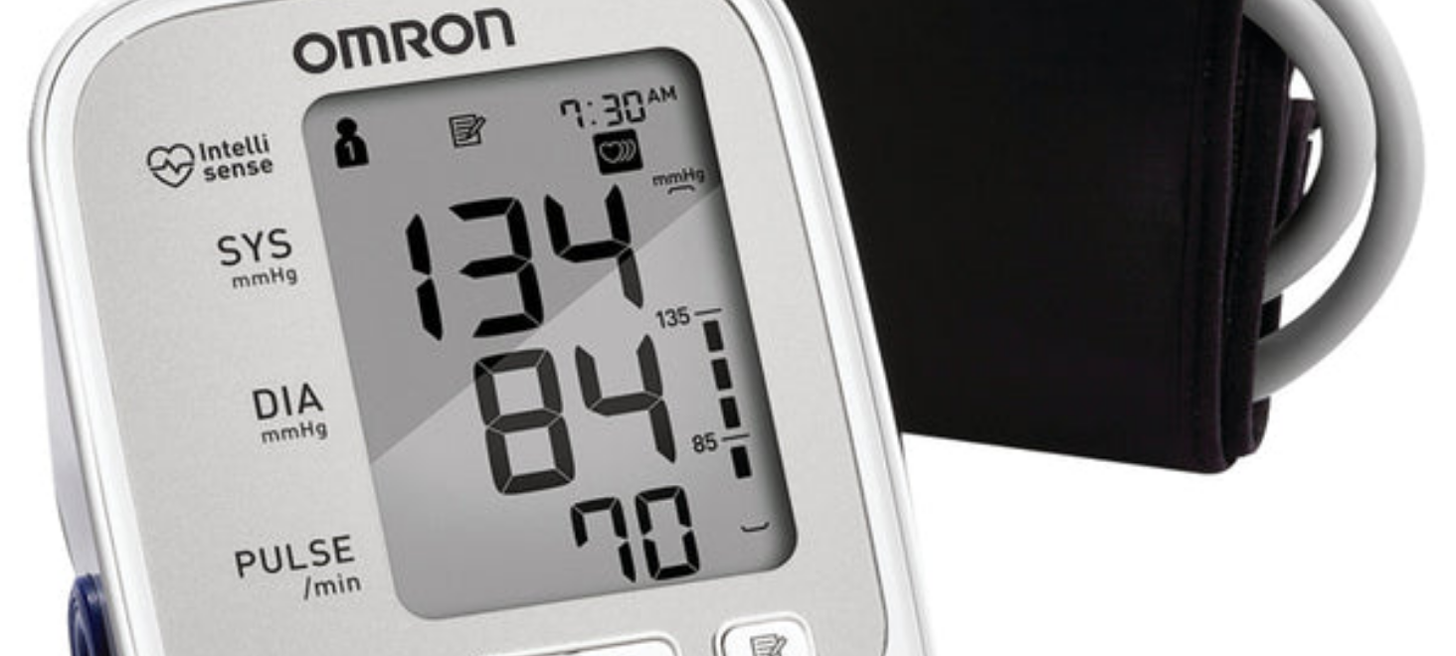








BRADFORD VTS TEACHING
www.bradfordvts.co.uk
BP Management and Monitoring ACEi/ARB
Disclaimer: Educational resource for GP trainees. Clinical decisions must be based on the most recent NICE/local guidelines at the time of patient contact.
AKT/SCA Exam Pearl
RAAS Blockade Monitoring Protocol
1
Baseline Assessment: Check U&Es (K+ and eGFR) before starting ACE inhibitor or ARB.
2
Post-Initiation: Recheck U&Es and eGFR 1–2 weeks after starting or any dose increase.
3
Acceptable Change: A fall in eGFR of up to 25% is expected and acceptable (haemodynamic effect).
Blood Pressure Targets
CKD + Proteinuria
<130/80 mmHg
T2DM (No CKD)
<140/90 mmHg
Add CCB or thiazide-like diuretic if targets not met with ACEi/ARB.
RED FLAG: When to Hold
If eGFR falls >25% or serum K+ rises >5.5 mmol/L:

Slide 20











BRADFORD VTS TEACHING
www.bradfordvts.co.uk
Blood Pressure and Lipid Targets
Disclaimer: Educational resource for GP trainees. Clinical decisions must be based on the most recent NICE/local guidelines at the time of patient contact.
AKT/SCA Exam Pearl
BP Target: CKD + Proteinuria
Lipid Management in CKD
<130/80 mmHg
Offer High-Intensity Statin to ALL with T2DM + CKD.
Per NICE NG203 (2021)
Preferred: Atorvastatin 20mg (minimum initial dose).
Titrate up to 80mg if needed to reach targets.
Standard T2DM target (no CKD) remains <140/90 mmHg.
Proteinuria defined as UACR ≥3 mg/mmol.
CV RISK REDUCTION TARGETS
<2.0
<1.8
PHARMACOLOGICAL HIERARCHY
LDL-C (mmol/L)
If Established CVD
1st Line: ACEi or ARB (Protective for kidneys).
Add CCB (Amlodipine) or Thiazide-like diuretic.
Note: Statins may not reduce proteinuria directly, but significantly reduce the 20x higher CV risk in this cohort.
NEVER combine ACEi + ARB (Dual Blockade Risk).

Slide 21










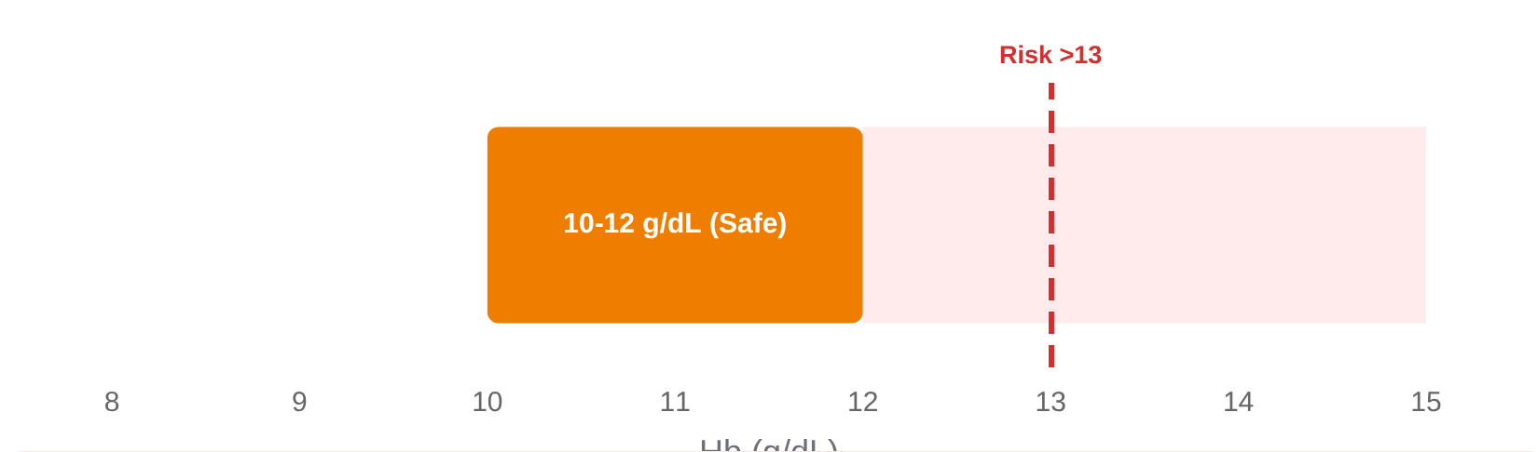


BRADFORD VTS TEACHING
www.bradfordvts.co.uk
Anaemia in Diabetic Kidney Disease
Disclaimer: Educational resource for GP trainees. Clinical decisions must be based on the most recent NICE/local guidelines at the time of patient contact.
AKT/SCA Exam Pearl
ESA Therapy (Nephrology Led)
Erythropoiesis-stimulating agents (ESAs) are initiated if Hb remains low despite iron replete status.
Pathophysiology & Screening
CKD causes reduced erythropoietin (EPO) production, leading to normocytic normochromic anaemia.
Requires regular monitoring of BP and Hb; ESAs can worsen hypertension.
Screening Trigger: Measure Hb if eGFR <45 ml/min/1.73m² (CKD Stage G3b+).
Ensure adequate iron stores are maintained during ESA therapy to optimize response.
Assessment: FBC, Ferritin, and Iron studies (TSAT) to exclude other causes.
Hb Targets & Visualization
Iron Management
Address iron deficiency first: Ferritin <100 µg/L or TSAT <20% indicates need for replacement.
Oral Iron: Ferrous sulfate/fumarate; monitor for GI intolerance.
IV Iron: If oral therapy is ineffective, not tolerated, or rapid correction is needed.
AKT/SCA Safety Warning
Avoid overtreating anaemia. Hb >13 g/dL is associated with increased risk of cardiovascular events, stroke, and thrombosis.

Slide 22



















BRADFORD VTS TEACHING
www.bradfordvts.co.uk
CKD Complications: Bone Disease & Hyperkalaemia
Disclaimer: Educational resource for GP trainees. Clinical decisions must be based on the most recent NICE/local guidelines at the time of patient contact.
AKT/SCA Exam Pearl
Mineral Bone Disease (CKD-MBD)
Hyperkalaemia Management
Screening: Monitor Calcium, Phosphate, and PTH in all patients with CKD G3b–G5 (eGFR <45).
Common Triggers: ACEi/ARB therapy, Finerenone, SGLT2i (mild), and low eGFR. Worsened by intercurrent illness (AKI).
Phosphate Control: Dietary restriction (avoid processed foods/colas) + Phosphate binders (e.g., Calcium Carbonate, Sevelamer).
Dietary Advice: Low potassium diet—limit bananas, tomatoes, potatoes, and "salt substitutes" (Lo-Salt).
Vitamin D Strategy: Advanced CKD requires activated Vitamin D (Alfacalcidol or Calcitriol) as kidneys cannot hydroxylate standard Vit D.
Potassium Binders: NICE-approved agents allow continued RAAS blockade in CKD patients.
Secondary Hyperparathyroidism: If PTH remains high despite phosphate/Vit D control, nephrologists may add Cinacalcet (calcimimetic).
Patiromer (TA623)
Sodium Zirconium Cyclosilicate (TA599)
Safety Threshold: Stop ACEi/ARB or Finerenone if K+ >5.5 mmol/L. Urgent review required.
MONITOR FROM
KEY MARKERS
eGFR <45 (G3b)
Ca / PO4 / PTH
Metabolic Acidosis:
If Bicarbonate <22 mmol/L (G4-G5), consider Sodium Bicarbonate to slow CKD progression.

Slide 23










BRADFORD VTS TEACHING
www.bradfordvts.co.uk
Metabolic Acidosis and Peripheral Neuropathy
Disclaimer: Educational resource for GP trainees. Clinical decisions must be based on the most recent NICE/local guidelines at the time of patient contact.
AKT/SCA Exam Pearl
Peripheral Neuropathy
Metabolic Acidosis (G4–G5)
Increased Prevalence: CKD significantly worsens the severity and progression of pre-existing diabetic neuropathy.
Common in advanced CKD due to reduced renal excretion of hydrogen ions and reduced bicarbonate production.
The "Double Hit": Patients suffer from both Diabetic (microvascular) and Uraemic (toxin-related) nerve damage.
Diagnostic Threshold: Serum bicarbonate < 22 mmol/L in patients with eGFR < 30 (CKD Stage 4–5).
Masking Effect: Uraemic symptoms (restless legs, cramps) can often mask or be confused with typical neuropathic pain.
Management: Oral sodium bicarbonate supplementation is recommended to maintain levels within normal range.
Treating acidosis slows the rate of eGFR decline and preserves muscle mass/bone health.
AKT/SCA CLINICAL FOCUS
Always screen for foot risk. CKD + Diabetes = High Risk. Uraemic neuropathy may improve with dialysis, whereas diabetic neuropathy is often irreversible.

Slide 24















BRADFORD VTS TEACHING
www.bradfordvts.co.uk
Referral Criteria to Nephrology
Disclaimer: Educational resource for GP trainees. Clinical decisions must be based on the most recent NICE/local guidelines at the time of patient contact.
AKT/SCA Exam Pearl
eGFR Threshold
Suspected Non-Diabetic CKD
Refer all patients with eGFR <30 ml/min/1.73m² (CKD Stage G4 or G5) for specialist management and RRT planning.
Haematuria + proteinuria, short diabetes duration (<5 yrs), or significant proteinuria without retinopathy.
Rapid Progression
A sustained decrease in eGFR of >5 ml/min/year or >10 ml/min within 5 years requires urgent review.
Resistant Complications
Difficult to control hypertension (on 4+ agents) or persistent hyperkalaemia (>5.5 mmol/L) despite primary care measures.
Significant Proteinuria
UACR >70 mg/mmol despite optimized ACEi/ARB and SGLT2i therapy (unless known to be diabetic and already managed).
AKT Exam Fact:
NICE NG203 specifically highlights UACR >70 mg/mmol as a referral threshold unless the patient has a known diagnosis and is already under specialist care. For the SCA, emphasize safety-netting for rapid decline.

Slide 25










BRADFORD VTS TEACHING
www.bradfordvts.co.uk
Sick Day Rules: The SADMAN Acronym
Disclaimer: Educational resource for GP trainees. Clinical decisions must be based on the most recent NICE/local guidelines at the time of patient contact.
SCA Patient Counselling Tool
When to Stop?
Temporarily stop these medications if you develop fever, sweats, vomiting, diarrhoea, or dehydration to prevent serious complications like AKI or Lactic Acidosis.
S
A
D
SGLT2 Inhibitors
ACE Inhibitors
Diuretics
Risk: DKA / AKI
Risk: AKI
Risk: Dehydration / AKI
Dapagliflozin, Empagliflozin, Canagliflozin
Ramipril, Lisinopril, Enalapril
Furosemide, Bendroflumethiazide, Indapamide
M
A
N
Metformin
ARBs
NSAIDs
Risk: Lactic Acidosis
Risk: AKI
Risk: Severe AKI
Stop if eGFR <45 or significantly dehydrated
Losartan, Candesartan, Irbesartan
Ibuprofen, Naproxen, Diclofenac
When to Restart? Only when eating and drinking normally for 24 to 48 hours.
*Seek medical advice if symptoms persist >48 hours

Slide 26







BRADFORD VTS TEACHING
www.bradfordvts.co.uk
Top Tips for GP Trainees
Disclaimer: Educational resource for GP trainees. Clinical decisions must be based on the most recent NICE/local guidelines at the time of patient contact.
AKT/SCA Exam Pearl
SCREENING MASTERY
THE NEW STANDARD OF CARE
Screen ALL patients with diabetes annually with eGFR AND UACR. HbA1c alone misses kidney disease.
SGLT2i: Now first-line for DKD (NICE NG28). Continue for renal benefit even as eGFR falls; stop only at eGFR <25 (Dapa).
Use first morning urine for UACR; it's the most reproducible.
Finerenone: Add to max ACEi/ARB in Stage 3–4 CKD with albuminuria. Always check potassium and eGFR first!
Confirm raised UACR (3–30) on 2 of 3 samples over 3–6 months after excluding UTI.
ACEi/ARB are mandatory for UACR ≥3 mg/mmol regardless of BP.
MEDICATION THRESHOLDS
SAFETY & REFERRAL RED FLAGS
Metformin: Reduce to max 1g/day if eGFR <45. STOP if eGFR <30 due to lactic acidosis risk.
NEVER combine ACEi + ARB. Dual blockade increases AKI and hyperkalaemia risk (ONTARGET trial).
Linagliptin: The "go-to" DPP-4i; no renal dose adjustment required even in ESRD.
Non-diabetic CKD? Suspect if: Haematuria, rapid eGFR drop (>5/yr), or no retinopathy. Refer to Nephrology.
Avoid Glibenclamide in CKD due to high risk of severe, prolonged hypoglycaemia.
ACEi Initiation: An eGFR dip of up to 25% is expected and acceptable.

Slide 27





BRADFORD VTS TEACHING
www.bradfordvts.co.uk
AKT Exam Pearls: High-Yield Facts
Disclaimer: Educational resource for GP trainees. Clinical decisions must be based on the most recent NICE/local guidelines at the time of patient contact.
AKT/SCA Exam Pearl
Thresholds & Staging
Pharmacology Cut-offs
UACR 3–30 mg/mmol (A2): Microalbuminuria. Trigger for ACEi/ARB + SGLT2i.
Metformin: Review at 45 (max 1g/day); Stop if <30.
SGLT2i: Initiate Dapa down to 25; Empa down to 20.
CKD G3b: eGFR 30–44 ml/min/1.73m². Increased monitoring required.
Linagliptin: No dose adjustment needed at any GFR.
UACR >70 mg/mmol: Consider nephrology referral (unless known DKD and stable).
When to Refer
NICE Add-ons & Safety
eGFR <30 (Stage G4): Mandatory referral for all patients.
Finerenone (TA877): Add to max ACEi/ARB for Stage 3–4 CKD + Albuminuria.
Rapid Decline: eGFR drop of >5 ml/min/year or >10 in 5 years.
Dual RAAS Blockade: Never combine ACEi + ARB (High AKI/K+ risk).
Hematuria: Visible or persistent non-visible with proteinuria.
Pro Tip:
eGFR dip <25% after ACEi start is acceptable & expected.

Slide 28





















BRADFORD VTS TEACHING
www.bradfordvts.co.uk
SCA Exam Pearls: Communication and Safety
Disclaimer: Educational resource for GP trainees. Clinical decisions must be based on the most recent NICE/local guidelines at the time of patient contact.
SCA Exam Pearl
Counselling: The SGLT2i "Shield"
Explaining the eGFR "Dip"
"Think of this tablet as a shield for your kidneys. It reduces the internal pressure, preventing the wear and tear that leads to dialysis."
The Analogy: "It’s like turning down a high-pressure hose. The flow (eGFR) drops slightly, but the pipes (kidneys) last much longer."
Expectation: Advise the patient a fall of up to 25% is a sign the drug is working.
Side Effects: Discuss thrush/UTI hygiene and "sugar in the urine" as a normal finding on this drug.
Follow-up: Mandatory blood test in 1–2 weeks to ensure stability.
DKA Awareness: Warn about "Euglycaemic DKA" — feeling very unwell even if blood sugars are normal.
SCA Strategy: Chunk & Check
Shared Decisions: "Would you like to start this now to protect your kidneys, or would you prefer more time to read the leaflet?"
Sick Day Rules (Safety-Netting)
Avoid Jargon: Use "kidney filtering rate" instead of "eGFR" and "protein leak" instead of "albuminuria."
Stop these drugs during Dehydration, Vomiting, or Diarrhoea to prevent AKI.
S
A
D
M
A
N
(SGLT2i, ACEi, Diuretics, Metformin, ARB, NSAIDs)
ICE: Explore the patient's concerns about dialysis or "starting yet another tablet."

Slide 29
















BRADFORD VTS TEACHING
www.bradfordvts.co.uk
Red Flags in Diabetic Kidney Disease
Disclaimer: Educational resource for GP trainees. Clinical decisions must be based on the most recent NICE/local guidelines at the time of patient contact.
AKT/SCA EXAM PEARL
Non-Diabetic CKD
End-Stage (G5)
Haematuria + significant proteinuria: Refer Nephrology urgently to rule out glomerulonephritis or malignancy.
eGFR <15 ml/min/1.73m²: Urgent specialist referral for imminent dialysis or renal transplant planning.
RAAS Blockade Response
AKI & SADMAN Drugs
eGFR fall >25% after starting ACEi/ARB: Hold dose, recheck, and investigate for potential renal artery stenosis.
Acute illness + SADMAN meds: Stop all, hydrate aggressively, and hospitalise if severe or if eGFR drops sharply.
Severe Hyperkalaemia
Severe Anaemia
Potassium >5.5 mmol/L on finerenone/ACEi: STOP medication immediately and conduct an urgent clinical review.
Hb <8 g/dL in the context of CKD: Urgent assessment for occult bleeding or erythropoietin deficiency.
SCA Tip: If you identify a red flag during a consultation, communicate the urgency clearly and explain the next steps (e.g., immediate cessation of medication or hospital referral).

Slide 30












BRADFORD VTS TEACHING
www.bradfordvts.co.uk
Common Pitfalls to Avoid
Disclaimer: Educational resource for GP trainees. Clinical decisions must be based on the most recent NICE/local guidelines at the time of patient contact.
AKT/SCA Exam Pearl
SCREENING & MONITORING
DOSING & THRESHOLDS
Relying on HbA1c alone: Omitting annual UACR means early-stage DKD (A2/microalbuminuria) is missed.
Metformin Overuse: Failing to STOP metformin when eGFR falls below 30 (Lactic Acidosis risk).
Ignoring UACR for staging: CKD staging is incomplete without the 'A' category; UACR determines RAAS blockade.
Glibenclamide in CKD: Use of long-acting sulfonylureas leads to severe, prolonged hypoglycaemia.
DANGEROUS COMBINATIONS
ADVANCED THERAPIES
Dual RAAS Blockade: Prescribing ACEi and ARB together increases risks of hyperkalaemia and AKI significantly.
Stopping SGLT2i prematurely: Benefit persists even as eGFR falls; don't stop unless eGFR <25/20.
NSAIDs in CKD: Major cause of avoidable AKI. Often missed if patients buy over-the-counter (Ibuprofen).
Finerenone Monitoring: Starting without a baseline potassium or failing to monitor at 4 weeks.
ALWAYS check potassium before Finerenone!

Slide 31


















BRADFORD VTS TEACHING
www.bradfordvts.co.uk
Quick Recall and Sources
Disclaimer: Educational resource for GP trainees. Clinical decisions must be based on the most recent NICE/local guidelines at the time of patient contact.
AKT/SCA Exam Pearl
AKT Fast Facts
Primary Guidelines
UACR 3–30: Start ACEi/ARB + SGLT2i regardless of HbA1c (NICE NG28).
NICE
NG28: Type 2 Diabetes (Updated Feb 2026)
NICE
NG203: Chronic Kidney Disease (Updated 2021)
Metformin: Review at eGFR 45 (max 1g); STOP if eGFR <30.
NICE
TA877: Finerenone for T2DM (March 2023)
Linagliptin: The only DPP-4i requiring NO dose adjustment in CKD.
NICE
TA775/TA942: Dapagliflozin & Empagliflozin
ACEi Dip: eGFR fall up to 25% is expected and protective; don't stop!
BNF
British National Formulary (Current 2026 Edition)
Management Triggers
Key Evidence & Trials
BP Target: <130/80 mmHg if CKD + proteinuria (UACR ≥3).
CREDENCE: Canagliflozin renal benefits in DKD.
DAPA-CKD: Dapagliflozin in CKD (+/- diabetes).
Finerenone: Add-on for Stage 3-4 CKD + albuminuria if K+ ≤4.8.
EMPA-KIDNEY: Breadth of empagliflozin renal benefit.
SADMAN: Sick day rules for SGLT2i, ACEi, Diuretics, Metformin, ARBs, NSAIDs.
FLOW: Semaglutide (GLP-1 RA) renal outcomes (2024).
Referral: eGFR <30, decline >5/yr, or UACR >70 despite meds.
FIDELIO/FIGARO: Finerenone CV/Renal data.

