Slide 1

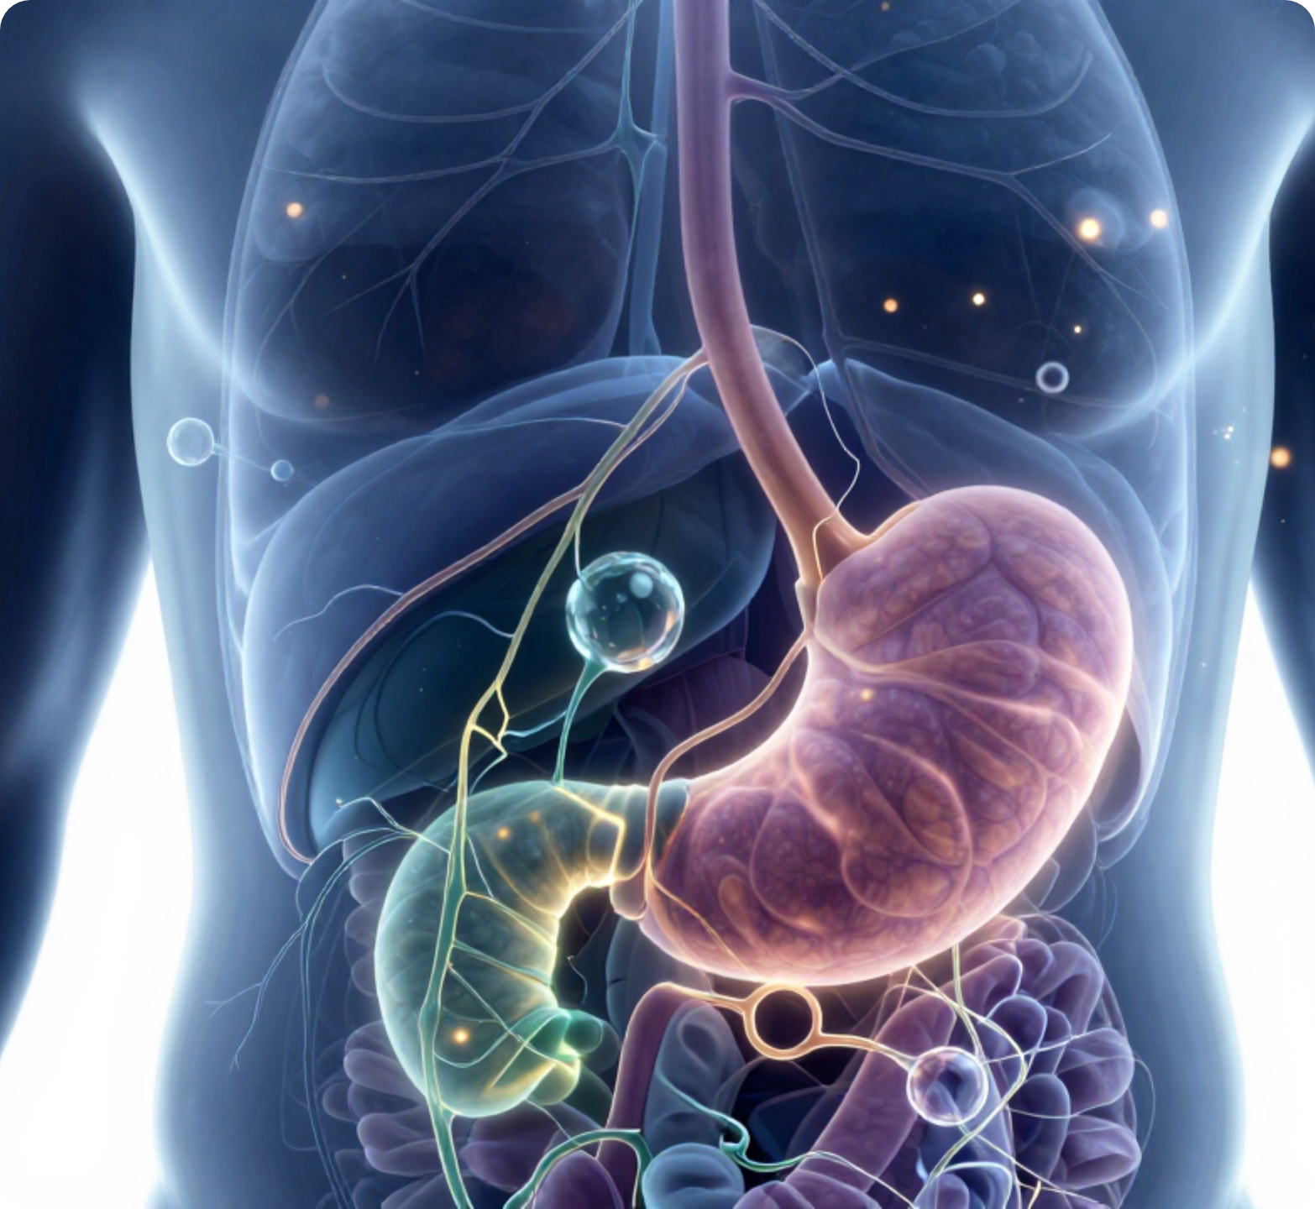







BRADFORD VTS TEACHING DECK
www.bradfordvts.co.uk
Steroid-Induced
Hyperglycaemia &
Diabetic Gastroparesis
A Clinical Practice Update for Primary Care Trainees
RCGP AKT PREP
SCA CASE STUDIES
CLINICAL CURRENCY UPDATES 2023–2026
JBDS-IP 2023
AGA 2025
NICE NG28 (Feb 2026)
BNF 2026
MHRA 2024
Disclaimer: For educational purposes only. This teaching resource is designed for GP trainees preparing for professional exams. Always refer to the latest NICE, JBDS, and AGA guidelines and local clinical protocols for direct patient management.

Slide 2








STEROID-INDUCED HYPERGLYCAEMIA
www.bradfordvts.co.uk
Disclaimer and Clinical Context
Disclaimer: For educational purposes only. Refer to latest NICE/JBDS guidelines for clinical practice.
Clinical Currency & Sources
Essential Disclaimer
JBDS-IP Guidelines (2023)
This teaching deck is designed exclusively for educational purposes for General Practice Trainees. While every effort has been made to ensure accuracy, clinical guidelines are subject to frequent change.
Management of Hyperglycaemia and Steroid Therapy.
AGA Practice Guideline (2025)
Management of Gastroparesis (Update 2025).
This resource does not replace clinical judgement or the need to consult local Trust protocols and specialist advice when managing complex individual cases.
NICE Guideline NG28 (Feb 2026)
Type 2 Diabetes in Adults: Management.
MHRA Drug Safety Updates (2013–2024)
Always verify drug doses in the current BNF/BNFC.
Domperidone, Metoclopramide & GLP-1 RA warnings.
BNF / BNFC (2026 Edition)
Standard reference for current prescribing.

Slide 3

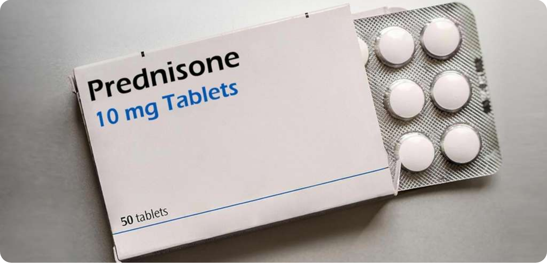













STEROID-INDUCED HYPERGLYCAEMIA
www.bradfordvts.co.uk
Part A: Why It Matters
Disclaimer: For educational purposes only. Refer to latest NICE/JBDS guidelines for clinical practice.
The Scale of the Problem
Steroids cause hyperglycaemia in30–50%of patients without prior diabetes.
In patients with pre-existing T2DM, glycaemic worsening is almost universal.
Risks of Untreated Hyperglycaemia
Clinical Prevalence
Increasedinfection riskand impaired wound healing.
Glucocorticoids are among the most common prescriptions in primary care.
Prolonged hospital stays and increasedmortality.
Risk of unmasking hidden Type 2 Diabetes (T2DM).
Key indications: Asthma/COPD, RA, IBD, PMR, Vasculitis, and Palliative care.
NICE NG28 & JBDS 2023 Guidance: ALL patients starting corticosteroids should have blood glucose monitored.

Slide 4










STEROID-INDUCED HYPERGLYCAEMIA
www.bradfordvts.co.uk
Part A: Mechanism & Risk Factors
Disclaimer: For educational purposes only. Refer to latest NICE/JBDS guidelines for clinical practice.
LIVER
PERIPHERAL TISSUES
PANCREAS
Hepatic Gluconeogenesis: Glucocorticoids stimulate genomic pathways that increase glucose production in the liver, leading to higher circulating blood sugar levels.
Insulin Resistance: Reduced glucose uptake in skeletal muscle and adipose tissue. Cells become less responsive to insulin's signal to absorb sugar from the bloodstream.
Beta-Cell Inhibition: Particularly at higher doses, steroids directly inhibit the pancreatic beta-cells' ability to secrete insulin in response to glucose.
The Characteristic Pattern
Steroids (like Prednisolone) primarily cause post-prandial hyperglycaemia. Glucose levels typically peak 4–8 hours after a morning dose, resulting in high levels from mid-morning through the evening, while fasting glucose may remain relatively normal.
Source: JBDS-IP 2023 Guidelines. Mechanism involves binding to intracellular glucocorticoid receptors.

Slide 5



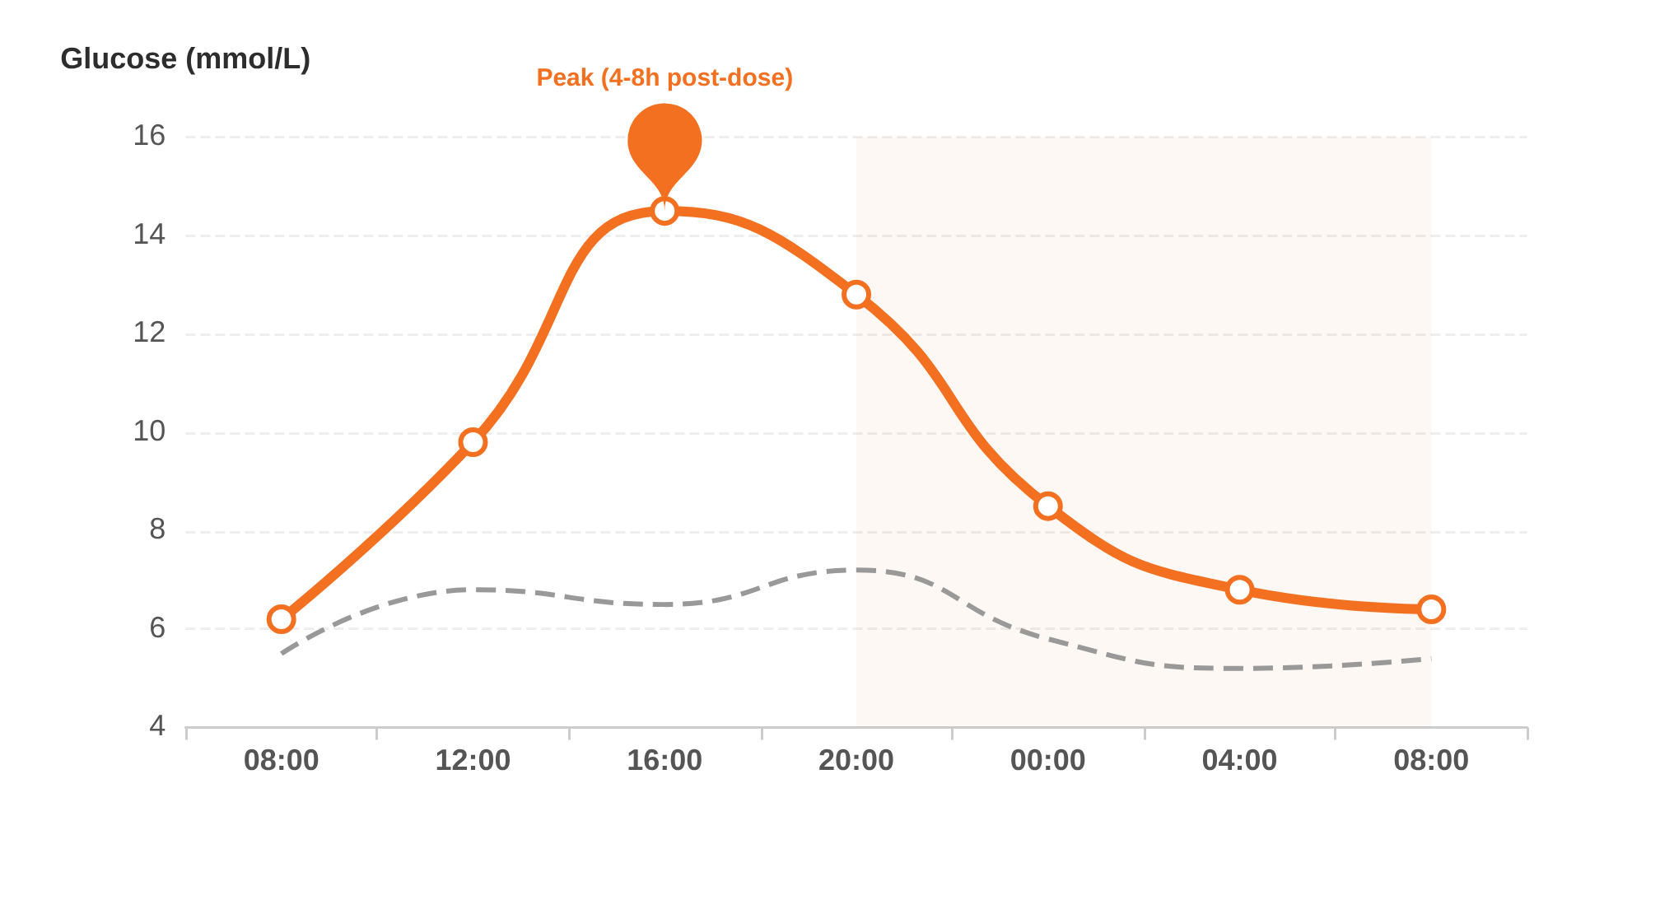





STEROID-INDUCED HYPERGLYCAEMIA
www.bradfordvts.co.uk
The Characteristic Glucose Pattern
Disclaimer: For educational purposes only. Refer to latest NICE/JBDS guidelines for clinical practice.
The Prednisolone Pattern
Post-Prandial Focus: Predominantly affects glucose 4–8 hours after morning dose.
Afternoon Rise: Glucose levels typically rise from mid-morning through afternoon/evening.
Fasting Stability: Morning fasting glucose often remains near-normal or baseline.
Monitoring Trap: Checking only fasting BG will miss 30–50% of steroid hyperglycaemia cases.
AKT EXAM PEARL
Test blood glucose at 2pm or pre-evening meal (not just fasting) to detect the characteristic prednisolone-induced spike.
Steroid-Induced Profile
Normal Glycaemic Profile

Slide 6








IDENTIFYING HIGH-RISK PATIENTS
www.bradfordvts.co.uk
Part A: Risk Factors for Steroid-Induced Hyperglycaemia
Disclaimer: For educational purposes only. Refer to latest NICE/JBDS guidelines for clinical practice.
Pre-existing Metabolic Status
Obesity & Anthropometrics
Known Type 2 Diabetes or Prediabetes/IGR. Steroids almost universally worsen glycaemic control in these patients.
BMI ≥ 30 kg/m². Increased baseline insulin resistance amplifies the hyperglycaemic effect of glucocorticoids.
Age & Ethnicity
Medical History
Age ≥ 45 years. High-risk ethnicities (South Asian, Black African, Afro-Caribbean) are predisposed to greater glycaemic excursions.
Family history of T2DM or previous Gestational Diabetes (GDM). These indicate a reduced beta-cell reserve.
Steroid Regimen Factors
Initial Response
High-dose therapy (e.g., Prednisolone > 20mg/day) or long-term courses exceeding 2 weeks in duration.
Elevated baseline blood glucose or HbA1c at the start of therapy often predicts significant steroid-induced spikes.
AKT RECALL: NICE (2026) recommends that ALL patients starting corticosteroids for ≥3 days should be screened, but vigilance is paramount in the high-risk groups identified above.

Slide 7














STEROID-INDUCED HYPERGLYCAEMIA
www.bradfordvts.co.uk
Part A: Relative Potency & Duration of Common Steroids
Disclaimer: For educational purposes only. Refer to latest NICE/JBDS guidelines for clinical practice.
Glucocorticoid
Relative Potency
Duration of Action
Clinical Impact on Glucose
Hydrocortisone
1 (Reference)
Short (8–12h)
Mimics physiological cortisol
Prednisolone
4
Intermediate (12–36h)
Peaks mid-afternoon (post-lunch)
Methylprednisolone
5
Intermediate
Similar to Prednisolone
Dexamethasone
25–30
Long (36–72h)
Suppresses glucose for days
Betamethasone
25–30
Long
Often used in antenatal care
Fludrocortisone
10*
Intermediate
Primarily mineralocorticoid effect
Budesonide
Low (Systemic)
Moderate Systemic
High local, low systemic absorption
AKT Insight: Prednisolone (Intermediate) predominantly causes post-prandial hyperglycaemia, whereas Dexamethasone (Long) can significantly impact fasting glucose the following morning.
Bradford VTS Clinical Teaching Deck 2026
Reference: JBDS-IP 2023 / BNF 2026

Slide 8

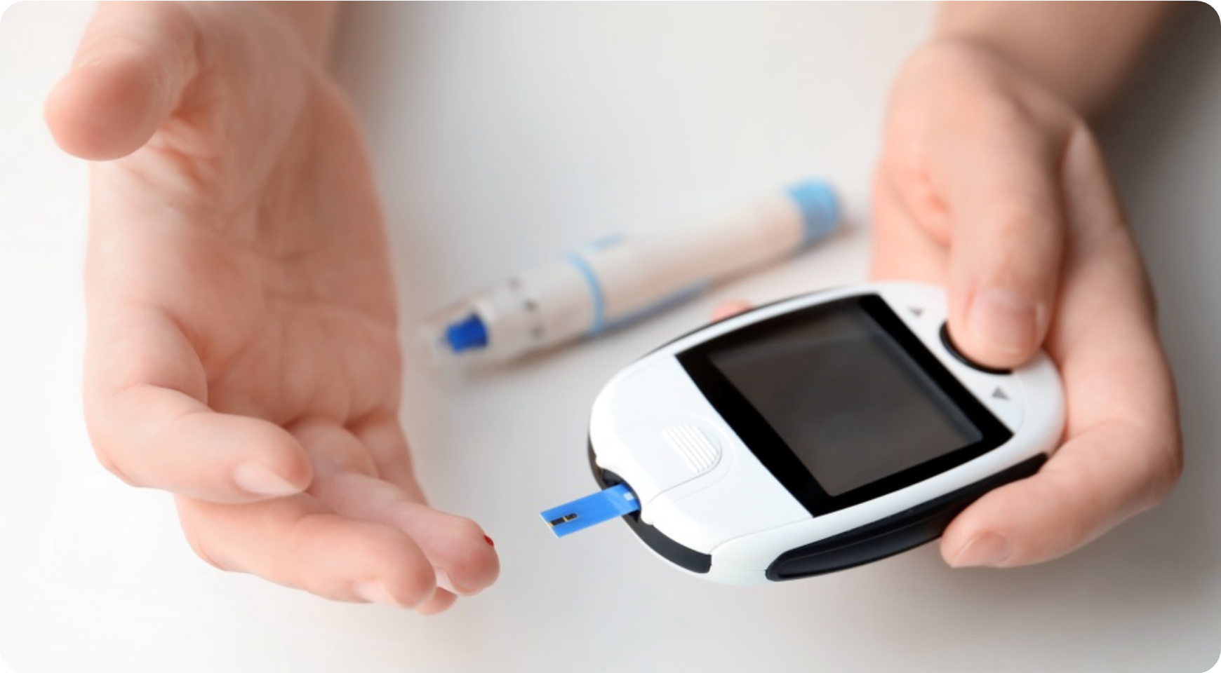











MONITORING GUIDELINES FOR PRIMARY CARE
Part A: NICE & JBDS 2023 Screening Recommendations
www.bradfordvts.co.uk
Disclaimer: For educational purposes only. Refer to latest NICE/JBDS guidelines for clinical practice.
Who & When to Screen
ALL patients starting corticosteroids for ≥3 days must be screened.
Measure Capillary Blood Glucose (BGM)—not just fasting.
Baseline Check: Before starting or with the first dose.
Follow-up: Repeat check at 48–72 hours post-initiation.
Known Diabetes Management
Steroids almost universally worsen glycaemia in pre-existing T2DM/Prediabetes.
AKT QUICK RECALL
Monitor at least 4 times daily (before meals and before bed).
NICE guidance states that ALL patients starting corticosteroids should have blood glucose monitored to prevent unrecognised hyperglycaemia.
Act sooner if readings are sustained above individualized targets.
Source: JBDS-IP 2023 Guidelines; NICE NG28 (Feb 2026)

Slide 9















PRE-TREATMENT HBA1C & THRESHOLDS
www.bradfordvts.co.uk
Part A: JBDS-IP 2023 & NICE NG28 Monitoring Standards
Disclaimer: For educational purposes only. Refer to latest NICE/JBDS guidelines for clinical practice.
Treatment Thresholds
HbA1c at Initiation
Initiate hypoglycaemic therapy if capillary blood glucose (CBG) meets:
NICE/JBDS 2023 Mandate: Check HbA1c for ALL patients starting corticosteroids.
Timing: Perform at baseline or within 4–6 weeks if not recently checked.
> 12.0
Objective: Identify pre-existing undiagnosed Type 2 Diabetes or Prediabetes.
ON TWO OR MORE READINGS
Known T2DM: Act sooner if readings are sustained above individualised targets.
High Risk: Essential for those with BMI ≥ 30, Age ≥ 45, or high-risk ethnicity.
Frequency: Monitor at least 4x daily in known diabetes.
SPEAKER NOTES
NICE and JBDS 2023 guidelines now explicitly require checking HbA1c when starting steroids. This isn't just to monitor the current course, but to identify the high number of patients who have underlying, undiagnosed dysglycaemia. For the AKT, remember the threshold for "steroid-induced hyperglycaemia" treatment is two or more capillary readings above 12 mmol/L. For patients with pre-existing diabetes, don't wait for 12; any significant deviation from their usual target should trigger a medication review or intensification.

Slide 10











MANAGEMENT STEP 1 AND 2: OPTIMISATION
www.bradfordvts.co.uk
Part A: Steroid-Induced Hyperglycaemia
Disclaimer: For educational purposes only. Refer to latest NICE/JBDS guidelines for clinical practice.
Step 1: Steroid Optimisation
Step 2: Existing Medications
Dose Review: Use the lowest effective steroid dose for the shortest possible duration.
Intensify Therapy: Review and maximize doses of Metformin, SGLT2i, DPP4i, or GLP-1 RA.
Route Selection: Prefer topical or inhaled steroids to minimize systemic absorption when appropriate.
Sulfonylureas: May require dose increases to cover steroid peaks, but monitor closely for hypo risk.
Lifestyle: Advise patients on reducing high-GI foods and maintaining physical activity levels.
T2DM Vigilance: In known diabetes, act sooner if readings are sustained above individual targets.
Note: In patients with pre-existing T2DM, steroid-induced hyperglycaemia is almost universal. Do not wait for HbA1c to rise before adjusting current therapy.
JBDS-IP Guidelines 2023 | NICE NG28 2026
Slide 10 of 35

Slide 11















MANAGEMENT STEP 3: PREFERRED ORAL AGENTS
www.bradfordvts.co.uk
Part A: Pharmacological Strategies for Steroid-Induced Hyperglycaemia
Disclaimer: For educational purposes only. Refer to latest NICE/JBDS guidelines for clinical practice.
PATTERN RECOGNITION IS KEY
Gliclazide MR (Gold Standard)
Prednisolone causes an afternoon/evening rise. Gliclazide MR (Modified Release) has a pharmacokinetic profile that peaks to cover this specific rise, making it superior to standard Gliclazide in this context.
Recommended Regime (JBDS 2023)
Initial Dose: 30mg – 60mg OD, taken in the morning.
Timing: Must be taken at the same time as Prednisolone.
Titration: Increase in 30mg increments up to 120mg OD if needed.
Alternative: DPP-4 Inhibitors
Use if Gliclazide not tolerated or hypo risk is high:
Matches Glucose Peak
Easily Stopped
Lower Hypo Risk
Sitagliptin 100mg OD
Linagliptin 5mg OD
Well Tolerated
Note: Weight neutral and low hypo risk, but less potent than Sulfonylureas.

Slide 12

















MANAGEMENT STEP 4: INSULIN THERAPY (JBDS 2023)
www.bradfordvts.co.uk
Part A: Steroid-Induced Hyperglycaemia
Disclaimer: For educational purposes only. Refer to latest NICE/JBDS guidelines for clinical practice.
Once-Daily Morning Steroids
Complex Steroid Regimes
Preferred Regime: Isophane (NPH) insulin (e.g., Humulin I).
Twice-daily steroids: Usually require twice-daily NPH or a full basal-bolus regime.
Mechanism: Intermediate-acting peak (4–8h) matches the prednisolone glucose rise.
Dexamethasone: Long-acting steroid; often requires long-acting basal insulin or QDS short-acting.
Timing: Administer with prednisolone or at lunchtime.
Initial Dosing & Titration
Adjusting Existing Insulin
Start with 0.1 – 0.3 units/kg/day.
Increase total daily dose by 20 – 30% during the steroid course.
Titrate daily based on afternoon and evening capillary blood glucose.
Ensure a plan is in place to reduce doses as steroids are tapered.
Target: Maintain BG 6 – 12 mmol/L (avoiding hypos).
Refer to specialist if control is erratic or DKA risk is high.
SPEAKER NOTESJBDS 2023 identifies Insulin as the primary recommendation for significant hyperglycaemia (readings >12 mmol/L). The choice of insulin is driven by the steroid's pharmacokinetics. For Prednisolone, NPH insulin is ideal because its intermediate-acting peak coincides with the mid-afternoon glucose spike. Avoid long-acting analogues (like Glargine) for morning-only steroids as they increase nocturnal hypoglycaemia risk when the steroid effect has worn off.

Slide 13








STEROID-INDUCED HYPERGLYCAEMIA
www.bradfordvts.co.uk
Step Down and Stopping Treatment
Disclaimer: For educational purposes only. Refer to latest NICE/JBDS guidelines for clinical practice.
Post-Steroid Follow-up
The Tapering Strategy
Immediate Monitoring: Continue capillary BG checks for 48 hours post-cessation.
Synchronized Reduction: Hypoglycaemic medications must be stepped down proportionally as the steroid dose is weaned.
The 3-Month Rule: Check HbA1c 12 weeks after steroids have stopped to confirm resolution.
Gliclazide MR Taper: Reduce dose (e.g., from 120mg to 60mg to 30mg) in tandem with prednisolone reduction.
Persistent T2DM: If HbA1c remains ≥48 mmol/mol, manage as Type 2 Diabetes.
Insulin Adjustment: Typically requires a 20–30% dose reduction for every significant steroid step-down.
JBDS 2023: Many patients "unmask" pre-existing undiagnosed T2DM during steroid therapy.
Complete Cessation: Stop all steroid-specific glucose-lowering agents once steroids are discontinued and BG is stable.
Primary Care Action
Update patient's clinical record: "History of Steroid-Induced Hyperglycaemia".
Safety Alert: Failure to taper hypoglycaemic treatment alongside steroids is a leading cause of iatrogenic hypoglycaemia in primary care.
Flag for future steroid courses.

Slide 14







STEROID-INDUCED DIABETES VS. HYPERGLYCAEMIA
www.bradfordvts.co.uk
Part A: Differentiating Transient Outcomes from Persistent Disease
Disclaimer: For educational purposes only. Refer to latest NICE/JBDS guidelines for clinical practice.
Steroid-Induced Hyperglycaemia
Steroid-Induced Diabetes
Definition: Temporary elevation in blood glucose while taking corticosteroids.
Definition: Persistent hyperglycaemia that continues after the steroid course has concluded.
Resolution: Blood glucose levels return to pre-steroid baseline once medication is tapered or stopped.
Diagnostic Criteria: HbA1c remains ≥48 mmol/mol (6.5%) three months after stopping steroids.
Management: Short-term monitoring and treatment that is discontinued with the steroids.
Management: Requires long-term T2DM clinical pathway, including coding and regular review.
Clinical Action Point: The 12-Week Rule
If blood glucose does not normalise immediately post-taper, repeat HbA1c at 12 weeks (3 months) after the final dose of steroids. This differentiates temporary "steroid stress" from unmasked Type 2 Diabetes.
The "Unmasking" Effect: Steroids often reveal pre-existing, undiagnosed T2DM or Prediabetes.
Bradford VTS Teaching Deck • Clinical Currency: JBDS-IP 2023 / NICE Feb 2026 • Always check local formulary for prescribing.

Slide 15














DIABETIC GASTROPARESIS
www.bradfordvts.co.uk
Part B: Overview & Pathophysiology
Disclaimer: For educational purposes only. Refer to latest NICE/JBDS/AGA guidelines for clinical practice.
Pathophysiology
Autonomic Neuropathy: Chronic hyperglycaemia causes oxidative stress, damaging the Vagus Nerve.
Definition
Enteric Nervous System: Loss of interstitial cells of Cajal (the gastric "pacemaker").
Gastroparesis is a chronic clinical syndrome characterized by delayed gastric emptying in the absence of any mechanical obstruction (e.g., tumor or ulcer).
Smooth Muscle Dysfunction: Impaired fundic relaxation and antral contractility.
Key Diagnostic Criteria:
Objective evidence of delayed emptying.
Epidemiology
Upper GI symptoms (nausea, vomiting, satiety).
No structural blockage on endoscopy/imaging.
T1DM: Up to 50% have delayed emptying; 5–12% are symptomatic.
T2DM: Increasing prevalence due to rising obesity and longer disease duration.
GLP-1 RA Link: Medications can unmask or worsen underlying dysmotility.
References: AGA Clinical Practice Guideline on Gastroparesis 2025 | NICE NG28 2026 | www.bradfordvts.co.uk

Slide 16












CLINICAL PRESENTATION: THE CLASSIC TRIAD
www.bradfordvts.co.uk
Part B: Diabetic Gastroparesis — Identifying Key Symptoms
Disclaimer: For educational purposes only. Refer to latest NICE/JBDS guidelines for clinical practice.
THE CLASSIC SYMPTOM TRIAD
1. Nausea
2. Vomiting
3. Early Satiety
The most common symptom. Often persistent and worsens after eating.
Characteristically involves undigested food consumed many hours (or even days) earlier.
Feeling prematurely full after consuming only a small amount of food.
ADDITIONAL CLINICAL FEATURES
Post-prandial bloating/fullness
AKT/SCA PEARL
Abdominal discomfort/pain
Vomiting of undigested food from hours earlier is a high-yield diagnostic clue. If a patient with long-standing T1DM presents with this + erratic BM control, gastroparesis must be top of your differential.
GORD-like symptoms / Heartburn
Unintentional weight loss
Erratic blood glucose control
Chronic constipation

Slide 17











IMPACT ON GLYCAEMIC CONTROL
www.bradfordvts.co.uk
Part B: Diabetic Gastroparesis
Disclaimer: For educational purposes only. Refer to latest NICE/JBDS guidelines for clinical practice.
Clinical Glycaemic Profile
Early Post-Prandial Hypoglycaemia
The Mismatch Mechanism
Insulin peaks 1–2 hours post-meal, but glucose is still stuck in the stomach.
In healthy digestion, glucose absorption and insulin action are synchronized. Gastroparesis breaks this "coupling" entirely.
Late Post-Prandial Hyperglycaemia
Glucose finally enters the bloodstream 4–6 hours later, long after the insulin effect has waned.
Delayed Emptying
Food remains in the stomach while rapid-acting insulin starts working in the blood.
Unpredictable Absorption
Glucose entry into the bloodstream is no longer linear or predictable based on meal size.
RESULT: KINETIC MISMATCH
The Bezoar Effect
Undigested food masses can solidify and release a sudden, massive glucose load hours or days later, causing "unexplained" spikes.

Slide 18












DIAGNOSTIC PATHWAY AND EXCLUSIONS
www.bradfordvts.co.uk
Part B: Diabetic Gastroparesis — Ensuring Clinical Safety
Disclaimer: For educational purposes only. Refer to latest NICE/JBDS guidelines for clinical practice.
Mandatory Exclusions
Primary Investigation: OGD
Mechanical Obstruction: Gastric outlet obstruction must be ruled out before assuming dysmotility.
Upper GI Endoscopy (OGD): The essential "gatekeeper" test to visualize structural abnormalities.
Peptic Ulcer Disease: Chronic ulcers can mimic symptoms of nausea and early satiety.
Pathognomonic Sign: Finding solid food residue in the stomach after an overnight fast (in the absence of obstruction).
Upper GI Malignancy: Gastric cancer must be considered, especially if weight loss or "red flags" are present.
Biopsy: May be required to exclude other causes of inflammation or malignancy.
Cyclical Vomiting Syndrome: A key differential diagnosis often confused with gastroparesis.
Clinical Context
Gastroparesis is a diagnosis of exclusion; functional testing follows normal structural imaging.
Review current medications (e.g., GLP-1 RAs, opioids) that may cause secondary delayed emptying.
AGA Clinical Practice Guideline on Gastroparesis 2025 • NICE NG28 February 2026 • GP Trainee Exam Preparation

Slide 19



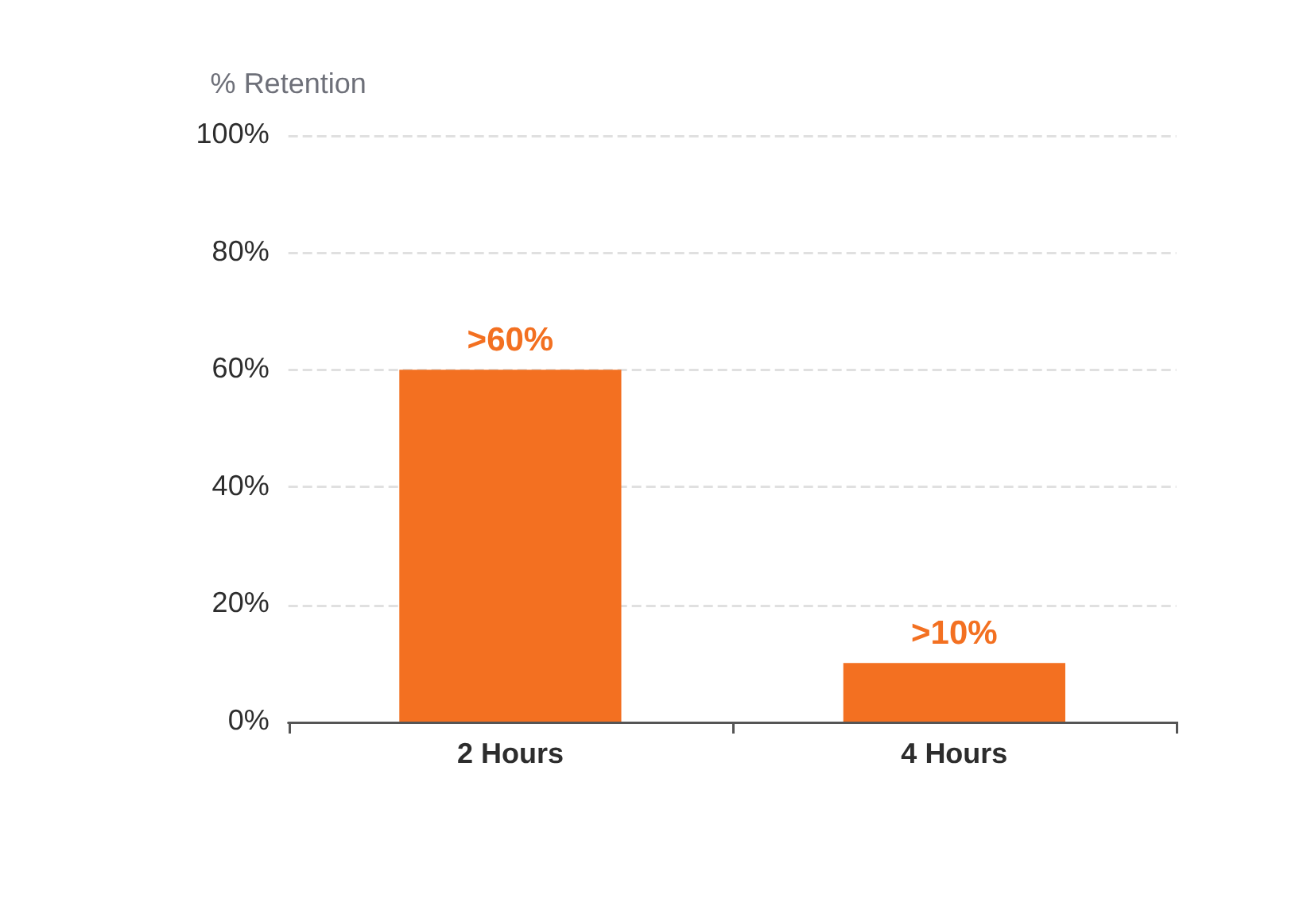






GOLD STANDARD: 4-HOUR SCINTIGRAPHY
www.bradfordvts.co.uk
Part B: Diagnosis & AGA 2025 Guidelines
Disclaimer: For educational purposes only. Refer to latest NICE/JBDS guidelines for clinical practice.
Gastric Retention Thresholds for Diagnosis
The Scintigraphy Procedure
Mandatory Duration: 4-hour study required (not 2-hour).
Standardized Meal: Technetium-labeled solid (e.g., egg whites).
Imaging Points: Captured at 0, 1, 2, and 4 hours post-ingestion.
Objective Measurement: Quantifies % of meal remaining in stomach.
AGA 2025 CLINICAL STANDARD
PREPARATION & RELIABILITY
Stop medications affecting motility (opioids, GLP-1 RAs, anticholinergics) for 48–72 hours prior to ensure accuracy. Correct hyperglycaemia (<15 mmol/L) before the test.

Slide 20





















DIABETIC GASTROPARESIS
www.bradfordvts.co.uk
Management Step 1: Glycaemic Control
Disclaimer: For educational purposes only. Refer to latest AGA 2025 and NICE NG28 (2026) guidelines.
Glycaemic Targets
Insulin Timing Adjustments
Aim for HbA1c ≤58 mmol/mol (7.5%) to reduce symptom severity and autonomic damage.
Post-meal bolus: Administer rapid-acting insulin AFTER the meal to match delayed glucose absorption.
Stabilizing glucose is the MOST important intervention for improving gastric motility.
Avoid pre-meal boluses which often trigger early post-prandial hypoglycaemia.
Advanced Technology (CSII)
Clinical Rationale
Insulin Pumps (CSII) allow fine-tuned basal rates and "extended" or "square-wave" boluses.
Hyperglycaemia acutely inhibits gastric emptying, creating a vicious cycle of dysmotility.
Consider Continuous Glucose Monitoring (CGM) to detect delayed hyperglycaemic spikes.
Reduced glucose variability prevents the "insulin-absorption mismatch" seen in severe cases.
SCA / AKT Pearl
Mismatch between insulin peak and glucose entry causes early hypos and late spikes. Timing is everything.
Bradford VTS Teaching Deck: Glycaemic Control in Gastroparesis
Clinical Currency: AGA 2025 | NICE 2026

Slide 21









MANAGEMENT STEP 2: DIETARY MODIFICATIONS
www.bradfordvts.co.uk
Part B: Diabetic Gastroparesis — AGA 2025 Clinical Practice Guideline
Disclaimer: For educational purposes only. Refer to latest NICE/JBDS/AGA guidelines for clinical practice.
Meal Structure & Composition
Items to Avoid
Small, Frequent Meals: Move to 5–6 small meals daily rather than 3 large ones to reduce gastric load.
Carbonated Drinks: Gas causes distension and worsens bloating/early satiety.
Low-Fat Diet: Fat naturally delays gastric emptying; keep intake minimal to facilitate faster transit.
Alcohol: Inhibits GI motility and can worsen neuropathy symptoms.
Smoking: Nicotine significantly delays gastric emptying.
Low-Fibre Intake: Avoid high-fibre foods (e.g., skins, seeds, whole grains) which slow emptying and increase risk of bezoar formation.
SCA Tip: Always screen for "bezoar-forming" high-fibre foods like celery or citrus pith.
Consistency & Textures
Referral & Assessment
Soft/Liquid Focus: Pureed or liquid-based nutrients pass more easily through a paretic stomach.
Dietitian Referral: AGA 2025 emphasizes early involvement of a specialist dietitian.
Homogenized Solids: Chew thoroughly; consider "step-down" from solids to liquids if symptoms flare.
Nutritional Screening: Monitor weight and BMI; screen for micronutrient deficiencies (Vit B12, Iron, Vitamin D).
Hydration: Sip fluids throughout the day; avoid large volumes during meals.
Symptom Diary: Encourage patients to track food-symptom correlations.
Source: AGA Clinical Practice Guideline on Gastroparesis (2025); NICE NG28 (2026).

Slide 22








PROKINETIC MEDICATIONS: DOMPERIDONE
www.bradfordvts.co.uk
Part B: Diabetic Gastroparesis — Clinical Safety & MHRA Guidance
Disclaimer: For educational purposes only. Refer to latest NICE/JBDS guidelines for clinical practice.
MHRA 2014 RESTRICTION
Mechanism of Action (MOA)
Cardiac Safety Requirements
Peripheral D2 receptor antagonist. It increases esophageal peristalsis, enhances gastroduodenal coordination, and facilitates gastric emptying by stimulating motility.
High risk of QTc interval prolongation and serious ventricular arrhythmias.
Standard Dosing (UK)
• 10mg TDS (maximum 30mg/day)
• Administer 15–30 minutes before meals
• Use the lowest effective dose for shortest time
Clinical Update 2024-2025
US FDA 2024 supply concerns noted; supply via expanded access IND may be limited. Always check local UK formulary for current availability.
Reference: MHRA Drug Safety Update 2014 | AGA Gastroparesis Guideline 2025 | BNF 2026 — Slide 22 of 35

Slide 23









PROKINETIC MEDICATIONS: METOCLOPRAMIDE
Part B: Diabetic Gastroparesis Management
www.bradfordvts.co.uk
Disclaimer: For educational purposes only. Refer to latest NICE/JBDS guidelines for clinical practice.
Overview & Mechanism
MHRA 2013 RESTRICTION
Mechanism of Action (MOA)
Maximum Duration: 5 DAYS
Dual-action: Central and peripheral D2 receptor antagonist + 5-HT4 receptor agonist.
Prescribing must be limited to short-term use only to minimize the risk of neurological adverse effects.
Clinical Effects
Extrapyramidal Side Effects (EPSE)
Increases gastric motility and acts as a potent anti-emetic (via 5-HT3 antagonism at high doses).
Risk of acute dystonia, akathisia, and tardive dyskinesia.
Standard Adult Dosage
Tardive dyskinesia risk increases with dose and duration of treatment; it may be irreversible.
10mg TDS (maximum 30mg/day). Not for chronic use.
Key Contraindications
GP Practical Tip
Parkinson’s Disease (worsens motor symptoms)
Phaeochromocytoma (risk of hypertensive crisis)
Gastrointestinal obstruction or perforation
Metoclopramide is unsuitable for the long-term management of diabetic gastroparesis. It is primarily used for short-term symptomatic relief of nausea/vomiting during acute flares or post-operatively.

Slide 24

















ERYTHROMYCIN & ANTI-EMETICS
www.bradfordvts.co.uk
Part B: Diabetic Gastroparesis Management
Disclaimer: For educational purposes only. Refer to latest NICE/JBDS guidelines for clinical practice.
Erythromycin (Prokinetic)
Symptom-Specific Control
Mechanism: Acts as a motilin receptor agonist to stimulate gastric contractions.
Ondansetron: 4–8mg TDS if vomiting is the predominant symptom. Generally well tolerated.
Usage: Effective for short-term rescue; tachyphylaxis (reduced effect) typically develops after 4 weeks.
Alternatives: Promethazine or Prochlorperazine can be used for breakthrough symptoms.
Avoid: Long-term metoclopramide due to MHRA warnings regarding tardive dyskinesia.
Regime: 125–250mg TDS–QDS, taken 15-30 mins before meals.
Low-dose strategy preferred
AKT PEARL: QTc Monitoring
AGA 2025 Clinical Note
Erythromycin increases risk of QTc prolongation. Obtain baseline ECG and avoid co-prescription with other QTc-prolonging drugs.
Anti-emetics improve symptoms but do not improve gastric emptying. Use as adjuncts to prokinetics and dietary modification.
Consider rotating prokinetics to maintain efficacy.
Speaker Notes: Erythromycin is a unique antibiotic that mimics motilin, a hormone that triggers gastric movement. It is highly effective initially but loses potency within a month (tachyphylaxis), so it’s best used for short "bursts" or rotated. ALWAYS check the QTc on an ECG before starting. For vomiting, Ondansetron is the preferred non-prokinetic anti-emetic due to its safety profile. Remind trainees that while Ondansetron stops the patient from feeling sick, it doesn't help the food move through the stomach—that's why it's an adjunct to prokinetics like Domperidone or Erythromycin.

Slide 25













MANAGING HYPOGLYCAEMIA IN GASTROPARESIS
www.bradfordvts.co.uk
Part B: Acute Management & Patient Safety
Disclaimer: For educational purposes only. Refer to latest NICE/JBDS guidelines for clinical practice.
Standard oral hypoglycaemia treatments (Rule of 15) fail in gastroparesis due to delayed gastric emptying. A "buccal-first" approach is critical to prevent severe or prolonged hypos.
The "Gastric Trap"
The Buccal Solution
Delayed Absorption: Glucose drinks/tablets remain in the stomach for hours rather than entering the small intestine.
Glucogel / Dextrogel: Essential first-line. Rub the gel directly into the gums and inside of the cheeks.
Mismatch: Blood glucose continues to drop while the treatment sits unabsorbed, leading to dangerous lows.
Mucosal Absorption: Glucose is absorbed directly into the bloodstream via the oral mucosa, bypassing the stomach.
Rebound Risk: Patients often over-treat because they don't feel better quickly, causing massive later spikes.
Glucagon Kit: Ensure family/carers are trained in IM Glucagon if the patient becomes unable to swallow.
Secondary Care: If buccal route fails or patient is obtunded, IV 10% or 20% Glucose is mandatory.
AVOID: Orange juice, Lucozade, or standard Dextrose tablets as primary rescue.
AKT Tip: Remember that Glucogel is not just for unconscious patients in gastroparesis; it is the preferred oral route.
AGA 2025 | NICE NG28 (2026)

Slide 26










DIABETIC GASTROPARESIS
www.bradfordvts.co.uk
Part B: GLP-1 Receptor Agonists Warning
Disclaimer: For educational purposes only. Refer to latest NICE/JBDS guidelines for clinical practice.
The "Double-Edged" Mechanism
GLP-1 RAs (Semaglutide, Liraglutide, Dulaglutide) inherently delay gastric emptying as part of their glucose-lowering effect.
Clinical Practice Points
Pre-prescribing Screen: Proactively ask about nausea, early satiety, or history of erratic glucose before starting any GLP-1 RA.
In gastroparesis, this physiological effect becomes a pathological exacerbation of existing autonomic nerve damage.
Relative Contraindication: Avoid GLP-1 RAs in patients with confirmed or highly suspected gastroparesis.
Can lead to severe vomiting, malnutrition, and profound glycaemic instability.
Urgent Action: If a patient on GLP-1 RA develops severe vomiting or "food sitting in stomach," STOP the medication immediately.
MHRA / EMA Monitoring (2024)
Consider alternative therapies (e.g., SGLT2i or DPP-4i) which do not impact gastric motility.
Ongoing surveillance regarding severe Gastrointestinal adverse effects, including intestinal obstruction and ileus, specifically in high-risk groups.
Bradford VTS | Clinical Teaching Deck 2026

Slide 27






DIABETIC GASTROPARESIS
www.bradfordvts.co.uk
Part B: Severe Cases and Surgical Options
Disclaimer: For educational purposes only. Refer to latest NICE/JBDS/AGA guidelines for clinical practice.
Nutritional Support
Specialist Interventions
Naso-jejunal (NJ) Feeding: Short-term bypass of the stomach for severe symptoms or acute malnutrition.
Gastric Electrical Stimulation: (GES/Enterra) for intractable nausea/vomiting.
NICE 2004
Jejunostomy (PEJ): Permanent percutaneous tube for long-term enteral nutrition in treatment-refractory cases.
G-POEM / Pyloromyotomy: Emerging endoscopic or surgical division of pyloric muscle.
AGA 2025
Parenteral Nutrition (PN): Reserved only as a last resort if enteral feeding is not feasible or tolerated.
Pyloric Botox: Injection to relax the pylorus; limited evidence and variable success rates.
Primary Care Role: Monitor for weight loss >10%, electrolyte disturbances, and tube site infections. Patients with intractable symptoms despite Step 3 (Prokinetics) require urgent Gastroenterology referral for these advanced options.

Slide 28















AKT EXAM PEARLS: PART 1
Steroid Thresholds, Insulin Timing & Prokinetic Safety
www.bradfordvts.co.uk
Disclaimer: For educational purposes only. Refer to latest NICE/JBDS guidelines for clinical practice.
STEROID THRESHOLDS
According to JBDS 2023 guidelines, initiate treatment for steroid-induced hyperglycaemia when:
MHRA SAFETY RESTRICTIONS
Two or more capillary blood glucose readings are >12 mmol/L.
Check HbA1c in all patients starting steroids for ≥3 days.
Domperidone (2014)
Max dose: 10mg TDS for max 1 week.
Mandatory ECG to monitor QTc prolongation risk.
NPH INSULIN STRATEGY
Metoclopramide (2013)
Prescribe for a maximum of 5 days.
Match the insulin action to the steroid peak:
Avoid due to risk of extrapyramidal side effects (e.g., tardive dyskinesia).
Morning Prednisolone: Give NPH (e.g., Humulin I) in the morning or at lunchtime.
Why NPH? Its intermediate action coincides with the afternoon glucose rise.
Quick Recall: What is the maximum duration for Metoclopramide? (Answer: 5 days) • What BG reading triggers treatment? (Answer: 2+ readings >12 mmol/L)

Slide 29








AKT EXAM PEARLS: PART 2
www.bradfordvts.co.uk
Diagnostic Gold Standards & Clinical Patterns
Disclaimer: For educational purposes only. Refer to latest NICE/JBDS guidelines for clinical practice.
GASTROPARESIS GOLD STANDARD
STEROID POTENCY RECALL
4-hour solid gastric emptying scintigraphy is mandatory (AGA 2025).
Dexamethasone is highly potent (25–30x) vs. Prednisolone (4x).
Exam Trap: 2-hour studies are insufficient and often tested as a distractor.
Long-acting steroids (Dexamethasone) affect fasting glucose the next day.
Abnormal result: >10% retention at 4 hours.
Hydrocortisone (1x) is the reference standard for glucocorticoid potency.
PREDNISOLONE PATTERN
INITIATION SCREENING
Glucose typically peaks 4–8 hours after a morning dose.
NICE 2026: Check HbA1c for ALL patients starting steroids (>3 days).
Expect afternoon/evening hyperglycaemia; fasting BG may remain normal.
Purpose: To identify pre-existing undiagnosed T2DM or pre-diabetes.
Treatment threshold: Two readings >12 mmol/L (capillary glucose).
Monitoring must include a pre-tea/2pm check to detect the rise.

Slide 30

SCA EXAM PEARLS: COUNSELLING SCENARIOS
www.bradfordvts.co.uk
Communication Tips for Steroid Use and Gastroparesis Management
Disclaimer: For educational purposes only. Refer to latest NICE/JBDS guidelines for clinical practice.
Scenario 1: Steroid Initiation
Scenario 2: Diabetic Gastroparesis
Explain the Mechanism: Use simple terms—"Steroids act like a fuel for your liver, causing it to release extra sugar into the bloodstream."
Erratic Absorption: Explain that nerve damage means the stomach empties "unpredictably," causing a mismatch between insulin and food.
Focus on the Pattern: Advise that sugar levels peak mid-afternoon/evening. Advise testing at 2 PM or post-lunch, not just fasting.
Insulin Timing: Discuss moving rapid-acting insulin to after the meal to ensure it matches when the food actually enters the system.
Hypo Rescue: Emphasize using buccal Glucogel. Standard drinks sit in the stomach; gel is absorbed through the gums, bypassing the delay.
Safety Netting: Counsel on symptoms of severe hyperglycaemia (excessive thirst, polyuria, blurred vision) and when to contact the GP or 111.
Exam Tip: In the SCA, focus on shared decision-making regarding dietary changes and monitoring frequency.

Slide 31








RED FLAGS: STEROID HYPERGLYCAEMIA
www.bradfordvts.co.uk
Part A: Emergency Recognition & Safety Precautions
Disclaimer: For educational purposes only. Refer to latest NICE/JBDS guidelines for clinical practice.
Persistent Hyperglycaemia
Diabetic Ketoacidosis (DKA)
Failure of BG to return to baseline after steroid taper (Steroid-induced Diabetes).
HbA1c ≥48 mmol/mol at 3 months post-cessation confirms T2DM.
Risk of unmasking undiagnosed Type 1 Diabetes when starting steroids.
Undiagnosed pre-existing T2DM is the most common cause of "persistence".
Rapid onset of abdominal pain, vomiting, and Kussmaul breathing.
Action: Check blood ketones if glucose >11 mmol/L and patient is unwell.
Clinical "Red Flag" Triad
Hyperosmolar State (HHS)
Polyuria & Polydipsia: Profound osmotic symptoms.
Common in elderly T2DM patients on Dexamethasone.
Unexplained Weight Loss: Signs of insulin deficiency/catabolism.
Visual Disturbance: Sudden blurring due to osmotic lens changes.
Severe hyperglycaemia (>30 mmol/L) without significant ketosis.
Profound dehydration, confusion, and electrolyte imbalance.
URGENT assessment required for any patient with suspected DKA or HHS.
Clinical Reference: JBDS-IP 2023 Guidelines & NICE NG28 (Feb 2026). Ensure patients are issued with a Steroid Emergency Card where appropriate.

Slide 32







RED FLAGS: DIABETIC GASTROPARESIS
www.bradfordvts.co.uk
Identifying severe complications requiring urgent specialist intervention
Disclaimer: For educational purposes only. Refer to latest NICE/AGA guidelines for clinical practice.
Severe Malnutrition
Bezoar Formation
Weight loss >10% of total body weight indicates severe gastric failure. Nutritional intake is significantly impaired and requires urgent assessment.
Undigested food solidifying in the stomach (seen on endoscopy). High risk of gastric outlet obstruction and sudden, massive glucose spikes.
Aspiration Risk
GLP-1 RA Intolerance
Persistent vomiting, especially of food from many hours prior, carries a high risk of aspiration pneumonia and severe electrolyte imbalances.
Severe vomiting or bowel symptoms after starting GLP-1 receptor agonists. These can unmask or dangerously worsen underlying gastroparesis.
Required Clinical Actions for Red Flags
Urgent referral to Gastroenterology / Gastromotility Specialist
Referral to Specialist Dietitian for nutritional support
Consideration for NJ tube or PEJ feeding
Urgent cessation of GLP-1 RA therapy if suspected
Baseline ECG to assess QTc before prokinetic rescue
Endoscopic evaluation to exclude malignancy/obstruction

Slide 33






COMMON PITFALLS TO AVOID
www.bradfordvts.co.uk
Steroid Hyperglycaemia & Diabetic Gastroparesis
Disclaimer: For educational purposes only. Refer to latest NICE/JBDS guidelines for clinical practice.
Steroid-Induced Hyperglycaemia
Diabetic Gastroparesis
Fasting Focus: Relying solely on fasting blood glucose (BG). This misses the characteristic afternoon peak caused by morning prednisolone.
Misdiagnosis: Attributing nausea and bloating to IBS or functional dyspepsia without reviewing the patient's glycaemic stability.
Taper Neglect: Failing to reduce hypoglycaemic medication doses as steroids are tapered, leading to severe iatrogenic hypoglycaemia.
Standard Hypo Care: Using orange juice or glucose tablets for hypos. In gastroparesis, these sit in the stomach; Glucogel is mandatory.
Post-Steroid Gap: Not checking HbA1c 3 months after stopping treatment; steroid-induced hyperglycaemia often unmasks pre-existing T2DM.
Drug Duration: Prescribing metoclopramide for >5 days or domperidone without an ECG, risking tardive dyskinesia or QTc death.
High-Risk Blindness: Not screening high-risk ethnicities or obese patients starting even short courses (>3 days) of steroids.
GLP-1 RA Usage: Continuing or starting GLP-1 receptor agonists in patients with symptoms, as they worsen gastric stasis significantly.
SLIDE 33 / 35
Bradford VTS Teaching Deck • 2026 Edition

Slide 34
















STEROID-INDUCED HYPERGLYCAEMIA & DIABETIC GASTROPARESIS
www.bradfordvts.co.uk
Top Tips Summary: Final Key Takeaways for Clinical Practice & Exams
Disclaimer: For educational purposes only. Refer to latest NICE/JBDS guidelines for clinical practice.
Part A: Steroid Hyperglycaemia
Part B: Diabetic Gastroparesis
Screen Everyone: Check capillary BG at 48–72 hours for ALL patients on oral steroids for ≥3 days.
High Index of Suspicion: Suspect in long-standing T1DM with unexplained erratic glucose, nausea, and early satiety.
Pattern Recognition: Prednisolone peaks in the afternoon. Test BG at 2pm/post-lunch, as fasting BG is often misleadingly normal.
Gold Standard: Diagnosis requires 4-hour solid gastric emptying scintigraphy (AGA 2025). 2-hour studies are insufficient.
Match the Dose: Use Gliclazide MR or NPH Insulin in the morning to coincide with the steroid-induced glucose rise.
Dietary First-line: Recommend small, frequent, low-fat, and low-fibre meals. Soft or liquid foods are better tolerated.
The Taper: Always reduce hypoglycaemic medication in tandem with steroid weaning to avoid severe hypoglycaemia.
Safety First: Domperidone (max 1 week) and Metoclopramide (max 5 days). Always check ECG for QTc before prokinetics.
Long-term Follow-up: Check HbA1c 3 months after stopping steroids to identify unmasked Type 2 Diabetes.
Hypo Management: Use Glucogel (buccal). Avoid oral drinks/tablets as delayed gastric emptying slows absorption.
Exam Pearl: Pattern recognition and MHRA safety restrictions are high-yield AKT topics.
Clinical Currency: 2023-2026 Guidelines

Slide 35















STEROID-INDUCED HYPERGLYCAEMIA & GASTROPARESIS
www.bradfordvts.co.uk
Resources and References
Disclaimer: For educational purposes only. Refer to latest NICE/JBDS guidelines for clinical practice.
Primary Clinical Guidelines
Pharmacopoeia & Dosing
JBDS-IP (2023): Management of Hyperglycaemia and Steroid (Glucocorticoid) Therapy. Joint British Diabetes Societies for Inpatient Care.
BNF (2026): Section on Diabetes (Insulin NPH, Gliclazide MR) and GI Motility (Prokinetics).
AGA (2025): Clinical Practice Guideline on the Management of Gastroparesis. American Gastroenterological Association.
MHRA (2024): GLP-1 Receptor Agonists: Ongoing monitoring of GI adverse effects and gastroparesis risks.
NICE NG28 (2026): Type 2 Diabetes in Adults: Management. Updated February 2026.
NICE IPG (2004): Gastric Electrical Stimulation for Gastroparesis. Interventional Procedure Guidance 103.
Further Learning & Exam Prep
Access the full suite of AKT/SCA revision decks, roleplay scenarios, and high-yield clinical summaries on the Bradford VTS website.
Safety & Regulatory Alerts
MHRA (2014): Domperidone: risk of cardiac side effects – restricted indication, new contraindications, and reduced dose and duration.
www.bradfordvts.co.uk
MHRA (2013): Metoclopramide: risk of neurological adverse effects – restricted dose and duration of use.
Download Revision Guides

