Slide 1




BRADFORD VTS TEACHING DECK
Alcohol misuse in primary care —
identification, assessment and brief intervention
www.bradfordvts.co.uk
Created May 2026 — updated to current NICE 2023/2024 standards
Disclaimer: Always double check this advice and drug doses with the latest NICE/BNF guidance.
This document is for educational purposes only.
www.bradfordvts.co.uk

Slide 2






Why does this matter?
Alcohol misuse — the UK burden
10 million
24,000
£21 billion
People at risk
Deaths per year
Annual cost
Drinking at levels harmful to
health in England
Alcohol-related deaths in
England annually
To England — crime, health,
lost productivity
Only 18% of people with alcohol problems
are identified in primary care
That means 8 in 10 are missed
The single most effective intervention in reducing harmful
alcohol use is being told by a doctor to cut down.
Primary care sees the broadest cross-section of the population — the opportunity is ours.
Linked to 60+ medical conditions
3% of all cancers
www.bradfordvts.co.uk

Slide 3






















Understanding units of alcohol
What counts as a unit — and how much is too much?
What is 1 unit?
Special considerations
CMO 2016 low-risk guidance
10 ml
Updated 2016 —
old guidance is WRONG
(8g) of pure alcohol
Pregnancy
The safest approach is not
to drink at all during pregnancy.
Litres × ABV% = units
✕ Men: 21 units/week
✕ Women: 14 units/week
Pre-2016 — do not use
Chief Medical Officer, 2016
e.g. 1 litre of 4% lager = 4 units
Pint of 4% lager
(568ml)
2.3 units
Recommendation is
not to drink
Both men AND women:
≤ 14 units/week
Standard bottle
of 12% wine
(750ml)
9 units
SCA tip: ‘No level of alcohol is 100%
safe — 14 units represents lower risk,
not a safe limit.’ Use this language
with patients.
Spread over 3 or more days
Single 25ml
measure of
40% spirits
1 unit
Avoid saving up and binge drinking
“Lower risk” — NOT “safe”
AKT pearl: CMO 2016 = 14 units/week
for BOTH sexes. This is a favourite
AKT question.
Spreading drinks over 3+ days
significantly reduces risk even at
the same weekly total.
www.bradfordvts.co.uk

Slide 4











Definitions — hazardous, harmful, and dependent drinking
NICE / WHO / ICD-10 terminology — essential for AKT and clinical practice
Hazardous Drinking
Harmful Drinking
Alcohol Dependence
Above limits — no harm yet
Drinking causing actual damage
ICD-10: 3 or more criteria in past year
Definition: Drinking above
recommended limits (more than
14 units/week) but without current
significant harm
Definition: Drinking that is already
causing physical or mental
health damage
Definition: A cluster of physiological,
behavioural, and cognitive phenomena
ICD-10 criteria — 3 or more of the
following in the past 12 months:
ICD-10: Use that is causing actual
health damage — confirmed by
history, examination, and
investigation
ICD-10: Pattern of use carrying a
high risk of future harm
1. Strong desire or compulsion to drink
2. Difficulty controlling drinking behaviour
3. Withdrawal symptoms when drinking stops
Key point: Risk is present —
damage has not yet occurred
4. Tolerance — needing more for same effect
Key point: Harm is happening now —
not just a future risk
5. Neglect of other interests in favour of drinking
6. Persistent use despite clear harmful
consequences
AUDIT 8–15
AUDIT 16–19
AUDIT ≥20 → refer
● AKT EXAM FOCUS
• Dependence threshold: suspect if >50 units/week (men) or >35 units/week (women)
• AUDIT ≥20 = possible dependence → refer for specialist assessment; do NOT offer brief intervention alone
• Binge drinking: >8 units/session (men), >6 units/session (women)
www.bradfordvts.co.uk
Bradford VTS Teaching Deck | Alcohol Misuse in Primary Care

Slide 5
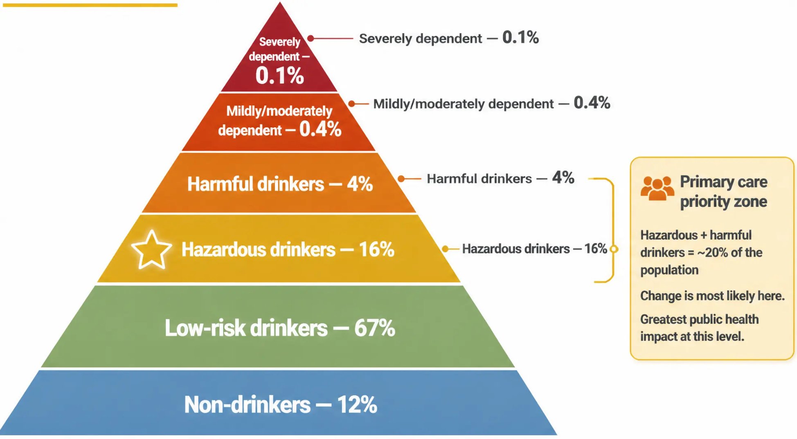




Population Typology — UK Alcohol Consumption
The alcohol pyramid
Severely
dependent patients
need specialist
services — not
primary care alone.
The single most
effective
intervention:
being told by your
doctor to cut down.
www.bradfordvts.co.uk
6

Slide 6

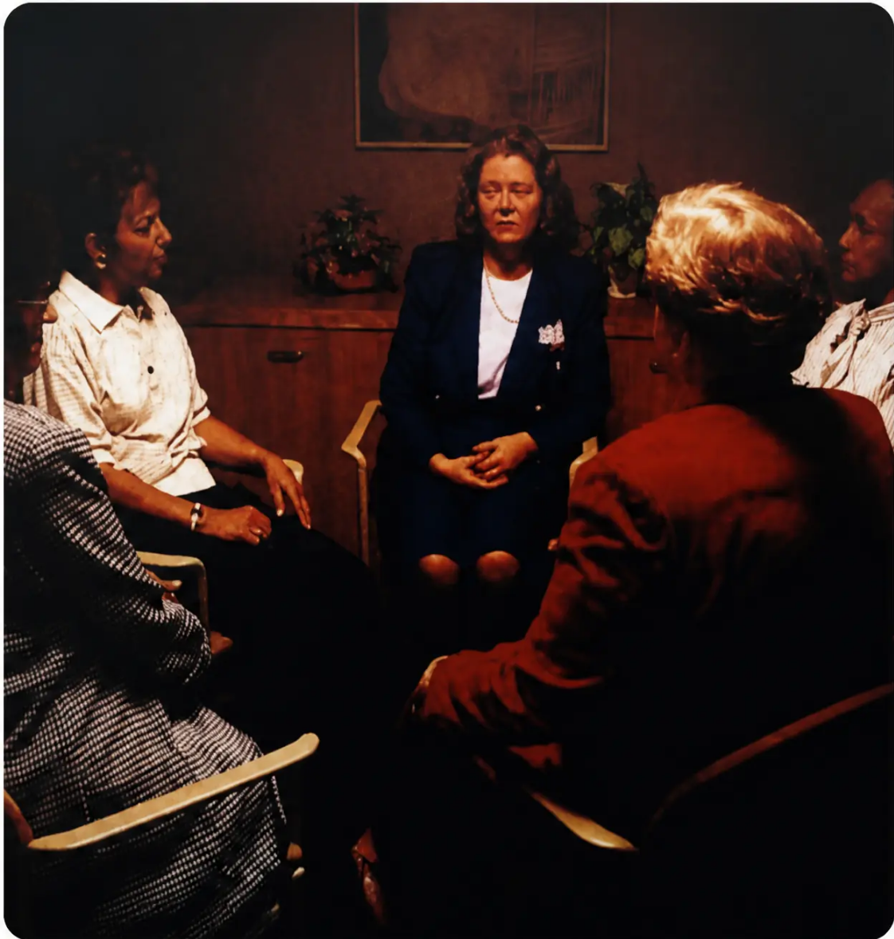



When and how to ask about alcohol in primary care
www.bradfordvts.co.uk
When to ask
● New patient registration and NHS health checks
● Lifestyle questionnaire completion
● Physical triggers: raised BP, abnormal LFTs, raised MCV, recurrent accidents
● Mental health presentations: depression, anxiety, insomnia
● Social red flags: family problems, employment issues, legal difficulties
● Smell of alcohol at any time of day
How to ask
SCA
“I ask all my patients about alcohol as it affects
health in many ways...”
● Begin with two simple questions: “How many days a week do you drink?” /
“How many drinks on a typical day?”
● Then move to a validated tool — AUDIT or AUDIT-PC
(NICE first-line recommendation)
Who should ask
All members of the primary health care team — doctors, nurses,
HCAs, and allied health professionals.
A ‘whole team alcohol aware’ approach requires training across the full PHCT.
www.bradfordvts.co.uk

