Slide 1
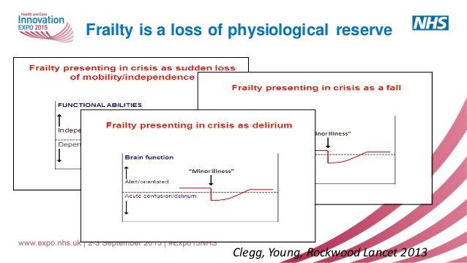

Slide 2
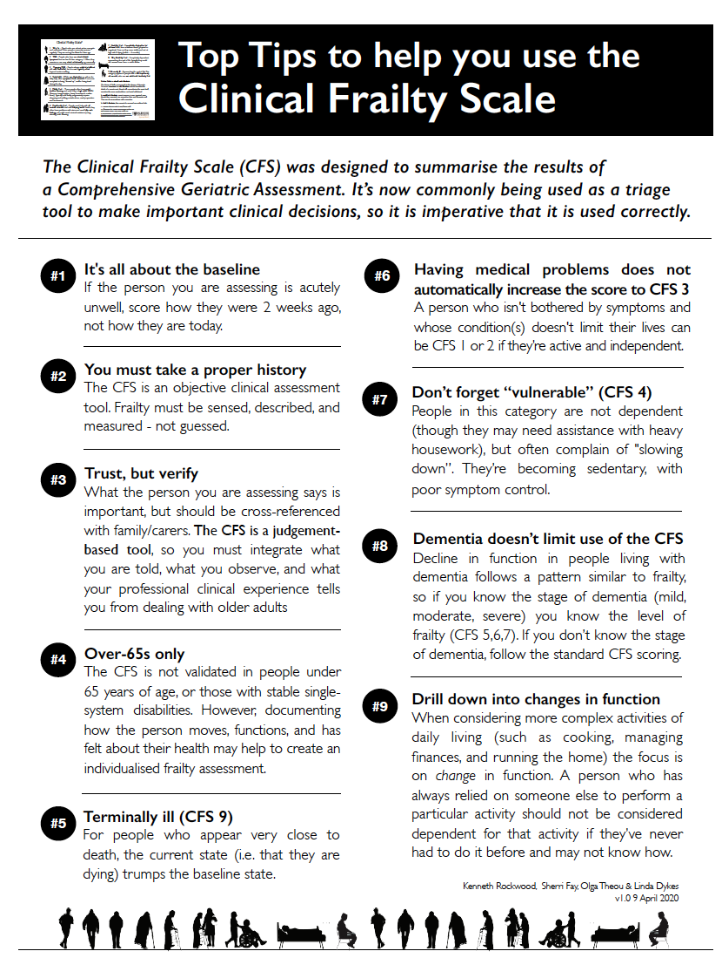
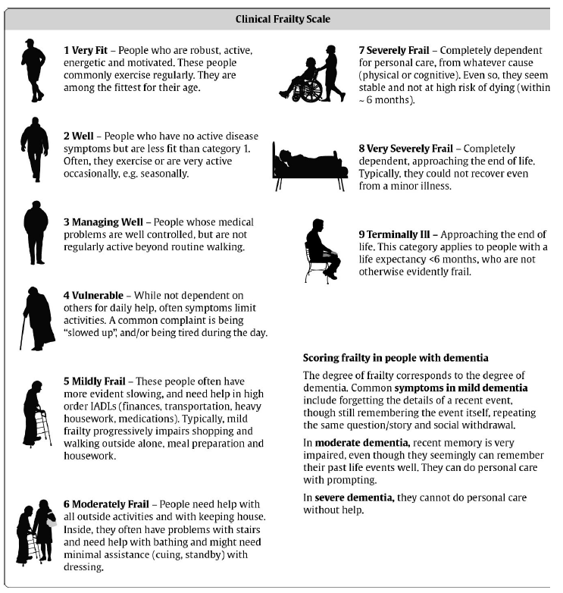
Measuring Frailty-Rockwood CFS

Slide 3

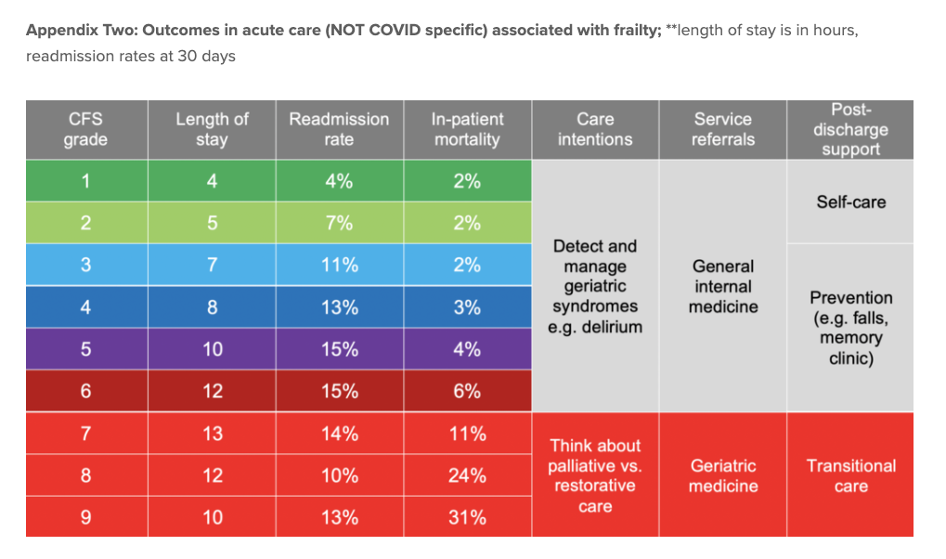

Slide 4
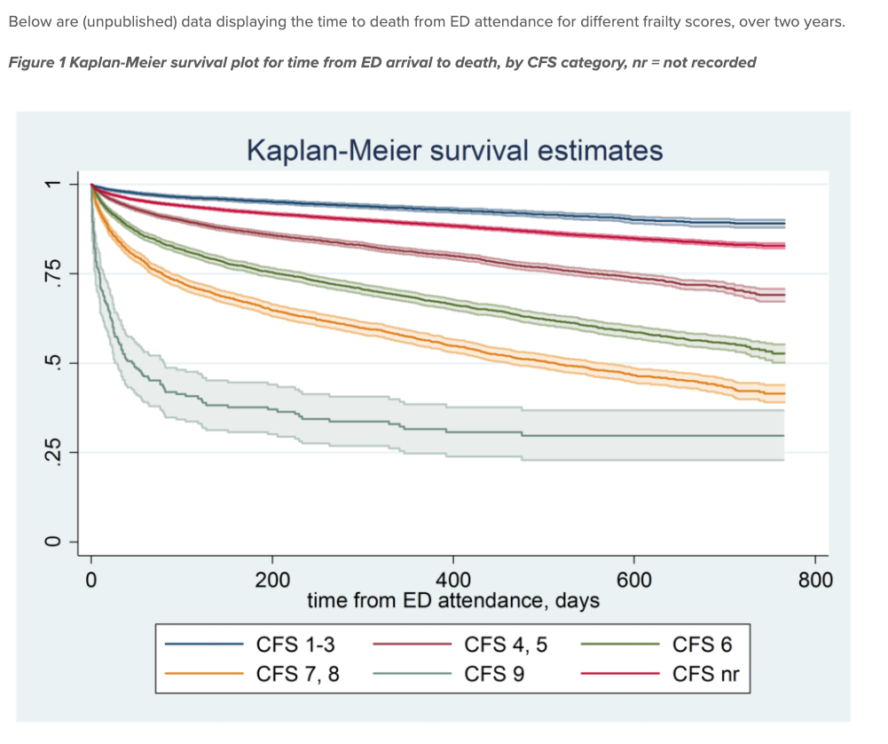

Slide 5
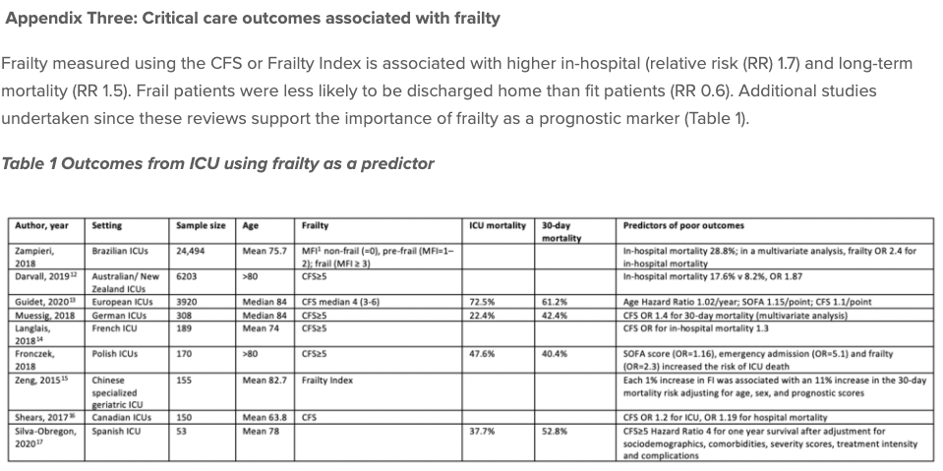

Slide 6
Medicines of no proven benefit
Reduction of medicine burden
Reduce Anticholinergic burden
Switch of Warfarin to NOACS
Reduce risks of AKI/Delirium
To reduce external contact into care homes
Deprescribing

Slide 7
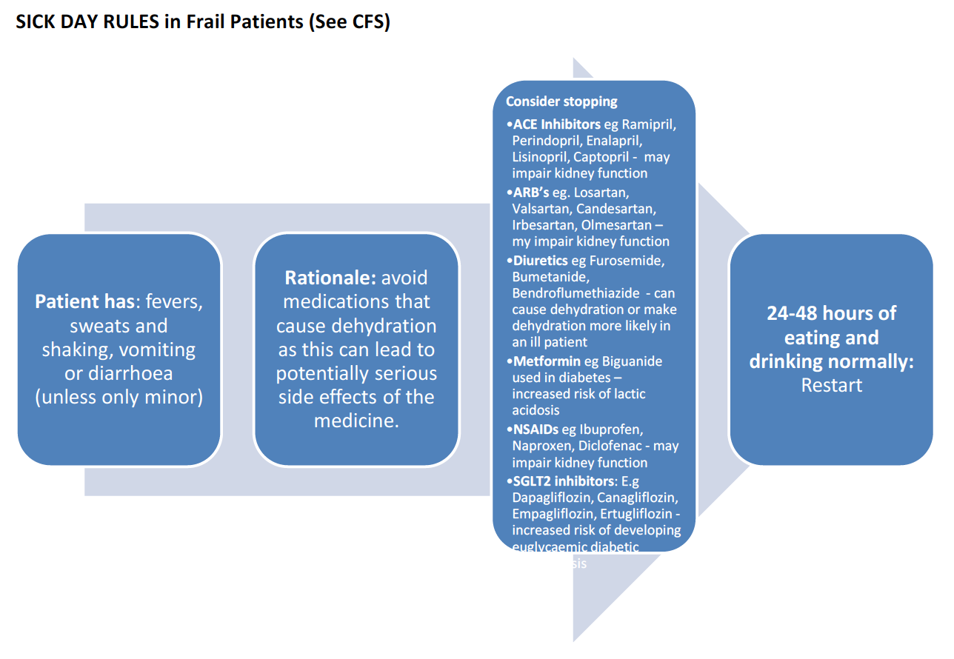

Slide 8
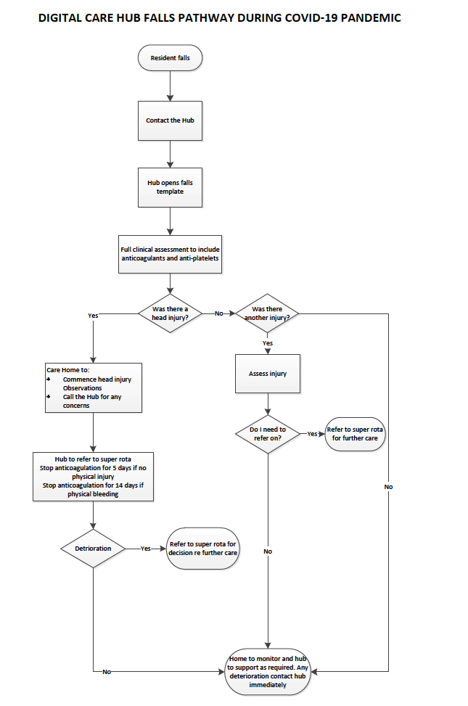

Slide 9
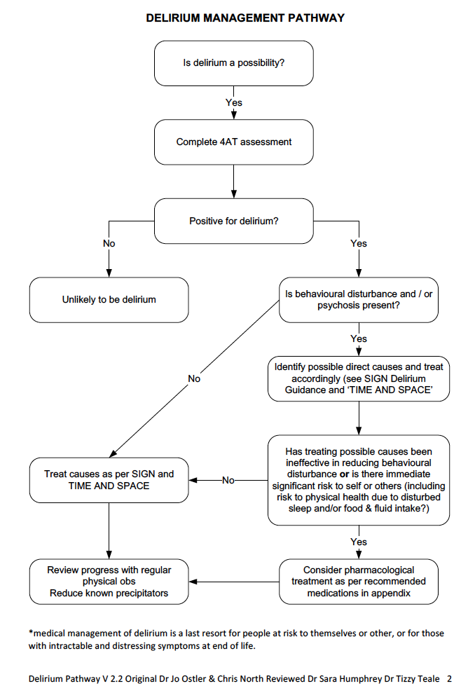

Slide 10
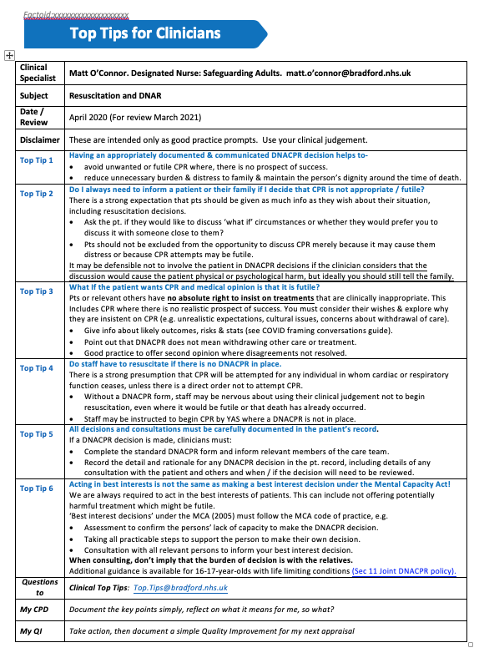
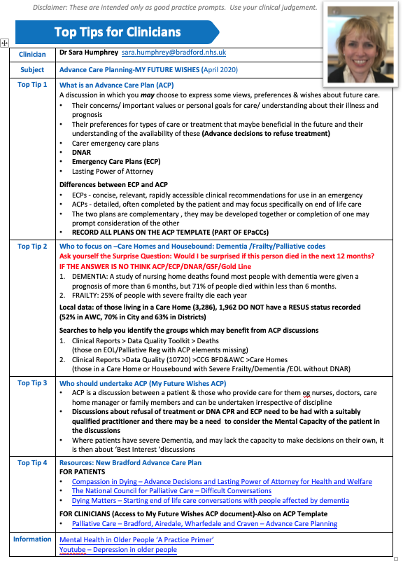

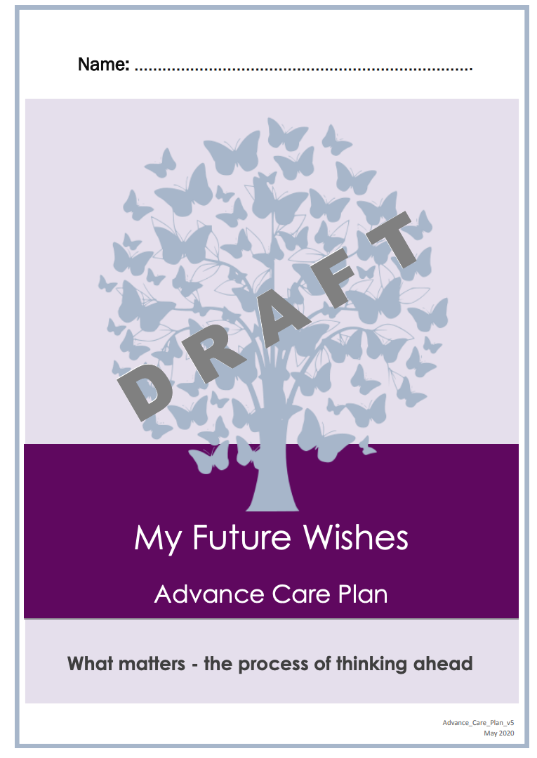
Framework for practices to support difficult consultations around ACP and DNAR
Sample letter & conversation starters for telephone consultations
Data searches to understand their care home & housebound population
Cross team Governance check to ensure the message was ‘right’
District wide approach
Targeting Primary Care & Care Homes
Top Tips on a page & Slide sets to support best practice

