Slide 1
ENT
BRADFORD VTS TEACHING DECK
An generalist’s guide...

Slide 2
ENT update in 60 minutes!!
Impossible
But lets use time constructively
Objectives- look at 4 common clinical problems and differentials, and derive an examination strategy not to miss anything.
Hand out on Latest evidence...

Slide 3
3 clinical problems
Dizziness
Rhinitis
Eustachian tube problems
And then summary of latest evidence/ recommended treatments including Bells Palsy

Slide 4
Now...
Split into 3 GROUPS –
HAND OUT CASE SHEETS
10 MINUTES TO CONFER AND WRITE DOWN ANSWERS

Slide 5
Case 1: Dizziness
A 60 year old woman reports sudden dizziness when she arises from bed. She feels nauseous and had been vomiting. She recently had a severe cold. Her vomiting has settled, but she is dizzy on turning her head to the right. She is frightened to leave her house.
What should you cover?
What should you do?

Slide 6
Dizziness
Taking a history—Dizziness means different things to different patients. Elicit a precise description of her symptoms by providing alternatives: Does the room spin around (vertigo)? Do you feel unsteady (dysequilibrium)? Do you feel like you may faint (presyncope)? Do you feel lightheaded?

Slide 7
4 types of dizziness
Vertigo
Disequilibrium
Pre-syncope
Non- specific dizziness

Slide 8
Vertigo
An illusion of movement, either of body or of environment- spinning, tilting, and moving sideways but must be some abnormal sensation of movement
Sub-classify vertigo according the duration of symptoms, and whether the vertigo is brought on by changes in position or occurs spontaneously.
Association of vertigo with hearing loss or tinnitus also provides important diagnostic information.

Slide 9
Causes of Dizziness 1: true vertigo
Cause | Key feature from history | Key discerning sign
Peripheral: BPPV 12-26% | Episodic, lasts seconds provoked by head movement. | Hallpike +ve with latency. Fatigueable.
Vestibular neuronitis | Acute sustained vertigo 1-7days without hearing loss. Recent febrile illness | Spontaneous unidirectional nystagmus suppressed by visual fixation
Menieres | Spontaneous, lasts hours Tinnitus and hearing loss ‘Fullness’ feeling | Low frequency hearing loss
Central: Migraine (second most common after BPPV) – 10% | Vertigo occurs in spontaneous episodes may be (but not always) associated with headache. | Usually normal
Vertebro-basilar TIA 7% | Spontaneous vertigo lasting 4-8 minutes usually associated with other neurological deficits | Nil to find- as has resolved.
Cerebello pontine Tumour/ MS CVA 2-3% | Sustained vertigo Possible hearing loss. | Direction changing nystagmus. Hallpike +ve (no latency) Pure vertical or horizontal nystagmus

Slide 10
Dizziness 2: Disequilibrium
-is a sensation of unsteadiness, not localized to the head, that occurs when walking and that resolves at rest.
The most common cause of disequilibrium is "multiple sensory deficits" in elderly patients with reduction in vestibular, visual and proprioceptive function—all three of the balance-preserving senses.
Exclude peripheral neuropathy / cerebellar degeneration - alcohol consumption, nutrition, diabetes mellitus, and family history
Hearing loss would be associated with many causes of gradual vestibular dysfunction, such as acoustic neuroma, so ASK in history.

Slide 11
Cause of dizziness 2: Disequilibrium
Cause | Key feature from history | Key sign from examination
Multiple sensory deficits in elderly patients 1-17% | No dizziness at rest. Relieved by touching wall | Gait. Rombergs. Look for cataracts, maculopathy, V/A.
Peripheral Neuropathy 5% | Alcohol, DM, Toxins, Vitamin deficiency. | Rombergs +ve. Sensory loss, decreased reflexes.

Slide 12
Dizziness 3: Presyncope
is the lightheadedness of a near-faint.
Features of a patient’s dizziness may suggest specific diagnoses, so
sudden onset of presyncope is suspicious for arrhythmia
exertional presyncope classically suggests aortic stenosis;
presyncope with emotional stress or on urination suggests vasomotor
syncope.
Presyncope on standing, or orthostatic hypotension, has an enormous
differential diagnosis.
Medications are a common cause of orthostasis.
Peripheral neuropathy is also a common cause, most often from diabetes.

Slide 13
Cause of dizziness 3: Presyncope
Cause | Key feature from history | Key sign from examination
Orthostatic hypotension (incl. meds, infection) 2-7% | Dizziness occurs on assuming upright posture | Postural BP drop. Rectal exam (PR blood). Anaemia.
Arrhythmia up to 5% | Abrupt onset: palpitations | Tachy/brady cardia
Vasomotor or Vasovagal | Previous occurences, emotional distress | Nil
Situational e.g. Micturitional 1% | Ask re events surrounding episode | Nil.

Slide 14
Dizziness 4: Nonspecific dizziness
Many patients with dizziness have neither vertigo, disequilibrium, nor presyncope.
Their history is distinguished mostly by its vagueness e.g. feeling of floating, disconnectedness, unreality, (depersonalization) or fear of losing control.
These patients tend to have a psychiatric disorder such as anxiety or panic disorder.
sleep pattern, loss of appetite, concentration disturbance, and suicidal ideation) and panic symptoms (diaphoresis, flushing, palpitations, chest pressure, paraesthesias, and nausea) should be sought.

Slide 15
Cause of dizziness 4: Non specific unsteadiness
Cause | Key feature from history | Key sign from examination
Nonspecific lightheadedness None of the above syndromes. Psychiatric (Anxiety, depression, panic, somatization) 6-16% | Hard to describe. May feel floating, disembodied, head fullness. Life stress. Panic syndrome: palpitations, doom sensation, diaphoresis. | criteria for depression or panic on mental status exam.
Hyperventilation 1-23% | Circum-oral paraesthesia may be present. Other panic symptoms. | 3 minute hyperventilation: positive predictive value = 20%

Slide 16
Examination strategy: Vertigo
Diagnosis Mainly from the History
Examination—Include cranial nerves, in particular fundoscopy for papilloedema (II), eye movements (III, IV, and VI), corneal reflex (V), and facial movement (VII). Nystagmus is common in acute vertigo.
Check cerebellar function (past pointing, dysdiadochokinaesia).
Vibration sense (a 128 Hz tuning fork on the ankle) is useful for screening for peripheral neuropathy.
Otoscopy is unlikely to be abnormal without hearing loss, pain, or discharge.
Cardiovascular exam. Heart sounds, Sitting and standing BP (5 mins in elderly).
Hallpike's manoeuvre will confirm benign paroxysmal positional vertigo (BPPV).

Slide 17
Diagnosis of vertigo
Vertigo of central neurological origin is uncommon and less likely to be horizontal or rotatory.
Rarely, vertigo results from a brainstem cerebrovascular accident, intracranial lesion, or migraine.
"Red flag" symptoms :
  persistent, worsening vertigo or dysequilibrium;
  atypical "non-peripheral" vertigo, such as vertical movement;
  severe headache, especially early in the morning;
  diplopia; cranial nerve palsies;
  dysarthria, ataxia, or other cerebellar signs
  papilloedema.
Case- dizziness on arising from bed suggests postural hypotension, while vomiting suggests peripheral vestibular disease. A cold suggests vestibular neuritis, but vertigo brought on by head turning suggests BPPV. Anxiety may impede central adaptation.

Slide 18
Conclusion: Vertigo
Importance of a good history and how a single diagnosis may not be reached.

Slide 19
Dixon-Hallpike and Epley’s

Slide 20
Nystagmus with BPPV
Note latency and horizontal nystagmus (can also be rotational)

Slide 21
Case 2 Rhinitis
A woman presents in early summer with a history of progressively worsening symptoms of a constant runny nose and frequent sneezing bouts. She was prescribed antihistamine tablets many years ago, which were helpful but made her drowsy. Lately, she has used "over the counter" decongestant nasal sprays, which, although initially helpful, now do not relieve symptoms. Tired and upset, she wants to know what else might help.
What do you cover?
What do you do?

Slide 22
Rhinitis- History
Rhinitis :definition- 2 or more of the following
  nasal blockage, sneezing, rhinorrhoea, and nasal itch.
  >1 hour of each per day
Does the problem disrupt work and sleep? Does it interfere with relationships or cause social embarrassment?
What is the underlying cause? Does the patient have a personal or family history of allergy? (aspirin??)

Slide 23
Differential
Allergy is by far the commonest cause of chronic symptoms.
  Seasonal Rhinitis (hay fever), pollens and fungal spores are the most likely triggers;
  Perennial rhinitis are typically due to house dust mite or pet allergy.
Infection (viral or bacterial)
Vasomotor Rhinitis (stress / temperature change etc)
Structural problems of the nose, and less commonly endocrine problems (hypothyroidism)
iatrogenic disease (for example, the combined contraceptive pill).

Slide 24
Rhinitis: red flags
Unilateral nasal blockage or discharge
Bloodstained nasal discharge
which may suggest nasopharyngeal carcinoma.

Slide 25
What do you do?
Alarm symptoms warrant urgent referral.
Treat underlying cause. Viral and bacterial infections are usually self limiting, although the latter may require systemic antibiotics. Structural nasal problems will usually require a surgeon's opinion.

Slide 26
Chronic Allergic Rhinitis
Step 1
Daily nasal steroid spray
Start 2 weeks prior to anticipated onset
Step 2
Add non-sedating antihistamine
Step 3
Mast cell stabilisers (cromoglycate), topical antihistamine, allergen avoidance
Consider pred. 20mg for 5 days
Try different ones

Slide 27
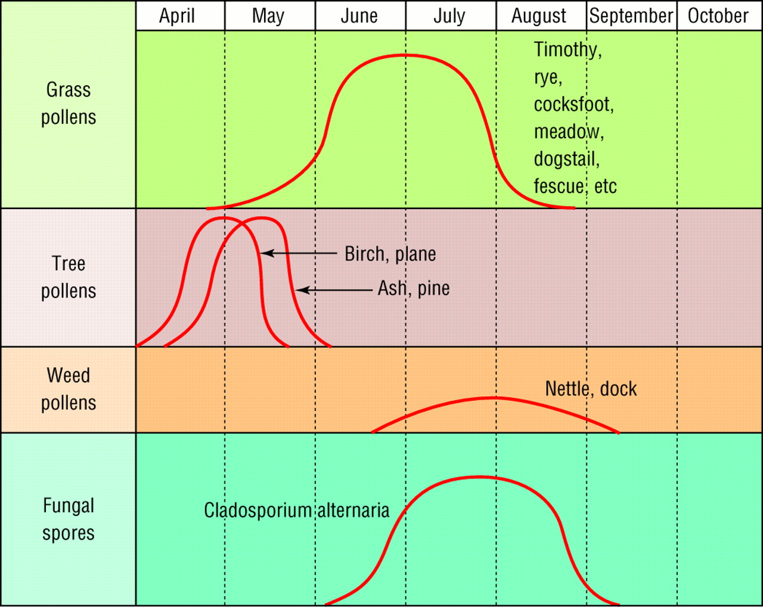
Pollen Calendar

Slide 28
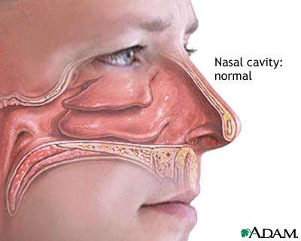
Examination of the nose

Slide 29
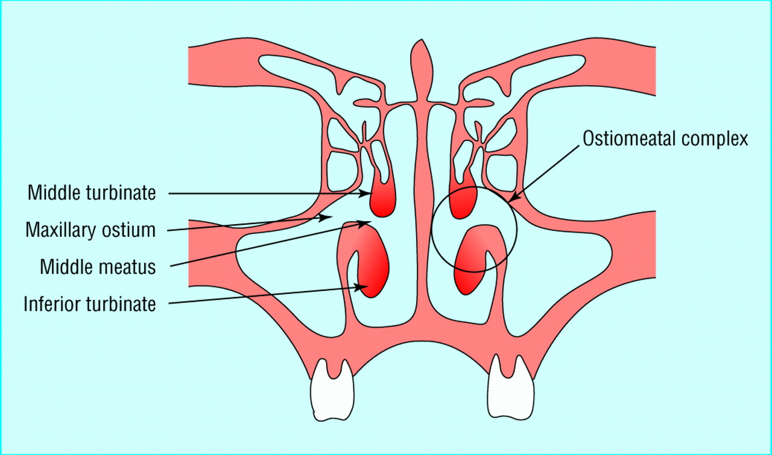

Slide 30
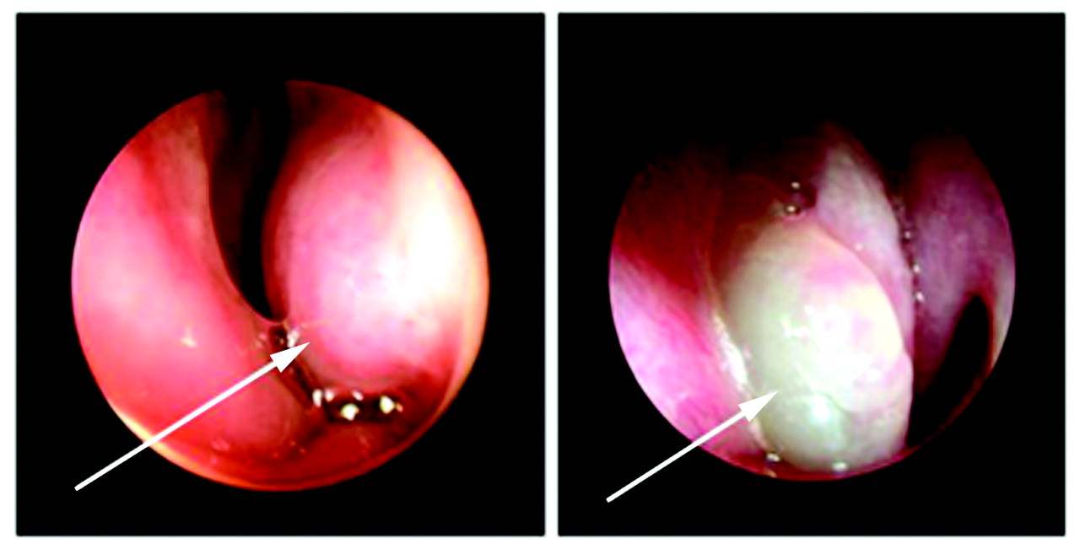

Fig 4 Endoscopic view of enlarged left inferior turbinate (arrow) in patient with perennial rhinitis (left), compared with patient with characteristic nasal polyps (arrow) (right)
Saleh, H. A et al. BMJ 2007;335:502-507
Copyright ©2007 BMJ Publishing Group Ltd.

Slide 31
Which treatment for which symptom?
Effects of drugs on nasal symptoms | Itch or sneezing | Discharge | Blockage | Impaired smell
Topical corticosteroids | +++ | +++ | ++ | +
Oral Antihistamines | +++ | ++ | +/
Sodium cromoglycate* | + | + | +/
Ipratropium Bromide |  | +++
Topical Decongestants |  |  | +++
Oral corticosteroids | +++ | +++ | +++ | ++ *First line treatment in children.

Slide 32
Case 3: Otitis Media and eustachian tube dysfunction
A worried mother brings her 5 year old son into surgery. He has a history of recurrent ear infections and there has been concern from his teacher that he is missing instructions in class. Over the last few days he has had intermittent pain in his left ear. She is demanding antibiotics and a referral for grommets.
What do you cover?
What do you do?

Slide 33
Otitis media history
Acute otitis media / chronic otitis media with effusion or eustachian tube dysfunction (AOM / COME / EUD)
AOM follows an URTI or is secondary to any cause of eustachian tube inflammation or blockage.
  otalgia, hearing loss, fever, and dysequilibrium.
ETD follows an upper respiratory tract infection or allergic rhinitis
  aural fullness, difficulty popping ears, intermittent sharp ear pain, hearing loss, tinnitus, and dysequilibrium.
COME
  hearing loss, tinnitus, and dysequilibrium. COME is not associated with fever. Children may have speech/language delay.

Slide 34
What do you do?
Examination:
ETD -usually normal. The pathologic condition is more often observed on rhinoscopy, which can reveal nasal obstruction with either a deviated septum or hypertrophied inferior turbinates. Chronic ETD may reveal retraction pockets or collapsed middle ear disease with erosion of incus/stapedius. Difficulty auto-inflating the ear drum.
AOM reveals an erythematous bulging tympanic membrane that can be featureless. Fever may also be present. Sometimes a discharge if ruptured (history of resolving pain)
COM is associated with a dull-appearing tympanic membrane. Tuning fork examination may reveal lateralization to the ipsilateral side in the absence of sensorineural hearing loss. Bone conduction is also greater than air conduction in the affected ear.

Slide 35
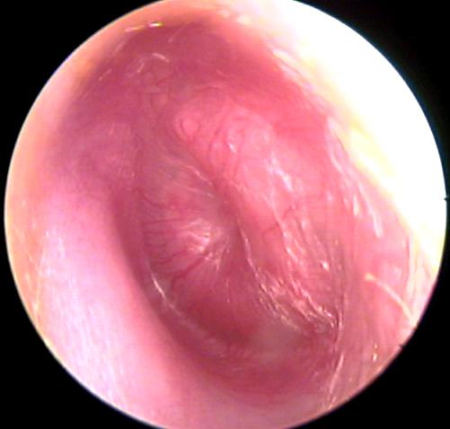
Acute Otitis Media

Slide 36
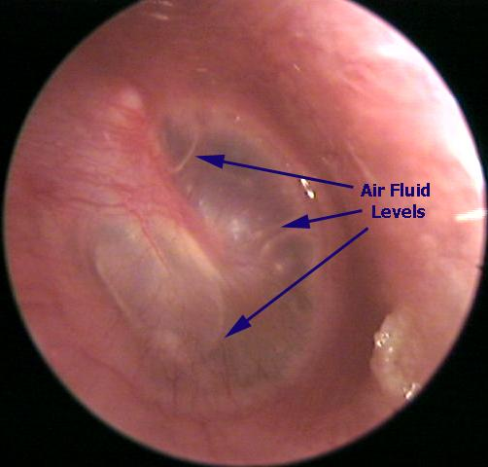
Serous Otitis Media

Slide 37
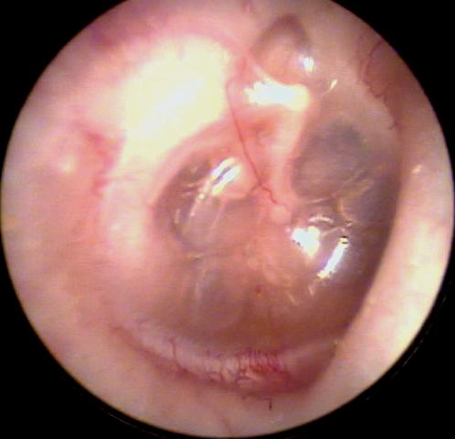
Serous otitis media with retraction

Slide 38
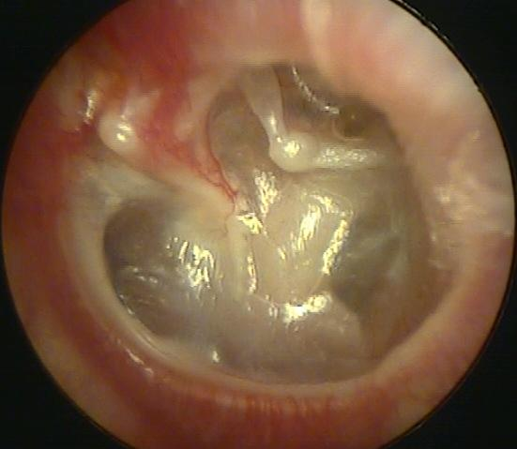
Eustachian Tube dysfunction

Slide 39
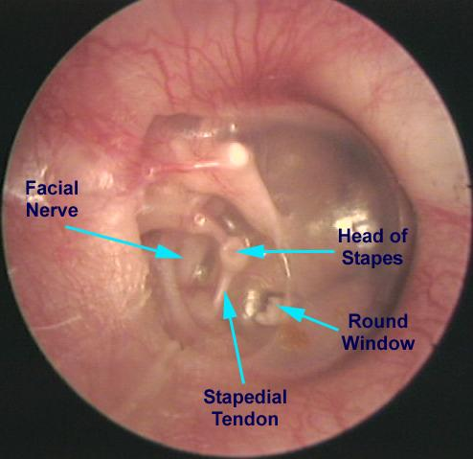

Slide 40
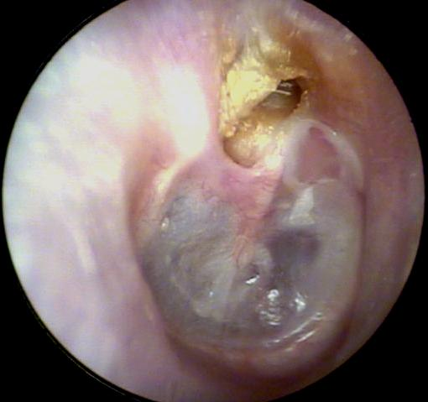
Cholesteatoma

Slide 41
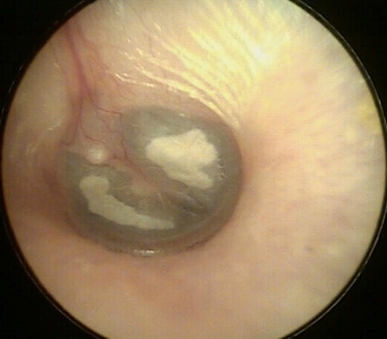
tympanosclerosis

Slide 42
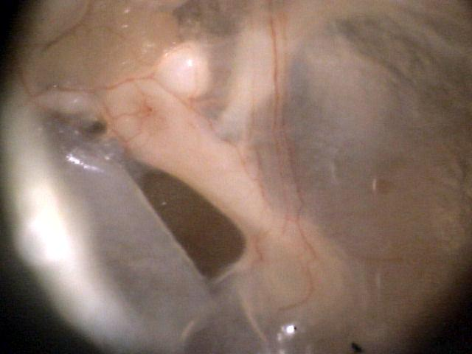
‘Monolayer’ (healed perforation)

Slide 43
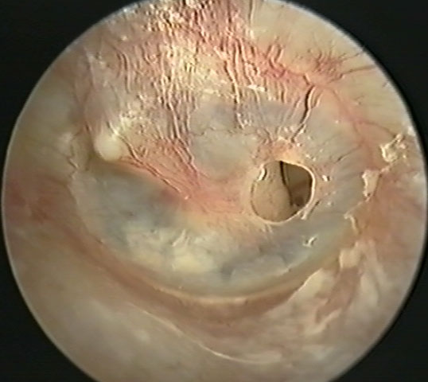
Perforation

Slide 44
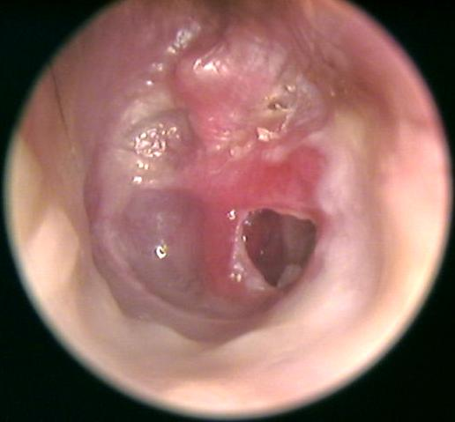
Marginal perforation plus cholesteatoma formation

Slide 45
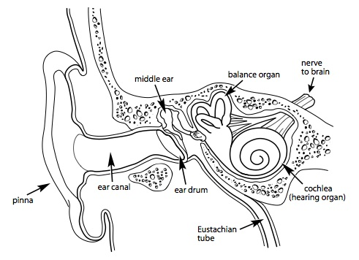
Diagram of the middle ear

Slide 46
Rinne Test
Hold a tuning fork first against the mastoid process then a few centimeters from the auditory meatus. Say to the patient "Which is loudest, ONE (on the mastoid) or TWO (near the auditory meatus). Normal hearing patients report that TWO is louder. This is reported as AC>BC ("Air conduction greater than bone conduction").
In a conductive hearing loss, this result reverses. This means that bone conduction is greater than air conduction, and this is best reported as an "abnormal Rinne" or a "reversed Rinne".

Slide 47
Weber Test
Hold a tuning fork on the middle of the patient's forehead and ask them "Where do you hear this loudest: left, right, or in the middle?" If the patient can't hear it, make sure the room is quiet or try putting in between their front teeth.
The sound localizes toward the side with a conductive loss ("toward the worse hearing ear") or away from the side with a sensorineural loss ("toward the better hearing ear"). You can remember this by doing the test on yourself, and plugging one ear with your finger to simulate a conductive loss.
The Weber Test is only useful if there is an asymmetrical hearing loss.

Slide 48
Management
AOM- see sheet.
COME-observation, antibiotics, or grommets. Meta-analysis sugegsts only 14% increase in resolution rate when antibiotics are given. Multiple courses of antibiotics have no proven benefit.
Consider surgical intervention after 3-4 months of effusion with a 20 dB or greater hearing loss.

Slide 49
Management ETD
Time, Autoinsufflation (eg an Otovent) and oral and nasal steroids. Decongestants (pseudoephedrine) are helpful, but not as useful for chronic ETD. Consider cardiovascular s/e of oral decongestants and development of tachyphylaxis with the use of nasal decongestants (no more than 3-5 d).
Nasal and oral antihistamines can also be beneficial in patients with allergic rhinitis. Leukotriene antagonists are helpful in some patients when oral steroids are not an option.
Myringotomy with tube insertion is reserved for the refractory patient with debilitating symptoms.

Slide 50
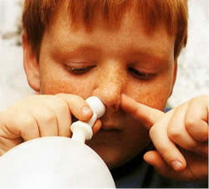
Otovent (you thought I was joking)

