Slide 1



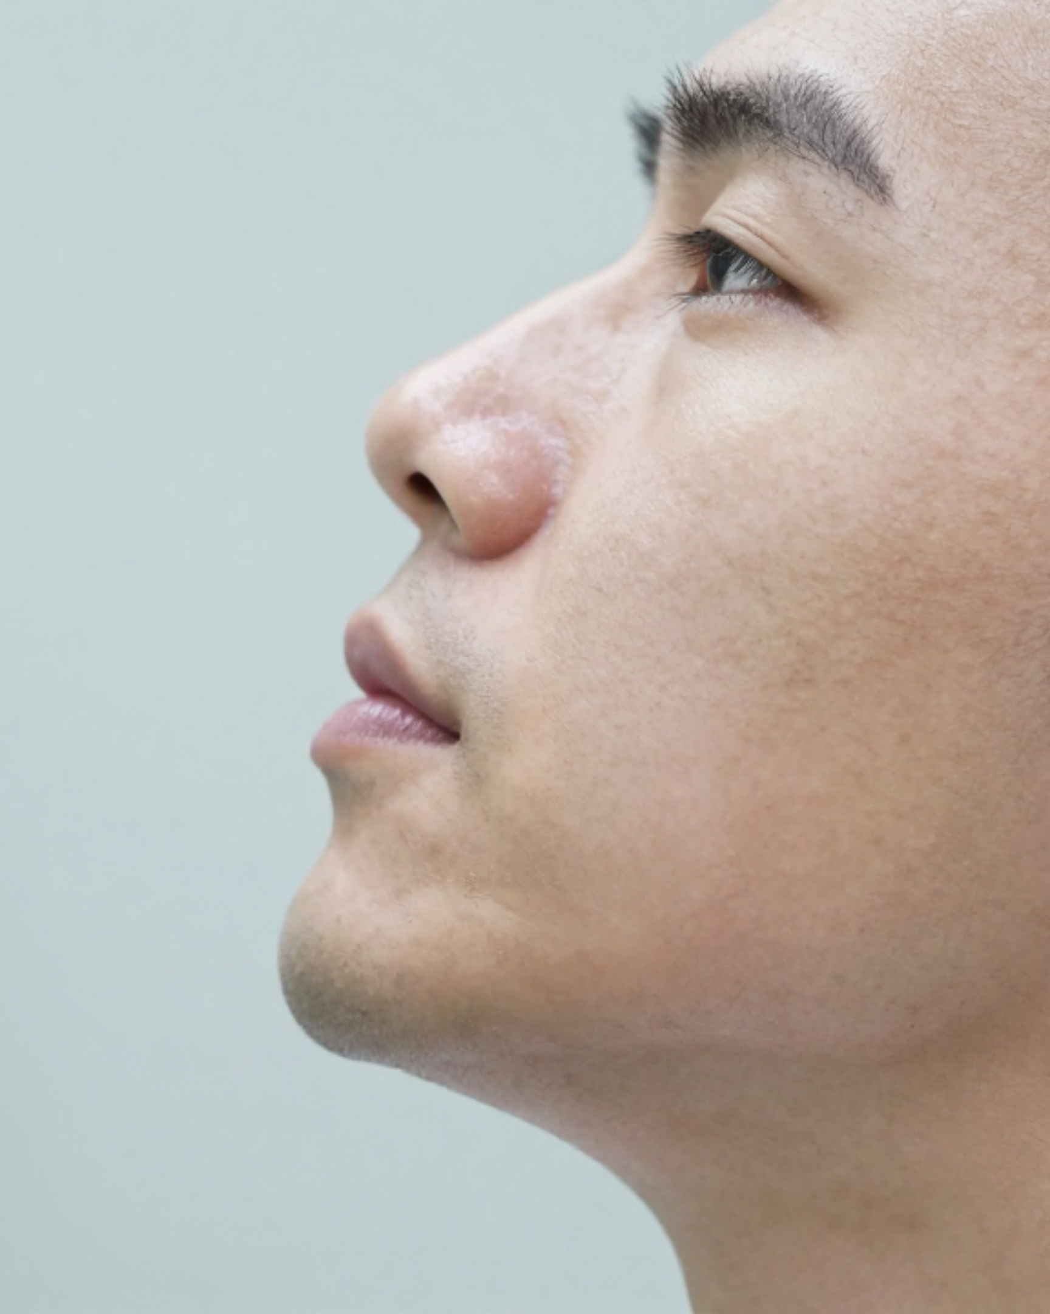
ENT EMERGENCIES
Bradford VTS Teaching Deck
in General Practice
Updated: NICE CKS, BNF May 2026 & Resus Council UK 2021
Comprehensive Ear, Nose & Throat Management
Urgent Referral Pathways & Red Flags
High-Yield AKT & SCA Exam Pearls
GP Trainee Clinical Resources • May 2026 Edition

Slide 2











ENT EMERGENCIES
Anatomical Framework & Clinical Escalation
EAR Emergencies
NOSE Emergencies
THROAT Emergencies
Sudden SNHL(Emergency Refer)
Severe Epistaxis(Uncontrolled)
Quinsy(Peritonsillar Abscess)
Acute Mastoiditis
Septal Haematoma(Risk of Abscess)
Ludwig's Angina(Airway Crisis)
Malignant Otitis Externa
Displaced Nasal Fracture
Epiglottitis / Supraglottitis
Facial Nerve Palsy(LMN vs UMN)
Foreign Body(Unilateral Discharge)
Acute Stridor(Inspiratory)
Perichondritis & Haematoma
Complicated Sinusitis
Airway Foreign Body
Traumatic TM Perforation
Orbital/Intracranial Spread
Parapharyngeal Abscess
Foreign Bodies(Battery = Red Flag)
Clinical Core: Rapid recognition by anatomical region allows for immediate life-saving interventions and streamlined secondary care escalation.

Slide 3














CRITICAL EAR EMERGENCIES
SSNHL & Acute Mastoiditis Management
Sudden SNHL
Acute Mastoiditis
Definition: Hearing loss of ≥30 dB over ≥3 frequencies, developing over ≤72 hours. Often unilateral.
Complication of Acute Otitis Media (AOM). Requires rapid identification of physical signs.
URGENT ACTION
EMERGENCY ADMISSION
SAME-DAY ENT REFERRAL (EMERGENCY)
SAME-DAY A&E + ENT REFERRAL
High-dose Prednisolone: 1 mg/kg/day (max 60 mg) for 14 days, starting immediately. BNF MAY 2026
Features: Post-auricular swelling, erythema, tenderness, and loss of post-auricular crease.
Prognosis: Earlier treatment significantly improves hearing recovery outcomes.
Management: IV antibiotics (Ceftriaxone) ± surgical drainage (Cortical Mastoidectomy).
Safety Net: MRI required to exclude acoustic neuroma (vestibular schwannoma).
Complications: Subperiosteal abscess, meningitis, intracranial abscess.
CARDINAL SIGN: Pinna displaced forward and downward.

Slide 4










ENT EMERGENCIES
Malignant Otitis Externa & Perichondritis
Malignant Otitis Externa
Perichondritis of Pinna
Risk Groups: Elderly diabetics or immunocompromised patients.
Cardinal Sign: Erythema and swelling sparing the lobule (no cartilage).
Features: Severe, relentless deep-seated pain; granulation tissue on canal floor.
Etiology: Often follows trauma or high ear piercing (Pseudomonas / S. aureus).
Pathogen: PSEUDOMONAS AERUGINOSA invading the skull base.
DANGER: Facial nerve palsy (CN VII) is a sinister, late complication.
Management: Oral Ciprofloxacin 7–14 days (BNF 2026).
GP MANAGEMENT PATHWAY
Treat with Ciprofloxacin; Refer to ENT for drainage if an abscess develops.
URGENT ACTION
SAME-DAY ENT REFERRAL + IV Anti-pseudomonals + CT Temporal Bone
AKT PEARL
Lobule involvement = Cellulitis; Sparing lobule = Perichondritis.

Slide 5












ENT EMERGENCIES
Clinical Management & Referral Pathways
Auricular Haematoma
Traumatic TM Perforation
Ear Foreign Bodies
One gentle attempt at removal only if cooperative and visible.
Collection of blood between perichondrium and cartilage following blunt trauma.
Caused by barotrauma, slaps, cotton buds, or explosions. Severe pain followed by hearing loss.
No blind instrumentation without good visualization.
Risk: Cartilage necrosis leading to permanent "Cauliflower Ear".
Management: Keep ear strictly dry. Most heal spontaneously in 6–8 weeks.
Action: Urgent aspiration and compression dressing. Refer ENT if recurrent.
Referral: Not healed by 8 weeks or if ossicular chain disruption suspected.
BUTTON BATTERY
SAME-DAY EMERGENCY REFERRAL
Alkali leakage causes rapid liquefactive necrosis of tissues and cartilage.
Consider an emergency in any body orifice (Ear, Nose, Throat).

Slide 6

















EPISTAXIS MANAGEMENT PROTOCOL
Step-by-Step Clinical Management & Referral Criteria
First Aid (10-15 Minutes)
Persisting or Severe Bleeding
1
Position: Lean patient forward to prevent swallowing blood (reduces nausea).
Anterior Packing: Rapid Rhino or ribbon gauze if trained.
Silver Nitrate Cautery: Apply to visible bleeding point.
2
Compression: Firmly pinch the SOFT part of the nose continuously for 10–15 mins.
CAUTION: Never cauterize both sides of the septum simultaneously (Risk: Septal Perforation).
3
Adjuncts: Breathe through mouth; cold compress to back of neck.
4
Oral Hygiene: Spit out blood that enters the throat; do not swallow.
IF BLEEDING STOPS:
Refer A&E / ENT Immediately
Avoid blowing, straining, or hot drinks for 48h. Prescribe Naseptin cream (4 weeks) if anterior Kiesselbach's area visible.
Bleeding not controlled after packing
Posterior Epistaxis (high volume, elderly)
Anticoagulants (Warfarin, DOAC, Heparin)
Hemodynamic instability or severe blood loss
Note: Posterior bleeds often require interventional radiology or surgical ligation.

Slide 7









ENT EMERGENCIES
Septal Haematoma and Nasal Fractures
Septal Haematoma
Nasal Fracture
URGENT
Pathophysiology: Blood between septal cartilage and perichondrium following trauma.
Diagnosis: Purely clinical assessment. X-ray is unhelpful (does not dictate management).
Presentation: Bilateral nasal obstruction, increasing pain, and boggy swelling of the septum.
No Deformity: No specific treatment required once septal haematoma is excluded.
Major Risk: Cartilage necrosis → Abscess → Saddle-nose deformity.
Soft Tissue: If deformity causes obstruction, refer for non-urgent ENT follow-up.
CLINICAL ACTION REQUIRED
Displaced Fractures: Refer to ENT OPD within 7–10 days.
URGENT SAME-DAY ENT REFERRAL for surgical drainage and prophylactic antibiotics.
Assessment is best after swelling subsides but before healing (usually reduce within 2 weeks).

Slide 8
























ENT EMERGENCIES
Clinical Management & Referral Pathways
Nasal Foreign Bodies: Assessment & Protocols
Clinical Presentation
EMERGENCY: Button Battery
Child with unilateral offensive discharge is a foreign body until proven otherwise.
True ENT Emergency: Risks rapid liquefactive necrosis and septal perforation.
Common objects: Beads, paper, organic matter, or small toy parts.
Chemical burns can occur within hours due to alkali leakage.
Action: Immediate same-day referral to ENT for urgent removal.
May present with local pain, epistaxis, or nasal obstruction.
Primary Care Management
Referral Criteria
Attempt removal ONLY ONCE if the object is clearly visible and child is cooperative.
Failed initial attempt in primary care.
Uncooperative child or object poorly visualized.
"Parent's Kiss" technique or gentle suction may be attempted.
Evidence of tissue damage or secondary infection.
Strictly avoid blind instrumentation as it may push the object into the airway.
SCA Pearl: "Don't try to remove the battery yourself—this needs to go to A&E immediately to prevent permanent damage."

Slide 9
















ENT EMERGENCIES
Clinical Management & Referral Pathways
AIRWAY EMERGENCY
Quinsy (Peritonsillar Abscess)
Ludwig’s Angina
Deviation of uvula to the opposite side
Trismus (difficulty opening mouth)
"Woody" hardness of submandibular neck
Muffled "hot potato" voice and drooling
Bilateral floor of mouth cellulitis
Unilateral severe pain and dysphagia
Protruding tongue and stridor
Rapidly spreading odontogenic infection
SAME-DAY ENT REFERRAL
DIAL 999 IMMEDIATELY

Slide 10











EPIGLOTTITIS AND SUPRAGLOTTITIS
Critical Airway Management & GP Safety Protocol
CRITICAL PROHIBITIONS
DO NOT examine the throat
Clinical Presentation
DO NOT use a tongue depressor
Acute onset severe sore throat, odynophagia & fever
Drooling, muffled "hot potato" voice & toxic look
DO NOT lie the patient down
Inspiratory stridor = partial airway obstruction
*Adult form now more common than paediatric post-Hib vaccine.
CARDINAL SIGN: TRIPOD POSITION
IMMEDIATE AIRWAY EMERGENCY
Patient sits upright, leans forward, and absolutely refuses to lie down. Do not force them into a supine position.
CALL 999
Request Anaesthetics + ENT + Senior A&E

Slide 11



















ENT EMERGENCIES
Croup and Airway Foreign Bodies
Clinical Differentiation: Croup vs. Epiglottitis
COMPLETE AIRWAY OBSTRUCTION
Feature
Croup (Laryngotracheobronchitis)
Epiglottitis (Supraglottitis)
Conscious: 5 Back Blows followed by 5 Abdominal Thrusts (Heimlich).
1
Onset
Slow (over days)
Rapid (over hours)
2
Unconscious: Start CPR immediately and call 999/2222.
Fever
Mild
3
Repeat cycles until obstruction cleared or medical help arrives.
High / Toxic Appearance
Drooling
No
Yes (Severe Odynophagia)
Stridor
Barking cough ("Seal-like")
Inspiratory (No barking cough)
Partial Obstruction & Inhaled FB
Voice
Hoarse
Muffled ("Hot Potato")
Partial Obstruction: Encourage coughing; monitor closely; refer ENT if persistent.
Position
Comfortable lying down
Tripod (Refuses to lie down)
Bronchial Aspiration: Cough/wheeze/reduced air entry → Refer for bronchoscopy.
Urgent Action
Dexamethasone ± Nebulised Adrenaline
999 — DO NOT EXAMINE THROAT
Fish Bone: If not visible → Soft tissue lateral neck X-ray → Urgent ENT referral.
Source: Resuscitation Council UK (2021) | BNF May 2026
Bradford VTS Teaching Deck

Slide 12














ENT EMERGENCIES
Clinical Management & Referral Pathways
Bell's Palsy (Idiopathic LMN)
Ramsay Hunt Syndrome
Clinical FeaturesUnilateral facial weakness (LMN: forehead/eyebrow involved), inability to close eye, drooping mouth.
PresentationSevere ear pain + vesicles on pinna, ear canal, or palate + Facial palsy (CN VII + VIII).
Medical Management (NICE CKS)Oral Prednisolone 25mg BD for 10 days.Gold Standard: Start within 72 hours of symptom onset for best prognosis.
Urgent Rx (BNF 2026)Aciclovir 800mg 5x daily (7 days) + Prednisolone.
Danger Signs: Refer Urgently
Essential Eye CareLubricant drops (day), eye ointment (night), and tape eye shut at night to prevent exposure keratopathy.
Stroke (UMN Pattern)Forehead spared; patient can still wrinkle brow. 999 Immediately.
Progressive / ComplexSlowly progressive (>3 weeks), parotid mass, or chronic ear disease (Cholesteatoma).
Bilateral PalsyConsider Lyme disease, Sarcoidosis, or Guillain-Barré Syndrome.

Slide 13





















ENT RED FLAG SUMMARY
Quick-Reference Emergency Management & Actions
Emergency
Key Feature
Action
Sudden SNHL
Hearing loss developing over ≤72 hours
Same-day ENT + Steroids
Mastoiditis
AOM + swelling behind ear + pinna forward
Same-day A&E + IV Abx
Malignant OE
Diabetic + severe pain + canal granulations
Same-day ENT Referral
Battery (Ear/Nose)
Any button battery in ear or nasal canal
Immediate ENT Emergency
Septal Haematoma
Boggy septal swelling after nasal trauma
Same-day ENT Drainage
Quinsy
Trismus + uvula shift + hot potato voice
Same-day ENT Drainage
Ludwig’s Angina
Woody submandibular swelling + airway risk
999 IMMEDIATELY
Epiglottitis
Tripod position + drooling + NO EXAM
999 IMMEDIATELY
Airway FB
Complete obstruction / choking presentation
Choking Protocol / 999
Ramsay Hunt
Facial palsy + vesicles in ear/palate
Urgent Aciclovir + Steroids

Slide 14













ENT EMERGENCIES
Clinical Management & Referral Pathways
AKT: Ear & Facial Nerve
SCA: Safety Netting
Sudden SNHL is a same-day ENT emergency; start prednisolone 1mg/kg immediately.
Empower patients to recognize SNHL early through specific safety netting advice.SUGGESTED PHRASING
"If you develop a sudden drop in hearing, please call us the same day — this needs urgent treatment."
Acute Mastoiditis cardinal sign is the pinna displaced forward and downward.
Bell's Palsy requires prednisolone within 72 hours and proactive eye lubrication.
SCA: Direct Action
AKT: Airway & Trauma
Use clear, authoritative language for immediate A&E or 999 escalations.SUGGESTED PHRASING
"I need you to go to A&E now — the infection has spread around your ear and needs hospital treatment."
Epiglottitis: DO NOT examine the throat or use a tongue depressor; call 999.
Septal Haematoma carries a high risk of cartilage necrosis and saddle-nose deformity.
Button Batteries in any orifice cause rapid alkali necrosis; remove immediately.
Prevent home removal attempts of batteries to avoid worsening chemical burns.

Slide 15


















QUICK RECALL AND GUIDELINE SOURCES
Final summary of emergency actions and a list of current guideline sources including NICE CKS and BNF May 2026.
EAR ESSENTIALS
THROAT & AIRWAY
GUIDELINE SOURCES
Sudden SNHL: Same-day ENT referral + Prednisolone 1mg/kg (max 60mg).
Epiglottitis: DO NOT examine throat; 999; Keep patient upright.
NICE CKS (ENT Emergencies)
Mastoiditis: Pinna displaced forward/down → Same-day A&E referral.
Ludwig’s Angina: 999; Woody submandibular swelling is an airway emergency.
BNF May 2026 Edition
Resus Council UK (2021)
Malignant OE: Diabetic + severe pain/granulations → Urgent ENT.
Quinsy: Trismus + uvula deviation → Same-day ENT for drainage.
ENT UK Clinical Guidelines
NOSE & TRAUMA
FACIAL NERVE
GP SAFETY PEARL
Battery FB: Emergency removal required (risk of liquefactive necrosis).
Bell’s Palsy: Oral Prednisolone within 72 hours + essential eye care.
"IF IN DOUBT, ESCALATE."
Septal Haematoma: Urgent surgical drainage to prevent saddle-nose deformity.
Ramsay Hunt: Facial palsy + ear vesicles → Aciclovir + steroids.
ENT emergencies can rapidly compromise the airway or cause permanent sensory loss. Maintain a low threshold for same-day specialist review.
Epistaxis: Pinch soft nose 15 mins; refer if posterior or uncontrolled.
Stroke Check: UMN pattern (forehead sparing) → 999 immediately.

