Slide 1
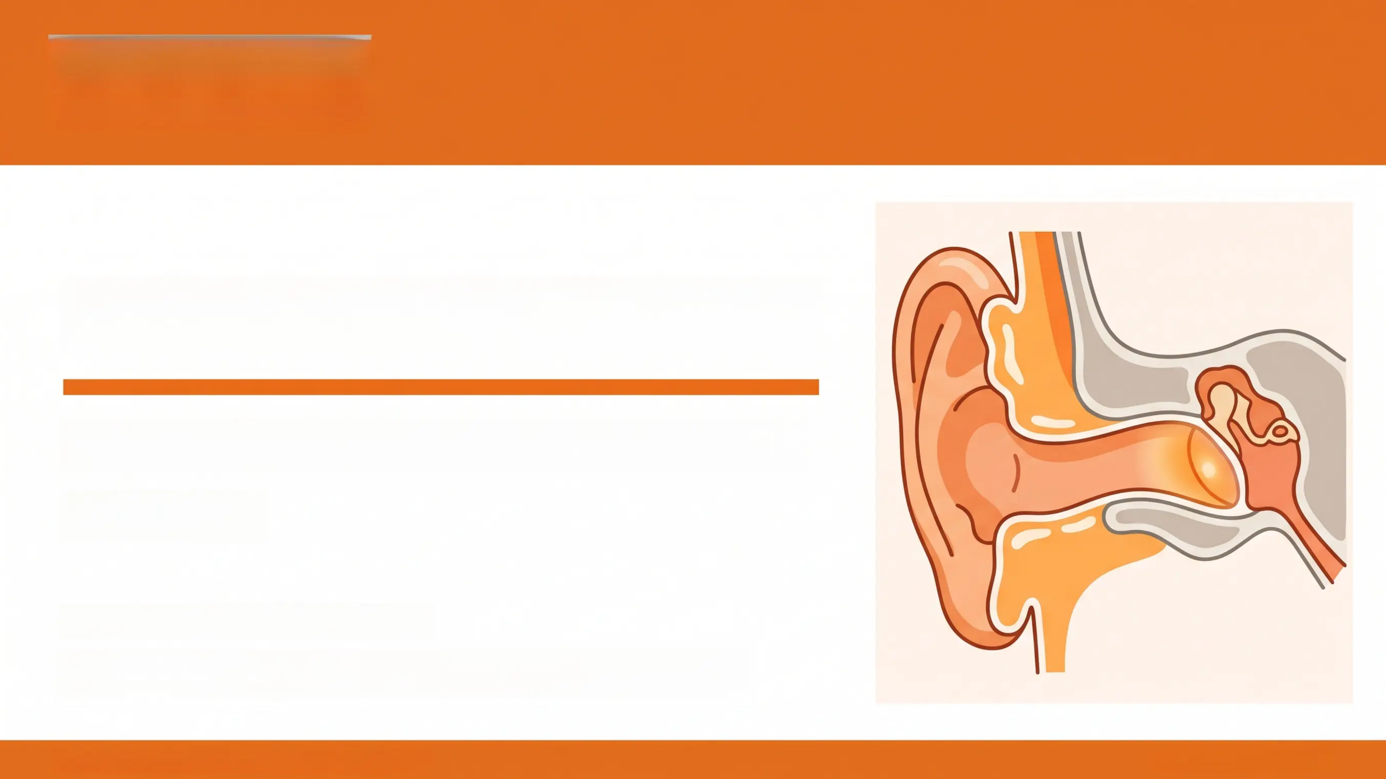
Bradford VTS
BRADFORD VTS TEACHING DECK
Ear Conditions in GP 1
May 2026
www.bradfordvts.co.uk 🔗
*For educational use only. Always refer to current NICE guidelines and
BNF in clinical practice.
Bradford VTS | Ear Conditions in GP | May 2026
www.bradfordvts.co.uk

Slide 2

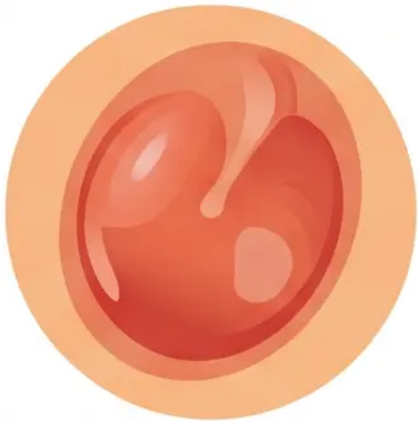
Ear Conditions in GP
May 2026
Acute Otitis Media (AOM)
Diagnosis and Management — NICE NG91
Clinical Diagnosis
Management — NICE NG91 (2018, reaffirmed 2024)
1️⃣ Watchful Wait (most children >2 years, mild symptoms, unilateral)
• Reassure: most resolve spontaneously within 2–3 days
• Analgesia: paracetamol ± ibuprofen
2️⃣ Back-up Antibiotic Prescription
• Give prescription to fill only if not better in 72 hours
• Empowers families; reduces unnecessary antibiotic use
3️⃣ Immediate Antibiotics:
• Under 2 years + bilateral AOM
• Systemically unwell; otorrhoea; immunocompromised
• Cleft palate; cochlear implant; recurrent (3+ in 6 months)
• Red, bulging tympanic membrane
• Loss of light reflex and bony landmarks
• Otalgia — severe earache, often sudden onset
• Fever and irritability (especially in children)
• Possible otorrhea if TM has perforated
• Age group: most common 6 months – 5 years
• Amoxicillin 500 mg three times daily × 5–7 days (adults))
weight-based paediatric dose)
*Penicillin allergy: Clarithromycin 500 mg twice daily × 5–7 days
⚠️ Common Pitfalls — Don't Miss
• NOT 3 days — outdated SMAC 1998 recommendation; NICE NG91
specifies 5–7 days
*Tympanometry Type B seen in OME — AOM is a clinical
diagnosis based on acute symptoms.
• NOT amoxicillin if EBV / glandular fever suspected — causes a
severe widespread maculopapular rash
Bradford VTS | Ear Conditions in GP | May 2026
www.bradfordvts.co.uk | Slide 2 of 14

Slide 3

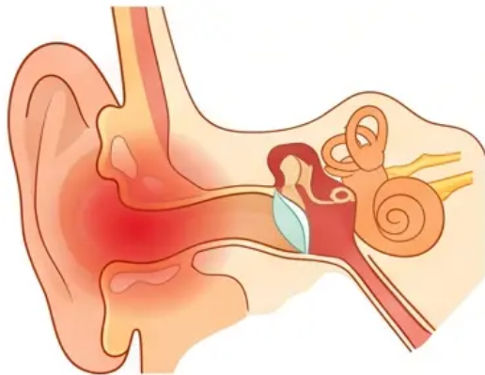
Ear Conditions in GP | May 2026
AOM: Complications &
Immediate Antibiotics
Prescribe Antibiotics NOW if...
Complications of AOM
Common / Expected:
Age under 2 years with bilateral AOM
Otitis Media with Effusion (glue ear) — most common sequela
Tympanic membrane perforation — usually heals spontaneously
Otorrhoea (ear discharge)
Systemically unwell (high fever, lethargy, poor feeding)
Serious
Mastoiditis — post-auricular swelling, pinnadisplaced forward and
downward; same-day A&E
Immunocompromised patient
Facial nerve palsy — urgent ENT same day
Cleft palate or cochlear implant
Rare but Life-Threatening:
Meningitis
Recurrent AOM — three or more episodes in six months
Intracranial abscess
Sigmoid sinus thrombosis
*NICE NG91 (2018, reaffirmed 2024) — First-line: Amoxicillin 5–7 days
❗ RED FLAG — Mastoiditis: Post-auricular swelling + pinna displaced forward → Same-day A&E referral. Do not wait for antibiotic response.
Bradford VTS | Ear Conditions in GP | Slide 3 of 14
www.bradfordvts.co.uk

Slide 4
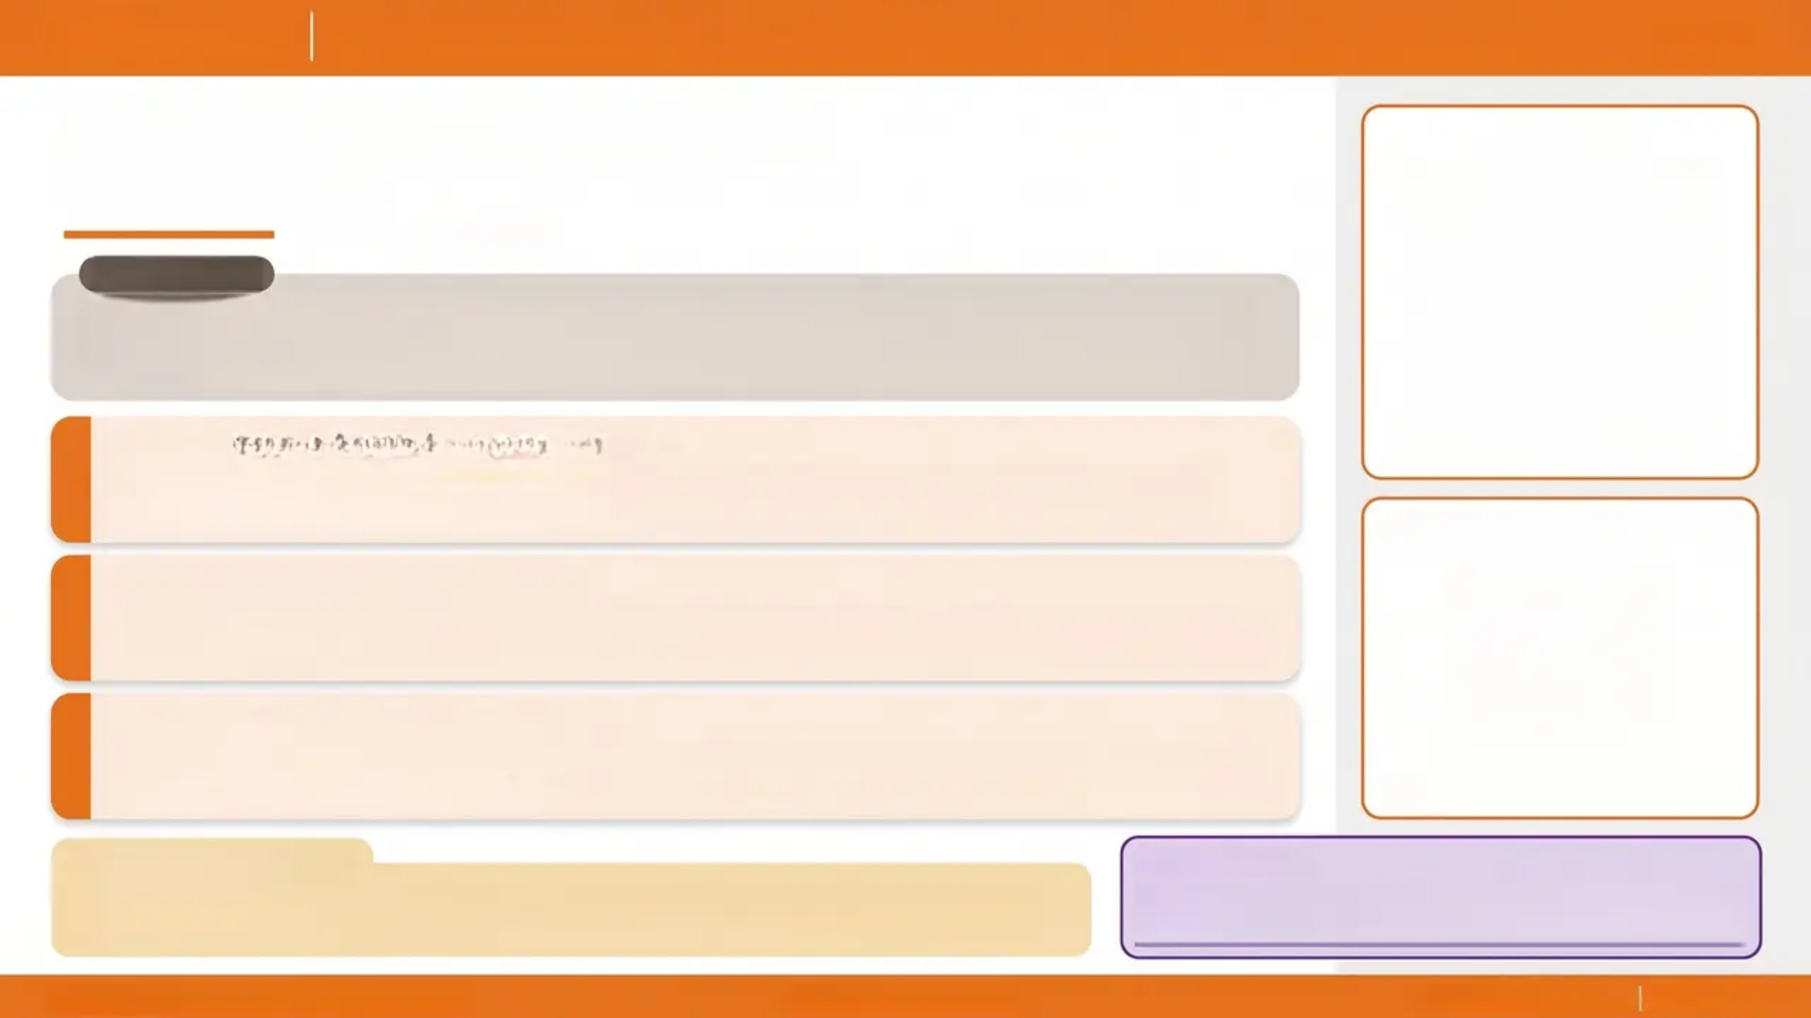
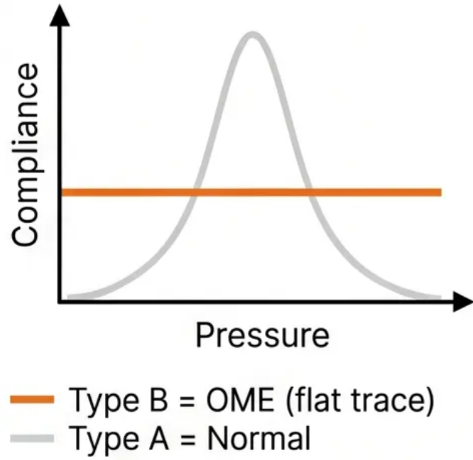
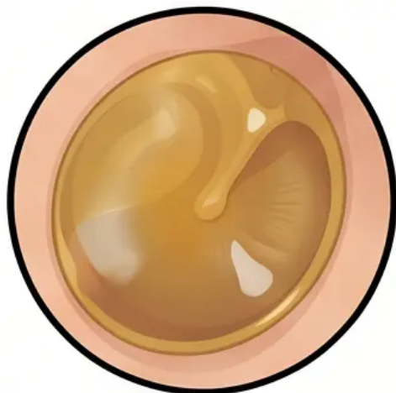
Bradford VTS
Ear Conditions in GP
May 2026
Otitis Media with Effusion
OME / Glue Ear
What is OME?
Fluid in the middle ear without signs of acute infection. The most common cause of conductive
hearing loss in children. Often asymptomatic — discovered on routine audiometry or when
parents notice hearing difficulties.
Watchful Wait — 3 Months
1
80% of cases resolve spontaneously within 3 months. No active treatment needed
initially. Reassure parents and monitor.
Tympanic membrane appearance
Autoinflation (Otovent)
2
Evidence-based. Recommend for children aged 4 years and over. Child blows up a small
balloon through one nostril to open the Eustachian tube. Atro. Available OTC.
Refer to ENT if Persistent
3
Persistent OME beyond 3 months with bilateral hearing loss ≥ 25 dB. Consider grommets
± adenoidectomy. Lower threshold for Down's syndrome or cleft palate.
Amber / opaque TM — loss of light reflex
⚠️ Special Populations
🎓
AKT Pearl
Down's syndrome and cleft palate: lower threshold for ENT referral — do not wait the full 3 months if
concerns exist.
Grommets threshold: bilateral hearing loss ≥ 25 dB
persisting beyond 3 months. NICE NG233 (2023).
Bradford VTS | Ear Conditions in GP | May 2026
NICE NG233 (August 2023)
www.bradfordvts.co.uk | Slide 4 of 14

Slide 5

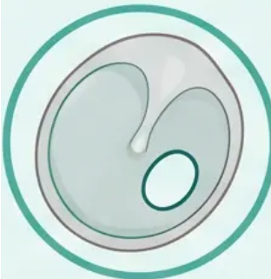
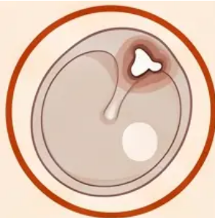
Bradford VTS | Ear Conditions in GP
May 2026
Chronic Ear Disease: Safe vs. Unsafe Perforation
CSOM — Chronic Suppurative Otitis Media
Identifying perforation type determines urgency — one requires routine ENT review; the other is a cholesteatoma until proven otherwise.
✔ Tubotympanic (Safe Type)
⚠ Atticoantral (Unsafe Type)
Central Perforation
Attic / Marginal Perforation
• Perforation site: Central — does not involve the attic or margins of
the TM
• Discharge: Mucopurulent, odourless or mildly malodorous
• Hearing loss: Conductive — proportional to perforation size
• Risk: Lower — no cholesteatoma; generally benign course
• Perforation site: Attic (Shrapnell's membrane) or marginal — involves
the posterosuperior TM
• Discharge: Offensive, foul-smelling, keratin-laden — a key clinical alarm
• Hearing loss: Conductive ± sensorineural if ossicular chain eroded
• Risk: HIGH — cholesteatoma until proven otherwise
• Cholesteatoma = skin in the wrong place. Keratin accumulates,
erodes bone. Can invade mastoid, ossicles, facial nerve canal, dura.
Management
→ Ear toilet (aural microsuction or dry mopping)
→ Topical antibiotics — ciprofloxacin drops
(safe with TM perforation)
→ Dry ear precautions — no swimming, no water in ear
→ ENT review — non-urgent; consider myringoplasty
Management
→ Do NOT manage in primary care
→ Urgent ENT referral — clinic within 2 weeks
→ If facial nerve palsy, severe pain, or systemic
illness: same-day ENT
Central perforation
Attic perforation + crust
⚠ Aminoglycoside Ear Drops (Neomycin, Framycetin) — NOT safe with TM perforation → risk of ototoxicity
✔ Ciprofloxacin ear drops — safe with TM perforation
Bradford VTS | Ear Conditions in GP | Slide 5 of 14
www.bradfordvts.co.uk

Slide 6
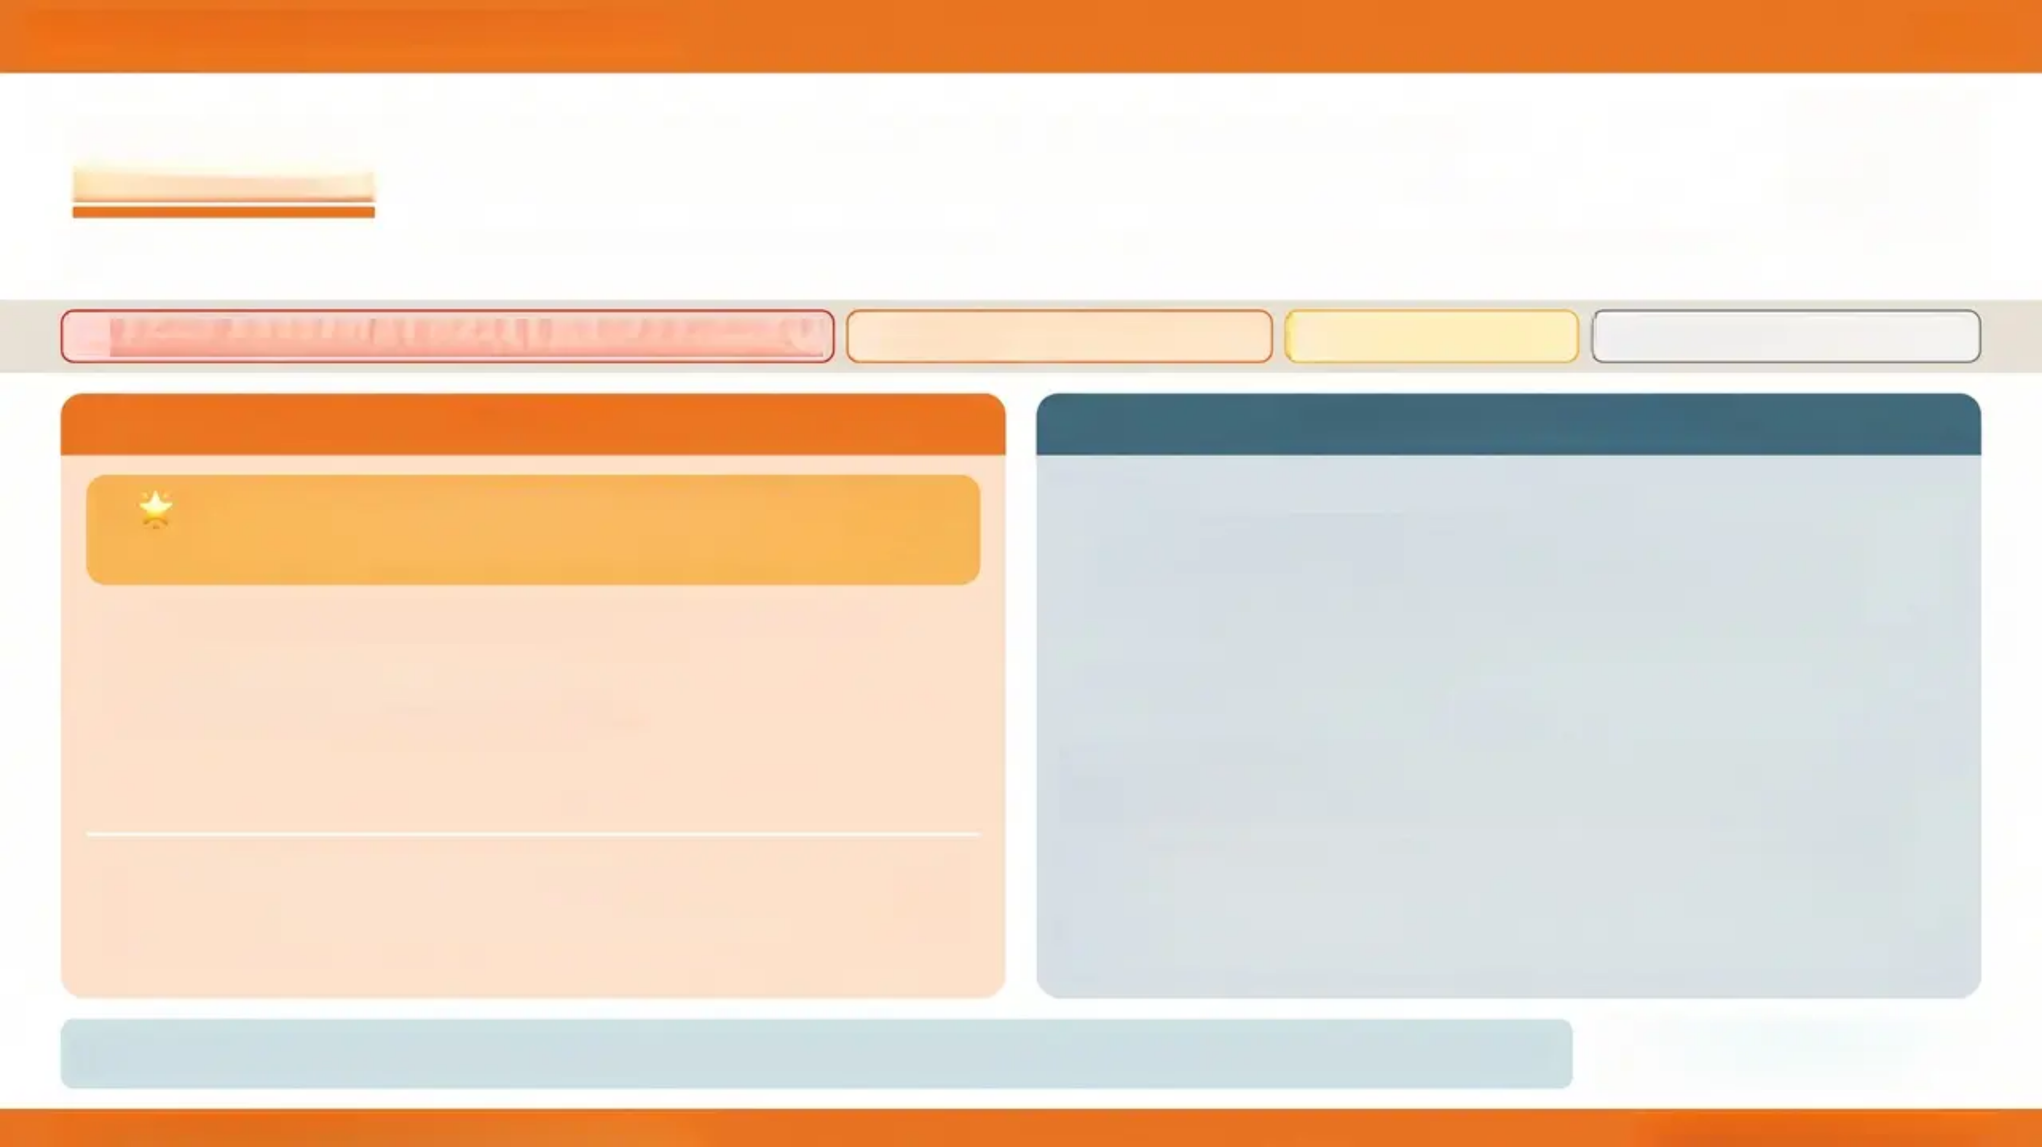
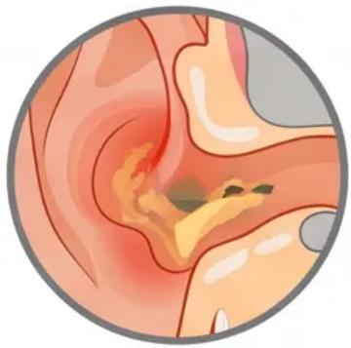






Bradford VTS | Ear Conditions in GP
6 / 14
Otitis Externa (OE): Modern Management
Inflammation of the external auditory canal — 'swimmer's ear'. Bacterial (Pseudomonas, Staph aureus) or fungal.
Otorrhoea + itch
TM normal or obscured
Canal oedema & erythema
Severe otalgia — worsened by tragal pressure / pulling pinna
MILD OE
MODERATE-SEVERE OE
> 🌟 FIRST-LINE: Acetic Acid 2% Spray (EarCalm)
NICE CKS 2024 — KEY GUIDELINE CHANGE
Topical antibiotic + steroid drops:
✅ Ciprofloxacin + hydrocortisone (e.g. Cilodex)
SAFE with TM perforation
🛑 Neomycin + dexamethasone (e.g. Otomize)
Use with caution — NOT safe with TM perforation (ototoxic)
❌ Framycetin drops
NOT safe with TM perforation
- Aural toilet (microsuction or dry mopping) — removes debris, improves
drop penetration
- Pope's wick — insert if severe canal oedema to allow drops to reach the
canal
- Oral antibiotics NOT routinely needed — only if: spreading cellulitis,
immunocompromised, or pinna/facial involvement
- Restores natural acidic environment of ear canal
- Effective against bacteria and fungi
- Available over the counter (OTC)
- 1 spray every 2-3 hours — up to 7 days
- No antibiotic resistance concern
⚠️ Pitfall: Previous guidelines did not specify acetic acid as first-line — this
is a high-yield AKT change from NICE CKS 2024.
- Orange callout = NICE guideline update
- Red badge = Contraindication / danger
- Amber badge = Pitfall / caution
Prevention: Keep ears dry • No cotton buds • Ear plugs for swimming if recurrent • Acetic acid spray after swimming
Left: “Bradford VTS | Ear Conditions in GP | May 2026”
Right: www.bradfordvts.co.uk

Slide 7


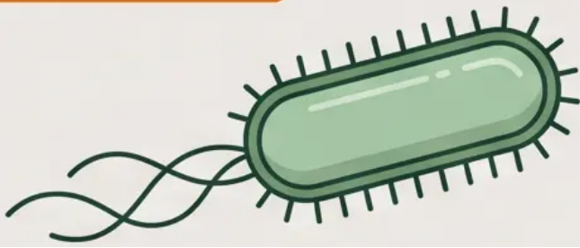



Slide 7 of 14
Malignant Otitis Externa
A Clinical Emergency
Necrotising osteomyelitis of the skull base — almost exclusively in diabetics and the immunocompromised
SAME-DAY ENT REFERRAL + IV ANTI-PUSEUDOMONAL ANTIBIOTICS + URGENT CT PETROUS BONE
Do not discharge. Do not delay. This is a skull base emergency.
Clinical Features
The Organism
Recognise It: Classic Triad
Severe, unremitting otalgia — Out of proportion; does not respond to standard analgesia;
persists at rest and at night
Granulation tissue at the bony-cartilaginous junction — Pathognomonic finding on
otoscopy; looks like fleshy tissue at the floor of the EAC
Pseudomonas aeruginosa
High-risk host — Diabetic (especially poorly controlled), elderly, immunocompromised
(HIV, haematological malignancy, steroids)
- Gram-negative rod
- Thrives in moist, warm environments
- Resistant to many standard antibiotics
- Requires anti-pseudomonal cover
(e.g. IV piperacillin-tazobactam or
ciprofloxacin IV)
Progression Without Treatment
Cranial nerve VII palsy (facial nerve) — first nerve affected; facial droop
Further CN palsies (IX, X, XI, XII) — as osteomyelitis spreads along skull base
Refer: Same-day ENT referral —
do not manage in primary care
Investigate: Urgent CT petrous bone and
skull base — assess extent of osteomyelitis
Treat: IV anti-pseudomonal antibiotics —
inpatient; prolonged course (weeks to months)
Bradford VTS | Ear Conditions in GP | May 2026
www.bradfordvts.co.uk

Slide 8
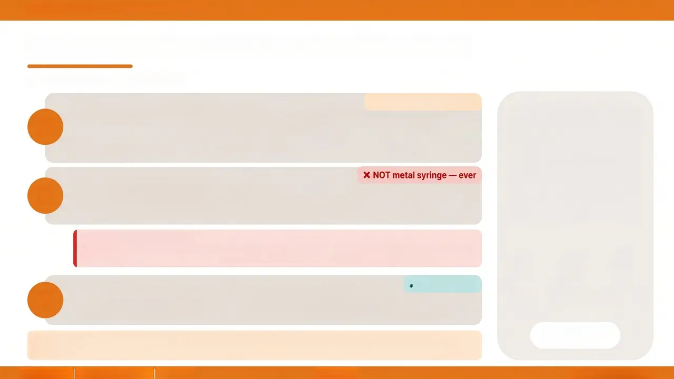

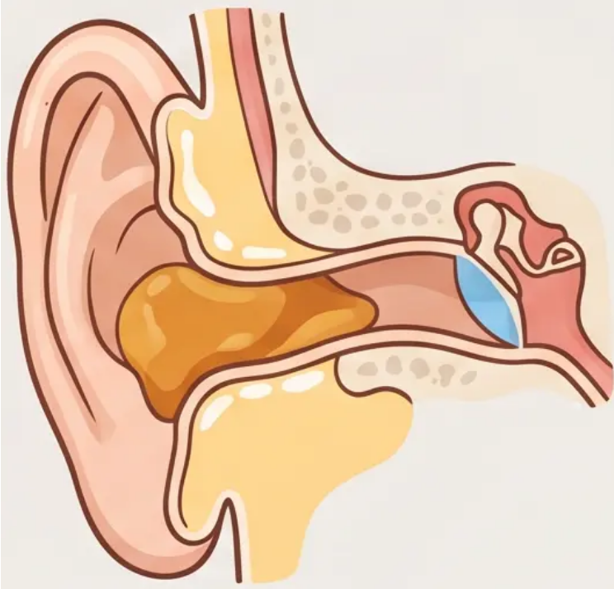

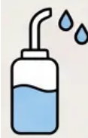
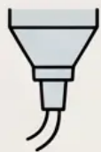

BRADFORD VTS
Ear Wax: Assessment and Safe Removal
NICE CKS Earwax — July 2025
Ear Softening — First Line
⚠️ Avoid in TM perforation
1
• Olive oil drops — preferred first choice (safe, evidence-based, readily available)
• Almond oil or sodium bicarbonate drops: alternatives
• Use twice daily for 3-5 days before irrigation
• Avoid if known or suspected TM perforation
Electronic Ear Irrigation
2
• Use electronic irrigator only (e.g. Propulse)
• Metal Higginson syringe: ABANDONED — risk of TM perforation and canal trauma
• Perform after softening drops × 3-5 days • Warm water, gentle controlled pressure
Contraindications to Irrigation
• Known or suspected TM perforation
• Only hearing ear
• Previous ear surgery (same
• Active acute OE or AOM
• Non-vegetable foreign body in canal
• Cleft palate repair history
✔ Gold standard
Microsuction — If Irrigation Fails or Contraindicated
3
Soften
first
Electronic
irrigation
Microsuction
if needed
• Gold standard for wax removal
• Refer to audiology or ENT
• Safe even with TM perforation
• Preferred in complex or recurrent cases
NICE CKS Earwax
July 2025
Key Principle: No treatment if asymptomatic — even if wax is visible on otoscopy. Only treat when
symptomatic (hearing loss, otalgia, tinnitus, vertigo, prevents examination).
Bradford VTS | Ear Conditions in GP | May 2026
Slide 8 of 14
www.bradfordvts.co.uk

Slide 9
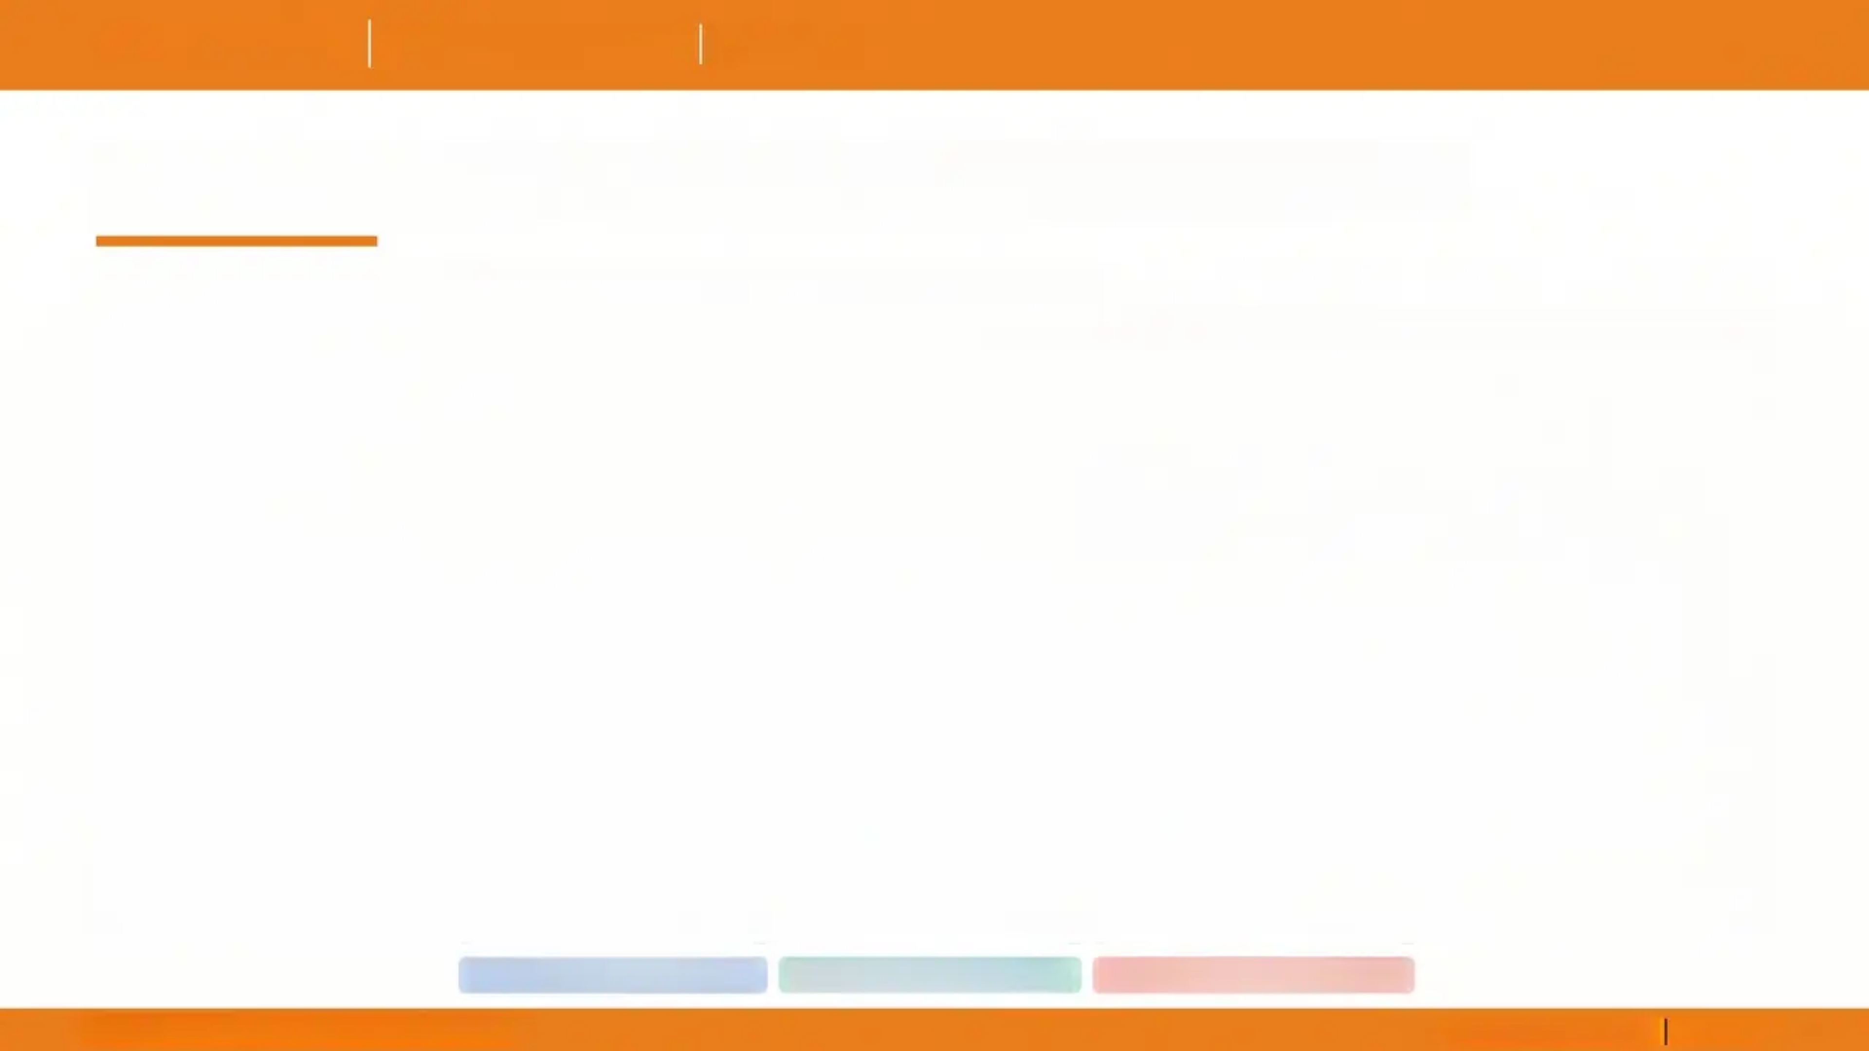


















Bradford VTS | Ear Conditions in GP | May 2026
Drug Summary for Common Ear Conditions
BNF May 2026 — for reference only; always check current BNF in clinical practice
Drug / Indication
Dose & Duration
Key Clinical Notes
Amoxicillin —
Acute Otitis Media (AOM)
500 mg three times daily × 5–7 days (adults); weight-based paediatric dose — see BNF
⚠️ NOT if EBV suspected — severe rash Duration is 5–7 days — NOT 3 days (outdated SMAC 1998 recommendation).
Clarithromycin — AOM (penicillin allergy)
500 mg twice daily × 5–7 days (adults)
Use when penicillin allergy confirmed. Same 5–7 day duration applies. Check interactions (e.g. statins — risk of myopathy).
Acetic Acid 2% Spray (EarCalm) — Otitis Externa, mild
1 spray into affected ear every 2–3 hours × up to 7 days
✅ NICE CKS 2024 — First-line mild OE Restores acidic canal environment. Effective against bacteria and fungi. Available OTC.
Ciprofloxacin Ear Drops (e.g. Cilodex with hydrocortisone) — Otitis Externa, moderate–severe
As directed on preparation; typical course 7 days
✅ Safe with TM perforation Fluoroquinolone; no ototoxicity risk. Preferred topical antibiotic when TM perforation present or suspected.
Neomycin / Aminoglycoside Ear Drops (e.g. Otomize, Gentisone HC)
As directed; use with caution
🚫 NOT safe with TM perforation — ototoxic Risk of sensorineural hearing loss (ototoxicity). Avoid if perforation known or suspected. Framycetin also in this group — same contraindication.
Systemic oral antibiotics
Topical ear preparations
Caution / Contraindication
Bradford VTS | Ear Conditions in GP | May 2026
www.bradfordvts.co.uk | Slide 9 of 14

Slide 10




Bradford VTS
GP Training Programme
AKT Pearls
High-Yield Exam Facts
Six high-yield facts — know these cold for the exam.
Acetic Acid 2% = First-Line for Mild OE
01
02
AOM Antibiotics = 5-7 Days. NOT 3 Days.
NICE CKS 2024 key change. EarCalm spray — 1 spray
every 2–3 hours × 7 days. Restores acidic environment;
effective against bacteria and fungi.
NICE NG91. The 3-day course is an outdated SMAC 1998
recommendation. Amoxicillin 500 mg tds × 5–7 days
(adults).
Never Amoxicillin if EBV Suspected
03
04
Ciprofloxacin Drops = Safe with TM
Perforation
Causes a severe widespread maculopapular rash. Use
clarithromycin or await monospot result before
prescribing.
Aminoglycosides (neomycin, framycetin) are NOT safe —
risk of sensorineural hearing loss (ototoxicity).
Electronic Irrigation Only — NOT the Metal Syringe
05
OME Grommets Threshold: ≥25 dB Bilateral
× 3 Months
06
Earwax 2025. Old Higginson metal syringe abandoned — risk of
TM perforation. Olive oil softening first × 3–5 days.
NICE NG233 (2023). Watchful wait 3 months first;
autoinflation (Otovent) for children ≥4 years.
Bradford VTS | Ear Conditions in GP | May 2026
www.bradfordvts.co.uk

Slide 11
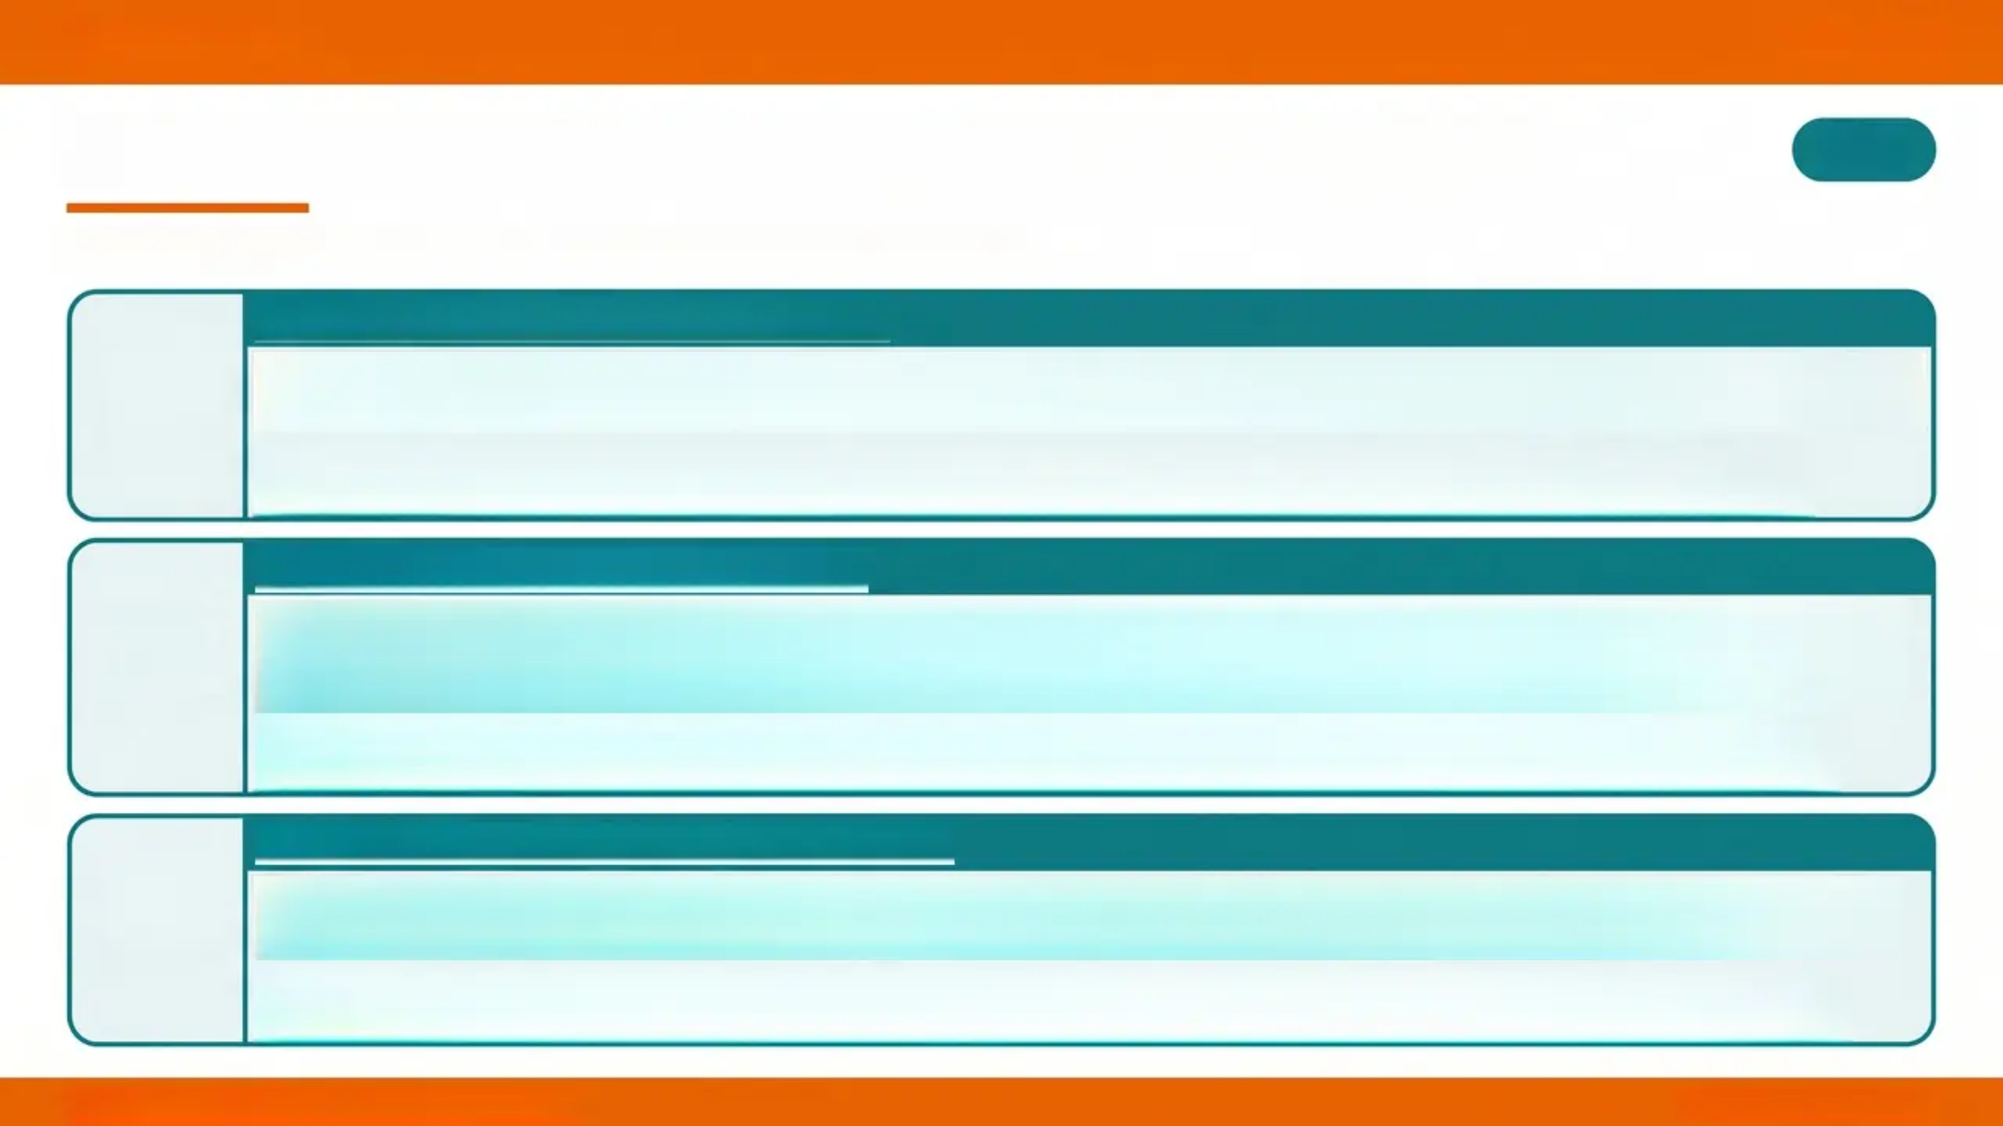

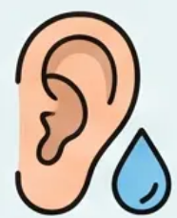
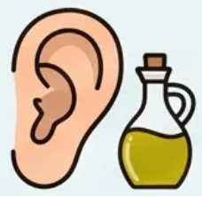
Bradford VTS
Slide 11 of 14
SCA Pearls: Consultation and Communication
SCA
What to say — and how to say it — in the consultation room
AOM in a Child — Back-Up Prescription
'Most ear infections clear up on their own within 2-3 days — the body is very good at fighting these. I’d like to give you
a prescription to hold onto; if he’s not better in 3 days, or develops a high fever or ear discharge, then start the antibiotics.'
Tip: Explain the back-up prescription model clearly — many parents expect antibiotics immediately. Validate their concern
before explaining the watchful wait approach.
Otitis Externa — Ear Drop Explanation
'Swimmer's ear is an infection of the skin of the ear canal. These ear drops will treat the infection, and the steroid
helps reduce the swelling. Use them [frequency/days] and try to keep the ear as dry as possible — no swimming until
it clears.'
Tip: Add safety-netting — 'If pain spreads to your face or jaw, or you develop a fever, please come back urgently.' This covers
malignant OE red flag.
Ear Wax — Explaining the Removal Process
'Your symptoms are caused by a build-up of ear wax. I’d like you to put some olive oil drops in the ear twice a day for
5 days — this softens the wax. Then come back and we can wash it out safely using a gentle electronic irrigator.'
Tip: Reassure patients that the electronic irrigator is gentle and safe — many have heard of the old metal syringe and may be
anxious. Confirm no contraindications before booking irrigation.
Bradford VTS | Ear Conditions in GP | May 2026
www.bradfordvts.co.uk

Slide 12
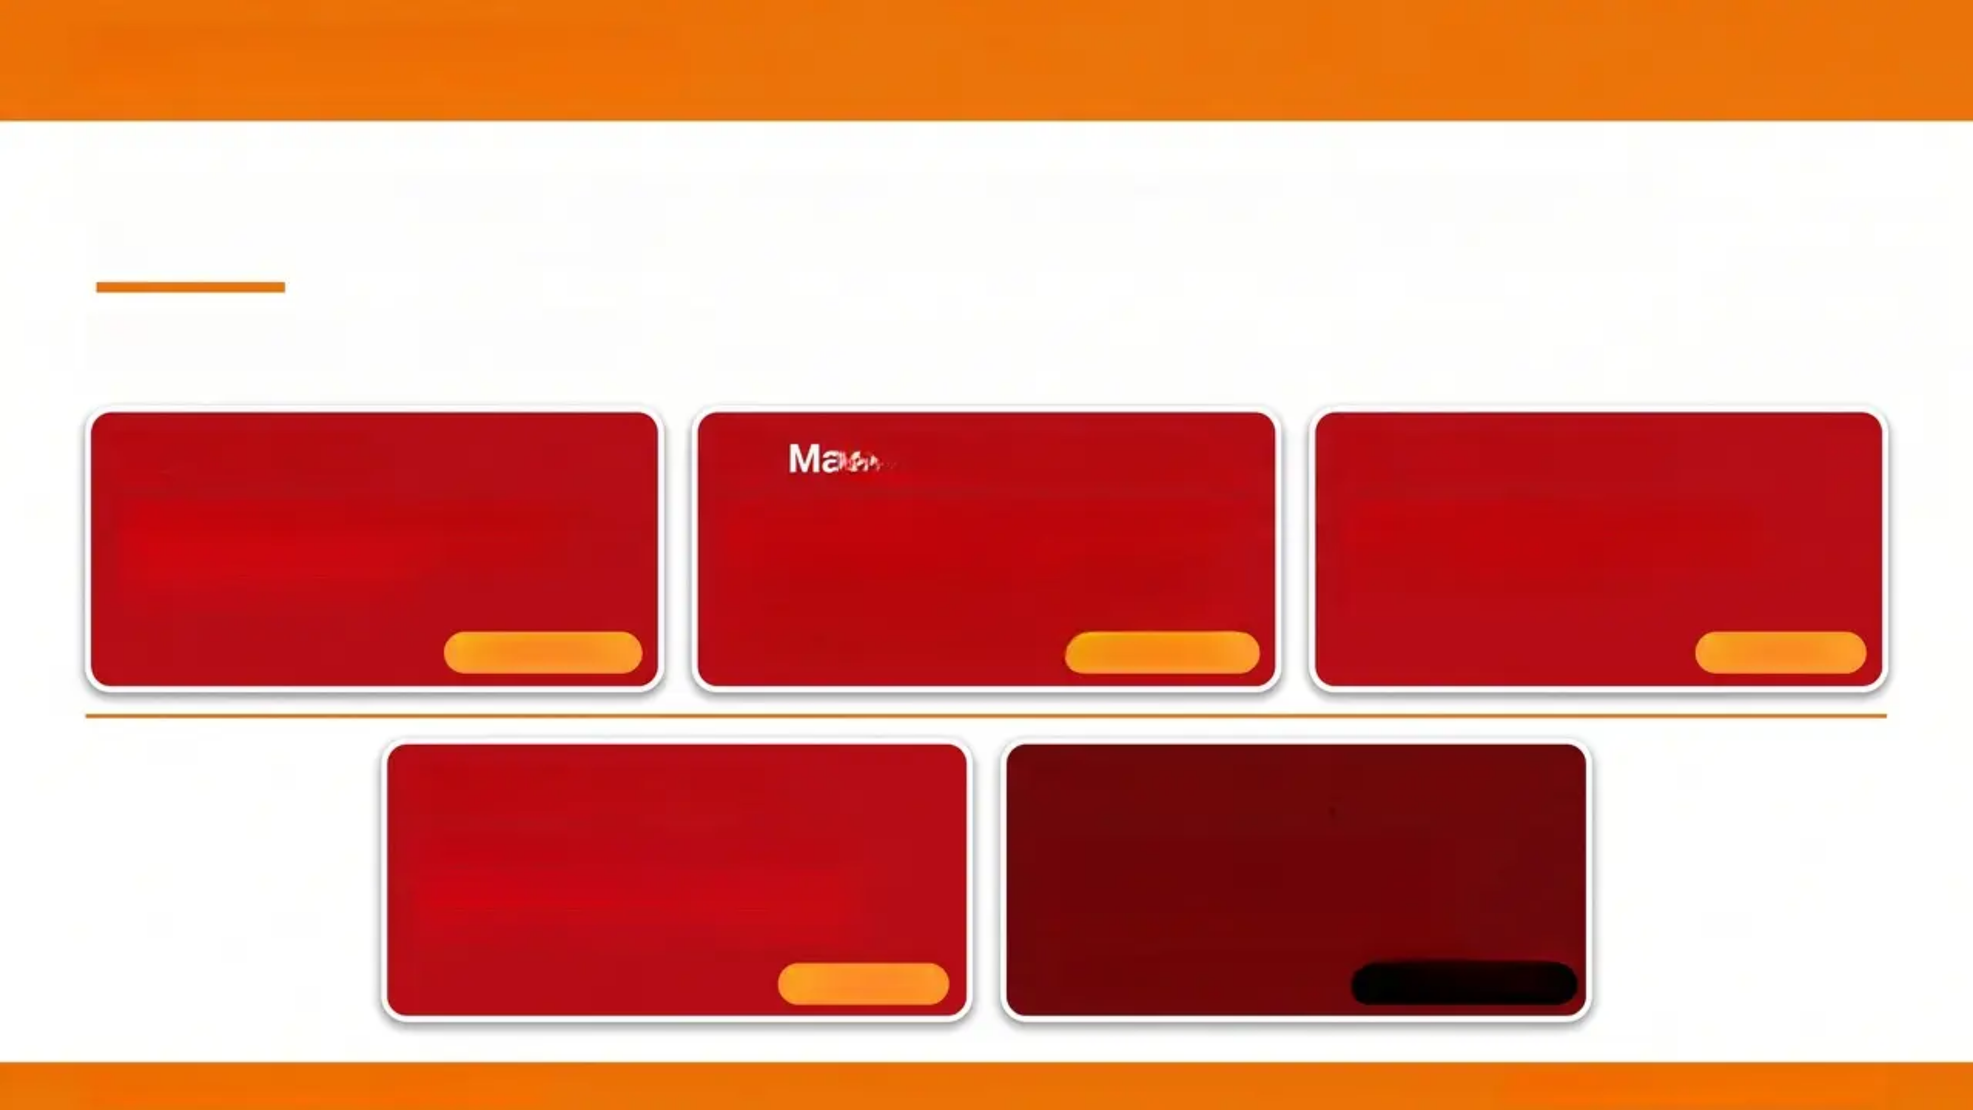





Bradford VTS
GP Training
Programme
Red Flags: Urgent Referrals and Emergencies
Know when to act — same day or sooner
Mastoiditis
Cholesteatoma
Malignant (Necrotising) OE
• Post-auricular swelling and tenderness
• Pinna displaced forward / outward
• Complication of AOM
• Diabetic or immunocompromised patient
• Granulation tissue at bony-cartilaginous
junction
• Cranial nerve palsy (VII first)
• Attic or marginal TM perforation
• Offensive, keratin-laden discharge
• Conductive hearing loss
SAME-DAY A&E
SAME-DAY ENT
URGENT ENT
Facial Nerve Palsy
Intracranial Spread of AOM
• Acute ear infection + facial weakness
• May indicate intratemporal spread
• Do not delay — same-day referral
• Severe headache, vomiting, altered
consciousness
• Meningitis / intracranial abscess
• Rare but life-threatening
URGENT ENT
999 / EMERGENCY
Bradford VTS | Ear Conditions in GP | May 2026
www.bradfordvts.co.uk | Slide 12 of 14

Slide 13


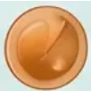


Bradford VTS
GP Training Programme
Quick Recall
Key Learning Points
One condition. One glance. Everything you need.
Acute Otitis Media (AOM)
OME — Glue Ear
• Red, bulging TM — loss of light reflex, loss of landmarks
• Watchful wait most children >2 years, mild, unilateral
• Amoxicillin 5-7 days — NOT 3 days ❌
• NOT amoxicillin if EBV suspected — causes widespread rash 🚩
• Immediate Abx if: <2 yrs bilateral, otorrhoea, systemic illness
• Refer: mastoiditis → same-day A&E
• Amber/opaque TM, flat Type B tympanogram
• 80% resolve spontaneously within 3 months
• Watchful wait 3 months — autoinflation (Otovent) ≥4 yrs
• Grommets threshold: bilateral ≥25 dB, persistent >3 months
• (NICE NG233 2023)
• Lower threshold: Down's syndrome, cleft palate
Otitis Externa (OE)
Ear Wax (Cerumen)
• Tragal tenderness + canal oedema — key signs
• Mild OE → Acetic acid 2% (EarCalms) — FIRST-LINE (NICE CKS 2024) ✅
• Moderate-severe → ciprofloxacin drops (safe with TM perforation ✅)
• Aminoglycosides/neomycin — NOT safe with TM perforation ❌
• Aural toilet + ear wick if severe canal oedema
• Malignant OE: diabetic + granulations + CN palsy → same-day ENT 🟥
• No treatment if asymptomatic — even if visible on otoscopy
• Step 1: Olive oil drops × 3-5 days (first choice, NICE CKS 2025)
• Step 2: Electronic irrigation only — NOT metal Higginson syringe ❌
• Contraindications to irrigation: TM perforation, only hearing ear,
previous ear surgery, active AOM/OE
• Step 3: Microsuction if irrigation fails or contraindicated — gold
standard
Bradford VTS | Ear Conditions in GP | May 2026
www.bradfordvts.co.uk | Slide 13 of 14

Slide 14

Bradford VTS | Ear Conditions in GP
May 2026
Disclaimer and Resources
DISCLAIMER
This presentation has been prepared for Bradford VTS GP trainee educational purposes only. The content reflects
guidelines current as of May 2026, including NICE NG91, NICE NG233, NICE CKS Otitis Externa (May 2024 / Feb 2026
update), and NICE CKS Earwax (July 2025). Clinical practice should always be guided by the most up-to-date national
guidelines, local formulary, and individual patient circumstances. Drug doses should be verify BNF before prescribing.
This material does not constitute medical advice and must not be used for direct patient care decisions.
Key Guidelines Referenced
NICE NG91 — Otitis media (acute): antimicrobial prescribing (2018, reaffirmed 2024)
NICE NG233 — Otitis media with effusion in under 12s: surgery (August 2023)
NICE CKS: Otitis Externa — May 2024 update / February 2026 review
NICE CKS: Earwax — July 2025 update
www.bradfordvts.co.uk
Bradford GP Training Programme — West Yorkshire
Bradford VTS | Ear Conditions in GP | May 2026
www.bradfordvts.co.uk
14 / 14

