Slide 1
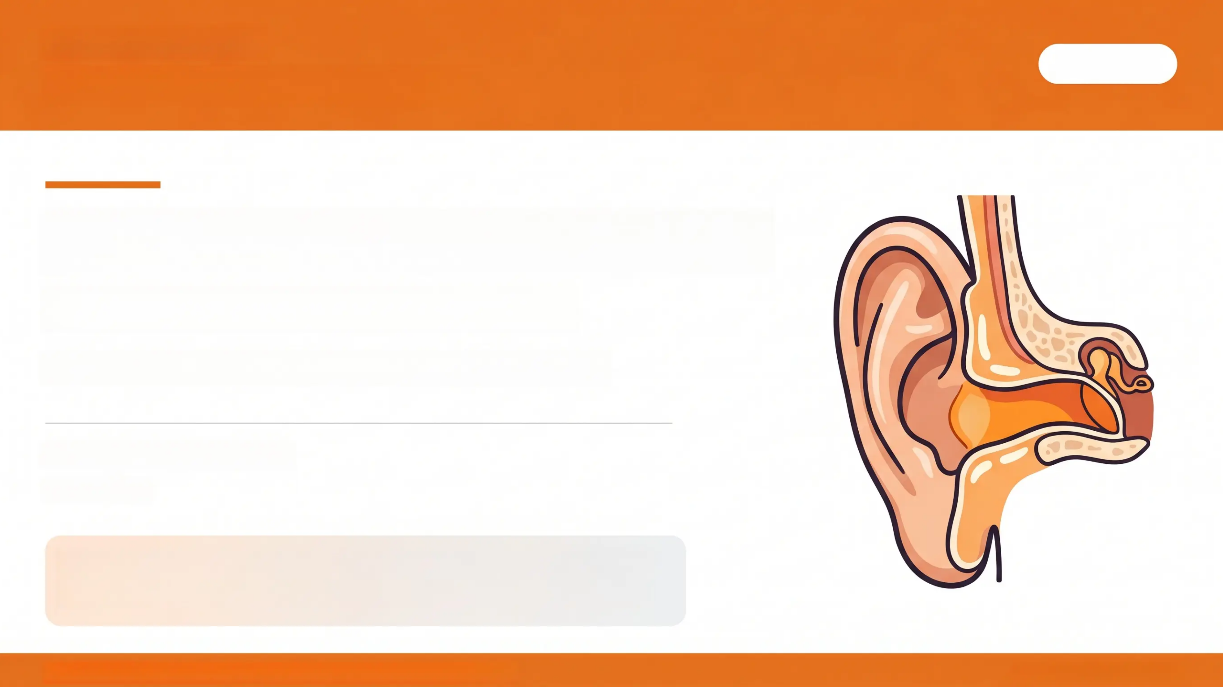
Bradford VTS Teaching Deck
May 2026
Eardrums
Bradford VTS Teaching Deck
For GP Trainees · Foundation & Core Training
www.bradfordvts.co.uk
May 2026
For educational use by GP trainees. Clinical decisions should always be
based on current NICE guidance, local protocols, and individual patient
assessment. Content reviewed May 2026.
Bradford VTS • The Eardrum Made Simple • Educational Use Only
www.bradfordvts.co.uk

Slide 2
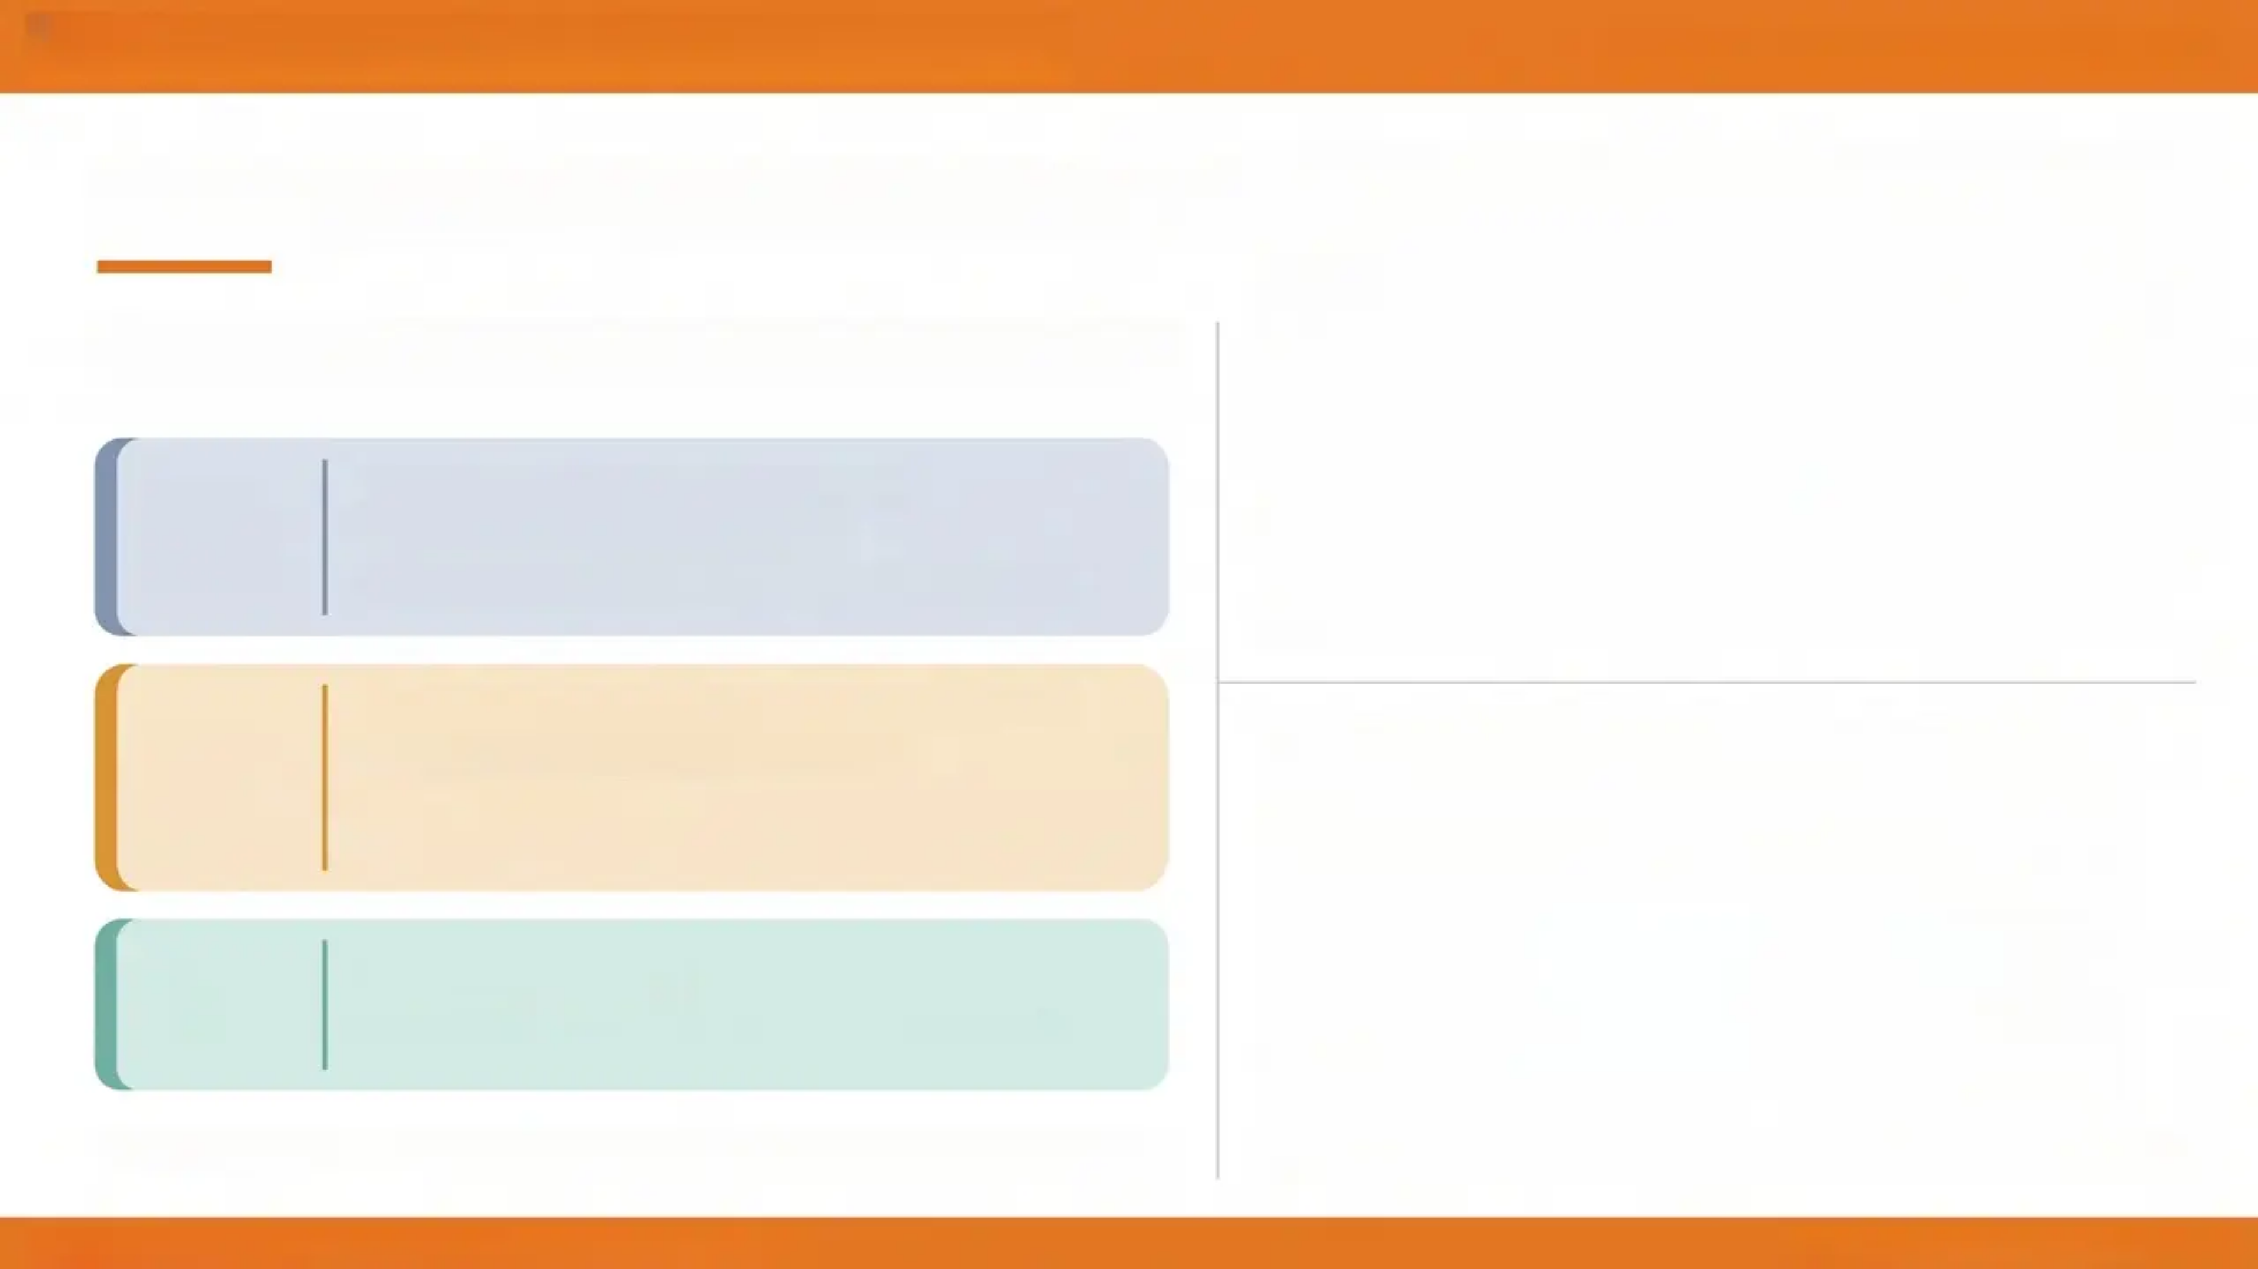
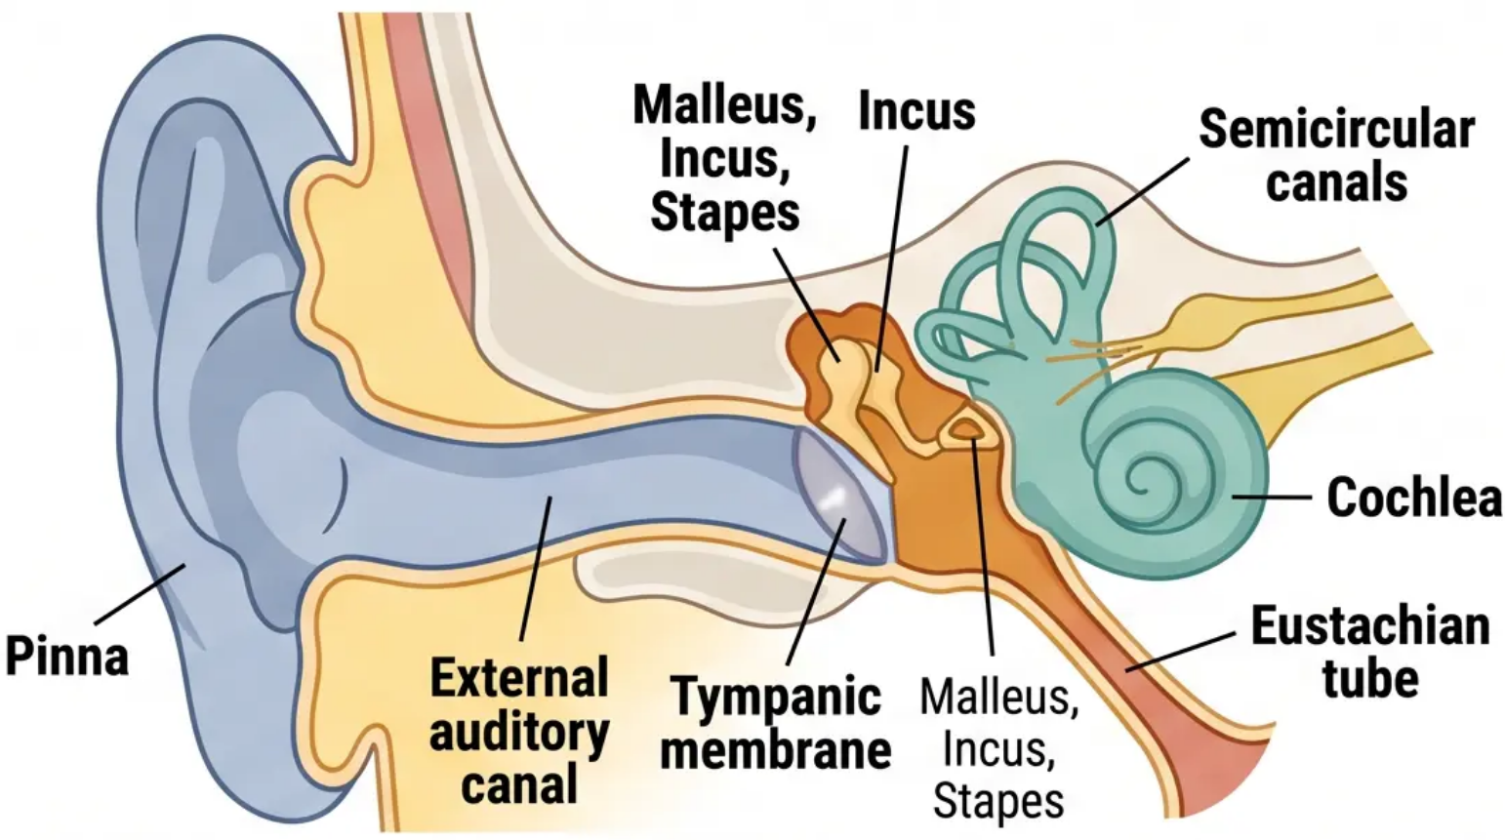
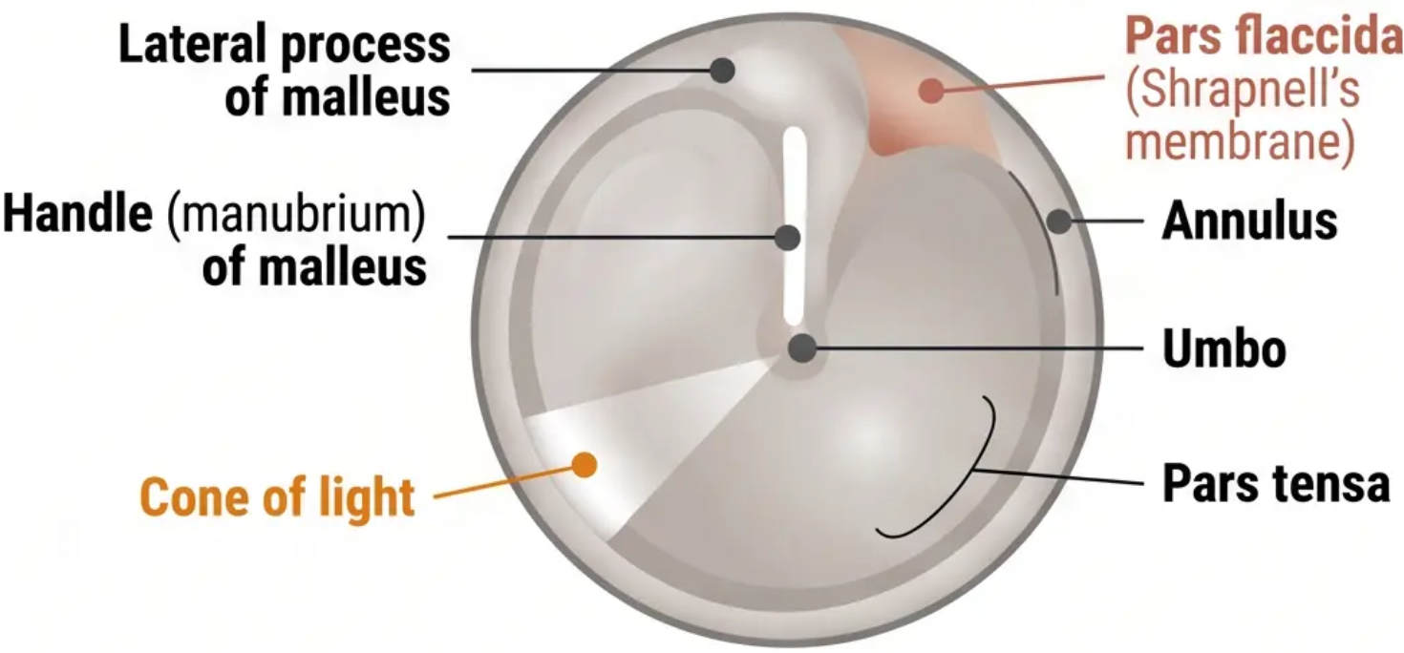
Normal Ear Anatomy and TM Landmarks
Bradford VTS · The Eardrum Made Simple
Normal Ear Anatomy and TM Landmarks
From pinna to cochlea — and what to look for on otoscopy
Outer
Ear
• Pinna (auricle) — collects sound
• External auditory canal (EAC)
• Tympanic membrane (TM) — the boundary
• Ossicular chain: malleus → incus → stapes
• Oval window and round window
• Eustachian tube — pressure equalisation
• Mastoid air cells
Middle
Ear
Inner
Ear
• Cochlea — hearing
• Vestibule + semicircular canals — balance
The TM sits at approximately 55° angle — pearly grey, translucent, cone-shaped.
Pars flaccida — small, lax, superior. Origin of acquired cholesteatoma.
Bradford VTS · The Eardrum Made Simple · Educational Use Only
Slide 2 of 15 · www.bradfordvts.co.uk

Slide 3

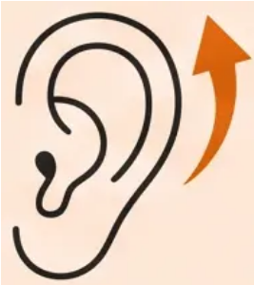
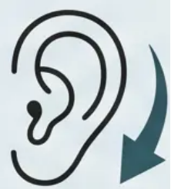
Otoscopy Technique and Systematic Assessment
Bradford VTS · The Eardrum Made Simple
How to Look in the Ear — and What to Look For
Technique matters before interpretation
Canal Straightening Technique
Systematic Assessment Checklist
1. External Auditory Canal (EAC)
Adult / Child ≥ 3 years
Child < 3 years
Wax, discharge, inflammation, foreign body
2. Tympanic Membrane — Colour
Pearly grey = normal · Red = AOM · Amber = OME
3. TM — Position
Pull pinna UP
and BACK
Pull pinna DOWN
and BACK
Neutral · Retracted (ET dysfunction) · Bulging (AOM)
4. TM — Translucency and Light Reflex
Straightens the S-shaped
adult EAC
Straighter, more horizontal
infant EAC
Cone of light anteroinferior · Absent = abnormal TM
5. TM — Landmarks
Handle of malleus · Umbo · Lateral process · Annulus
Practical Tips
• Use the largest speculum that fits comfortably
• Brace hand against patient's head — prevents injury if they move
• Warm the speculum tip if possible — improves comfort
If pneumatic otoscopy available:
Assess TM mobility — reduced movement suggests middle
ear fluid or perforation
Bradford VTS · The Eardrum Made Simple · Educational Use Only
Slide 3 of 15 · www.bradfordvts.co.uk

Slide 4

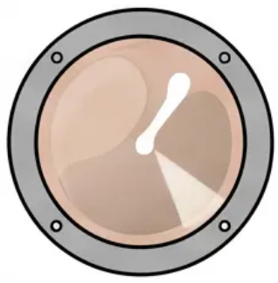


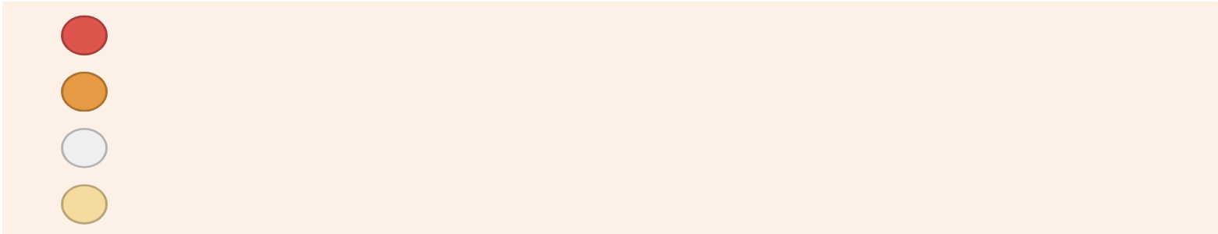

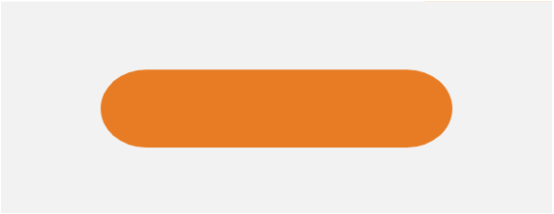








Assessing the Tympanic Membrane
Normal vs Abnormal — Four Key Criteria
May 2026
Assessing the TM: Normal vs Abnormal
Evaluate colour · position · translucency · light reflex
Normal
Abnormal
- "Red" — Acute otitis media
COLOUR
Pearly grey
- "Amber / opaque" — Glue ear (OME)
Translucent, clean, uniform tone
- "White calcified" — Tympanosclerosis
- "Yellow / white bulge" — Pus behind TM
Neutral / flat
- "Retracted" — Negative middle ear pressure / ET dysfunction
POSITION
Sits at approximately 55° angle, neither retracted nor bulging
- "Bulging" — Acute otitis media (AOM)
- "Opaque / amber" — Fluid behind TM (OME)
TRANSLUCENCY
Semi-translucent
- "Air-fluid level or bubbles visible" — OME with partial fluid
Landmarks visible through membrane
- "Thickened / white plaques" — Tympanosclerosis
Present
- "Absent" — TM abnormal (AOM, OME, perforation, retraction)
LIGHT REFLEX
Cone of light — bright triangular reflection,
anteroinferior quadrant
- "Distorted" — TM irregular surface or scarring
Clinical tip: Always assess all four criteria together — no single sign is pathognomonic.
A red TM alone may be caused by crying or fever. Combine with position, translucency, and symptoms.
Bradford VTS · The Eardrum Made Simple · Educational Use Only
Slide 4 of 15 · www.bradfordvts.co.uk

Slide 5




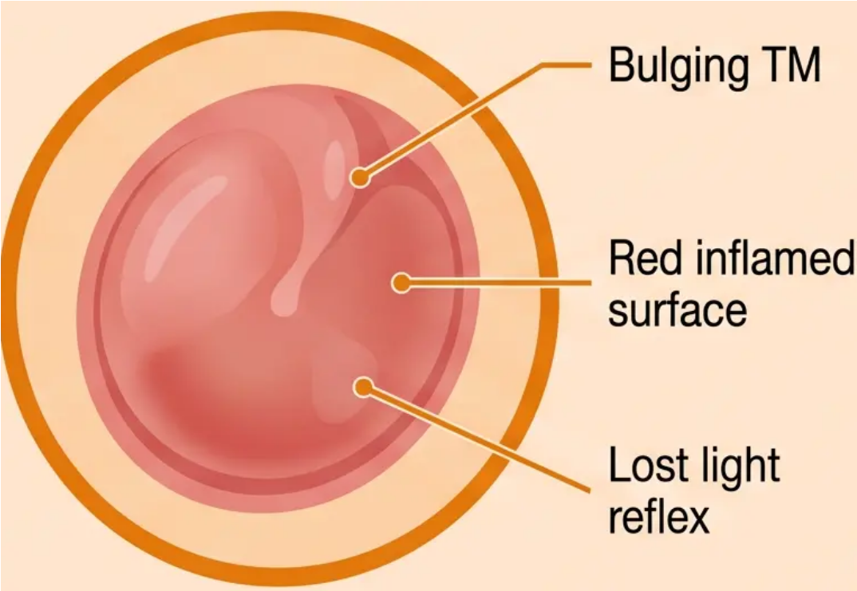





Acute Otitis Media (AOM) Management · NICE NG91
Page 5 of 15
Acute Otitis Media (AOM) Management
Watchful Wait First
Most cases resolve within 24–72 hours
Offer a back-up (delayed) prescription
Safety-net: return if worsening, fever, or no
improvement at 72 hours
Diagnosis, management decisions, and prescribing guidance
How the TM Looks
Red and bulging —
inflamed, tense TM
Prescribe Amoxicillin When...
→ Systemic features present (high fever, unwell child)
→ Child under 2 years with bilateral AOM
→ No improvement at 72 hours
Loss of landmarks —
malleus handle obscured
Amoxicillin 500 mg three times daily · 5-7 days
No light reflex —
cone of light absent
(NICE NG91 — NOT 3 days)
Important: Suspected EBV
Yellow/white tinge —
pus collecting behind TM
Do NOT prescribe amoxicillin if glandular fever (EBV)
is suspected
Amoxicillin in EBV → widespread maculopapular rash
Consider throat exam, lymphadenopathy, and
monospot/Paul-Bunnell if in doubt
NICE Reference Strip
NICE NG91 · Otitis Media (Acute): Antimicrobial Prescribing · Updated 2018
Bottom Footer Strip
Bradford VTS · The Eardrum Made Simple · Educational Use Only
www.bradfordvts.co.uk

Slide 6
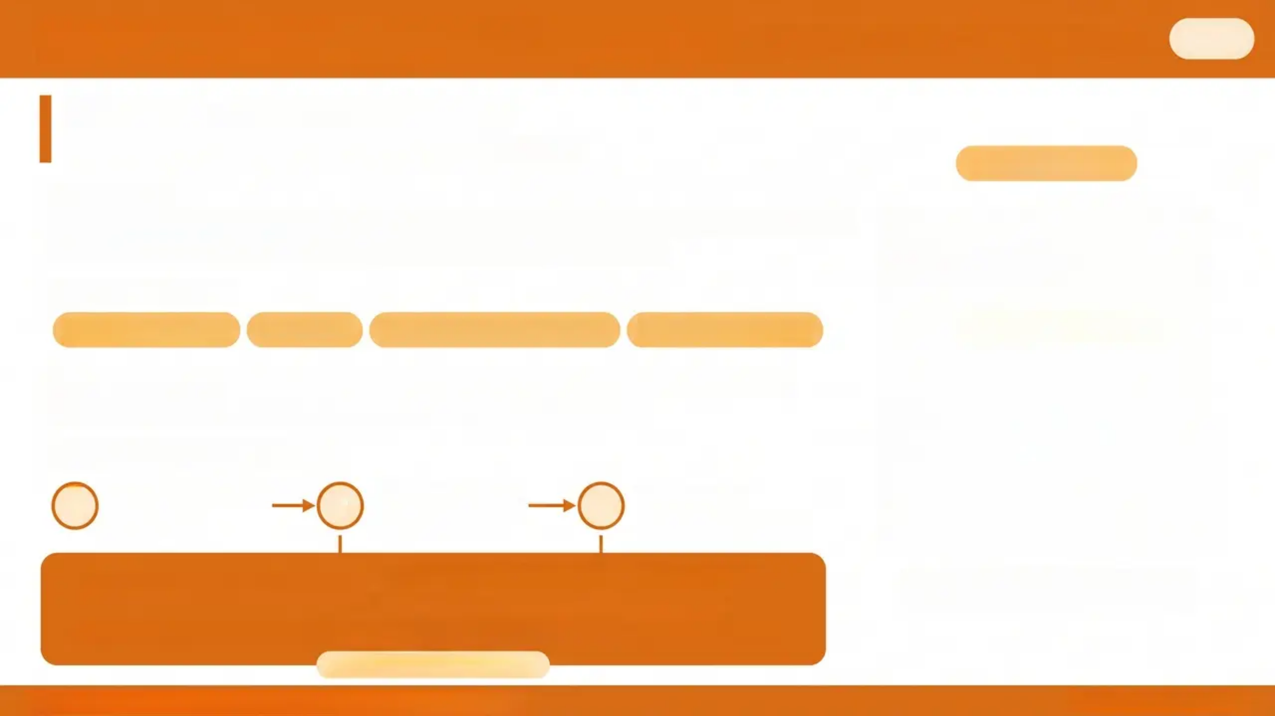
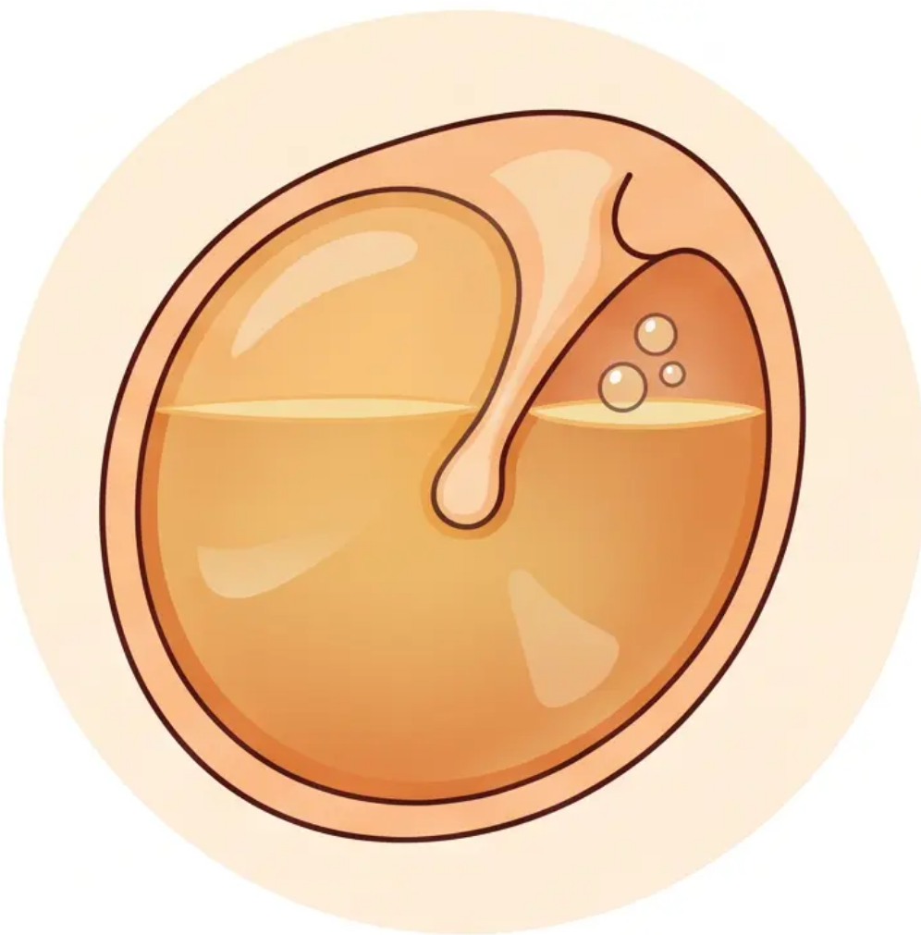
Otitis Media with Effusion (Glue Ear)
OME · NICE NG233 (August 2023)
6 / 15
OME: What You Need to Know
Amber TM · Fluid Level · Conductive Hearing Loss
Otoscopic View
WHAT IS IT?
• Fluid accumulates in the middle ear behind an intact TM – no acute infection or fever
• Most common cause of hearing loss in children aged 2–5 years
TM APPEARANCE
Amber or opaque
Retracted
Fluid level or air bubbles
Light reflex absent
NATURAL HISTORY 80% resolve spontaneously within 3 months
Watchful waiting is the appropriate first step for most children
MANAGEMENT (NICE NG233)
1
Watchful Wait
Autoinflation
Audiology
2
3
3 months
Otovent balloon
Formal hearing test
Refer for Grommets if:
• Persistent OME > 3 months AND
• Bilateral hearing loss ≥ 25 dB
± Speech/language delay • Down's syndrome • Cleft palate → lower threshold applies
Otoscopic appearance: amber
retracted TM with visible fluid level
Bradford VTS · The Eardrum Made Simple · Educational Use Only
www.bradfordvts.co.uk

Slide 7


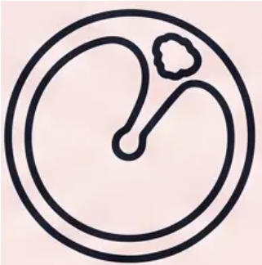


Bradford VTS · The Eardrum Made Simple
7 / 15
Tympanic Membrane Perforations
Location determines safety — know the difference
Central
Perforation
Attic / Marginal
Perforation
✅ SAFE
⚠️ UNSAFE
• Location: Within the pars tensa, away from the annulus
• Common causes: Post-AOM, trauma, barotrauma
• Hearing loss: Proportional to perforation size
• Spontaneous healing: 80–90% close within 6–8 weeks
• Water precaution: Keep ear dry; cotton wool with
Vaseline when showering
• Location: Pars flaccida (attic) or near the annulus (marginal)
• Key concern: Cholesteatoma until proven otherwise
• Signs: Attic crust, white pearly debris, offensive otorrhoea
• Risk: Ossicle erosion, mastoid involvement, facial nerve
damage
• Do not watch and wait
Refer to ENT if not healed at 3 months
⚠️ URGENT ENT REFERRAL — do not delay
Central = usually safe · Attic or marginal = cholesteatoma until proven otherwise
Bradford VTS · The Eardrum Made Simple · Educational Use Only
www.bradfordvts.co.uk

Slide 8
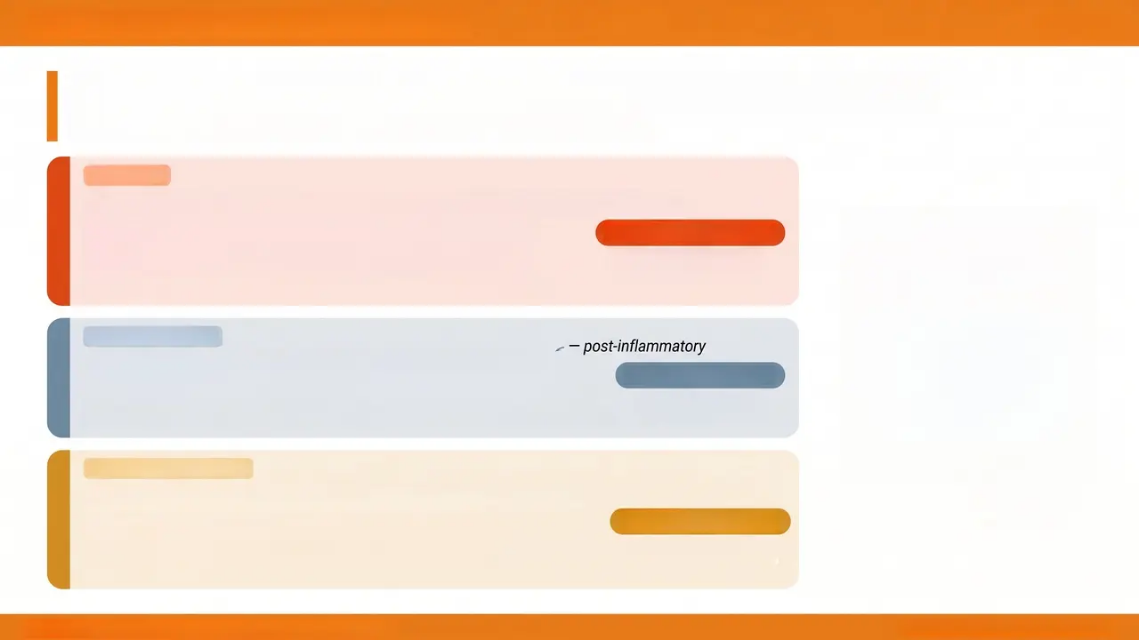
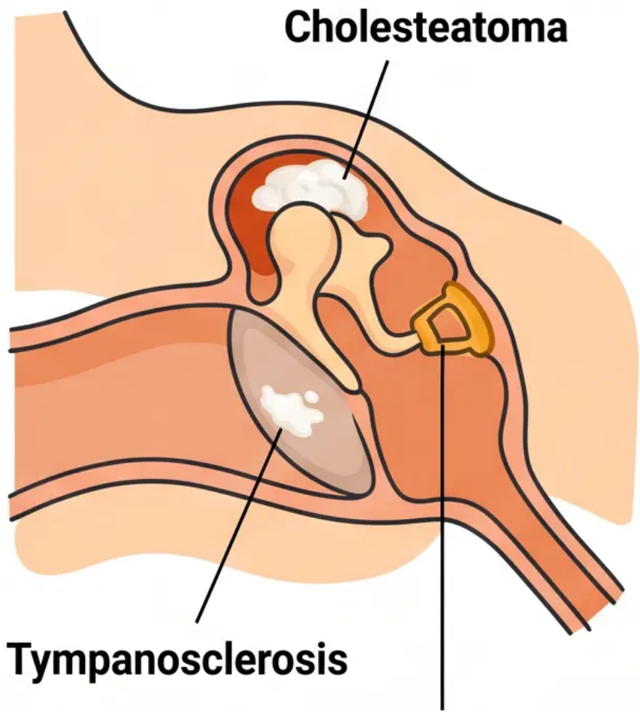
Bradford VTS · The Eardrum Made Simple
May 2026
Cholesteatoma, Tympanosclerosis & Otosclerosis
Three distinct conditions — very different urgency levels
RED FLAG
Cholesteatoma
Keratinising squamous epithelium invading the middle ear
• Appearance: Attic crust, white pearly mass, keratin debris in EAC
• Warning signs: Offensive otorrhoea unresponsive to treatment +
conductive hearing loss + attic perforation
• Complications: Erodes ossicles, mastoid, facial nerve canal, tegmen
URGENT ENT REFERRAL
Surgical excision
(mastoidectomy) required
INCIDENTAL FINDING
Tympanosclerosis
White calcified plaques on the TM –
No treatment needed
Unless symptomatic –
review audiogram
• Cause: Previous AOM, grommet insertion – calcium deposits in TM layers
• Clinical significance: Usually incidental; rarely causes significant hearing loss
PROGRESSIVE CONDITION
Otosclerosis
Abnormal bone remodelling fixing the stapes at the oval window
Stapes fixation
(Otosclerosis)
Carhart Notch @ 2 kHz
• TM appearance: Normal – diagnosis is NOT made on otoscopy
• Audiogram hallmark: Carhart notch – characteristic dip in bone conductiat 2 kHz
BC dip on audiogram –
classic otosclerosis sign
• Management: Hearing aids; stapedectomy or stapedotomy
Bradford VTS · The Eardrum Made Simple · Educational Use Only
Slide 8 of 15 · www.bradfordvts.co.uk

Slide 9

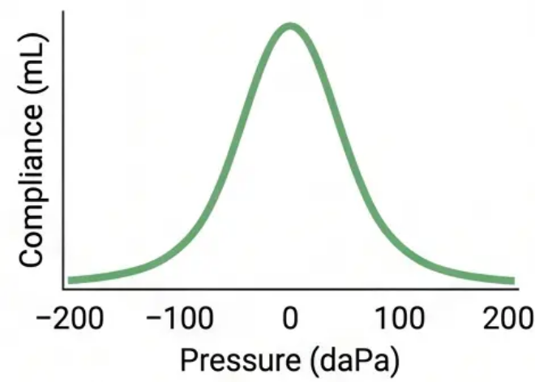
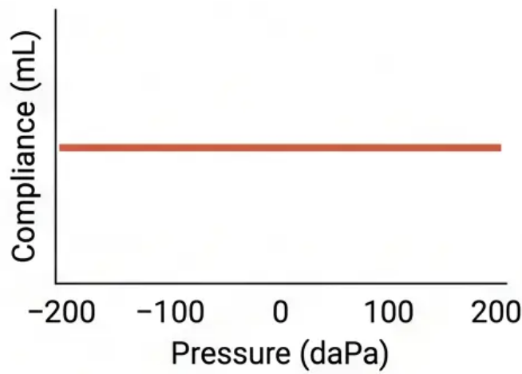
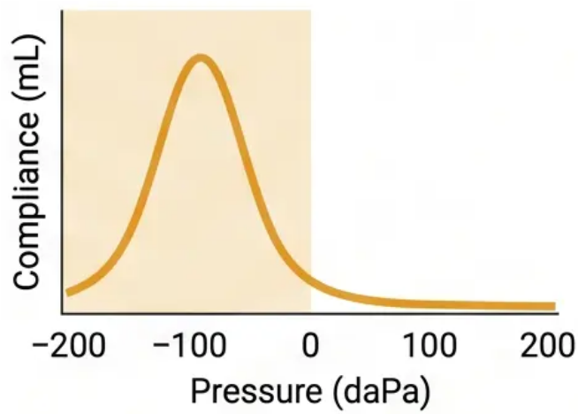
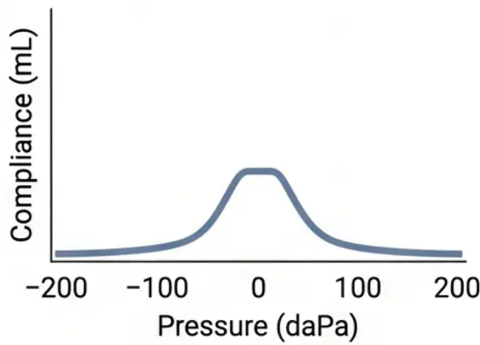
Understanding Tympanometry Results
Bradford VTS · The Eardrum Made Simple
Reading the Tympanogram
Measures middle ear pressure and TM compliance – not cochlear function
Type A
Type B
Type C
Type As
Normal
Flat – No Peak
Negative Pressure
Shallow Compliance
• Peak at 0 daPa
• Compliance 0.3–1.6 mL
• No compliance peak
• OME (glue ear),
perforation, or impacted
• Peak at < -100 daPa
• Eustachian tube
dysfunction, early OME
• Low-amplitude peak
• Otosclerosis or
tympanosclerosis
Normal middle ear
Check ear canal volume (ECV)
Retracted TM likely
Consider Carhart notch on
audiogram
A = Normal
B = Flat = Fluid/Perforation
C = Negative = ET Dysfunction
As = Shallow = Otosclerosis
Bradford VTS · The Eardrum Made Simple · Educational Use Only
www.bradfordvts.co.uk

Slide 10

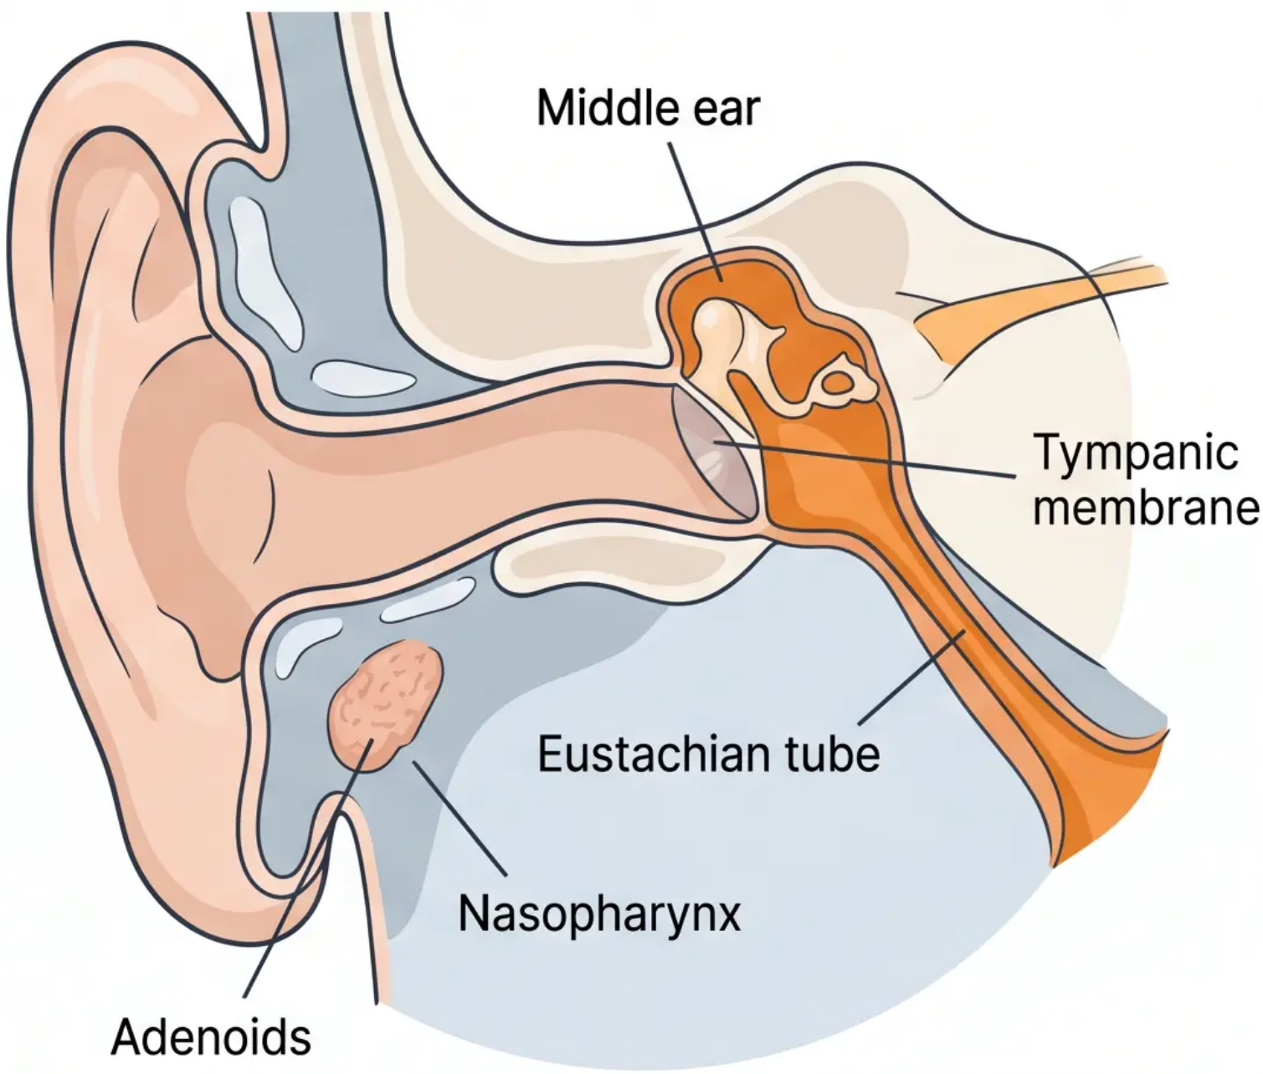
Bradford VTS · The Eardrum Made Simple
10 / 15
Eustachian Tube Function and Dysfunction
Pressure • Drainage • Protection
NORMAL FUNCTION
What the Eustachian Tube Does
Pressure equalisation — balances middle ear pressure with
atmospheric pressure
Drainage — clears middle ear secretions into the nasopharynx
Protection — prevents nasopharyngeal secretions from entering
the middle ear
DYSFUNCTION
When It Fails
Causes
URTI / viral illness
Allergic rhinitis
Enlarged adenoids
Cleft palate
Barotrauma (flying, diving)
Consequences
Negative middle ear pressure
TM retraction
Otitis Media with Effusion
Conductive hearing loss
AUTOINFLATION
Otovent — inflate a balloon through one nostril while
pinching the other. Opens the ET mechanically.
NICE NG233 (2023): Recommended as first-line non-surgical treatment for OME in children.
*Eustachian tube: ~35 mm long, runs at ~45° in adults, more horizontal in children
Bradford VTS · The Eardrum Made Simple · Educational Use Only
www.bradfordvts.co.uk

Slide 11

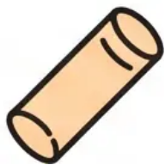


Slide 11 of 15
Grommet Insertion and Post-Operative Care
NICE NG233 (August 2023) · Ventilation Tube Guidance
NICE NG233 Indications
for Grommets
• Persistent OME >3 months + bilateral hearing loss ≥25 dB
• Speech or language delay attributed to hearing loss
• Bilateral OME in children with Down’s syndrome or cleft palate
Surgical: GA required
Day case procedure,
usually <30 min
How They Work
Water & Activity Advice
Possible Complications
- Small ventilation tube inserted through
a tiny incision in the TM
- Bypasses dysfunctional Eustachian tube
- Equalises middle ear pressure
- Drains accumulated fluid
- Usually lasts 6–12 months before
natural extrusion
- 20% of children require reinsertion
- Bathing: Fine — surface water poses no
risk
- Swimming: Earplugs advised for deep
diving or full submersion
- Flying: Completely fine — grommets help
equalise pressure
- School / normal activity: Resume
immediately
- Avoid forceful nose blowing immediately
post-op
- Persistent perforation — occurs in
~2% of cases
- Typanosclerosis — white calcified
plaques on TM
- Recurrent OME after grommet extrusion
- Otorrhoea (discharge) — treat with
topical antibiotic drops
- Rarely: scarring or long-term TM changes
Bradford VTS · The Eardrum Made Simple · Educational Use Only
www.bradfordvts.co.uk

Slide 12

AKT Pearls for the Eardrum
High-Yield Exam Facts for GP Trainees
Slide 12 of 15
What the AKT Expects You to Know
Tympanograms · Perforations · Carhart Notch · Grommet Thresholds
Type B Tympanogram =
Flat Trace
Type C = Negative Middle
Negative Middle Ear Pressure
Type As = Shallow, Reduced
Shallow, Reduced Compliance
- No peak detected;
- Think: OME (glue ear), TM perforation, or
impacted wax
- Check ECV (ear canal volume) to
distinguish: large ECV = perforation;
normal ECV = fluid
- Peak shifted to < -100 daPa
- Think: Eustachian tube dysfunction or
early OME
- TM likely retracted
- Low-amplitude peak
- Think: Otosclerosis or tympanosclerosis
- Stapes fixation limits TM movement
Grommet Referral — NICE
NG233 (2023)
Perforation Safety Rule
Central vs Attic Perforation
Carhart Notch = Otosclerosis
- Dip in bone conduction at 2 kHz on pure
tone audiogram
- Mechanical artefact of stapes fixation — not
true sensorineural loss
- Associated with progressive conductive
hearing loss, normal TM
- Management: hearing aids or stapedectomy
- Refer if: persistent OME > 3 months AND
bilateral hearing loss ≥ 25 dB
- Δ Previous threshold was lower — updated
in August 2023
- Also refer: Down's syndrome or cleft palate
with bilateral OME regardless of threshold
- Do NOT rush to grommets — watch wait first
- Central = SAFE — usually post-AOM or
trauma; 80–90% heal spontaneously in
6–8 weeks
- Attic / Marginal = UNSAFE —
cholesteatoma until proven otherwise
- Δ Attic perforation → Urgent ENT referral
Remember: Attic perforation = urgent ENT. Type B tympanogram ≠ always OME — check ECV.
Bradford VTS · The Eardrum Made Simple · AKT Pearls
www.bradfordvts.co.uk · May 2026

Slide 13





Bradford VTS · The Eardrum Made Simple
SCA Focus
SCA Pearls: Communicating with Parents
How to explain glue ear, hearing tests, and grommets in plain language
SCENARIO 1 · GLUE EAR DIAGNOSIS
SCENARIO 2 · AUDIOGRAM RESULTS
SCENARIO 3 · GROMMET PROCEDURE
The fluid you have is called glue
ear — it happens when the tube
that drains the middle ear gets
blocked.
The hearing test shows you have
a fluid-based hearing loss — the
inner ear (the nerve of hearing) is
perfectly healthy.
A small ventilation tube is put into
the eardrum under a short general
anaesthetic — it lets air into the
middle ear and drains the fluid.
Most children's hearing returns to
normal on its own within 3 months,
so we watch and wait first.
The hearing loss is temporary and
caused by the fluid sitting behind
the eardrum.
It usually falls out on its own after
6–12 months. Bathing is fine;
swimming with earplugs is advised.
Tip: Reassure parents that watchful waiting
is active, not passive.
Tip: Separating 'fluid loss' from 'nerve damage'
reduces parental anxiety immediately.
Tip: Parents worry most about the
anaesthetic — address this directly and early.
Bradford VTS · The Eardrum Made Simple - Educational Use Only
www.bradfordvts.co.uk

Slide 14





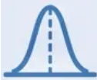
Bradford VTS · The Eardrum Made Simple
May 2026
Quick Recall and Summary
Key facts to carry into your AKT, SCA, and clinical practice
Normal TM
AOM (NICE NG91)
• Pearly grey, translucent, cone-shaped
• Cone of light — anteroinferior quadrant
• Handle of malleus visible as white vertical line
• Umbo at centre; annulus at periphery
• Pars tensa (majority) · Pars flaccida (superior, small)
• TM: red, bulging, loss of landmarks + light reflex
• Watchful wait first — most resolve in 24–72 h
• Amoxicillin 500 mg TDS, 5–7 days if: systemic features,
<2 yrs bilateral, no improvement at 72 h
• 🚨 NOT amoxicillin if EBV suspected (rash risk)
• 🚨 NOT 3 days (old 1998 guidance — now superseded)
OME (NICE NG233, 2023)
Cholesteatoma — Red Flags
Tympanometry
• TM: amber/opaque, retracted, fluid level
or bubbles
• 80% resolve spontaneously within 3 months
• Watchful wait → autoinflation (Otovent)
• Refer if persistent >3 months + bilateral
≥25 dB loss
• Grommets ± adenoidectomy if indicated
• Attic/marginal perforation = unsafe —
cholesteatoma until proven otherwise
• Offensive otorrhoea unresponsive to treatment
• White/pearly mass or keratin debris in EAC
• Conductive hearing loss + attic crust
→ URGENT ENT referral → surgical excision
A — Normal peak at 0 daPa → normal middle ear
As — Shallow peak → otosclerosis / tympanosclerosis
Ad — High peak → ossicular discontinuity
B — Flat, no peak → OME / perforation / wax
C — Negative pressure peak → ET dysfunction /
early OME
*Type B + large ECV = likely perforation (not OME)
URGENT ENT
Bradford VTS · The Eardrum Made Simple · Educational Use Only
www.bradfordvts.co.uk • Slide 14 of 15

Slide 15





Bradford VTS Vocational Training Scheme
May 2026
Disclaimer and Professional Use
Please read before using this resource
Educational Use Only
This teaching deck has been produced exclusively for educational purposes within the Bradford Vocational Training Scheme (VTS) GP
training programme. It is intended to support learning for GP trainees at foundation and core training level.
Clinical Decision Making
Nothing in this resource constitutes formal clinical advice. All patient management decisions must be based on current NICE
guidelines, local trust protocols, up-to-date evidence, and individual clinical assessment. This deck does not replace professional judgement.
Guideline Currency
Management recommendations are referenced to NICE NG91 (Acute Otitis Media) and NICE NG233 (Otitis Media with Effusion,
August 2023). Guidelines are subject to revision – always verify against the most current published version at www.nice.org.uk.
Copyright and Distribution
This resource is the intellectual property of Bradford VTS. It may be used freely within GP training for non-commercial educational
purposes. Reproduction or redistribution for commercial use is not permitted without prior written consent.
www.bradfordvts.co.uk
Thank you for using this resource. We hope it supports your learning and your patients.
Bradford VTS • The Eardrum Made Simple • Educational Use Only
www.bradfordvts.co.uk • May 2026

