Slide 1

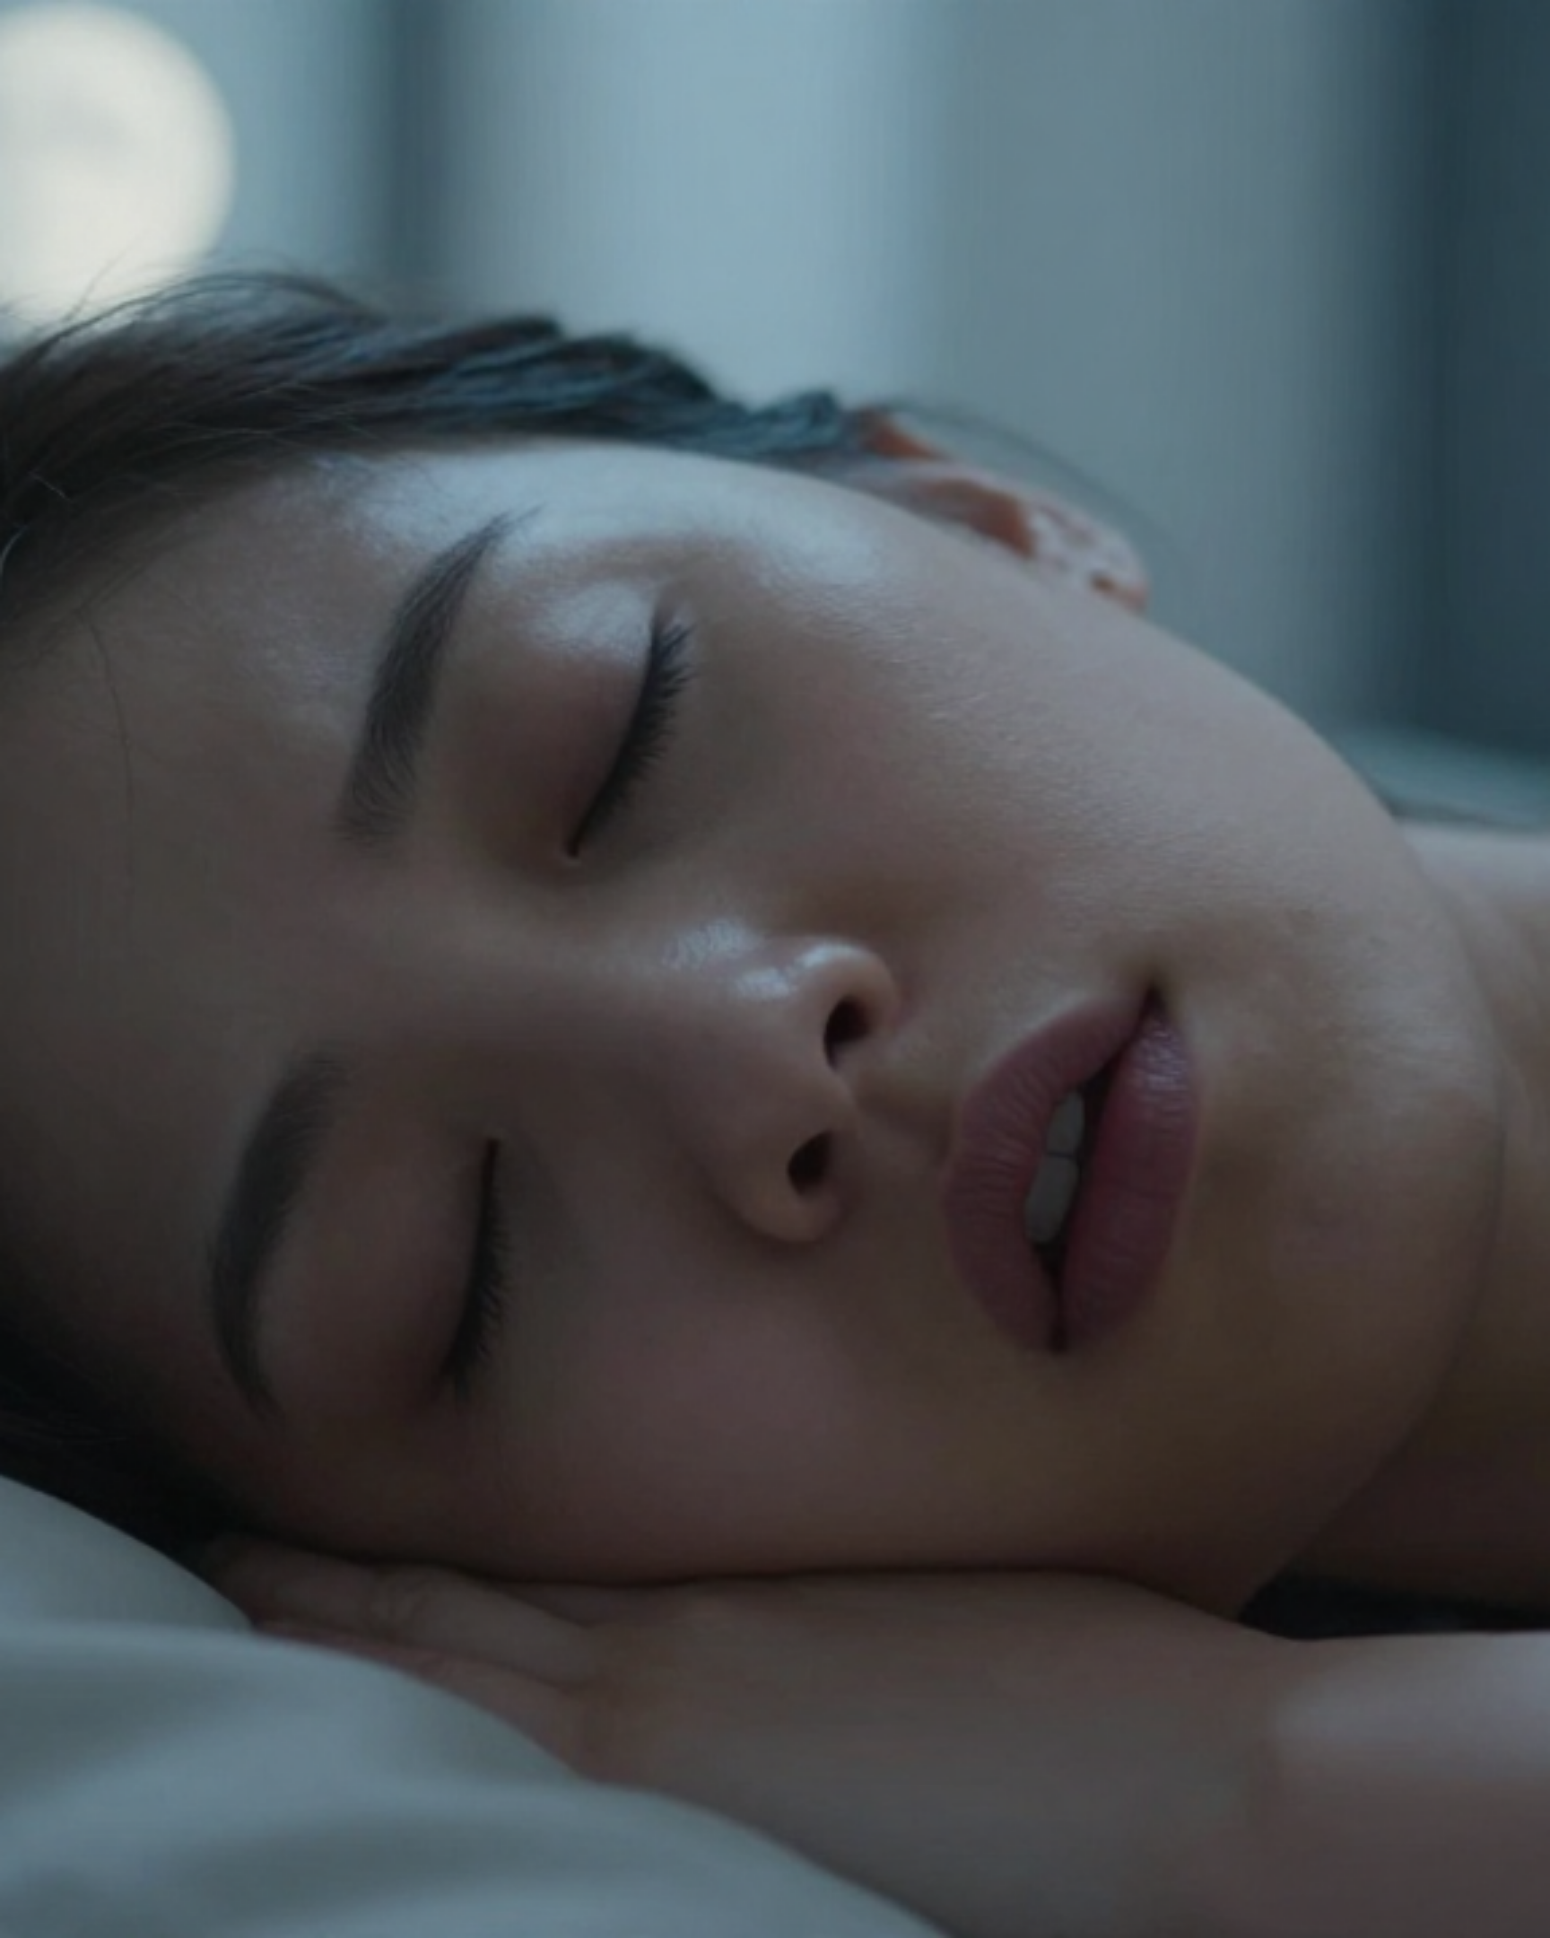





BRADFORD VTS TEACHING DECK
Obstructive Sleep Apnoea & Snoring
Comprehensive Primary Care Training: Pathophysiology, Diagnostic Assessment, and Evidence-Based Management for GP Trainees.
NICE NG202 (2021)
NICE CKS (2025)
BNF May 2026
DVLA COMPLIANCE
Target Audience: GP Trainees (Postgraduate Medicine)
Academic Session: May 2026

Slide 2


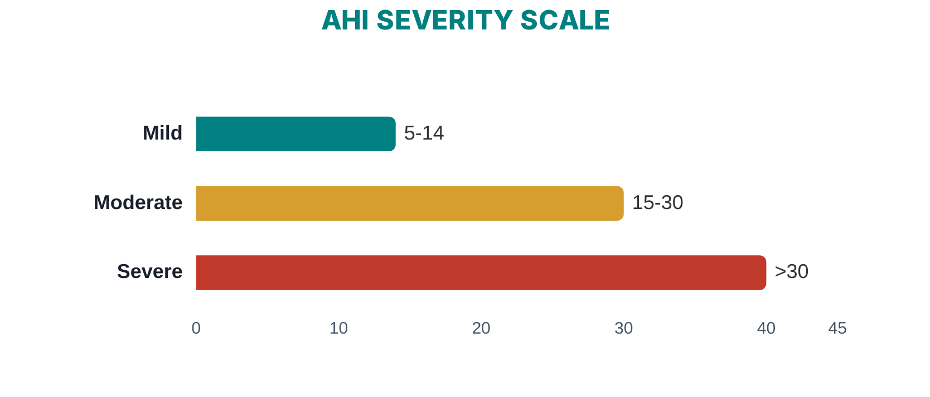








DEFINITIONS AND SEVERITY CLASSIFICATION
NICE GUIDELINE NG202 / CKS 2025 REFERENCE
Respiratory Events
Snoring
Noise from partial upper airway obstruction; vibration of soft palate and pharyngeal walls. Often non-pathological.
Apnoea
Complete cessation of nasal/oral airflow for at least 10 seconds.
Hypopnoea
≥30–50% reduction in ventilation from baseline, associated with oxygen desaturation or arousal.
The Syndrome (OSAHS)
Severity
AHI Range (Events/Hour)
Mild OSAHS
5 – 14
Obstructive Sleep Apnoea/Hypopnoea Syndrome
Recurrent episodes of upper airway collapse during sleep causing apnoeas/hypopnoeas plus clinical symptoms (e.g., EDS).
Moderate OSAHS
15 – 30
Apnoea-Hypopnoea Index (AHI)
Severe OSAHS
> 30
The total number of apnoea and hypopnoea events per hour of sleep.

Slide 3




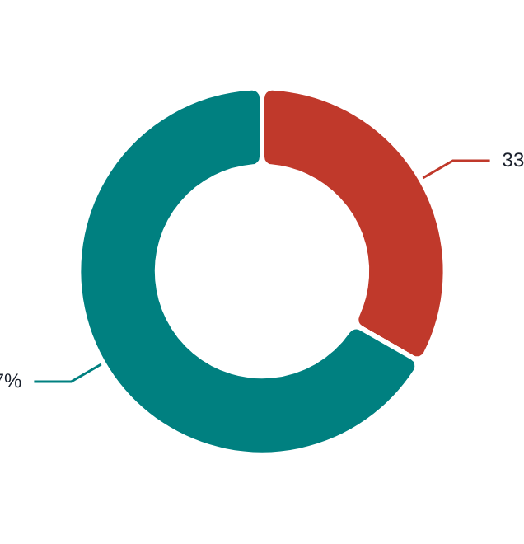


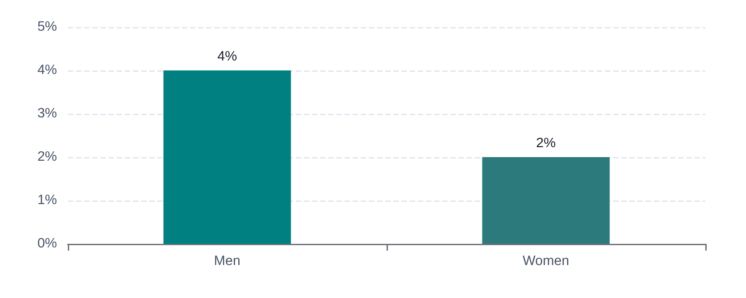






EPIDEMIOLOGY AND PREVALENCE
NICE GUIDELINE NG202 / CKS 2025 REFERENCE
PREVALENCE STATISTICS
THE "SLIM OSA" PARADOX
~4%
Middle-aged Men affected
Rhetorical Focus:
~2%
Middle-aged Women affected
"Why does a BMI under 25 not rule out OSA?"
1 in 3 sufferers have a BMI < 25.
Peak age range: 40–60 years.
High index of suspicion required for non-obese patients.
Prevalence is similar to Type 1 Diabetes; however, underdiagnosis remains a significant hurdle in primary care.
AKT Tip: Do not rely solely on obesity as a screening filter. One-third of your OSAHS caseload will be patients of normal weight.

Slide 4















PATHOPHYSIOLOGY OF AIRWAY COLLAPSE
NICE GUIDELINE NG202 / CKS 2025 REFERENCE
Primary Sites of Obstruction
1. SLEEP ONSET & COLLAPSE
Pharyngeal muscle tone decreases during sleep, leading to partial or complete upper airway obstruction.
Nose & Nasopharynx:Deviated septum, polyps
Oropharynx:Large tonsils, long soft palate
Tongue Base:Macroglossia, retrognathia
Laryngotracheal:Epiglottic collapse
2. HYPOXIA & RESPIRATORY EFFORT
Obstruction causes apnoea/hypopnoea, oxygen desaturation, and increased effort to breathe against the blockage.
CRITICAL THINKING FOR GPS
3. NEURAL AROUSAL & RESET
"Why does a BMI under 25 not rule out OSAHS?"
Brain triggers a brief arousal from deep sleep; muscle tone is restored, airway reopens, and the cycle repeats.
Recall that 1 in 3 sufferers are not obese; anatomical factors and pharyngeal stability are often the primary drivers.

Slide 5





RISK FACTORS FOR OSAHS
NICE GUIDELINE NG202 / CKS 2025 REFERENCE
ANTHROPOMETRICS & DEMOGRAPHICS
LIFESTYLE & MEDICATIONS
Obesity: The most significant modifiable factor (BMI > 30).
Alcohol: Acts as a pharyngeal muscle relaxant; risk increases with evening consumption.
Sedative Medications: Benzodiazepines, Z-drugs, opioids, and certain antihistamines.
Neck Circumference: >43 cm (Male) or >40 cm (Female).
Gender & Age: Higher prevalence in males and with increasing age (peaks 40–60 years).
Smoking: Induces upper airway inflammation and oedema.
ANATOMICAL FACTORS
CLINICAL & SYSTEMIC FACTORS
Oropharyngeal: Macroglossia (large tongue), tonsillar hypertrophy, or large adenoids.
Reversible Causes: Hypothyroidism and Acromegaly (always screen with TSH if suspected).
Craniofacial: Retrognathia (receding chin) or micrognathia.
Comorbidities: Down’s Syndrome (macroglossia/midface hypoplasia) and family history.
Nasal Obstruction: Deviated septum, nasal polyps, or chronic turbinate hypertrophy.
Pregnancy: Increased upper airway oedema and weight gain.

Slide 6









CLINICAL FEATURES AND SYMPTOMS
NICE GUIDELINE NG202 / CKS 2025 REFERENCE
Primary Daytime Symptoms
Night-time Symptoms
Excessive Daytime Sleepiness (EDS)
Loud, Habitual Snoring
Most significant feature; falling asleep involuntarily.
Often the primary reason for partner consultation.
Unrefreshing Sleep & Fatigue
Witnessed Apnoeas
Feeling tired despite seemingly adequate hours of rest.
Gasping, choking, or pauses in breathing (partner report).
Morning Headaches
Restless Sleep
Resulting from nocturnal hypercapnia and hypoxia.
Excessive thrashing or "fighting for air" in bed.
SAFETY CRITICAL: Falling asleep while driving or operating machinery.
Cognitive & Social Impact
Associated Nocturnal Signs
Impaired Concentration
Nocturia
Reduced memory and poor cognitive performance.
Waking frequently to pass urine (common in OSAHS).
Mood & Personality Changes
Nocturnal Sweating
Irritability, anxiety, or depressive symptoms.
Often localized to the head and neck area.
Sexual Dysfunction
Gastro-oesophageal Reflux
Reported impotence or significant loss of libido.
Higher prevalence due to negative intrathoracic pressure.

Slide 7






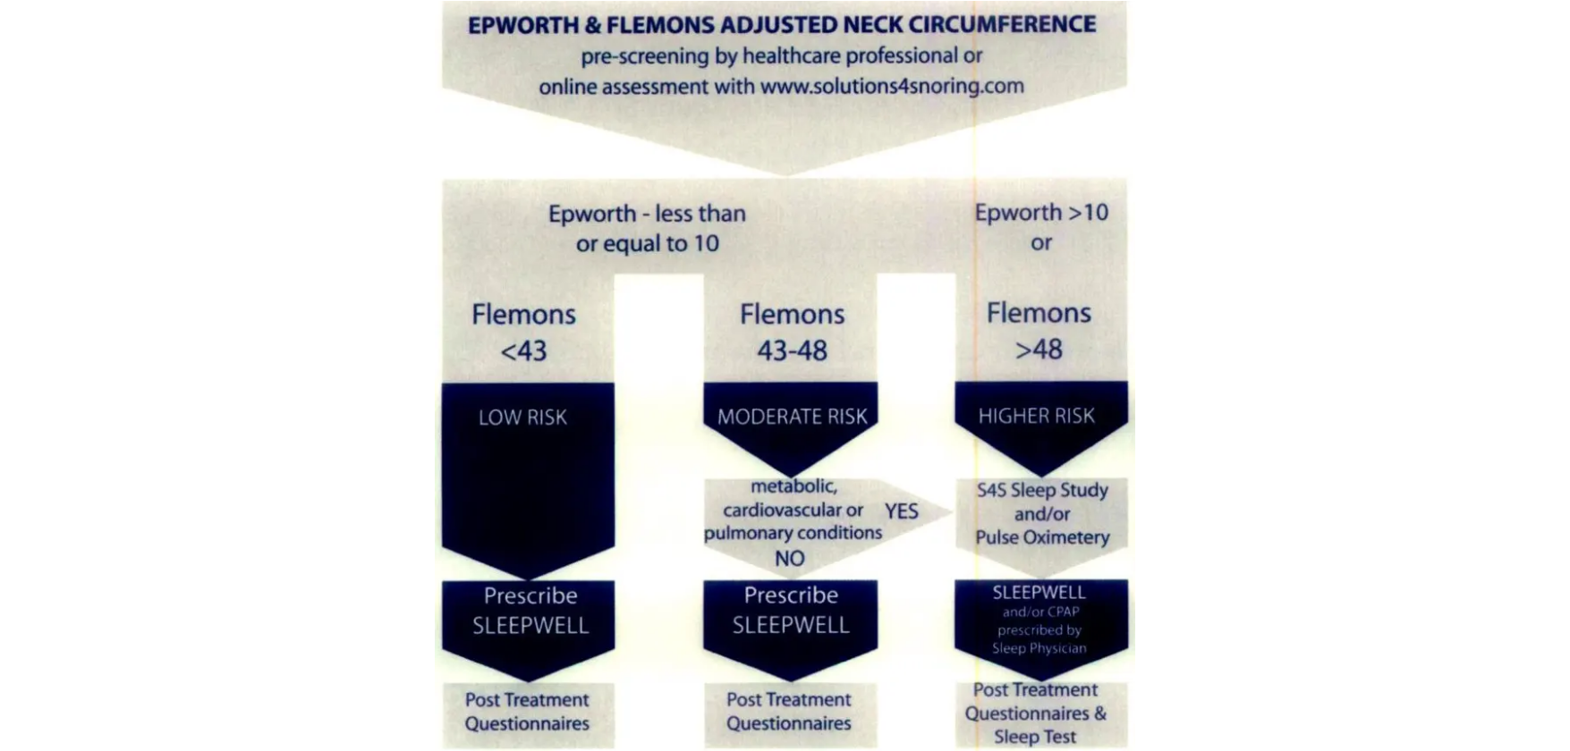





ASSESSMENT TOOLS ESS AND STOP-BANG
NICE GUIDELINE NG202 / CKS 2025 REFERENCE
Epworth Sleepiness Scale (ESS)
STOP-Bang Questionnaire
Snoring (Loud)
BMI > 35 kg/m²
Likelihood of dozing (0-3) in 8 everyday situations:
●Sitting and reading
Tired (Daytime)
Age > 50 years
Observed apnoea
Neck > 40 cm
●Watching television
Pressure (HTN)
Gender (Male)
●Sitting inactive in a public place
●Passenger in a car for 1 hour
Score ≥ 3: High risk for Moderate/Severe OSA
●Lying down to rest in the afternoon
●Sitting and talking to someone
●Sitting quietly after lunch without alcohol
●In a car, while stopped for a few minutes
Score Range
Interpretation & Action
0 – 10
Normal — OSA unlikely
11 – 15
Possible excessive daytime sleepiness (EDS)
≥ 16
High probability of significant EDS — REFER

Slide 8














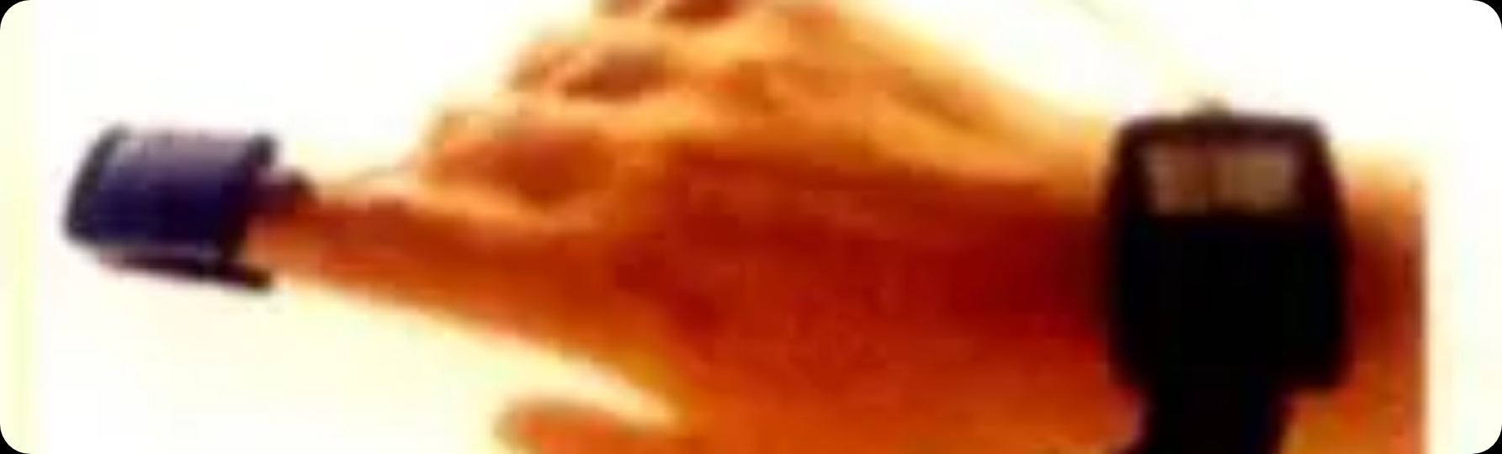



PHYSICAL EXAMINATION & INVESTIGATIONS
NICE GUIDELINE NG202 / CKS 2025 REFERENCE
Clinical Physical Examination
Definitive Investigation
General: Weight, height, BMI; Neck circumference >43cm (Male) or >40cm (Female).
Overnight Sleep Study: Polysomnography or limited sleep study/oximetry (can be home-based).
Upper Airway (ENT): Nasal obstruction, polyps, septal deviation, large tonsils/adenoids, macroglossia, or retrognathia.
SpO2 / Oximetry
Nasal Airflow
Chest/Abdo Movement
ECG & Snoring
CVS/Respiratory: Blood pressure (check for nocturnal hypertension), heart sounds, and full chest examination.
AHI Index: Measures apnoea + hypopnoea events per hour.
Laboratory Workup
TSH: Always check to exclude hypothyroidism as a reversible cause.
Comorbidity Screen: FBC, fasting glucose, and lipids to assess cardiovascular risk profile.

Slide 9
















MANAGEMENT STEP 1 AND 2 LIFESTYLE AND SNORING
NICE GUIDELINE NG202 / CKS 2025 REFERENCE
1
LIFESTYLE ADVICE (ALL PATIENTS)
Weight Loss: Most important modifiable factor. 10% weight loss significantly improves AHI.
Alcohol Reduction: Especially in the 4 hours before sleep; reduces pharyngeal muscle relaxation.
Smoking Cessation: Reduces upper airway inflammation and edema.
Positional Therapy: Lateral sleep position prevents tongue base collapse (avoid supine).
Medication Review: Avoid sedatives (Benzodiazepines, Z-drugs, Opioids).
2
SNORING (WITHOUT SIGNIFICANT OSA)
Nasal Health: Treat obstruction if present (INCS, antihistamines).
Criteria: ESS < 10 and no witnessed apnoeas
Mandibular Advancement Device (MAD): Advances lower jaw forward; effective for snoring and mild OSA.
Nasal Dilators: "Breathe Right" strips; low risk but limited evidence for OSA.
Evidence suggests positional therapy is specifically effective for patients with "supine-predominant" OSA.
ENT Referral: Only if anatomical cause identified (large tonsils, polyps) that is surgically treatable.

Slide 10

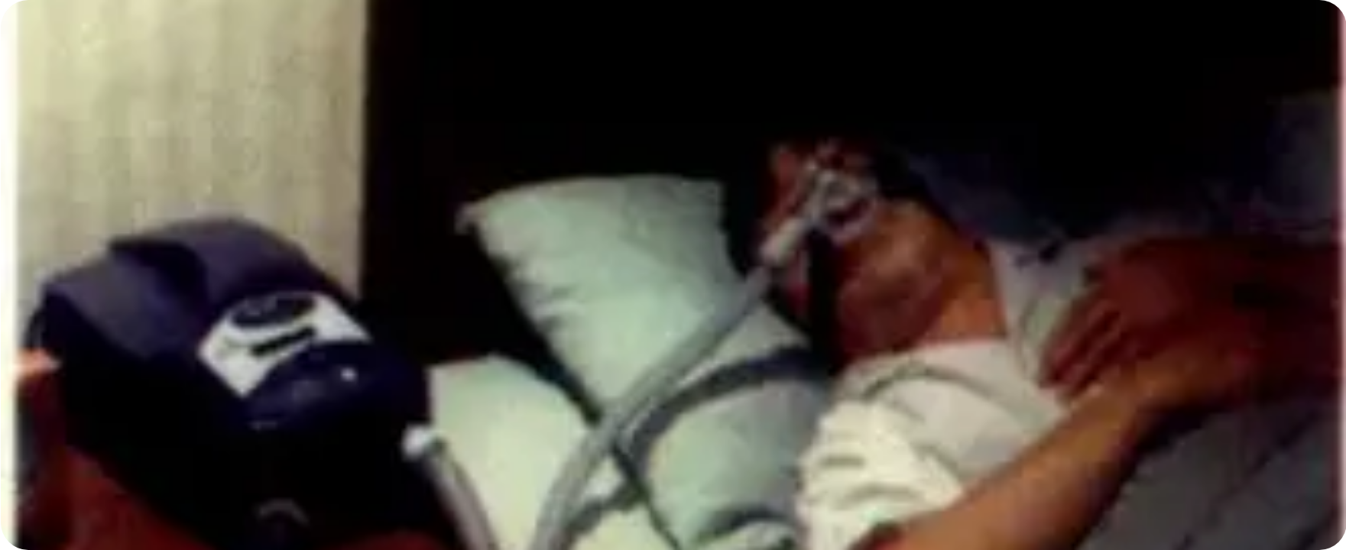












MANAGEMENT STEP 3: CPAP THERAPY
NICE GUIDELINE NG202 / NICE TA139 REFERENCE
NICE Indications (TA139)
Moderate or Severe OSAHS: Recommended as first-line treatment if AHI ≥ 15, regardless of symptoms.
Mild OSAHS: Recommended if AHI 5–14 AND symptoms (e.g., daytime sleepiness) significantly affect quality of life.
Trial Period: Often initiated via specialist sleep clinics to assess response and mask fit.
Clinical Benefits & Compliance
Mechanism of Action
Symptom Control: Significant reduction in EDS, improved mood, and cognitive function.
Continuous Positive Airway Pressure: Delivers a constant stream of compressed air via a mask. This acts as a "pneumatic splint", keeping the upper airway open during sleep, preventing pharyngeal collapse and subsequent apnoeas.
Safety: Significant reduction in Road Traffic Accident (RTA) risk.
Physiology: Reduces nocturnal hypertension and cardiovascular strain.
GP Tip: Common issues include dryness or mask leak. Suggest a heated humidifier or different mask style to improve long-term compliance.

Slide 11








SURGICAL OPTIONS AND COMPLIANCE
NICE GUIDELINE NG202 / CKS 2025 REFERENCE
Secondary Care Interventions
CPAP Compliance & Support
Tonsillectomy: Primary option if large tonsils identified as the anatomical cause.
Most effective in children
Common Barriers
Nasal congestion, dryness, mask discomfort, and noise disturbances for partners.
UPPP: Uvulopalatopharyngoplasty involving removal of excess soft palate tissue.
Limited evidence in adults
Optimising Therapy
Use of heated humidifiers, mask fitting sessions, and early clinic follow-up.
Bariatric Surgery: Considered for patients with morbid obesity where lifestyle interventions fail.
Long-term AHI reduction
GP Tip: Compliance is safety-critical. If a patient stops CPAP, they may no longer be legally safe to drive. Refer back to sleep clinic if side effects prevent use.

Slide 12




















DRIVING AND DVLA REGULATIONS
NICE GUIDELINE NG202 / CKS 2025 REFERENCE
Mandatory Driving Ban
Licence Category Requirements
Any patient with significant excessive daytime sleepiness (EDS) from any cause MUST NOT DRIVE until symptoms are controlled.
Group 1 (Car/Bike)
Group 2 (HGV/Bus)
Driving is a safety-critical activity; OSAHS increases accident risk by 7-fold.
Must notify DVLA if symptoms of EDS occur.
MUST NOTIFY DVLA immediately of diagnosis.
Can drive if CPAP/MAD is effective and sleepiness is resolved.
Stricter compliance monitoring (CPAP downloads).
The GP's Professional Duty
Communication & Documentation
Returning to the Road
Advise patient of their legal duty to notify DVLA if EDS affects driving.
Patients with OSAHS on CPAP therapy may usually continue driving once:
Document this advice clearly in medical notes.
Medical review confirms control of symptoms and adherence to treatment.
If they refuse to stop driving, GMC guidance on public interest may apply.
Sleepiness is no longer a risk to road safety.

Slide 13








CARDIOVASCULAR CONSEQUENCES OF UNTREATED OSAHS
NICE GUIDELINE NG202 / CKS 2025 REFERENCE
Systemic Hypertension
Pulmonary & Right Heart
Well-established causal relationship; risk increases with OSAHS severity.
Chronic nocturnal hypoxia leads to Pulmonary Hypertension.
Potential development of Cor Pulmonale (Right Heart Failure).
Loss of normal nocturnal BP "dipping" due to repeated arousals.
Symptoms: Peripheral oedema, raised JVP, and unrefreshing sleep.
Strong association with Resistant Hypertension (failure of 3+ meds).
Cardiac & Cerebrovascular
Metabolic & Safety Risks
Strongly associated with Atrial Fibrillation and other dysrhythmias.
Association with Metabolic Syndrome and Insulin Resistance.
Increased risk of Ischaemic Stroke and Coronary Artery Disease.
7x Increased Risk of road traffic accidents (RTA).
Intermittent hypoxaemia triggers oxidative stress and inflammation.
Untreated OSAHS is linked to significantly increased all-cause mortality.

Slide 14








RED FLAGS AND TOP CLINICAL TIPS
NICE GUIDELINE NG202 / CKS 2025 REFERENCE
Urgent Safety Red Flags
Diagnostic Wisdom
High-Risk EDS: Excessive sleepiness causing immediate driving or occupational safety risks.
The Slim OSA: Up to 1/3 of patients have a BMI <25; do not rely on obesity for diagnosis.
OSA Triad: Witnessed apnoeas combined with obesity and persistent daytime fatigue.
Dual Screening: Use ESS + STOP-Bang together to maximize detection sensitivity.
Routine TSH: Always check thyroid function as it is a highly treatable cause of OSA.
Clinical Complications
Management & Legal
Cor Pulmonale: Signs of right heart failure (peripheral oedema, raised JVP).
DVLA Duty: Advise all EDS patients to notify DVLA and document this in notes.
Endocrine Triggers: Suspected hypothyroidism or acromegaly as the underlying cause.
Impactful Changes: Weight loss and alcohol reduction are the most effective lifestyle interventions.
Device Choice: CPAP is gold standard for moderate/severe; MAD for snoring/mild cases.

Slide 15








EXAM PEARLS FOR AKT AND SCA
NICE GUIDELINE NG202 / CKS 2025 REFERENCE
AKT: Diagnostic Thresholds
ESS ≥10: Refer for sleep study. ESS ≥16: High probability of significant EDS.
AHI ≥15: Moderate/Severe OSAHS. CPAP is the first-line gold standard treatment.
NICE CKS 2025: Use ESS + STOP-Bang together for maximum screening sensitivity.
SCA: Safety & Communication
AKT: Clinical Nuances
DVLA Duty: Must advise patients with EDS to stop driving and notify DVLA. Document this advice clearly.
BMI Fallacy: Up to 1/3 of OSAHS sufferers have a healthy BMI (<25).
SCA Phrase: "Losing just 10% of your body weight can significantly improve your breathing at night."
Reversible Causes: Always check TSH; hypothyroidism is a common treatable trigger.
CPAP Brief: "The machine uses gentle air pressure to act like a splint, keeping your airway open while you sleep."
Mandibular Advancement: Evidence-based for snoring and mild OSA.

