Slide 1


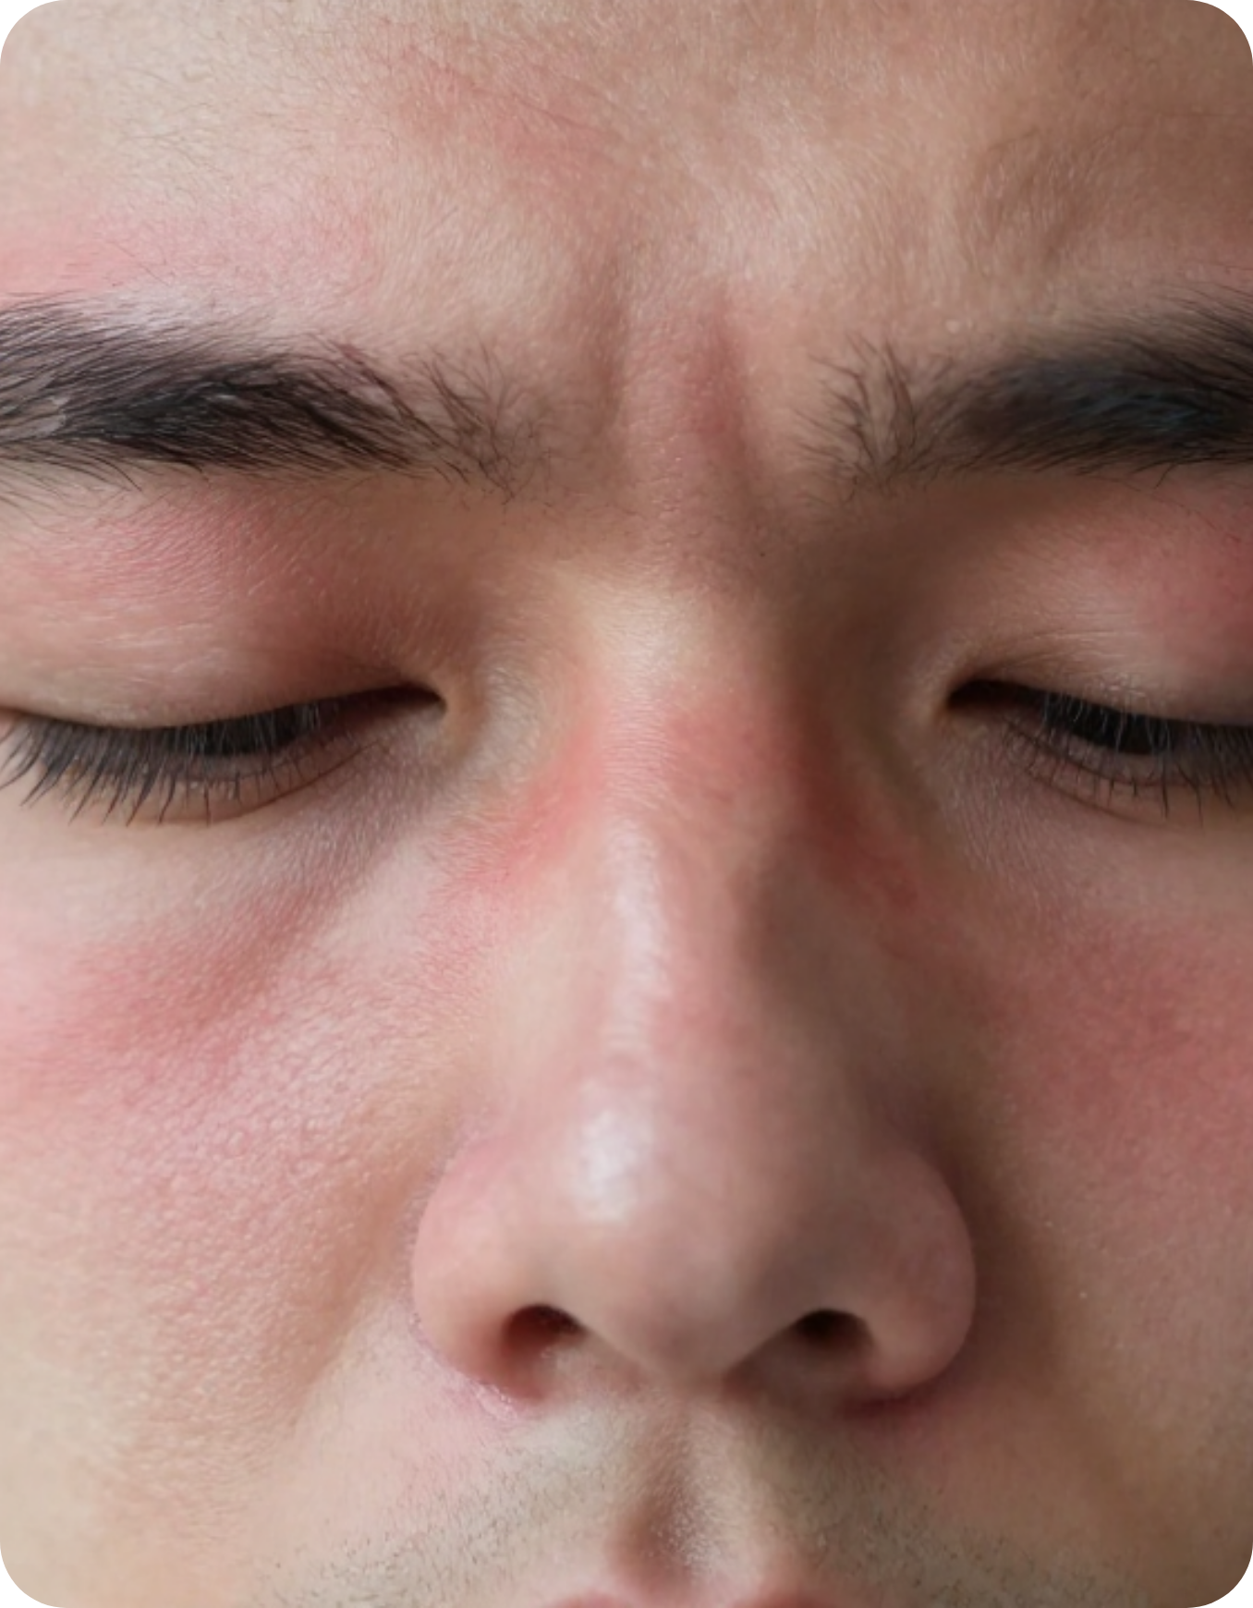



BRADFORD VTS TEACHING DECK
Sinusitis & Rhinosinusitis in General Practice
A comprehensive guide to evidence-based management, clinical criteria, and exam preparation for GP trainees.
NICE NG79
CKS 2024
BNF MAY 2026
Clinical Session: 2026-05-07
Focus: Primary Care & AKT/SCA Pearls

Slide 2







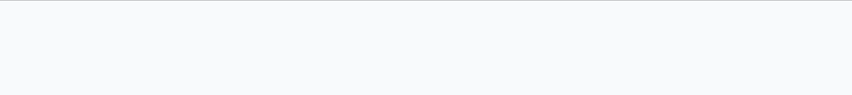



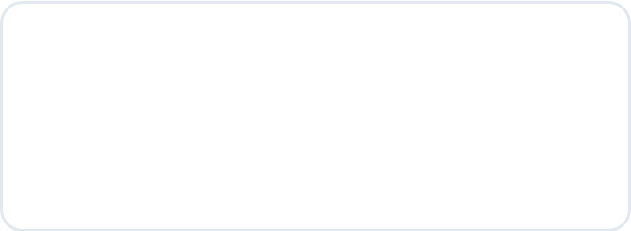




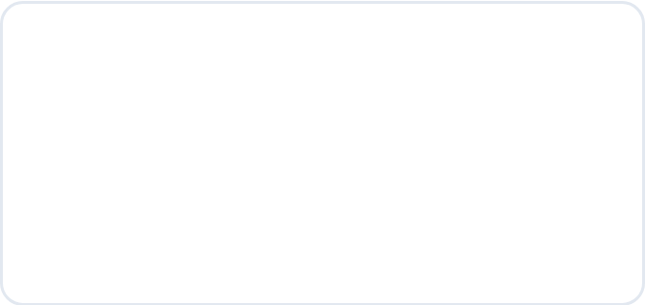




Definition and Classification
NICE CKS 2024 & CLINICAL CRITERIA
Rhinosinusitis is inflammation of the nose and paranasal sinuses. "Sinusitis" alone is often inaccurate as the nose is almost always involved.
Temporal Classification
TYPE
DURATION
KEY FEATURES
Acute
≤ 12 weeks
Complete resolution of symptoms. Usually starts as viral (cold).
CLINICAL DIAGNOSIS
Subacute
4 – 12 weeks
Partial improvement but symptoms linger beyond the acute phase.
Diagnostic Criteria (Requires ≥2 Symptoms)
Nasal blockage or congestion
Nasal discharge (ant/post drip)
Recurrent
≥ 3 episodes/year
Each episode lasts >10 days; patient is symptom-free between bouts.
Chronic
> 12 weeks
No complete resolution. Irreversible mucosal changes; polyps may be present.
Facial pain, pressure, or fullness
Reduced or absent sense of smell

Slide 3



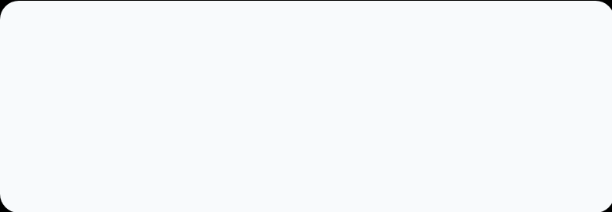
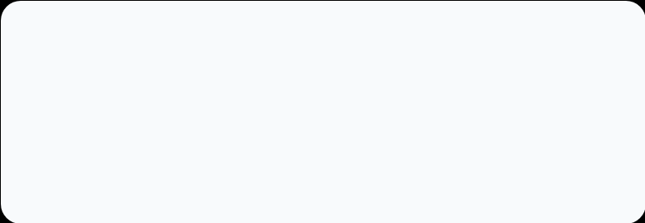


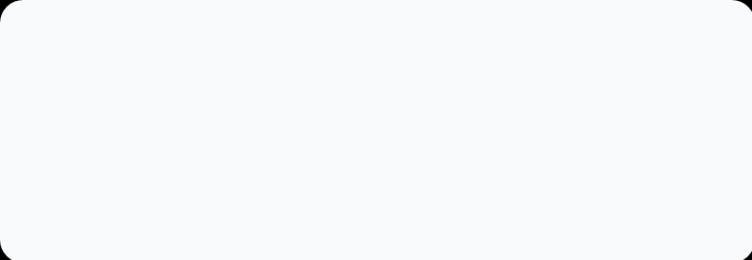
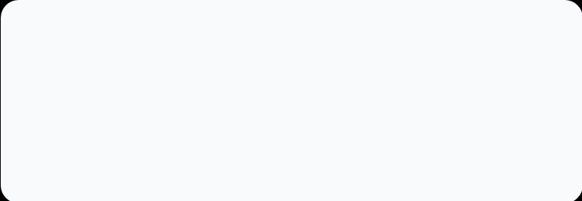









Clinical Case Scenario and Risk Factors
CLINICAL GUIDANCE & PRESCRIBING
The Scenario: Jo's Presentation
Identifying Triggers & Risks
Jo (35F, Teacher) presents with a 6-day history of URTI symptoms. She describes a bilateral blocked nose, intense facial pressure, and a total loss of smell (didn't notice toast burning).
Post-URTI
Smoking
Most common trigger; 90% of colds involve sinuses.
Causes ciliary dysfunction & impaired clearance.
Crucially, she reports aching in her upper gums, which she compares to teething. She is feeling stressed due to upcoming exams and demands antibiotics today.
Dental Infection
Diving/Swimming
Upper molar roots project into maxillary floor.
Barotrauma and pressure-related inflammation.
Psychosocial Factors
Depression and high stress (like Jo's exams) impact recovery.
TRAINEE VOTING: MANAGEMENT CHOICE
A: Immediate Antibiotics (Phenoxymethylpenicillin)
B: Delayed Prescription (Wait 7-10 days)
CRITICAL SAFETY ALERT
C: Symptomatic Care Only (Watchful Wait)
Beware of MAO Inhibitors (e.g., Selegiline). Use of sympathomimetic decongestants in these patients carries a high risk of Hypertensive Crisis.

Slide 4




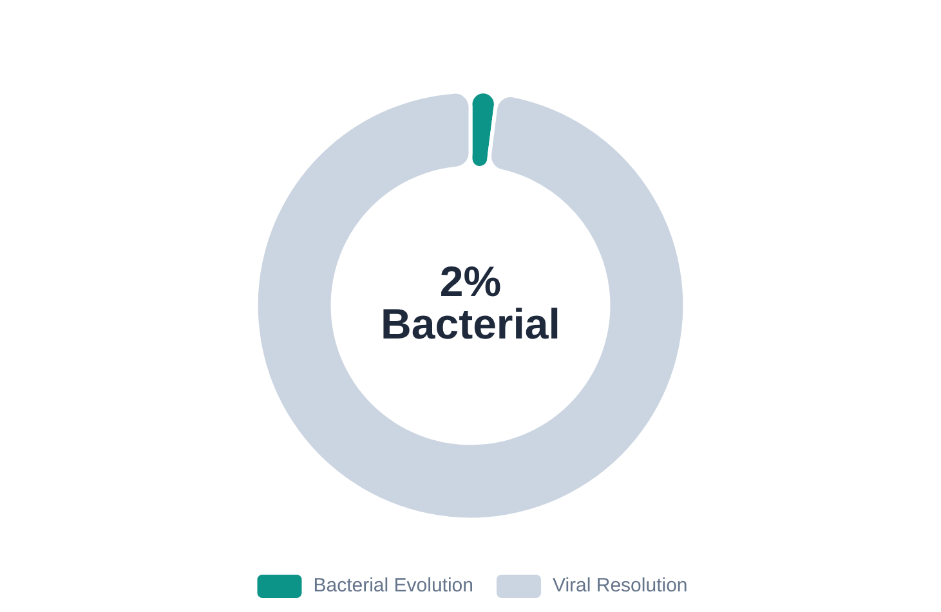








Pathophysiology: Viral vs Bacterial
PROGRESSION & SECONDARY INFECTION CRITERIA
Suspect Bacterial Cause If:
Incidence & Transformation Rates
Symptoms last >7–10 days without improvement.
"Double Sickening": Worsening after initial recovery.
Severe local pain, fever, or purulent discharge.
Key Pathogens & Exam Tip
Primarily S. pneumoniae and H. influenzae.
AKT: Viral rhinosinusitis is the "normal" course; bacterial is the complication.
Facial pain (upper jaw toothache) is highly suggestive.
90% of URTI involve sinuses; only 2% progress to bacterial.
Rhetorical Checkpoint: Based on these criteria, how many patients did you see last week who actually required an antibiotic?

Slide 5










Predisposing Factors
IDENTIFYING COMMON TRIGGERS AND RARE CLINICAL CONDITIONS
Common Triggers
Rare but Important
Allergic Rhinitis
Ciliary/Mucosal Disorders
The most common underlying cause; chronic inflammation impairs drainage.
Cystic Fibrosis and Primary Ciliary Dyskinesia (PCD).
Smoking & Environment
Bradford Note: PCD prevalence is higher in the local South Asian population.
Impairs mucociliary clearance and ciliary function.
Dental Infections
Systemic Conditions
Upper molar roots project into the maxillary sinus floor.
Sarcoidosis and GPA (formerly Wegener’s Granulomatosis).
Anatomical Obstruction
Immunodeficiency
Nasal polyps or a significantly deviated nasal septum.
HIV or Common Variable Immunodeficiency (CVID).
Barotrauma
Samter’s Triad
Swimming and diving (pressure-related sinus entry).
A specific phenotype requiring specialist management.
Aspirin Sensitivity + Polyps + Asthma

Slide 6














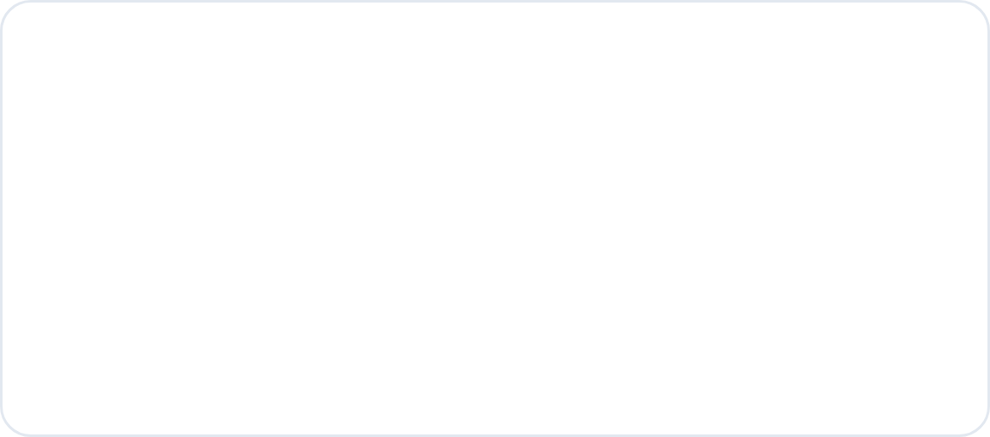
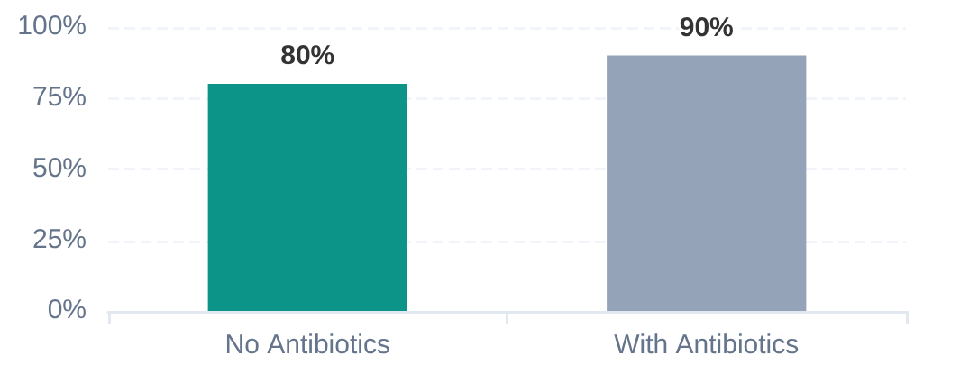
Management Strategy for Acute Rhinosinusitis
CLINICAL GUIDANCE & PRESCRIBING: NICE NG79 PRINCIPLES
No Antibiotic Strategy
Delayed Prescription
Immediate Prescription
Watchful waiting for most patients with symptoms <10 days.
"Back-up" strategy: Provide a prescription to be used later.
Patient is systemically very unwell (severe fever, rigors).
Reassurance: viral infection is the most common cause.
Advise collection only if symptoms do not improve in 7–10 days.
Symptoms worsen significantly after initial partial improvement.
Focus on symptomatic relief and nasal irrigation.
Collect sooner if symptoms worsen significantly.
High-risk: immunocompromised or significant comorbidities.
AKT Pearl: Delayed prescribing reduces overall antibiotic consumption without increasing complications.
SAFETY NETTING: Always advise on red flags (orbital swelling, neuro signs) regardless of strategy.
8 in 10 patients improve within 2 weeks without any antibiotics.
% Resolution within 14 Days

Slide 7


















Symptomatic and Supportive Treatments
EVIDENCE-BASED CLINICAL CARE & PATIENT ADVICE
Analgesia & Basic Support
Intranasal Corticosteroids (INCS)
Regular Analgesia: Paracetamol ± Ibuprofen for pain/fever.
First-line choice: Mometasone spray (Cochrane evidence-based).
Saline Nasal Irrigation: Use hypertonic saline (150 mL per nostril).
Dosage: 200 mcg once or twice daily for 14 days.
Reduces symptoms, improves QoL, and reduces antibiotic use.
Higher dose (400 mcg) may be more effective in severe cases.
AKT PEARL: Cochrane evidence shows 73% improvement vs 66% with placebo.
Steam & Traditional Options
Steam Inhalation: Low evidence of benefit; not routinely recommended by NICE.
Low risk if patients find it soothing; warn about burn risks.
Focus patient education on steroid sprays and saline rinses.
Nasal irrigation helps clear mucus and reduce inflammatory mediators.

Slide 8
















Decongestants and Antibiotic Selection
CLINICAL GUIDANCE & PRESCRIBING (BNF MAY 2026 / NICE NG79)
Nasal Decongestants
Antibiotic Selection (5-Day Course)
Usage: Sympathomimetics for short-term symptomatic relief only.
Scenario
Drug & Dosage
Limit: Maximum 7 days use to prevent rebound congestion (Rhinitis Medicamentosa).
Phenoxymethylpenicillin 500mg QDS
or Amoxicillin 500mg TDS
First-line
Safety: Ephedrine nasal drops are generally considered safest per BNF.
Doxycycline 200mg (Day 1), then 100mg daily (Adults only)
Penicillin Allergy
AKT / CLINICAL PEARL
DO NOT USE ERYTHROMYCIN for sinusitis. It lacks coverage for H. influenzae, which accounts for ~21% of bacterial cases.
CRITICAL DRUG INTERACTION
NEVER use sympathomimetic decongestants with MAO Inhibitors (e.g., Selegiline, Phenelzine). This combination carries a severe risk of Hypertensive Crisis.
NICE NG79 recommends a 5-day course to balance efficacy and stewardship.

Slide 9












Chronic Rhinosinusitis Management
CLINICAL GUIDANCE & PRESCRIBING
Initial Medical Trial (Primary Care)
ENT Referral Criteria
Criterion: Symptoms > 12 Weeks
Persistent Symptoms: Failed medical management in primary care exceeding 12 weeks.
High-dose INCS: Mometasone spray 400 mcg daily. Evidence shows 73% improvement vs placebo.
Nasal Polyps: All patients with visible polyps requiring formal assessment or surgery.
Saline Irrigation: Improves QoL, reduces symptoms, and decreases overall antibiotic demand.
Urgent Red Flags: Suspected sinonasal tumour or unilateral bloody discharge (2WW).
Steroid Flare: Short course oral steroids indicated for acute nasal polyp flares.
Extended Antibiotic Strategy
Surgical & Specialist Care
Long-course Trial: Consider 3-month course for CRS without polyps (unlicensed use).
FESS: Functional Endoscopic Sinus Surgery for refractory cases or anatomical obstructions.
Choice: Co-amoxiclav or Doxycycline. Acts via antibacterial and anti-inflammatory pathways.
Samter's Triad: Identifying Aspirin sensitivity + Polyps + Asthma for specialist management.
Rare Conditions: Screens for Cystic Fibrosis or Primary Ciliary Dyskinesia (PCD).
Monitoring: Review response at 12 weeks before deciding on ENT referral.

Slide 10


















Red Flags and Emergency Referrals
CRITICAL CLINICAL SIGNS & DISPOSITION
Same-Day A&E / ENT
Urgent ENT Referral
Orbital Involvement
Unilateral Symptoms
Swelling, erythema, or proptosis (Orbital cellulitis/abscess risk).
Unilateral polyp, mass, or bloody discharge (Suspicion of malignancy).
Diplopia (Double Vision)
Facial Numbness
Suggests orbital nerve involvement or intracranial extension.
Maxillary paraesthesia suggests perineural spread of a tumor.
Neurological Signs
Duration >12 Weeks
Severe headache, meningism, or focal deficits (Intracranial abscess).
Chronic rhinosinusitis failing maximum medical therapy in primary care.
Immunocompromised
Recurrent Failures
Severe symptoms in high-risk patients (Aggressive fungal infection).
Failure of second-line antibiotics or suspicion of rare pathologies (GPA).
Pathway: Immediate telephone referral to ENT Registrar or A&E assessment.
Pathway: 2-Week Wait (2WW) if cancer suspected; routine ENT if chronic.
SAFETY NETTING
"If you develop any swelling around your eye, double vision, or a severe headache that won't go away—this is an emergency and you must go straight to A&E."

Slide 11



















Diagnostic Scoring & Common Pitfalls
MEREC CRITERIA & CLINICAL TRAPS
MEREC Bacterial Scoring
Clinical Pitfalls to Avoid
1
Toothache originating from the upper jaw
Antibiotic Overuse: Prescribing for viral URTI (98% of cases are viral).
2
Poor response to nasal decongestants
Erythromycin: Using it for sinusitis (fails to cover 21% of H. influenzae).
3
Purulent nasal secretions visible on examination
Rebound Rhinitis: Using decongestant sprays for >7 days.
4
Abnormal transillumination of sinuses
MAO Interaction: Missing hypertensive risk with sympathomimetics.
5
Coloured (purulent) nasal discharge
Red Flag Blindness: Missing unilateral mass or orbital swelling.
Interpretation: 4+ points = High probability of bacterial cause.
AKT / SCA PEARL
Note: Even with 4+ points, 80% still resolve without antibiotics.
"Diplopia + Sinus Pain = Immediate Hospital Referral"

Slide 12










Exam Pearls for AKT and SCA
HIGH-YIELD FACTS, PRESCRIBING RULES & COMMUNICATION STRATEGIES — NICE NG79 · NICE CKS 2024 · BNF MAY 2026
SCA Communication Strategies
STRUCTURED CLINICAL ASSESSMENT
AKT High-Yield Facts
APPLIED KNOWLEDGE TEST
DELAYED PRESCRIPTION RATIONALE
Acute rhinosinusitis: prefer watchful wait or delayed prescription — NICE NG79 first principle
"Most sinus infections are caused by viruses and will clear up on their own within 2–3 weeks. I'd like to give you a prescription that you can use if you're not improving after a week, rather than starting antibiotics now."
Immediate antibiotics ONLY if: systemically unwell, worsening after initial improvement, significant comorbidity, or complications
First-line antibiotic: Phenoxymethylpenicillin (Pen V) 500 mg QDS × 5 days — or Amoxicillin 500 mg TDS × 5 days
EXPLAINING NASAL STEROID SPRAY
"The nasal steroid spray will help reduce the inflammation inside your nose and sinuses — this is the best treatment we have for this. It takes a day or two to kick in, so it's important to keep using it."
Penicillin allergy: Doxycycline 200 mg day 1, then 100 mg daily × 5 days (adults only)
NOT Erythromycin — lacks H. influenzae coverage (21% of bacterial sinusitis)
INCS (mometasone): Cochrane evidence — 73% improved vs 66% placebo; use in all cases
SAFETY-NETTING — GO STRAIGHT TO A&E IF:
Saline irrigation: evidence-based — reduces symptoms and antibiotic use
Swelling or redness around the eye — may indicate orbital cellulitis
Double vision (diplopia) — possible orbital or intracranial extension
Unilateral symptoms + bloody discharge = 2WW referral for sinonasal tumour
Severe headache or neck stiffness — possible meningitis or cerebral abscess
Orbital swelling + sinusitis = EMERGENCY referral (orbital cellulitis)
Symptoms significantly worsening after initial improvement
NICE NG79 — Sinusitis Antimicrobials 2017/2024
NICE CKS Sinusitis 2024
GUIDELINES
BNF May 2026
Bradford VTS — AKT/SCA Exam Prep

Slide 13

















Sinusitis Management: NICE NG79
CLINICAL GUIDANCE & PRESCRIBING
Diagnostic Core
Best Practice
Prescribing Pearls
Safety Netting
Criteria: ≥2 symptoms (Blockage, Discharge, Facial Pain, Anosmia).
NICE NG79: Watchful wait or delayed Rx for most patients.
1st Line: Penicillin V or Amoxicillin for 5 days.
Emergency: Orbital swelling, diplopia, or severe headache.
Cochrane Evidence: INCS (Mometasone) reduces symptoms effectively.
Allergy: Doxycycline 200mg day 1, then 100mg (Adults).
Tumour Red Flag: Unilateral symptoms or bloody discharge.
Viral First: 90% of colds involve sinusitis; 80% resolve in 2 weeks.
NO Erythromycin: Lacks H. influenzae coverage.
Interactions: No decongestants with MAO inhibitors (HTN crisis).
Saline Irrigation: High-volume saline reduces antibiotic need.
Bacterial: Suspect if symptoms >10 days or "double sickening".
Top Takeaway: Focus on Delayed Prescribing and Intranasal Steroids. Avoid antibiotics for viral symptoms <10 days. Always check for unilateral red flags.

