Slide 1

BRADFORD VTS TEACHING DECK
‘Vertigo & BPPV’
A Clinical Teaching Resource
for GP Trainees
May 2026
www.bradfordvts.co.uk
'This resource is intended for educational use by GP trainees. Clinical guidance is based on NICE CKS
and BNF (May 2026). Always apply clinical judgement and refer to current local guidelines.'
www.bradfordvts.co.uk

Slide 2
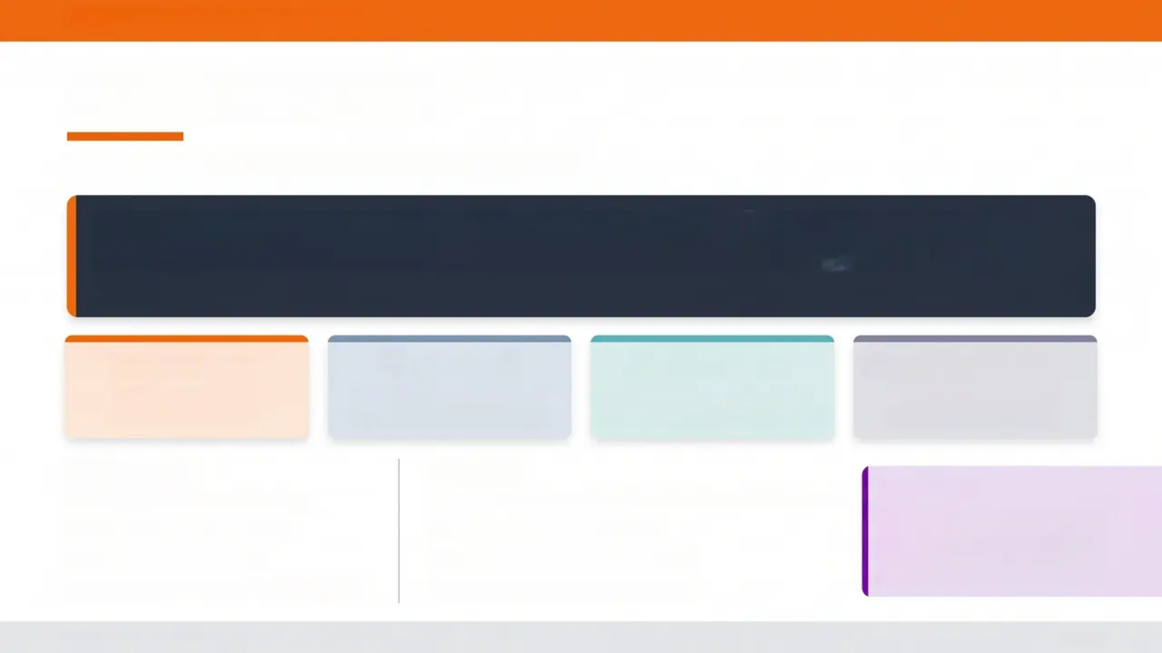




BRADFORD VTS TEACHING DECK
Defining Vertigo
An illusion of movement — not just dizziness
Vertigo is an illusion or hallucination of movement — most often rotational —
arising from dysfunction of the vestibular system.
'It is NOT simple light-headedness, presyncope, or a vague sense of unsteadiness.'
True Vertigo
Presyncope
Disequilibrium
Non-Specific Dizziness
Vestibular cause —
rotational illusion
Cardiovascular — 'about to
faint' feeling
Cerebellar or proprioceptive —
unsteadiness without spinning
No clear vestibular or
cardiovascular pattern
Peripheral
Central
Inner ear — 90% of vertigo cases
AKT Pearl
Brainstem or cerebellum — less common but more serious
True vertigo = vestibular cause.
Dix-Hallpike, HIT, and HINTS
tests only apply when true
vertigo is confirmed.
• BPPV — most common
• Vestibular neuritis
• Ménière's disease / Labyrinthitis
• Cerebellar stroke or TIA
• Vertebrobasilar insufficiency
• MS, posterior fossa tumour
www.bradfordvts.co.uk
2 / 14

Slide 3
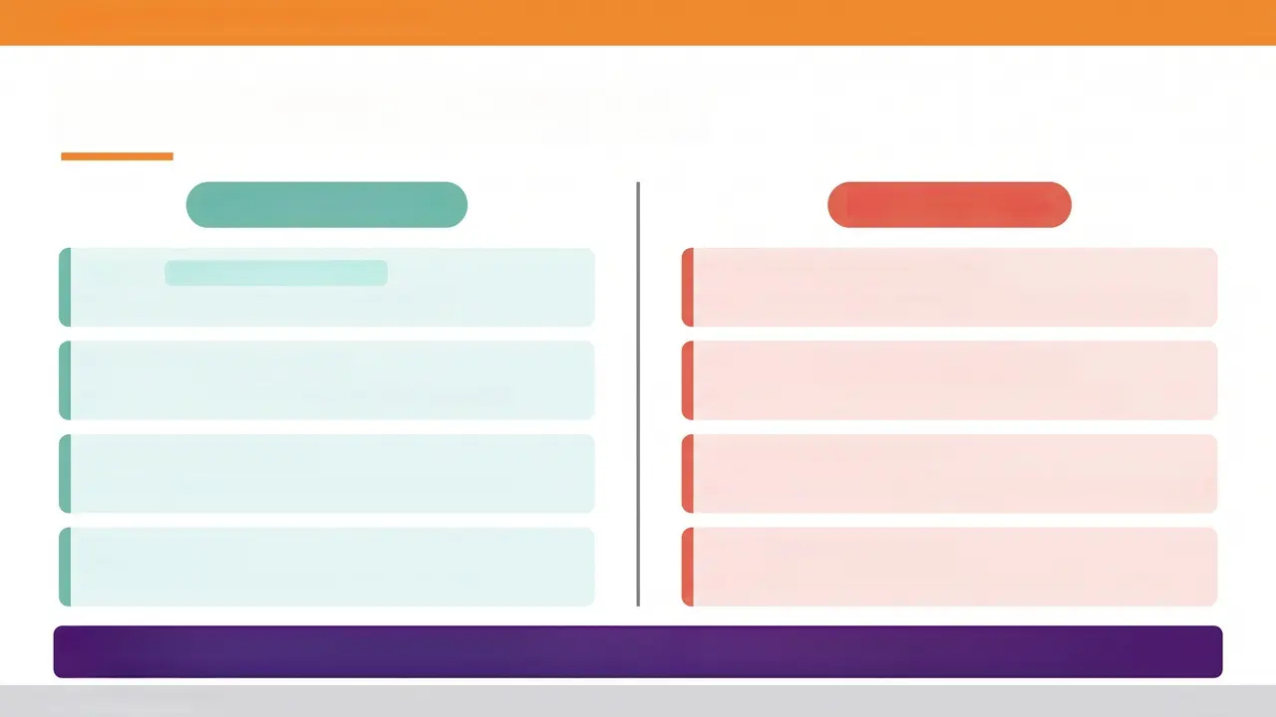

BRADFORD VTS TEACHING DECK
“Common Causes of Vertigo”
PERIPHERAL — 90%
CENTRAL — 10%
BPPV
Most common cause overall
Cerebellar Stroke / TIA
Sudden onset — HINTS exam abnormal — urgent imaging
Brief positional vertigo — displaced otoconia
Vestibular Neuronitis
Vertebrobasilar Insufficiency
Posterior circulation — associated brainstem signs
Acute severe vertigo — no hearing loss — post-viral
Ménière's Disease
Multiple Sclerosis
Vertigo + unilateral SNHL + tinnitus + aural fullness
Demyelination — consider in young adults with relapsing
course
Labyrinthitis
Vestibular Migraine
Common but diagnosis of exclusion — headache history
As neuronitis but with hearing loss and tinnitus
AKT PEARL: Peripheral causes account for ~90% of vertigo. BPPV alone is the single most common cause. Always ask: is the
nystagmus fatigable? Is there a latency? These distinguish peripheral from central.
www.bradfordvts.co.uk
3 / 14

Slide 4



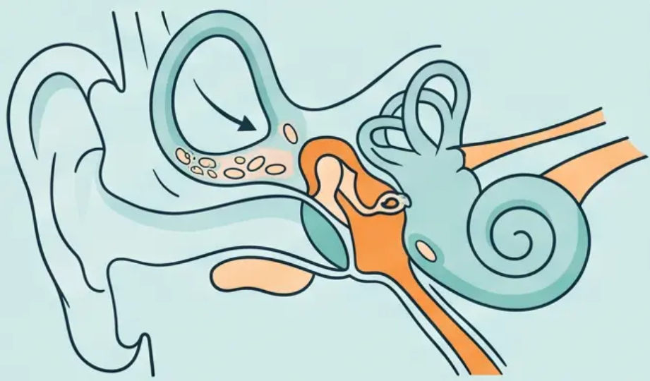



BRADFORD VTS TEACHING DECK
BPPV: Diagnosis and Findings
"Displaced otoconia · Dix-Hallpike technique · Nystagmus interpretation"
The Dix-Hallpike Test
What Is Happening Inside the Ear?
1. Patient sits upright on the examination couch, head turned
45° toward the side being tested
2. Clinician rapidly lowers patient to lying position — head
extended 30° below horizontal, supported by clinician
3. Observe eyes for nystagmus — maintain position for up to
60 seconds
POSITIVE Dix-Hallpike — BPPV
• Otoconia — calcium carbonate crystals normally sit in the
utricle of the inner ear
✔ Direction: Upbeat torsional nystagmus (top pole of eye beats
toward the affected/lower ear)
• Displacement — crystals migrate into the posterior
semicircular canal (most common)
✔ Latency: Onset after 5-20 seconds delay following positioning
✔ Fatigability: Nystagmus resolves within 1 minute and
diminishes with repeated testing
• Effect — abnormal endolymph movement when the head
changes position creates a false sense of rotation
AKT Pearl
Dix-Hallpike positive = upbeat torsional nystagmus + 5-20 sec
latency + fatigable. All three features must be present. Absence
of fatigability suggests a central cause — do not miss this.
"Posterior canal BPPV accounts for approximately 90% of all BPPV cases"
www.bradfordvts.co.uk
4 / 14

Slide 5

BRADFORD VTS TEACHING DECK
BPPV Treatment: Epley & Brandt-Daroff
Canalith repositioning in clinic and at home
Epley Maneouvre
Brandt-Daroff Exercises
Performed in clinic — ~80% success first attempt
Home exercise programme — when Epley not possible or for
residual symptoms
1
Sit upright, head turned 45° toward the affected ear
Patient seated on examination couch
1
Sit upright on the edge of the bed
Head tilted 45° toward the affected side
2
Rapidly lower to lying — head extended 30° below
horizontal
Hold until nystagmus resolves — up to 1 minute
2
Quickly lie down to that side — hold for 30 seconds
Or until dizziness fully settles
3
Turn head 90° to opposite side (now facing away
from affected ear)
Keep head extended throughout
3
Sit back upright — then repeat to the opposite side
Perform 3 times daily for 2 weeks
4
Roll body to face downward, then sit up slowly
Crystals guided back to utricle
Brandt-Daroff does not reposition crystals — it promotes
central compensation. Less effective than Epley but
useful for home management.
Repeat if needed. Advise patient: dizziness during the
manoeuvre is expected and normal.
🎓 AKT Pearl: No betahistine for BPPV — NICE CKS. Epley is first-line. Brandt-Daroff is a home alternative, not a replacement.
www.bradfordvts.co.uk
5 / 14

Slide 6









BRADFORD VTS TEACHING DECK — VERTIGO & BPPV
Vestibular Neuronitis Management
Acute peripheral vertigo — what to do, and what NOT to do
Vestibular Sedatives — Critical Rule
Clinical Features
Prochlorperazine
5–10 mg three times daily oral
or 3 mg buccal twice daily
Acute onset severe rotational vertigo — often
follows a viral URTI
Cinnarizine
15 mg three times daily — short-term
No hearing loss (distinguishes from labyrinthitis)
Maximum 3-5 days ONLY
No tinnitus
Long-term use suppresses central compensation — the brain cannot
recalibrate while the vestibular system is chemically sedated.
Prolonged use prolongs recovery and is actively harmful.
Horizontal nystagmus — fast phase directed
away from the affected ear
AKT: Prochlorperazine beyond 5 days = wrong answer
Nausea and vomiting — often prominent in the
acute phase
SCA PEARL
Explain to the patient: 'A viral infection has
inflamed your balance nerve. Your brain needs
a few weeks to recalibrate. The tablets help with
the spinning feeling short-term, but doing gentle
head movement exercises will actually speed
up your recovery more than tablets alone.'
MANAGEMENT SUMMARY
- Vestibular sedatives: 3-5 days maximum
- Vestibular rehabilitation (Cawthorne-
Cooksey exercises)
- Refer to ENT or neurology if no
improvement by 6 weeks
- Refer urgently if central features develop
Head Impulse Test (HIT) positive — corrective
saccade toward the affected side
www.bradfordvts.co.uk
6 / 14

Slide 7
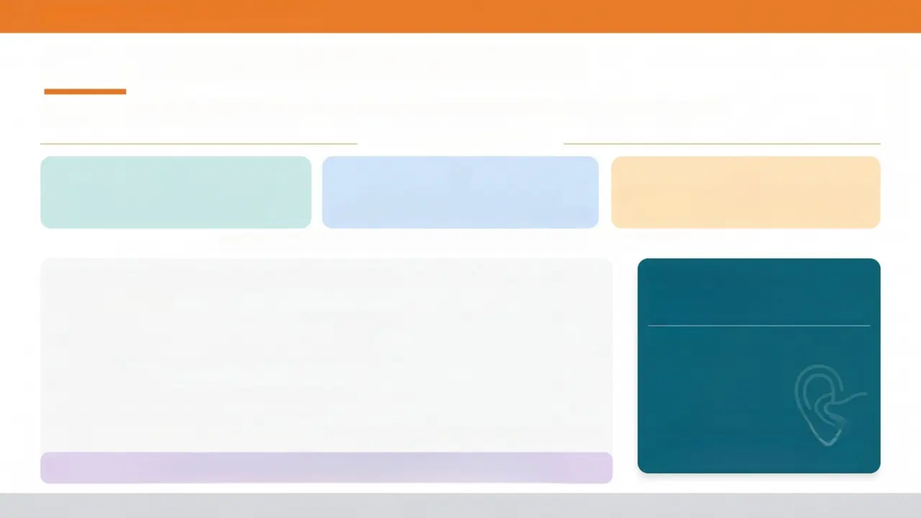





BRADFORD VTS TEACHING DECK
Ménière's Disease and Betahistine
Recognising the triad, managing attacks, and prescribing betahistine correctly
THE DIAGNOSTIC TRIAD
Episodic Rotational Vertigo
Unilateral Fluctuating SNHL
Unilateral Tinnitus + Aural Fullness
Attacks lasting 20 min – 24 hours
Low-frequency hearing loss early; progressive
Often precedes or accompanies attacks
Pathophysiology: endolymphatic hydrops — excess endolymph pressure in the inner ear
BETAHISTINE
1) Betahistine — see highlighted box to the right
2) Low-salt diet
16 mg three times daily
(may increase to 24 mg three times daily)
Reduces endolymphatic hydrops; advise < 1.5 g sodium/day
ONLY FOR:
3) Vestibular sedatives — acute attacks only
✔ Ménière's disease
Prochlorperazine short-term only. Do NOT use long-term.
4) Audiogram
NOT FOR:
X BPPV
Confirms low-frequency sensorineural hearing loss
X Vestibular neuronitis
5) ENT Referral — all confirmed cases
X Non-specific tinnitus (NICE NG155)
To exclude acoustic neuroma; consider intratympanic gentamicin or surgery in refractory disease
Prescribing betahistine outside Ménière's
disease is not supported by NICE CKS
AKT PEARL
"Betahistine indication = Ménière's ONLY. If the question describes BPPV or vestibular
neuronitis – betahistine is the wrong answer."
www.bradfordvts.co.uk
7 / 14

Slide 8
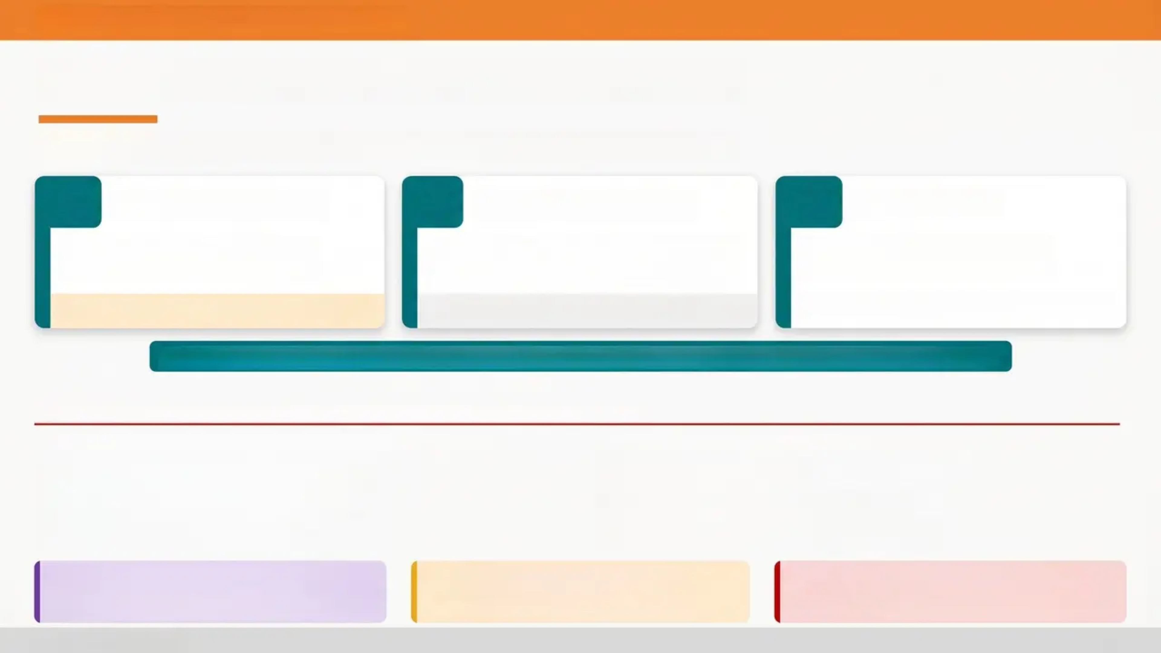






BRADFORD VTS TEACHING DECK
Central Causes & the HINTS Exam
Head Impulse Test
Nystagmus Pattern
Test of Skew
NORMAL in central vertigo — no
corrective saccade seen
Direction-changing nystagmus = central
Unidirectional nystagmus = peripheral
Vertical ocular misalignment on
alternate cover test
⚠️ Counterintuitive — a normal HIT is the red flag
Skew deviation present = central cause
Does not suppress with fixation in central
HINTS: Abnormal HIT + Direction-Changing Nystagmus + Skew Deviation = CENTRAL — Urgent Referral
Central Vertigo — Features Requiring Urgent CT/MRI
• Sudden onset “thunderclap” vertigo
• Occipital or severe headache
• Diplopia or visual disturbance
• Dysphagia or dysarthria
• Limb ataxia or falling to one side
• Facial numbness
• No fatigability of nystagmus
• Direction-changing nystagmus
AKT Pearl: A NORMAL head impulse test in
acute continuous vertigo is a central red flag —
not reassuring.
Pitfall: Do not reassure and discharge a
patient with continuous vertigo and a
normal HIT — arrange urgent imaging.
Red Flag: Posterior circulation stroke may
mimic peripheral vertigo — HINTS exam is
more sensitive than CT in first 24–48 hours.
www.bradfordvts.co.uk
8 / 14

Slide 9
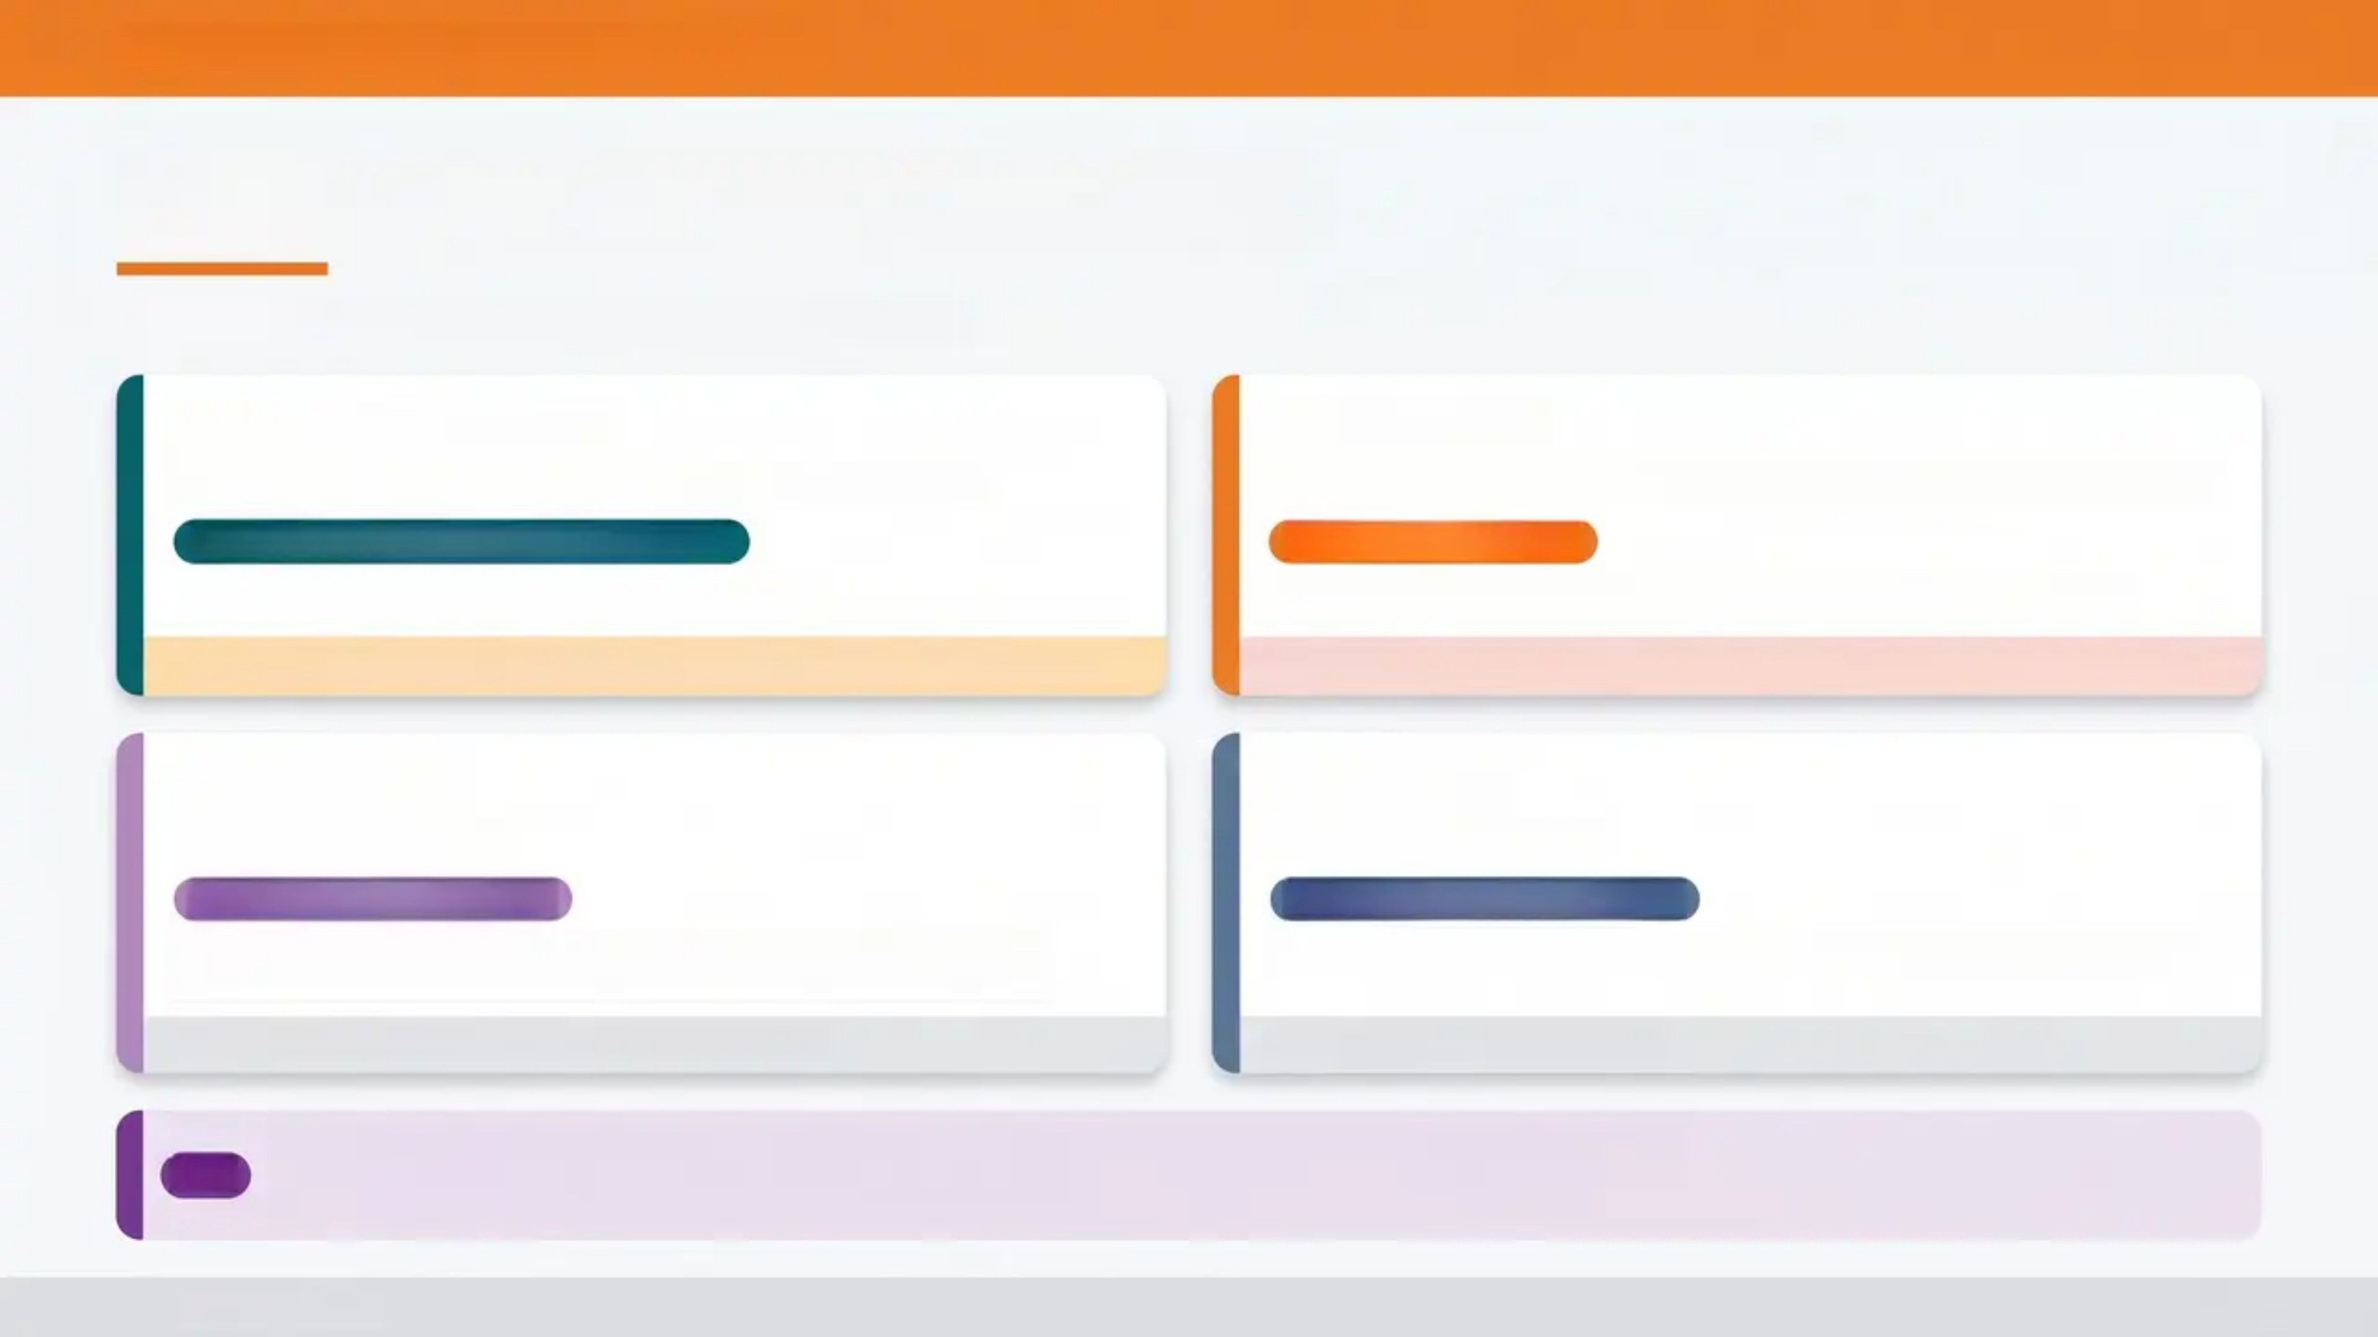
BRADFORD VTS TEACHING DECK
“Summary of Drug Treatments”
Pharmacological options — know your indications
Prochlorperazine
Betahistine
5–10 mg three times daily oral / 3 mg buccal twice daily
16 mg three times daily (may increase to 24 mg three times daily)
Acute vestibular episodes — nausea/vomiting
Ménière's disease ONLY
Short-term use only — 3 to 5 days maximum.
Reduces frequency and severity of attacks in Ménière's disease.
⚠️ Long-term use delays central vestibular compensation — avoid prolonged prescribing
❌ NOT indicated for BPPV, vestibular neuritis, or non-specific tinnitus — NICE CKS
Cinnarizine
Cyclizine
Long-term use
15 mg three times daily
50 mg three times daily
Peripheral vestibular disorders
Nausea and vomiting with vertigo
Short-term symptomatic relief. Antihistamine and calcium channel
blocker action.
Antihistamine antiemetic. Useful when nausea is the dominant symptom.
Not first-line — use when prochlorperazine not tolerated
Short-term symptomatic use only
AKT
AKT Pearl: Betahistine = Ménière's only. Vestibular sedatives = maximum 3–5 days.
Long-term prochlorperazine in an AKT scenario = always the WRONG answer.
www.bradfordvts.co.uk
9 / 14

Slide 10



BRADFORD VTS TEACHING DECK
‘AKT Examination Pearls’
'High-yield facts — know these cold'
Betahistine Indication
Dix-Hallpike Positive = BPPV
Betahistine = Ménière's ONLY
Upbeat torsional nystagmus with a latency of 5–20 seconds,
lasting under 1 minute, and fatiguing with repeated testing.
Do NOT prescribe betahistine for BPPV, vestibular neuronitis,
or non-specific tinnitus. This is a classic AKT distractor.
💡 Pitfall: No latency or no fatigue = think central
❌ Wrong Answer Trap: BPPV + betahistine = incorrect
HINTS Exam Key
Prochlorperazine Duration
Labyrinthitis vs Neuronitis
Vestibular Sedatives: 3–5 Days MAX
Labyrinthitis vs Vestibular Neuronitis
In acute continuous vertigo — a normal
Head Impulse Test (no corrective
saccade) suggests central pathology.
Counterintuitive but critical.
Prochlorperazine beyond 5 days delays
central compensation and prolongs
recovery. Long-term use = wrong
management in AKT scenarios.
Labyrinthitis = vertigo + hearing loss +
tinnitus (all three — cochlear involvement).
Vestibular neuronitis = vertigo only —
no cochlear features.
Normal HIT ≠ reassuring here
Short-term only — then stop
The triad differentiates them
www.bradfordvts.co.uk
10 / 14

Slide 11










BRADFORD VTS TEACHING DECK
“SCA Communication & Safety-netting”
SCA
PEARLS
Slide 11 of 14 — Talking to Patients
SCA PEARLS
Explaining to Your Patient
Safety-netting: When to Return
WHAT IS BPV?
Symptoms not improving after 2–4 weeks of Epley /
Brandt-Daroff exercises
“The crystals in your inner ear have become displaced. When you move
your head, they trigger false signals of movement. The good news is
there is a simple exercise you can do now that usually fixes it.”
Severe constant vertigo that does not settle between
episodes
THE EPLEY MANOEUVRE
New headache — especially occipital or sudden-onset
“I'm going to move your head through a series of positions to guide the
crystals back to where they should be. You may feel dizzy during the
procedure — this is normal and expected.”
Difficulty walking or falls — unsteady gait, ataxia
Facial numbness, slurred speech, or swallowing
difficulty
VESTIBULAR NEURONITIS
“A viral infection has inflamed the balance nerve. The brain needs to
recalibrate, which takes a few weeks. The tablets are short-term —
doing gentle head movement exercises will speed your recovery.”
If any red flag develops — attend A&E immediately.
Do not wait for a GP appointment.
“Acknowledge the dizziness is frightening — validate before you explain.”
www.bradfordvts.co.uk
11 / 14

Slide 12
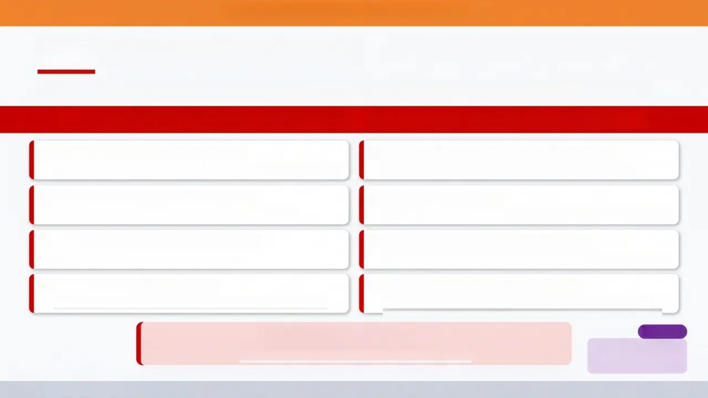

BRADFORD VTS TEACHING DECK
‘Red Flags for Urgent Referral’
‘Central vertigo features requiring immediate assessment, imaging, and specialist referral’
SUSPECT CENTRAL CAUSE → URGENT CT/MRI + SPECIALIST REFERRAL
Sudden ‘Thunderclap’ Onset
Limb Ataxia or Falling to One Side
Vertigo of maximal severity at onset — consider posterior fossa haemorrhage
Inability to walk straight; cerebellar stroke until proven otherwise
Occipital or Severe Headache
Facial Numbness
Ipsilateral facial sensory loss — lateral medullary (Wallenberg) syndrome
Headache accompanying vertigo is a cardinal central red flag
Diplopia or Visual Disturbance
Direction-Changing Nystagmus
Double vision suggests brainstem involvement
Nystagmus that reverses direction with gaze — central, never peripheral
Dysphagia or Dysarthria
No Fatigability of Nystagmus
Persistent, non-fatiguing nystagmus = central cause; BPPV nystagmus
always fatigues
Difficulty swallowing or slurred speech — posterior circulation stroke
HINTS Exam — Central Pattern = All Three:
H — Head Impulse Test: NORMAL (no corrective saccade) Δ, I — Nystagmus: Direction-changing
T — Test of Skew: Vertical ocular misalignment present
AKT Pearl
Normal HIT + direction-
changing nystagmus =
CENTRAL = urgent referral
'A normal head impulse test in acute continuous vertigo is counterintuitively the dangerous finding — it suggests central pathology.'
www.bradfordvts.co.uk
12 / 14

Slide 13


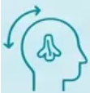





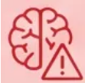
BRADFORD VTS TEACHING DECK
Quick Recall Summary
Four conditions — key facts at a glance
BPPV
Vestibular Neuronitis
- Positional, brief (seconds to 2 min)
- Dix-Hallpike: upbeat torsional nystagmus,
5-20 sec latency, fatigable
- Treatment: Epley manoeuvre
- Home: Brandt-Daroff exercises
- ❌ No betahistine
- Acute severe vertigo — post-viral
- Acute severe vertigo — post-viral
- No hearing loss, no tinnitus
- HIT positive (corrective saccade)
- Prochlorperazine: 3-5 days ONLY
- Vestibular rehab speeds recovery
Ménière's Disease
Central — Red Flags
- Triad: episodic vertigo + unilateral SNHL + tinnitus
- Attacks: 20 min - 24 hours
- Betahistine 16 mg tds — Ménière's ONLY
- Low-salt diet; audiogram
- Refer all confirmed cases to ENT
- Headache, diplopia, dysarthria, ataxia
- HINTS: normal HIT = central (⚠️ counterintuitive)
- Direction-changing nystagmus
- Skew deviation = central
- Urgent CT/MRI + specialist referral
AKT PEARL
Betahistine = Ménière's only. Prochlorperazine > 5 days = wrong answer. Normal HIT in acute vertigo = central red flag.
www.bradfordvts.co.uk
13 / 14

Slide 14

BRADFORD VTS TEACHING DECK
Disclaimer
This teaching resource has been produced by Bradford VTS for the educational use of GP trainees
and educational supervisors. It is intended as a revision and learning aid only and does not constitute
formal clinical guidance.
All clinical decisions must be made by a qualified healthcare professional using current local
protocols, individual patient circumstances, and up-to-date national guidance. The content of this
deck does not replace clinical judgement.
Drug dosages, clinical recommendations, and diagnostic criteria are based on NICE CKS and BNF
current at the time of production (May 2026). Guidelines are subject to change – always verify with
the most current published guidance before clinical application.
Bradford VTS accepts no liability for clinical decisions made on the basis of this educational material.
www.bradfordvts.co.uk
© Bradford VTS — May 2026. For educational use only.
www.bradfordvts.co.uk
14 / 14

